Slide 1
WEB-BASED DOCUMENT TRACKING AND MANAGEMENT PLATFORM
for Secure and Efficient Document Workflow Automation
A THESIS FINAL PRESENTATION
TOM TOM G. CATRAL

Slide 2
STATEMENT OF THE PROBLEM
Why the system was developed
MANUAL ROUTING
LIMITED VISIBILITY
RECORD RISKS
Physical delivery and handwritten tracking make status monitoring slow and dependent on personnel availability.
Users cannot consistently see the current holder, pending action, route history, or document status in real time.
Paper files and disconnected logs increase the risk of delays, misplacement, duplicate entries, and incomplete accountability.
Core research question: How can BLGF Region II improve the security and efficiency of its document workflow through a web-based platform?

Slide 3
OBJECTIVES OF THE STUDY
GENERAL OBJECTIVE
Develop and evaluate a Web-Based Document Tracking and Management Platform for secure and efficient document workflow automation at BLGF Region II.
• Document the problems encountered in the existing manual process.
• Design and implement registration, routing, tracking, search, notifications, reporting, and audit functions.
• Evaluate the developed system using the eight ISO/IEC 25010 product-quality characteristics.
• Provide conclusions and recommendations based on actual evaluation results.

Slide 4
SCOPE AND DELIMITATION
IN SCOPE
DELIMITATIONS
Incoming and outgoing documents
Real-time routing and status tracking
Role and permission controls
Attachments and recipient conversations
Search, notifications, QR, slips and reports
Audit and envelope dispatch logs
Designed for BLGF Region II workflows
Authorized users and supported web environment
Evaluation based on 23 respondents
27 indicators under ISO/IEC 25010
Deployment and policies remain subject to agency approval

Slide 5
RESEARCH METHODOLOGY
DESIGN
PARTICIPANTS
INSTRUMENT
Descriptive research identified workflow problems; developmental research guided the design, construction, testing, and evaluation of the WDTMP.
23 evaluators
13 BLGF employees
10 IT experts
A 27-indicator questionnaire covering all eight ISO/IEC 25010 product-quality characteristics, rated through a five-point Likert scale.
Data analysis: weighted means per indicator and category; 4.21-5.00 = Very Great Extent.

Slide 6
DEVELOPMENT APPROACH
Iterative Agile / controlled overlapping phases
Requirements
>
Design
>
Development
>
Testing
>
Deployment
>
Evaluation
>
Feedback was used to refine routing, permissions, attachments, notifications, reports, and usability before succeeding increments.

Slide 7
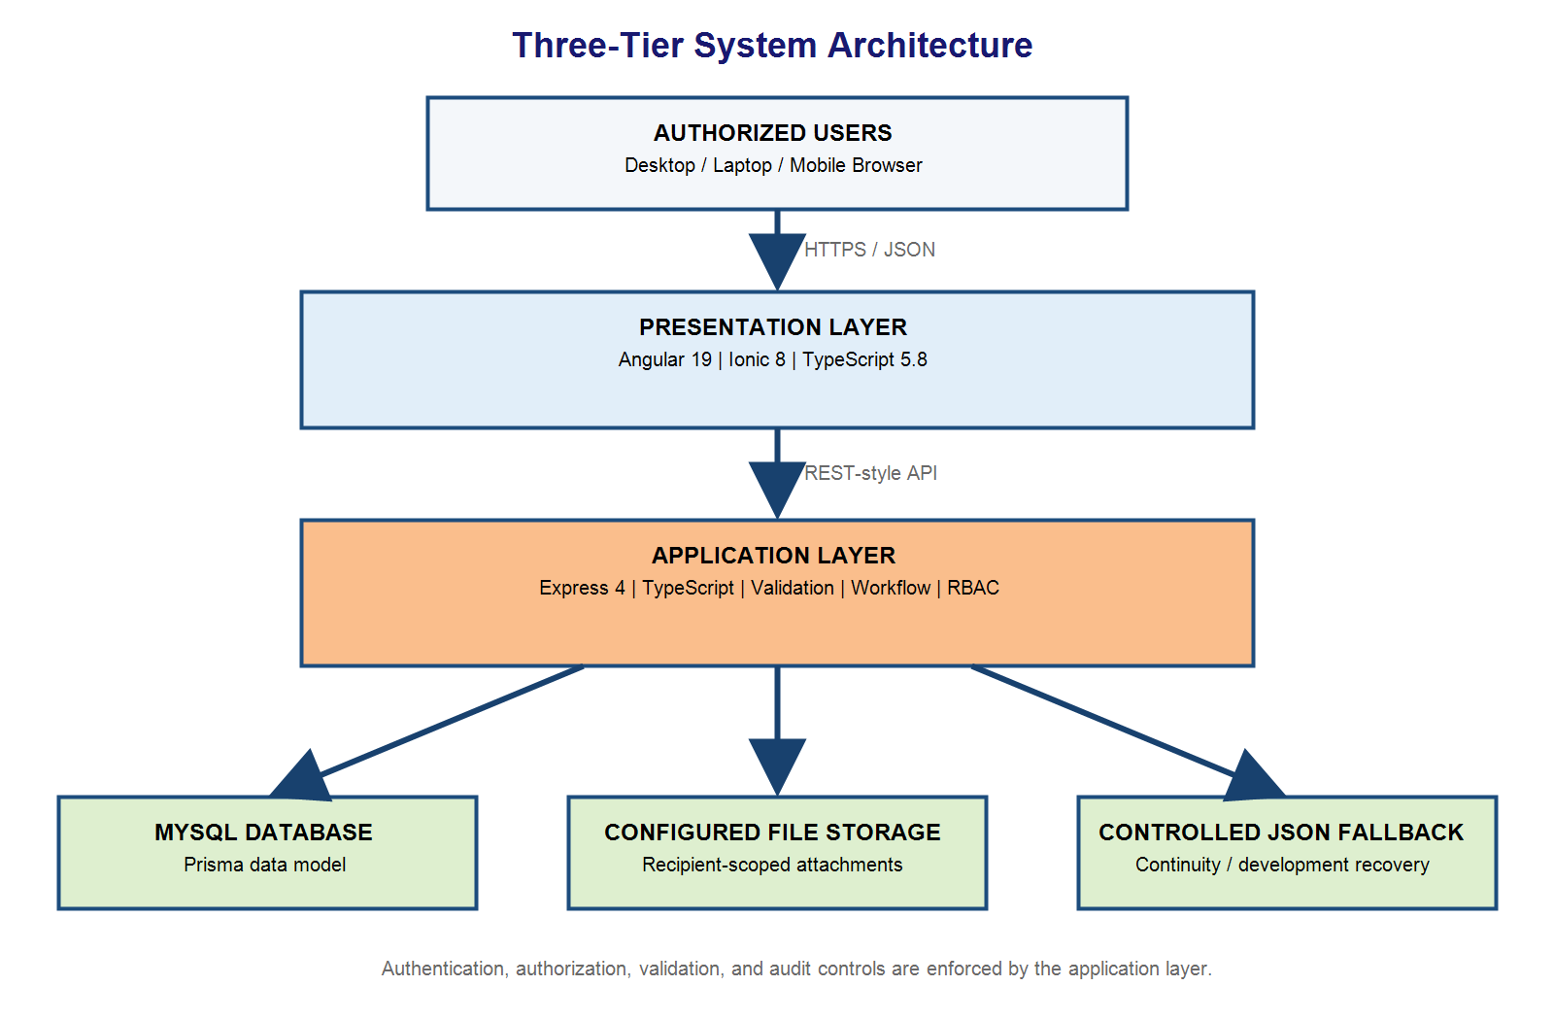
SYSTEM ARCHITECTURE
Presentation, application, and data tiers
Figure 2. Multi-tier architecture of the WDTMP

Slide 8
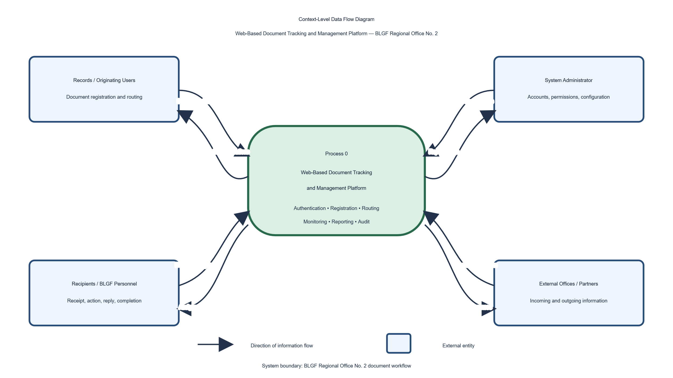
CONTEXT-LEVEL DATA FLOW
System boundary and external information exchanges
Figure 4. Context-Level Data Flow Diagram

Slide 9
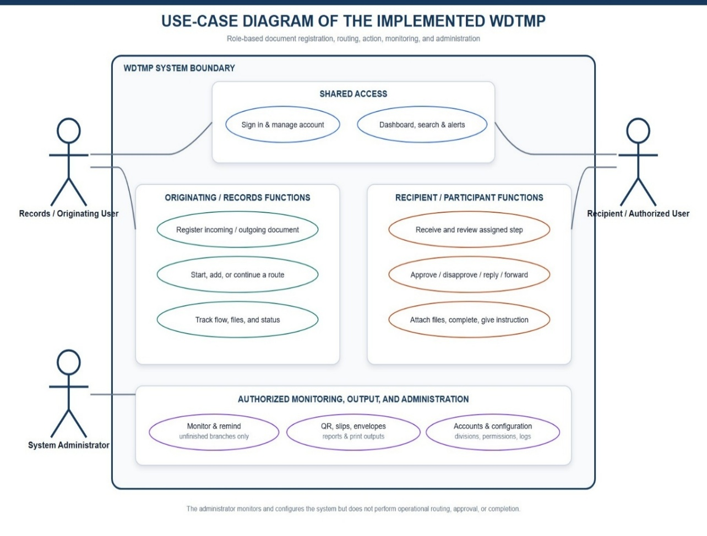
ACTORS AND CORE WORKFLOW
• System Administrator: accounts, permissions, settings, reports and logs
• Records/Originating User: registers and initiates document routes
• Recipient/Authorized User: receives, acts, replies, attaches and completes
• Every significant action remains traceable through route history and audit logs
Implemented use-case diagram

Slide 10
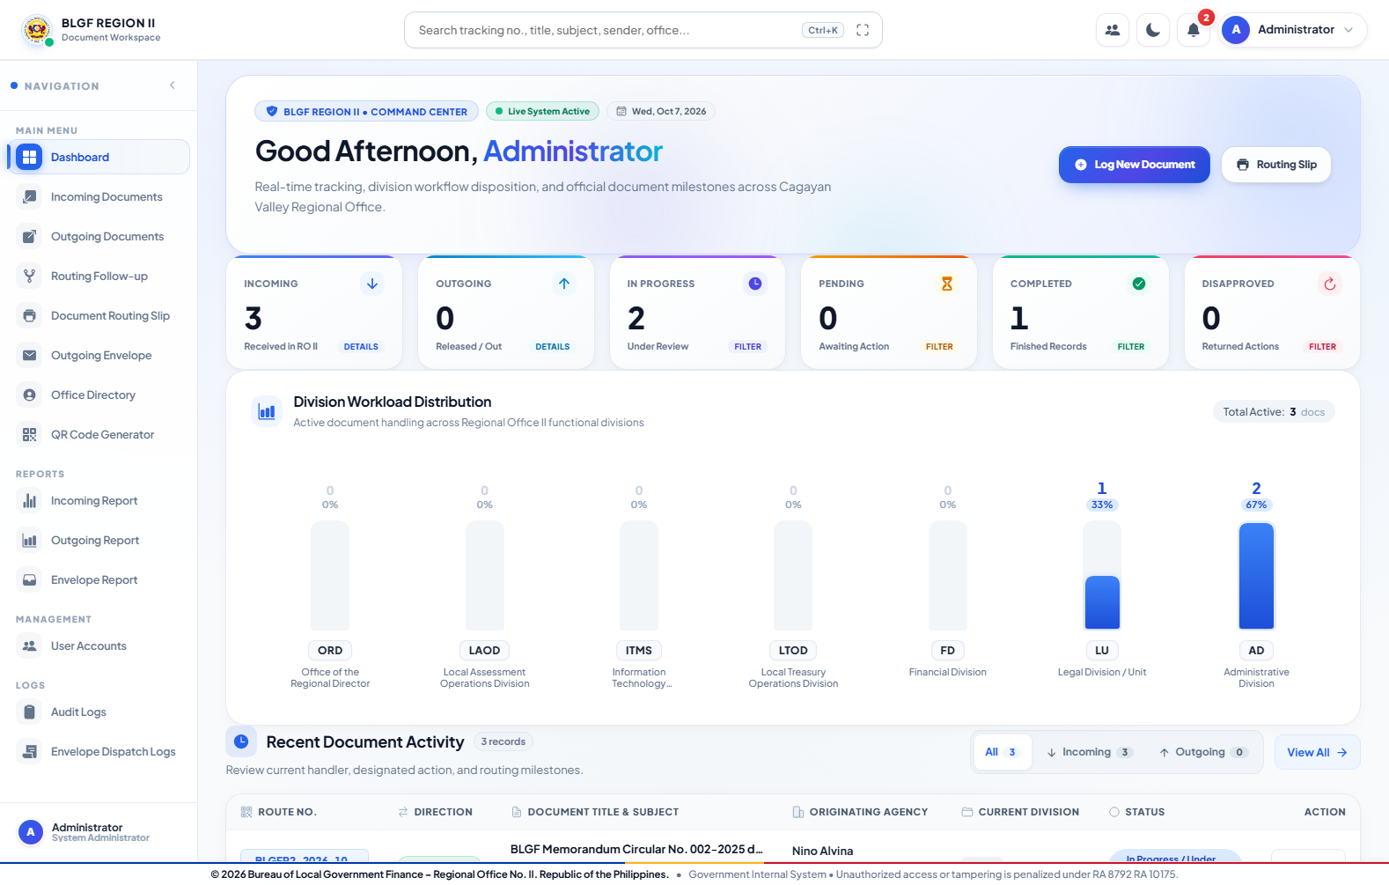
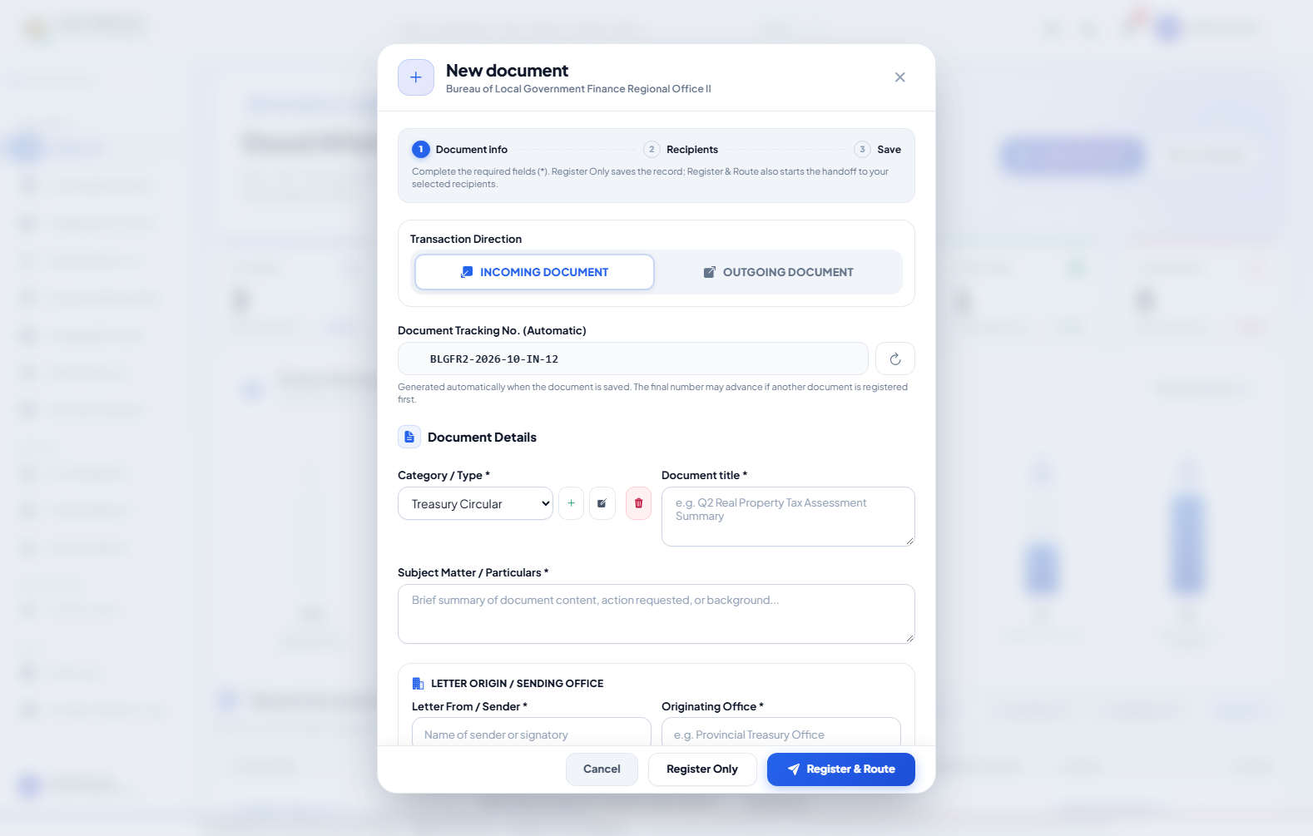
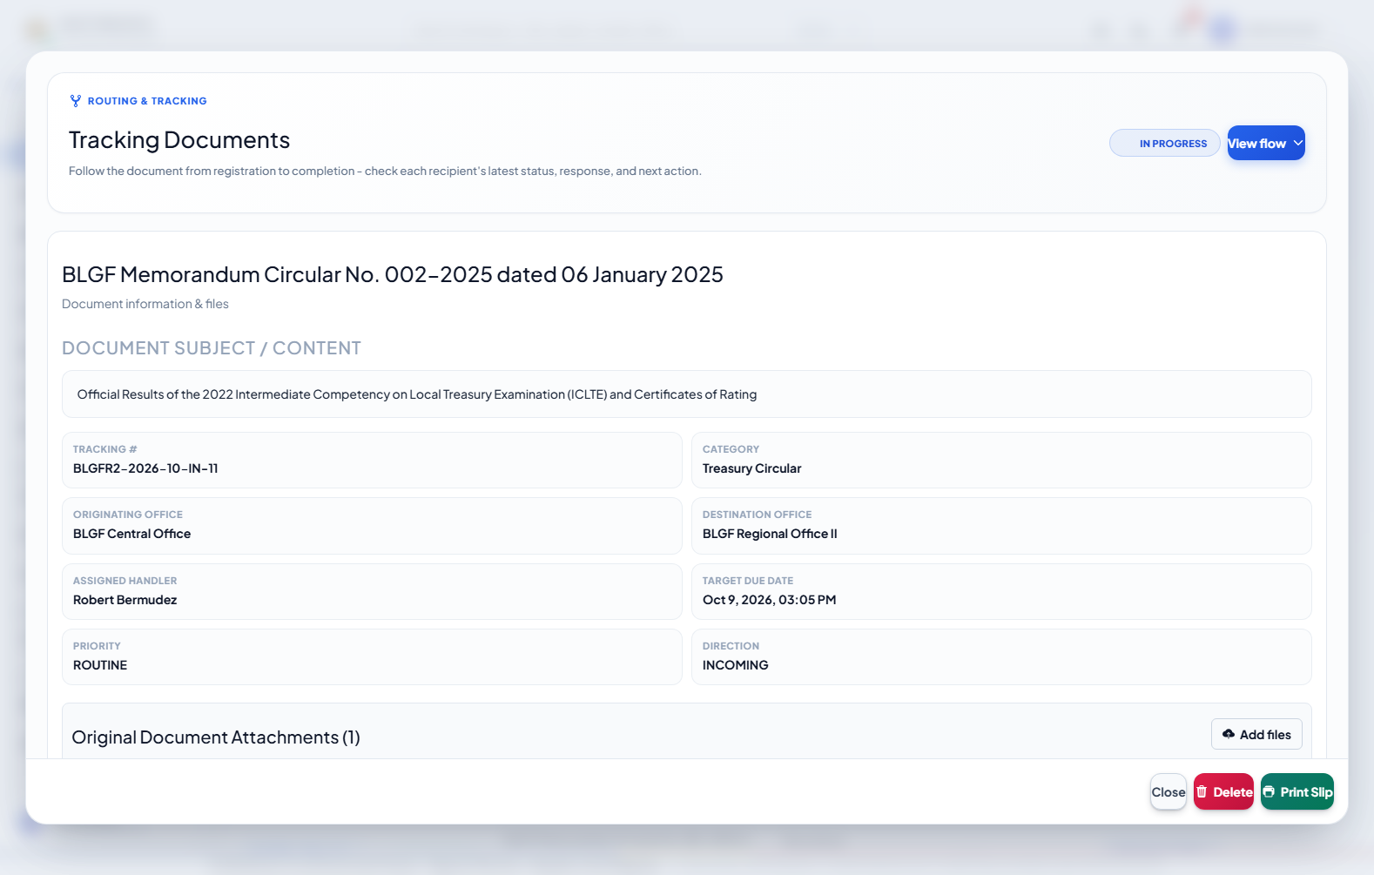
SYSTEM DEMONSTRATION I
Registration, dashboard, and document routing
Dashboard
Log New Document
Details and Routing
One permanent tracking number links document metadata, recipient routes, attachments, actions, status changes, and the complete transaction history.

Slide 11
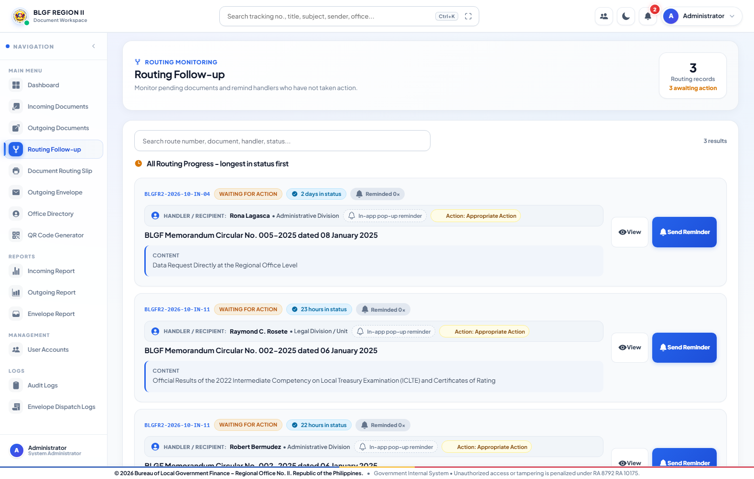
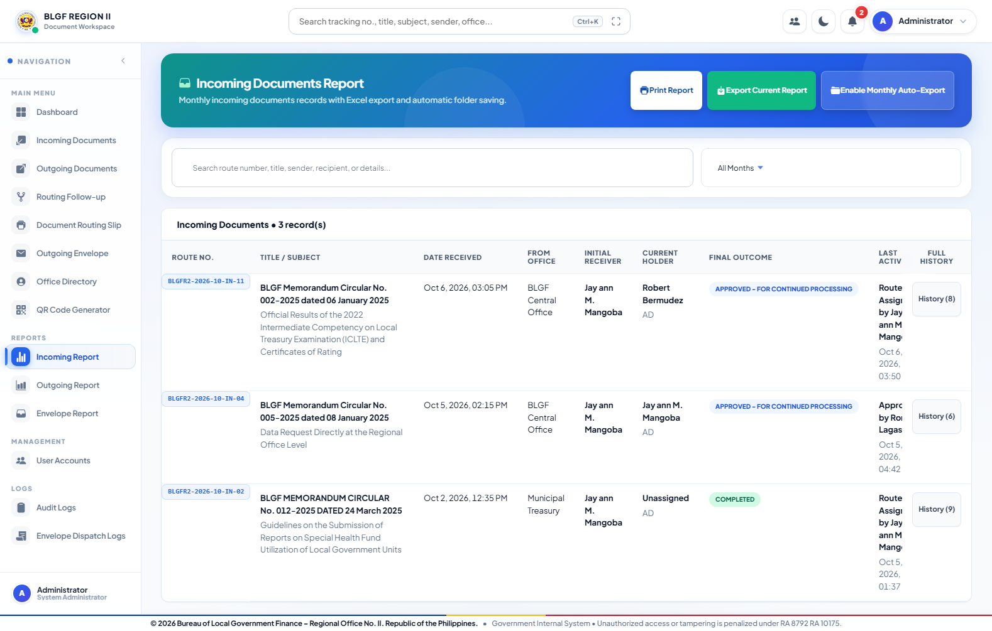
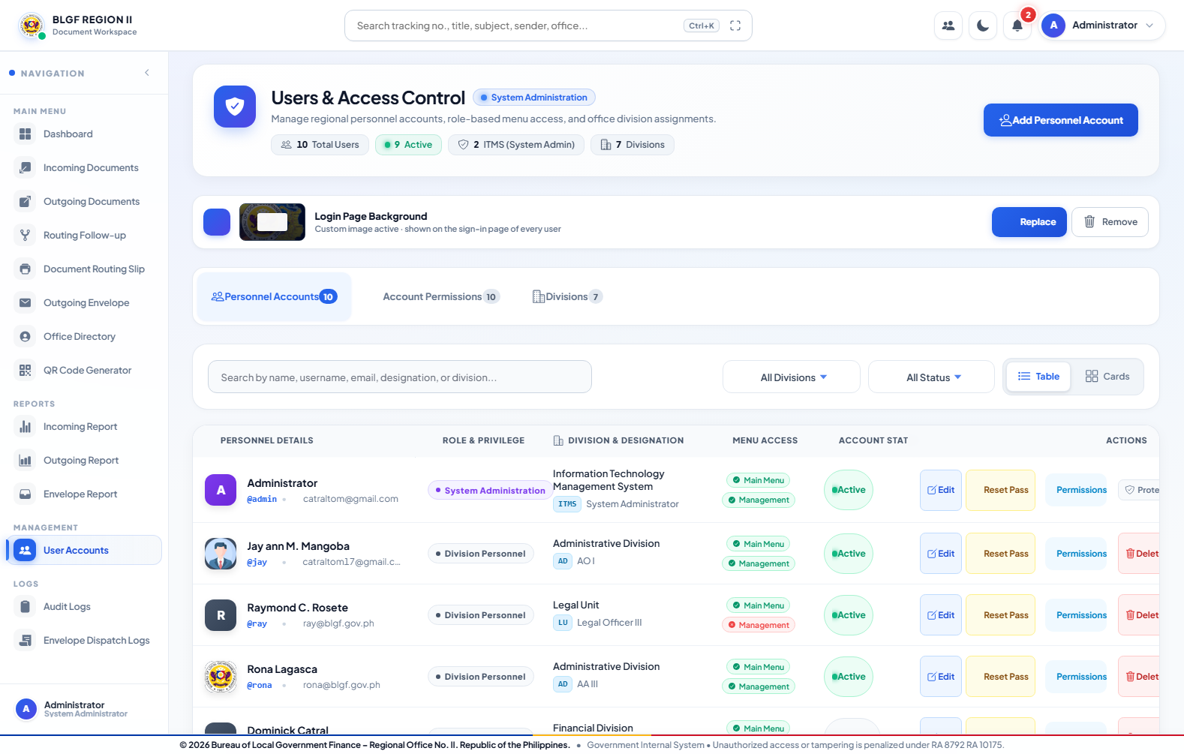
SYSTEM DEMONSTRATION II
Monitoring, reporting, and administration
Routing Follow-up
Transaction Reports
User Accounts
Visibility and actions are controlled by role, account permissions, assignment, and route participation.

Slide 12
ISO/IEC 25010 EVALUATION
Actual survey administration and analysis
RESPONDENTS
INDICATORS
INTERPRETATION
23 total
13 BLGF employees
10 IT experts
27 actual indicators
8 quality characteristics
5-point Likert scale
4.21-5.00
VERY GREAT EXTENT
Weighted mean used
The reported results correspond to the digital questionnaire actually administered and reproduced in Appendix D.2.

Slide 13
ISO 25010 CATEGORY RESULTS
All characteristics were rated to a Very Great Extent
Functional Suitability
4.98
Reliability
4.97
Usability
4.98
Performance Efficiency
4.96
Compatibility
4.96
Security
4.93
Maintainability
5.00
Portability
4.97
GRAND MEAN: 4.97 - VERY GREAT EXTENT

Slide 14
INDIVIDUAL INDICATOR HIGHLIGHTS
Chapter IV reports each indicator, not only the summary
PERFECT MEANS - 5.00
IMPROVEMENT PRIORITIES
Required document-management functions
Workflow-task support
Data and transaction-history preservation
Documentation sufficiency
Straightforward task completion
Expected workload capacity
Role-based restriction
All four maintainability indicators
Protection from unauthorized access/modification - 4.87
Efficient computing/network resource use - 4.91
Module information exchange - 4.91
Installation/deployment procedures - 4.91
All remained within Very Great Extent.

Slide 15
SUMMARY OF FINDINGS
• The existing manual workflow was vulnerable to delays, incomplete visibility, misplaced records, and weak traceability.
• The developed WDTMP provides end-to-end registration, routing, monitoring, retrieval, reporting, and auditing.
• All 27 indicators and all eight ISO/IEC 25010 characteristics were rated to a Very Great Extent.
• The overall evaluation produced a grand mean of 4.97; maintainability ranked highest at 5.00.
• Security remained highly rated at 4.93 but should receive continued review and strengthening.

Slide 16
CONCLUSIONS
The developed WDTMP addressed the identified workflow problems by consolidating document transactions into a secure, searchable, role-controlled, and auditable platform.
The 4.97 grand mean confirms that the system satisfies the evaluated ISO/IEC 25010 quality requirements to a Very Great Extent.
The platform is suitable for controlled operational adoption at BLGF Region II, subject to institutional approval, deployment preparation, and user training.

Slide 17
RECOMMENDATIONS
• Conduct controlled deployment with user orientation, role assignment, and documented operating procedures.
• Continue security testing, access reviews, backup verification, and audit-log monitoring.
• Maintain updated deployment documentation and monitor computing/network performance.
• Perform periodic user evaluation and incorporate approved workflow improvements.
• Consider future integrations only after privacy, interoperability, and institutional requirements are validated.

Slide 18
EXECUTIVE SUMMARY
PROBLEM
SOLUTION
EVALUATION
DIRECTION
Manual routing caused delays, limited visibility, record risks, and weak accountability.
WDTMP centralizes registration, routing, tracking, search, reporting, permissions, and audit trails.
23 respondents rated 27 indicators. Grand mean: 4.97, interpreted as Very Great Extent.
Proceed with controlled adoption while strengthening security, deployment guidance, and monitoring.

Slide 19
THANK YOU!
QUESTIONS AND DISCUSSION
TOM TOM G. CATRAL

