Slide 2
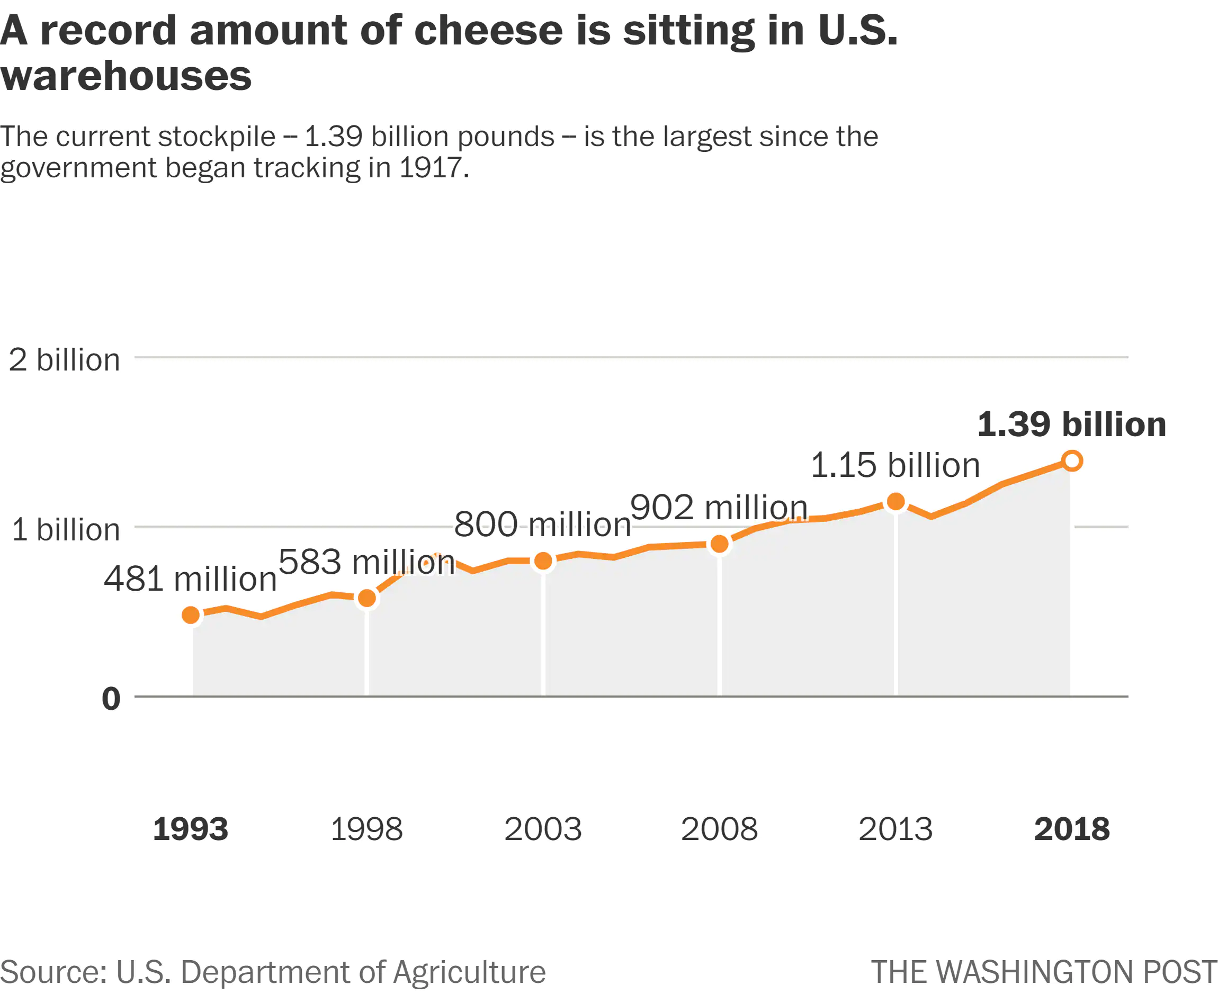
Clear title that is informative rather than just descriptive
Units – billions of pounds weight are not readily assimilated. Would Tons or Tonnes be better?
Sub-tile summerises key finding of the graphic
Line graph is labelled rather than using a key so reader does not have to move eyes to and from a legend
Minimal axis labelling and lines keeps image clean
Good use of grey infill with white devisors allows viewer to relate numbers to horizontal axis
Good use of labels to define the changing value.
Selection of text labels in good units that range from 0 to 1000 as good SI practice
X axis labels are a long way from y=0 base line and rather ‘separate’
Labelling origin of y-axis non-informative and distracting – could have been omitted. Need not be in bold font
SOURCE: https://www.washingtonpost.com/news/wonk/wp/2018/06/28/americas-cheese-stockpile-just-hit-an-all-time-high/?noredirect=on

Slide 3
Serif fonts used in titles, san-serif in labels.
An ordered bar chart with horizontal bars would be a preferable format
Pie chart. Rarely the best option as human eye/brain is not good at comparing the segment size
There is space to display segment sizes as percentages or in dollars but these are not shown – no feeling of scale
Three dimension design of pie chart adds nothing to visual effect
Labels. Font colour is same as segment so some labels have very poor contrast and are unreadable
Labels. Font is so small that cannot be read on mobile phone or other displays.
The myPlate website relates to encouraging people to eat healthily. Not sure how the two images relate
Colour scheme non-inspiring and unlikely to work for viewers with various colour-blind issues nor in black and white (eg printing on laser printer - See inset).
Source: Posted on LinkedIn by Ryan Slabaugh 7 Feb 2023 : Last accessed 24 Feb 2024

