Slide 1
Breakfastclub
A Multi-agent based classroom simulator
manuel.pasieka@protonmail.ch

Slide 2
How different personalities effect classroom attention and happiness?

Slide 3
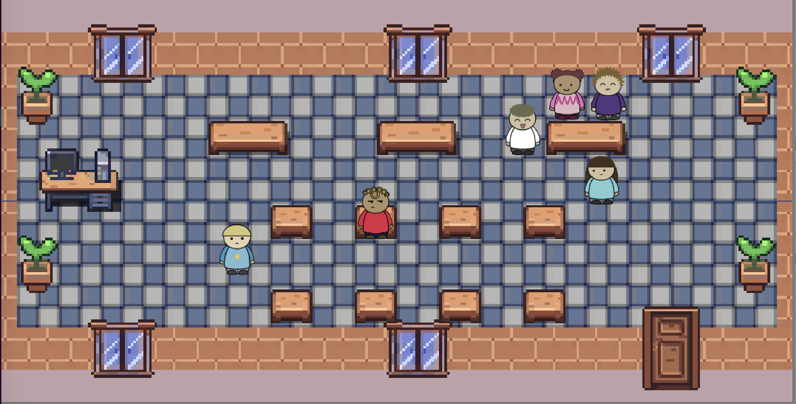
Breakfastclub
Unity3D based multi-agent simulation
Agent behavior is based on OCEAN (Big Five) Personality Trait model
Model attention, happiness and motivation
Different personality profiles are compared to each other

Slide 4
The Agents
Behavior
Internal States
Personality
Chat
Take a break
Study alone
Study in groups
Quarrel/Argue
Motivation
Happiness
Attention
Openness
Conscientiousness
Extraversion
Agreeableness
Neuroticism

Slide 5
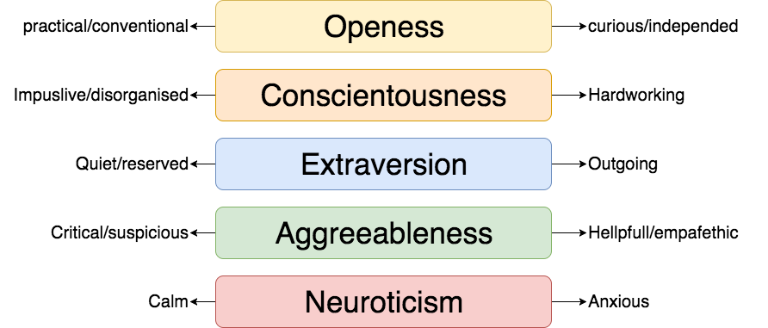
OCEAN – Personality Trait Model

Slide 6
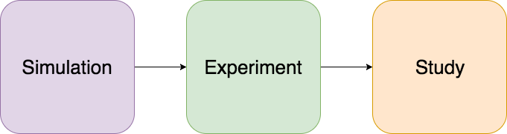
Three phase Analysis
What is the behavior of one set of agents?
What is the average happiness and attention of a combination of personalities?
How do different personality combinations compare to each other?

Slide 7
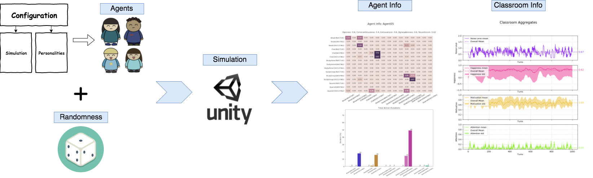
Simulation
What is the behavior of one set of agents?

Slide 8
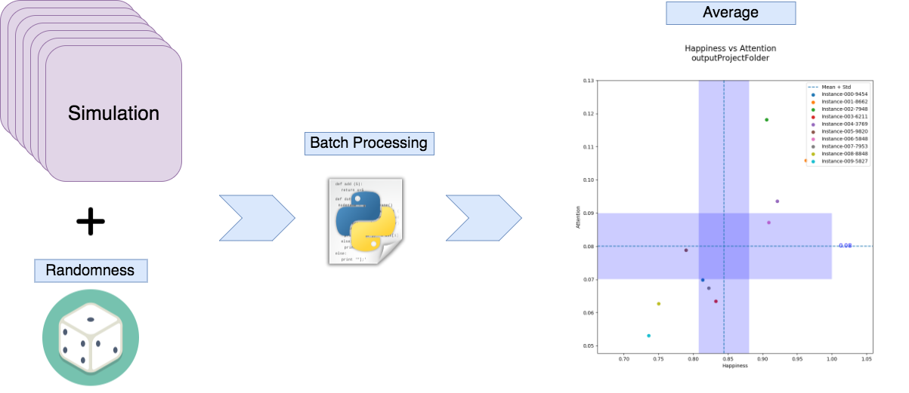
What is the average happiness and attention of a combination of personalities?
Experiment

Slide 9
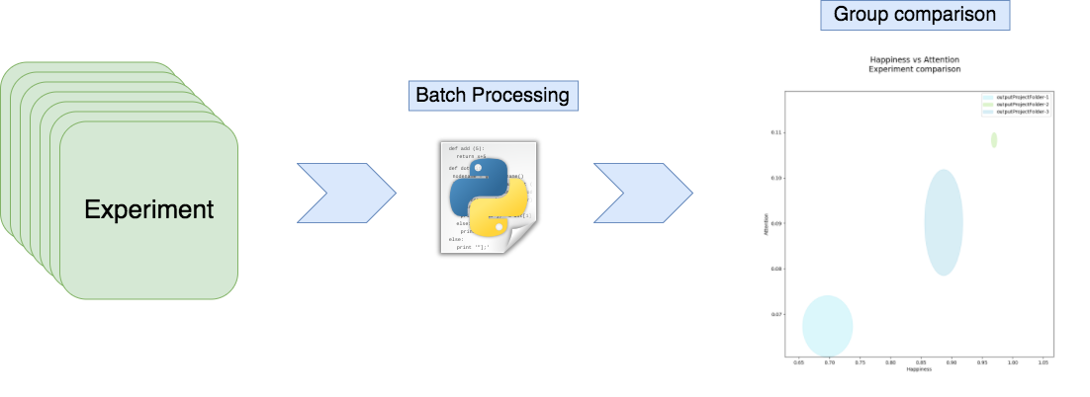
Study
How do different personality combinations compare to each other?

Slide 10
Results

Slide 11
Outlook

Slide 12
Máster Universitario en Inteligencia Artificial
Prof. Dr. Michael Kickmeier-Rust
(Supervisor)
Thank you

