Slide 1
Coursera Capstone project

Slide 2
Intro
Both Belgian cities Antwerp and Gent feel similar, but are they?
Are there clear differences?

Slide 3
Data
Find neighborhoods/areas
Fill in empty spaces in the cities
Use foursquare API to obtain nearest venues

Slide 4
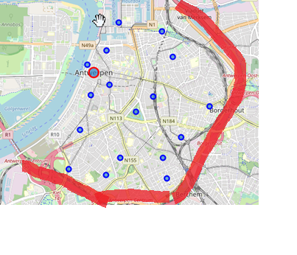
DATA - Antwerp
Focus on inner city

Slide 5
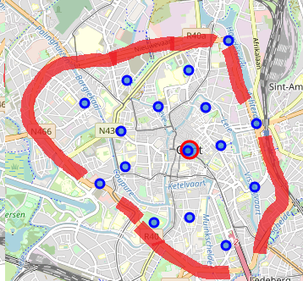
DATA - Gent
Focus on inner city

Slide 6
Methodology
Clustering
Elbow method
Comparing most common venues

Slide 7
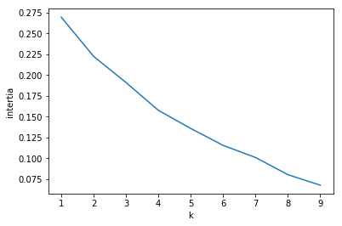
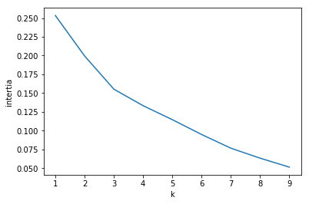
Methodology
Figure 1: Inertia in function of the number of clusters k for Antwerp. Optimal number of clusters seems to be 2 or 4.
Figure 2: Inertia in function of the number of clusters k for Gent. Optimal number of clusters seems to be 3.

Slide 8
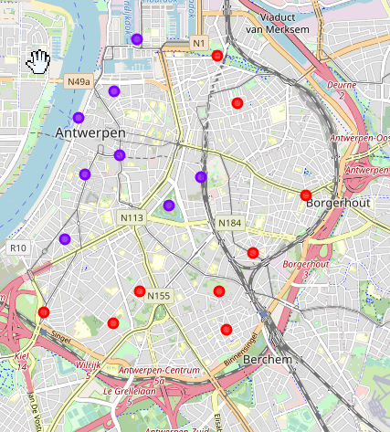
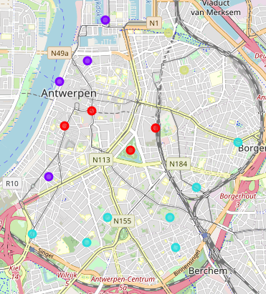
Results - Antwerp
Figure 3: Results of clustering areas in Antwerp. K = 2.
Figure 3: Results of clustering areas in Antwerp. K = 4.

Slide 9
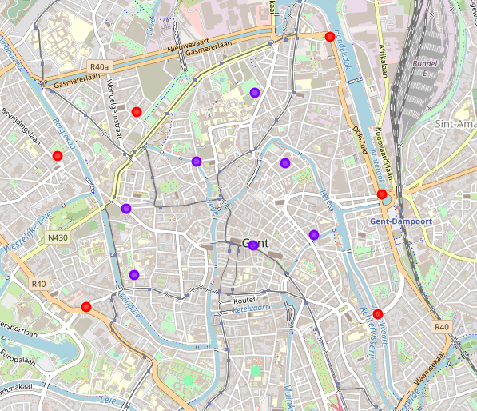
Results - Gent
Results of clustering areas in Gent. K = 3.

Slide 10
Results - Discussion
Both cities have a more touristy part around the center of the city: while other parts are more residential: a lot of bakers and bars and less shopping venues.

Slide 11
Results – top 10 venues
For a final comparison let us look at the most common venues in Gent and Antwerp.
Both have coffee shops as the most common venues. Gent seems to be more of a fashion city compared to Antwerp: clothing store is the second most common venue in Gent while in Antwerp it is not even in the top 10. Both cities seem to have a lot of diverse restaurants.
Antwerp seems to have relatively more bars than Gent while Gent has more Cocktail bars.

Slide 12
Discussion
Antwerp and Gent indeed seem to have sort of the same pattern of type of neighborhoods/areas in terms of venues: more touristy areas in the center of the city vs more residential areas in the periphery. Based on the clustering I can recommend visiting the centers since these center areas are a lot more diverse.
The difference between the city in terms of venues are
Relatively more clothing stores in Gent while relatively more plaza’s and bars in Antwerp. For people that like the more small-scale shopping experience I would recommend Gent, while people that like the more shopping center experience I would recommend Antwerp.
More bars in Antwerp: If you would like to hang out in the pub or bar, I would recommend Antwerp.
A lot of sushi restaurants in Antwerp.
Relatively more lunch opportunities in Gent.
Relatively many juice bars in Gent
Relatively more Spanish restaurants in Gent.
But overall, both cities are indeed remarkably similar.

Slide 13
Conclusion
We found a similar cluster pattern and quite a lot of similar venues in the top 10 for Antwerp and Gent. Some small differences can be found and may turn the decision of a potential reader towards a certain city. However just throwing a dice might also work if the differences are of no interest to the potential reader.
If we want to research further differences in experience it can be interesting to take other type of features in consideration, e.g. different types of surface areas, population, amount of tourists, …
To make a recommendation for one or another city solely based on venues might not be enough for a lot of individuals.

