Slide 1

Eventage
Tom Croteau, Rony Alvarez, Andrew Manuele
Wiki: https://github.com/paceuniversity/cs6392016team1/wiki
YouTube: (link goes here)

Slide 2
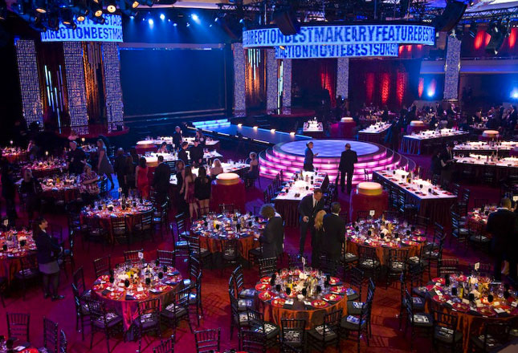
The Problem
Any event these days revolved around social media
You take a picture
Post to Facebook, Twitter, Instagram individually
Time consuming
Takes away from the event

Slide 3
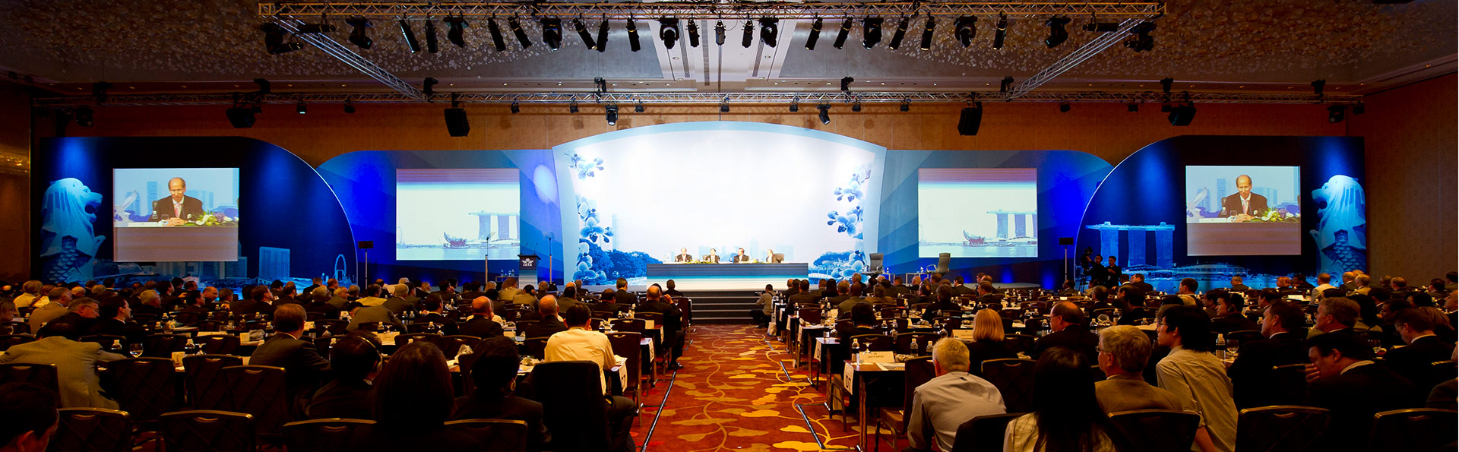
The Solution
John is always on the road
Conventions for work, not for profit events, evening galas
John wants his followers on social media to enjoy every event with him, without missing the events himself
With Eventage he can quickly take photos/videos
They will automatically save and be ready for him to view afterwards
He can even choose to save his texts and phone calls!
“Montage Mode” allows him to customize a mini montage of his event

Slide 4
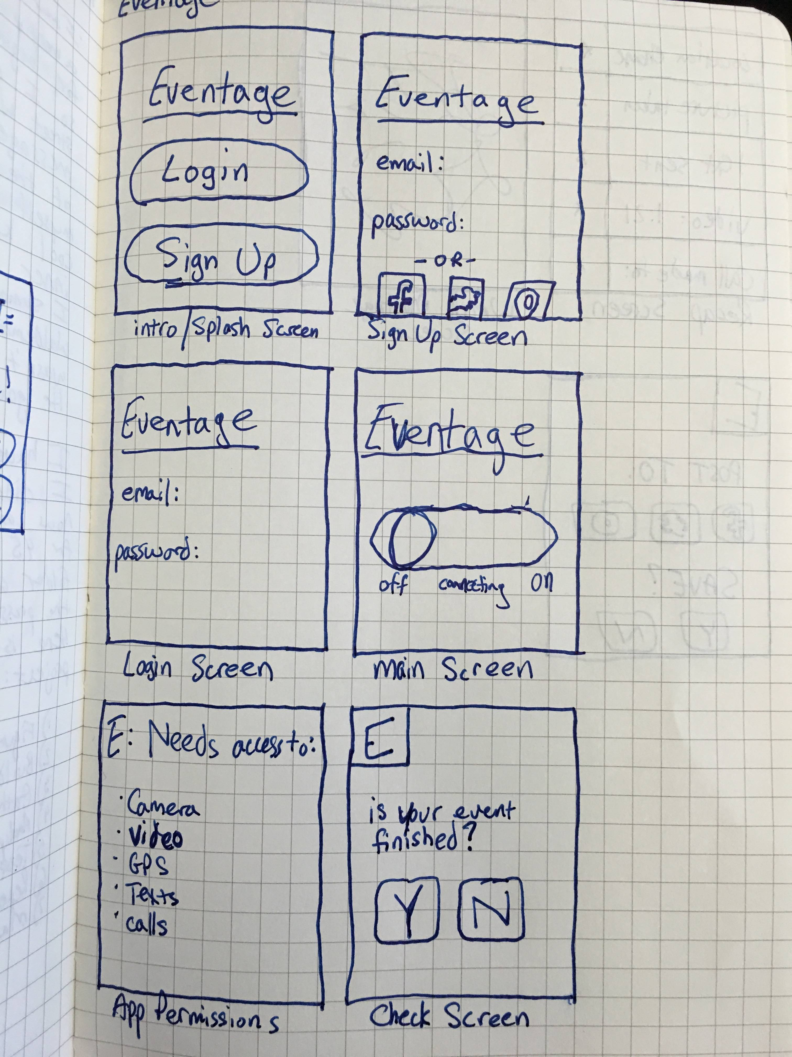
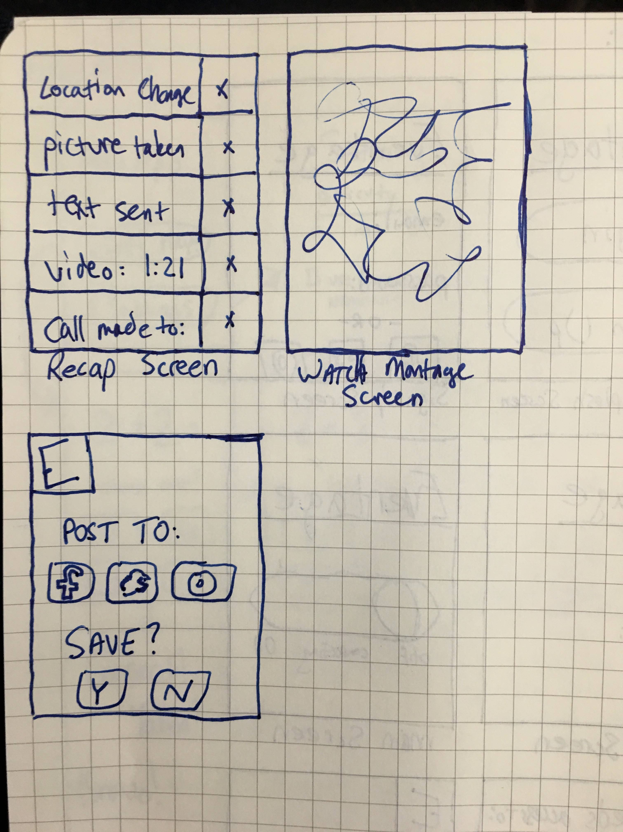
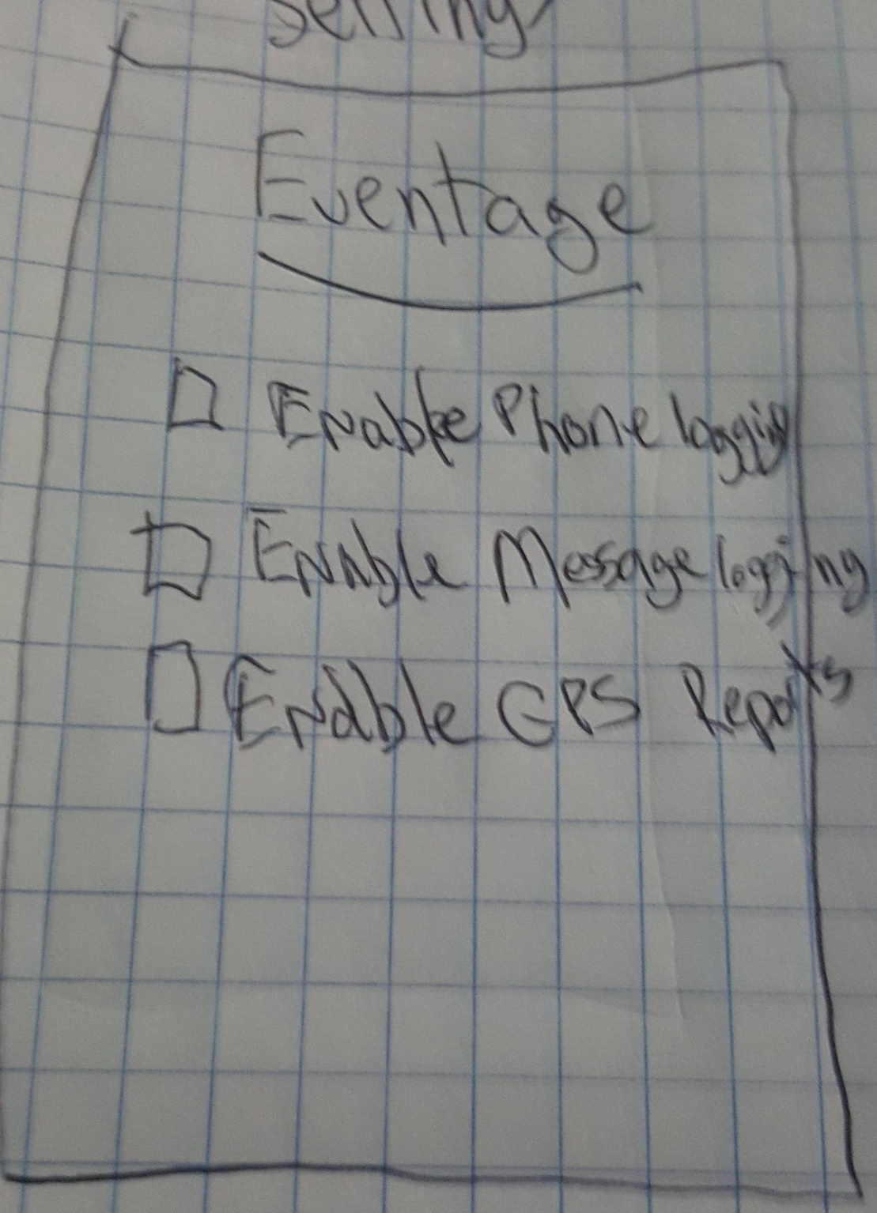
Prototype 1

Slide 5

Prototype 2

Slide 6
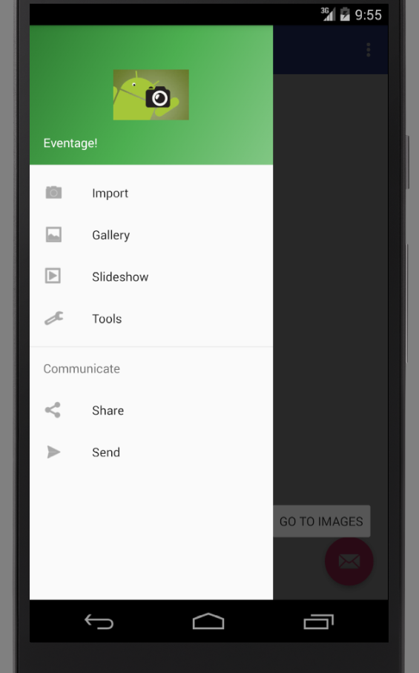
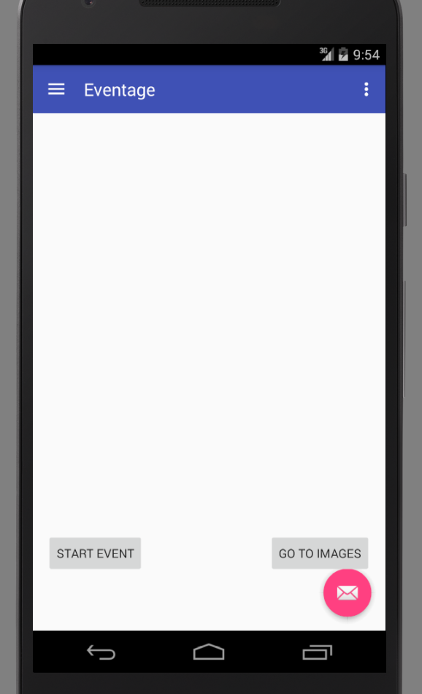
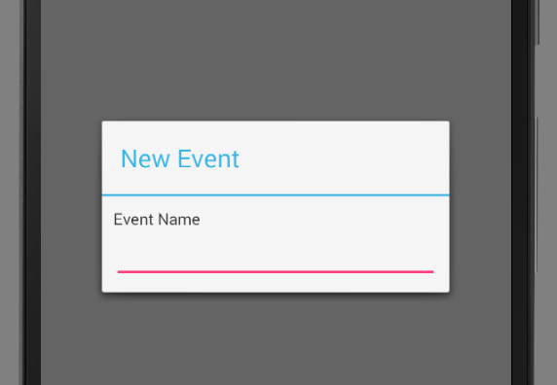
Final Prototype

Slide 7
Key Features

Slide 8
Problems Encountered

