Slide 1

Learning To Schedule Sport Tournaments from Tensor Data
Tom De Bièvre

Slide 2

Context
Many real world problems require constraints
Sport scheduling is really complex and laboursome
Major League Baseball season 2018-2019
  2 leagues
  Each league consists of 3 divisions
  162 games per team per regular season
Could this be automated to lower the amount of work?
DTAI, Department of Computer science

Slide 3
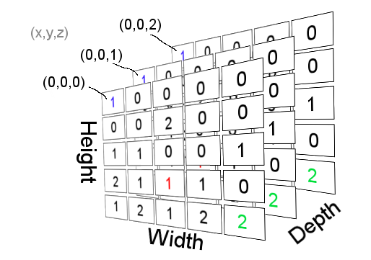
Aim
Constraint programming to make scheduling easier
Learning/acquiring constraints using tensor manipulation
Make schedule problems easier
Particular interest in sports!
DTAI, Department of Computer science

Slide 4

Approach: Literature study
Different kinds sport schedules? Terminology?
  Single / double elimination(cfr knockout phases)
  Multilevel (cfr Boxing/chess)
  Round Robin variations
Cost functions
    Minimum breaks
    Minimum carry-over
    Minimum travel distance
DTAI, Department of Computer science

Slide 5
Approach: Literature study
Sport scheduling constraints (Nurmi et al, 2010)
  Hard constraints
  Soft constraints
Previous work on sport scheduling?
  A Model Seeker
  Travelling tournament problem
DTAI, Department of Computer science

Slide 6
Approach: Literature study
A Model Seeker: Extracting Global Constraint Models from Positive Examples Beldiceanu N., Simonis H. (2012)
  Searching conjunctions of identical constraints
  Global constraints → Edge cases?
DTAI, Department of Computer science

Slide 7
Approach: Literature study
The Traveling Tournament Problem: Description and Benchmarks
Kelly Easton, George Nemhauser & Micheal Trick
  Combining HAP patterns and Minimal distance travelling
  Feasability & optimality combined
  Constraint programming & integer programming
  Unsolved if n>6
DTAI, Department of Computer science

Slide 8
Approach: Literature study
Automating Personnel Rostering by Learning Constraints Using Tensors
Kumar M., Teso S. De Causmaecker P., De Raedt L. (2018)
  Base approach for discovering numerical constraints
  Learning: tensor extraction and aggregation on input schedules
  Support multi dimensional tensors
  No support for soft constraints (yet)
DTAI, Department of Computer science

Slide 9
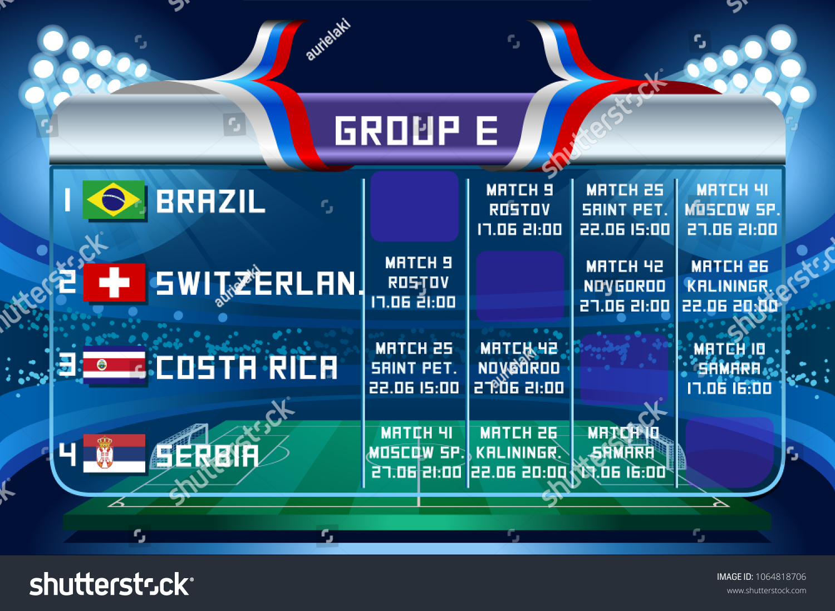
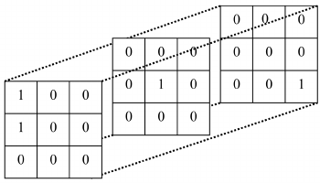
Approach: Research Questions
To what extent could CountOR learn sportconstraints as is?
Could we adapt/generalize CountOR to CountSPORT to learn scheduling constraints?
  To what extend can we acquire all constraints?
Could we integrate minimizing/maximizing cost functions into CountSPORT?
DTAI, Department of Computer science

Slide 10
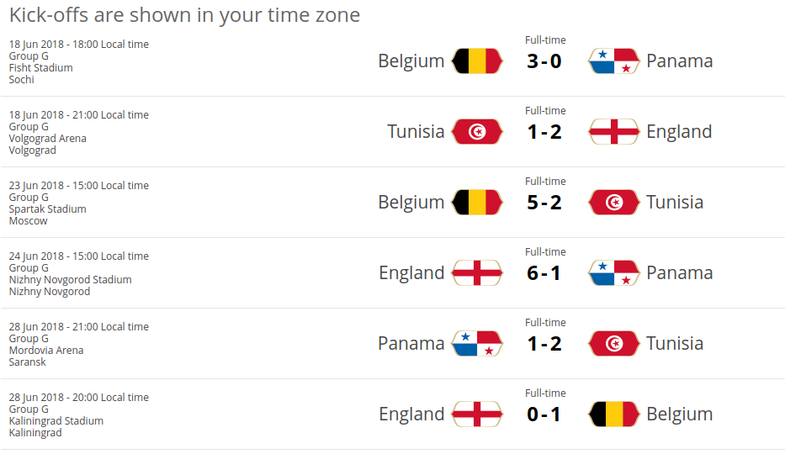
Practical Approach: Schedule to tensor
R1
R2
R3
DTAI, Department of Computer science

Slide 11
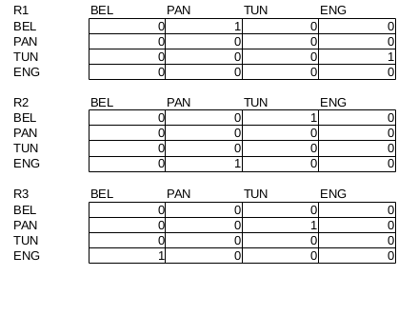
Practical Approach: Schedule to tensor
DTAI, Department of Computer science

Slide 12
Practical approach I: planning (until feb)
Generate schedules using own Hard Constraints
Use CountOR to acquire constraints
Generate new set using acquired constraints
Check satisfiability

Slide 13
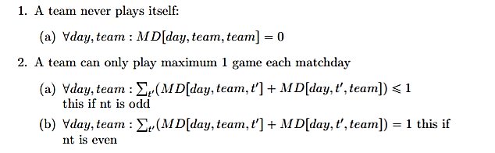
Practical approach: CountOR(benchmark)
Generate set of schedules using own constraints
Hard Constraints
DTAI, Department of Computer science

Slide 14
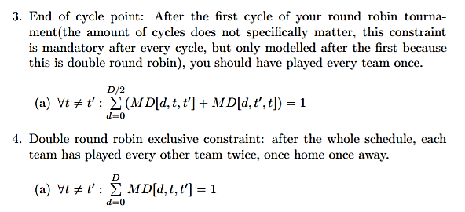
Practical approach: CountOR(benchmark)
DTAI, Department of Computer science

Slide 15
Practical approach: CountOR(benchmark)
Learn with CountOR as is
  Generate new set schedules using acquired constraints
  Check satisfiability
DTAI, Department of Computer science

Slide 16
Practical approach: planning II (mar-apr)
Generate schedules w. Hard Constraints
+ Soft constraints
CountSPORT to acquire constraints
And minimize cost penalty
Generate set using acquired constraints
Check satisfiability and match with benchmark

Slide 17

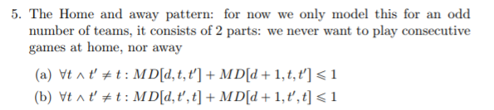
Practical approach: CountSPORT
Adapt CountOR
  Hard constraints
  Soft constraints?

Slide 18


Putting it to work: a practical use case
Scheduling the Belgium football competition (format used since 2009)
  16 teams: 30 games in regular competition
  Playoff 1: Division of 6 teams
  Playoff 2: 2 divisions of 4 teams
  Playoff 3: 1 division of 2 teams
Lots of edge cases
DTAI, Department of Computer science

