Slide 1
Flash Fill and
Equation Discovery
Craps Jeroen 27/10/’14
De Groote Tom
Begeleiders:
Angelika Kimmig
Luc De Raedt
Notes:
add your names & the date

Slide 2
Overzicht
Example-based learning
Spreadsheet tabel transformaties
Ons doel
Equation discovery
Notes:
I typically use font sizes around 42pt for bullet points, and almost never go below 36pt for presentations, that just gets too small to read from the back of a room.

Slide 3
End-user programming
Repetitieve taken
Weinig tot geen programmeerkennis
Non-triviale transformaties
Notes:
I’d move this slide and the next one to the very beginning as motivation for the entire talk, this really is the key point of why you are taking your audience through all of the material, so tell them early (we all like to know where we are going, and why...)

Slide 4
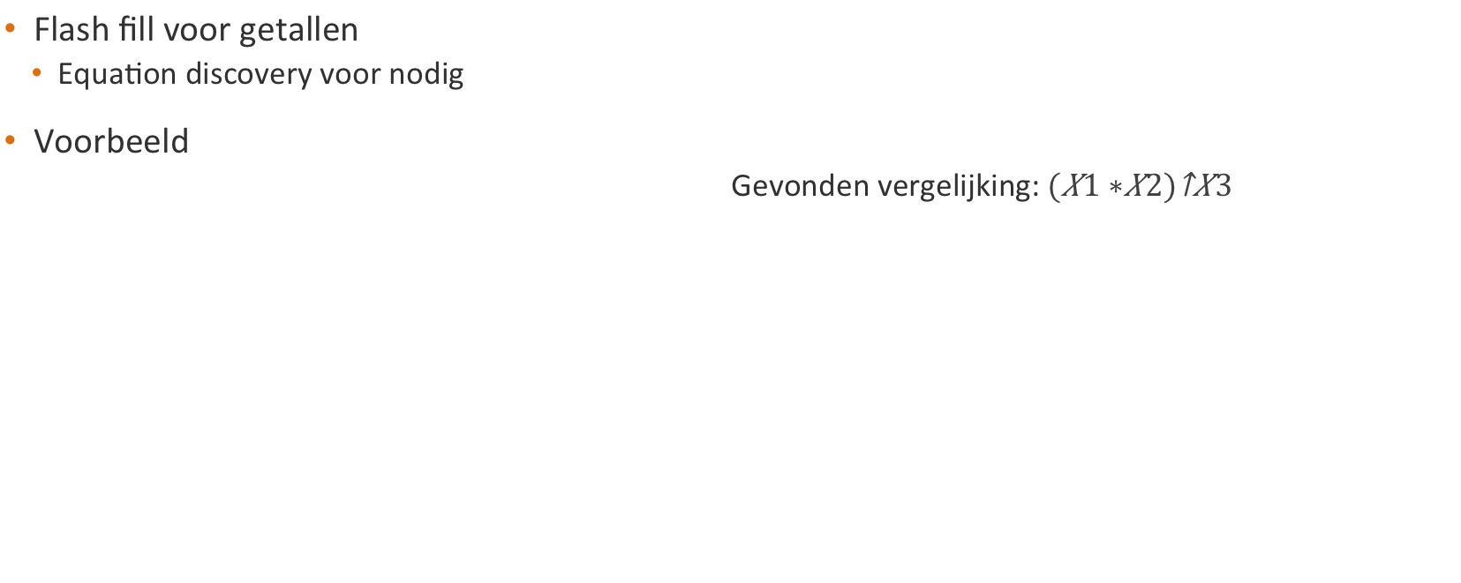

Ons doel
X1 | X2 | X3 | Y
1 | 2 | 2 | 9
4 | 3 | 3
1 | 8 | 2
8 | 9 | 2
2 | 2 | 2
X1 | X2 | X3 | Y
1 | 2 | 2 | 9
4 | 3 | 3 | 343
1 | 8 | 2 | 81
8 | 9 | 2 | 289
2 | 2 | 2 | 16

Slide 5
Overzicht
Example-based learning
Spreadsheet tabel transformaties
Ons doel
Equation discovery
Notes:
I typically use font sizes around 42pt for bullet points, and almost never go below 36pt for presentations, that just gets too small to read from the back of a room.

Slide 6
Soorten problemen vergeleken
Conceptueel
Procedureel
Geen beslissingsmethode
Creatief denken
Bewijs en constructie problemen
Beslissingsmethode
Memoriseren en toepassen
Notes:
make the focus statement visually, e.g., by adding a frame around the corresponding text, or an arrow pointing to it
what are you comparing? not clear from this slide -> e.g., make the title more specific
mention an example for each type

Slide 7
Probleem generatie
Genereren adhv voorbeeld problemen
Voordelen
  Moeilijkheidsgraad duidelijk bepalen
  Voorkomen spieken
  Copyright problemen vermijden
2 principes conceptuele probleem generatie
  Example-based template generatie
  Probleem genereren dmv oplossing
Notes:
well-known abbreviations are ok
spell-check all slides at end (“examble”)
be careful with too literal translations, e.g., title sounds stiff to me with the two nouns; I’d probably use a verb form here, but you are the language experts, so rely on your judgement

Slide 8
Oplossing generatie
Automatisch generen oplossing
Belang
  Voorbeeld oplossing
  Oplossing op basis van deeloplossing
  Hints
2 principes conceptuele oplossing generatie
  Redeneren over voorbeelden
  Enkel oplossingen met kleine oplossingslengte
Notes:
reasoning = redeneren

Slide 9
Feedback generatie
Controleren correctheid oplossing
  Waarom incorrect
  Waar en hoe fout verbeteren
Hint in verband met gemaakte fout
Iedereen gelijke beoordeling
Handmatig analyseren fouten tijdrovend
2 principes feedback conceptuele problemen
  Aanpassingsafstand
  Tegenvoorbeeld

Slide 10
Toepassing:
Voorbereiden examen
Automatisch generatie probleem
  Moeilijkheidsgraad kiezen
Oplossing
  Verdergaand eigen deeloplossing
  Hints
Feedback
  Score
  Helpen verbeteren
Notes:
I’d mention these examples already when discussing the different categories; makes it easier for the audience to get the ideas
in general, whenever you can easily give an example or figure to illustrate a (reasonably complex) construct or idea, do so

Slide 11
Overzicht
Example-based learning
Spreadsheet tabel transformaties
Ons doel
Equation discovery
Notes:
I typically use font sizes around 42pt for bullet points, and almost never go below 36pt for presentations, that just gets too small to read from the back of a room.

Slide 12
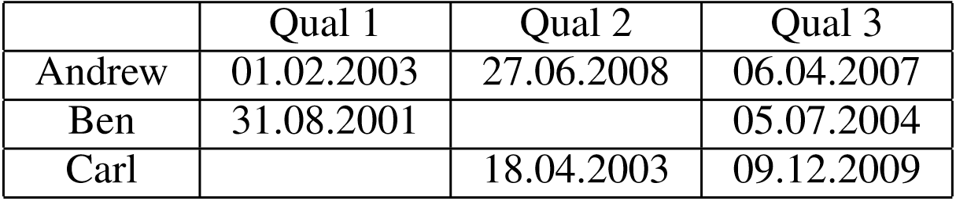
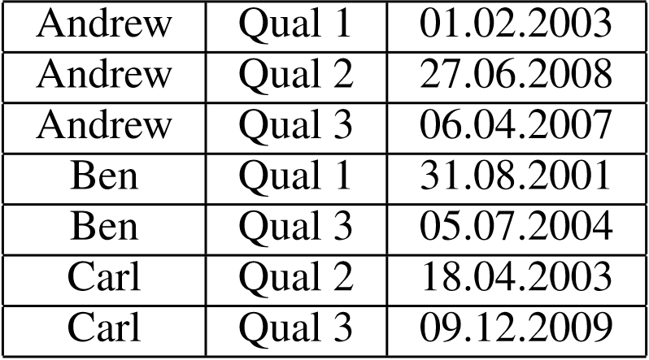
Concept oplossing generatie
Voorbeeld input tabel:
Voorbeeld output tabel:

Slide 13
Voorbeeldprogramma
Filterprogramma
Mapping
Relatieve functies
ProgFromEx
Notes:
this slide and the following two will very much depend on what you are saying; from the text alone, I have no idea what the point you want to make here is

Slide 14
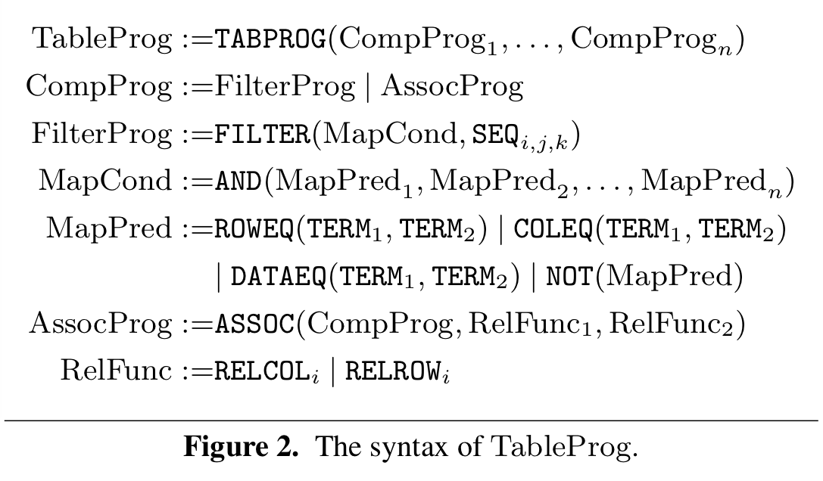
Grammatica
Notes:
always include source of figures on slide (small font ok for that)

Slide 15
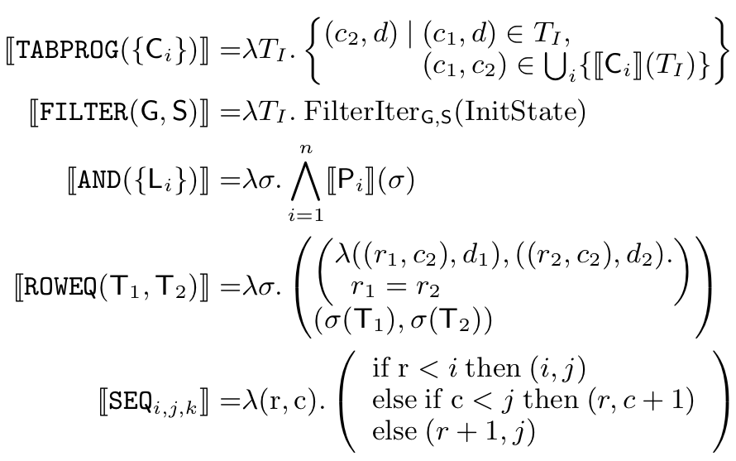
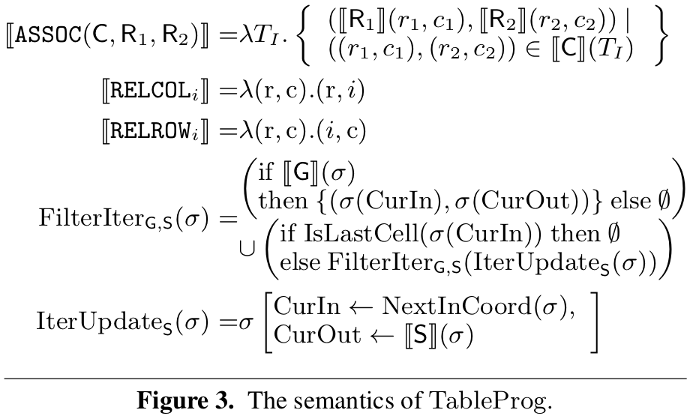
Domein kennis

Slide 16
Overzicht:
Equation discovery
Definitie: Equation discovery
Inductive Language Bias
Context vrije grammatica

Slide 17
Definitie
“Equation discovery is a machine learning task that deals with the problem of learning quantitative laws and models, expressed in the form of equations, in collections of measured numeric data.”
– Encyclopedia of machine learning
Notes:
Applicaties toelichten tijdens presentatie!

Slide 18
Inductive language bias
Inductive bias
3 Types
  Language bias
  Search bias
  Validation bias
Declaratief

Slide 19
Context vrije grammatica (1)
“A context free grammar consists of a finite set of variables , each of them representing a subclass of subexpressions or phrases in the language represented by the grammar.”
- Todorovski & Džeroski

Slide 20

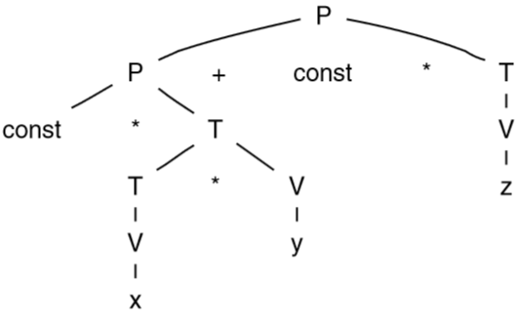
Context vrije grammatica (2)
Voorbeeld language bias: context vrije grammatica
Parse tree
  Parse task
  Parse generation
Notes:
link back to the type of bias this specifies

Slide 21
Conclusie
(NOG TE DOEN)

Slide 22
Papers
Spreadsheet Table Transformations from Examples,
CACM, W.R. Harris, S. Gulwani
Example-Based Learning in Computer-Aided STEM Education,
CACM 2014, Sumit Gulwani
Integrating domain knowledge in equation discovery,
LNCS 4660, Springer Berlin Heidelberg, 2007, Todorovski, Ljupčo, and Sašo Džeroski
Equation Discovery, Enclyclopedia of Machine Learning.
Notes:
Good to have this slide in the presentation, but I'd move it to the "appendix", and add short references (eg [Gulwani, CACM 14]) on the first slide discussing content of that paper. Alternatively, refer to the papers in the outline.
In my experience, referring to the sources while telling a story is easier than first iterating over the sources and then their content.
For starting the presentation, I'd instead strongly suggest one slide with an attention-catching example -- get the audience interested in why you are presenting these papers / motivate your talk. And then regularly refer back to the motivating example later, saying why/how the stuff you’re talking about is relevant to your problem (that also is a good test on whether a slide or topic should be in the presentation -- does it add to the story or is needed to understand a part that does so? if not, cut it out)

Slide 23
Vragen?

