Slide 1
Predicting the potential of professional soccer players
Ruben Vroonen
Tom Decroos
Jan Van Haaren
Jesse Davis
MLSA17 @ ECML/PKDD17
18/09/2017

Slide 2
Predicting the potential of professional soccer players
Ruben Vroonen
Tom Decroos
Jan Van Haaren
Jesse Davis
MLSA17 @ ECML/PKDD17
18/09/2017

Slide 3
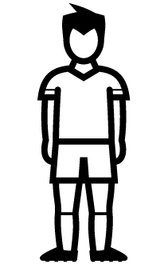
Meet Bob, a young professional soccer player
Bob
Age: 19
Year: 2017

Slide 4
Bob has a set of skill ratings
Bob
Age: 19
Year: 2017
Attacking: 75/100
Defending: 67/100
Stamina: 50/100
Intelligence: 72/100

Slide 5

Meet Bob from the future
Bob
Age: 19
Year: 2017
Bob
Age: 21
Year: 2019
Attacking: 75/100
Defending: 67/100
Stamina: 50/100
Intelligence: 72/100

Slide 6
What are his skill ratings?
Bob
Age: 19
Year: 2017
Bob
Age: 21
Year: 2019
Attacking: 75/100
Defending: 67/100
Stamina: 50/100
Intelligence: 72/100
Attacking: ?/100
Defending: ?/100
Stamina: ?/100
Intelligence: ?/100

Slide 7
Overview
Related Work
PECOTA and CARMELO
Data
SoFIFA.com ratings
APROPOS
Our approach for predicting players’ potential
Experiments
Evaluating the predictive accuracy

Slide 8
Overview
Related Work
PECOTA and CARMELO
Data
SoFIFA.com ratings
APROPOS
Our approach for predicting players’ potential
Experiments
Evaluating the predictive accuracy

Slide 9
Similar systems have already been deployed in baseball (1) and basketball (2)
PECOTA Player Empirical Comparison Analysis Test Algorithm Nearest neighbors analysis on player statistics using Bill James’s similarity scores
CARMELO Career-Arc Regression Model Estimator with Local Optimization Nearest neighbors analysis on Wins Above Replacement (WAR) using simple similarity score

Slide 10
Overview
Related Work
PECOTA and CARMELO
Data
SoFIFA.com ratings
APROPOS
Our approach for predicting players’ potential
Experiments
Evaluating the predictive accuracy

Slide 11
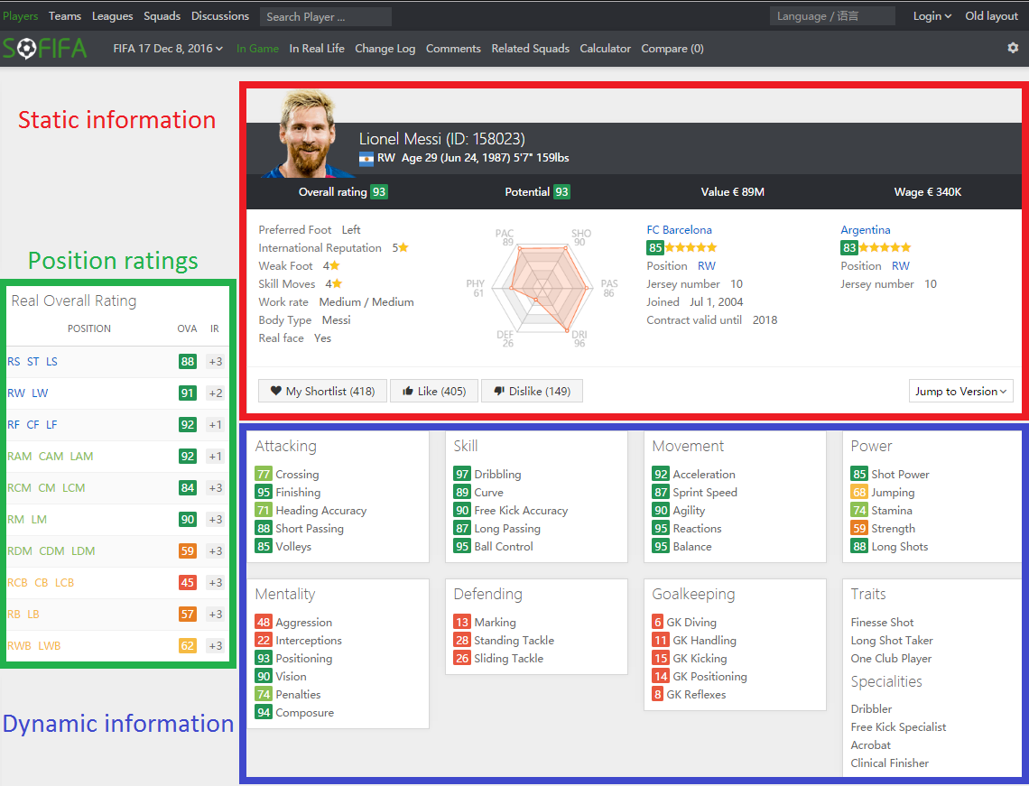
A player card from SoFIFA.com contains 24 skill ratings for a specific player and age

Slide 12
The data
Competitions:
England, France, Germany, Italy and Spain
Stats:
10,000 players
57,000 player cards
Data from 2007-2017
Preprocessing challenges:
Incorrect or missing age
Position of substitute players

Slide 13
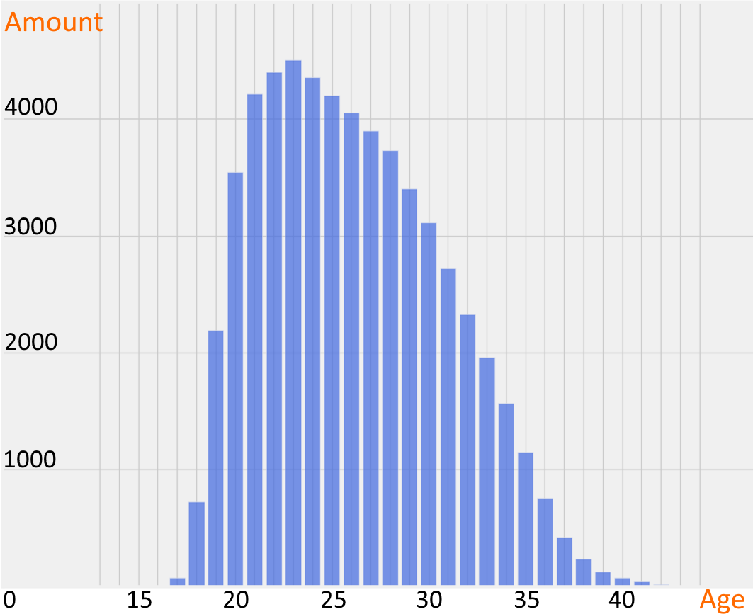
The most interesting categories (young and old players) have the least available data
Number of players

Slide 14
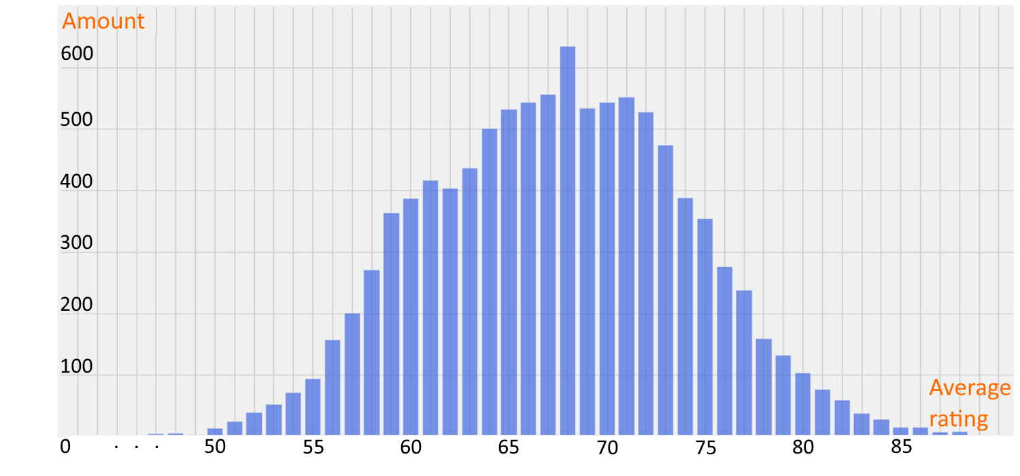
Most skill ratings follow a normal distribution…
Number of players

Slide 15
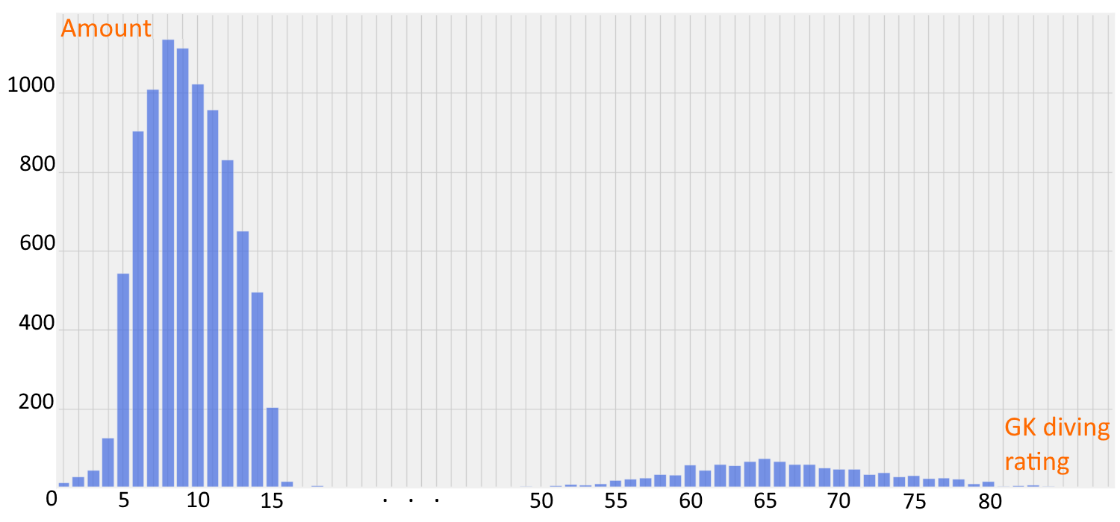
… except goalkeeping skills
Number of players

Slide 16
Overview
Related Work
PECOTA and CARMELO
Data
SoFIFA.com ratings
APROPOS
Our approach for predicting players’ potential
Experiments
Evaluating the predictive accuracy

Slide 17
Reminder: our task is to predict the skill ratings of future Bob
Bob
Age: 19
Year: 2017
Bob
Age: 21
Year: 2019
Attacking: 75/100
Defending: 67/100
Stamina: 50/100
Intelligence: 72/100
Attacking: ?/100
Defending: ?/100
Stamina: ?/100
Intelligence: ?/100

Slide 18
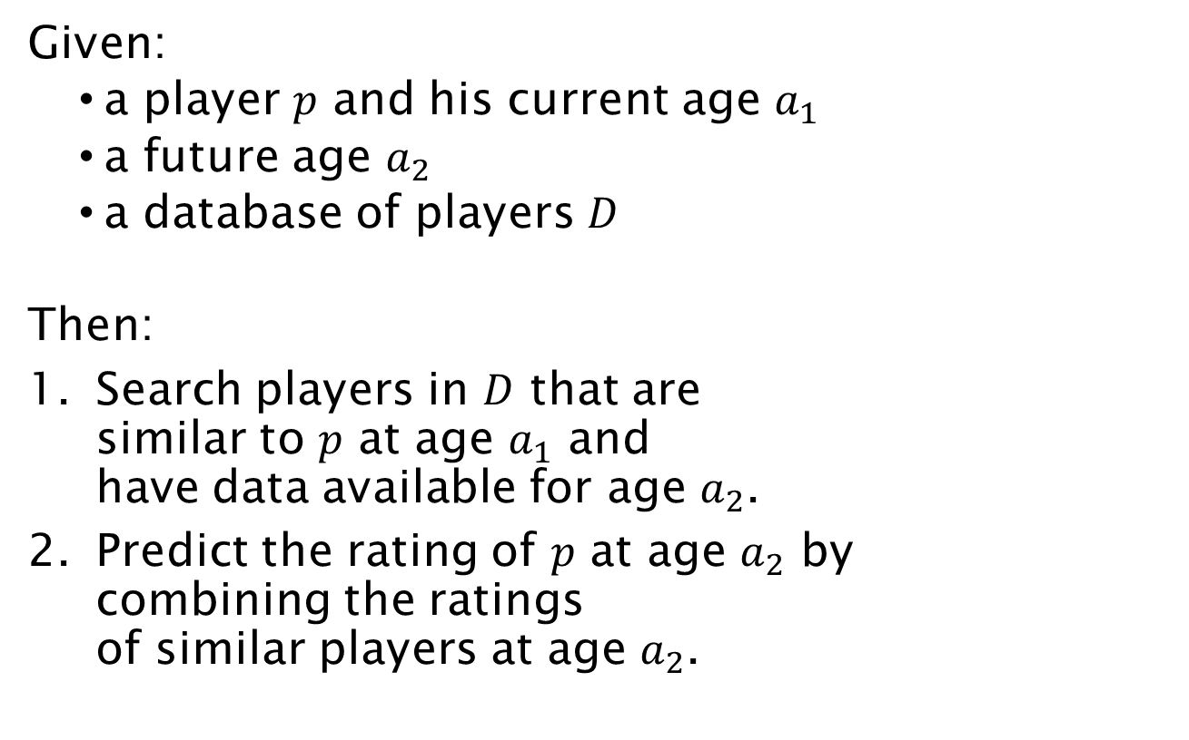
APROPOS follows a nearest neighbors approach
Given:
a player $p$ and his current age $a_{1}$
a future age $a_{2}$
a database of players $D$
Then:
Search players in $D$ that are similar to $p$ at age $a_{1}$ and have data available for age $a_{2}$.
Predict the rating of $p$ at age $a_{2}$ by combining the ratings of similar players at age $a_{2}$.

Slide 19
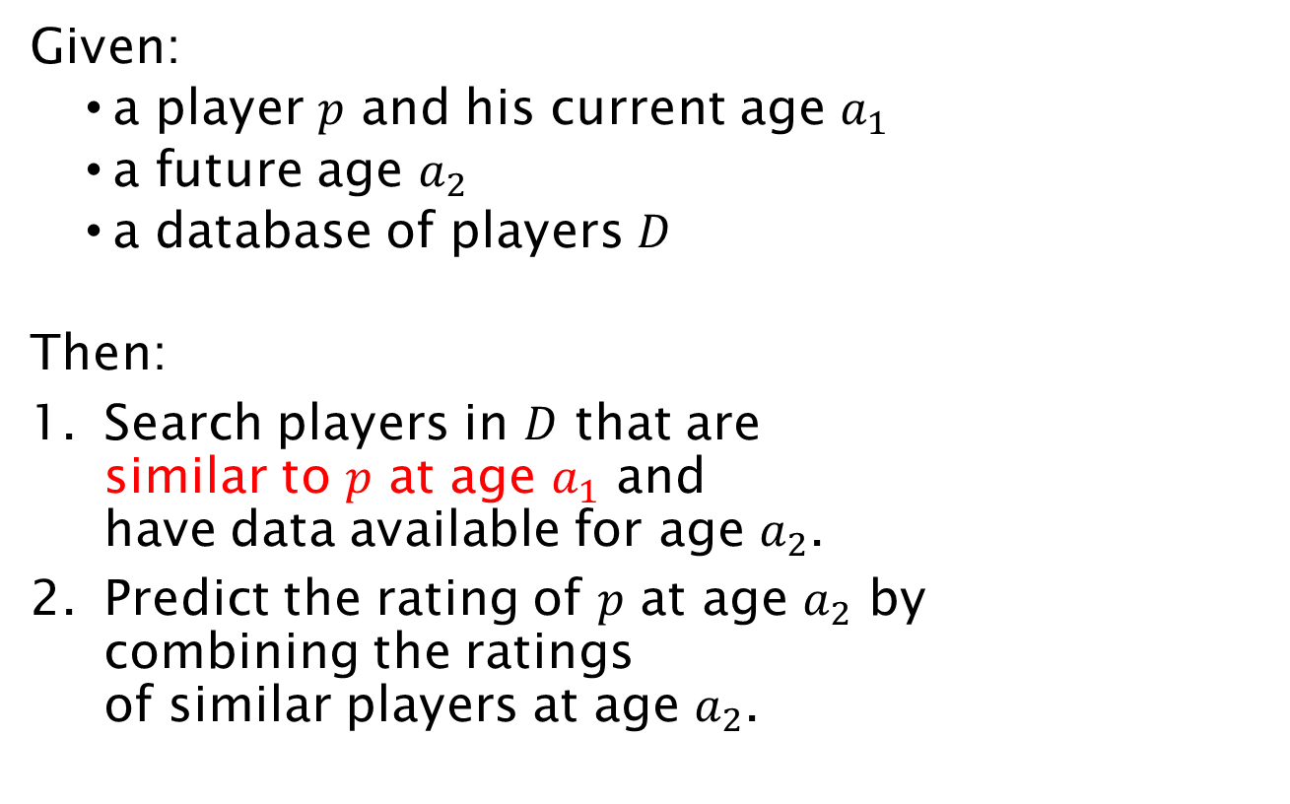
APROPOS follows a nearest neighbors approach
Given:
a player $p$ and his current age $a_{1}$
a future age $a_{2}$
a database of players $D$
Then:
Search players in $D$ that are similar to $p$ at age $a_{1}$ and have data available for age $a_{2}$.
Predict the rating of $p$ at age $a_{2}$ by combining the ratings of similar players at age $a_{2}$.

Slide 20
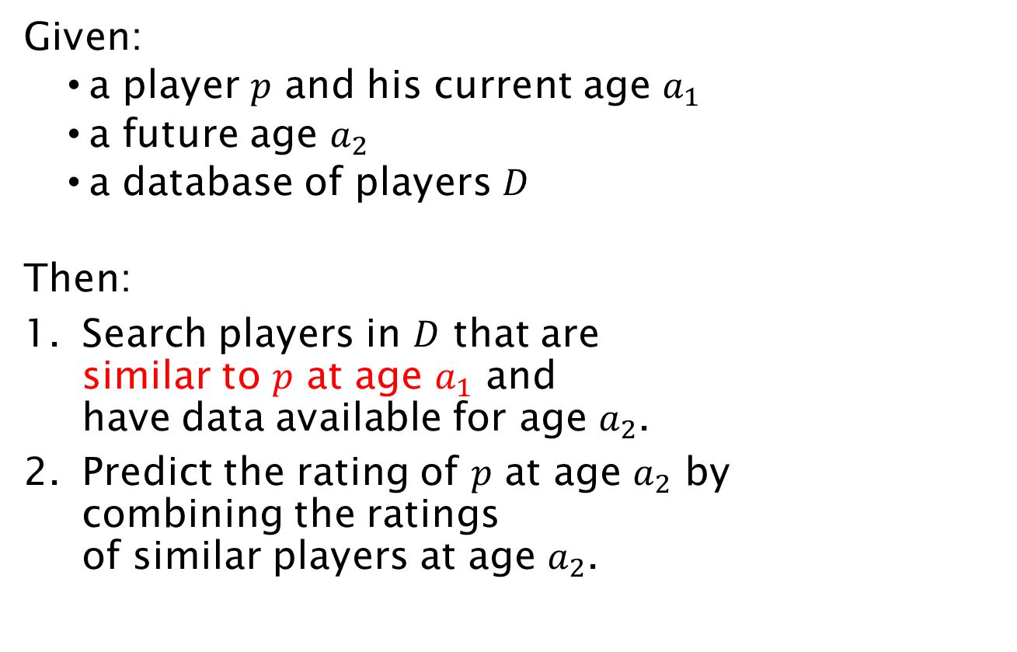
APROPOS follows a nearest neighbors approach
Given:
a player $p$ and his current age $a_{1}$
a future age $a_{2}$
a database of players $D$
Then:
Search players in $D$ that are similar to $p$ at age $a_{1}$ and have data available for age $a_{2}$.
Predict the rating of $p$ at age $a_{2}$ by combining the ratings of similar players at age $a_{2}$.
Similarity score

Slide 21
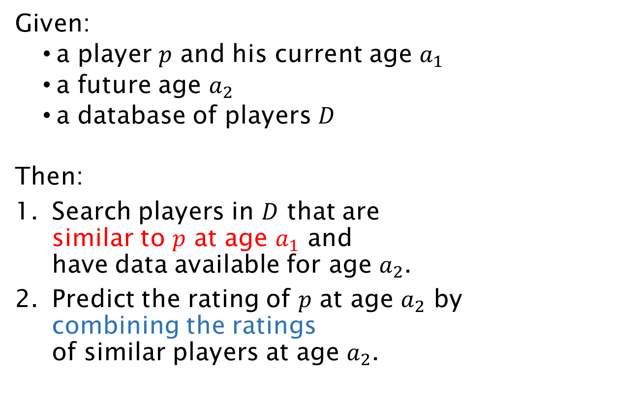
APROPOS follows a nearest neighbors approach
Given:
a player $p$ and his current age $a_{1}$
a future age $a_{2}$
a database of players $D$
Then:
Search players in $D$ that are similar to $p$ at age $a_{1}$ and have data available for age $a_{2}$.
Predict the rating of $p$ at age $a_{2}$ by combining the ratings of similar players at age $a_{2}$.
Similarity score

Slide 22
APROPOS follows a nearest neighbors approach
Given:
a player $p$ and his current age $a_{1}$
a future age $a_{2}$
a database of players $D$
Then:
Search players in $D$ that are similar to $p$ at age $a_{1}$ and have data available for age $a_{2}$.
Predict the rating of $p$ at age $a_{2}$ by combining the ratings of similar players at age $a_{2}$.
Similarity score
Prediction method

Slide 23
APROPOS follows a nearest neighbors approach
Given:
a player $p$ and his current age $a_{1}$
a future age $a_{2}$
a database of players $D$
Then:
Search players in $D$ that are similar to $p$ at age $a_{1}$ and have data available for age $a_{2}$.
Predict the rating of $p$ at age $a_{2}$ by combining the ratings of similar players at age $a_{2}$.
Absolute
Similarity score
Evolutional
Absolute
Prediction method
Evolutional

Slide 24
The absolute similarity score expresses the difference between skill ratings
 | Bob |  |  | Alice
Age | 17 | 18 | 19 | 17 | 18 | 19
Dribbling score | 68 | 72 | 78 | 81 | 82 | 85

Slide 25
The absolute similarity score expresses the difference between skill ratings
 | Bob |  |  | Alice
Age | 17 | 18 | 19 | 17 | 18 | 19
Dribbling score | 68 | 72 | 78 | 81 | 82 | 85
$$f\left(Bob,Alice\right)= \sqrt{{\left(68−81\right)}^{2}+{\left(72−81\right)}^{2}+{\left(78−85\right)}^{2}}$$

Slide 26
The absolute similarity score expresses the difference between skill ratings
 | Bob |  |  | Alice
Age | 17 | 18 | 19 | 17 | 18 | 19
Dribbling score | 68 | 72 | 78 | 81 | 82 | 85
$$f\left(Bob,Alice\right)= \sqrt{{\left(68−81\right)}^{2}+{\left(72−81\right)}^{2}+{\left(78−85\right)}^{2}}$$

Slide 27
The absolute similarity score expresses the difference between skill ratings
 | Bob |  |  | Alice
Age | 17 | 18 | 19 | 17 | 18 | 19
Dribbling score | 68 | 72 | 78 | 81 | 82 | 85
$$f\left(Bob,Alice\right)= \sqrt{{\left(68−81\right)}^{2}+{\left(72−81\right)}^{2}+{\left(78−85\right)}^{2}}$$

Slide 28
The absolute similarity score expresses the difference between skill ratings
 | Bob |  |  | Alice
Age | 17 | 18 | 19 | 17 | 18 | 19
Dribbling score | 68 | 72 | 78 | 81 | 82 | 85
$$f\left(Bob,Alice\right)= \sqrt{{\left(68−81\right)}^{2}+{\left(72−81\right)}^{2}+{\left(78−85\right)}^{2}}$$

Slide 29
The evolutional similarity score expresses the difference between skill evolution
 | Bob |  |  | Alice
Age | 17 | 18 | 19 | 17 | 18 | 19
Dribbling score | 68 | 72 | 78 | 81 | 82 | 85

Slide 30
The evolutional similarity score expresses the difference between skill evolution
 | Bob |  |  | Alice
Age | 17 | 18 | 19 | 17 | 18 | 19
Dribbling score | 68 | 72 | 78 | 81 | 82 | 85
+4
+6
+1
+3

Slide 31
The evolutional similarity score expresses the difference between skill evolution
 | Bob |  |  | Alice
Age | 17 | 18 | 19 | 17 | 18 | 19
Dribbling score | 68 | 72 | 78 | 81 | 82 | 85
+4
+6
+1
+3
$$f\left(Bob,Alice\right)= \sqrt{{\left(4−1\right)}^{2}+{\left(1−3\right)}^{2}}$$

Slide 32
The evolutional similarity score expresses the difference between skill evolution
 | Bob |  |  | Alice
Age | 17 | 18 | 19 | 17 | 18 | 19
Dribbling score | 68 | 72 | 78 | 81 | 82 | 85
+4
+6
+1
+3
$$f\left(Bob,Alice\right)= \sqrt{{\left(4−1\right)}^{2}+{\left(1−3\right)}^{2}}$$

Slide 33
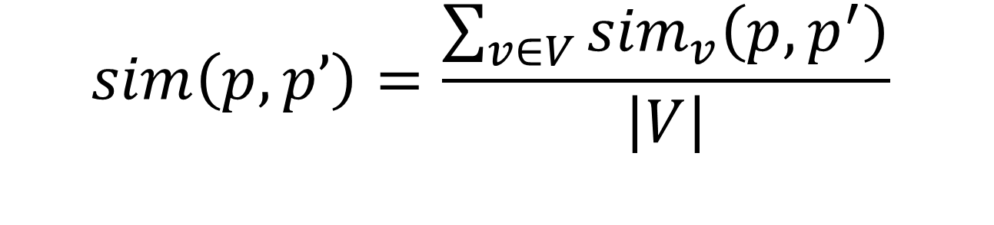
The similarity score between players is computed as the average over all skills
$$sim\left(p, p’\right)=\frac{\sum_{v∈V}{{sim}_{v}\left(p,p^{′}\right)}}{\left|V\right|}$$

Slide 34
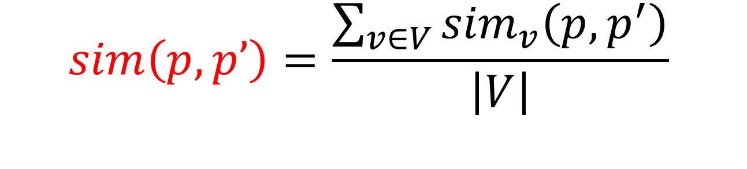
The similarity score between players is computed as the average over all skills
Total similarity between 2 players
$$sim\left(p, p’\right)=\frac{\sum_{v∈V}{{sim}_{v}\left(p,p^{′}\right)}}{\left|V\right|}$$

Slide 35
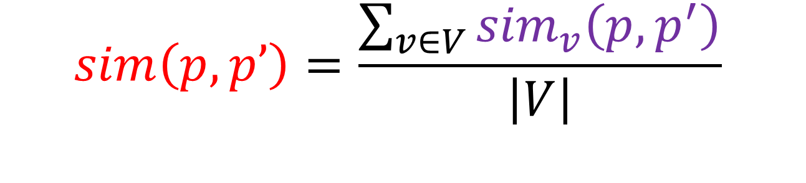
The similarity score between players is computed as the average over all skills
Normalized similarity per skill (e.g. dribbling)
Total similarity between 2 players
$$sim\left(p, p’\right)=\frac{\sum_{v∈V}{{sim}_{v}\left(p,p^{′}\right)}}{\left|V\right|}$$

Slide 36
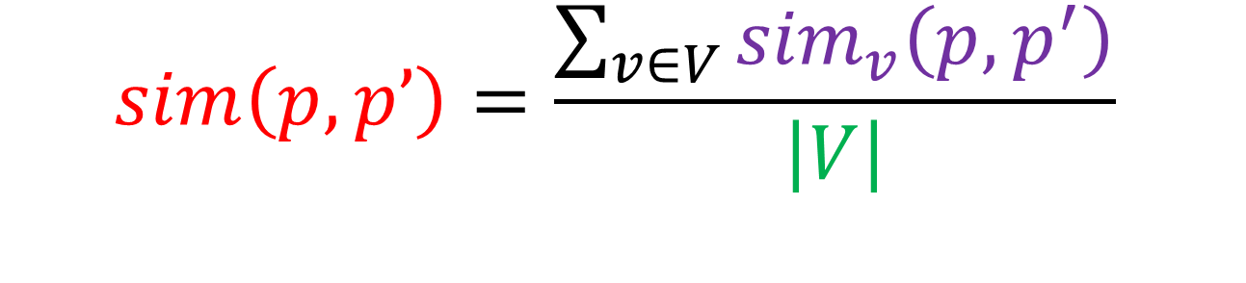
The similarity score between players is computed as the average over all skills
Normalized similarity per skill (e.g. dribbling)
Total similarity between 2 players
$$sim\left(p, p’\right)=\frac{\sum_{v∈V}{{sim}_{v}\left(p,p^{′}\right)}}{\left|V\right|}$$
Total number of skills (=24)

Slide 37
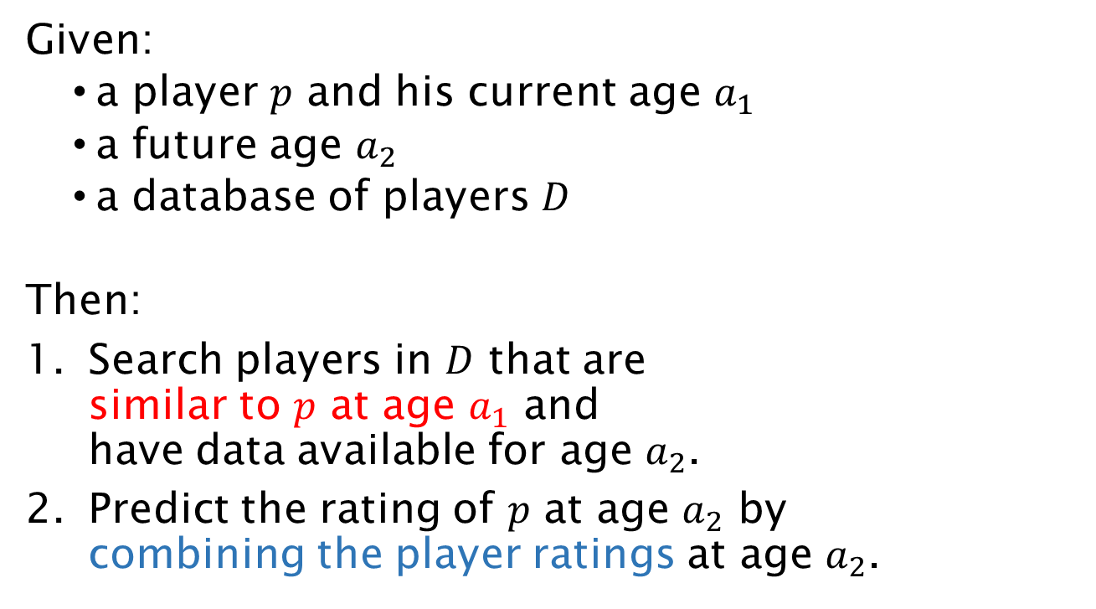
APROPOS follows a nearest neighbors approach
Given:
a player $p$ and his current age $a_{1}$
a future age $a_{2}$
a database of players $D$
Then:
Search players in $D$ that are similar to $p$ at age $a_{1}$ and have data available for age $a_{2}$.
Predict the rating of $p$ at age $a_{2}$ by combining the player ratings at age $a_{2}$.
Absolute
Similarity score
Evolutional
Absolute
Prediction method
Evolutional

Slide 38
We want to predict Bob’s dribbling rating at age 21
 | Bob
Age | 19 | 21
Dribbling | 78 | ?

Slide 39
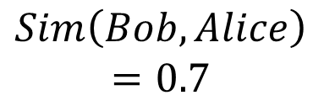
Alice is a similar player to Bob for whom we have historical data
 | Bob |  | Alice
Age | 19 | 21 | 19 | 21
Dribbling | 78 | ? | 85 | 86
$$Sim\left(Bob,Alice\right)$$
$$=0.7$$

Slide 40
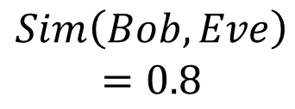
Eve is also a similar player to Bob for whom we have historical data
 | Bob |  | Alice |  | Eve
Age | 19 | 21 | 19 | 21 | 19 | 21
Dribbling | 78 | ? | 85 | 86 | 64 | 75
$$Sim\left(Bob,Alice\right)$$
$$=0.7$$
$$Sim\left(Bob,Eve\right)$$
$$=0.8$$

Slide 41
The absolute prediction method uses the skill ratings of similar players
 | Bob |  | Alice |  | Eve
Age | 19 | 21 | 19 | 21 | 19 | 21
Dribbling | 78 | ? | 85 | 86 | 64 | 75
$$Sim\left(Bob,Alice\right)$$
$$=0.7$$
$$Sim\left(Bob,Eve\right)$$
$$=0.8$$

Slide 42
The absolute prediction method uses the skill ratings of similar players
 | Bob |  | Alice |  | Eve
Age | 19 | 21 | 19 | 21 | 19 | 21
Dribbling | 78 | ? | 85 | 86 | 64 | 75
$$Sim\left(Bob,Alice\right)$$
$$=0.7$$
$$Sim\left(Bob,Eve\right)$$
$$=0.8$$
$$Dribbling prediction= \frac{0.7∗86+0.8 ∗75}{0.7+0.8}$$

Slide 43
The absolute prediction method uses the skill ratings of similar players
 | Bob |  | Alice |  | Eve
Age | 19 | 21 | 19 | 21 | 19 | 21
Dribbling | 78 | ? | 85 | 86 | 64 | 75
$$Sim\left(Bob,Alice\right)$$
$$=0.7$$
$$Sim\left(Bob,Eve\right)$$
$$=0.8$$
$$Dribbling prediction= \frac{0.7∗86+0.8∗75}{0.7+0.8}=80$$

Slide 44
The evolutional prediction method uses the skill evolutions of similar players
 | Bob |  | Alice |  | Eve
Age | 19 | 21 | 19 | 21 | 19 | 21
Dribbling | 78 | ? | 85 | 86 | 64 | 75
$$Sim\left(Bob,Alice\right)$$
$$=0.7$$
$$Sim\left(Bob,Eve\right)$$
$$=0.8$$

Slide 45
The evolutional prediction method uses the skill evolutions of similar players
 | Bob |  | Alice |  | Eve
Age | 19 | 21 | 19 | 21 | 19 | 21
Dribbling | 78 | ? | 85 | 86 | 64 | 75
+1
+11
$$Sim\left(Bob,Alice\right)$$
$$=0.7$$
$$Sim\left(Bob,Eve\right)$$
$$=0.8$$

Slide 46
The evolutional prediction method uses the skill evolutions of similar players
 | Bob |  | Alice |  | Eve
Age | 19 | 21 | 19 | 21 | 19 | 21
Dribbling | 78 | ? | 85 | 86 | 64 | 75
+1
+11
$$Sim\left(Bob,Alice\right)$$
$$=0.7$$
$$Sim\left(Bob,Eve\right)$$
$$=0.8$$
$$Dribbling prediction=78+ \frac{0.7∗1+0.8∗11}{0.7+0.8}$$

Slide 47
The evolutional prediction method uses the skill evolutions of similar players
 | Bob |  | Alice |  | Eve
Age | 19 | 21 | 19 | 21 | 19 | 21
Dribbling | 78 | ? | 85 | 86 | 64 | 75
+1
+11
$$Sim\left(Bob,Alice\right)$$
$$=0.7$$
$$Sim\left(Bob,Eve\right)$$
$$=0.8$$
$$Dribbling prediction=78+ \frac{0.7∗1+0.8∗11}{0.7+0.8}=84$$

Slide 48
Overview
Related Work
PECOTA and CARMELO
Data
SoFIFA.com ratings
APROPOS
Our approach for predicting players’ potential
Experiments
Evaluating the predictive accuracy

Slide 49
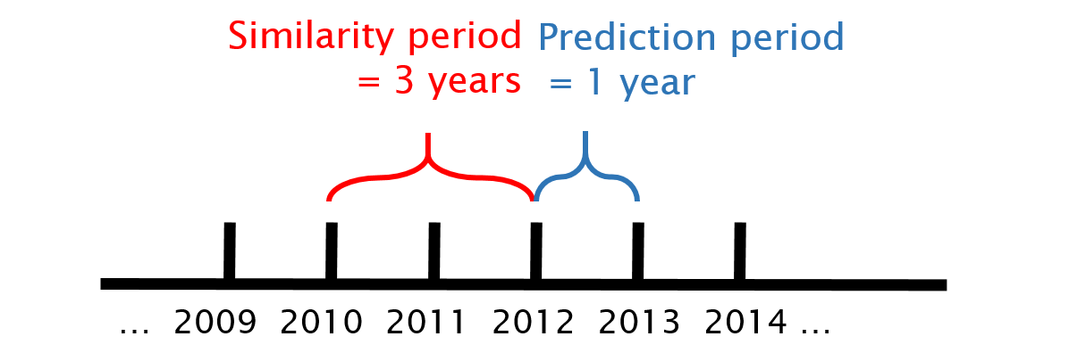
We predict skill ratings for 1000 players in 2012

Slide 50
We compare 2 baseline models against 3 instances of APROPOS
Baseline 1: average skill rating of age group
Baseline 2: current skill rating as prediction
ABS-ABS
ABS-EVO
EVO-EVO

Slide 51
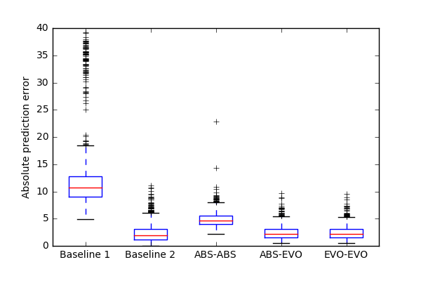
APROPOS performs better than baseline 1 and roughly equal to baseline 2.

Slide 52
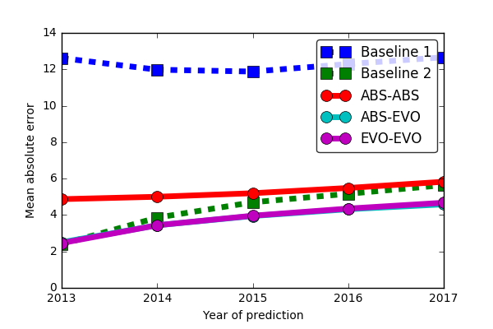
APROPOS beats Baseline 2 when predicting farther in the future

Slide 53
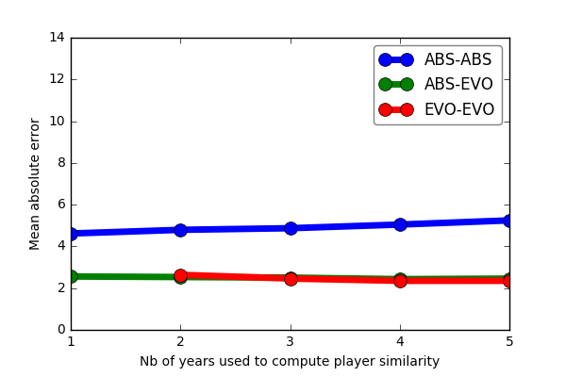
The nb of years used to compute player similarity has little effect on performance

Slide 54
Conclusion
Predicting the potential of professional soccer players is an interesting task.
APROPOS solves this task using a nearest neighbors approach.
The best results are obtained by combining player-specific info with population-based info.

