Slide 1
STARSS: A Spatio-Temporal Action Rating System for Soccer
Tom Decroos
MLSA workshop at ECML17
18 September 2017
Jan Van Haaren - Vladimir Dzyuba - Jesse Davis

Slide 2
Soccer analytics attempts to quantify and explain soccer
Ronaldo or Messi, who is the better player?
What are the odds that my team will win?
What is the best strategy for our team?
Should this player have scored his shot?

Slide 3
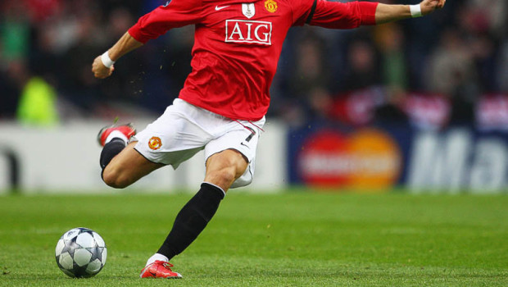
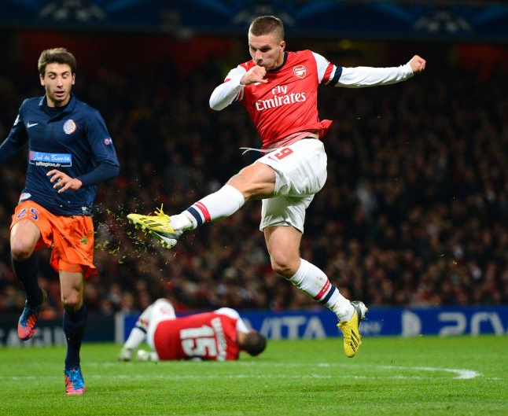
Some shots are better than others
Expected goals (xG) models
quantify the value of a shot.
.16
.09

Slide 4
Shots are rare actions; xG models ignore most gameplay

Slide 5
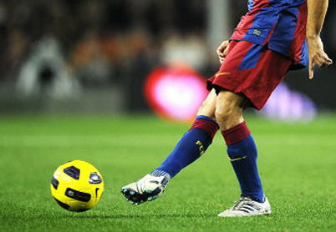
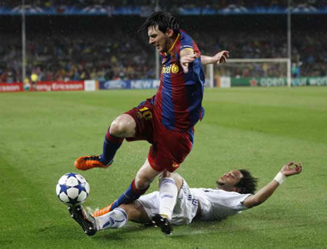
Some actions are better than others
Can we quantify the
value of any action?
Shot
Pass
Ball recovery
.12
.04
.01

Slide 6
Overview
Data Action streams
STARSS Our approach for rating actions
Experiments
Identifying top players

Slide 7
Overview
Data Action streams
STARSS Our approach for rating actions
Experiments
Identifying top players

Slide 8
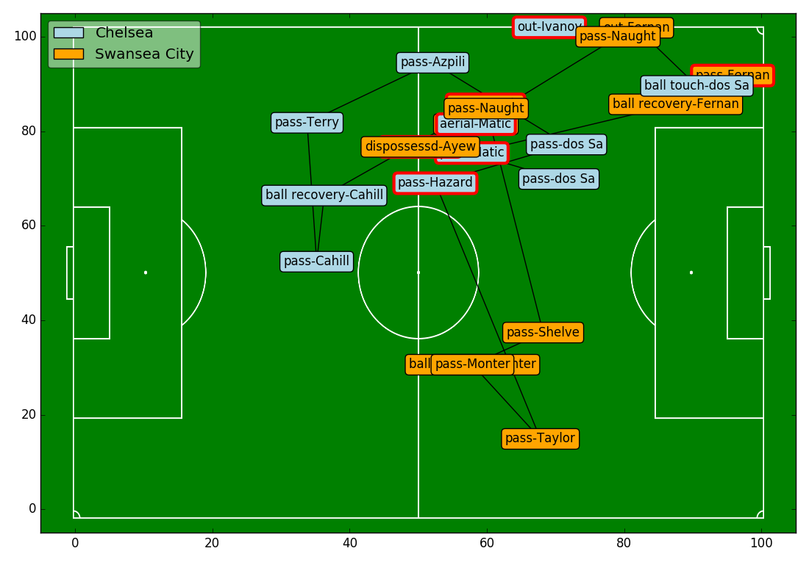
A soccer match is described by a stream of ±1750 on-the-ball actions
=
1 minute of gameplay

Slide 9
An action has attributes such as type, timestamp, location, team, player, …
Action
Pass
12min 36sec
X: 32.2, Y: 85.1
Neil Taylor
Swansea
…

Slide 10
Overview
Data Action streams
STARSS Our approach for rating actions
Experiments
Identifying top players

Slide 11
STARSS rates actions using 3 simple steps
Split action stream in phases Temporal aspect + expert knowledge
Rate phases Spatio-Temporal Nearest Neighbours
Distribute phase rating over individual actions Exponential decay

Slide 12
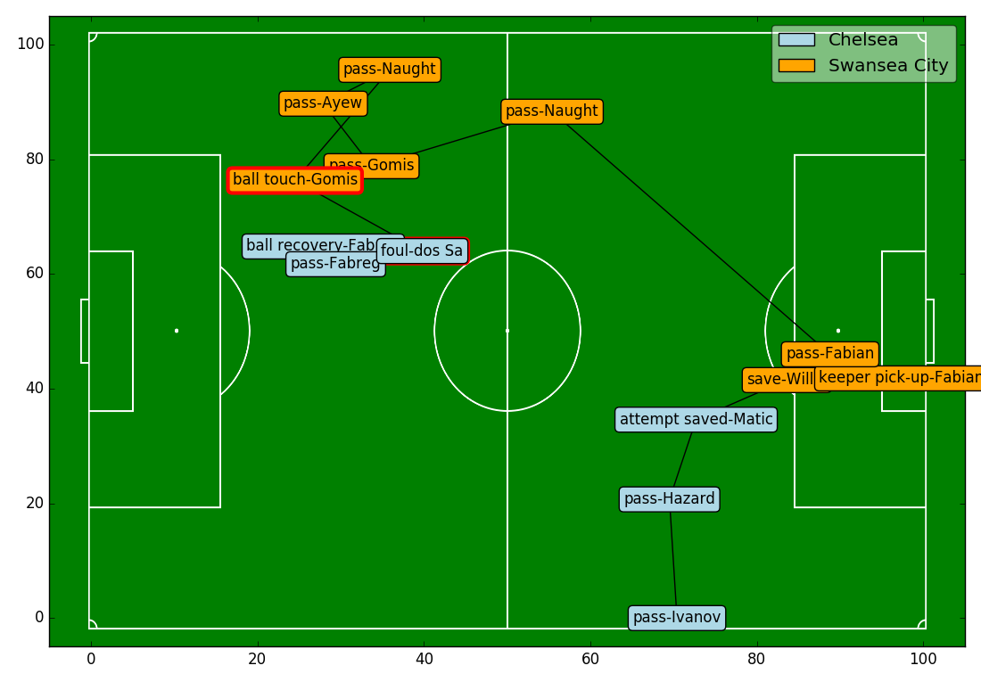
Action streams are split in phases based on time and change of possession

Slide 13
Action streams are split in phases based on time and change of possession
phase i

Slide 14
Action streams are split in phases based on time and change of possession
phase i+1
phase i

Slide 15
Action streams are split in phases based on time and change of possession
phase i+2
phase i+1
phase i

Slide 16
Action streams are split in phases based on time and change of possession
phase i+2
phase i+1
phase i+3
phase i

Slide 17
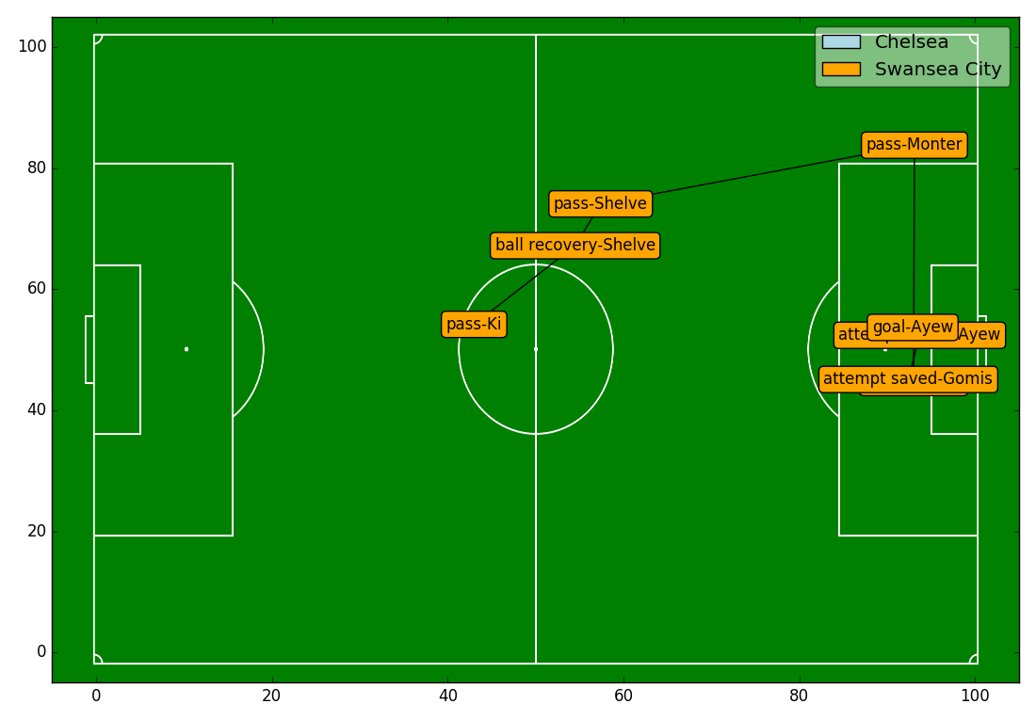
How good is this phase?

Slide 18
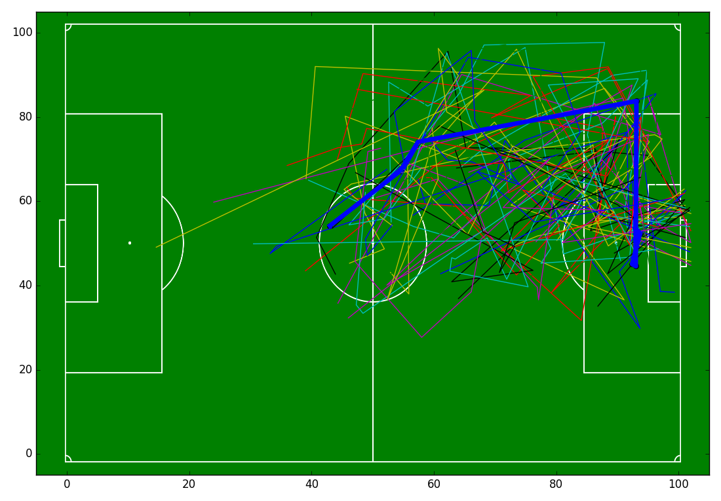
How good is this phase? Let’s look at what happened in similar phases

Slide 19
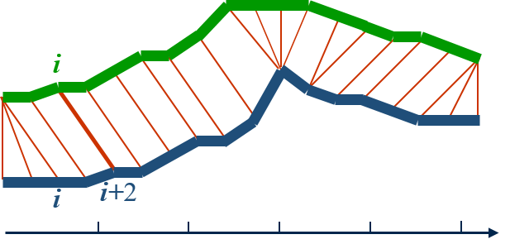
Dynamic Time Warping (DTW) is a great distance measure for phases
Similar shapes are matched, even if not synced on the time axis
time
https://www.psb.ugent.be/cbd/papers/gentxwarper/DTWalgorithm.htm

Slide 20
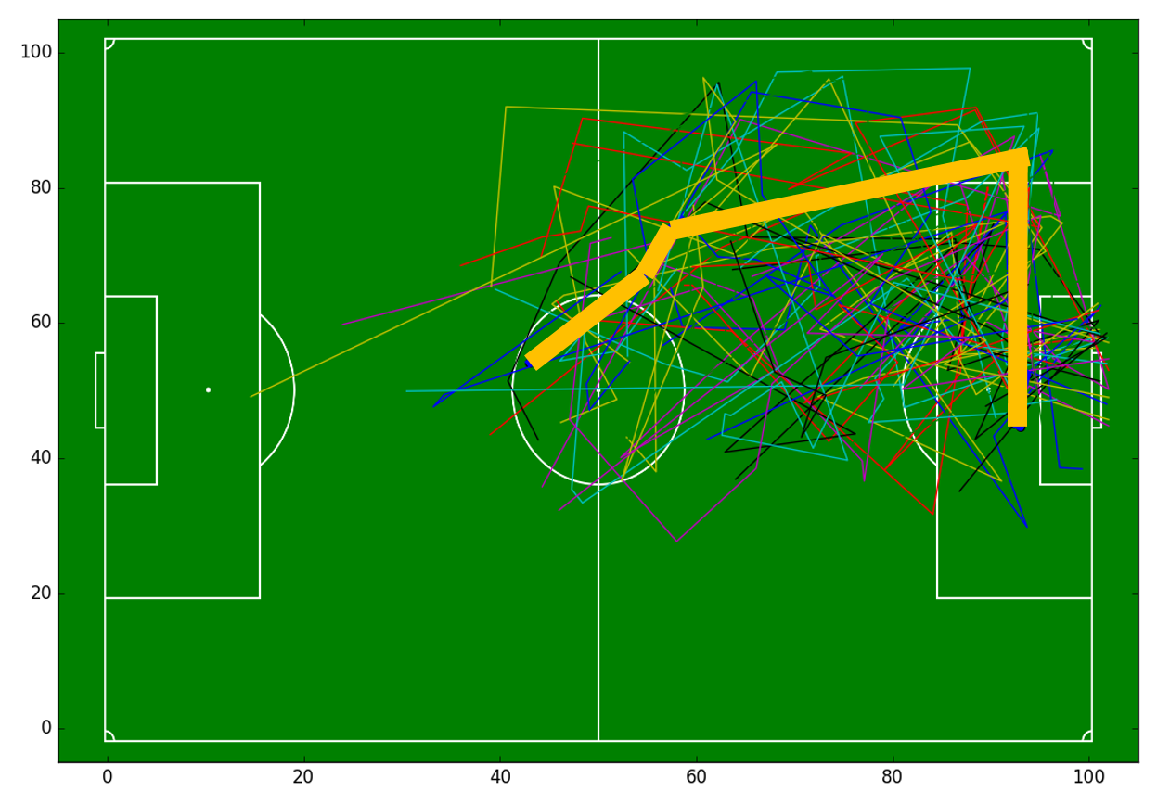
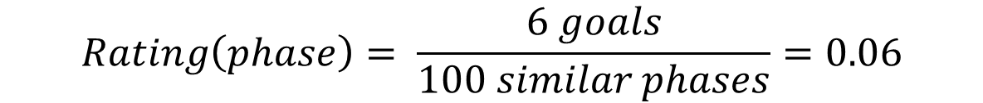
Phases are rated using a k-nearest neighbours approach
Search k similar phases using DTW (e.g., 100)
Count number of phases that end in a goal (e.g., 6)
$$Rating\left(phase\right)= \frac{6 goals}{100 similar phases}=0.06$$

Slide 21
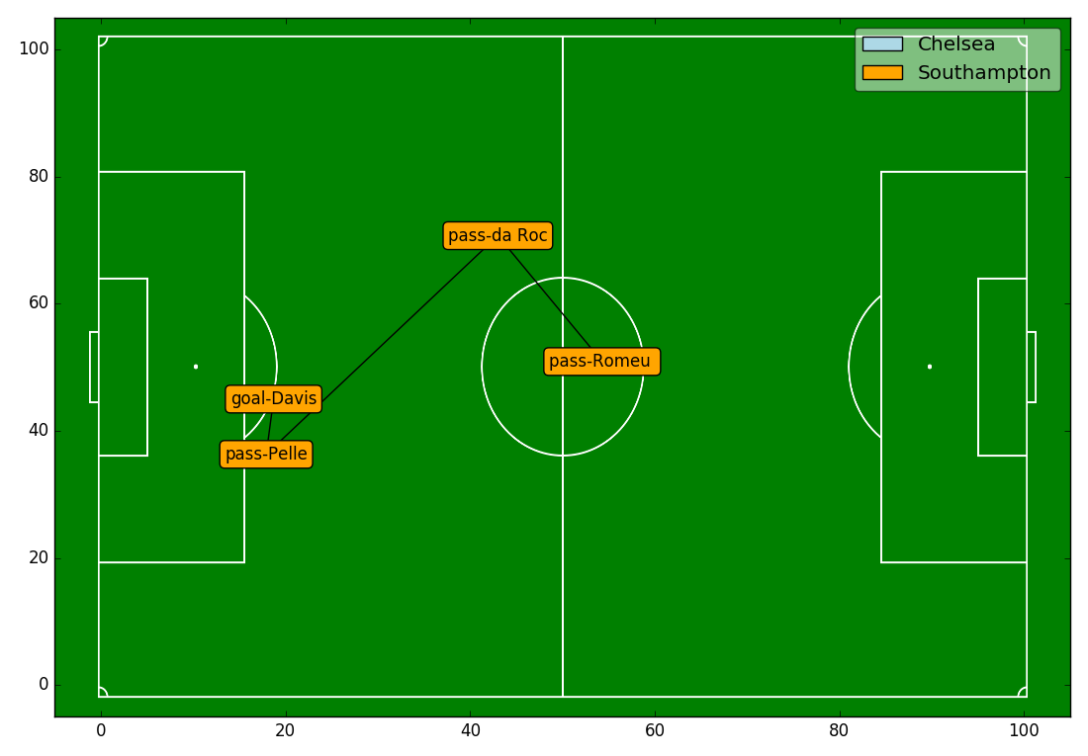
The phase rating is distributed over its individual actions using exponential decay
phase rating: 0.19
Actions at the end
are more important

Slide 22
The phase rating is distributed over its individual actions using exponential decay
phase rating: 0.19
.07
Actions at the end
are more important

Slide 23
The phase rating is distributed over its individual actions using exponential decay
phase rating: 0.19
.07
.05
Actions at the end
are more important

Slide 24
The phase rating is distributed over its individual actions using exponential decay
phase rating: 0.19
.04
.07
.05
Actions at the end
are more important

Slide 25
The phase rating is distributed over its individual actions using exponential decay
phase rating: 0.19
.04
.03
.07
.05
Actions at the end
are more important

Slide 26
Overview
Data Action streams
STARSS Our approach for rating actions
Experiments
Identifying top players

Slide 27
Players can be rated over a season by aggregating their action values
Rank | Team | Player | Rating Per90 | Minutes played | Goals Per90 | Assists Per90
1 | Arsenal | Alexis Sanchez | 0.289 | 2446 | 0.478 | 0.147
2 | West Ham United | Dimitri Payet | 0.279 | 2571 | 0.315 | 0.420
3 | West Ham United | Mauro Zarate | 0.262 | 790 | 0.342 | 0.000
4 | Chelsea | Willian | 0.249 | 2749 | 0.164 | 0.196
5 | Liverpool | Philippe Coutinho | 0.244 | 2003 | 0.359 | 0.225
6 | Arsenal | Santi Cazorla | 0.240 | 1292 | 0.000 | 0.209
7 | Arsenal | Mesut Ozil | 0.240 | 3047 | 0.177 | 0.561
8 | Sunderland | Wahbi Khazri | 0.240 | 1077 | 0.167 | 0.084
9 | Aston Villa | Rudy Gestede | 0.237 | 1657 | 0.272 | 0.109
10 | Manchester City | Kevin De Bruyne | 0.233 | 2003 | 0.315 | 0.404
11 | Tottenham Hotspur | Christian Eriksen | 0.231 | 2938 | 0.184 | 0.398
12 | Arsenal | Olivier Giroud | 0.231 | 2424 | 0.594 | 0.223
13 | Liverpool | Christian Benteke | 0.229 | 1518 | 0.474 | 0.178
14 | Tottenham Hotspur | Erik Lamela | 0.228 | 2383 | 0.189 | 0.340
15 | Manchester City | David Silva | 0.222 | 1800 | 0.100 | 0.550

Slide 28
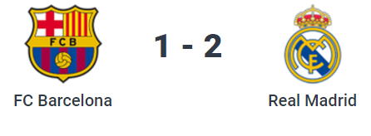

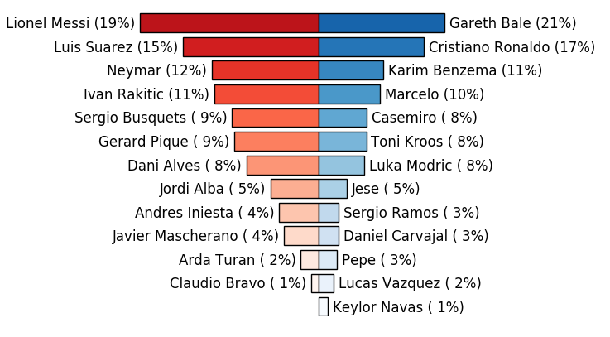
Players can be rated over a match by aggregating their action values

Slide 29
Future work
Improve distance measure for phases Allow subsequence-matching
Convert phase ratings to action ratings intelligently Action rating based on phase rating before action
Design interesting and convincing experiments Collaborate with domain experts Predict future actions (shot/pass/tackle?)

Slide 30
STARSS: A Spatio-Temporal Action Rating System for Soccer
Tom Decroos
MLSA workshop at ECML17
18 September 2017
Jan Van Haaren - Vladimir Dzyuba - Jesse Davis

