Slide 1
AMIE: Automatic Monitoring of Indoor Exercises
Tom Decroos, Kurt Schütte, Tim Op De Beéck, Benedicte Vanwanseele, Jesse Davis
ECMLPKDD’18

Slide 2

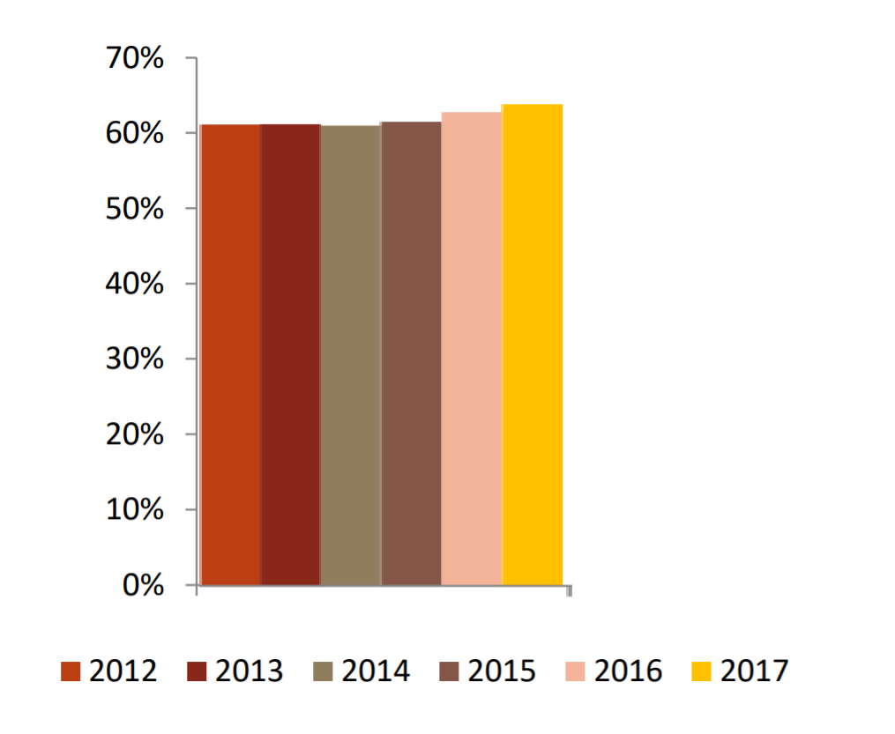

People are becoming more active
Participation rate of US citizens
in fitness sports (running, cycling)

Slide 3
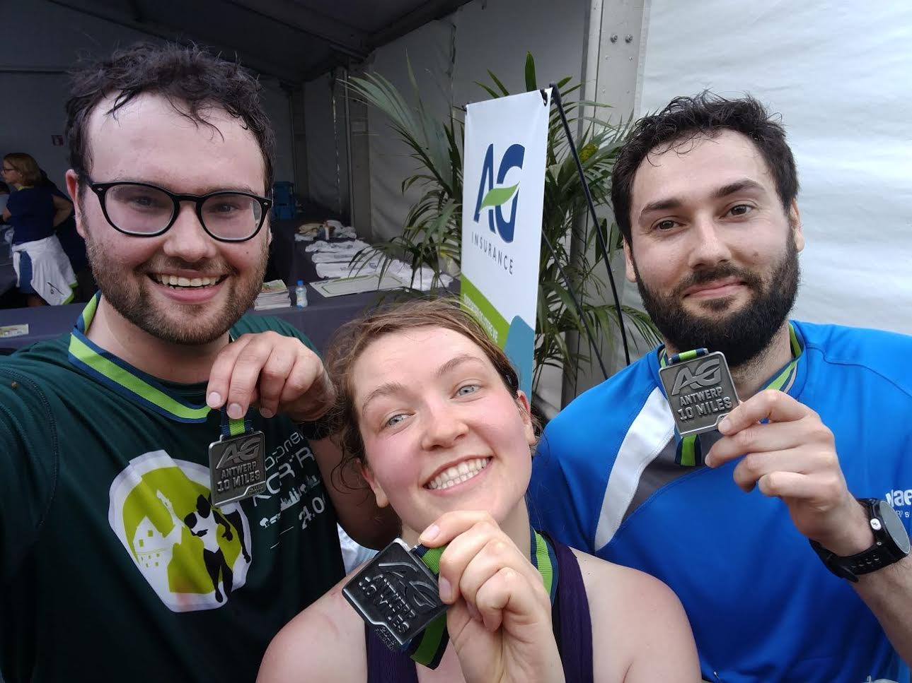

People are becoming more active

Slide 4
Activity leads to sports-related injuries
30 million children in the US participate in sports 3.5 million injuries per year
Source: American Academy of Pediatrics

Slide 5
Problem: The current rehabilitation paradigm is often ineffective because people …
Don’t visit the physiotherapist due to time and cost
Don’t do their exercises
Don’t learn the correct movements of rehabilitation exercises

Slide 6
An automated home monitoring system could provide 3 benefits:
Motivate the patient
Show the patient the correct movements
Monitor and give feedback on exercises

Slide 7
An automated home monitoring system could provide 3 benefits:
Motivate the patient
Show the patient the correct movements
Monitor and give feedback on exercises
Psychology and Kinesitherapy research
Machine Learning and Kinesitherapy research

Slide 8
Overview
Related work
Collected data
Our 4-step approach
Experiments

Slide 9
Overview
Related work
Collected data
Our 4-step approach
Experiments

Slide 10
Some papers discuss their model, but not their experiments
Anton et al.: A Kinect-based telerehabilitation system
Tang et al.: Physio@home: Exploring visual guidance and feedback techniques for physiotherapy exercises
Zhao et al.: A Kinect-based rehabilitation exercise monitoring and guidance system
Some papers discuss their experiments, but not their model
Komatireddy et al.: Quality and quantity of rehabilitation exercises delivered by a 3D motion controlled camera.

Slide 11
Overview
Related work
Collected data
Our 4-step approach
Experiments

Slide 12
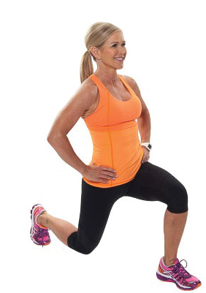
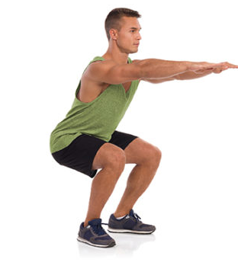
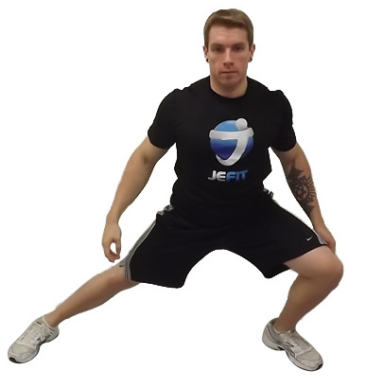
Collected data: 3 exercise types
Squat
Forward lunge
Side lunge

Slide 13
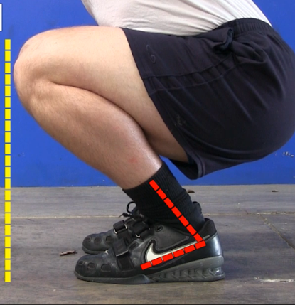
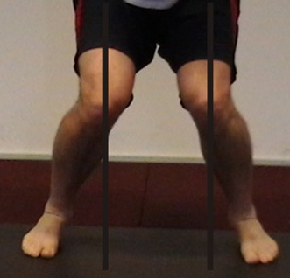
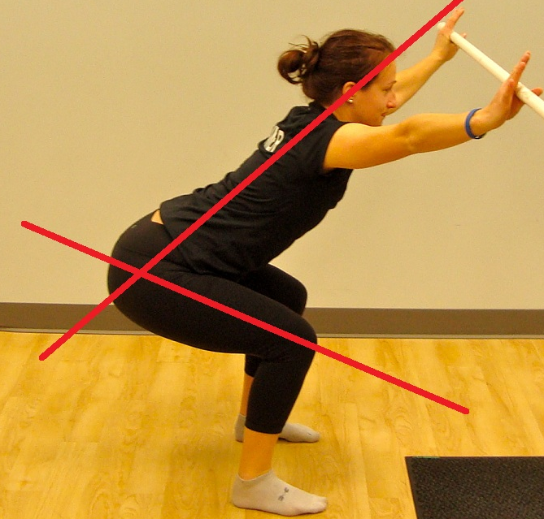
Collected data: 3 mistake types
Knees over toes
Knock knees
Forward trunk lean

Slide 14
Collected data: exercise sessions recorded by Kinect camera
10 subjects performed 3 exercise types
https://dtai.cs.kuleuven.be/software/amie
Notes:
Add url for dataset

Slide 15
Collected data: exercise sessions recorded by Kinect camera
10 subjects performed 3 exercise types
Each exercise type consisted of:
3 correct repetition sets
3 incorrect repetition sets
https://dtai.cs.kuleuven.be/software/amie
Notes:
Add url for dataset

Slide 16
Collected data: exercise sessions recorded by Kinect camera
10 subjects performed 3 exercise types
Each exercise type consisted of:
3 correct repetition sets
3 incorrect repetition sets
Total = 10 x 3 x (3+3) = 180 labelled repetition sets
https://dtai.cs.kuleuven.be/software/amie
Notes:
Add url for dataset

Slide 17
Overview
Related work
Collected data
Our 4-step approach
Experiments

Slide 18
Given: A set of X repetitions
Do: Identify mistakes in each repetition
Our 4-step approach:
Extract the Kinect data into Python Dataframes
Partition the set into individual repetitions
Construct a feature vector for each repetition
Learn a model to detect mistakes

Slide 19
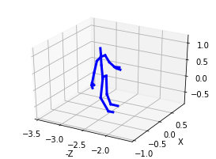
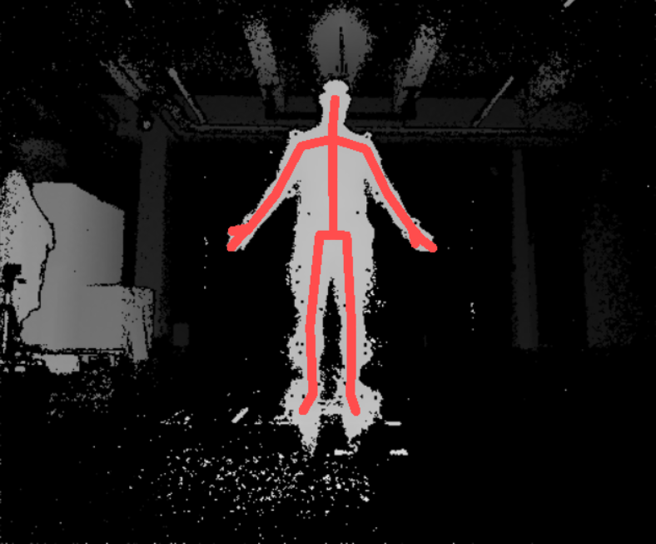
Extract the Kinect data into Python Dataframes
25 (x,y,z) joints
https://dtai.cs.kuleuven.be/software/amie
Notes:
Add url for tool

Slide 20
Partition each set into individual repetitions
Key insight: people return to stable position between repetitions
Notes:
Key insight: return to stable position between repetitions
idea: use reference stick figure

Slide 21
Partition each set into individual repetitions
Key insight: people return to stable position between repetitions
Idea: use a reference stick figure
Reference stick figure
Notes:
Key insight: return to stable position between repetitions
idea: use reference stick figure

Slide 22
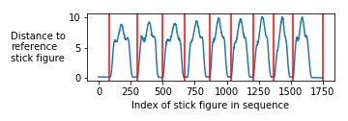
Partition each set into individual repetitions
Key insight: people return to stable position between repetitions
Idea: use a reference stick figure
Reference stick figure
Notes:
Key insight: return to stable position between repetitions
idea: use reference stick figure

Slide 23
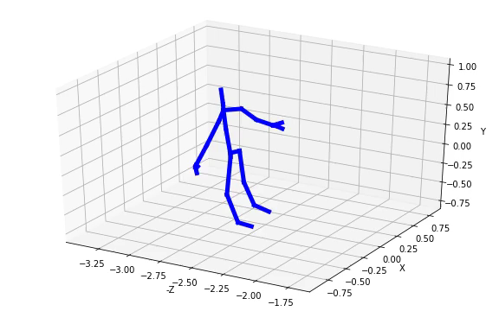
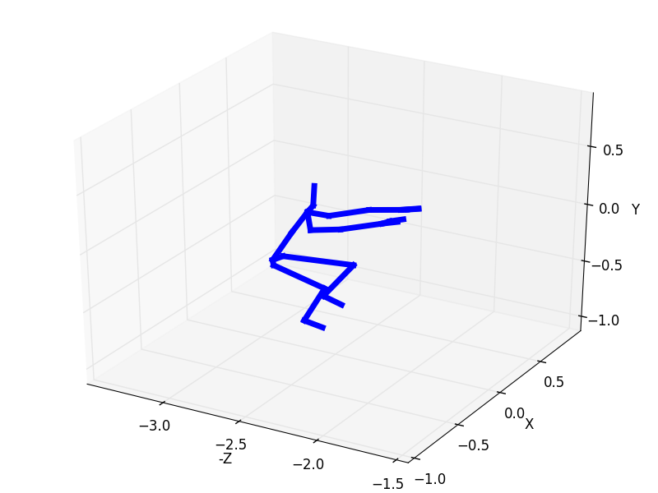
Construct a feature vector for each repetition
Repetition
= stick figure time series
Notes:
Explain the problems with this data.
1. It is heterogenial in location, orientation, subject size.
Subjects execute at different speeds. Time series have no fixed size.
Transformations are these to solve these problems.

Slide 24
Construct a feature vector for each repetition
Repetition
= stick figure time series
Problems:
Heterogeneity in height, weight, location, orientation, …
Temporal data
Notes:
Explain the problems with this data.
1. It is heterogenial in location, orientation, subject size.
Subjects execute at different speeds. Time series have no fixed size.
Transformations are these to solve these problems.

Slide 25
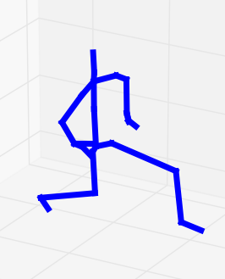
Construct a feature vector for each repetition
Repetition
= stick figure time series
Heterogeneity transform
Compute joint angles
Notes:
What is the challenge

Slide 26
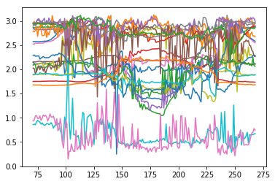
Construct a feature vector for each repetition
Repetition
= stick figure time series
Heterogeneity transform
Compute joint angles
= 30-D angle time series

Slide 27
Construct a feature vector for each repetition
Repetition
= stick figure time series
Heterogeneity transform
Compute joint angles
Mean
Std
Min
Max
Median
= 30-D angle time series
Temporal transform
Compute 5 summary statistics per angle

Slide 28
Construct a feature vector for each repetition
Repetition
= stick figure time series
Heterogeneity transform:
Compute joint angles
= 30-D angle time series
Temporal transform:
Compute 5 summary statistics per angle
= 150-length feature vector

Slide 29
Learn models Task 1: predict exercise type
Squat
Forward lunge
Side lunge
Notes:
Possibly skip this for time.

Slide 30
Learn models Task 2: predict mistake type
Forward
Trunk Lean
None
Knee Over Toes
Knock Knees

Slide 31
Overview
Related work: why it is not enough
Collected data
AMIE: a 4-step approach
Experiments
Q1: Can we detect exercise type?
Q2: Can we detect mistake type?
Q3: Can we detect some mistakes better than others?

Slide 32
Methodology: evaluation scheme
Problem: Using data from same person in train and test data can give overly optimistic results.
Goal: Learn concept, don’t memorize repetitions of person
Notes:
Create methodology slide
Drop rule example
Explain the cross validation issue

Slide 33
Methodology: evaluation scheme
Problem: Using data from same person in train and test data can give overly optimistic results.
Solution: Leave-one-person-out cross-validation
Goal: Learn concept, don’t memorize repetitions of person
Notes:
Create methodology slide
Drop rule example
Explain the cross validation issue

Slide 34
Methodology: classifiers
Decision Tree
Logistic Regression
Naive Bayes
Random Forest
XGBoost
Notes:
Create methodology slide
Drop rule example
Explain the cross validation issue

Slide 35
Methodology: baselines
Nearest Neighbors - Dynamic Time Warping [Su et al.]
Handcrafted rule set [Zhao et al.]
IF knee_z < toes_z
THEN Knees Over Toes-mistake
Notes:
Create methodology slide
Drop rule example
Explain the cross validation issue

Slide 36
Q1: Can we detect exercise type?
Classifier | Accuracy
Decision Tree | 97.3%
Logistic Regression | 98.9%
Naïve Bayes | 97.2%
Random Forest | 98.7%
XGBoost | 99.0%
NN-DTW (raw coordinates) | 96.5%
NN-DTW (angles) | 99.0%
AMIE
Baselines
Notes:
Replace table with bar chart

Slide 37
Q2: Can we detect mistake type?
Classifier | Accuracy
Decision Tree | 55.5%
Logistic Regression | 67.2%
Naïve Bayes | 54.7%
Random Forest | 67.5%
XGBoost | 73.8%
NN-DTW (raw coordinates) | 55.5%
NN-DTW (angles) | 54.9%
Handcrafted rule set | 59.0%
AMIE
Baselines
Notes:
Replace table with bar chart

Slide 38
Q3: Can we detect some mistakes better than others?

Slide 39
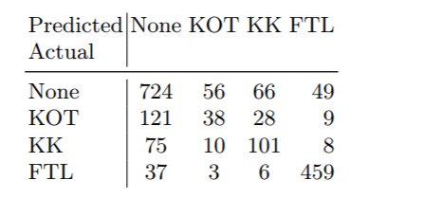
Q3: Can we detect some mistakes better than others?
Notes:
Can be dropped for time.

Slide 40
Q3: Can we detect some mistakes better than others?
Notes:
Can be dropped for time.

Slide 41
Q3: Can we detect some mistakes better than others?
Notes:
Can be dropped for time.

Slide 42
Contributions
We highlight a shortcoming in the literature
We comprehensively describe our data set, model and experiments.
We release both the data set and the used software.
https://dtai.cs.kuleuven.be/software/amie

Slide 43
Future work
Optimize accuracy by
Improving tracking quality of the Kinect
Improving the used machine learning model
Transform model predictions to actual feedback.
“Move your left leg a bit more to the right”

