Slide 1
Characterizing Soccer Players’ Playing Style from Match Event Streams
Aron Geerts, Tom Decroos, Jesse Davis
MLSA@ECMLPKDD’18

Slide 2
Goal
Given:
Event stream data
Do:
Represent playing style in a player vector that is:
Human-interpretable
Suitable for data analysis

Slide 3
Why characterize playing style?
Applications in …
Scouting
Monitoring player development
Match preparation

Slide 4
Data
Approach
Results

Slide 5
Data
Approach
Results

Slide 6
Event streams from 9155 soccer matches
Seasons
Competitions
2012/2013
2013/2014
2014/2015
2015/2016
2016/2017
English Premier League
Spanish Primera Division
Italian Serie A
French Ligue Un
German Bundesliga

Slide 7
Event streams contain event type, location, and player
Tackle
Pass
Pass
Shot
Type:
Pass
12min 36sec
(32.2, 85.1)
Neil Taylor
Time:
Location:
Player:
+- 1750 events per match event stream

Slide 8
Data
Approach
Results

Slide 9
Goal: represent playing style

Slide 10
Goal: represent playing style
Q1: What information to consider?
Shots, goals, passes, fouls, yellow/red cards, take-ons, clearances, aerials, interceptions, recoveries, tackles (Kumar et al.)
Q2: How to encode this information?

Slide 11
Goal: represent playing style
Q1: What information to consider?
Shots, goals, passes, fouls, yellow/red cards, take-ons, clearances, aerials, interceptions, recoveries, tackles (Kumar et al.)
Q2: How to encode this information?

Slide 12
Goal: represent playing style
Q1: What information to consider?
Shots, goals, passes, fouls, yellow/red cards, take-ons, clearances, aerials, interceptions, recoveries, tackles (Kumar et al.)
Q2: How to encode this information?

Slide 13
Key idea: represent each event type in a small set of features
Construct a heatmap per player and event type
Compress heatmap to small set of features

Slide 14
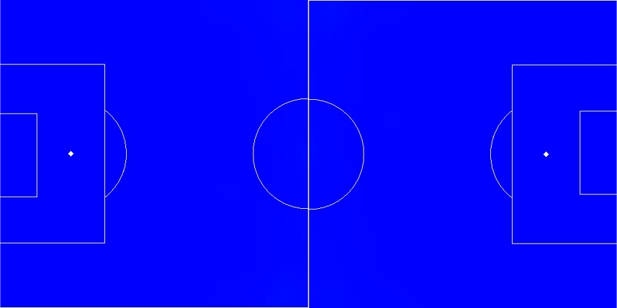
Construct heatmaps per event type and player

Slide 15
Construct heatmaps per event type and player

Slide 16
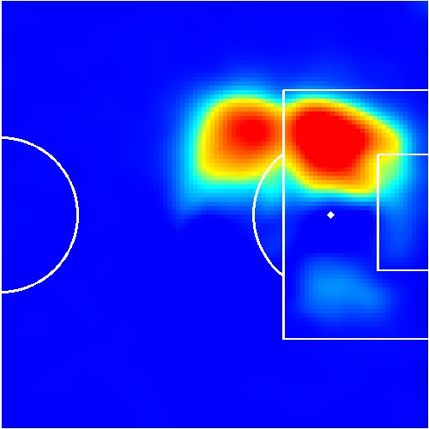
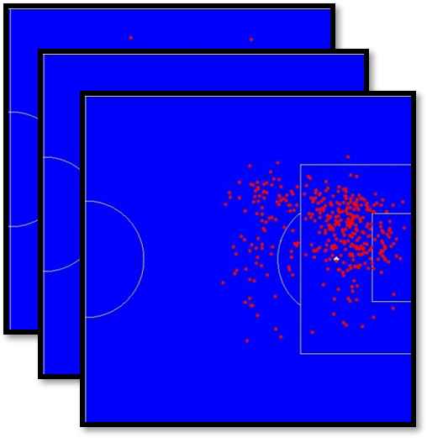
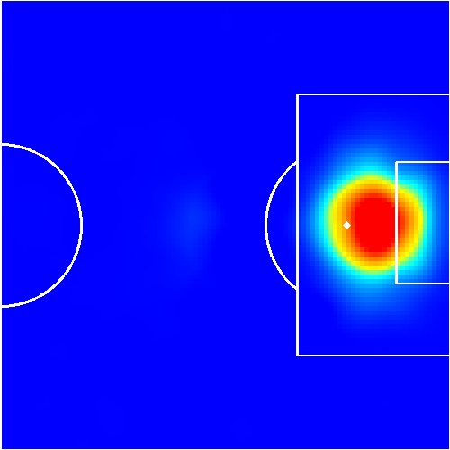
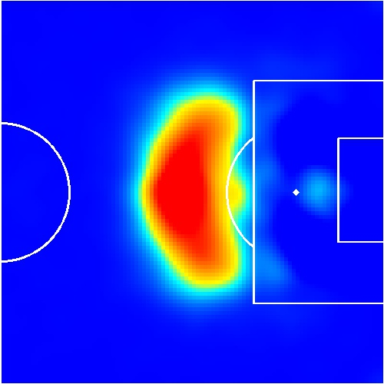
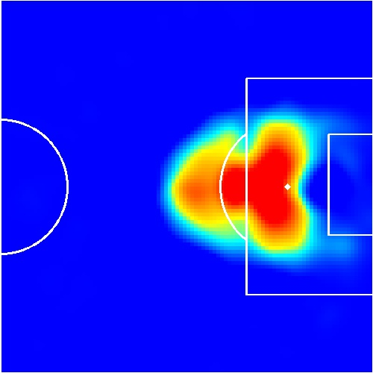
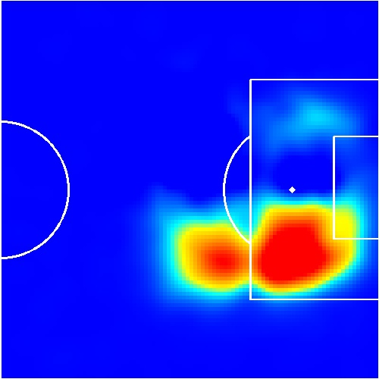

Compress heatmaps to small sets of features
$$≈$$

Slide 17
Compress heatmaps to small sets of features
#players
$$≈$$
Heatmap of events

Slide 18
Compress heatmaps to small sets of features
Non-negative matrix factorizarion
$$≈$$

Slide 19
Compress heatmaps to small sets of features
Principal components
$$≈$$

Slide 20
Compress heatmaps to small sets of features
Feature vectors
$$≈$$
#players

Slide 21
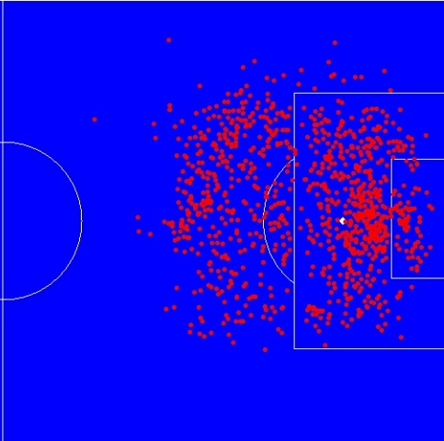
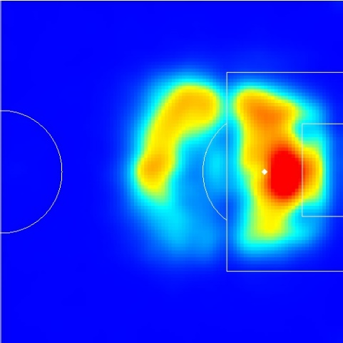
Feature vectors represent event heatmaps with minimal loss of accuracy
Reconstructed shotmap using length-5 feature vector
Ronaldo’s raw shotmap

Slide 22

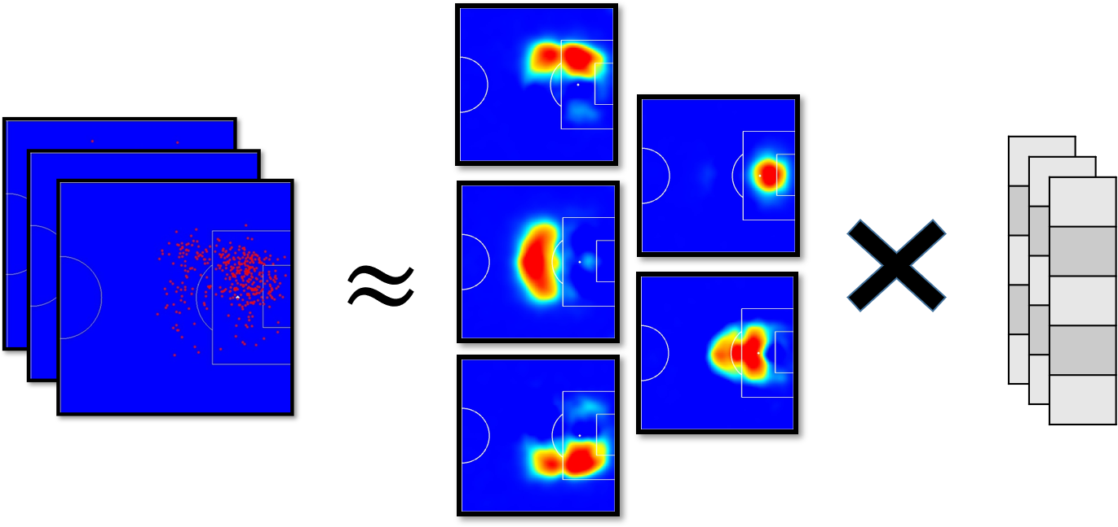
Player vector = [ X_{shot} ++ X_{pass} ++ X_{tackle} ++ ... ]
Shots
Passes
Tackles
...

Slide 23
Player vector = [ X_{shot} ++ X_{pass} ++ X_{tackle} ++ ... ]
Shots
Passes
Tackles
...

Slide 24
Player vector = [ X_{shot} ++ X_{pass} ++ X_{tackle} ++ ... ]
Shots
Passes
Tackles
...

Slide 25
Player vector = [ X_{shot} ++ X_{pass} ++ X_{tackle} ++ ... ]
Shots
Passes
Tackles
...

Slide 26
Player vector = [ X_{shot} ++ X_{pass} ++ X_{tackle} ++ ... ]
Shots
Passes
Tackles
...

Slide 27
Data
Approach
Results

Slide 28
Data
Approach
Results
Q1: Can we recover typical player positions?
Q2: Can we find similar players?
Q3: Can we monitor player development?

Slide 29
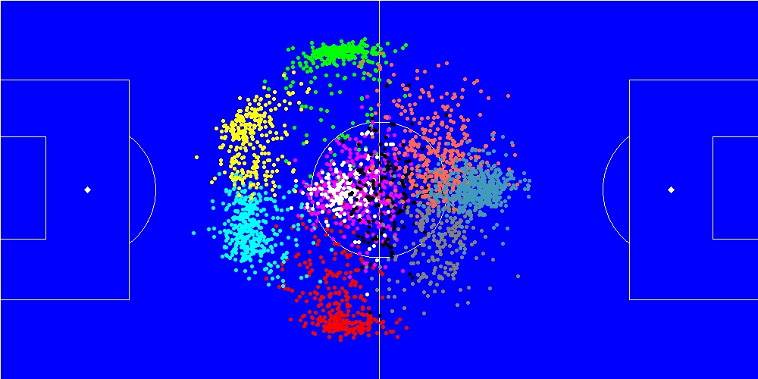
Q1: Can we recover typical player positions?
Approach: k-means clustering with k = 10
Average player positions colored by assigned cluster

Slide 30


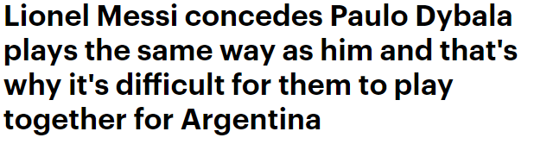
Q2: Can we find similar players?

Slide 31
Q2: Can we find similar players?
Rank | Player
1 | Sergio Aguëro
2 | Daniel Sturridge
3 | Gonzalo Higuain
4 | Giuseppe Rossi
5 | Carlos Tévez
6 | Antonio Di Natale
7 | Robert Lewandowski
8 | Javier Saviola
9 | David Villa
10 | Luis Suárez
11 | Jermain Defoe
12 | Pierre-Emerick Aubameyang
13 | Alexis Sánchez
14 | Loïc Remy
15 | Paolo Dybala

Slide 32
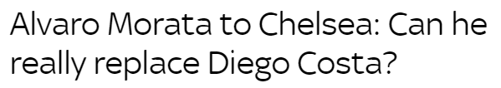
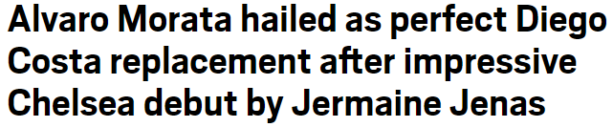
Q2: Can we find similar players?
In 2017, Chelsea sold Diego Costa and bought Alvaro Morata.

Slide 33
Q2: Can we find similar players?
Morata is the most similar player to Costa (out of 3205)
In 2017, Chelsea sold Diego Costa and bought Alvaro Morata.

Slide 34
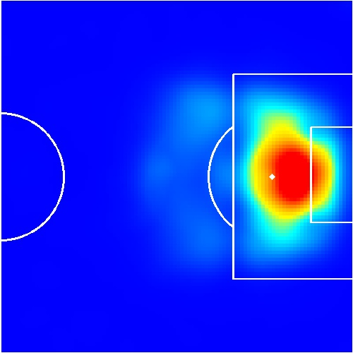
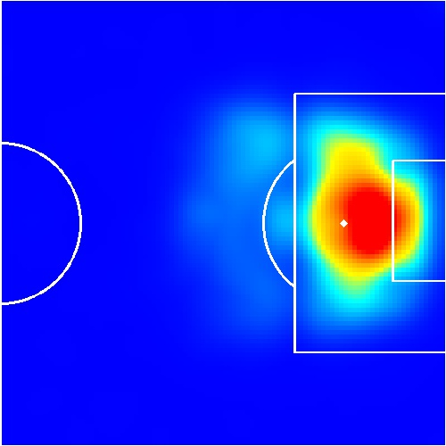
Q2: Can we find similar players?
Morata is the most similar player to Costa (out of 3205)
In 2017, Chelsea sold Diego Costa and bought Alvaro Morata.
Goals Diego Costa
Goals Alvaro Morata

Slide 35
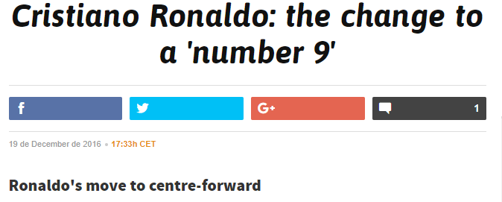
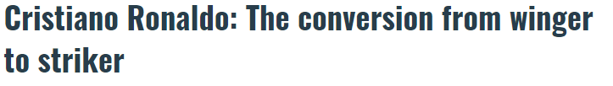
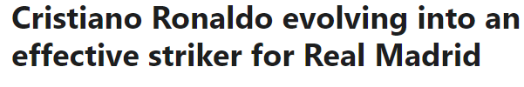
Q3: Can we monitor player develoment?

Slide 36
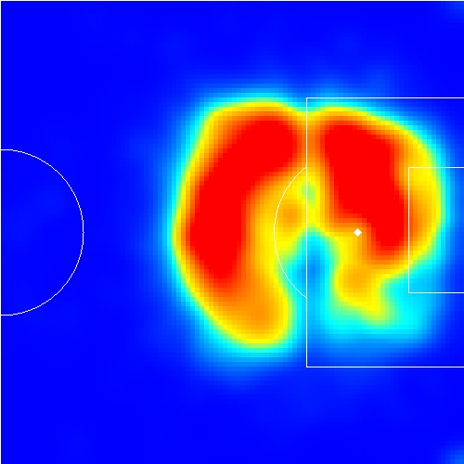
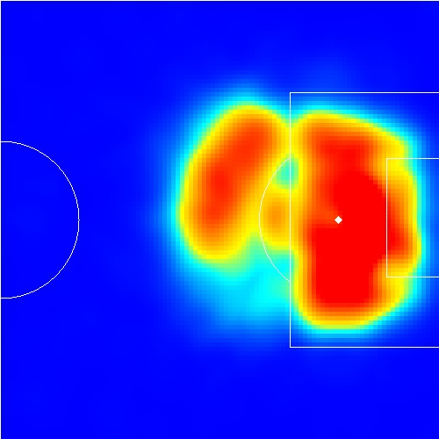
Q3: Can we monitor player develoment?
Ronaldo 2012/13
Ronaldo 2016/17

Slide 37
Conclusion: We built player vectors that ...
Give indication of a players’ playing style
Are data-driven constructed
Are human-interpretable
Are suitable for data analysis

