Slide 1
Predicting Baseball Game Outcomes
By: Thomas Dobbs

Slide 2
Project Overview
GOAL: Predict baseball game outcomes.
WHY:
I love baseball [even though it’s boring] and they have a LOT of data
The type of data being logged is very detailed
Data collection & manipulation will be complex
If my model is good enough, betting on baseball games could become a side hobby ;)
FEATURES:
Pitcher (Pitch repertoire)(Bucket types of pitchers)
Batters (Lineup)(Bucket types of batters)
TARGET: Win or Lose

Slide 3
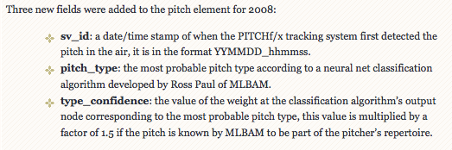

Data History
Major League Baseball has been tracking detailed pitch by pitch stats since 2006 with the PITCHf/x[1] camera system. There are roughly 30 data points logged for every pitch; data points that go as far as describing the exact pitch location, the velocity of the ball from the pitcher’s hand, and the break angle of the ball from the pitcher’s hand to the plate.
Cool Fact: MLB uses Machine Learning to Classify the pitch_type!
[1] PITCHf/x, created and maintained by Sportvision, is a system that tracks the speeds and trajectories of pitched baseballs. This system, which made its debut in the 2006 MLB playoffs, is installed in every MLB stadium.

Slide 4
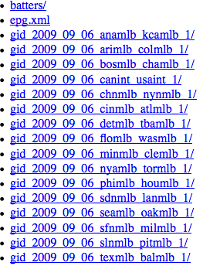
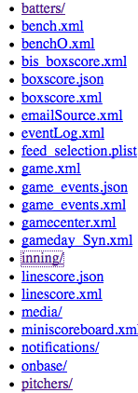
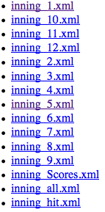

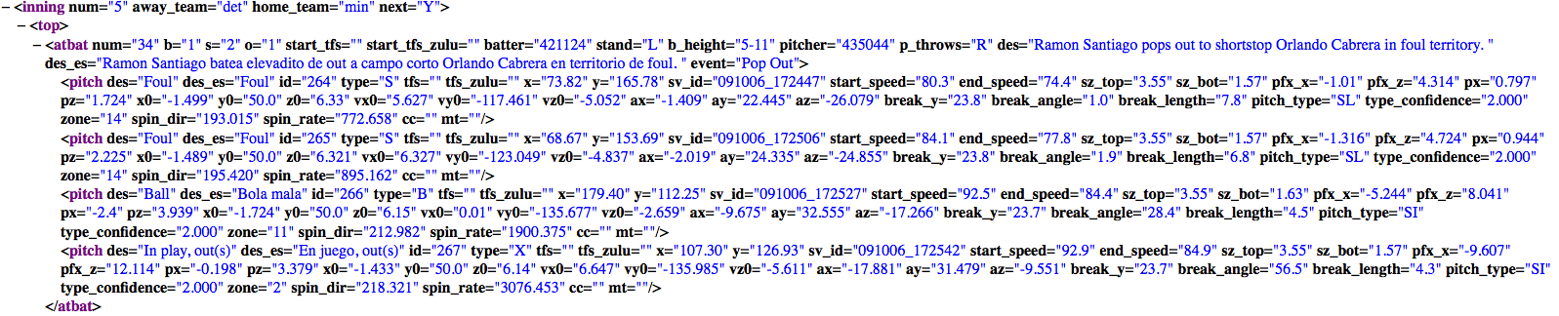
Data Format
PITCHf/x data is located on the MLB.com website and it’s NOT pretty.
There are a web of URLs to iterate through and at the end of the trail, the data is stored in an XML file.

Slide 5
Data Acquisition
Luckily we live in an open source world! Turns out someone put together a Python parser to pull PITCHf/x data on September 2015! – Although it was not exactly what I was looking for, it provided a great starting point for my project.
http://www.beyondtheboxscore.com/2015/9/24/9374949/a-new-python-based-pitchf-x-parser-scraper (He’s a chemical engineer and baseball enthusiast and I want to give him a hug)

Slide 6
Data Exploration (EDA)

