Slide 1
MOMENTUM
ESTATES
Real Estate Web Application
Investment & Technical Documentation
Gaborone, Botswana | 2026

Slide 2
EXECUTIVE SUMMARY
PROJECT OVERVIEW
STRATEGIC VALUE
A comprehensive web-based platform transforming how Momentum Estates manages properties, connects with clients, and scales operations across Botswana and internationally.
Digital transformation enabling 24/7 operations, automated property management, global reach, and data-driven decision making for sustainable growth.
KEY DELIVERABLES
Full-stack web application (responsive design)
Property listing & management system
Virtual tour integration & online enquiries
Multi-user system (buyers, sellers, agents, admin)
Advanced search with filters & saved properties
Payment processing for deposits & bookings
Analytics dashboard for revenue & performance tracking

Slide 3
MARKET OPPORTUNITY
5.43%
STABLE
RISING
Market Growth
2024-2028
Botswana
Economy
Middle Class
Urbanization
MARKET DRIVERS
RESIDENTIAL DEMAND
COMMERCIAL & INDUSTRIAL
• Affordable housing shortage in major cities
• Luxury apartment demand from expatriates
• Mixed-use development growing appeal
• SEZ investment & foreign capital growth
• Logistics & warehousing expansion needs
• Modern office & retail space demand

Slide 4
BUSINESS CASE FOR WEB APPLICATION
WHY DIGITAL TRANSFORMATION?
⏰
⚡
📊
24/7 AVAILABILITY
OPERATIONAL EFFICIENCY
DATA-DRIVEN INSIGHTS
Properties accessible anytime, anywhere. No office hours limitations. Global investor reach.
Automated property management. Reduced admin overhead. Real-time inventory tracking.
Analytics dashboard. Market trends. Customer behavior insights for strategic decisions.
COMPETITIVE ADVANTAGES
Virtual tours reduce physical viewings by 60%
Online enquiries convert 3x faster than phone calls
Payment integration enables instant deposit processing
SEO & digital marketing expand reach beyond traditional methods
Scalable infrastructure supports growth without proportional cost increase

Slide 5
PLATFORM FEATURES & CAPABILITIES
PROPERTY MANAGEMENT
USER EXPERIENCE
• Comprehensive listings (buy, rent, sell)
• Multiple property types (residential, commercial, industrial)
• Image galleries, floor plans, virtual tours
• Real-time inventory & availability tracking
• Advanced search with multiple filters
• Saved properties & shortlist functionality
• User accounts (buyers, sellers, agents)
• Email & SMS notifications
TRANSACTION PROCESSING
ADMIN DASHBOARD
• Online enquiry submission system
• Payment gateway for deposits & bookings
• Multiple payment methods (card, mobile, PayPal)
• Automated email confirmations & invoices
• Revenue analytics & performance metrics
• Property management (add, edit, publish/draft)
• Lead tracking & customer management
• Content management (blog, about, policies)
MARKETING & SEO
FUTURE SCALABILITY
• Google & Bing search console integration
• Optimized meta tags & structured data
• Social media integration & sharing
• Multi-vendor architecture ready
• International operations support
• API-ready for mobile app integration

Slide 6
TECHNICAL ARCHITECTURE
TECHNOLOGY STACK
FRONTEND
BACKEND
DATABASE
SERVICES
• HTML5/CSS3
• JavaScript ES6+
• Bootstrap 5
• Responsive Design
• Django 4.x
• Python 3.10+
• REST API
• JWT Auth
• PostgreSQL
• Redis Cache
• 3NF Schema
• 20+ Tables
• AWS S3
• SendGrid
• Paystack
• PayPal
SYSTEM ARCHITECTURE
PRESENTATION: Responsive web interface (desktop, tablet, mobile)
BUSINESS LOGIC: Django MVC, RESTful APIs, authentication, property logic
DATA LAYER: PostgreSQL + Redis caching, AWS S3 media, automated backups

Slide 7
SOFTWARE DEVELOPMENT LIFECYCLE
PROFESSIONAL SDLC APPROACH
1
Business Modeling
2
Requirements Engineering
Market analysis, revenue model, feasibility study
Functional & non-functional requirements, user stories
3
System Analysis & Design
4
Implementation
UML diagrams, database design, architecture
Frontend + backend development, API integration
5
Testing & QA
6
Risk Analysis
Unit, integration, UAT, performance testing
Risk matrix, mitigation strategies, disaster recovery

Slide 8
DEVELOPMENT TIMELINE
8-10 WEEK IMPLEMENTATION SCHEDULE
WK 2-3
Planning & Design
PROJECT HIGHLIGHTS
WK 3-7
Backend Core
Total Development Effort
15 weeks
Key Milestones:
✓ Week 2: Complete technical design
✓ Week 7: Backend MVP ready
✓ Week 8: Full frontend integration
✓ Week 14: UAT complete
✓ Week 15: Production launch
WK 7-8
Frontend Integration
WK 9-12
Payment & Features
WK 12-14
Testing & QA
WK 15
Deployment

Slide 9
COMPREHENSIVE COST ANALYSIS
ONE-TIME DEVELOPMENT COSTS
Cost Item | Hours | Rate (BWP) | Amount (BWP)
Business Planning & Analysis | 15-20h | 400-600 | 6,000 - 12,000
Requirements & Documentation | 8-12h | 400-600 | 3,200 - 7,200
System Design & UML | 20-25h | 400-600 | 8,000 - 15,000
Backend Development | 75-90h | 500-700 | 37,500 - 63,000
Frontend Integration | 35-45h | 400-600 | 14,000 - 27,000
Testing & QA | 35-40h | 400-600 | 14,000 - 24,000
Deployment & Setup | 20-25h | 400-600 | 8,000 - 15,000
TOTAL: BWP 90,700 - 163,200
MONTHLY OPERATIONAL COSTS
Service | Monthly Cost (BWP)
Web Hosting (VPS) + Database | 500 - 1,200
File Storage (AWS S3/Cloudinary) | 100 - 300
Email Service (SendGrid) | 0 - 200
Payment Gateway Fees | 2.9% per transaction
Domain + SSL + Monitoring | 17 - 100
TOTAL: BWP 617 - 1,900/month (BWP 7,400 - 22,800/year)

Slide 10
INTERNATIONAL DEVELOPER RATES
MARKET BENCHMARKING FOR SIMILAR PROJECTS
Region | Junior Dev | Mid-Level | Senior Dev | Project (250h)
United States | $40-60/h | $70-100/h | $120-180/h | $30K - 45K
South Africa | R400-600/h | R700-1K/h | R1.2-1.8K/h | R175K - 250K
China | $25-40/h | $45-70/h | $80-120/h | $18K - 30K
Botswana | P250-400/h | P500-700/h | P800-1.2K/h | P90.7K - 163K
Exchange Rates: USD 1 = P13.5 | ZAR 1 = P0.75
VALUE COMPARISON
United States
South Africa
Premium quality, $30K-60K (P405K-810K). Excellent but expensive.
Competitive rates, R175K-300K (P131K-225K). Proximity advantage.
China
Botswana (Local)
Lower cost, $18K-35K (P243K-473K). Communication challenges.
Best value P90.7K-163K. Direct communication, local expertise.

Slide 11
ROI & BENEFITS ANALYSIS
60%
3x
24/7
Cost Reduction
Faster Conversion
Global Reach
Fewer viewings, less admin
Online enquiries vs. calls
Unlimited market access
FINANCIAL PROJECTIONS
Metric | Before Platform | After Platform | Improvement
Monthly Leads | 50-80 | 200-400 | +250%
Conversion Rate | 12-15% | 25-35% | +133%
Admin Hours/Week | 40h | 15h | -62.5%
Market Reach | Local only | Global | Unlimited
Cost per Lead | P80-120 | P20-40 | -67%
BREAK-EVEN: 6-8 MONTHS | 3-YEAR ROI: 400-600%

Slide 12
RISK ANALYSIS & MITIGATION
Payment Gateway Downtime [HIGH]
Mitigation: Multiple providers (Paystack, PayPal, mobile). Automatic failover.
Server Crash / Downtime [HIGH]
Mitigation: Auto-scaling infrastructure. Load balancing. 99.9% uptime SLA.
Data Loss / Security Breach [CRITICAL]
Mitigation: Daily backups. Database replication. Encryption at rest & in transit.
Poor Performance Under Load [MEDIUM]
Mitigation: CDN for static assets. Redis caching. Database indexing.
Security Vulnerability [HIGH]
Mitigation: HTTPS enforcement. CSRF/XSS protection. Regular security audits.

Slide 13
SECURITY & COMPLIANCE
🔒 DATA SECURITY
✓ COMPLIANCE
• HTTPS/SSL encryption for all data
• Database encryption at rest
• Password hashing (bcrypt)
• JWT token authentication
• CSRF & XSS protection
• SQL injection prevention
• GDPR-compliant data handling
• POPIA (SA privacy law)
• Privacy Policy & Terms
• Cookie consent management
• User data export/deletion
• PCI-DSS payment processing
BACKUP & DISASTER RECOVERY
3-2-1 Backup Strategy:
3 copies of data | 2 different media | 1 off-site
• Daily automated database backups (30-day retention)
• Weekly full system snapshots (90-day retention)
• Real-time database replication to secondary region
• Recovery Time Objective (RTO): 4 hours
• Recovery Point Objective (RPO): 24 hours

Slide 14
POST-LAUNCH SUPPORT
BASIC
P2,000/2-3mo
STANDARD
✓ Bug fixes
✓ Security updates
✓ 48h response time
✓ Email support
✓ Monthly backup verification
✓ All Basic features
✓ Performance optimization
✓ 24h response time
✓ Phone + email support
✓ Minor feature updates
✓ Quarterly security audits

Slide 15
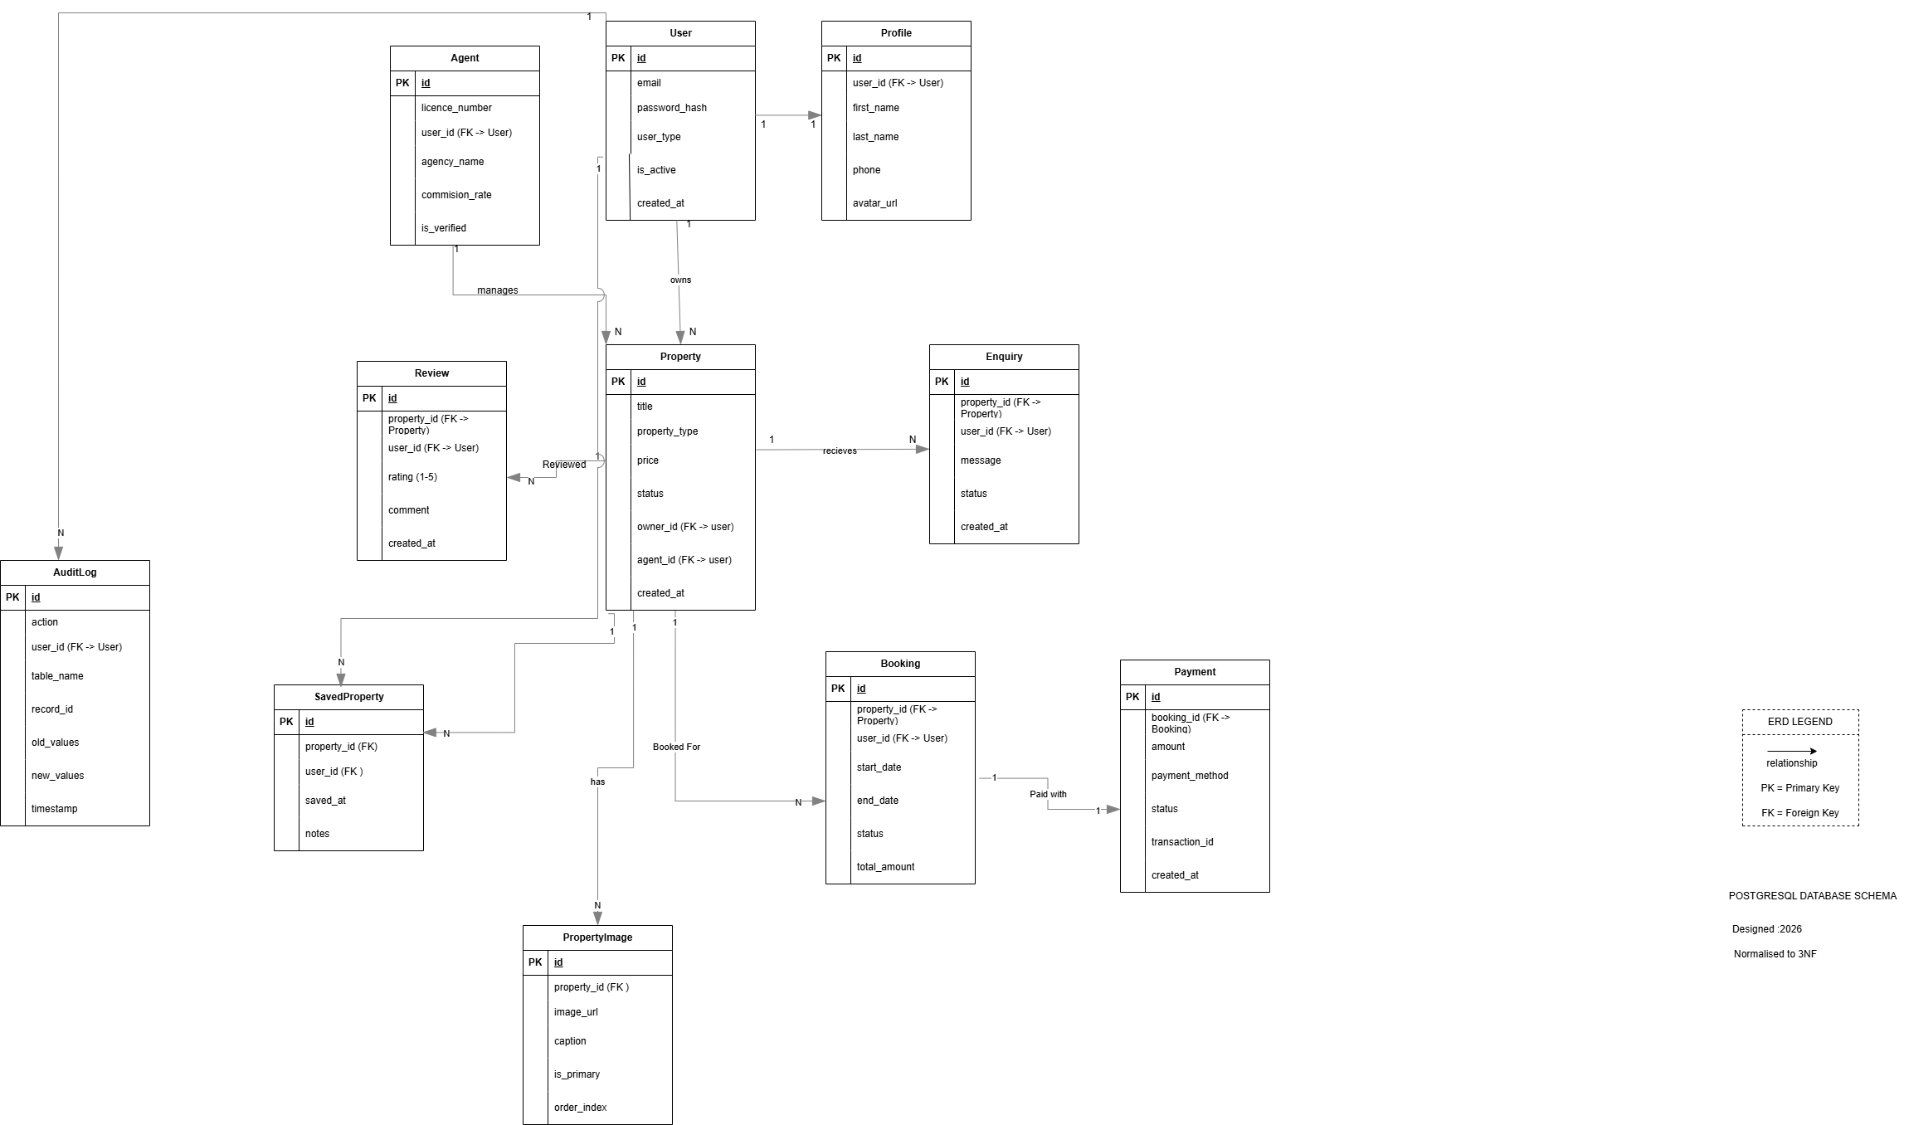
ENTITY RELATIONSHIP DIAGRAM
STANDARD
✓ All Basic features
✓ Performance optimization
✓ 24h response time
✓ Phone + email support
✓ Minor feature updates
✓ Quarterly security audits

Slide 16
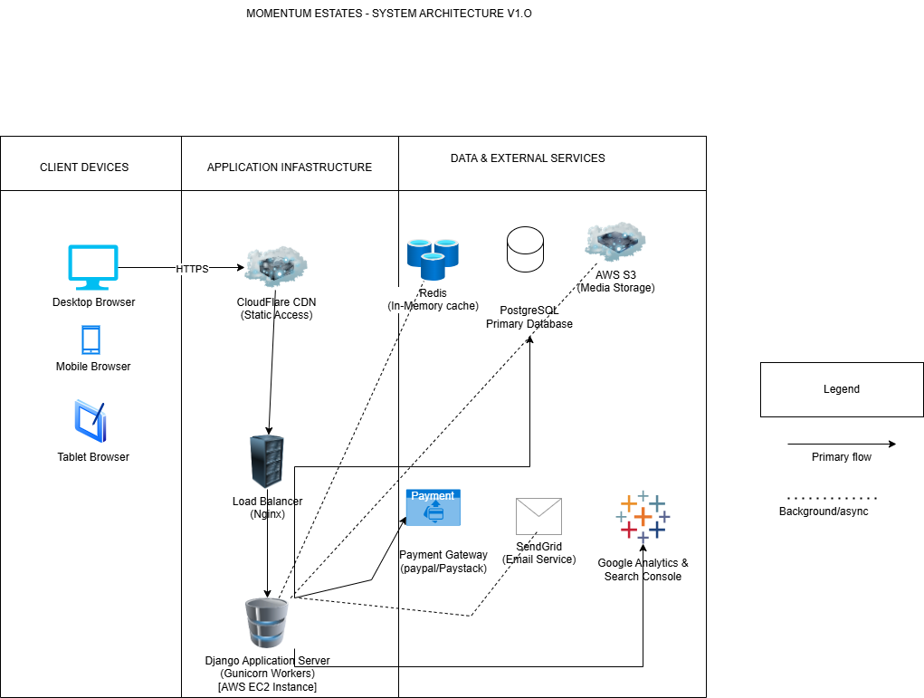
SYSTEM ARCHITECTURE DIAGRAM
STANDARD
✓ All Basic features
✓ Performance optimization
✓ 24h response time
✓ Phone + email support
✓ Minor feature updates
✓ Quarterly security audits

Slide 17
COMPETITIVE ADVANTAGE
WHY MOMENTUM ESTATES WINS
🎯
LOCAL MARKET EXPERTISE
🚀
FIRST-MOVER ADVANTAGE
Developer understands Botswana's real estate landscape. No cultural barriers.
Early digital adoption positions Momentum as tech-forward market leader.
📈
SCALABILITY READY
📊
DATA-DRIVEN DECISIONS
Multi-vendor architecture. Expandable to new regions and business models.
Analytics provide customer behavior insights for strategic planning.
⚡
OPERATIONAL EFFICIENCY
✨
BRAND DIFFERENTIATION
60% less manual work. Focus on relationships, not paperwork.
Modern presence builds trust. Demonstrates innovation and customer focus.

Slide 18
COMPETITIVE ADVANTAGE
WHY MOMENTUM ESTATES WINS
🎯
LOCAL MARKET EXPERTISE
🚀
FIRST-MOVER ADVANTAGE
Developer understands Botswana's real estate landscape. No cultural barriers.
Early digital adoption positions Momentum as tech-forward market leader.
📈
SCALABILITY READY
📊
DATA-DRIVEN DECISIONS
Multi-vendor architecture. Expandable to new regions and business models.
Analytics provide customer behavior insights for strategic planning.
⚡
OPERATIONAL EFFICIENCY
✨
BRAND DIFFERENTIATION
60% less manual work. Focus on relationships, not paperwork.
Modern presence builds trust. Demonstrates innovation and customer focus.

Slide 19
IMPLEMENTATION ROADMAP
FROM APPROVAL TO LAUNCH
1
Project Kickoff (Week 1-2)
Contract signing, requirements, project plan
2
Design & Planning (Week 2-3)
UML diagrams, database design, wireframes
3
Backend Development (Week 3-7)
Core backend, authentication, property models, API
4
Frontend Integration (Week 7-8)
Templates, search, forms, admin dashboard
5
Feature Integration (Week 9-12)
Payment gateway, virtual tours, email system
6
Testing & QA (Week 12-14)
Testing, bug fixes, performance optimization, UAT
7
Deployment (Week 15)
Server setup, SSL, domain, SEO, training, GO-LIVE
🎯 ESTIMATED GO-LIVE: 15 WEEKS FROM PROJECT START

Slide 20
NEXT STEPS
1
Review proposal and technical documentation
2
Schedule Q&A session with development team
3
Finalize project scope and requirements
4
Sign development agreement
5
Begin Phase 1: Planning & Design
LET'S BUILD THE FUTURE OF REAL ESTATE

Slide 22
THANK YOU
MOMENTUM ESTATES (PTY) LTD
📧 info@realtorsestates.co.bw
📞 +267 000 0000
📍 Gaborone, Botswana
Let's transform Botswana's real estate market together
© 2026 Momentum Estates. All rights reserved.

