Slide 1
Data Structures & Algorithms
Eoin Carroll
eoin.carroll@griffith.ie

Slide 2
Timetable
05th February – 30th April
Lecture:
Tuesday 11:00 – 12:30 in Room A108
Wednesday 12:30 – 14:00 in Room A107
Labs:
Monday 10:30 – 12:00 in Room W101
Monday 12:00 – 13:30 in Room W101

Slide 3
Introduction
Data Structures + Algorithms = Programs (Book Author: Niklaus Wirth)
Data Structure: method to store information.
Algorithm: method for solving a problem.
Notes:
The book was one of the most influential computer science books of the time and, like Wirth's other work, was extensively used in education.

Slide 4
Programs
Supply services to client users
There is a formal contract between client and supplier
User
A person,
Another program,
Another object
Programs must be:
Correct
Robust
Deliver results in a timely fashion
Notes:
All programs that we write and execute must meet certain contractual obligations.
The issue of robustness is typically handled by using exception handlers.

Slide 5
Critical Role of Computing Systems
A number of examples exist in:
Hospitals
Aviation
Transport Services
Weather Reporting
Nuclear Reactors, etc.
Critical Systems must meet deadlines
Must provide results in optimum time-frames
Notes:
For example, a brain scanner must provide results of a brain scan in optimum time if a consultant is to treat a brain injury in time to save the life of the patient.

Slide 6
Programs
How to define shortest time frame possible?
How to measure and compare performance of programs?
Algorithmic Analysis
Used to measure performance
Compare different solutions to same problem
Data Structures
Notes:
To attempt to deliver optimal solutions to problems two possible avenues will be explored: Algorithmic Analysis and Data Structures.

Slide 7
Algorithmic Analysis
Use benchmarking to compare different programs that solve the same problem.
Develop a mathematical model that can be used to classify programs.

Slide 8
Compute the sum of the first N natural numbers
Two separate functions that solve the problem are given below:
Which solution is the best?
static long sumN(long n){
long s = n * (n + 1)/2;
return s;
}
static long sumN1(long n){
long s = 0;
for(int j=0; j < n; j++)
s = s + (j + 1);
return s;
}
Notes:
Considering the benchmarking: (Run the programs on a standard PC with n somewhat 100000)
Analyze the actual code to compare the performance.
The search for optimal solution to problems is one of the key goals of algorithmic analysis.

Slide 9
Data Structure
A particular way of storing and organizing data so that it can be used efficiently.
A structure that enforces an ordering between the elements in the collection.
A way to organize data so that it can be managed efficiently.
A structure that optimizes the cost of insertion and retrieval.

Slide 10
Data Structure
Simple data structures:
A class that describes a real world entity:
Book
Car
Person, etc.
Complex data structures:
A collection of things organized in some order
Choice of data structure depends greatly on the data set to be modeled and the performance requirements of the application.

Slide 11
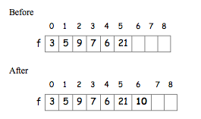
Cost of Insertion Vs. Cost of Retrieval
Manage a collection of integers so as to optimize both.
No ordering: append 10

Slide 12
Cost of Insertion Vs. Cost of Retrieval
Insertion
Simple assignment
Fixed cost
Retrieval
Linear search
Cost proportional to size of data set

Slide 13
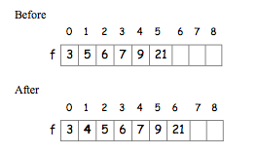
Cost of Insertion Vs. Cost of Retrieval
Ordered Sequence: insert 4
Notes:
Next we consider a sorted sequence. To add, say 4, now is more complex because we have to find where to place 4 in the sequence so that the whole sequence remains sorted after 4 is inserted. This means that we have to shift existing elements one position to the right until we find a value that is less than 4 or we reach the beginning of the sequence. The cost of this insertion is directly proportional to the number of elements that have to be moved. In the worst case this requires n moves.

Slide 14
Cost of Insertion Vs. Cost of Retrieval
Insertion
Shift elements one position right until correct place for 4 is found.
Cost proportional to size of sorted sequence.
Retrieval
Binary search
Cost is log₂N
Is there a structure that optimizes both?

Slide 15
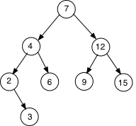
Binary Search Tree
BST
Insert 3
Notes:
The numbers are arranged so that there is a single root value and that each node in the tree has two descendents. Also notice that the values to the left of any node are always less than it and those to the right of it are always greater than it.
This has a cost of log2n because each time we check a node we eliminate half the tree.

Slide 16
Course Content
Recursion
Analysis of Algorithms
Fast Sorting
Dynamic Data Structures
Hashing
Binary Search Trees
AVL Trees
Graphs and Graph Theory, and
External Data Structures
Notes:
Name of the scientists: Adelson Velski and Landis (AVL)

Slide 17
Course Assessment
Coursework 60%
Weekly worksheets and labs
Must complete at least 7 of these during the course
Final marks based on best 7
Written Exam 40%

Slide 18
Weekly Layout
Mondays:
Labs = free work space
Tuesdays:
Worksheet submission
Worked solution in lecture
Wednesdays:
Lecture on new content

Slide 19
Lecture 01
Java Recap
Recursion

Slide 20
Objects
Object Orientation in computing was intended to make thinking about programming closer to thinking about the real world.
What is an object in real world?
Objects are separate from each other. They have their own identity.
Objects have characteristics (attributes).
Objects have behaviour.

Slide 21
Objects
In computing objects can represent real world objects that can be touched or seen. Objects in computing can also be things that we can not see or touch. For example, a bank account.
Objects are not always physical items.
Objects are not always visible items.
They have attributes. For example, balance, account number, etc.
They have behaviour. For example, deposit, withDraw, etc.

Slide 22
Classes
Software systems are operational models of real or virtual world activities based around objects that populate these worlds.
For example, people, cars, houses, etc.
These objects are said to belong to a certain class.
All may have same attributes but different values.
For example, both Adam and John have a name attribute but with different values i.e. Adam and John.

Slide 23
Classes
Thus, a class is a blueprint from which individual objects are created.
It provides a specification or a layout of how objects of that class should be created.
It specifies all common attributes of the objects that belongs to that class.
It also specifies all common behaviours of the objects that belongs to that class.

Slide 24
Defining Classes
In Java, a class is defined by a class keyword followed by a class name.
For example, the following Java code defines a class Person.
Classes can be defined as public, private, or protected
public class Person{
}

Slide 25
Defining Classes
Since real world objects have attributes and behaviours, we should also define objects’ attributes and behaviours in a class.
An attribute is defined by declaring a variable. In Java, an attribute is also called a field.
A behaviour is defined by declaring a method.

Slide 26
Defining Classes
The Person class with two attributes name and occupation and one behaviour called display().
public class Person{
private String name;
private String occupation;
public void display(){
System.out.println("Name of the person: "+ name);
System.out.println("Occupation of the person: "+ occupation);
}
}

Slide 27
Constructors
To set values of attributes we need to declare constructors for a class.
A constructor is a method in a class definition that initializes attributes of the class.
A constructor also executes any instructions enclosed within it.
A constructor is declared as a method except it uses the name of a class and have no return type.
It typically takes all or some of attributes for the class as arguments.

Slide 28
Constructors
A class can have none, one or more constructors.
If no constructor is declared (as in our Person class example), then Java compiler automatically adds a default constructor for that class.
A default constructor is added only if no constructor is declared for that class.
If more than one constructors are declared in a class, then they must have different argument lists i.e. different types and number of arguments.

Slide 29
Defining Classes
The Person class with a two-argument constructor.
public class Person{
private String name;
private String occupation;
public Person(String n, String o){
name = n;
occupation = o;
}
public void display(){
System.out.println("Name of the person: "+ name);
System.out.println("Occupation of the person: "+ occupation);
}
}

Slide 30
Creating Objects
Now that we have defined the Person class, we can use it to create object(s).
Since OOD emphasizes modularization, we create this object(s) in another class.
It is also possible to create object(s) from within a class definition.

Slide 31
Creating Objects
We can create a new class MyProgram.
In MyProgram class, we have to declare and assign a variable with a new Person object.
In this declaration, the Person class is used as a data type of this variable.
public class MyProgram{
public static void main(String[] args){
Person p = new Person("John", "Student");
}
}
Notes:
The new keyword in our code is a Java operator.
It creates an object by allocating memory for the new object and returns a reference to that memory.
It also invokes the object’s constructor.

Slide 32
Invoke Methods
Since we have a display method in the Person class.
We can invoke this method as follows.
The dot (.) plays an important role in Java.
It connects classes and objects to their members.
public class MyProgram{
public static void main(String[] args){
Person p = new Person("John", "Student");
p.display();
}
}

Slide 33
Homework for this week!
Setup the java environment on your machines (if you have).
Use java 8. See the following link for official instructions:
https://docs.oracle.com/javase/8/docs/technotes/guides/install/install_overview.html
Write and run simple helloworld and basic calculator like programs in java.

Slide 34
Recursion
In mathematics a definition is said to be recursive if it is defined in terms of itself.
In Mathematics recursion is defined by two properties:
A base case
A set of rules that reduce the chain of invocations to the base case.

Slide 35

Recursion
For example, factorial n is defined as:
The base case is n=0 and
The rule that reduces the chain is n*(n-1)!

Slide 36
Recursion
Finding 5! using the definition of factorial n.
n! = n*(n-1)!
5! = 5*(5-1)! = 5*4!
= 5*4*(4-1)! = 5*4*3!
= 5*4*3*(3-1)! = 5*4*3*2!
= 5*4*3*2*(2-1)! = 5*4*3*2*1!
= 5*4*3*2*1*(1-1)! = 5*4*3*2*1*0!
= 5*4*3*2*1*1
= 120

Slide 37
Recursion
Why do we need the base case?
In order to force recursion to terminate.
n! = n*(n-1)!
4! = 4*3! = 4*3*2!=4*3*2*1!
= 4*3*2*1*0!
= 4*3*2*1*0*-1!...

Slide 38
Recursion
In Mathematics recursion is also used to construct infinite sets of values.
Consider the following definition of the natural numbers based on the Peano axioms:
1 is a Natural number.
If n is a Natural number, then n+1 is a Natural number.

Slide 39
Recursion
For example – using the definition to show 3 is a Natural number:
1 ∈ N (R1)
⇒ 1+1 ∈ N (R2)
= 2 ∈ N (addition)
⇒ 2+1 ∈ N (R2)
= 3 ∈ N (addition)

Slide 40
Recursion
How to write an infinite sequence of a's with a finite piece of text?
S = aS
= aaS
= aaaS
= aaaaS = …
The power of recursion lies in the possibility of defining infinite set of objects by a finite piece of text.

Slide 41
Backus – Naur Form (BNF)
System that provides a formal notation to specify the syntax of a formal language such as a programming language.
The production rules defined in this notation can be used to determine the syntactic correctness of a block of code or a whole program.
Notation consists of two types of terms called terminal and non-terminal.
Rules are written in an equational style where non-terminals appear on the left hand side and terminals or non terminals on the right hand side.

Slide 42
Backus – Naur Form (BNF)
Every non-terminal symbol must appear on the left hand side of one syntactic equation.
For example, we can define the non-terminal term digit in terms of terminal symbols as follows:
<digit> ::= 0 | 1 | 2 | 3 | 4 | 5 | 6 | 7 | 8 | 9
Use of recursive definition:
<unSignedInt> ::= <digit> | <unSignedInt> <digit>

Slide 43
BNF
Example – show 256 is a valid unsigned integer:
Definition:
<unSignedInt> ::= <digit> | <unSignedInt> <digit>
<unSignedInt> => <unSignedInt> <digit>
=> <unSignedInt><digit> 6
=> <digit>56
=> 256

Slide 44
BNF
How to define an actual integer value having:
Sign – or +,
No leading zeros e.g. 000890 should be written as 890, and
Zero (0) is never preceded by a sign.
It's more complex, we will need to capture everything when defining different rules.

Slide 45
BNF
<integer> ::= <zero> | <signedInt> |<unsignedInt>
<signedInt> ::= <sign><unSignedInt>
<unsignedInt> ::= <pDigit> | <pDigit> <allDigits>
<alldigits> ::= <digit> | <digit> <allDigits>
<pDigit> ::= 1 | 2 | 3 | 4 | 5 | 6 | 7 | 8 | 9
<digit> ::= <zero> | <pDigit>
<sign> ::= + | -
Notes:
BNF production rules define the syntax rules for programming languages. From our perspective, they illustrate the power of recursion in formal notations.

Slide 46
Programming with Recursion
Consider a programming language that has no loops!
Repetition has to be coded with recursive calls on a given function.
Each invocation of the function must make progress towards a terminating condition.

Slide 47
Programming with Recursion
Example – recursive function to compute factorial n:
static int fac(int n){
if(n == 0)
return 1;
else
return(n*fac(n-1));
}
Notes:
The terminating condition is: n==0

Slide 48
Programming with Recursion
Example – recursive function to compute factorial 3:
fac(3)= return(3*fac(2))
= return(3*[return(2*fac(1))])
= return(3*[return(2*[return(1*fac(0))]])
= return(3*[return(2*[return(1*1)]])
= return(3*[return(2*1])
= return(3*2)
= 6
Notes:
The fac function is called again n again until the terminating case, n==0 is met.

Slide 49
Programming with Recursion
Write a recursive function that prints the decimal digits of a positive integer in words.
For example:
putDigits(209)
Output: two zero nine

Slide 50
Programming with Recursion
Print the decimal digits of a positive integer in words.
static void putDigits(int n){ //assume n > 0
if(n > 0){
putDigits(n/10);
printWord(n%10);
}
}
static void printWord(int k){
String[] words = {"zero","one","two","three",
"four","five","six","seven",
"eight","nine"};
System.out.print(words[k]+" ");
}

Slide 51
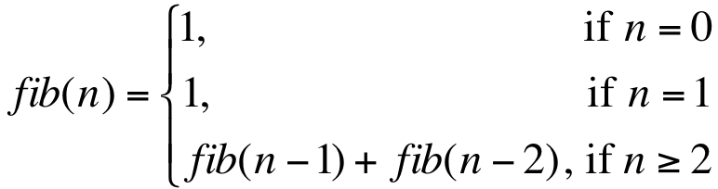
Programming with Recursion
Fibonacci numbers:
Notes:
Feebonachi
A series of numbers in which each number (Fibonacci number) is the sum of the two preceding numbers.

Slide 52
Programming with Recursion
Fibonacci numbers:
static int fib(int n){
if(n == 0)
return 1;
else if(n == 1)
return 1;
else
return(fib(n-1) + fib(n-2));
}

Slide 53
Programming with Recursion
Listing files in a directory.
Write a function that lists the names of all files in a folder including its subfolders.
Use File class in Java package java.io

Slide 54
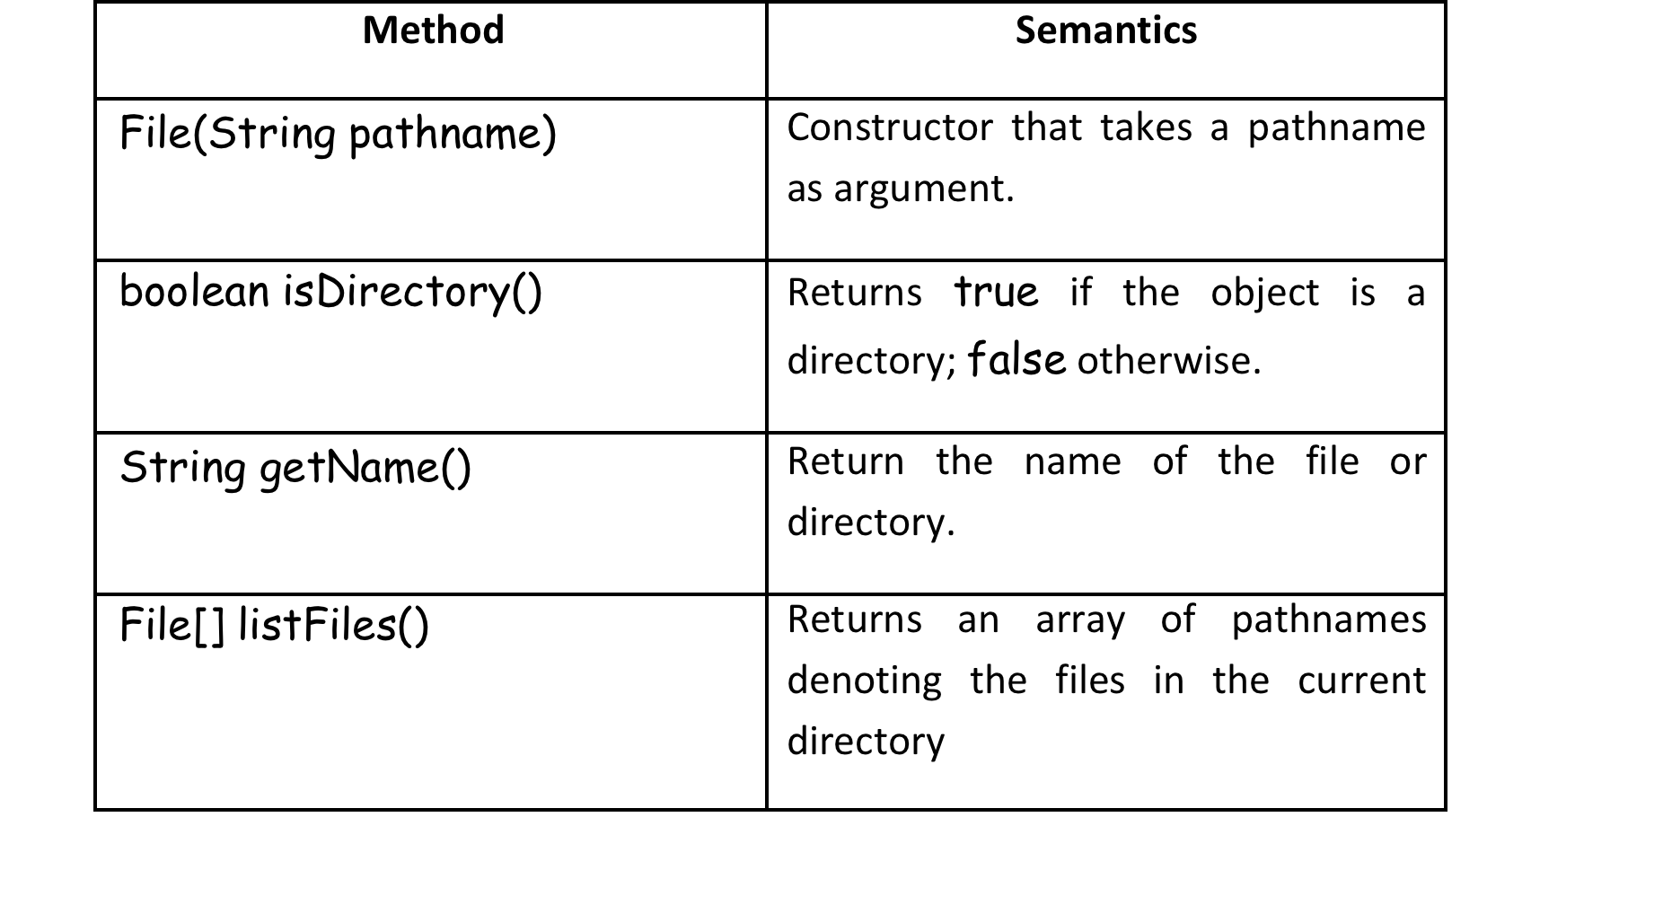
Programming with Recursion
Listing files in a directory:

Slide 55
Programming with Recursion
Listing files in a directory:
static void listFiles(File dir){
File files[] = dir.listFiles();
if(files != null){
for(File f : files)
if(f.isDirectory()) //recursive call here
listFiles(f);
else //print name of file
System.out.println(f.getName());
}
}

Slide 56
Programming with Recursion
Recursion over sequences.
Given an int array of N values write recursive functions to:
Compute the sum of the values in the array;
Linearly search the array for a given value x.
static int sum(int f[], int n){
if(n == f.length){
return 0;
}else{
return(f[n] + sum(f,n+1));
}
}
Notes:
We process the elements of an array when writing programs.
Normally we would use for loop or a while loop to iterate over a given sequence of values. But we can also use recursion over sequences.

Slide 57
Programming with Recursion
Example – Compute the sum of the values in the array:
int f[] ={2,4,7}
sum(f,0) = return(2 + sum(f,1))
= return(2 + return(4 + sum(f,2)))
= return(2 + return(4 + return(7 + sum(f,3))))
= return(2 + return(4 + return(7 + 0)))
= return(2 + return(4 + 7))
= return(2 + 11)
= 13

Slide 58
Programming with Recursion
Tail Recursion.
Consider the following function:
fac(n : Int) : Int = if(n == 0) 1 else n * fac(n-1)
fac(3) = 3*fac(2)
= 3*2*fac(1)
= 3*2*1*fac(0)
= 3*2*1*1
= 6
Needs stack to hold values until termination reached. For large N can get stack overflow.
Notes:
In traditional recursion, the typical model is that you perform your recursive calls first, and then you take the return value of the recursive call and calculate the result. In this manner, you don't get the result of your calculation until you have returned from every recursive call.
In tail recursion, you perform your calculations first, and then you execute the recursive call, passing the results of your current step to the next recursive step. This results in the last statement being in the form of "(return (recursive-function params))" (I think that's the syntax for Lisp). Basically, the return value of any given recursive step is the same as the return value of the next recursive call.
The consequence of this is that once you are ready to perform your next recursive step, you don't need the current stack frame any more. This allows for some optimization. In fact, with an appropriately written compiler, you should never have a stack overflow snicker with a tail recursive call. Simply reuse the current stack frame for the next recursive step. I'm pretty sure Lisp does this.

Slide 59
Programming with Recursion
A tail recursive function is a special case of recursion in which the last instruction executed in the method is the recursive call.
This type of function uses what is termed an accumulator parameter.
The idea is to allow the function to accumulate the result as it recursively invokes itself. In this way, the terminating state knows the result and can yield or return it.
Notes:
In traditional recursion, the typical model is that you perform your recursive calls first, and then you take the return value of the recursive call and calculate the result. In this manner, you don't get the result of your calculation until you have returned from every recursive call.
In tail recursion, you perform your calculations first, and then you execute the recursive call, passing the results of your current step to the next recursive step. This results in the last statement being in the form of "(return (recursive-function params))" (I think that's the syntax for Lisp). Basically, the return value of any given recursive step is the same as the return value of the next recursive call.
The consequence of this is that once you are ready to perform your next recursive step, you don't need the current stack frame any more. This allows for some optimization. In fact, with an appropriately written compiler, you should never have a stack overflow snicker with a tail recursive call. Simply reuse the current stack frame for the next recursive step. I'm pretty sure Lisp does this.

Slide 60
Programming with Recursion
Tail Recursion – Factorial
static int fac(int n) {
if(n == 0)
return 1;
else
return getFac(1,1,n);
}
static int getFac(int a, int n0, int n){
if(n0 == n)
return a;
else
return getFac(a*(n0+1),n0+1,n);
}
Notes:
Using regular recursion, each recursive call pushes another entry onto the call stack. When the recursion is completed, the app then has to pop each entry off all the way back down.
With tail recursion, the compiler is able to collapse the stack down to one entry, so you save stack space...A large recursive query can actually cause a stack overflow.
Basically Tail recursions are able to be optimized into iteration.

