Slide 1
Data Structures & Algorithms

Slide 2
Lecture 02
Analysis of Algorithms
Big O Notation

Slide 3
Analysis of Algorithms
Programs must be:
Correct
Robust
Deliver results in a timely fashion.
In many cases it is very critical that programs meet temporal deadlines.
For example, a program that manages safety bags in a car or a program that forecasts weather.
Notes:
Consider a program that manages the safety bag in a car. On impact it must respond in nanoseconds, otherwise passengers may be injured unnecessarily. A program that monitors weather must produce results in a time frame that makes weather reporting meaningful. There is no point getting today’s weather report tomorrow!

Slide 4
Analysis of Algorithms
We need to be able to say how long it will take a program to solve a given problem.
We also need to be able to compare performance to help choose between different programs that solve a given problem correctly.

Slide 5
Analysis of Algorithms
For example; computing the sum of the first N natural numbers. We can write this:
Or this:
static long sumN(long n){
long s = n * (n + 1)/2;
return s;
}
static long sumN1(long n){
long s = 0;
for(int j = 0; j < n; j++)
s = s + (j + 1);
return s;
}
Notes:
Both solutions are correct, assuming n >= 0.

Slide 6
Analysis of Algorithms
There are two ways to measure the quality of the performance of a program.
Use benchmarking to compare different programs that solve the same problem.
Analyse the code of the given program and work out a projected time.

Slide 7
Basic Mathematics
The analysis of certain type of algorithm requires an understanding of some basic mathematics. This includes Indices, Logarithms, and Sequences.

Slide 8
Basic Mathematics – Indices
Knowledge of powers or indices is essential for an understanding of most algebraic processes.
Basically, they are a shorthand way of writing multiplications of the same number.
For example:
4*4
can be written as = 4²

Slide 9
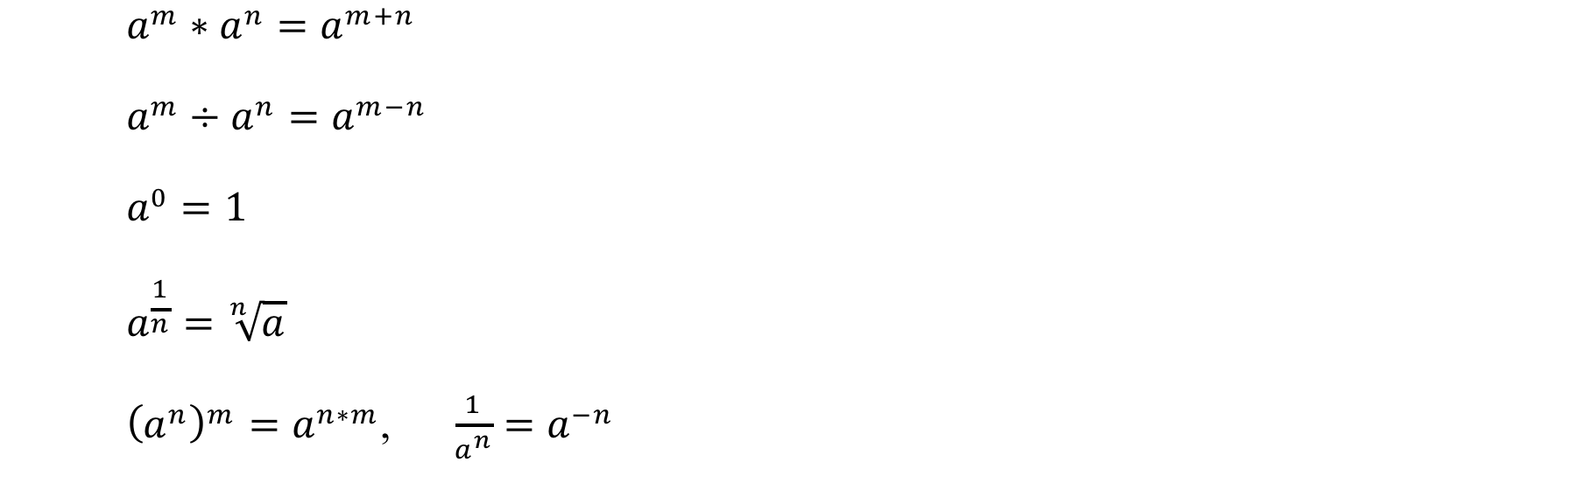
Basic Mathematics – Indices
Following are some basic rules of indices:

Slide 10
Basic Mathematics – Log
The definition of the log of x to the base b is given as:
log_{b}x = y
b^{y} = x
Read as:
the log of x to base b equals y
Which is equivalent to:
b to the power of y equals x.

Slide 11
Basic Mathematics – Log
For example:
log_{b}x = y
b^{y} = x
log₁₀100 = ?
log₁₀100 = 2
log₁₀1000 = ?
log₁₀1000 = 3
log₁₀165 = ?
log₁₀165 = 2.2175

Slide 12
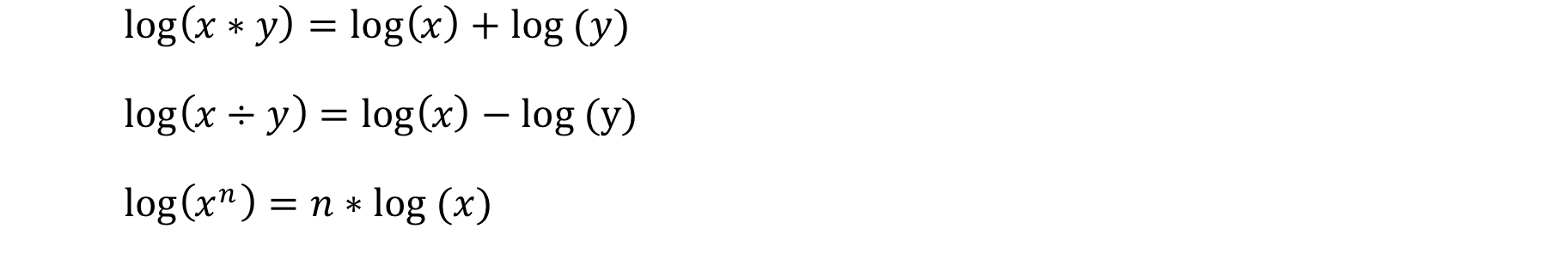
Basic Mathematics – Log
Following are some basic rules of log:
It is also possible to change the base of logs using the law:

Slide 13
Basic Mathematics – Log
Examples:
Show log360 = 3log2+2log3+log5
Changing base:

Slide 14
Basic Mathematics – Sequence
A sequence is a list of things (usually numbers) that are in order.
For example:
2, 4, 6, 8, …, n
The sequence 1,3,5,7, …, n is given by the rule 2*n-1, where n is the term number.
1st term
2nd term
n^{th} term

Slide 15
Basic Mathematics – Series
A series is defined to be the sum of the terms in a sequence.
The sequence 1,2,3,…,n becomes the series 1+2+3+…+n and the sum of the first n terms is given by the equation:
S(n) = n * (n-1)/2
Using the Greek letter (sigma):

Slide 16
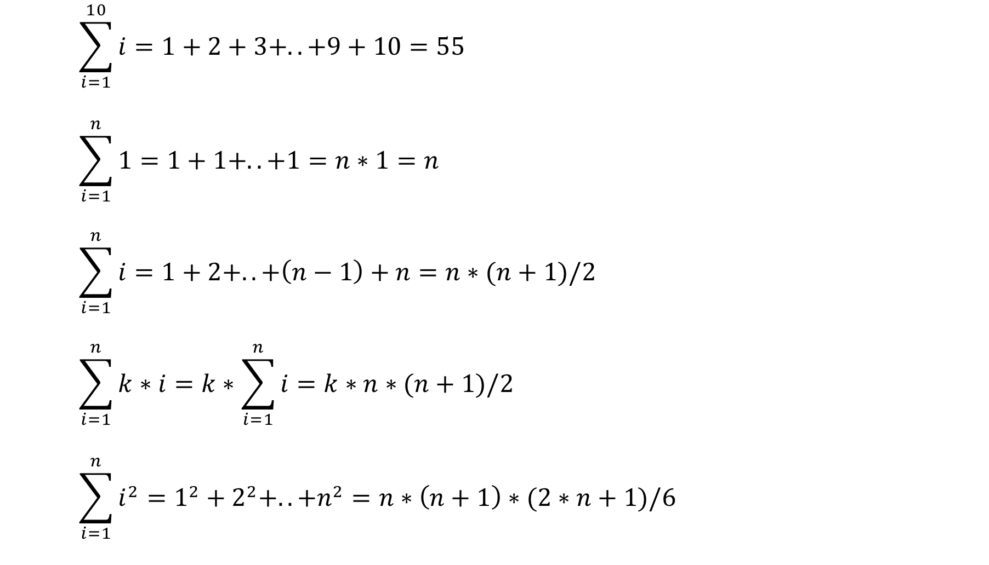
Basic Mathematics – Series
Examples:

Slide 17
Analysis of Algorithms
Logs are relevant in computing because they are used in the analysis of algorithms particularly in relation to what are termed divide and conquer algorithms, e.g. binary searching.
The log function grows very slowly and, hence, log scales are often used to compress large scale scientific data.
For example, Earth Quake of 7.0 is 1000 times greater than one of 4.0.
logQ1 = 7, Q1 = 10⁷
logQ2 = 4, Q2 = 10⁴
Q1 = 10⁷ = 10^{3 *} 10⁴
= 1000 * Q2

Slide 18
Compare Linear Sequence with Log Sequence
Linear sequence:
10,20, 30, 40, 50, 60, 70, 80, 90, 100, 110, 120, 130, 140, 150, 160, 170, 180, 190, 200
Common logs:
1.000, 1.301, 1.477, 1.602, 1.699, 1.778, 1.845, 1.903, 1.954, 2.000, 2.041, 2.079, 2.114, 2.146, 2.176, 2.204, 2.230, 2.255, 2.279, 2.301
Logs base 2:
3.322, 4.322, 4.907, 5.322, 5.644, 5.907, 6.129, 6.322, 6.492, 6.644, 6.781, 6.907, 7.022, 7.129, 7.229, 7.322, 7.409, 7.492, 7.570, 7.644
Notes:
The base 10 is know as common log

Slide 19
Calculating Running Times
We measure the cost (running time) in nanoseconds.
1sec = 10³ms (miliseconds)
1sec = 10⁶μs (microseconds)
1sec = 10⁹ns (nanoseconds)
A fast machine might execute a primitive instruction in 5ns, whereas a slow machine might take 20ns to execute the same primitive instruction.
This makes the task of calculating the running time of executing programs that are more complex.

Slide 20
Calculating Running Times on HAL
To simplify the task we will specify a time cost for executing primitive instructions on an ideal machine called HAL.
The real cost, when tested on an actual machine, will be some multiple of the cost of executing it on HAL.
For example, if the running time on HAL for a given program is 1000ns, then the running time on a machine four time faster than HAL will be 250ns.

Slide 21
Calculating Running Times on HAL
Statement Unit cost (ns)

Slide 22
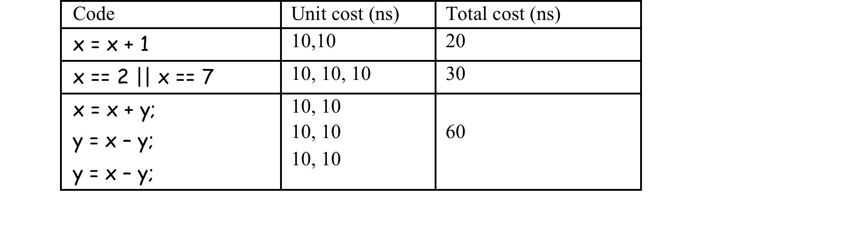
Calculating Running Times on HAL
Cost of executing:
+, -, *, /, %, <, >, ==, >=, <=, !=, =,
Be 10ns
Examples:

Slide 23
Calculating Running Times on HAL
Cost of function invocation, for each parameter, and return statement:
Be 50ns, 10ns, and 50ns.
What will be the total cost of invoking the following function sumN?
150ns. How?
static long sumN(long n){
long s = n * (n + 1)/2;
return s;
}
50 + 10
10 + 10 + 10 + 10
50

Slide 24
Calculating Running Times on HAL
The time taken to execute an if statement of the form if(b) s1; else s2; is the cost of b plus the max cost of s1, s2.
For example, the cost of executing:
if(x > 0) x = 1; else x=x*x;
is 30ns because the boolean expression costs 10ns and the max cost of (10ns,20ns) is 20ns.

Slide 25
Calculating Running Times on HAL
Calculating the cost of executing loops:
totalCost = cost of initialization of variables
+
(n+1) * cost of evaluating guard on loop
+
n * cost of executing loop body,
where n equals the number of iterations of the loop.
Example:
long s = 0;
for(int j = 0; j < 1000; j = j + 1)
s = s + (j + 1);

Slide 26
Calculating Running Times on HAL
Calculating the cost of executing loops:
Example:
long s = 0;
for(int j = 0; j < 1000; j = j + 1)
s = s + (j + 1);
totalCost = (10 + 10) + 1001 * 10 + 1000*(30+20)
= 20 + 10010 + 50000
= 60030ns

Slide 27
Calculating Running Times on HAL
What will be the total cost of invoking the following function sumN1?
totalCost =
(50 + 10) - invocation, parameter
+ (10+10) - initialization of variables
+ (n+1)*10 – evaluation of loop guard
+ n *50 - loop body
+ 50 - return value
static long sumN1(long n){
long s = 0;
for(int j=0; j < n; j++)
s = s + (j + 1);
return s;
}

Slide 28
Calculating Running Times on HAL
totalCost = 60 + 20 + (n + 1) * 10 + n * 50 + 50
= (140 + 60 * n) ns
Let n = 1000000 then the cost will be:
totalCost = 140 + 60*1000000 ns
= 6*10000microseconds
= 60 milliseconds
= 0.06seconds
Constant 140ns is ignored for huge n. As it won't make a difference.

Slide 29
Benchmarking Programs
Java provides a method from class System called nanoTime() that yields the elapsed time in nanoseconds from some base time.
Using this method we can record the start time and the the end time of a piece of code.
Then calculate the running time of the code under test.

Slide 30
Benchmarking Programs
For example:
long start = System.nanoTime();
//function to test
long end = System.nanoTime();
long k = end - start;
System.out.println(”Elapsed time in nanseconds:"+k);

Slide 31
Optimising Performance
By comparing performance we can choose possibly an optimal solution for a given task.
How to find out an optimum solution?
Consider the following example:
Find sum of the first n terms of the series:
1 + 3 + 6 + 10 + 15 + ..
The series is generated by taking the sum of the sum of the first n terms:
1 + (1+2) + (1+2+3) + (1+2+3+4) + ..

Slide 32
Optimising Performance
In order to find that we can use our earlier function (sumN) which computes sum of the first n terms.
T(n) = 140 + 200*n, given that the running cost of sumN(n) = 150ns
static long sumS1(int n){
long k = 0;
for(int j = 0; j < n; j++)
k = k + sumN(j+1);
return k;
}

Slide 33
Optimising Performance
And using the function (sumN1) which computes sum of the first n terms using loop.
T(n) = 140 + 190*n + 60*n², given that the running cost of sumN1(n) = 140+60*n
static long sumS2(int n){
long k = 0;
for(int j = 0; j < n; j++)
k = k + sumN1(j+1);
return k;
}

Slide 34
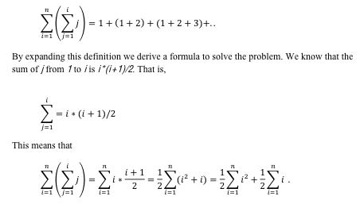
Optimising Performance
Even for a small values of n sumS1 will outperform sumS2 function.
The running time is dependent to the value of n.
Can we find a solution that has a fixed time?
We can describe the problem mathematically as:

Slide 35
Optimising Performance
By expanding this definition we derive a formula to solve the problem. We know:
This means that:

Slide 36

Optimising Performance
Replacing formulas for sum of first n² terms and the sum of the first n terms. (Notes page no. 54).

Slide 37
Optimising Performance
Now we have a formula to calculate any required term in the series. The following function uses the formula.
The running time of sumS3 is not relative to the value of n. Its cost is fixed, which is 180ns.
For n = 10000, sumS3 is 10000 times faster than sumS1 and 10 million times faster than sumS2.
static long sumS3(int n){
long k = n*(n+1)*(n+2)/6;
return k;
}

Slide 38
Big Oh Notation
Notation that is used to classify algorithms in terms of their performance.
Suppose we consider the following functions that define the timings for different programs:
t1(n) = 5 + n,
t2(n) = 50 + n,
t3(n) = 500 +100n,
t4(n) = 5000 +1000n.
Notes:
Automobiles are divided by size into several categories: subcompacts, compacts, midsize, and so on. These categories provide a quick idea what size car you’re talking about, without needing to mention actual dimensions. Similarly, it’s useful to have a shorthand way to say how efficient a computer algorithm is. In computer science, this rough measure is called “Big O” notation.

Slide 39
Big Oh Notation
Suppose we consider the following functions that define the timings for different programs:
t1(n) = 5 + n,
t2(n) = 50 + n,
t3(n) = 500 +100n,
t4(n) = 5000 +1000n.
The impact of the constants is significant for small values of n, say n < 1000000.
But for very large values of n they have little impact.
All of these functions converge, or meet, as n approaches infinity.
Notes:
Intuitively, this makes sense because in many different contexts we apply this
rule without thinking about. For example, suppose you pay 1 million euro for a property and then have to pay twenty thousand euro in fees. You would say the cost of the property is of the order 1 million. The additional twenty thousand may be ignored!

Slide 40
Big Oh Notation
Suppose we consider the following functions that define the timings for different programs:
t1(n) = 5 + n,
t2(n) = 50 + n,
t3(n) = 500 +100n,
t4(n) = 5000 +1000n.
Therefore, all of these functions form a set that are asymptotically dominated by t(n) = n.
Form a family of functions of O(n).

Slide 41
Big Oh Notation
Similarly we can argue that:
t(n) = 50n²
t(n) = 10000+ 10n²
t(n) = 1000+ 500n²
t(n) = 100 + 50000n²
All belong to the family of functions of O(n²).

Slide 42
Laws of Big Oh
Summation:
O(1)+O(1)+..+O(1) = k * O(1) = O(1),
O(n) + O(n)+..+O(n) = k * O(n) = O(n)
O(n) + O(m) = max(O(n), O(m))
e.g. O(n³) + O( n⁵) = O( n⁵)
Product:
O(n) * O(n) = O(n²)
n * O(n) = O(n²)
O(n) * O(m) = O(n * m)
O(k * f(n)) = k * O(f(n)) = O(f(n))
O(nª) * O(n^{b}) = O(n^{a+b})

Slide 43
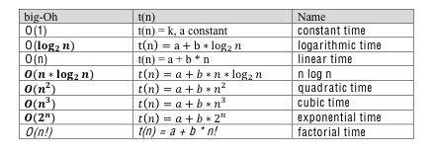
Big Oh Notation
Main classifications in order of increasing cost.
Notes:
Using the big-O notation we can give a classification of algorithms in terms of their projected performance.

Slide 44
Big Oh Notation
Notation provides a way to classify algorithms that can be used for comparison purposes.
A program that has O(1) will perform better than a program of O(n), in general.
We can also extend this idea to analyzing best case, average case and worse case scenarios for given algorithm.

Slide 45
Big Oh Notation
For example:
static boolean search(int f[], int x){
boolean found = false;
int j = 0;
while(j < f.length && ! found){
if(f[j] == x) found = true;
else j++; }
return found; }
Worst case: x not present O(N)
Best case: x is first element 0(1)
Average case?
Notes:
This notation provides a way to classify algorithms that can be used for comparison purposes.
The worst case scenario occurs when x is not present. In this case it is O(n), where n = f.length.
This leads to the question what is the best case? Clearly, if x is the first element the
result is O(1). However, it might be the second, third, fourth, etc. Suppose the possibility of searching for each element in the array is equally likely. Then the cost of searching for any one of them on average is (∑𝑛𝑖=0(𝑖))/n. This is (n*(n+1)/2)/n which is (n+1)/2. This is O(n) also.

