Slide 1
Data Structures & Algorithms

Slide 2
Lecture 08
Binary Search Trees
Notes:
Data Structures and Algorithms in java by Robert Lafore

Slide 3
Binary Tree
Given an ordered linked list of items the only way to search for a given item is to perform a linear search.
This is O(n), where n is the number of items in the list.
Is it possible to re-arrange the nodes so that a binary search of the items is possible?
Why? Because binary search gives us O(log n).

Slide 4
Binary Tree
Consider the following sorted list of values:
Apply binary search, for a given value of x:
Start at 7
Go left or go right
If left visit 4, if right visit 12
Go left or go right at 4
If left visit 2, if right visit 6
list = [2,4,6,7,9,12,15]

Slide 5
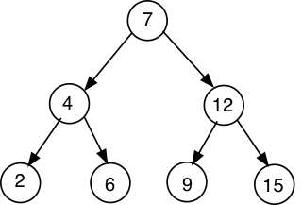
Binary Tree
Binary search gives rise to inverted tree structure:

Slide 6
Binary Tree
To optimise cost of searching we could store items in the structure of the comparison tree itself.
This would give rise to a retrieval cost of O(log N) and an insertion cost of O(log N) on condition that:
The number of left nodes is approximately equal to the number of right nodes.
This type of structure is called binary tree.

Slide 7
Binary Tree
A binary tree is a finite set of nodes that either is empty or consists of a root node with two disjoint binary trees called the left and right sub-trees of the root.
A node is an element in the tree.
Each node is connected to its parent and descendants by arcs called edges.
Nodes are either terminal, in which case they have no descendants (called leaves), or not terminal, in which case they have descendants and are called interior nodes.

Slide 8
Binary Tree
The number of direct descendants of an interior node is called its degree. In the case of binary trees the degree is always 2.
The number of edges that have to be traversed from the root node to a node k is called the path length or height of k. In general, a node at level j has path length j-1, assuming path length of the root node is 0.
The height of a tree is the maximum path length associated with any of its nodes.

Slide 9
Binary Tree
Root node:
7
Number leaf nodes:
4 – (2, 6, 9, 15)
Number of interior nodes:
2 – (4, 12)
Height of the tree:
2
Height of the node 12:
1 – given that root has a height of 0.

Slide 10
Binary Tree – Examples
A family tree inverted, where parents are viewed as descendants.
The history of a soccer tournament where the winner is the root.
An arithmetic expression with binary operators, where operands appear as leaf nodes.

Slide 11
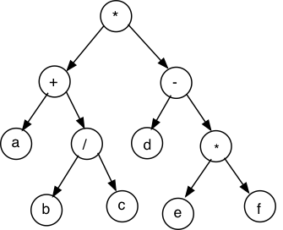
Binary Tree – Examples
The tree representation of (a + b/c) * (d – e*f)

Slide 12
Binary Search Tree
Binary search tree is a binary tree with the additional constraint that:
The value in every node must be greater than all values in its left sub-tree, and less than all values in its right sub-tree.
Duplicate values are not allowed.

Slide 13
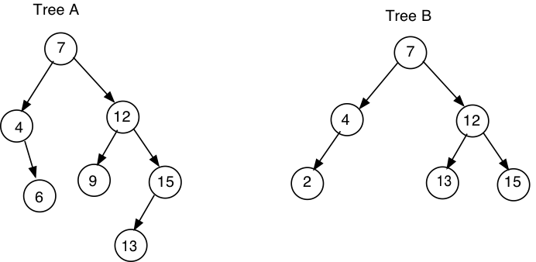
Binary Search Tree
Example:
Tree A satisfies the binary search tree conditions and Tree B does not.

Slide 14
Binary Search Tree – Depth First Traversal
Three ways to visit each node in a binary search tree.
Preorder:
process root;
process left sub-tree;
process right sub-tree
Inorder:
process left sub-tree;
process root;
process right sub-tree
Postorder:
process left sub-tree;
process right sub-tree;
process root

Slide 15
Binary Search Tree – Depth First Traversal
Example:
Preorder:
7, 4, 2, 6, 12, 9, 15
Inorder:
2, 4, 6, 7, 9, 12, 15
Postorder:
2, 6, 4, 9, 15, 12, 7
Inorder traversal of the tree gives a sorted list of values.

Slide 16
Binary Search Tree – Add an element
When adding a new value we must ensure that:
The value in every node must be greater than all values in its left sub-tree, and less than all values in its right sub-tree is invariant.
A new value is added as a leaf node in such a way that the above rule is preserved.

Slide 17
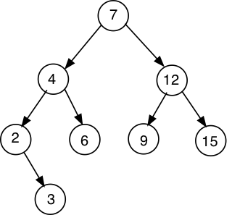
Binary Search Tree – Add an element
Inserting value 3 in the tree below:
=

Slide 18
Binary Search Tree – Constructing tree
To construct a binary search tree from a given list of values the first item on the list becomes the root node.
Example:
Construct a binary search tree from the list: 8,4,6,2,5,10,1,9,7
List values based on each of the traversals defined above.
Answer:

Slide 19
Binary Search Tree – Depth First Traversal
Example:
Preorder: root; left; right
8, 4, 2, 1, 6, 5, 7, 10, 9
Inorder: left; root; right
1, 2, 4, 5, 6, 7, 8, 9, 10
Postorder: left; right; root
1, 2, 5, 7, 6, 4, 9, 10, 8

Slide 20
Binary Search Tree – Delete an element
Three types of situation can occur:
Delete a leaf node (no descendant)
Delete a node with single descendant
Delete a node with two descendants

Slide 21
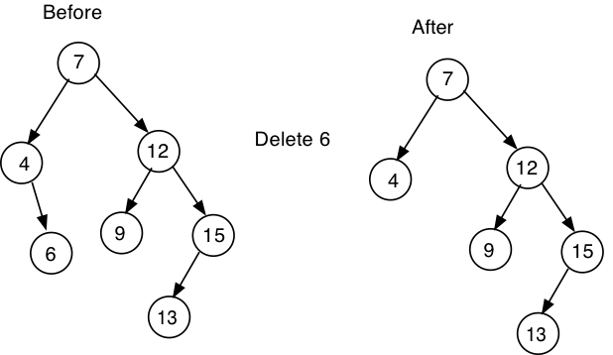
Binary Search Tree – Delete an element
Deleting a Leaf Node

Slide 22
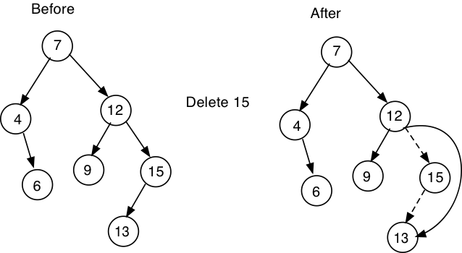
Binary Search Tree – Delete an element
Deleting a Single Descendant

Slide 23
Binary Search Tree – Delete an element
Deleting a Two Descendants:
We must replace the data item with some other element in the tree such that its invariant property is preserved.
One possible solution is to replace the value in the node to be deleted by the rightmost (maximum) element in its left sub-tree and then delete this node.
Find maximum in the left sub-tree
Copy the value to the node to be deleted
Remove the duplicate from left sub-tree

Slide 24
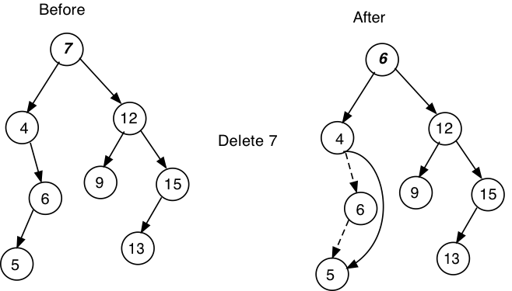
Binary Search Tree – Delete an element
Deleting a Two Descendants

Slide 25
Binary Search Tree – Delete an element
Delete node 6 and 8 from the following tree:

Slide 26
Binary Search Tree – Delete an element
Delete node 6

Slide 27
Binary Search Tree – Delete an element
Delete node 8

Slide 28

Binary Search Tree – Implementation
A binary search tree has to maintain a sorted list of data elements and, hence, its generic type must supply a compareTo method.
Each node has degree 2 and, hence, has to have a left and right reference to possible descendants.
A picture of a node might be:

Slide 29
Binary Search Tree – Implementation
Implementing the BNode class.
private class BNode<E extends Comparable<E>>{
private E data;
private BNode<E> left;
private BNode<E> right;
public BNode(E d){
data = d; left = null; right = null;
}
public E getData(){return data;}
public BNode<E> getLeft(){ return left;}
public BNode<E> getRight(){return right;}
public void setData(E x){data = x;}
public void setLeft(BNode<E> k){left = k;}
public void setRight(BNode<E> k){right =k;}
}

Slide 30
Binary Search Tree – Implementation
Implementing the BinarySearchTree class.
public class BinarySearchTree<E extends Comparable<E>> {
private BNode<E> root;
private int count;
public BinarySearchTree(){
root = null;
count = 0;
}

Slide 31
Binary Search Tree – Implementation
Implementing the BinarySearchTree class.
public void add(E x){
if(x == null) return;
if(root == null){
root = new BNode<E>(x);
count = 1;
}
else
add(root, x);
}

Slide 32
Binary Search Tree – Implementation
Implementing the BinarySearchTree class.
private void add(BNode<E> rt, E x){
if(x.compareTo(rt.getData()) < 0){
if(rt.getLeft() == null){
rt.setLeft(new BNode<E>(x));
count++;
} else{
add(rt.getLeft(), x);
}
} else if(x.compareTo(rt.getData()) > 0){
if(rt.getRight() == null){
rt.setRight(new BNode<E>(x));
count++;
} else{
add(rt.getRight(),x);
}
}else ; //x present, ignore
}

Slide 33
Binary Search Tree – Implementation
Implementing the BinarySearchTree class.
public boolean contains(E x){
return contains(root, x);
}
private boolean contains(BNode<E> rt, E x){
if(rt == null) {
return false;
} else{
if(rt.getData().equals(x)) {
return true;
} else if(x.compareTo(rt.getData()) < 0){
return contains(rt.getLeft(),x);
} else {
return contains(rt.getRight(), x);}
}
}

Slide 34
Binary Search Tree – Implementation
Implementing the BinarySearchTree class.
public ArrayList<E> inOrder(){
ArrayList<E> lst = new ArrayList<E>();
inOrder(root, lst);
return lst;
}
private void inOrder(BNode<E> rt, ArrayList<E> lst){
if(rt != null){
inOrder(rt.getLeft(), lst); //process left sub-tree
lst.add(rt.getData()); //process the root
inOrder(rt.getRight(),lst); //process right sub-tree
}
}

Slide 35
Binary Search Tree – Implementation
Implementing the BinarySearchTree class.
public ArrayList<E> preOrder(){
ArrayList<E> lst = new ArrayList<E>();
preOrder(root, lst);
return lst;
}
private void preOrder(BNode<E> rt, ArrayList<E> lst){
if(rt != null){
lst.add(rt.getData()); //process root
preOrder(rt.getLeft(), lst); //process left sub-tree
preOrder(rt.getRight(),lst); //process right sub-tree
}
}

Slide 36
Binary Search Tree – Implementation
Implementing the BinarySearchTree class.
public ArrayList<E> postOrder(){
ArrayList<E> lst = new ArrayList<E>();
postOrder(root, lst);
return lst;
}
private void postOrder(BNode<E> rt, ArrayList<E> lst){
if(rt != null){
postOrder(rt.getLeft(), lst); //process left sub-tree
postOrder(rt.getRight(),lst); //process right-subtree
lst.add(rt.getData()); //process root
}
}

Slide 37
Binary Search Tree – Implementation
Implementing the BinarySearchTree class.
public int size(){
return count;
}
public void remove(E x){
root = remove(root, x);
}
Notes:
Remove works as follows:
1. Find the node to delete
2.
If this node is a leaf node just drop it
else if left node null then return right sub-tree
else if right node null then return left sub-tree
else{
replace node value with value of rightmost
element in its left sub-tree;
drop this leaf node
}

Slide 38
Binary Search Tree – Implementation
Implementing the BinarySearchTree class.
The remove method works as follows:
Find the node to delete
If this node is a leaf node just drop it
else if left node null then return right sub-tree
else if right node null then return left sub-tree
else{
replace node value with value of rightmost
element in its left sub-tree;
drop this (duplicate) node
}
}
Notes:
Remove works as follows:
1. Find the node to delete
2.
If this node is a leaf node just drop it
else if left node null then return right sub-tree
else if right node null then return left sub-tree
else{
replace node value with value of rightmost
element in its left sub-tree;
drop this leaf node
}

Slide 39
Binary Search Tree – Implementation
Implementing the BinarySearchTree class.
public int height(){
if(root == null) {return 0;}
else
return (height(root) - 1); //root has height 0
}
private int height(BNode<E> rt){
if(rt == null) {
return 0;
} else{
return 1 + max(height(rt.getLeft()), height(rt.getRight()));
}
}
private int max(int a, int b){
return a >= b? a:b;
}

Slide 40
Binary Search Tree – Breadth First Traversal
Visit each node in the tree level by level starting at the root.
For example:
Output: 7 4 12 6 9 15 13

Slide 41
Binary Search Tree – Breadth First Traversal
Queue can be used to store elements at each level.
ArrayList can be used to store list of values.

Slide 42
Binary Search Tree – Implementation
Implementing the BinarySearchTree class.
public ArrayList<E> breadthFirst(){
ArrayList<E> lst = new ArrayList<E>();
CircularQueue<BNode<E>> queue = new
CircularQueue<BNode<E>>(count);
if(root == null) {
return lst;
}else{
queue.join(root);
while(!queue.empty()){
BNode<E> n = queue.top();
queue.leave();
lst.add(n.getData());
if(n.getLeft() != null) queue.join(n.getLeft());
if(n.getRight() != null) queue.join(n.getRight());
}
return lst;}
}

Slide 43
Binary Search Tree – Testing
Testing the BinarySearchTree class:
Output: 2 3 4 5 6 8 9 10
public static void main(String[] args) {
BinarySearchTree<Integer> bst = new BinarySearchTree<Integer>();
int f[] = {5,3,8,4,2,6,9,10};
for(int x:f) {
bst.add(x);
}
ArrayList<Integer> in_order = bst.inOrder();
Iterator<Integer> it = in_order.iterator();
while(it.hasNext()){
System.out.print(it.next()+" ");
}
}

