Slide 1
Data Structures & Algorithms

Slide 2
Lecture 09
AVL Trees & B-Trees

Slide 3
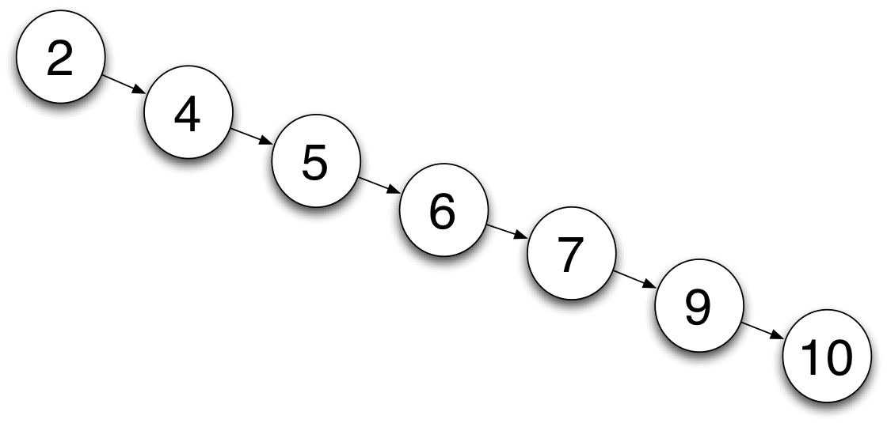
Binary Search Tree
Designed to optimize the cost of insertion and retrieval.
At best Insertion & Retrieval: O(log n)
At worst: O(n)
Example:
Consider creating binary search tree of: 2,4,5,6,7,9,10

Slide 4
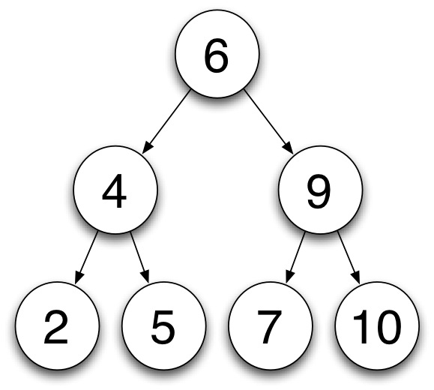
Binary Search Tree
Ideal would be to get a complete binary tree.
For example:

Slide 5
AVL Trees
Adelson-Velski and Landis (1962) introduced self balancing binary tree.
The number of left nodes and right nodes of any node cannot differ by more than 1.
Each node in the tree has a balance factor.

Slide 6
AVL Trees – Balance Factor
Each Node has a Balance Factor.
Balance Factor is difference between height of left sub-tree and right sub-tree.
An AVL tree may have nodes with Balance Factor of 1, 0 or -1.
Balance Factor is calculated by subtracting the height of right sub-tree from height of left sub-tree.

Slide 7
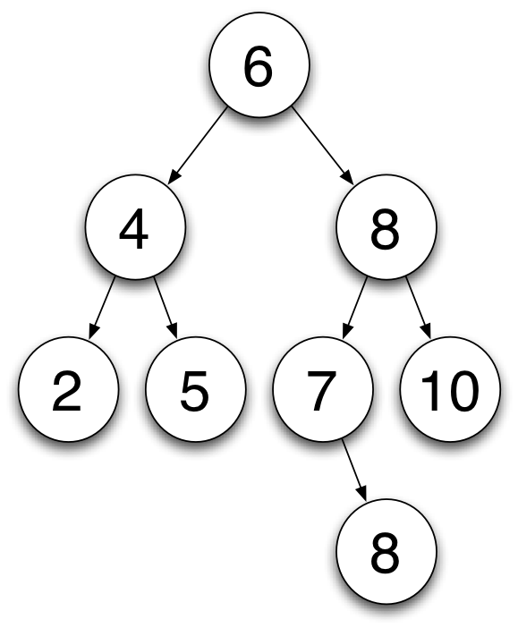
AVL Trees – Balance Factor
Example:

Slide 8
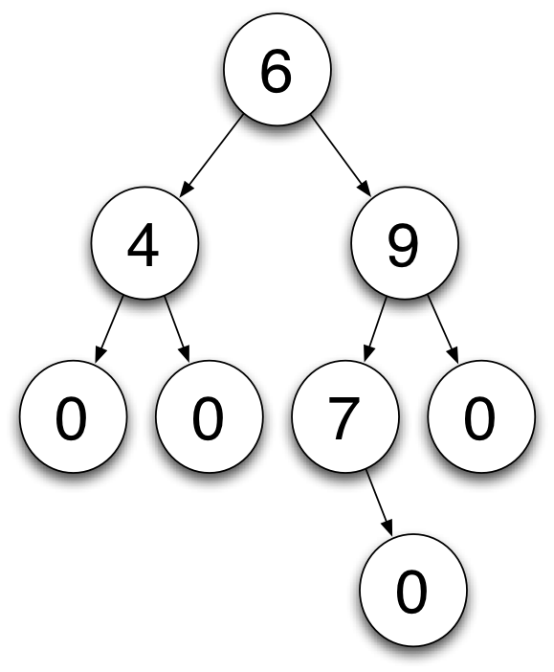
AVL Trees – Balance Factor
Example:
Leaf Nodes have no children as such have balance factor of 0.

Slide 9

AVL Trees – Balance Factor
Example:
Leaf Nodes have no children as such have balance factor of 0.
For each Node calculate by subtracting the height of right sub-tree from height of left sub-tree.

Slide 10
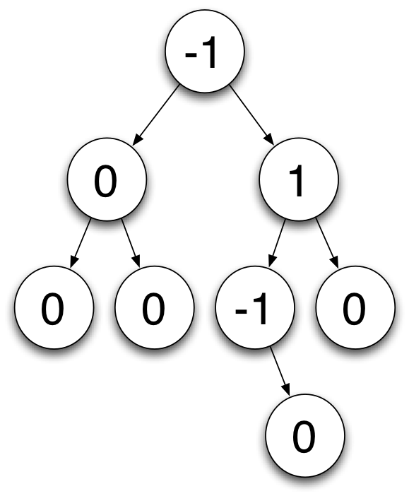
AVL Trees – Balance Factor
Leaf Nodes have no children as such have balance factor of 0.
For each Node calculate by subtracting the height of right sub-tree from height of left sub-tree.
An AVL tree may have nodes with Balance Factor of 1, 0 or -1

Slide 11
AVL Trees – Insertion
When inserting we wish to keep the tree as AVL tree.
Insertion same as binary search tree.
Tree may need to be rebalanced.

Slide 12
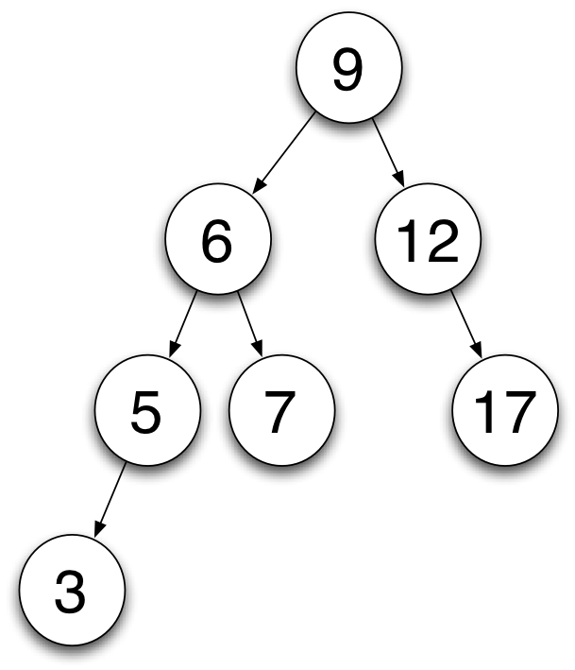
AVL Trees – Insertion
Example:

Slide 13
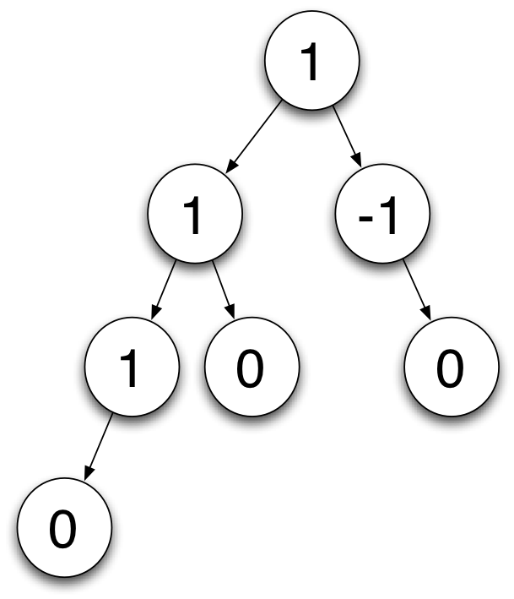
AVL Trees – Insertion
Example:
Tree is Balanced.

Slide 14
AVL Trees – Insertion
Example:
Tree is Balanced.
Insert number 2.

Slide 15
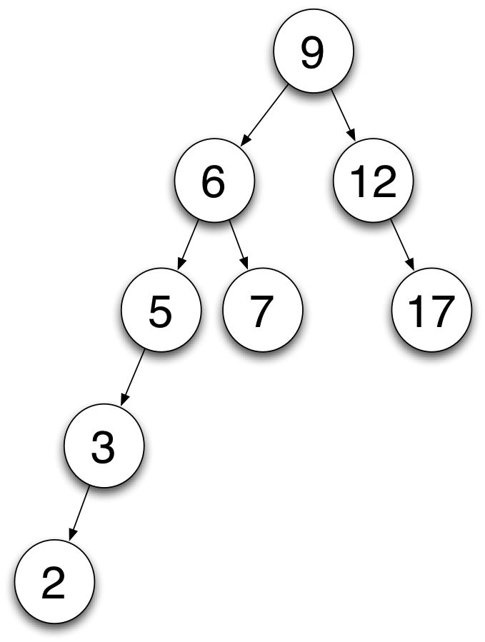
AVL Trees – Insertion
Example:
Tree is Balanced.
Insert number 2.

Slide 16

AVL Trees – Insertion
Example:
Tree is Balanced.
Insert number 2.
Tree becomes unbalanced.

Slide 17
AVL Trees – Insertion
Example:
Start at the inserted node and move up.
Find the first node to violate AVL property.
Rebalance this sub-tree.

Slide 18
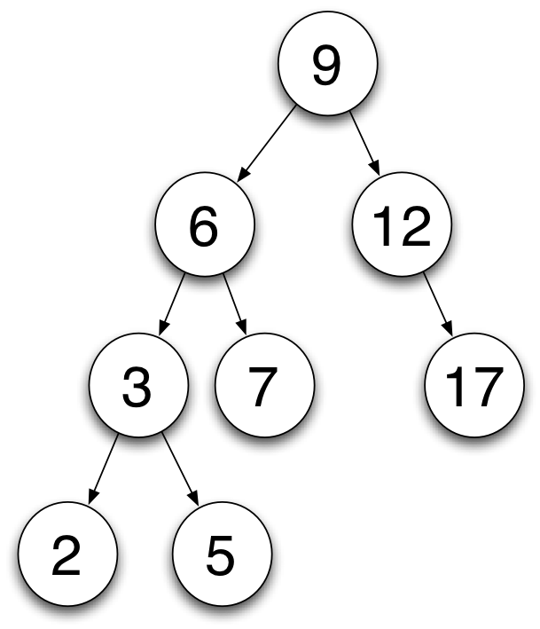
AVL Trees – Insertion
Example:
Inserted Node's Grandparent is placed at right child of it's own child.

Slide 19
AVL Trees – Rebalancing
The ordering of the nodes must be maintained.
Different rotations used to rebalance and maintain ordering.
Two basic rotations:
Right rotation
Left rotation

Slide 20
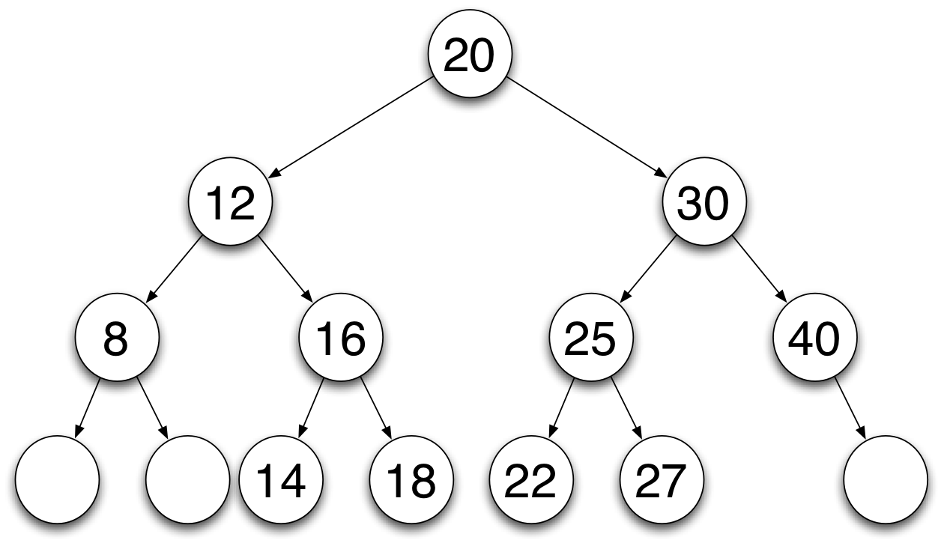
AVL Trees – Right Rotation
Example:
Notes:
The plan is to perform a right rotation about the root 20 keeping invariant the ordering for a binary search tree. This rotation will make 12 the new root. The triangle enclosing nodes 14, 16 and 18 has to shift to the right side of the new root. This means that the block of nodes will be placed as the left child of 20 in the new tree. This shift is illustrated in the second diagram below. The rotation only requires a change of pointers – the left pointer of 20 points to node 16 and the right pointer of node 12 points to node 20. This has a fixed time cost and, hence, is O(1). This is called a right rotation.

Slide 21
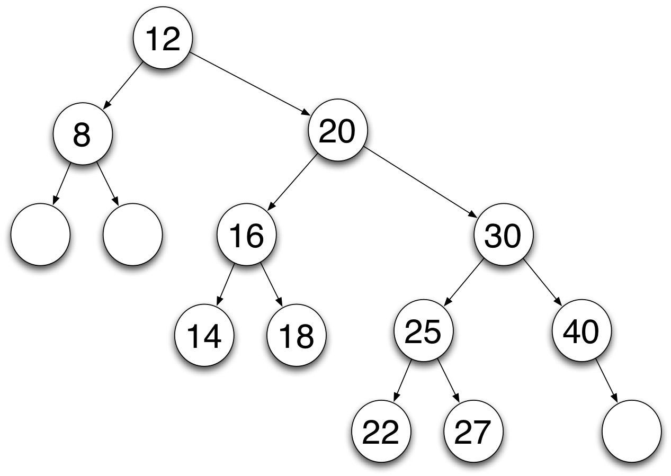
AVL Trees – Right Rotation
Example:

Slide 22
AVL Trees – Left Rotation
Example:
Notes:
The second rotation is called a left rotation. It is the mirror image of the right rotation described above. The pair of diagrams, given below, show the state of a tree before a left rotation and after it has taken place. To keep the ordering the right pointer of node 20 points to node 25 and the left pointer of node 30 points to node 20.

Slide 23
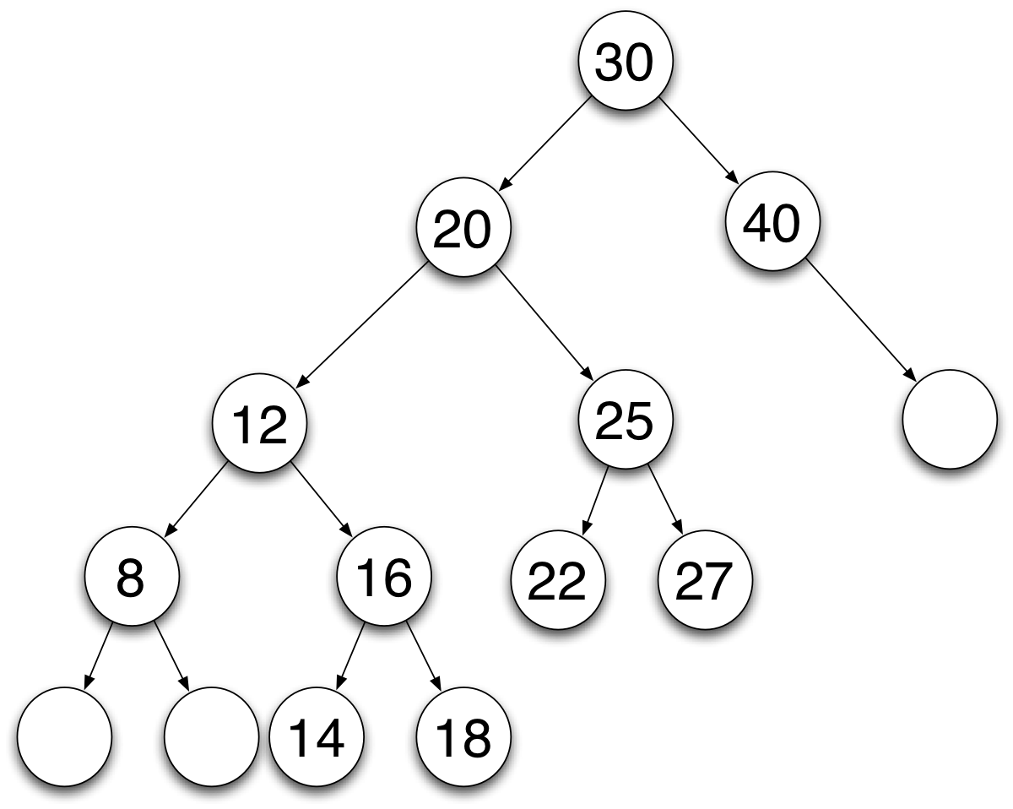
AVL Trees – Left Rotation
Example:

Slide 24
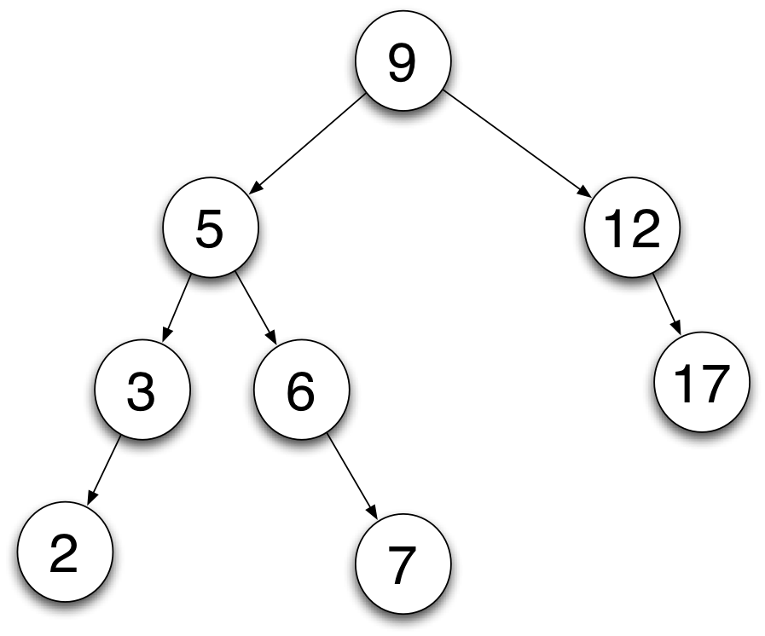
AVL Trees – Left Rotation
Example:
Insert 8.

Slide 25
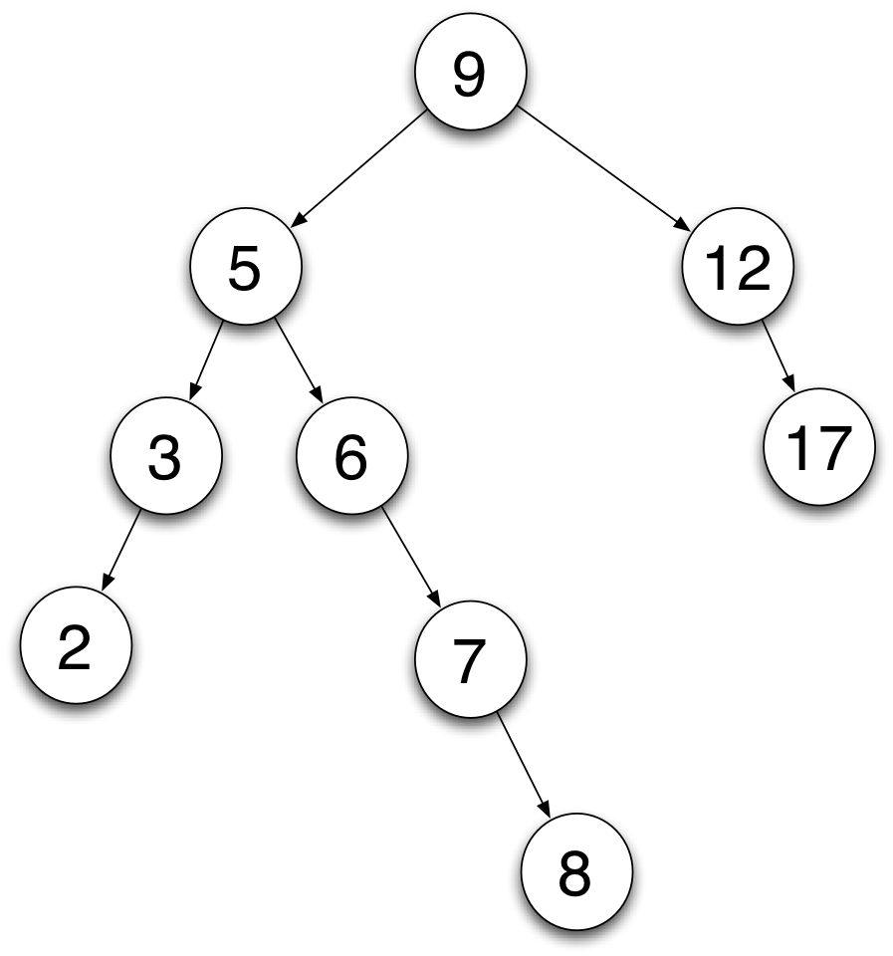
AVL Trees – Left Rotation
Example:
Insert 8.

Slide 26
AVL Trees – Left Rotation
Example:
Insert 8.

Slide 27
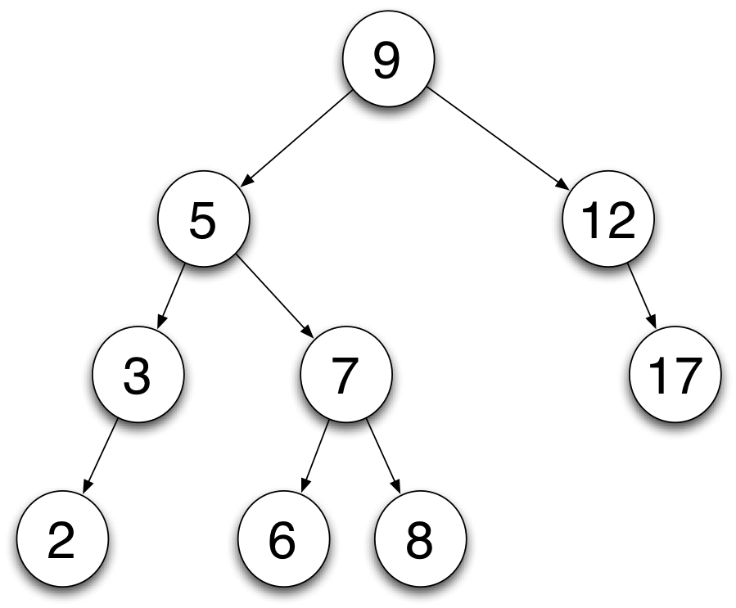
AVL Trees – Left Rotation
Example:
Insert 8.
Notes:
Lets build an AVL tree for the following list: 3, 2, 1, 4, 5, 6,

Slide 28
AVL Trees – Complex Rotation
Sometimes one rotation is not enough.
Left Right rotation:
Caused when balance goes from -1 to +2
Right Left rotation:
Caused when balance goes from +1 to -2

Slide 29
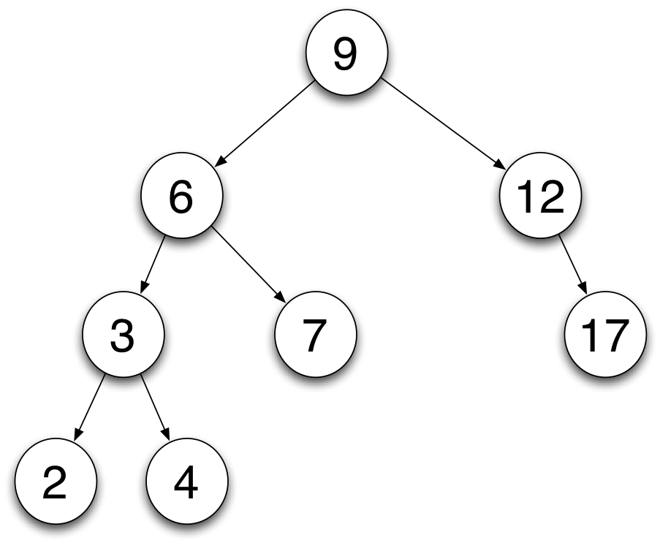
AVL Trees – Complex Rotation
Example of left-right rotation:
9 | 1
6 | 1
12 | -1
3 | 0
7 | 0
2 | 0
4 | 0
17 | 0

Slide 30
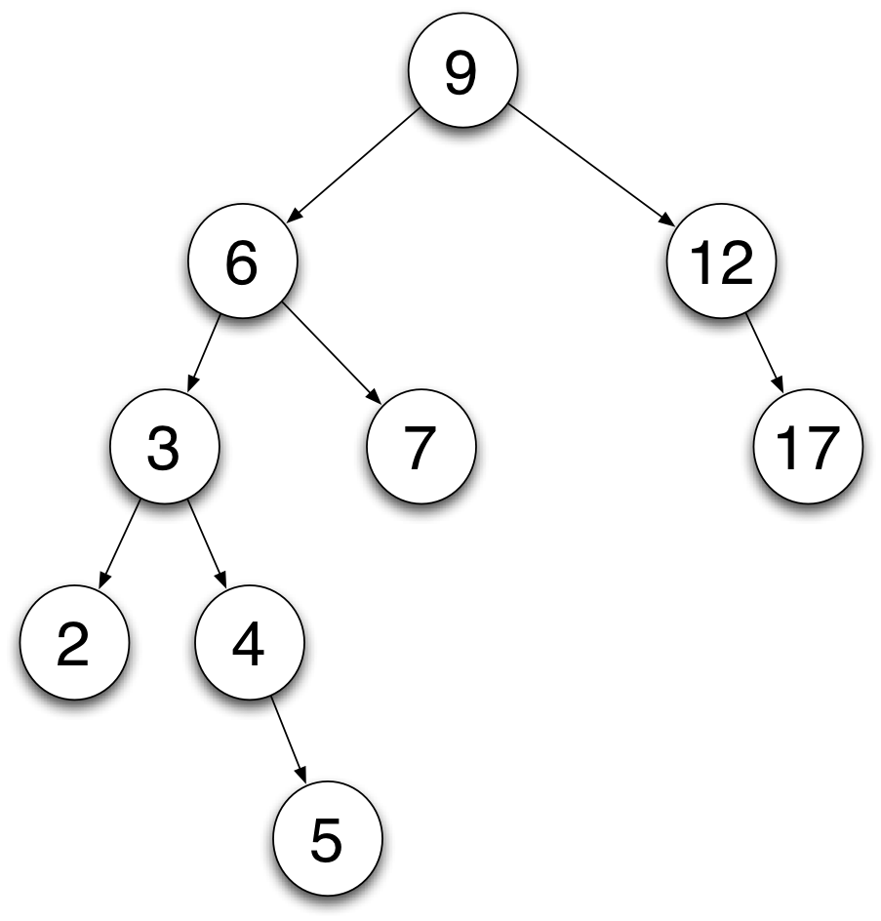
AVL Trees – Complex Rotation
Example of left-right rotation (Insert 5):
9 | 2
6 | 2
12 | -1
3 | -1
7 | 0
2 | 0
4 | -1
17 | 0
5 | 0

Slide 31
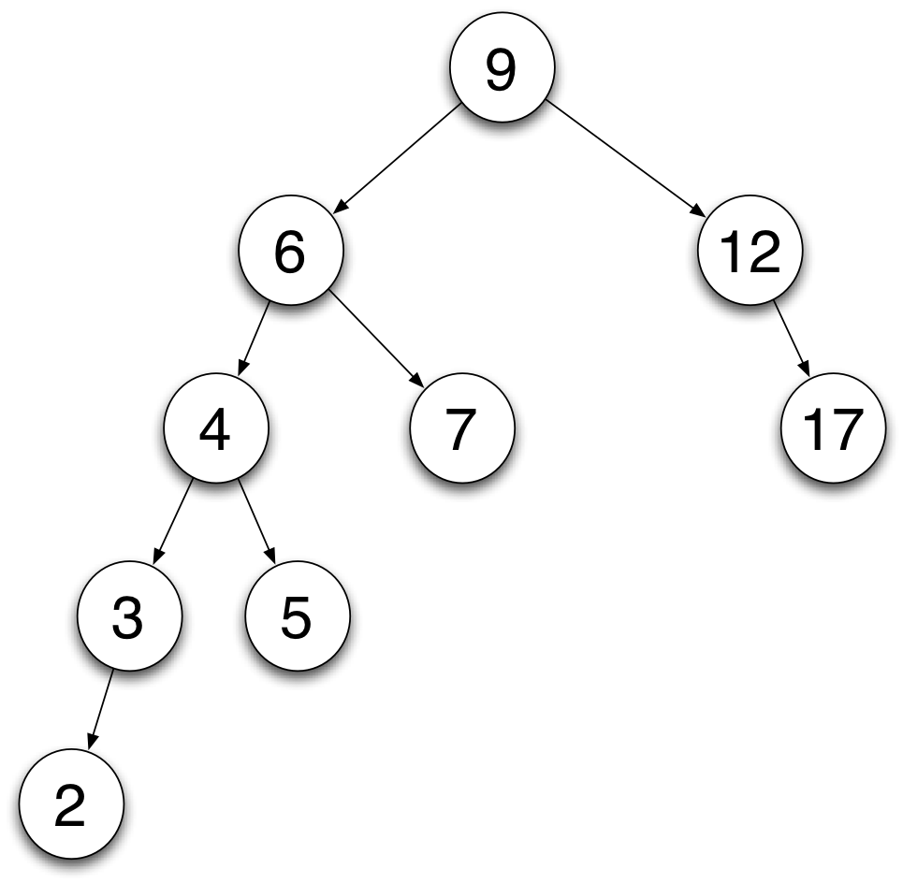
AVL Trees – Complex Rotation
Example of left-right rotation:
9 | 2
6 | 2
12 | -1
3 | 1
7 | 0
2 | 0
4 | 1
17 | 0
5 | 0

Slide 32
AVL Trees – Complex Rotation
Example of left-right rotation:
9 | 2
6 | 2
12 | -1
3 | 1
7 | 0
2 | 0
4 | 1
17 | 0
5 | 0

Slide 33
AVL Trees – Complex Rotation
Example of left-right rotation:
9 | 1
6 | 0
12 | -1
3 | 1
7 | 0
2 | 0
4 | 0
17 | 0
5 | 0

Slide 34
B-Tree
Cost of insertion and retrieval for AVL binary search tree is (log₂N).
Can we improve on this?
Introduce multi-way binary search tree where access is to an entire group or page of ordered values.
For example:
Suppose page size = 1000
Cost of insertion and retrieval is log₁₀₀₀N
Log₁₀₀₀1000³ = 3*log₁₀₀₀1000 = 3*1 = 3

Slide 35
B-Tree
Bayer and McCreight(1972) came up with the idea of forcing the tree to grow from the bottom up.
Called these type of trees B-Trees
Used widely
Operating Systems (Unix file system)
Database Management Systems
Notes:
B-trees have substantial advantages over alternative implementations when the time to access the data of a node greatly exceeds the time spent processing that data, because then the cost of accessing the node may be amortized over multiple operations within the node. This usually occurs when the node data are in secondary storage such as disk drives. By maximizing the number of keys within each internal node, the height of the tree decreases and the number of expensive node accesses is reduced. In addition, rebalancing of the tree occurs less often. The maximum number of child nodes depends on the information that must be stored for each child node and the size of a full disk block or an analogous size in secondary storage. While 2-3 B-trees are easier to explain, practical B-trees using secondary storage need a large number of child nodes to improve performance.

Slide 36
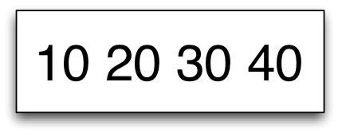
B-Tree
For example:
Tree of Order 2
Max number of items per page is 4
Insert 4 numbers
Notes:
Letting n = order of the B-tree, the rules for the tree are:
(1) Every page contains at most 2*n items.
(2) Every page, except root, contains at least n items.
(3) Every page is either a leaf page, i.e. has no descendants, or has m+1 descendants where m = the number of keys in the page.
(4) All leaf pages appear at the same level.

Slide 37
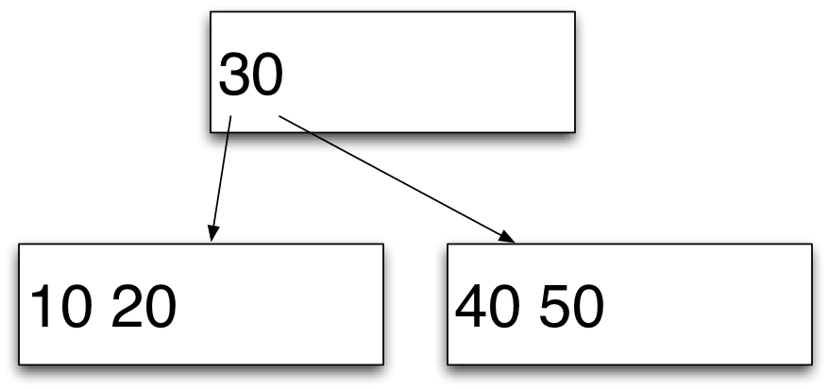
B-Tree
Insert 50
This causes us to:
Split the node in two
Place the smallest numbers in the left node
Place the largest numbers in the right node
Create a new root node and insert the middle value into it

Slide 38
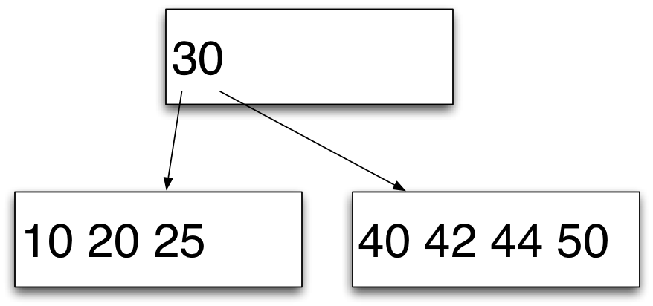
B-Tree
Insert 25, 42, & 44

Slide 39
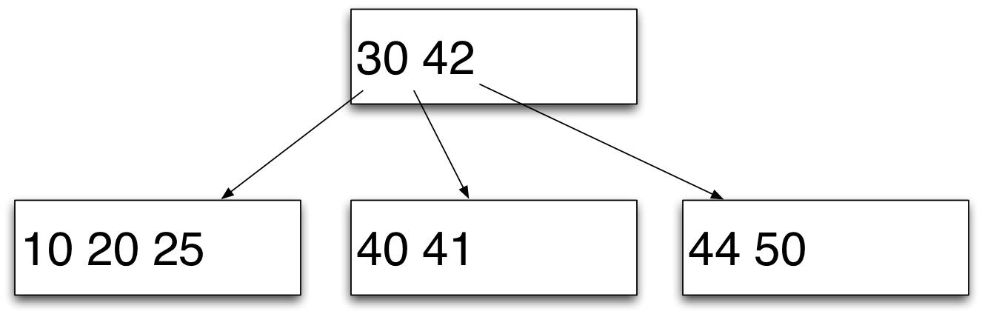
B-Tree
Insert 41

Slide 40
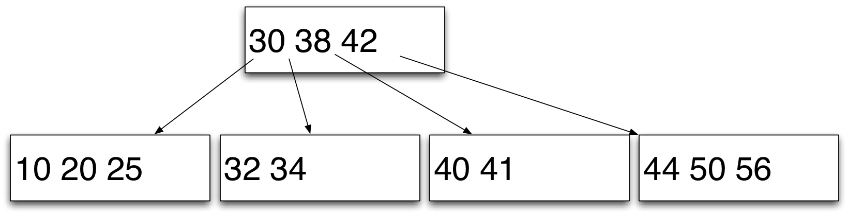
B-Tree
Insert 32, 38, 56, & 34

Slide 41
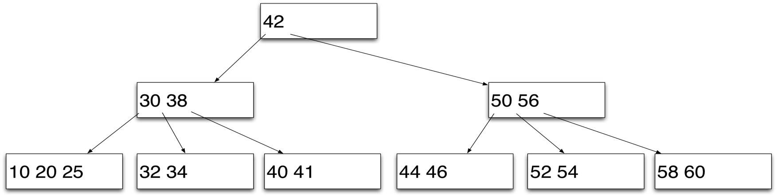
B-Tree
Insert 58, 60, 52, 54, & 46

Slide 42
B-Trees – Why are they important?
Suppose you create a file directory.
Index keys on the file stored in memory using a HashTable.

Slide 43
B-Trees – Why are they important?
Works well as long as the index data can be stored in memory.
What happens if index file too big for memory.
Create a B-Tree and root pages can be stored in memory.
Other pages lower down the tree only loaded on demand.
Notes:
B-trees have substantial advantages over alternative implementations when the time to access the data of a node greatly exceeds the time spent processing that data, because then the cost of accessing the node may be amortized over multiple operations within the node. This usually occurs when the node data are in secondary storage such as disk drives. By maximizing the number of keys within each internal node, the height of the tree decreases and the number of expensive node accesses is reduced. In addition, rebalancing of the tree occurs less often. The maximum number of child nodes depends on the information that must be stored for each child node and the size of a full disk block or an analogous size in secondary storage. While 2-3 B-trees are easier to explain, practical B-trees using secondary storage need a large number of child nodes to improve performance.

