Slide 1
Cytotoxic T-Lymphocyte Dynamics Modeling Thomas E. Perez Kyle Dewey PhD

Slide 2
Cytotoxic T-Lymphocyte Dynamics Modeling
Cell toxic

Slide 3
Cytotoxic T-Lymphocyte Dynamics Modeling
Cell toxic
Thymus

Slide 4
Cytotoxic T-Lymphocyte Dynamics Modeling
One of several types of white blood cells
Cell toxic
Thymus

Slide 5
Model 1
Kueh et al
Model 2
Wodarz et al
Complete T cell life cycle
Predator/Prey
Simulation
Metrics

Slide 6
SIMPLIFIED WORKFLOW
math model of Wodar z
K ueh model
A correlation links the two
Wodarz – Kueh correlation model

Slide 7
EXISTING MODEL
Pathways of T cell activation
Kueh pathway;
C
Wodarz pathway;
A or
B
Wodarz – Kueh correlation model

Slide 8
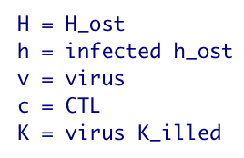

Slide 9
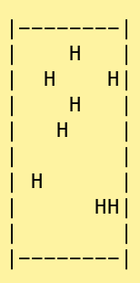
CTL DYNAMICS MODELING
"H" means Healthy Host cell

Slide 10
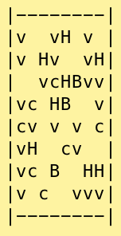
<infection !
"v"; virus particle
"B"; Bcl11b gene

Slide 11
INITIAL TISSUE STATUS

Slide 12
INITIAL TISSUE STATUS
IMMUNE RESPONSE

Slide 13
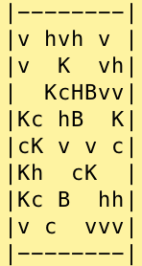
INITIAL TISSUE STATUS
IMMUNE RESPONSE
VIRUS PARTICLES KILLED

Slide 14
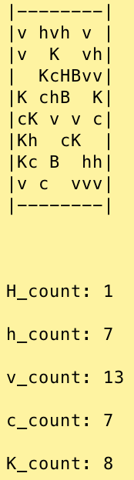
FINAL TISSUE STATUS including metrics

Slide 15
?
Questions please

