Slide 2
PAINFUL CHILDHOOD CANCERS
LEUKEMIA
BRAIN & other CNS type tumors
NEUROBLASTOMA
WILMS TUMOR
LYMPHOMA
RHABDOMYOSARCOMA
RETINOBLASTOMA
BONE CANCERS
cancer.org

Slide 3
Grades of tumors
High-grade tumors (grades III and IV)
Graded according to;
• size
• growth rate
• aggressiveness.
American Brain Tumor Association

Slide 5
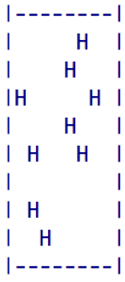
CTL DYNAMICS MODELING

Slide 6
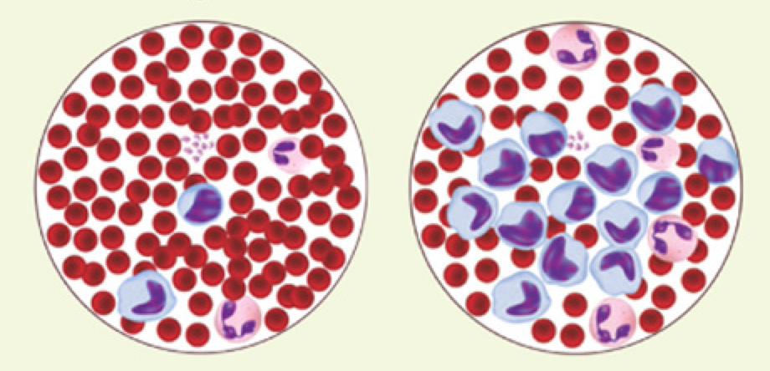
Cytotoxic T-Lymphocyte Dynamics Modeling

Slide 7
FACTORS
ADULTS: Usually environmental - (ionization radiation,
asbestos exposure, certain aerosols ...)
Mitigation - (exercise, nutrition, alcohol/drug abuse
deterrence …)
CHILDREN: Nothing definitive. Usually not caused
by inheritance, but develop during
pre-birth cell division.
Mitigation -
hopkinsmedicine.org

Slide 8
SIMPLIFIED WORKFLOW
Research A
Research B
Mathematical correlations

Slide 9
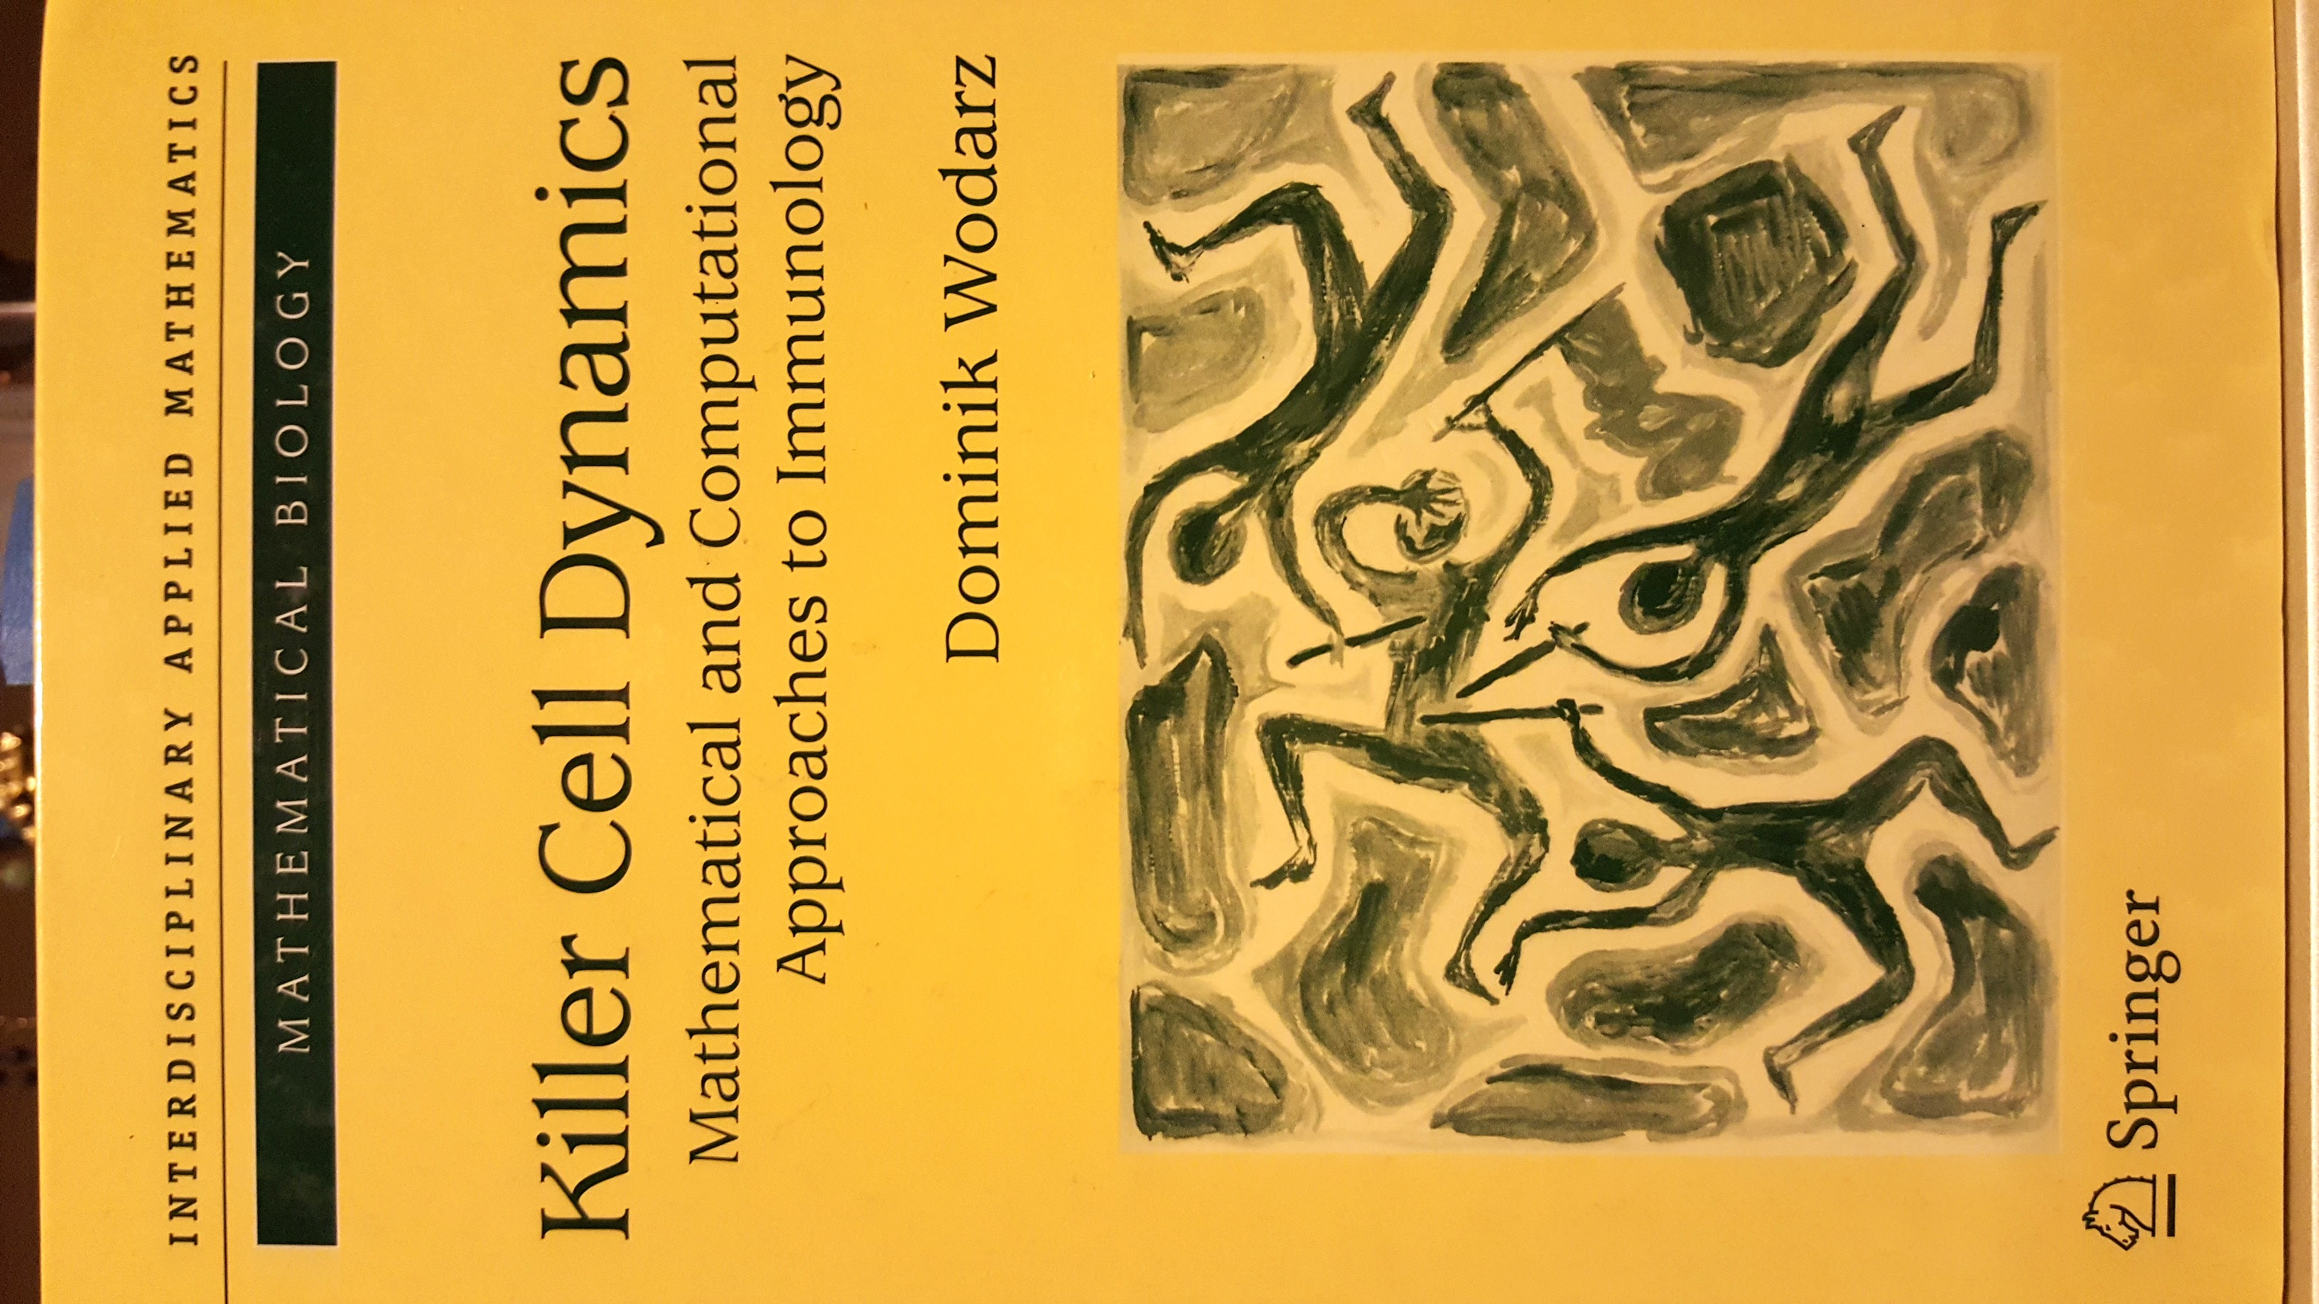

Slide 10
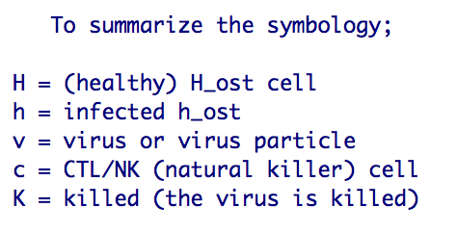

Slide 11
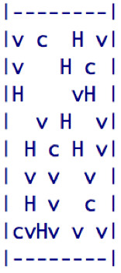
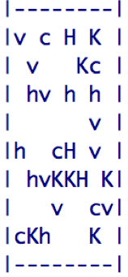
INITIAL TISSUE STATUS
IMMUNE RESPONSE
FEW VIRONS KILLED

Slide 12
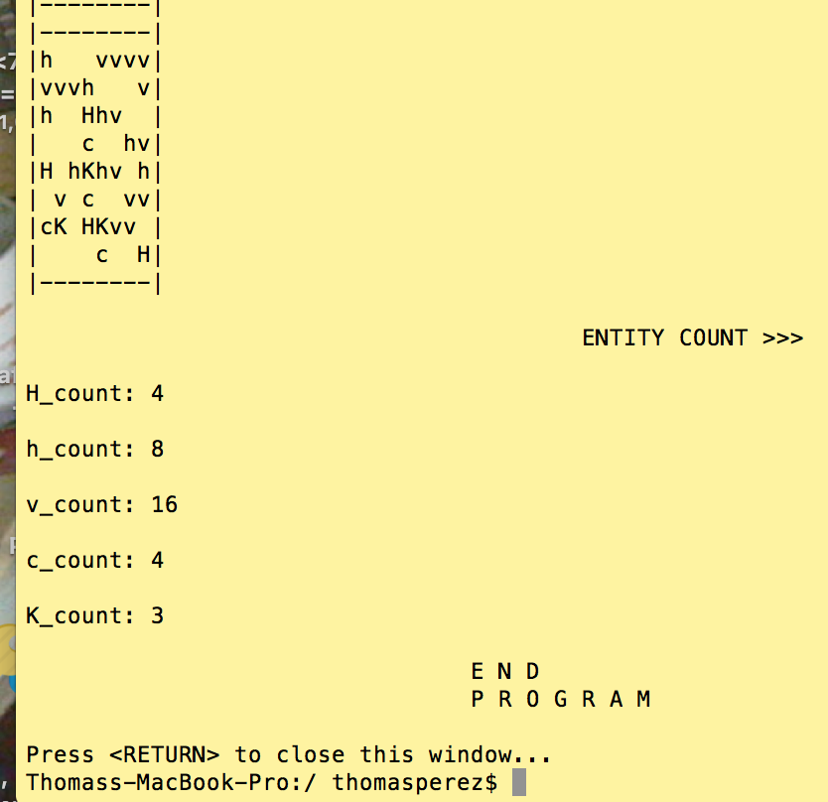
FINAL TISSUE STATUS inc metrics

Slide 13
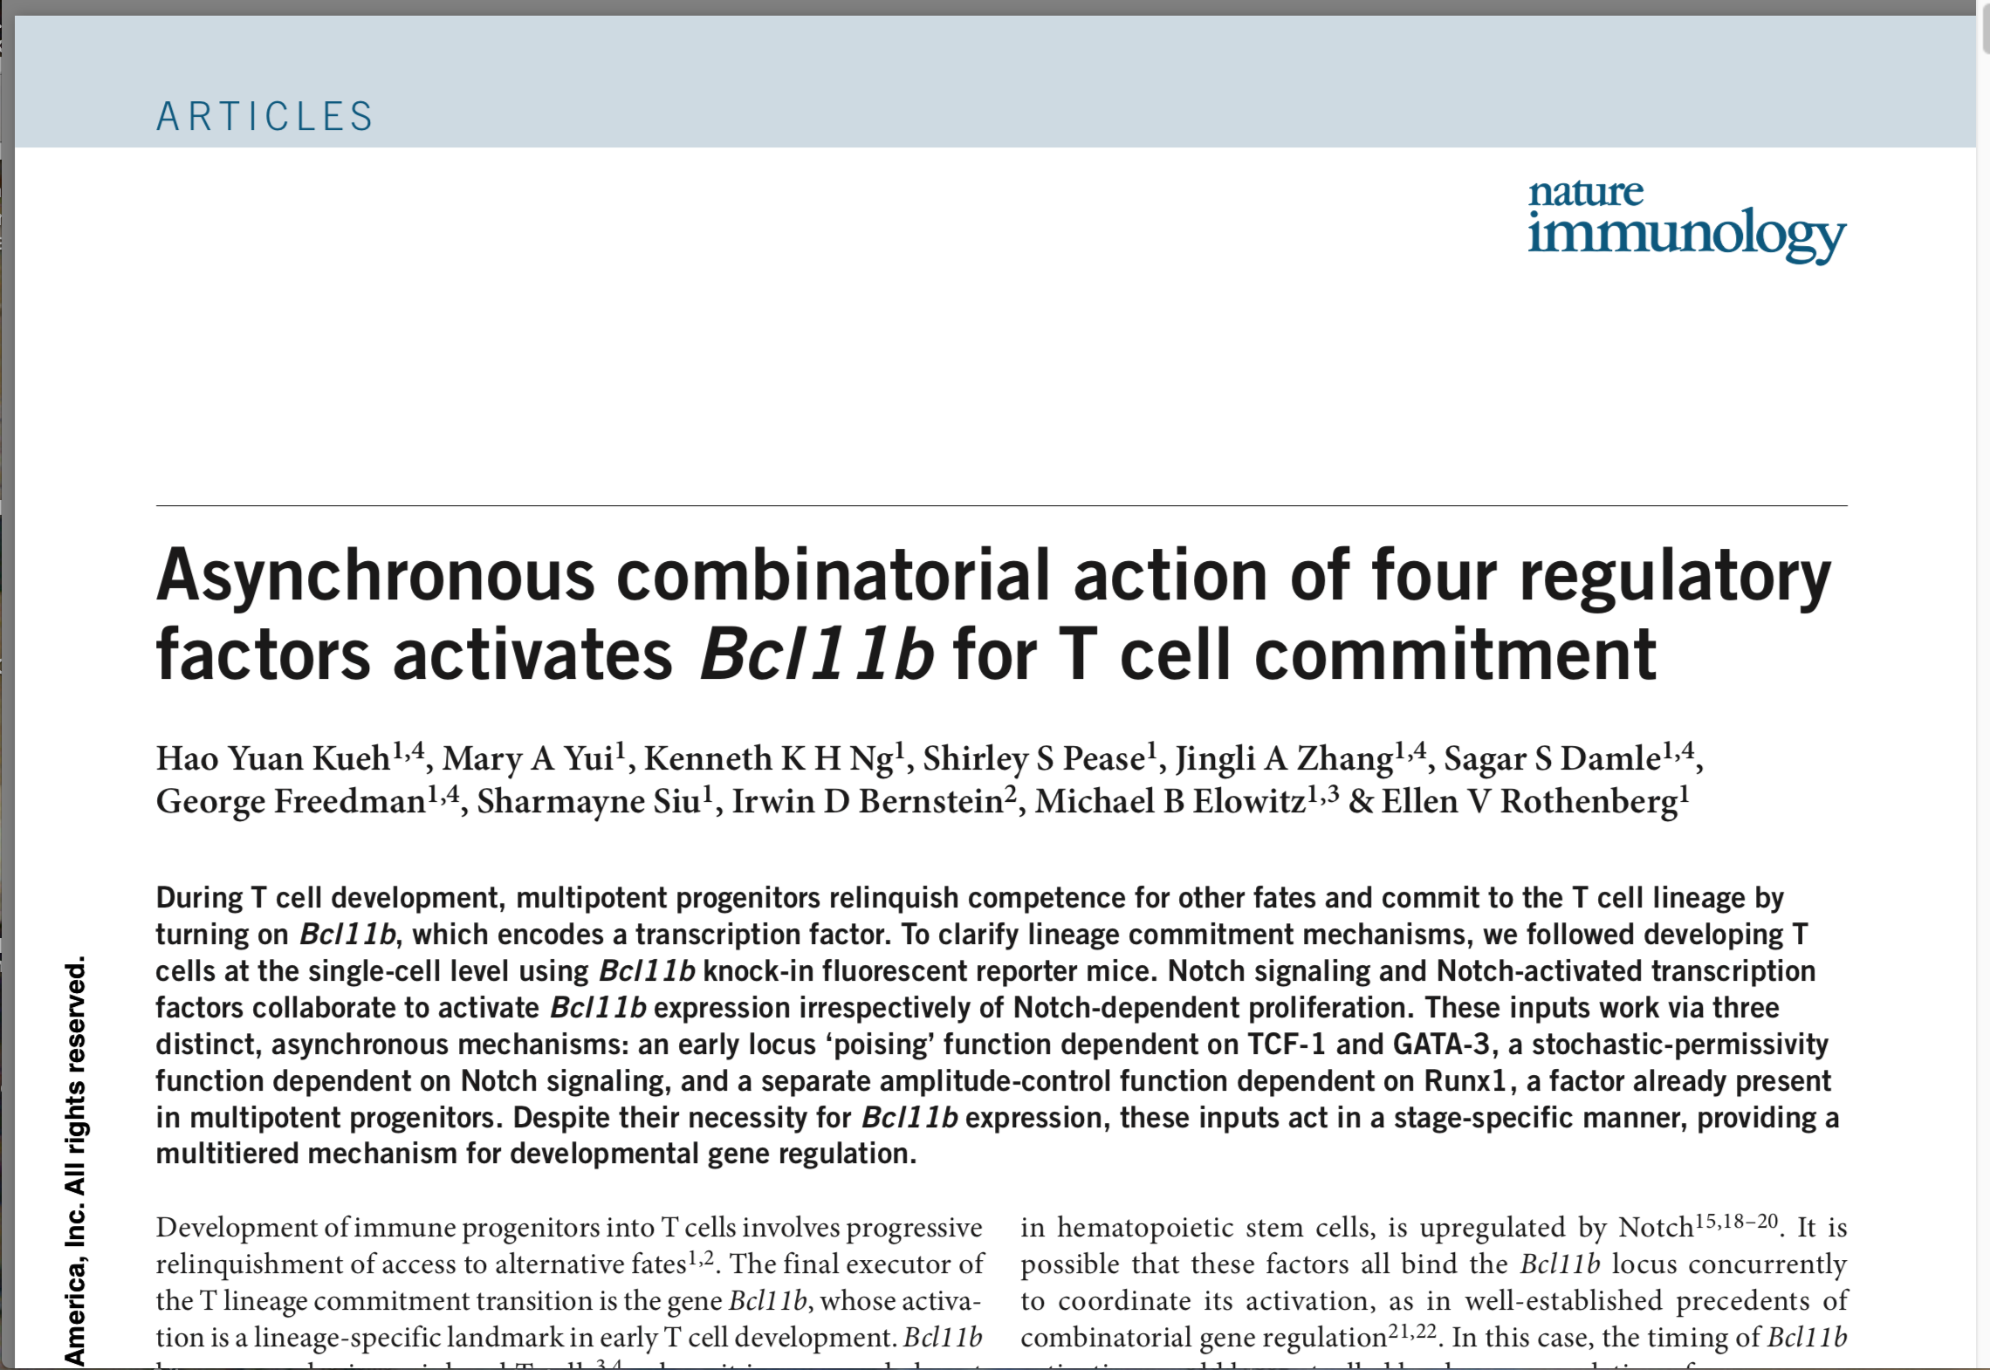

Slide 14
SIMPLIFIED WORKFLOW
Wodarz math’ model
Kueh non_math’ model
Mathematical correlations
Wodarz – Kueh correlation model

Slide 15
Questions ?

