Slide 1
Renting vs. Home Ownership in NYC
Diego Buonovino, Tom Fijalkowski

Slide 2
The Problem
COVID-19 disproportionately affected high-density, low-income neighborhoods
COVID has caused unemployment within these areas
These neighborhoods have a low percentage of private home ownership
There is going to be a very high demand for government subsidies in the form of rent relief

Slide 3
Our Theory
Home ownership is a better option than renting
Cheaper
Long-term financial well-being
Stabilizes the neighborhood

Slide 4
Target Questions
Is home ownership increasing or decreasing?
What is happening with pricing of houses and rental costs?
Is income sufficient for increased housing costs?
If a family could afford the down payment, what would the mortage payment be compared to the rent in the same neighborhood?
How has COVID-19 affected our hypothesis?

Slide 5
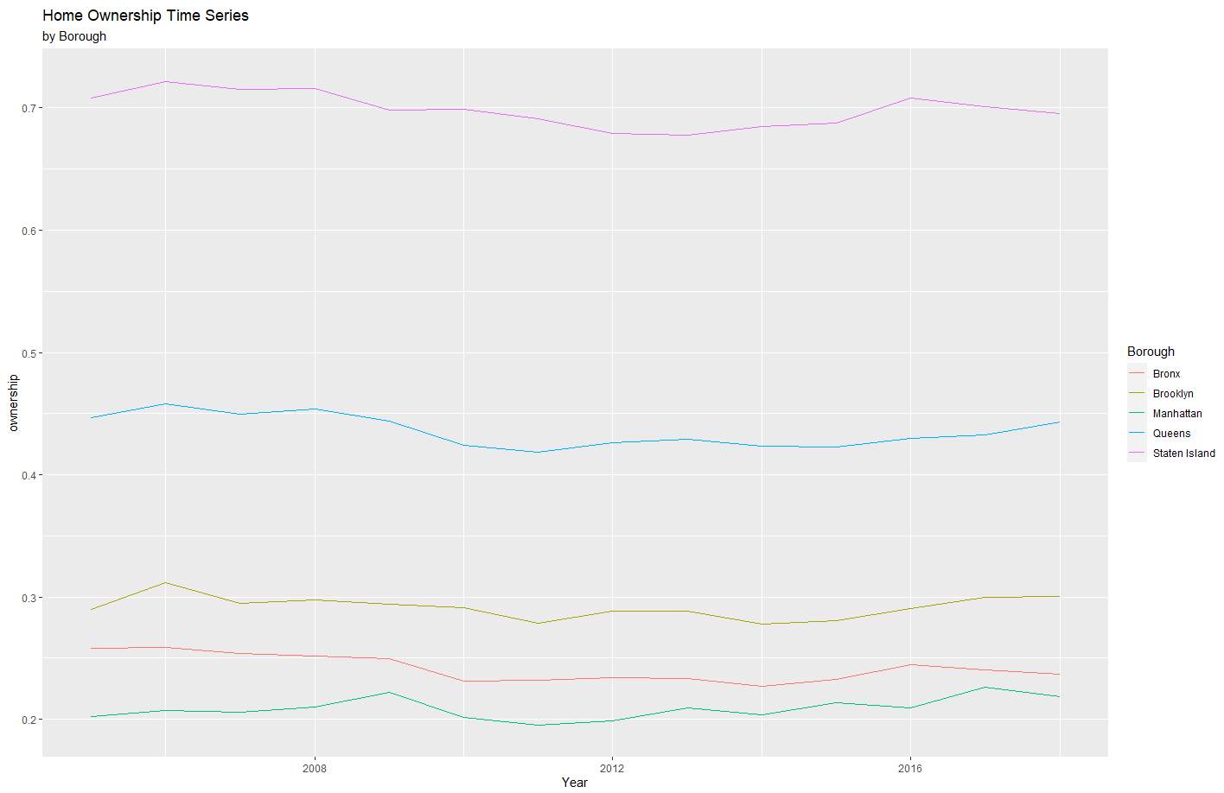
Is home ownership increasing?
Homeownership has stayed consistent from 2005 – 2013 with all boroughs except Staten Island having less than 50% of it's residents actually own a house
We want to ignore rent statistics when it comes to Staten Island because they represent a minority and not all of Staten Island

Slide 6
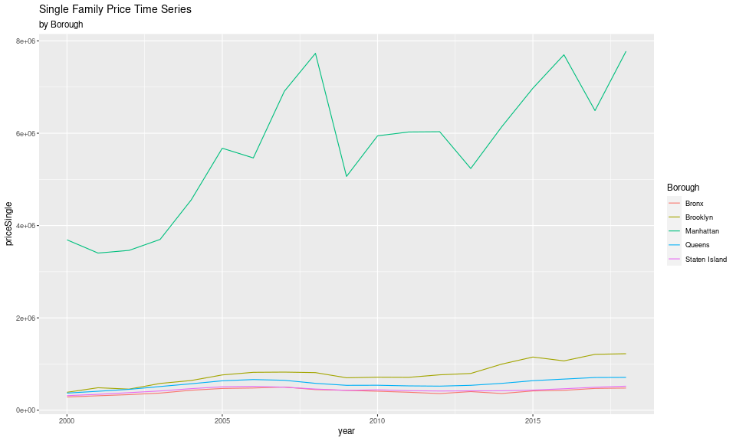
Price of Houses
Price of single-family houses stable within Bronx, Queens, and Staten Island
Brooklyn price of single-family houses slightly higher increase than previous 3 boroughs

Slide 7
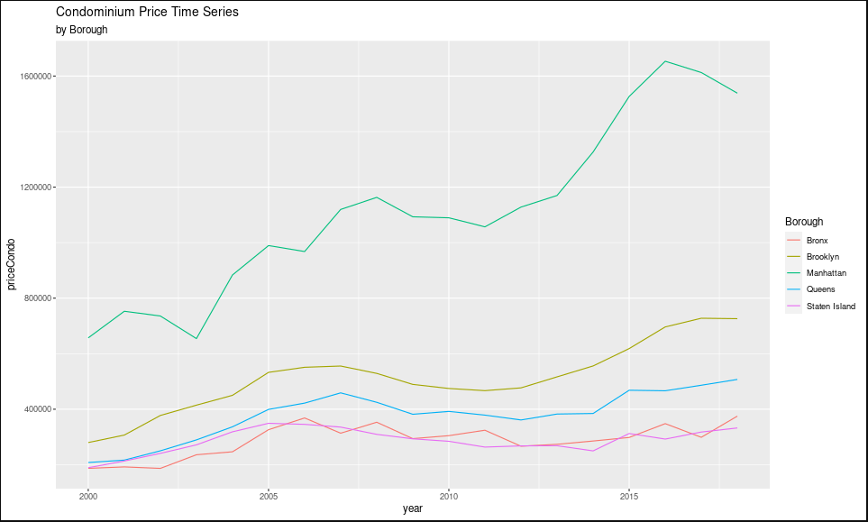
Price of Condos
Price of Condos also increasing similar to houses in the same borough

Slide 8
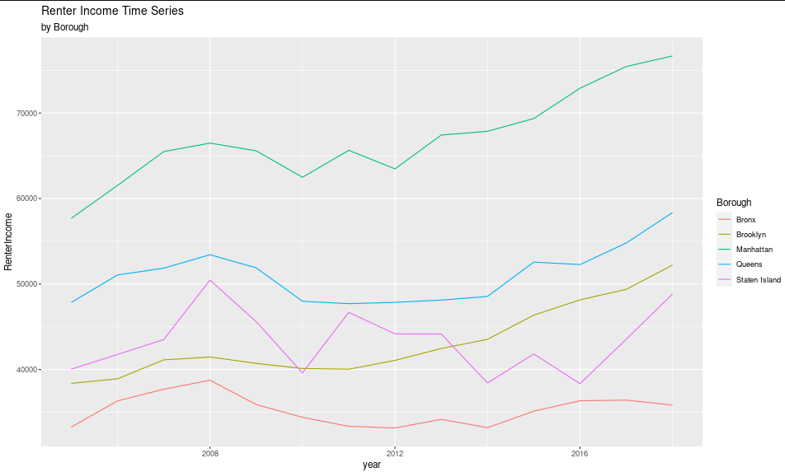
Renter Income
Renter income increasing in all boroughs except Bronx
Bronx renter income maintained the same since 2005

Slide 9
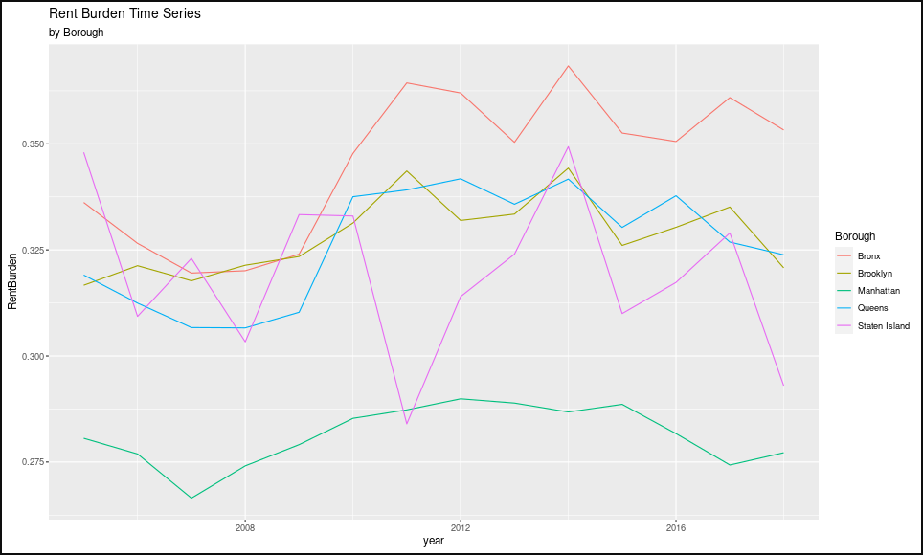
Renter Burden
Rent burden increasing even though renter incomes are increasing

Slide 10
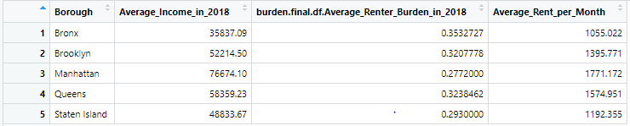
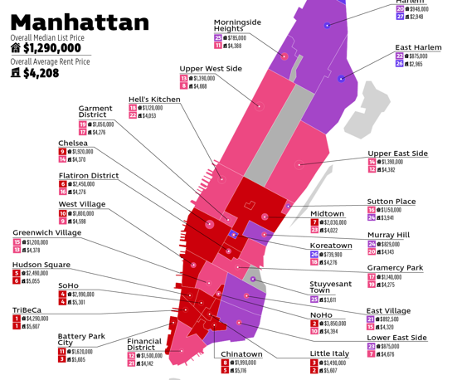
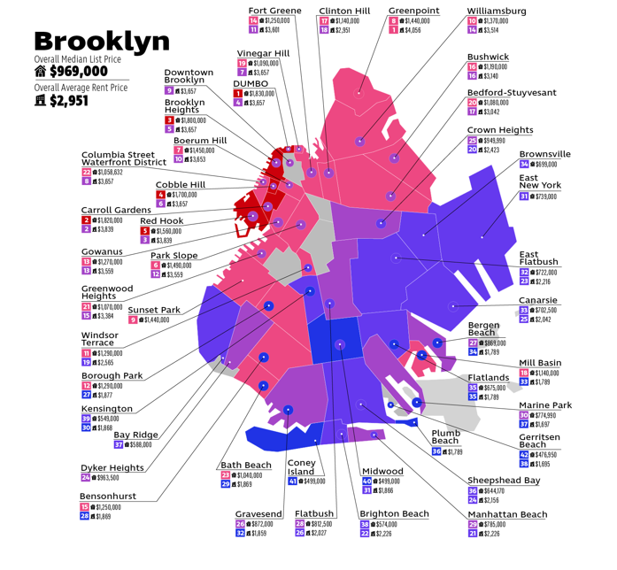
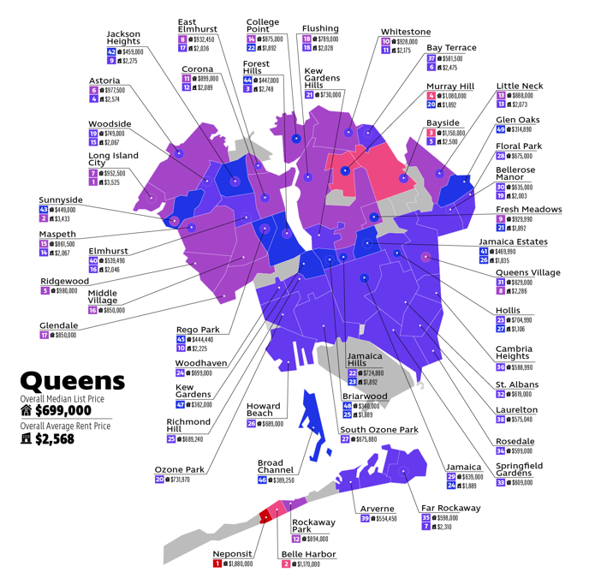
Average Rent per Borough in 2018
(Average Renter Income x Rent Burden)/ 12 months didn't produce accurate results, so we used external sources to see much higher average rents
- Statistics were not available for S.I. and Bronx

Slide 11
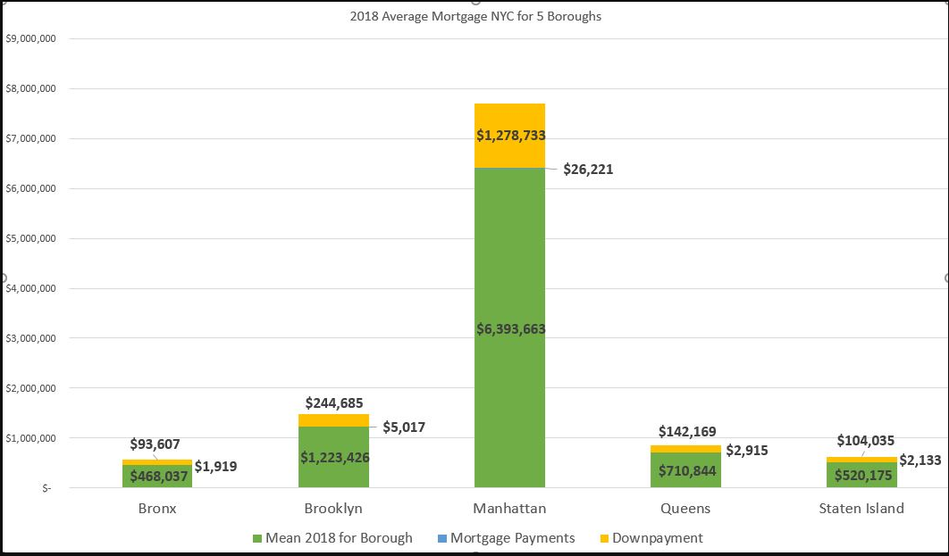
Average Mortgage Payment per Borough
Short-term: renting is more price effective than buying
Long-term: mortgaging is better than renting
Appreciation
Stability
Government loan programs to qualify for $0 down payment

Slide 12

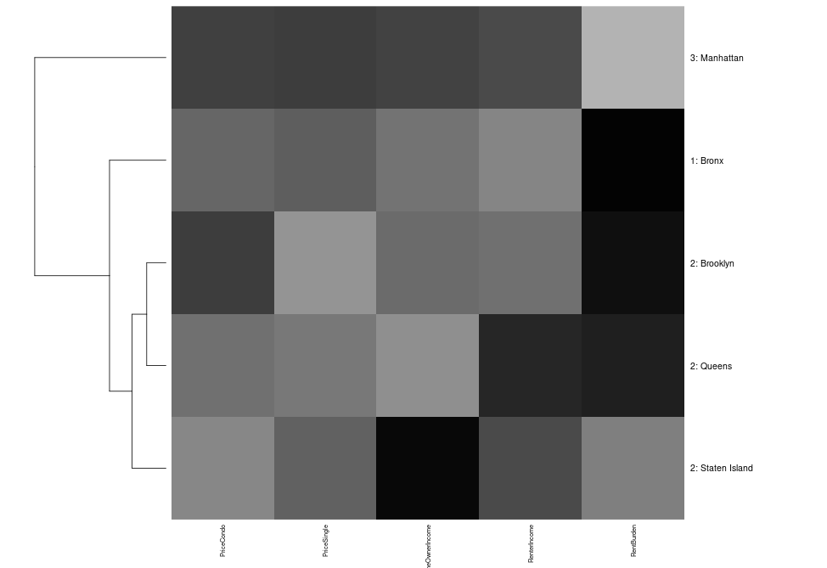
Boroughs
We want to identify which boroughs need the most government help
Manhattan is in its own cluster, which is very well off
Bronx is in its own cluster because how low renter income and high rent burden are
Cluster 2 has 3 boroughs with some wealthy neighborhoods and poor neighborhoods – let's take a deeper dive

Slide 13
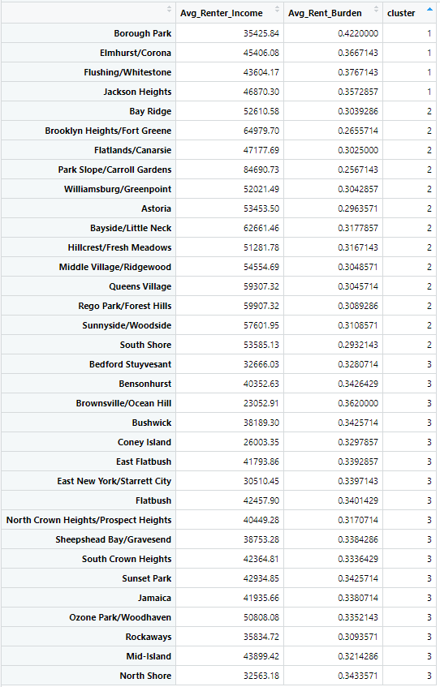

Sub-Boroughs
Cluster Group 1 has the highest rent burden
Cluster Group 3 has the lowest average rent income
We want to give government subsidies to neighborhoods in cluster 1 & 3

Slide 14
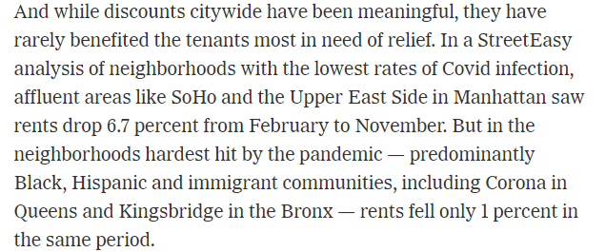
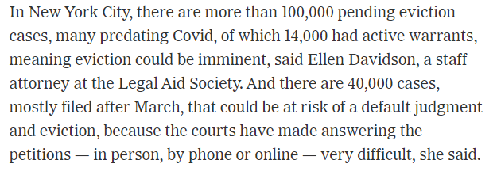
COVID-19
Since our data only went to 2018, we had to use external resources for COVID data
Even though COVID affected price of rents in NYC, it was mainly in Manhattan and the wealthier areas
The hard-hit sub-boroughs (Cluster 1 & 3) had rent only fall by 1% compared to 6-14% in affluent sub-boroughs
"100,000 pending evictions"
https://www.nytimes.com/2020/12/25/realestate/nyc-real-estate-market.html

Slide 15
Conclusion
Price of houses and condominiums aren't as exponential as rent prices based on rent burden
Owning a house would be better long-term because of the implied benefits
All of Bronx needs government subsidies, while only some of the neighborhoods in Brooklyn, Queens, and Staten Island need help
Manhattan doesn't need any government subsidies

Slide 16
Works Cited
The New York Times. (2020, December 29). The real estate collapse of 2020. The New York Times. Retrieved November 30, 2021, from https://www.nytimes.com/2020/12/25/realestate/nyc-real-estate-market.html.
Parker Waichman LLP. (n.d.). The New York City rent and housing prices by borough. Your Lawyer. Retrieved November 30, 2021, from https://www.yourlawyer.com/library/nyc-housing-prices-by-borough-and-neighborhood/.

