Slide 1
PostgreSQL

Slide 2
Download PostgreSQL
PostgreSQL
  Version 9.4 to 10
  https://www.postgresql.org/download/
PostGIS (OSX)
  https://postgis.net/install/

Slide 3
Setting up PostGIS (Windows)

Slide 4
Use stack builder
Ignore the versions on the graphics.
If anything doesn’t work. Remove completely and try install again.

Slide 5
Important Things
Install PostgreSQL on port 5432
Install the PostGIS extension 64bit (only install one version)
Create a spatial database
You can enable all of the GDAL Environment variables
user = postgres
password = postgres
Your connection to your local PostrgreSQL database will be
psql –d <database> -U <username>

Slide 6
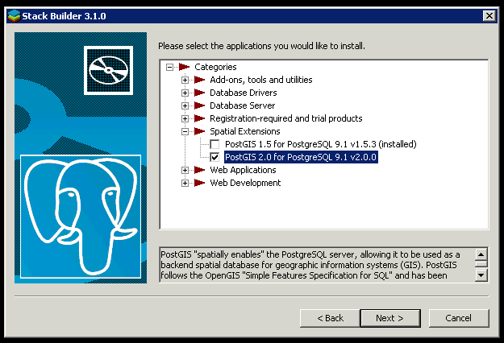
Add the PostGIS extension

Slide 7
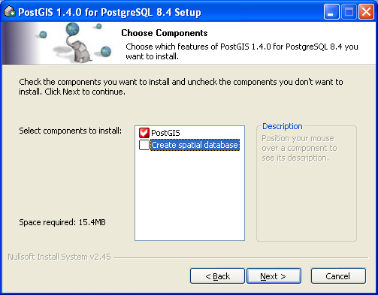
Create Spatial Database

Slide 8
Setting up a Database

Slide 9
Setting up a Database
When you install PostgreSQL you will choose
User = postgres
Password = postgres
You can change the password but you want it to be something you will never forget.

Slide 10
Setting up your USER
The user(name) and database should be the same name
  You can always create additional databases with new names
CREATE ROLE student;
CREATE DATABASE student;
ALTER ROLE student PASSWORD 'student'

Slide 11
SuperUser
To have full access on your new database cluster, you should provide the user with the superuser capabilities.
  CREATE, DROP, SELECT,
ALTER ROLE student with SUPERUSER;
ALTER ROLE student with CREATEDB CREATEROLE LOGIN;

Slide 12
Enable PostGIS
Connect to your new database
CREATE EXTENSION postgis();

