Slide 1












a
T_{θ} = 0.1s
b
θ-modulation of firing rate
c
STDP learning rule
d
Synaptic weight matrix, W_{ij}
e
Successor matrix, M_{ij}
2π
1
1
ΔW_{ij}
π
Postsynaptic cell i
Location i
θ-phase
30ms
t_{i} - t_{j}
0
0
-0.8
0
½
1
Fraction of distance through field
Presynaptic cell j
Location j

Slide 2
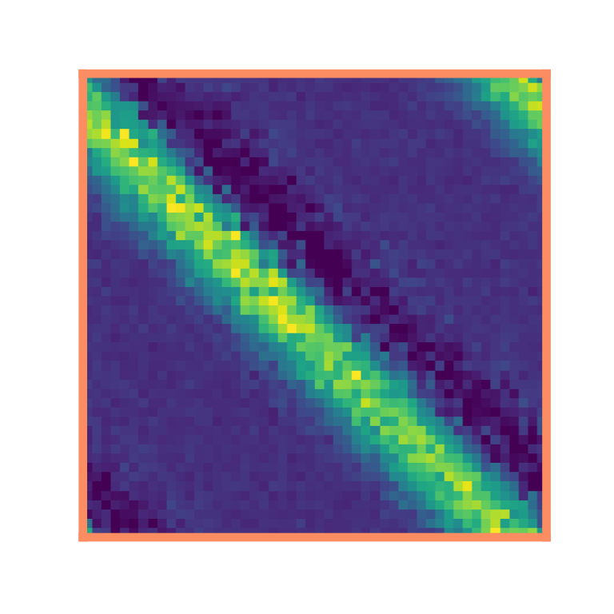
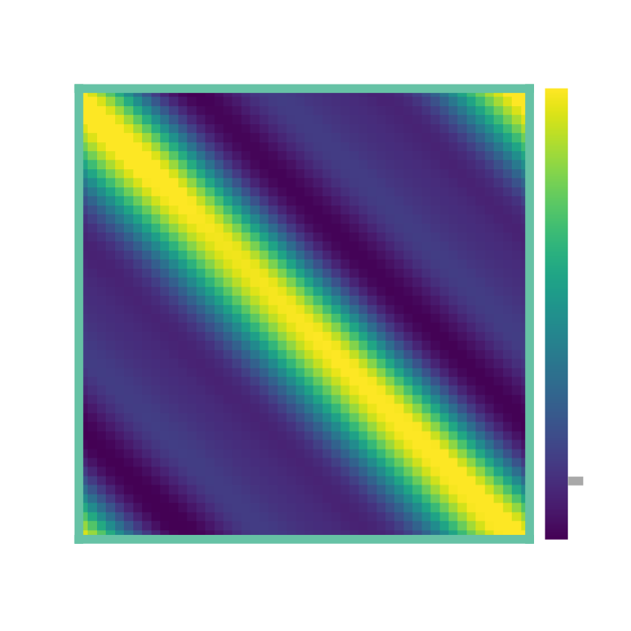
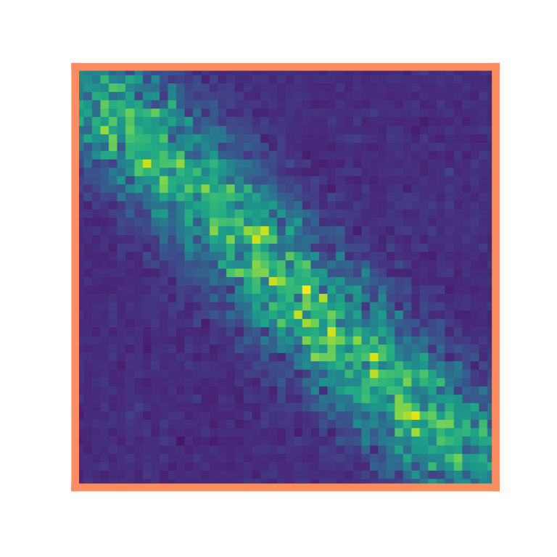
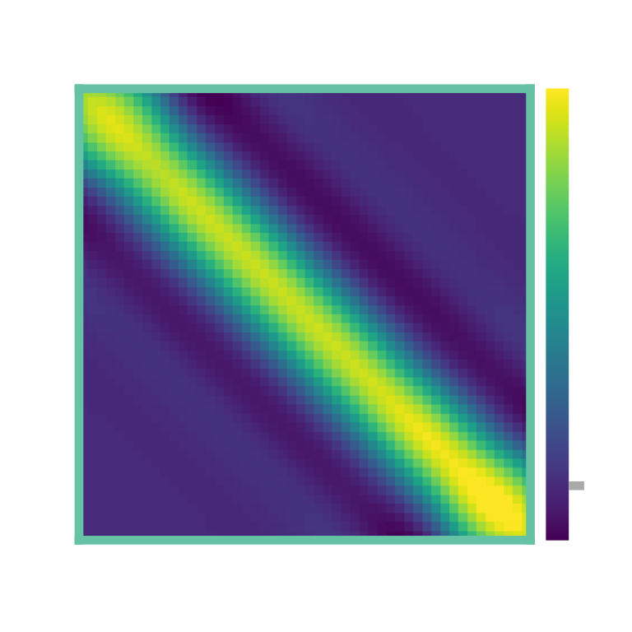
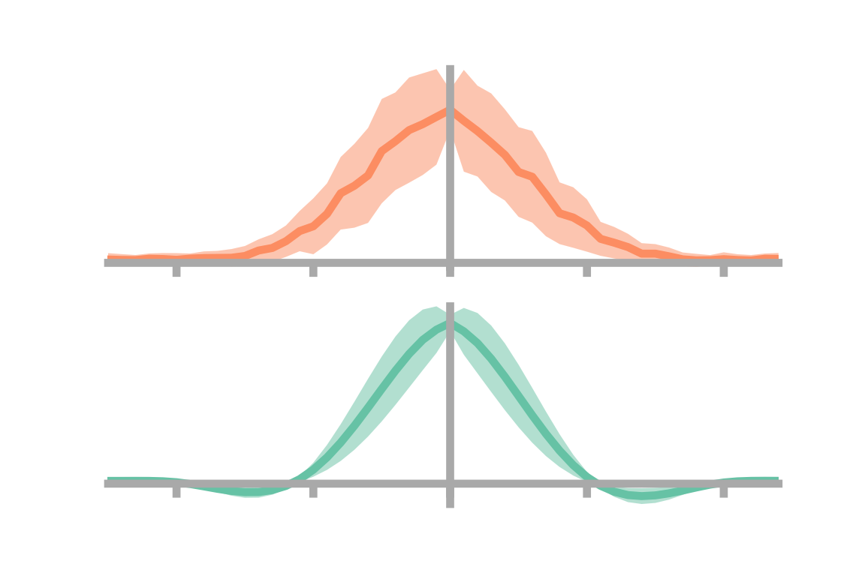
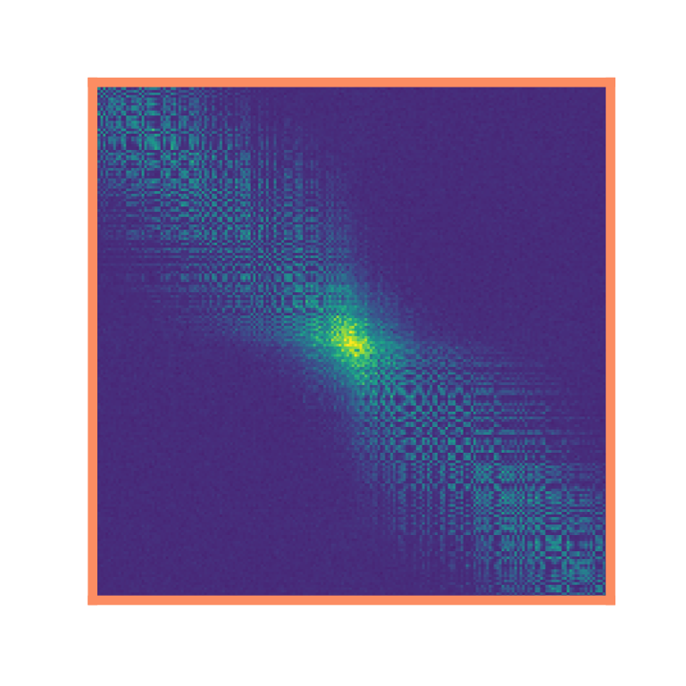
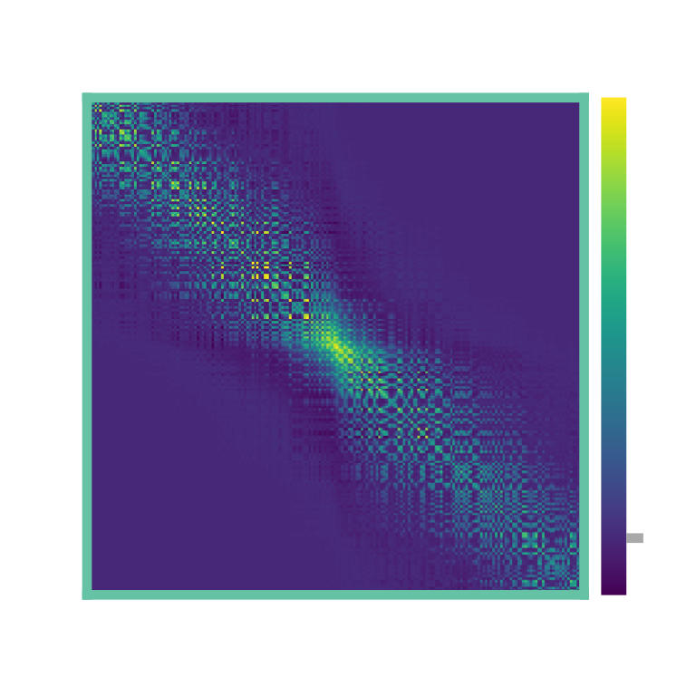
a
σ = 1 m
1D loop maze
b
Synaptic weight matrix, W_{ij}
c
Successor matrix, M_{ij}
d
i
e
0
-2
-1
x_{i} – x_{j} / m
1
2
j
f
1D corridor maze
g
h
i
j
0
-2
-1
2
x_{i} – x_{j} / m
1
k
2D two room maze
l
m
0

Slide 3



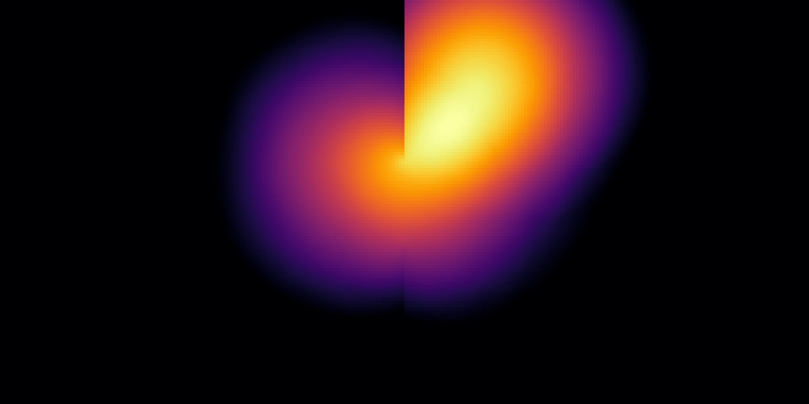
a
σ = 1 m
1D loop maze
Basis Cell
Place Cell
b
1D corridor maze
BC
PC
c
2D two room maze
2D two room maze
BC
σ = 1 m
BC
PC
PC

Slide 4
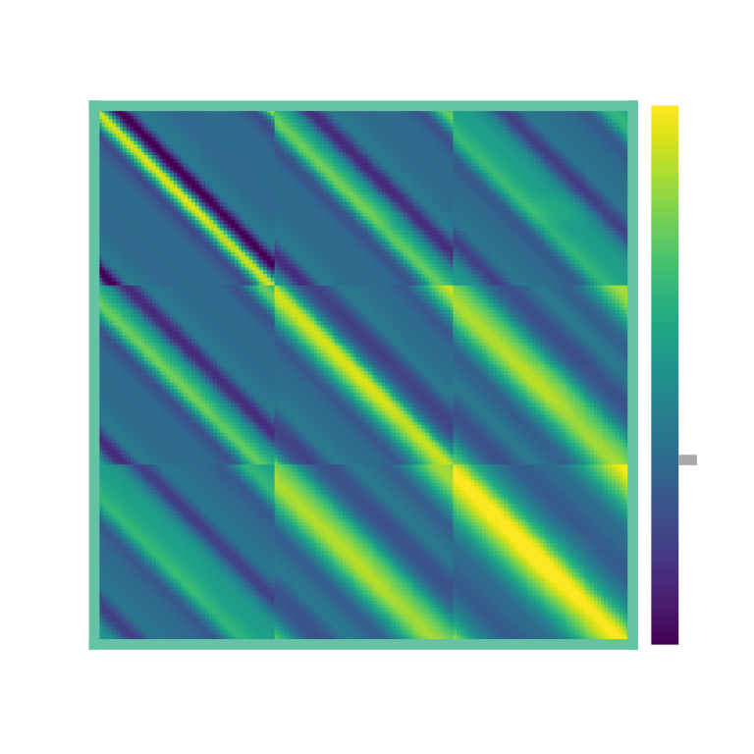

a
b
10
8
Dorsal
STDP SR timescale / s
6
HPC
4
2
Ventral
0
0
0.5
1
1.5
2
Basis cell size, σ / m
σ = 0.5 m
c
σ = 1 m
σ = 1.5 m
d
Synaptic weight matrix, W_{ij}
e
Successor matrix, M_{ij}
σ = 0.5 m
σ = 1 m
0
σ = 1.5 m

