Slide 1






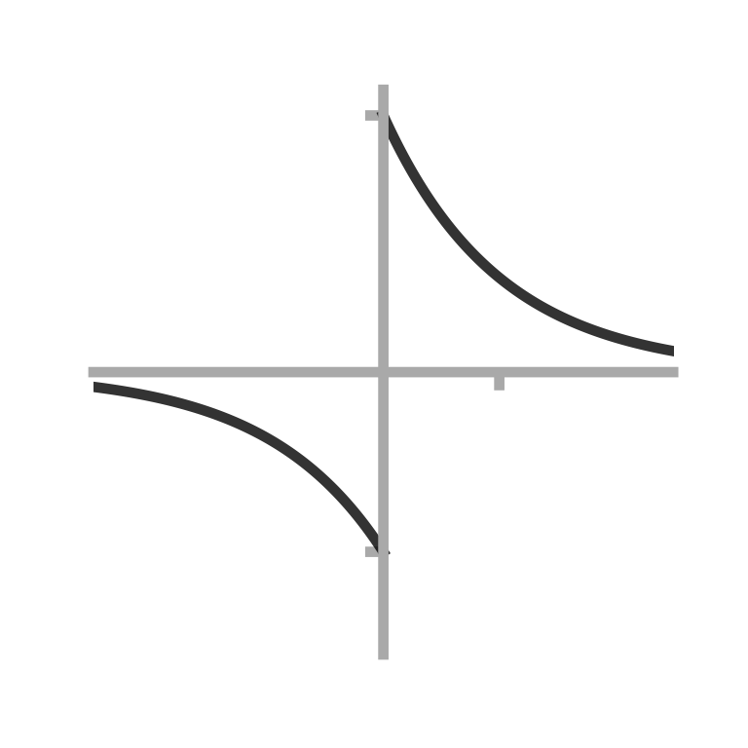






a
T_{θ} = 0.1s
b
θ-modulation of firing rate
c
STDP learning rule
d
Synaptic weight matrix, W_{ij}
e
Successor matrix, M_{ij}
2π
1
1
ΔW_{ij}
π
Postsynaptic cell i
Location i
θ-phase
20ms
t_{i} - t_{j}
0
0
-0.7
0
½
1
Fraction of distance through field
Presynaptic cell j
Location j

Slide 2
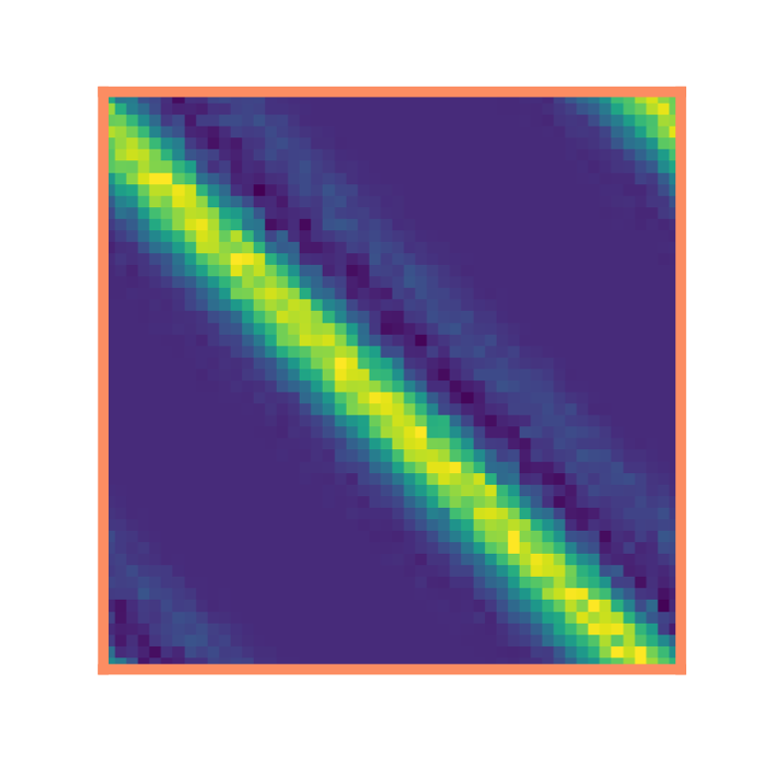
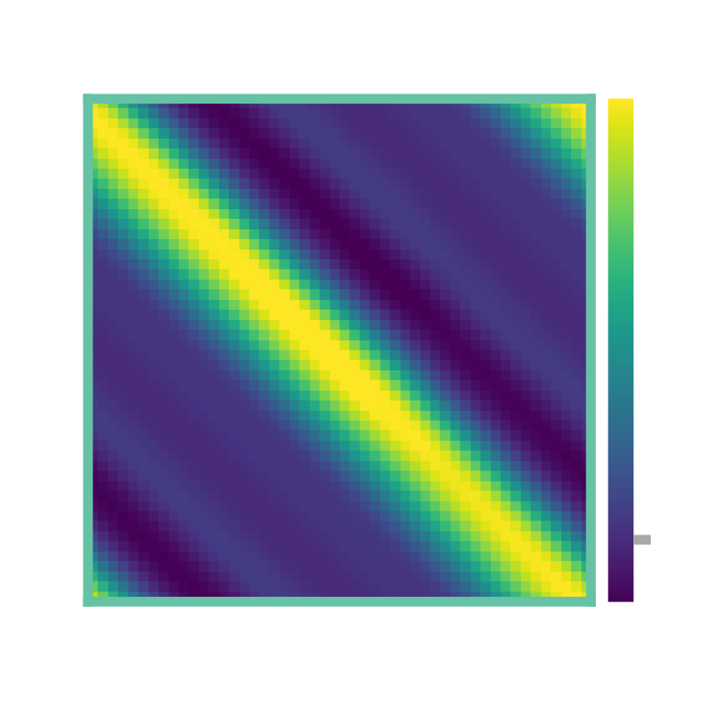
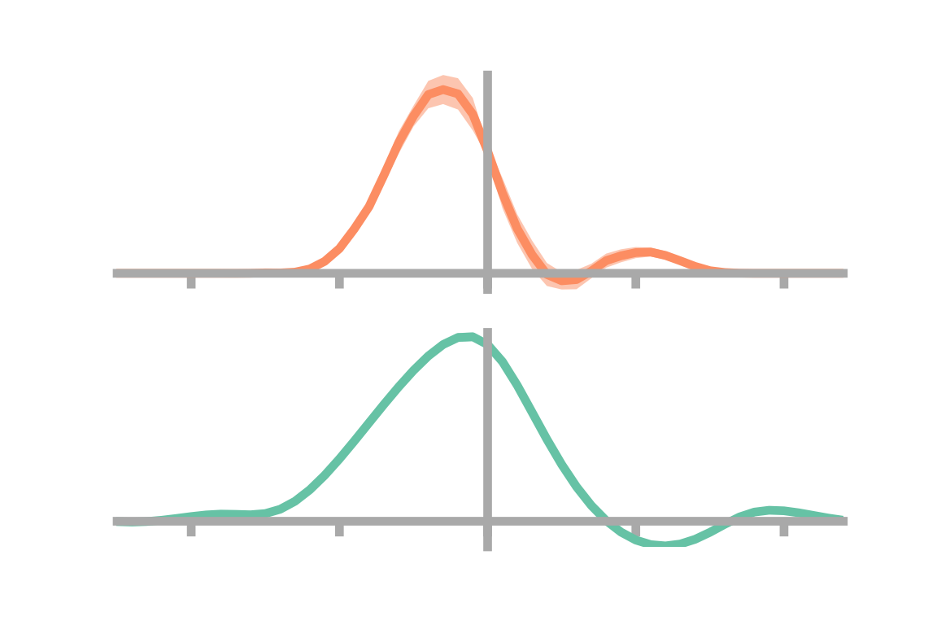
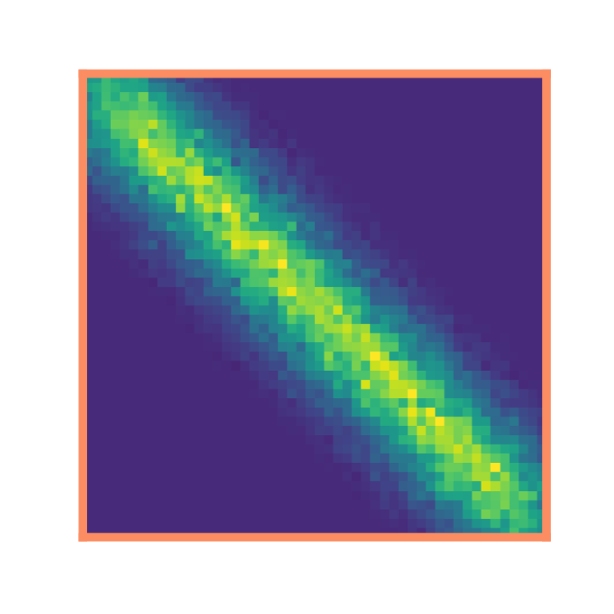

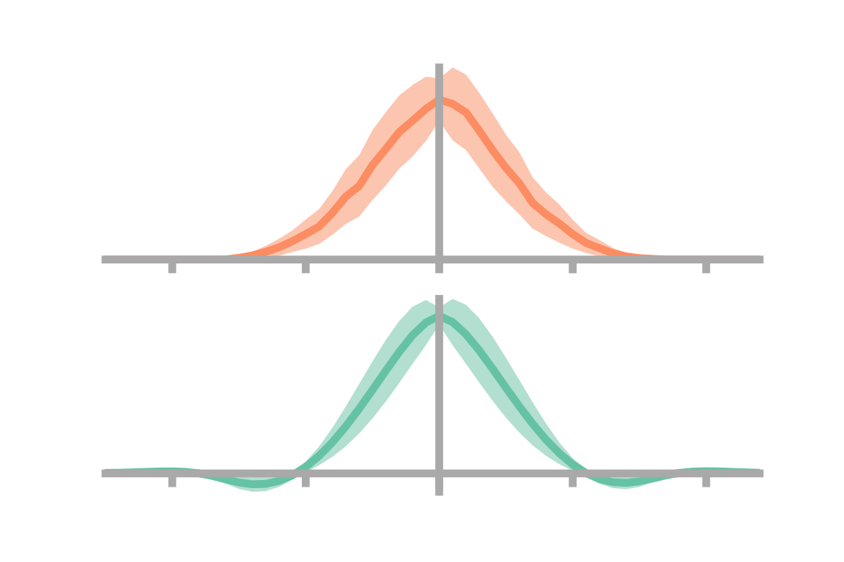
a
b
Synaptic weight matrix, W_{ij}
c
Successor matrix, M_{ij}
d
i
e
0
-2
-1
x_{i} – x_{j} / m
1
2
j
f
g
h
i
j
0
-2
-1
2
x_{i} – x_{j} / m
1
k
l
m
0

Slide 3




a
b
c
d

Slide 5
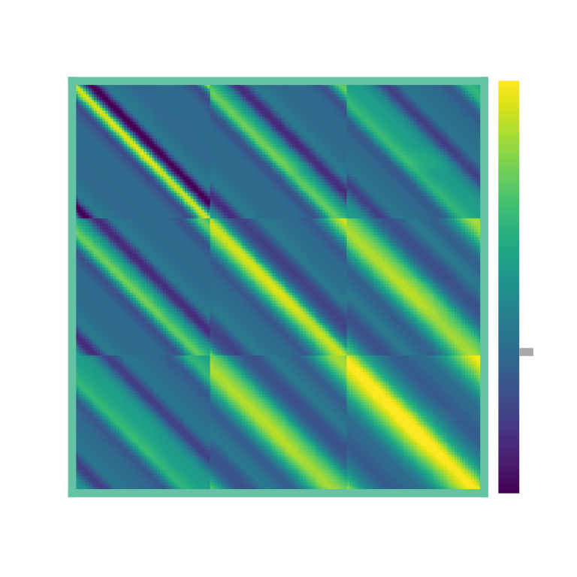

a
10
b
8
Dorsal
STDP SR timescale / s
6
HPC
4
2
Ventral
0
0
0.5
1
1.5
2
Basis cell size, σ / m
c
d
Synaptic weight matrix, W_{ij}
e
Successor matrix, M_{ij}
σ = 0.5 m
σ = 1 m
0
σ = 1.5 m

