Slide 1


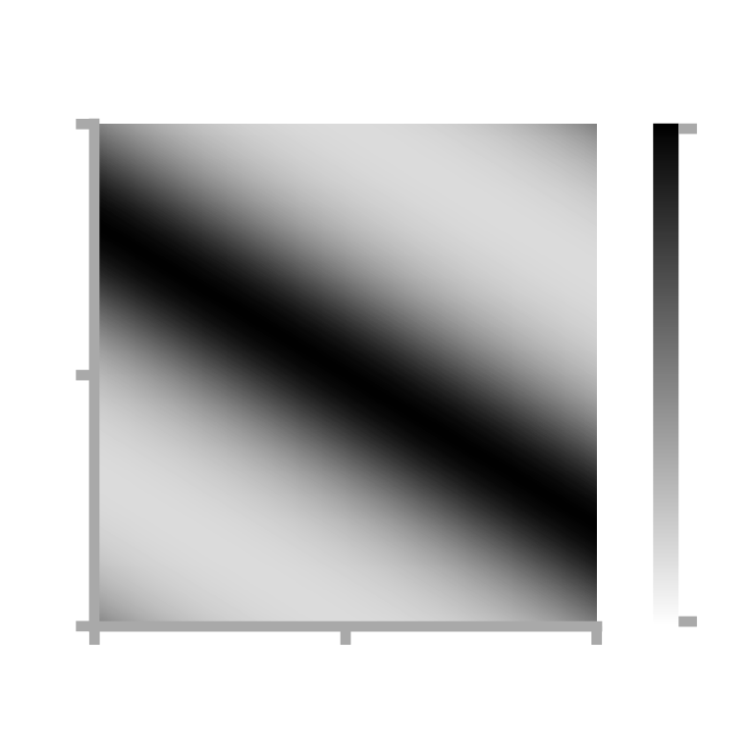


a
T_{θ} = 0.1s
“Theta
sweep”
b
θ-modulation of firing rate
c
STDP learning rule
d
Synaptic weight matrix, W_{ij}
e
Successor matrix, M_{ij}
2π
1
ΔW_{ij}
1
π
Postsynaptic cell i
Cell i
θ-phase
τ⁻ = 40 ms
t_{i} - t_{j}
τ⁺ = 20 ms
0
0
-0.4
0
½
1
Fraction of distance through field
Presynaptic cell j
Cell j

Slide 2
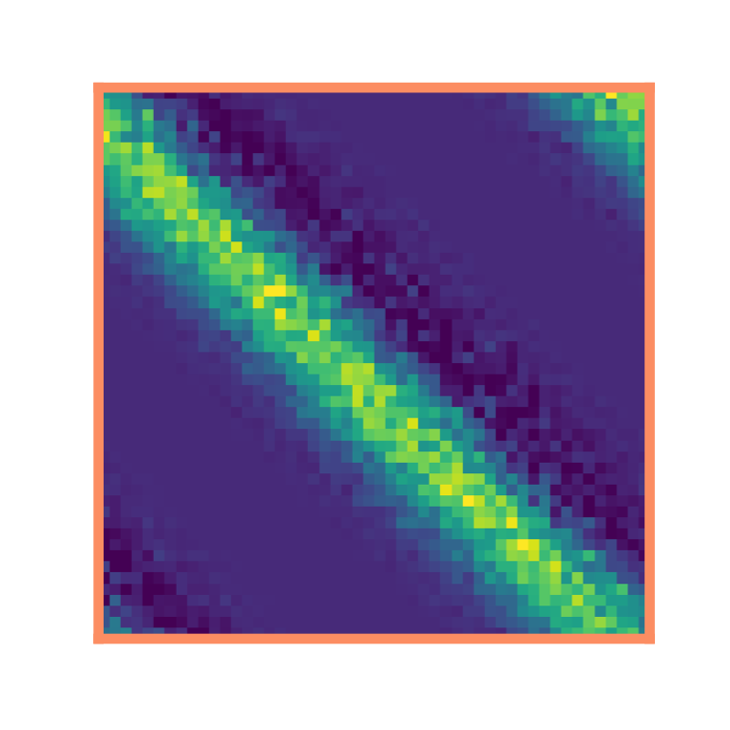
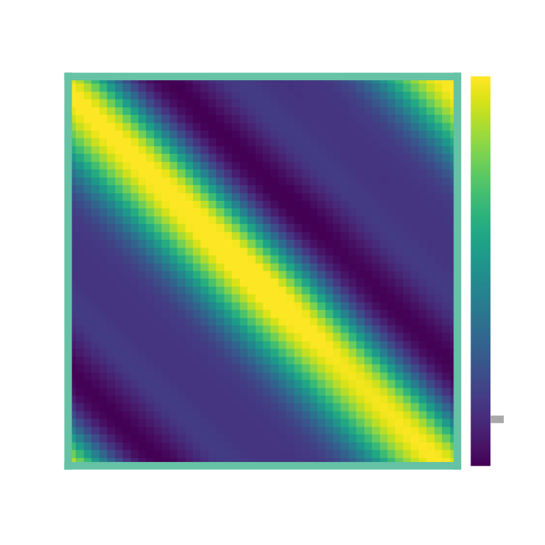
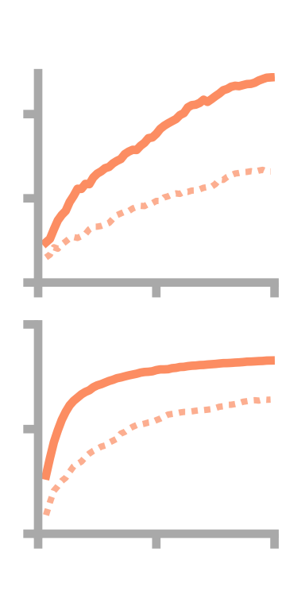
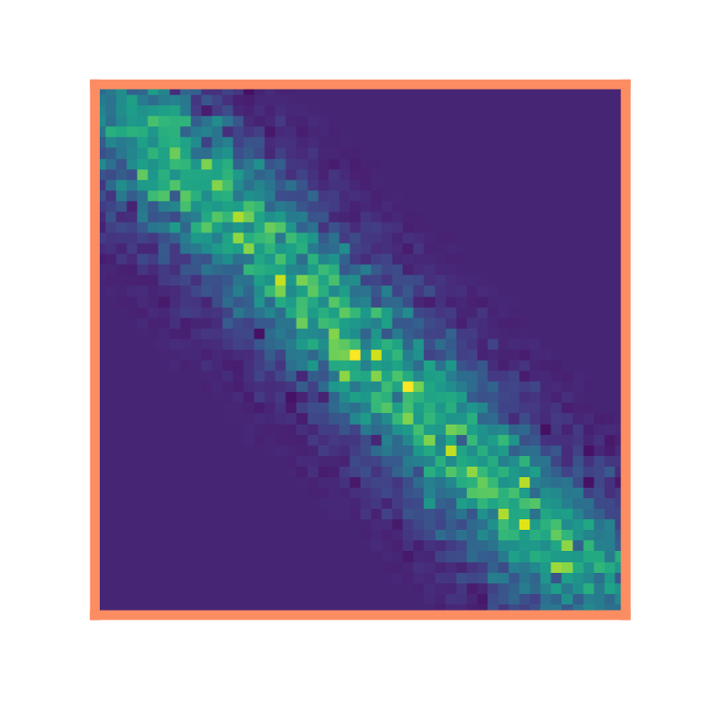
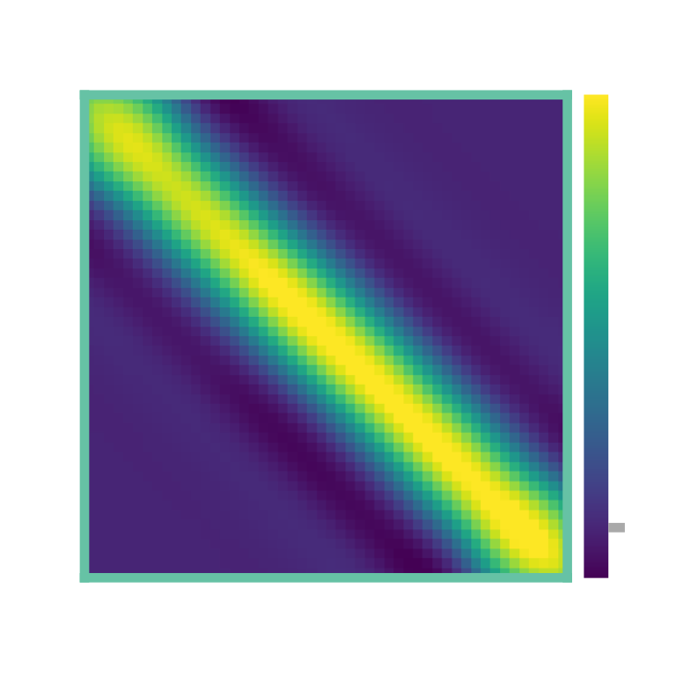
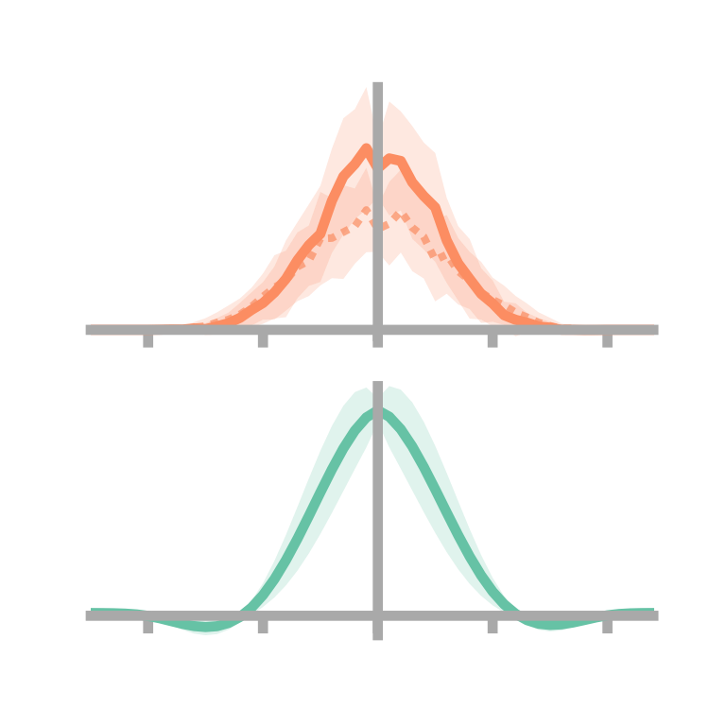
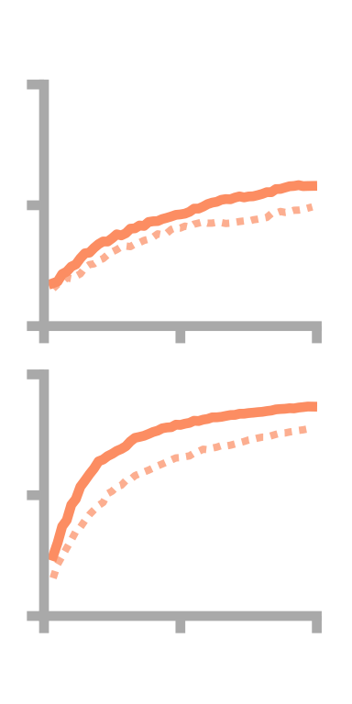
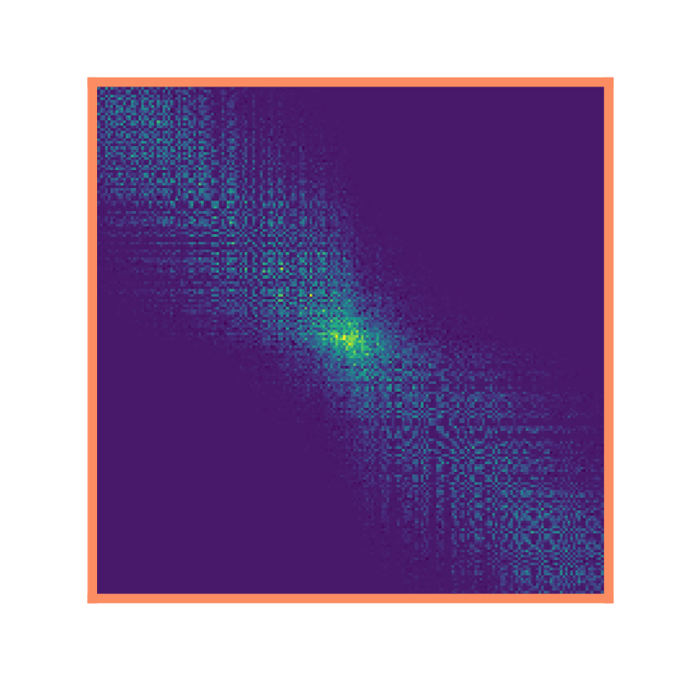
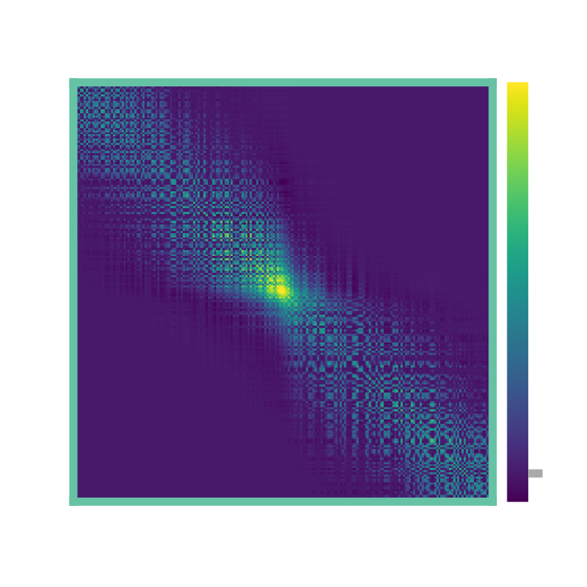
a
σ = 1 m
1D loop maze
b
Synaptic weights, W_{ij}
c
Successor matrix, M_{ij}
d
θ
e
No θ
4
SNR
2
i
0
1
R²
0
½
j
-2
-1
1
2
0
x_{i} – x_{j} / m
0
15
30
Learning time / min
f
1D corridor maze
g
h
i
j
4
2
SNR
i
0
1
R²
0
½
j
-2
-1
1
2
0
x_{i} – x_{j} / m
0
15
30
k
l
m
Learning time / min
2D two room maze
0

Slide 3

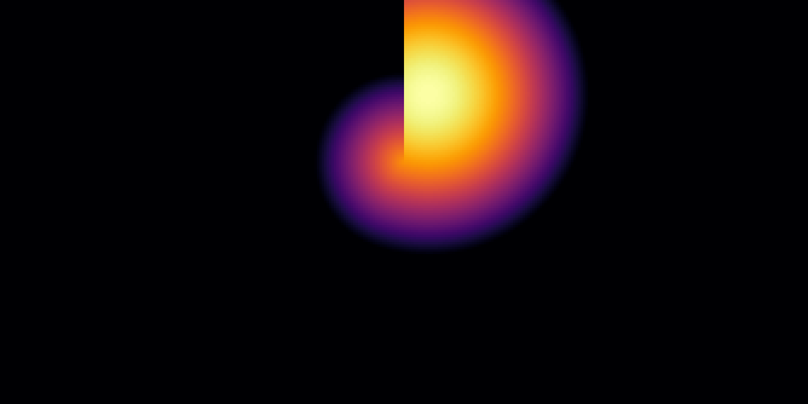


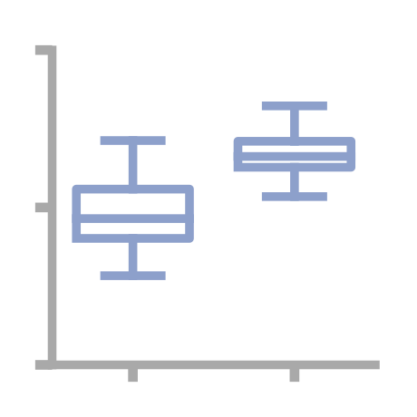
a
σ = 1 m
1D loop maze
skew = 0.00±0.00
Basis Feature
-0.20±0.06
Place Cell
b
1D corridor maze
0.00±0.00
BF
-0.01±0.06
PC
c
2D two room maze
d
2D two room maze
BF
e = 0.00
BF
PC
***
0.8
Eccentricity
0.4
e = 0.54
0
Cells
near
centre
Cells
near
wall
PC

Slide 4
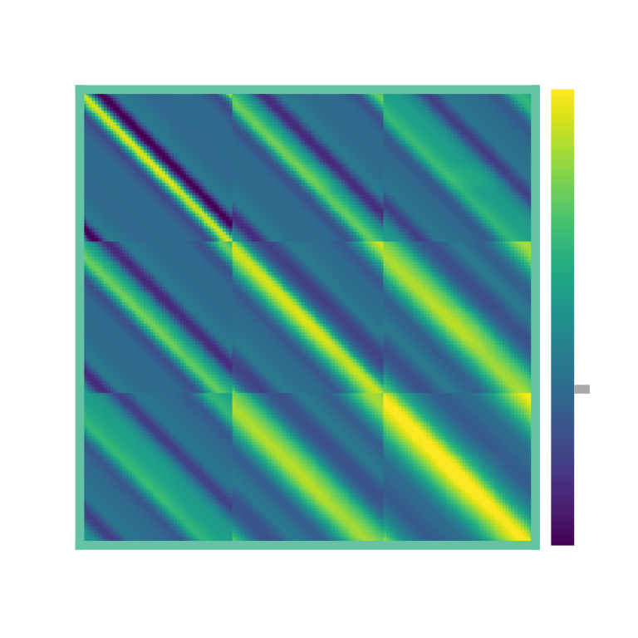
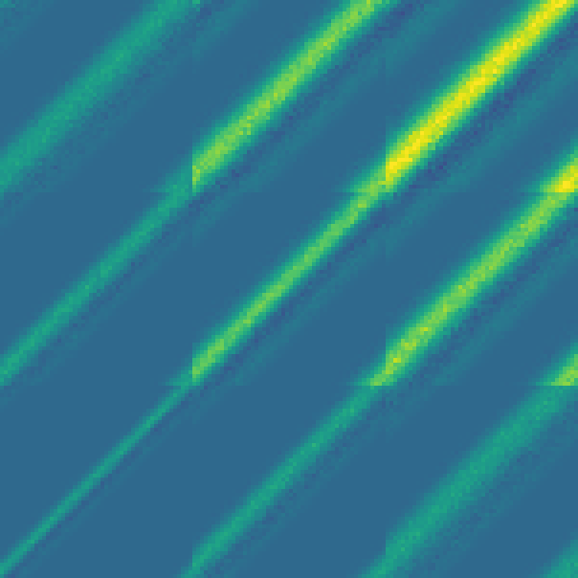
a
σ = 0.5 m
σ = 1 m
σ = 1.5 m
b
c
10
Dorsal
8
STDP matrix, W_{ij}
time horizon / s
HPC
6
4
Ventral
2
0
0
0.5
1
1.5
2
d
Synaptic weight matrix, W_{ij}
e
Basis cell size, σ / m
Successor matrix, M_{ij}
σ = 0.5 m
σ = 1 m
0
σ = 1.5 m

