Slide 1


Learning Successor Representations
(i) A generalized HPC model for learning SR and
(ii) Hebbian plasticity as an approximation to learning SR
Funky image
Tom George
Will de Cothi, Kim Stachenfeld & Caswell Barry

Slide 2

Successor theory
•
not
Cheap dot-product
over states.
If R(s) changes, all is not lost!
•
Discounted sum of future occupancies
TD learnable
•
1

Slide 3
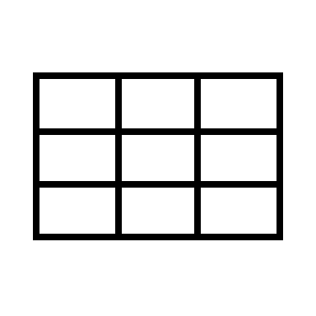

Successor theory and why it screams hippocampus
HOME
THAT ANNOYING
POT HOLE R=-5
•
•
STARBUCKS
R=+10
THE LAB
R=+100
•
1

Slide 4
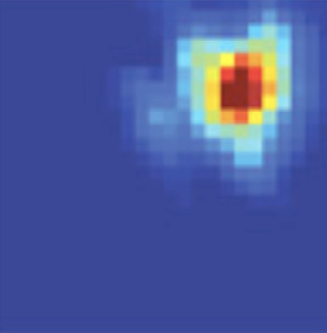
Successor theory and why it screams hippocampus
•
•
•
1

Slide 5
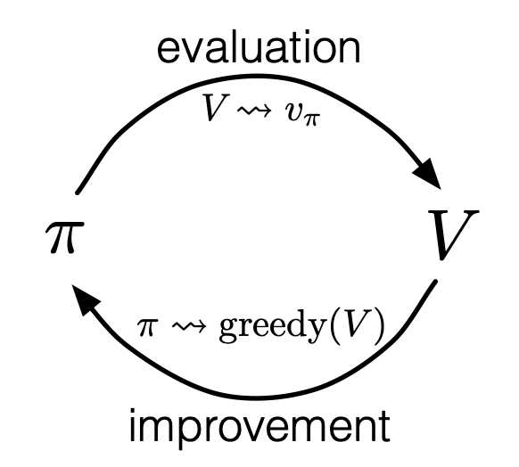
Successor theory and why it screams hippocampus
•
Fixed policy:
Policies often are fixed
Value learning still useful
Policy iteration:
•
•
1

Slide 6
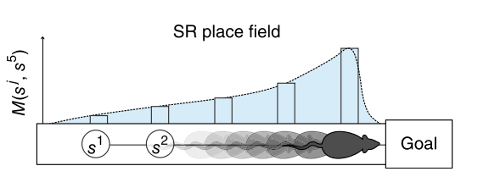
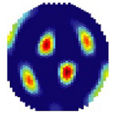
Successor theory and why it screams hippocampus
PLACE CELLS:
= “how well does state s predict future occurrence of state s’ “
•
•
GRID CELLS:
Encodes how locations connectivity.
M eigenvectors encode a spatial metric…aka grid cells
•
1

Slide 7
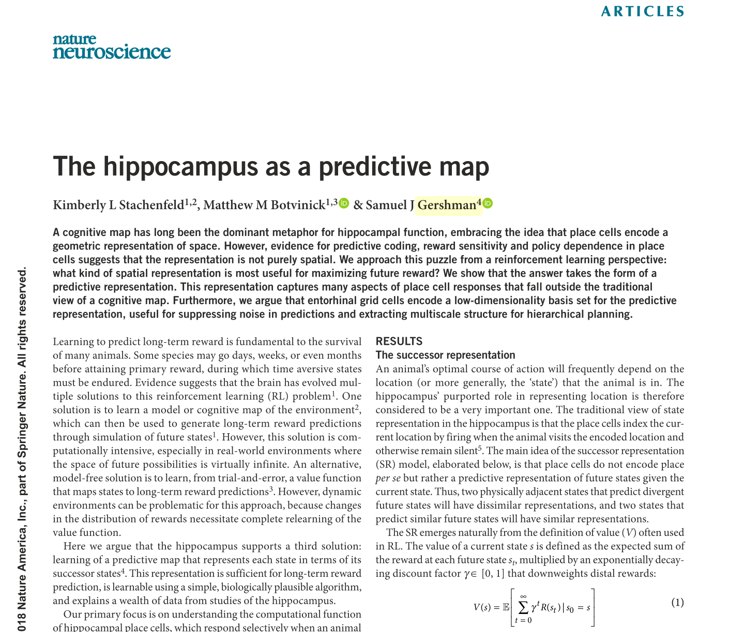
Successor theory and why it screams hippocampus
PLACE CELLS:
= “how well does state s predict future occurrence of state s’ “
•
•
GRID CELLS:
Encodes how locations connectivity.
M eigenvectors encode a spatial metric…aka grid cells
•
1

Slide 8
Roadmap
A state-general, space-and-time-continuous TD learning rule for SR
STDP as an approach to learning SR

Slide 9
Three problems with SR models
Discrete in space (boring)
Discrete in time (solved by Kenji) (interesting)
Limited to (unrealistic) one-hot state representations (interesting)

Slide 10
Continuous space
Discrete in space (boring)
Discrete in time (solved by Will)
Limited to (unrealistic) one-hot state representations (interesting)

Slide 11
Flexible and plausible state representations

Slide 12
Discrete time
Gamma is not independent of your (arbitrary) simulation parameters. Specifically it depends on dt.

Slide 13
Results
Multi maze, multi policy
Model works (grid cells, place cells)
Behavioural bias leads to skewed grid cells
Trivial implementation of rapid replay learning

Slide 14
Conclusions:
Models only need to be detailed when

Slide 15
Roadmap
A state-general, space-and-time-continuous TD learning rule for SR
STDP as an approach to learning SR

Slide 16
Issues with learning via TD
Physically how is this done
Is it necessary, aren’t most policies fairly simple

Slide 17
STDP: “cells that fire together, wire together”
Time scale issue

Slide 18
Theta sweeps could provide increase time scale to STDP range and increase training data

Slide 19
Implementation

Slide 20
STDP learning rule

Slide 21
Results

