Slide 1





a
T_{θ} = 0.1s
“Theta
sweep”
b
θ-modulation of firing rate
c
STDP learning rule
d
Synaptic weight matrix, W_{ij}
e
Successor matrix, M_{ij}
2π
1
ΔW_{ij}
1
(schematic)
(schematic)
π
Postsynaptic cell i
Cell i
θ-phase
τ⁻ = 40 ms
t_{i} - t_{j}
τ⁺ = 20 ms
0
0
-0.4
0
½
1
Fraction of distance through field
Presynaptic cell j
Cell j

Slide 2
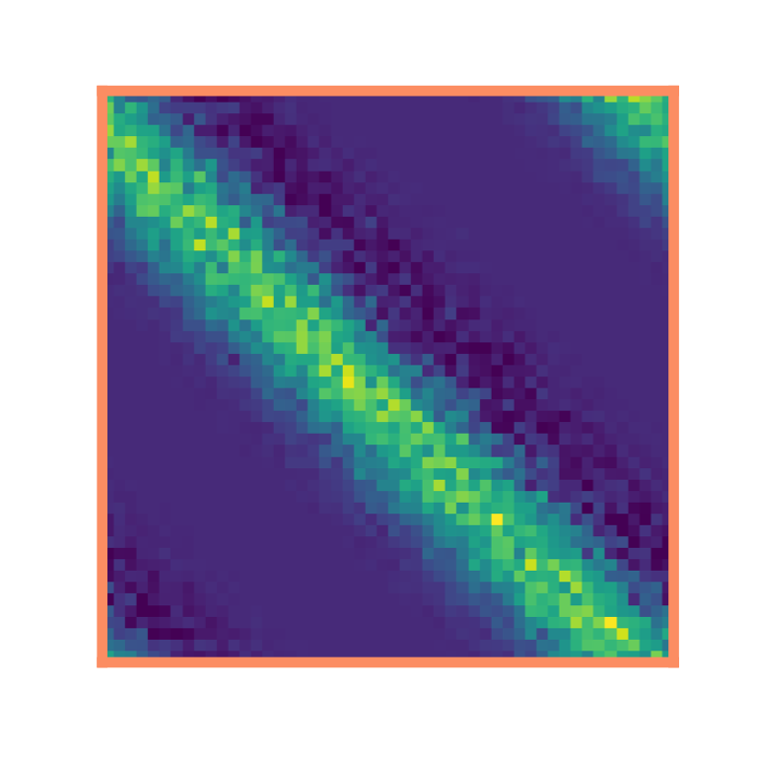
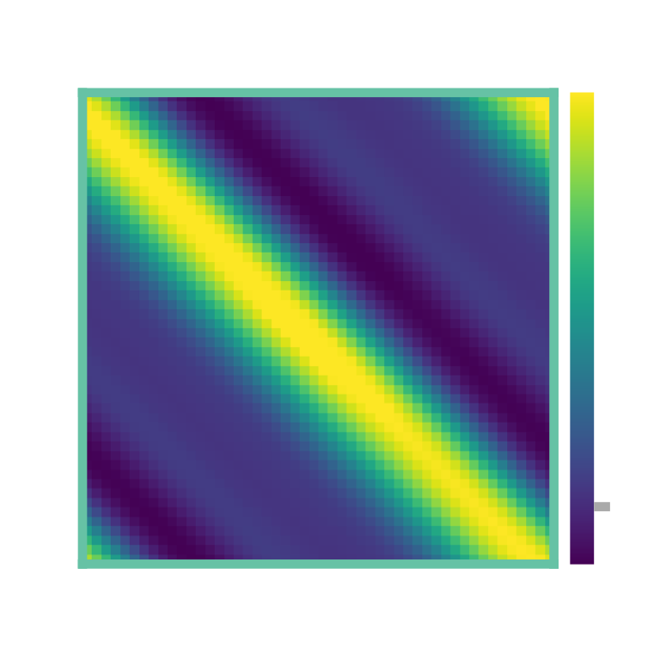
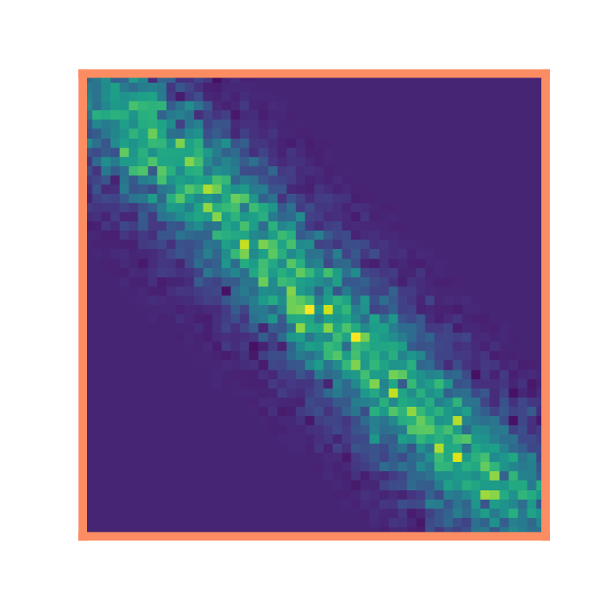

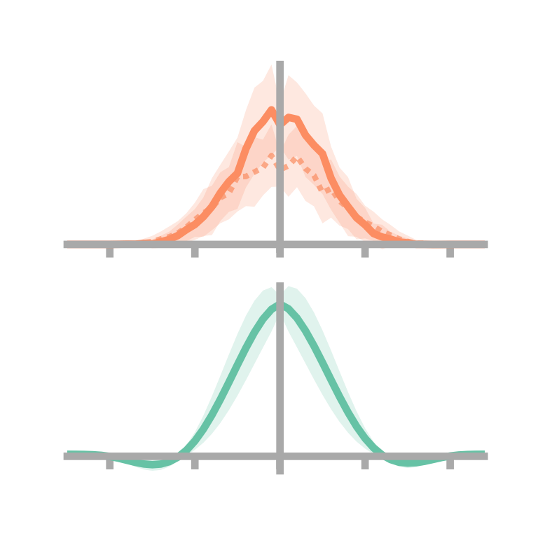
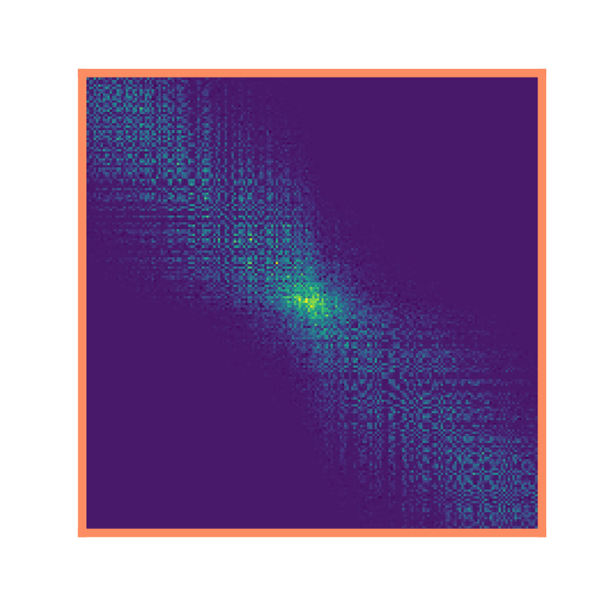
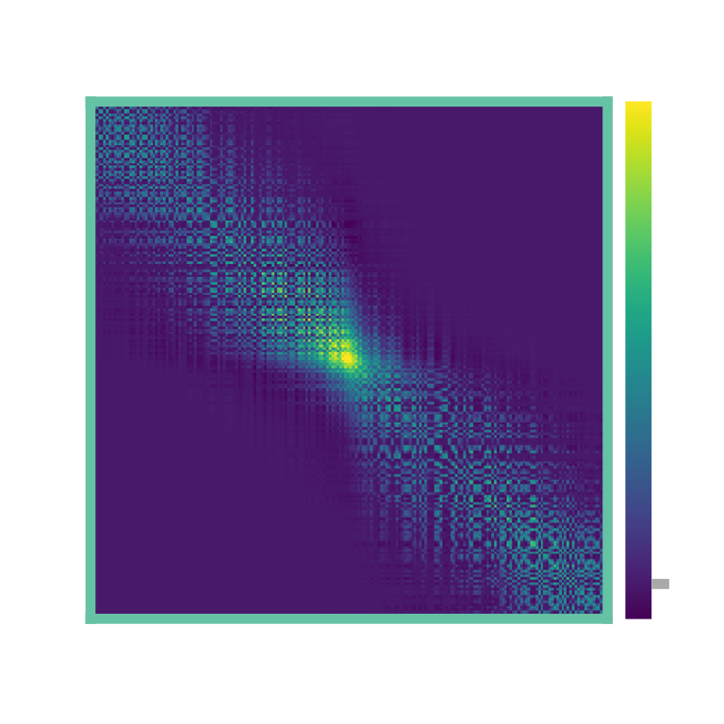
a
σ = 1 m
1D loop maze
b
Synaptic weights, W_{ij}
c
Successor matrix, M_{ij}
d
⟨W⟩
e
⟨W_{no-θ}⟩
1
½
R²
i
⟨M⟩
0
4
SNR
0
2
j
-2
-1
1
2
0
x_{i} – x_{j} / m
0
15
30
Learning time / min
f
1D corridor maze
g
h
i
j
1
R²
½
i
4
SNR
2
0
-2
-1
1
2
0
j
x_{i} – x_{j} / m
1
15
30
k
l
m
Learning time / min
2D two room maze
0

Slide 3







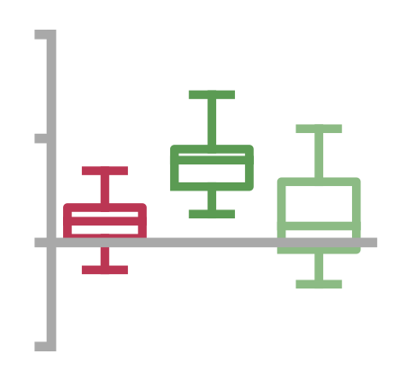
a
σ = 1 m
1D loop maze
side profile:
skew = 0.00±0.02
Basis Feature, f(x)
f(x)
-0.24±0.07
Place Cell, F(x;W)
R² = 0.97±0.01
F(x;W)
b
F(x;M)
0.00±0.16
1D corridor maze
BF
0.00±0.36
PC
R² = 0.98±0.01
c
d
0
x / m
5
BF
2D two room maze
2D two room maze
e = 0.00
BF
PC
***
ns
0.8
***
ns
0.4
***
***
(unbiased)
0.2
(unbiased)
0.4
Eccentricity
Movement towards
doorway / m
0
e = 0.57
0
Cells
near
centre
Cells near
wall
-0.2
Cells
near
centre
Cells near
doorway
PC

Slide 4
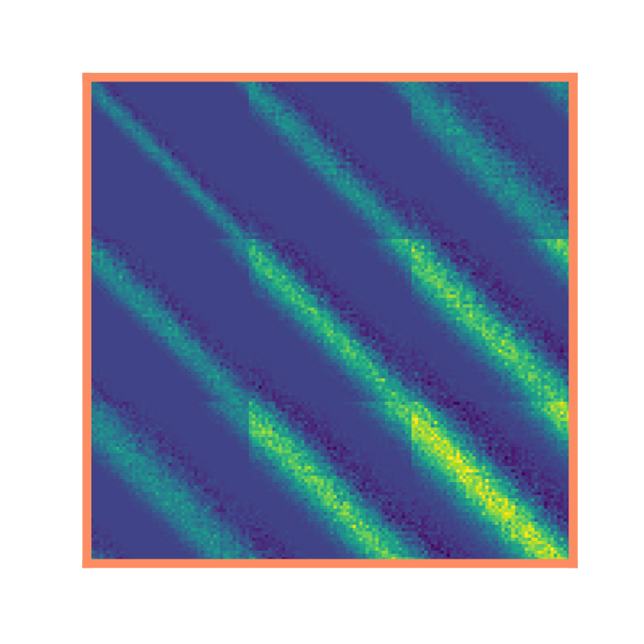
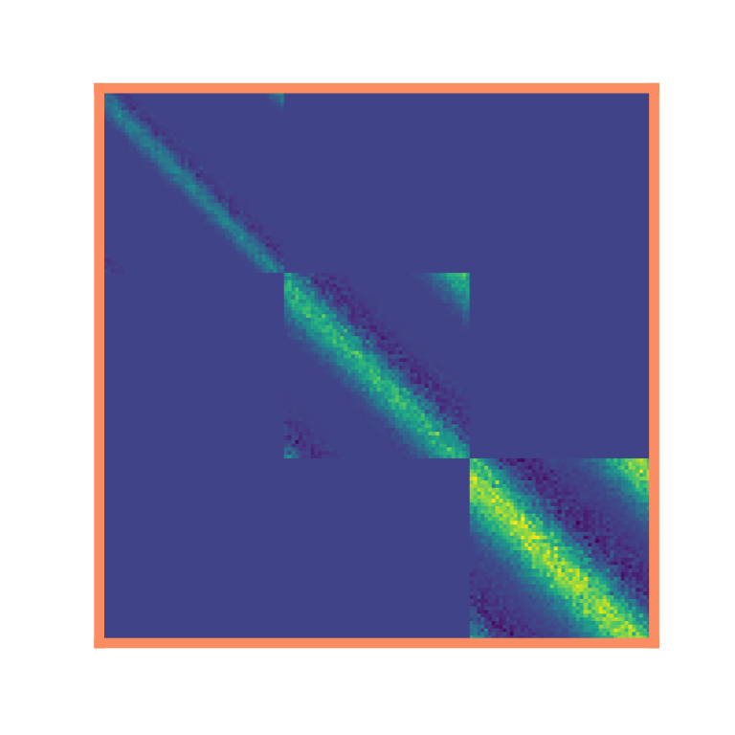
a
σ = 0.5 m
σ = 1 m
σ = 1.5 m
b
Place cells are ordered along the dorsal-ventral axis according to receptive field size
c
10
Dorsal
8
STDP matrix, W_{ij}
time horizon / s
HPC
6
4
Ventral
2
0
0
0.5
1
1.5
2
Basis cell size, σ / m
d
Synaptic weight matrix, W_{ij} :
homogeneous multiscale
e
ordered multiscale
σ = 0.5 m
σ = 1 m
σ = 1.5 m

Slide 5
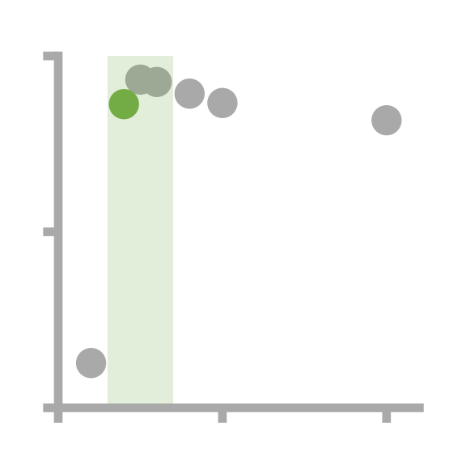
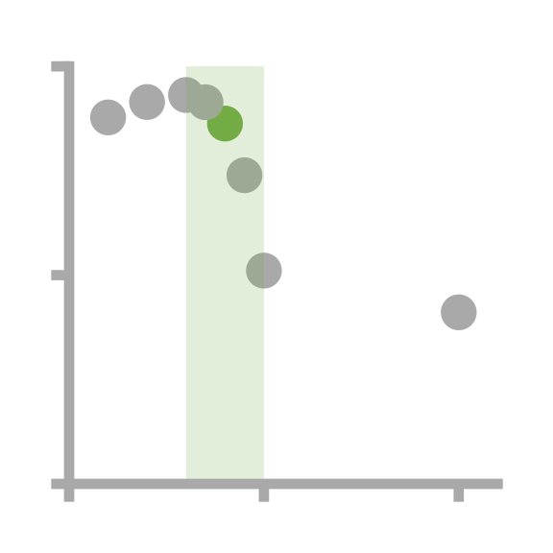

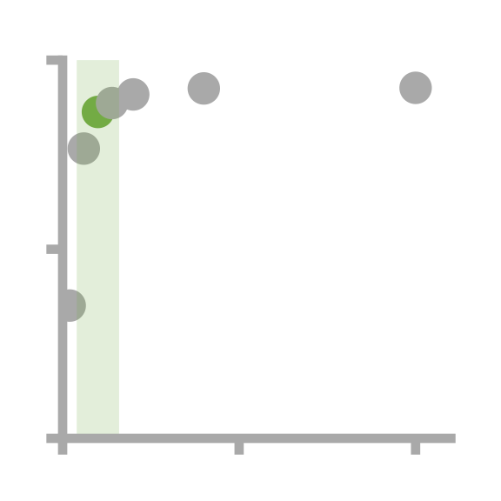
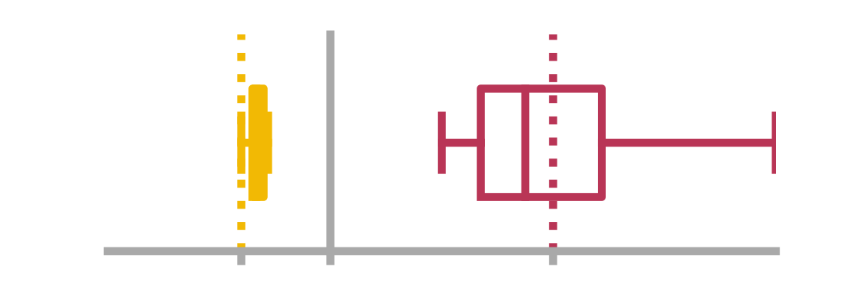
a
b
 |  |  | Sweep range | Top 3 sweep optima* |  |  | Biological parameters†
 |  |  |  | #1 | #2 | #3
Simulation | STPD | τ_{STDP}⁺ / ms | [10→100] | 20 | 10 | 40 | 20‡
parameters |  | τ⁻_{STDP}⁻ / ms | [10→100] | 45 | 40 | 100 | 40‡
 |  | a_{STDP} | [-0.1→-1.0] | -0.3 | -0.2 | -0.3 | -0.4‡
 |  | firing rate / Hz | [1→50] | 50 | 50 | 50 | 5§
 | θ | precess fraction, f | no sweep | 0.5‖
 |  | κ | no sweep | 1‖
 |  | θ-frequency, ν_{θ} / Hz | no sweep | 10¶
 |  | Learning rate, η_{STDP} | no sweep | 0.05
 | TD | τ_{TD} / s | no sweep | 4
 |  | Learning rate, η_{TD} | no sweep | 0.01
 |  | L2 regularisation, λ | no sweep | 0.01
Performance |  | R² (M,W) | - | 0.97 (0.76) | 0.97 (0.77) | 0.97 (0.82) | 0.86 (0.65)
metrics |  | SNR(W) | - | 66.7 (53.0) | 47.7 (26.3) | 61.8 (54.6) | 7.3 (3.7)
θ (No-θ) |  | x_{max} ⟨W⟩ vs. x_{max} ⟨M⟩ = -0.15 | - | -0.25 (-0.05) | -0.15 (-0.05) | -0.25 (-0.05) | -0.25 (-0.05)
Biological
parameters
⟨W⟩
⟨W_{no-θ}⟩
Best
parameters
⟨M⟩
c
d
1
= biologically
plausible range
a_{STDP}•T
T = τ⁻_{STDP}/τ⁺_{STDP}
R²
0
-0.8
0
2
0
50
100
0
50
100
-1
-0.5
0
0
50
100
Top 50 model parameters
τ⁺_{STDP} / ms
τ⁻_{STDP} / ms
a_{STDP}
Firing rate / Hz
Experimental data, Bi and Poo (1998),
see [?,?]
*as determined by R² (M,W_{θ})
† as used in paper, determined from literature…
‡ Bush et al. (2010)
§ Muller ….
‖ Fitted to Jeewajee and Barry (2014), figure 5a
¶ Find source

Slide 6
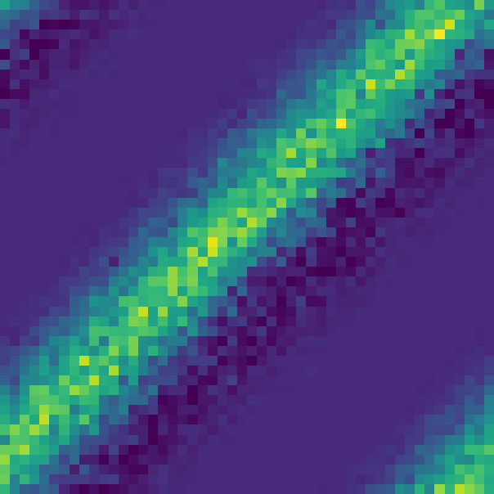

a
Basis Features, f_{i}(x)
••• i = 50
i = 1 •••
T_{θ} = 0.1s
“Theta
sweep”
b
Synaptic weights, W_{ij}
c
Successor matrix, M_{ij}
d
2D two room maze
x
1
Place cell
***
0.8
***
ns
0.4
i
Eccentricity
(unbiased policy)
e = 0.57
0
Cells near
wall
0
Cells
near
centre
50
1
j
50
e
σ = 1 m
1D loop maze
skew = 0.00±0.02
Basis Feature, f(x)
-0.24±0.07
Place Cell, F(x;W)

