Slide 1
Continuous not grid world
agent = MazeAgent(dt=0.05, v=0.1, numRooms=1, roomSize=1, policy='randomWalk')
agent.walls['barrier'] = np.array([[[0.3,0.7],[0.7,0.3]]])
for i in tqdm(range(2000)):
agent.movementPolicyUpdate()
fig, ax = agent.plotHistory()
Position is a continuous variable:
Walls are true 1D objects
A check is done on each step to handle wall collisions
A function maps continuous position to a (quantized?) state-rep, e.g. one-hot

Slide 2
Generalised SR-TD
Use general SR form. M is a matrix which maps some state vector onto another vector which I the discounted summer future occupancy
I.e. Ψ(S) is:
So we can learn Ψ(S) by standard TD methods
Or as a direct learning rule on M, this is can be rewritten as (assuming rescaling of α or normalised state vectors)
All that remains is to show that with one-hot numbered states, f(S_{t})_{i} = δ(i = S_{t}), standard SR equation comes out.
e.g. de Cothi 2020, it’s what I’m implementing
matrix columns give future occupancy i.e. place fields
e.g. Stachenfeld 2017

Slide 3
Place cells and grid cells
agent.alpha = 0.2
agent.gamma = 0.99
agent.dx = 0.1
for i in tqdm(range(100000)):
agent.movementPolicyUpdate()
agent.TDLearningStep()
fig, ax = agent.plotPlaceField()
fig, ax = agent.plotGridField()
γ = 0.9
γ = 0.999
Place cells leak over barrier since positions on either side of the barrier can map to same state rep

Slide 4
Two rooms
agent.doorsClosed = True
agent.doorsClosed = False
Biggest problems:
• Can be slow to train
• Defining position to state rep function non-trivial (I guess that’s the whole point)

Slide 5
Four rooms
Biggest problems:
• Can be slow to train
• Defining position to state rep function non-trivial (I guess that’s the whole point)

Slide 6
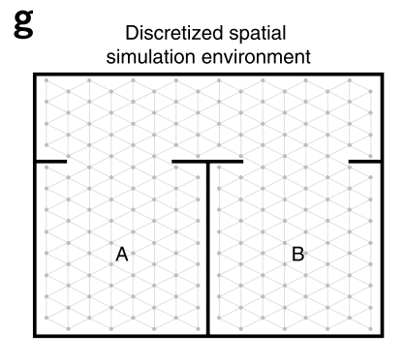
Grid cells bleeding across boundaries
Vertical / horizontal boundaries only ☹
Biggest problems:
• Can be slow to train
• Defining position to state rep function non-trivial (I guess that’s the whole point)

Slide 7


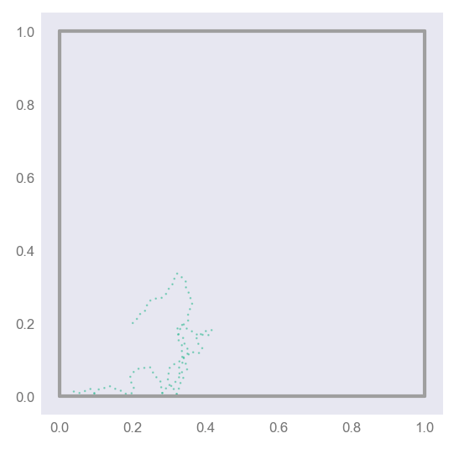
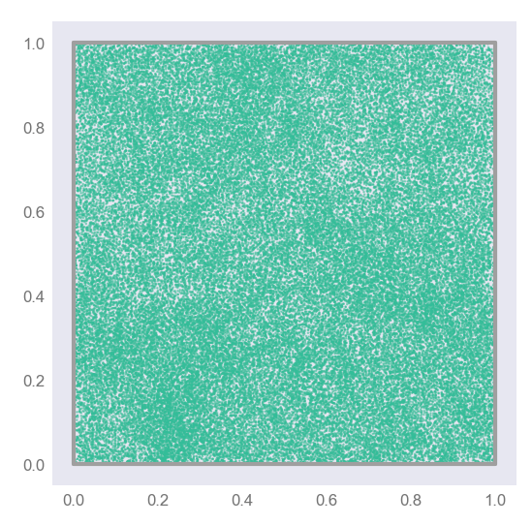
Code speed-up, O(1000x)
General formula:
One-hot specific formula:
Biggest problems:
• Can be slow to train
• Defining position to state rep function non-trivial (I guess that’s the whole point)

Slide 8
Motion models
Random Walk
Raudies
Windows screensaver

Slide 9
New mazes
Explore
Place
Grid

