Slide 1



j = 10
CA3 basis features, f_{j}(x)
a
j = 1
j = 20
j = 30
j = 40
j = 50
j = 10
Theta sweep
j = 20
j = 30
T_{θ} = 0.1s
j = 40
x
θ
rhythm
b
c
d
Synaptic weights, W_{ij}
(STDP learning)
e
Hippocampal model
STDP rule
Successor matrix, M_{ij}
(TD learning)
f_{j}(x)
ΔW_{ij}
max
j
CA3
Basis features
a^{pre}=1
i = 10
W_{ij} ≈ M_{ij}
20
≈
postsynaptic cell
τ^{post}=40 ms
^{post}
^{pre}
30
Successor features
t - t
i
CA1
_{i}
_{j}
τ^{pre}=20 ms
40
0
~
a^{post}=-0.4
j = 10
20
30
40
ψ_{i}(x)
presynaptic cell

Slide 2
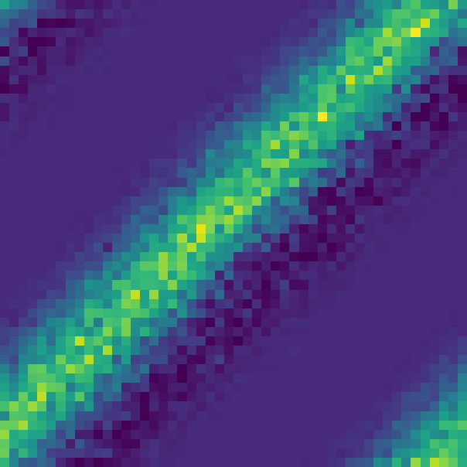

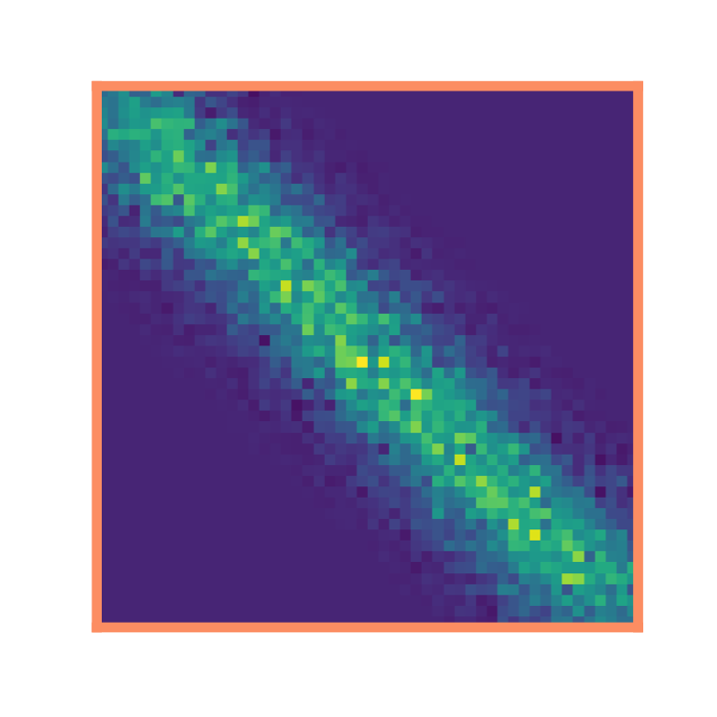

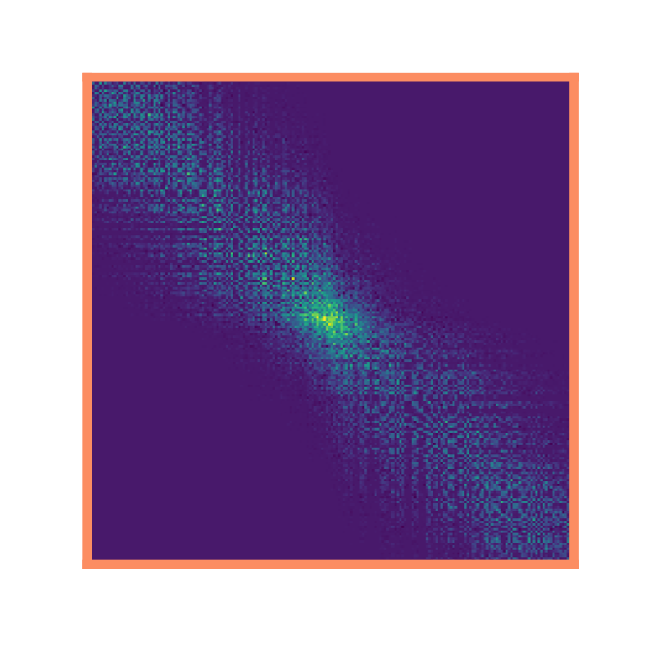
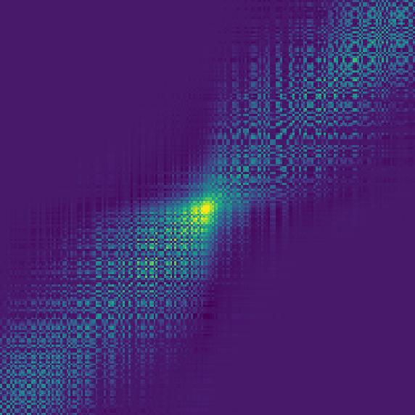
a
σ = 1 m
1D loop
c
Successor matrix, M_{ij}
5 m
Synaptic strength
b
Synaptic weights, W_{ij}
d
⟨W⟩
e
⟨W_{no-θ}⟩
1
½
R²
postsynaptic cell, i
⟨M⟩
0
4
SNR
0
2
presynaptic cell, j
-2
-1
1
2
0
R² = 0.87
x_{i} – x_{j} / m
0
15
30
Learning time / min
f
1D corridor
g
h
i
j
1
R²
½
i
4
SNR
0
2
-2
-1
1
2
0
j
R² = 0.88
x_{i} – x_{j} / m
0
15
30
far from doorway
Learning time / min
k
Two interconnected rooms
l
left
room
right
room
m
near doorway
far from doorway
i
σ = 1 m
5 m
j
0
R² = 0.74
1
R²
0
0
60
Time

Slide 3

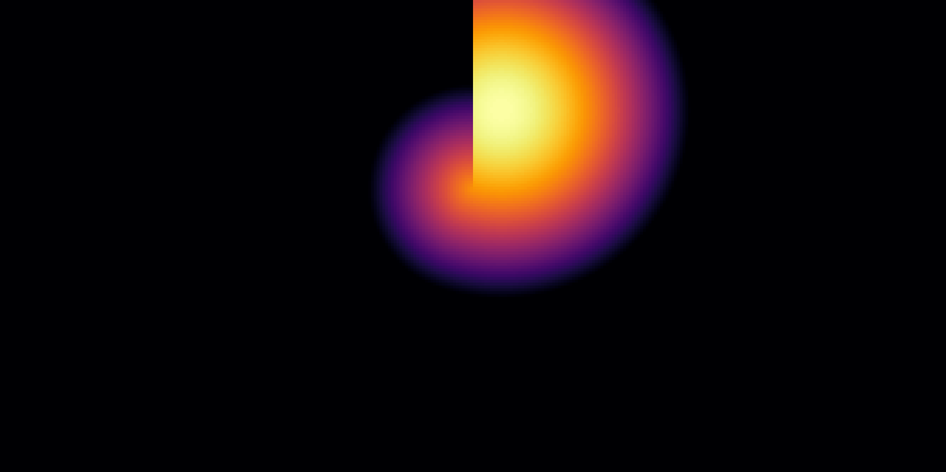

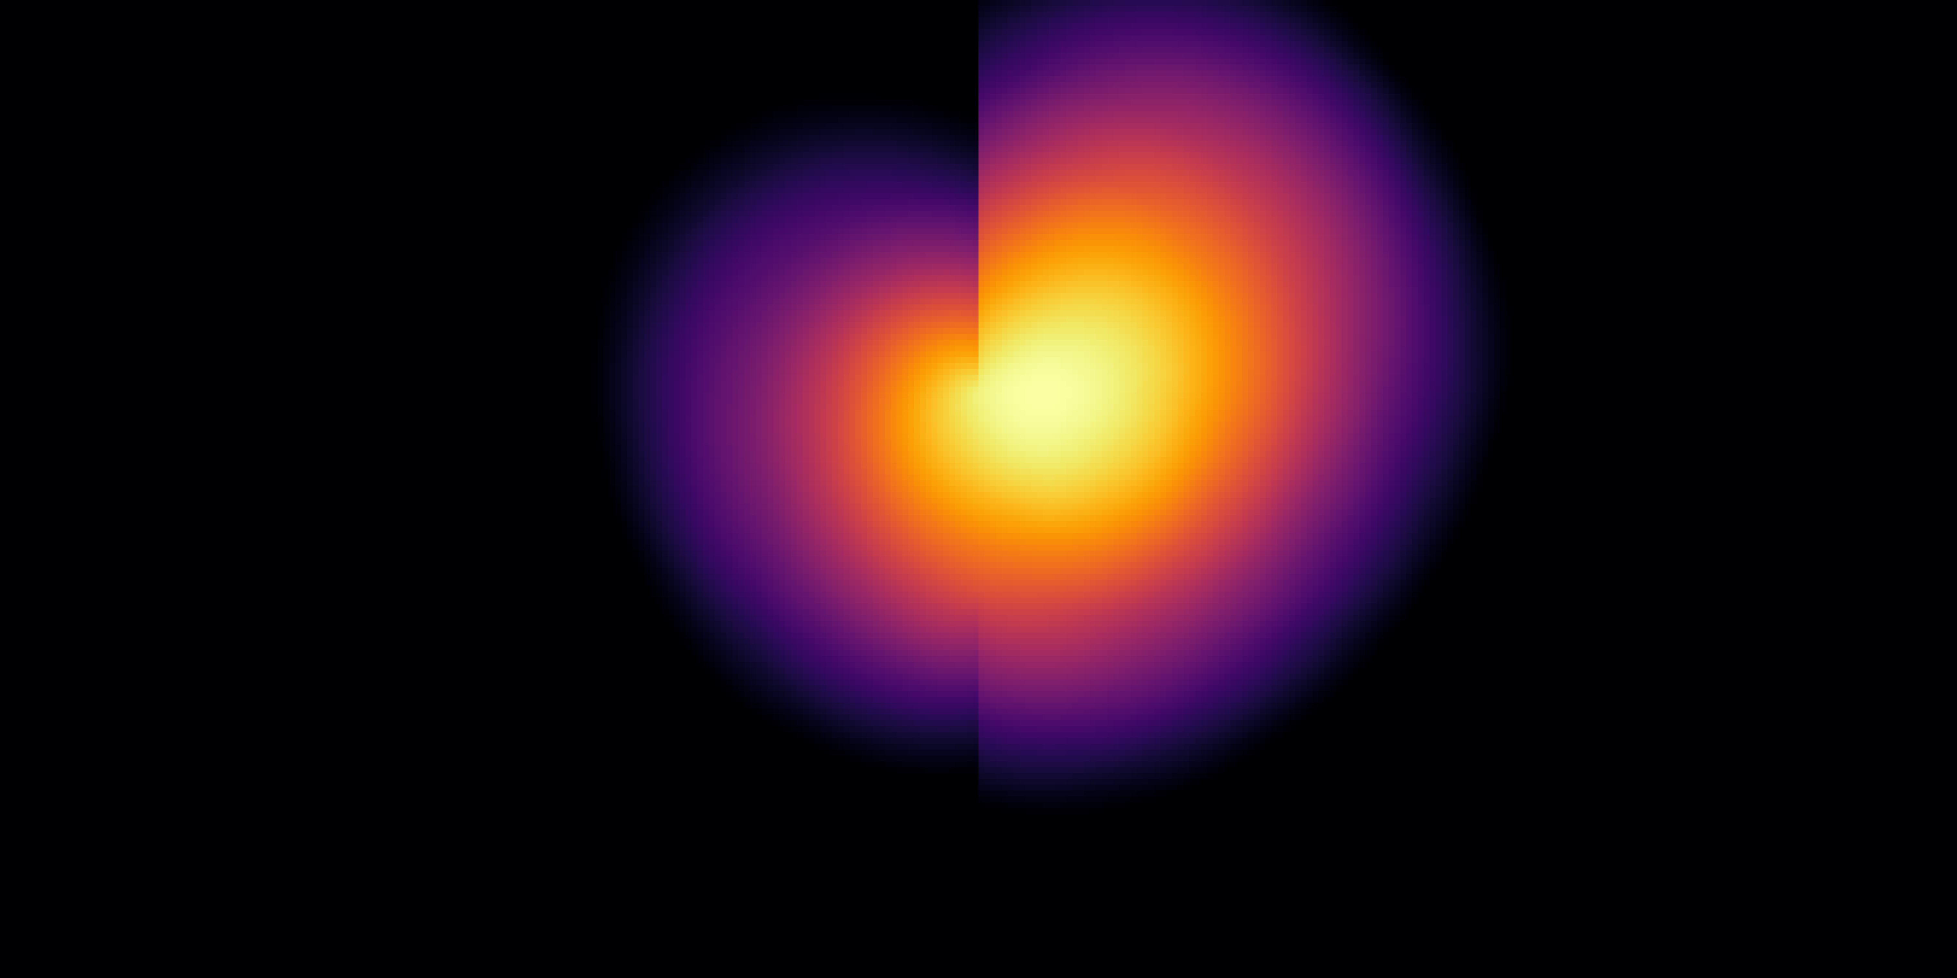
a
1D loop
Basis Feature, f(x)
Δ = shift
= skewness
side profile:
(x)
0
x / m
f(x)
TD successor feature,
Δ = -0.28±0.00 m,
= 0.39±0.01
5
(x)
(x)
STDP successor feature,
Δ = -0.38±0.03 m,
= 0.24±0.07
(x)
_{no-θ}(x)
R²( , ) = 0.98
STDP successor feature,
Δ = -0.05±0.07 m,
= 0.00±0.08
_{no-θ}(x)
b
1D corridor
R²( , _{no-θ}) = 0.81
Basis Feature, f(x)
f(x)
(x)
0
x / m
5
TD successor feature,
(x)
(x)
STDP successor feature,
(x)
_{no-θ}(x)
R²( , ) = 0.99
STDP successor feature,
_{no-θ}(x)
c
f
R²( , _{no-θ}) = 0.96
Basis Feature, f(x)
Two interconnected rooms
Basis Feature, f(x)
Two interconnected rooms
e = 0.00
(x)
(x)
STDP successor feature,
STDP successor feature,
φ
e = 0.57
d
***
***
ns
e
g
ns
h
Near centre
0.8
(unbiased)
Near
wall
0.4
***
***
Near
doorway
Eccentricity, e
Near
centre
0.2
(unbiased)
1
0.4
Movement towards
doorway / m
Density of cells / A.U.
0
Near
centre
Near
doorway
0
Near centre
Near
wall
0
Ellipse-to-wall angle, φ
½π
-0.2
0
Before learning
After learning

Slide 4
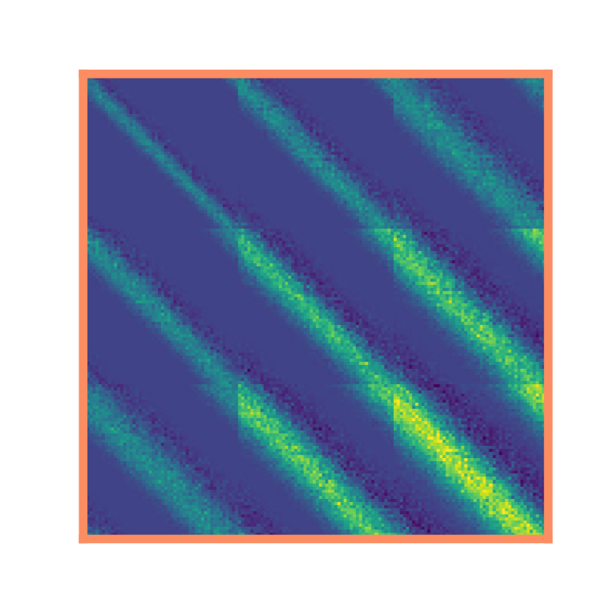
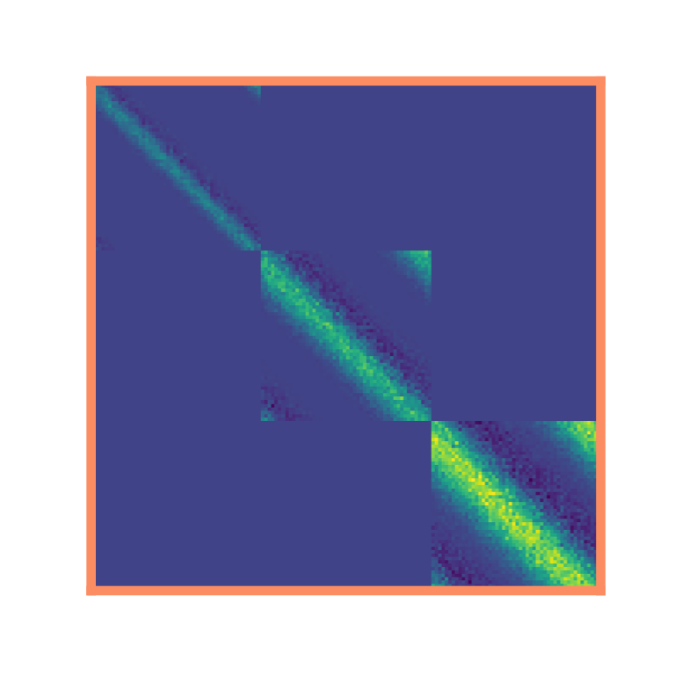
a
1D loop
σ = 0.5 m
(not to scale)
c
Synaptic weight matrices, W_{ij}
ordered multiscale
σ = 1 m
homogeneous multiscale
d
σ = 1.5 m
b
Place cells are ordered along the dorsal-ventral axis according to receptive field size
Dorsal
σ = 1.5 m
HPC
Ventral
σ = 1 m
σ = 0.5 m

Slide 5
a
b
 |  |  | Sweep range | Best parameters*: |  |  | Biological parameters†
 |  |  |  | #1 | #2 | #3
Simulation | STPD | τ^{pre} / ms | [10→100] | 20 | 10 | 40 | 20‡
parameters |  | τ^{post} / ms | [10→100] | 45 | 40 | 100 | 40‡
 |  | a^{post} | [-0.1→-1.0] | -0.3 | -0.2 | -0.3 | -0.4‡
 |  | firing rate / Hz | [1→50] | 50 | 50 | 50 | 5§
 | θ | precess fraction, f | no sweep | 0.5‖
 |  | κ | no sweep | 1‖
 |  | θ-frequency, ν_{θ} / Hz | no sweep | 10¶
 |  | Learning rate, η_{STDP} | no sweep | 0.05
 | TD | τ_{TD} / s | no sweep | 4
 |  | Learning rate, η_{TD} | no sweep | 0.01
 |  | L2 regularisation, λ | no sweep | 0.01
Performance |  | R² (M,W) | - | 0.97 (0.76) | 0.97 (0.77) | 0.97 (0.82) | 0.86 (0.65)
metrics |  | SNR(W) | - | 66.7 (53.0) | 47.7 (26.3) | 61.8 (54.6) | 7.3 (3.7)
θ (No-θ) |  | x_{max} ⟨W⟩ vs. x_{max} ⟨M⟩ = -0.15 | - | -0.25 (-0.05) | -0.15 (-0.05) | -0.25 (-0.05) | -0.25 (-0.05)
Biological
parameters
⟨W⟩
⟨W_{no-θ}⟩
#1 Best
parameters
⟨M⟩
c
d
1
= biologically
plausible range
a^{post}•T
T = τ^{post}/τ^{pre}
R²
= parameter used
in paper
0
-0.8
0
2
0
50
100
0
50
100
-1
-0.5
0
0
50
100
Top 50 model parameters
τ^{pre}_{STDP} / ms
τ^{post}_{STDP} / ms
a^{post}
Firing rate / Hz
Experimental data [Bi and Poo, (1998)]
*as determined by R² (M,W_{θ})
† as used in paper, determined from literature…
‡ Bush et al. (2010)
§ Skaggs et al. (1996)
‖ Fitted to Fig. 5a from Jeewajee and Barry (2014)
¶ Jeewajee and Barry (2014)

Slide 6
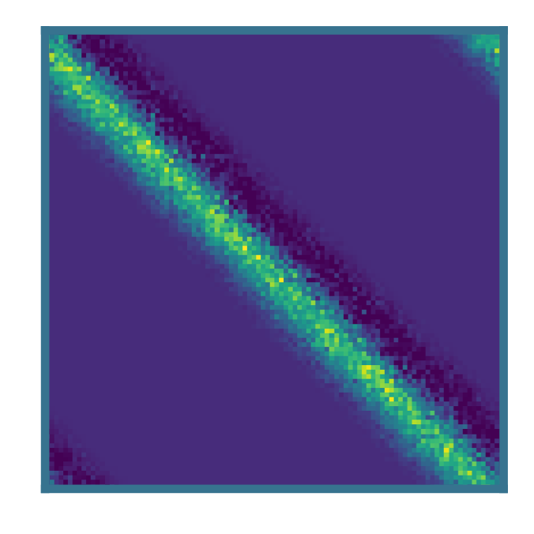
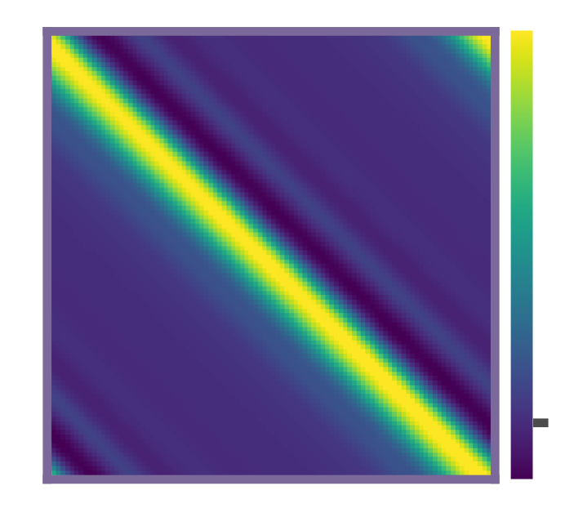
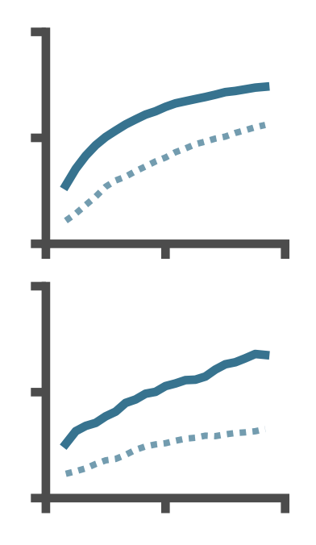
Speed and size variability
a
Faster speed, smaller place cells
Original
τ = 0.5 s
-1
0
1
0
6
12
0
30
60
Review Figure X: (a) We reduce the place cell diameter from 2 m to 0.4 m (5x decrease) and increase the motion speed from 16 cm s⁻¹ to 32 cm s⁻¹ (2x increase) as the reviewer requested. To facilitate learning on these smaller place cells we increase the cell density along the track from 10 cells m⁻¹ to 50 cells m⁻¹. To reduce the computational load of training we shrink the track length from 5 m to 2 m (any additional track is redundant when place cells are this small anyway). Note the adjusted training time: 12 minutes on a 2 m track at 32 cm s⁻¹ corresponds to the same number of laps as 60 min on a 5 m track at 16 cm s⁻¹ as shown for comparison in panel (b). (b) The reviewer suggested it looked as though the training hadn’t converged. We run the same experiment shown in paper figure 2a-e again for 60 minutes (twice as long) and observe only a small amount of extra convergence. (c) The reviewer requested we experiment with non-constant motion speed. In this example we make the motion speed variable but with the same mean as in the main paper figure (2a-e, place cell sizes etc. also match this experiment) but a large standard deviation (speed = 16 +- 16 cm s⁻¹). We observer no

Slide 7
Vary CA3 → CA1 connectivity
Review Figure X: (a)

