Slide 1

2
feature, f_{i}(x)
successor feature, ψ_{i}(x)
CA1 place field before
after
[Mehta et al. (200)]

Slide 2
2π
θ-phase
π
0
Entry
Exit

Slide 3
τ_{behaviour}
τ_{θ} ≈ τ_{STDP}
θ-rhythm (10 Hz)

Slide 4
Basis features
Synaptic weights
j
CA3
Successor matrix
i
CA1
Successor features

Slide 5


Synaptic weights, W_{ij}
Successor matrix, M_{ij}
STDP + phase precession
(our model)
Temporal difference
learning
postsynaptic neuron, i
0
presynaptic neuron, j
R² = 0.87

Slide 6
Synaptic strength
⟨W⟩
1
⟨W_{no-θ}⟩
½
R²
0
⟨M⟩
4
SNR
2
-2
-1
1
2
0
x_{i} – x_{j} / m
0
15
30
Learning time / min

Slide 7


Basis Feature, f(x)
side profile:
f(x)
(x)
0
x / m
5
TD successor feature,
(x)
(x)
STDP successor feature,
(x)
Cells skew on a 1D track, just like SRs
R²( , ) = 0.98
e = 0.57
Cells elongate near walls
Cells shift toward/through doorways

Slide 8
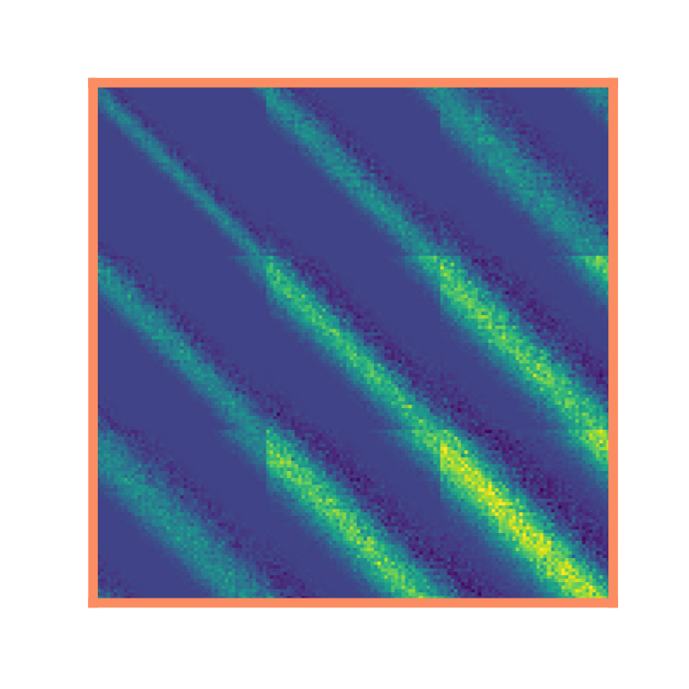
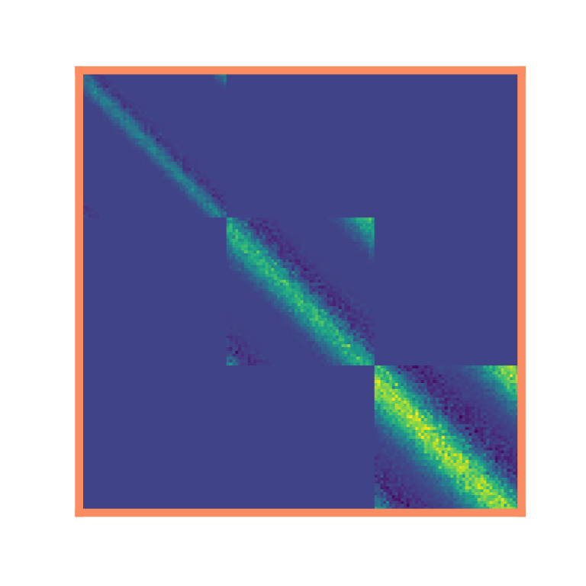
ordered multiscale
homogeneous multiscale
b
Place cells are ordered along the dorsal-ventral axis according to receptive field size
Without dorsal-ventral
ordering…
With dorsal-ventral
ordering…
Dorsal
HPC
σ = 1.5 m
Ventral
σ = 1 m
σ = 0.5 m
…multiscale SRs
are lost ☹
…multiscale SRs
are maintained ☺

