Slide 1
PCB pinout FAIREMBO Project
PCB WIRING | C1 |  |  | C2 |  |  | C3 |  |  | C4 |  |  | C5 | C6 | C7
L1 |  |  |  |  |  |  |  |  |  | 12V
L2 |  |  |  | MD20B DRIVER |  |  |  | 12V | C+ | . | . | . |  |  |  |  |  | 2998 DRIVER
L3 |  |  | M0 |  |  |  |  | GND | C- | . | . | . |  |  |  | . | I0
L4 |  |  | M1 |  |  |  |  | B2 | . |  |  |  |  |  |  | . | GND
L5 |  |  | M2 |  |  |  |  | B1 | .
L6 |  |  | REST |  |  |  |  | A1 | . |  |  |  |  |  |  |  |  |  |  |  | VIN | 12V
L7 |  |  | SLP |  |  |  |  | A2 | . |  |  |  |  |  |  |  |  |  |  |  | GND | GND
L8 |  | . | STEP |  |  |  |  | 5V |  |  |  |  |  |  |  |  |  |  |  |  | B+ (Black)
L9 |  | . | DIR |  |  |  |  | GND | GND |  |  | . | RELAY |  |  | . | DIR |  |  |  | B- (Green)
L10 |  |  |  |  |  |  | . | . | . |  |  | . |  |  |  | . | STEP |  |  |  | A- (Red)
L11 |  |  |  |  |  |  |  |  | S |  |  | S |  |  |  |  | STDBY |  |  |  | A+ (Blue)
L12 |  |  |  |  |  |  |  |  |  |  |  |  |  |  |  |  | ENBL
L13
L14
L15
L16
L17
L18
L19
L20
L21
Extruder motor pins
Cutting motor pins

Slide 2
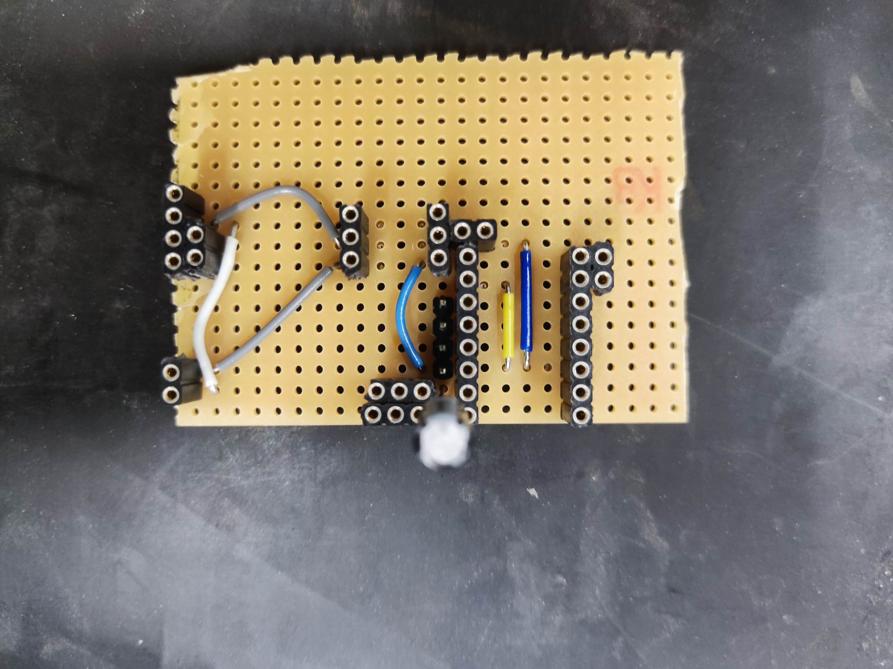
12V
GND
DIR/STEP
PWM pins 4 - 5
Extruder motor pins
RELAY Input
GND
5V
DIR/STEP
PWM pins 3 - 2
A2 pin

Slide 3
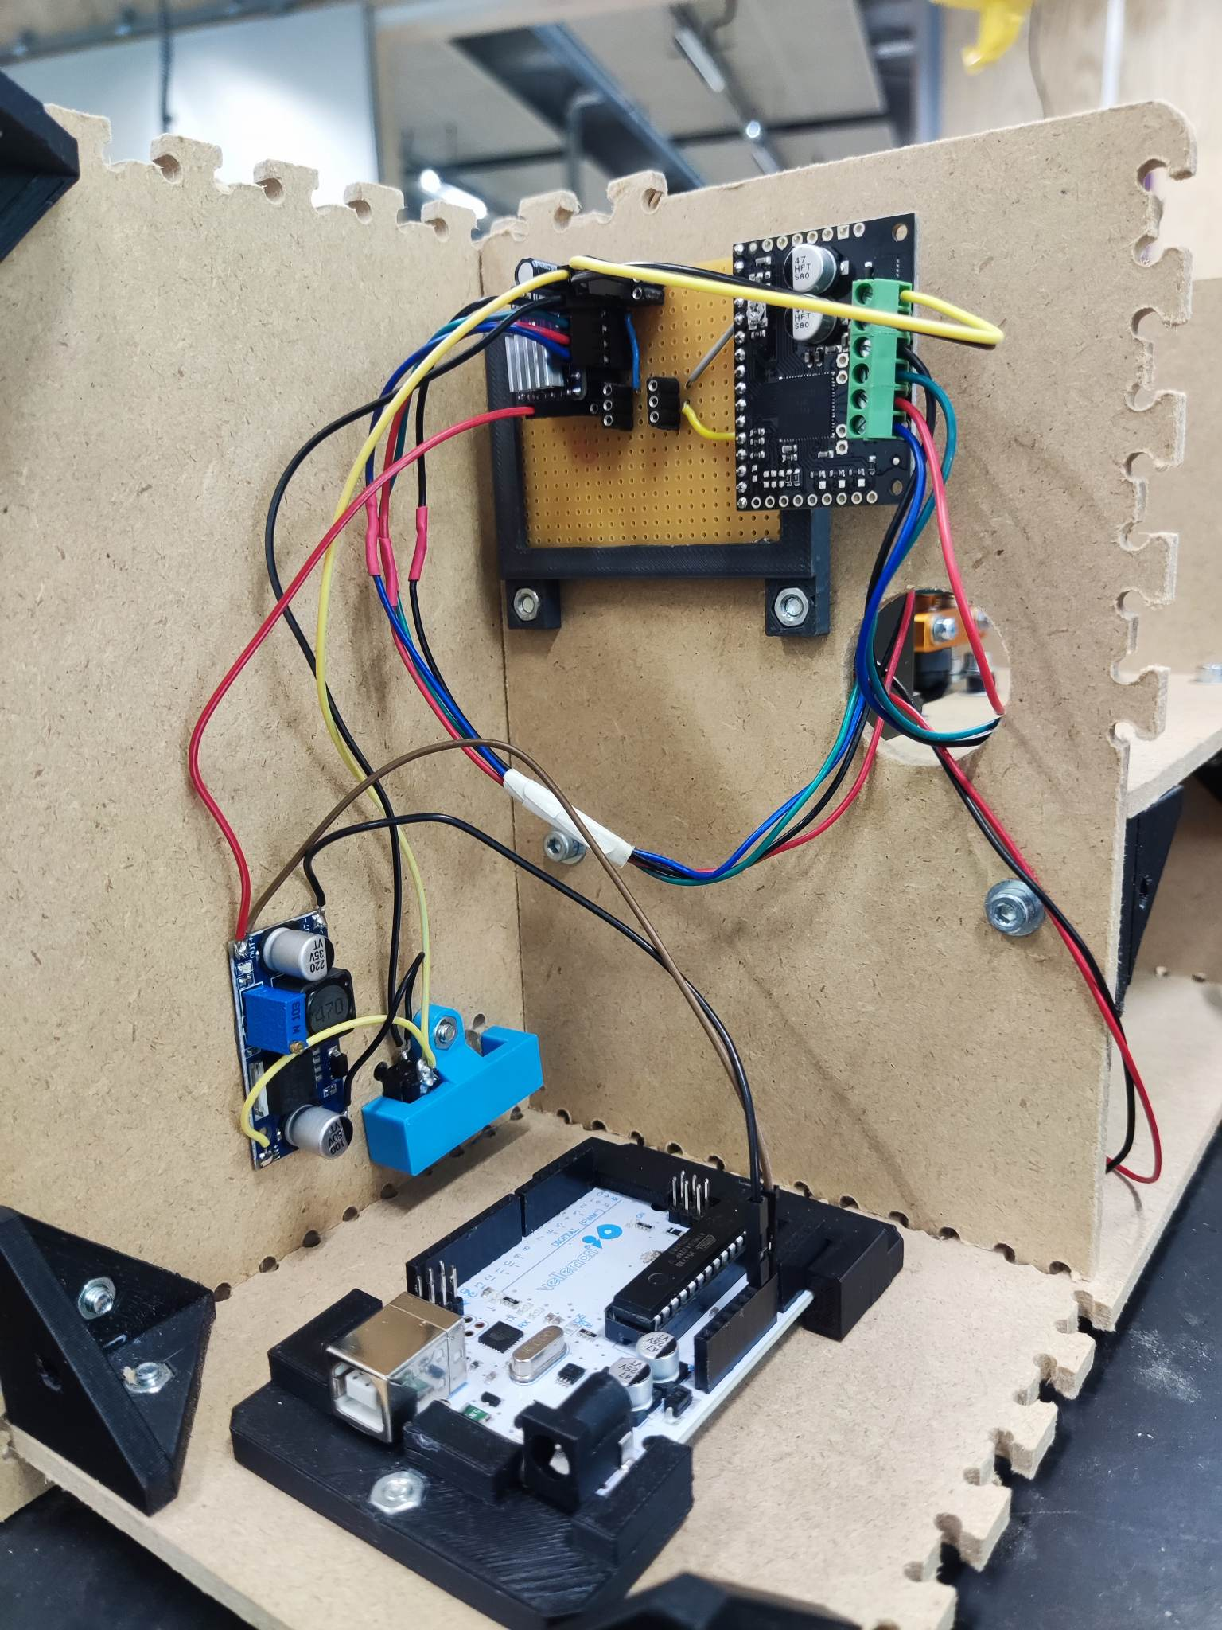
Cutting motor pins
5V OUT
Arduino Vin (5V) and GND
12V OUT

Slide 4
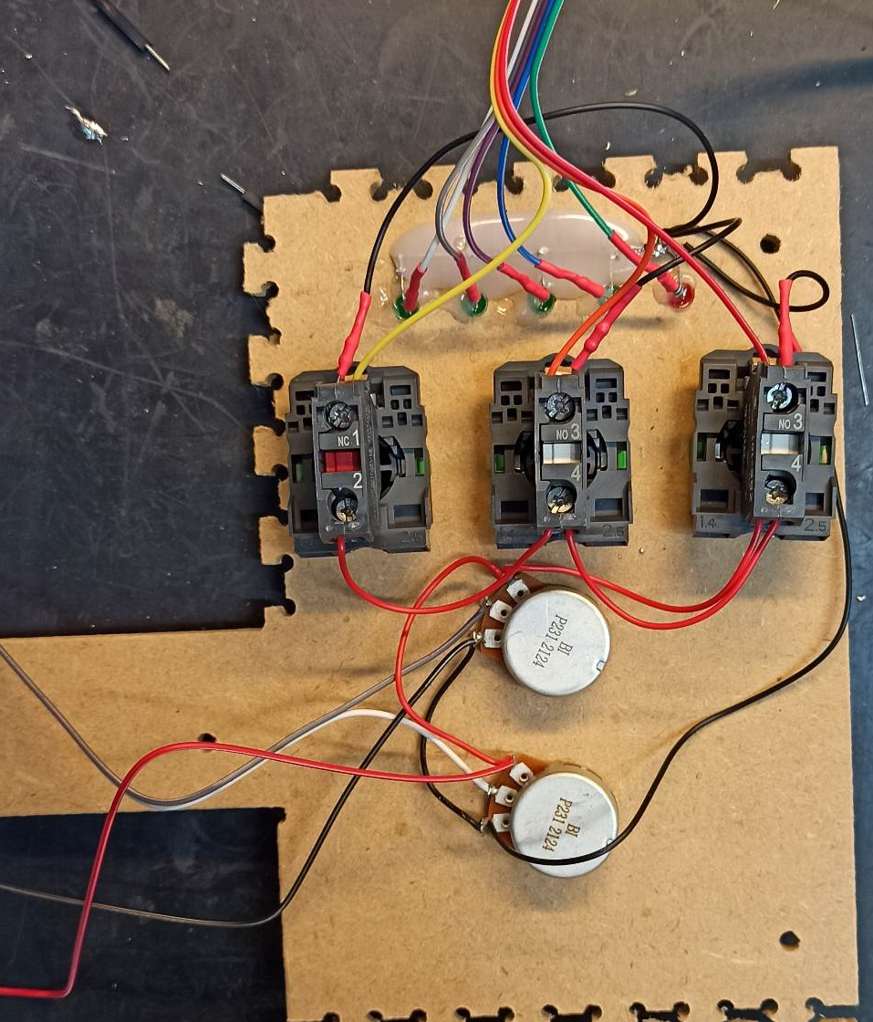
LED pins
6-7-8-9-10
Switches pins
11 (Pause) -12 (Stop) -13 (Start)
Potentiometer
A0 (Grey) – A1 (White)
GND/5V wires

