Slide 1
Find your best chess opening
By Tom Handley

Slide 2
01
The Idea + Problem

Slide 3
Problem with openings
Too many openings make choosing overwhelming
No personalised guidance for players
Opening success changes with rating
Most players choose randomly or copy others
Rating: Higher rating = stronger player.

Slide 4
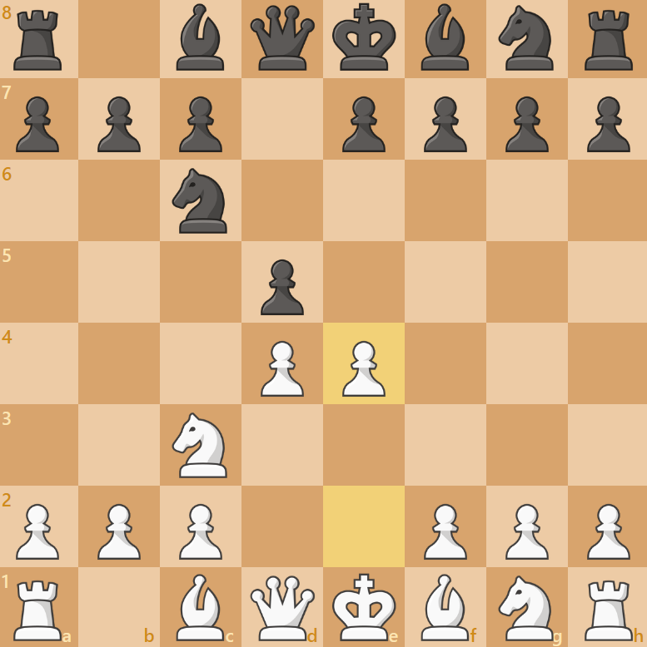
What is a Chess Opening?
The first 10–15 moves of the game
Develop pieces and control the centre
Every opening follows a specific plan
Different openings create unique positions

Slide 5
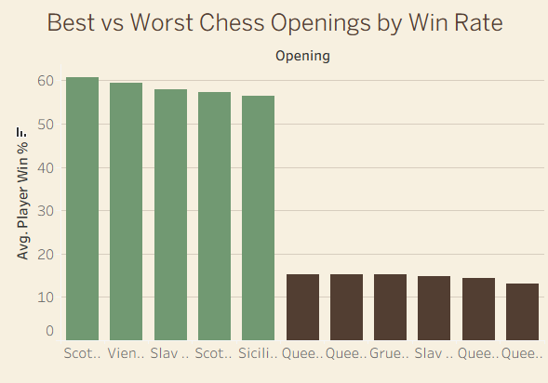

Why Openings Matter
Win Rates
Huge gap between best and worst.
Hard to Master
Some openings require high skill.
Just Weak
MARS
JUPITER
NEPTUNE
Poor results and easy to punish.
Follow the link in the graph to modify its data and then paste the new one here. For more info, click here
Filtered to openings with 1,000+ games for accuracy

Slide 6
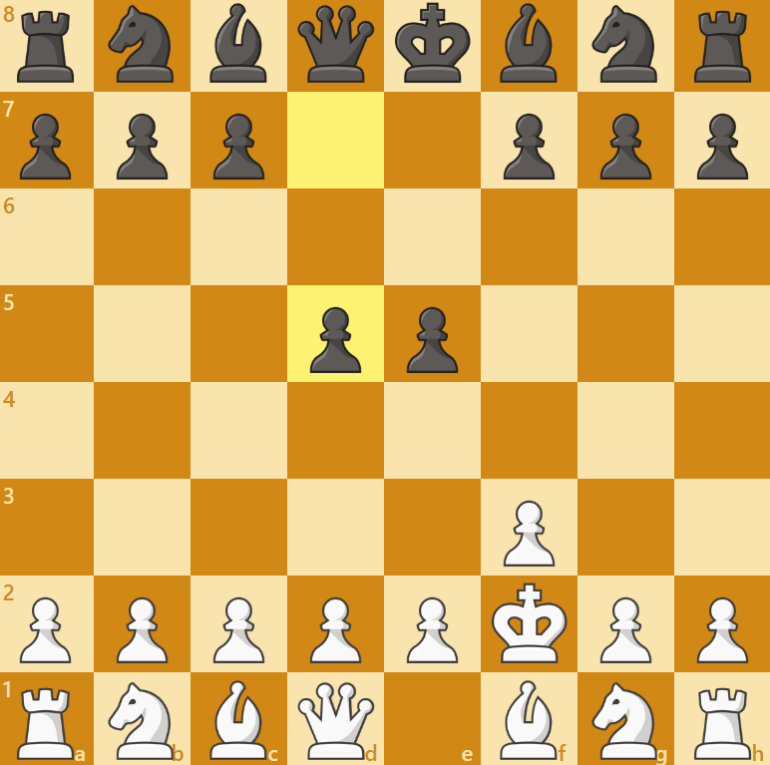
Pork Chop Opening

Slide 7
02
My Solution

Slide 8
Recommendation Opening System
Data Processing
Opening Recommendation
Extracts first eight moves, color, and opening name.
Suggests 6 openings matching style and rating.
Player Input
Model Prediction
Fetches latest games and player rating.
Random Forest model identifies main playstyle.

Slide 9
03
Understanding the Data

Slide 10
Data Sources
Openings.csv
Chess.com API
Games.csv
1,883 unique openings
ECO codes + win rates
Used for classifying openings and model training
Kaggle
User’s latest games
Live ratings + stats
Used for personalised analysis
40,000 real world games
Moves + outcomes + ratings
Used for model training
Kaggle

Slide 11
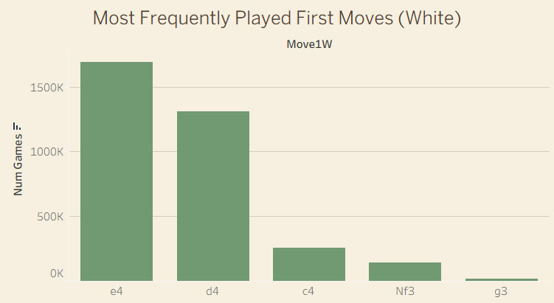
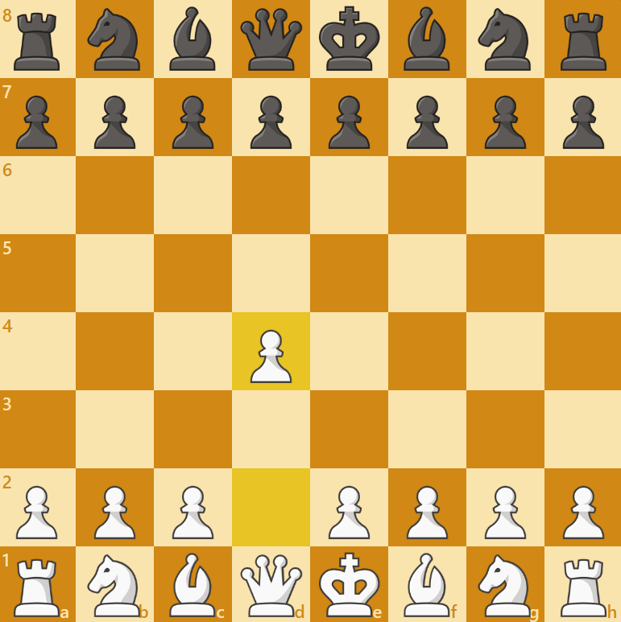
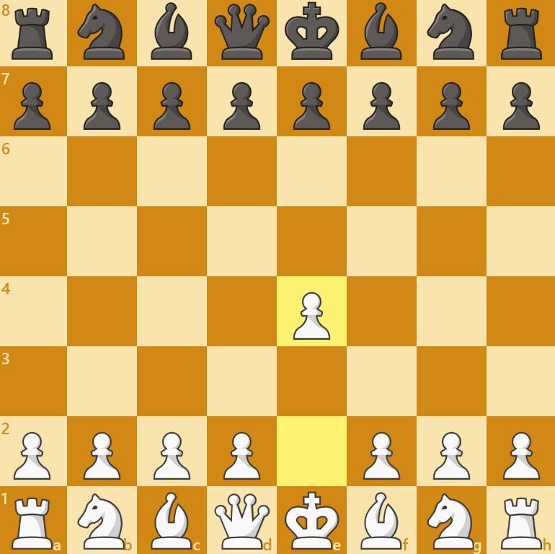
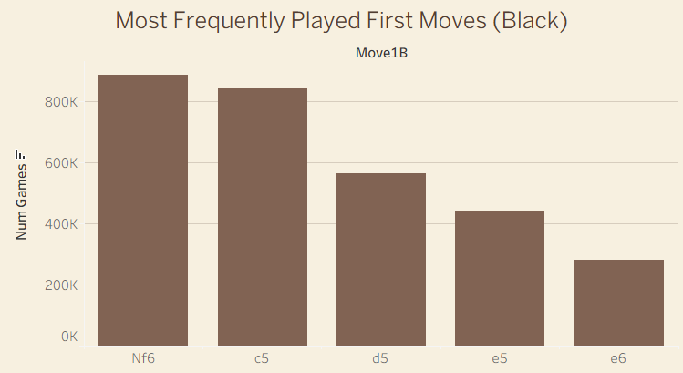
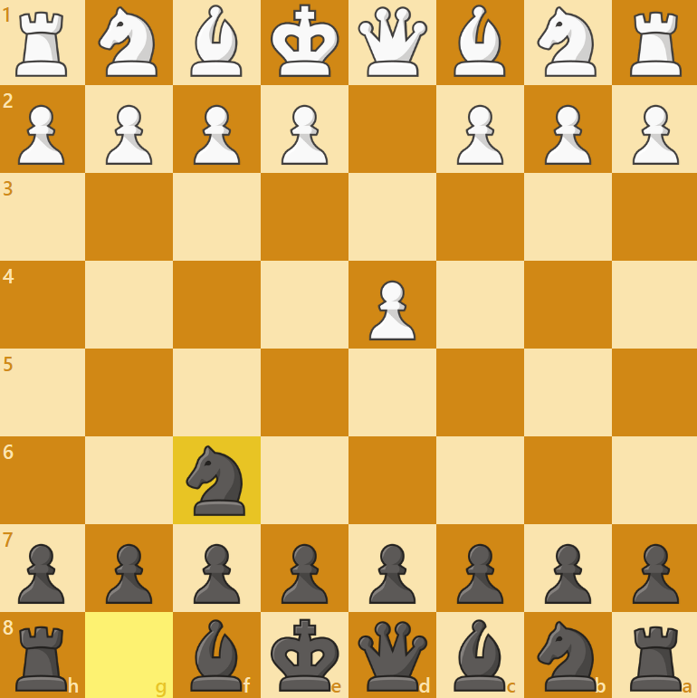
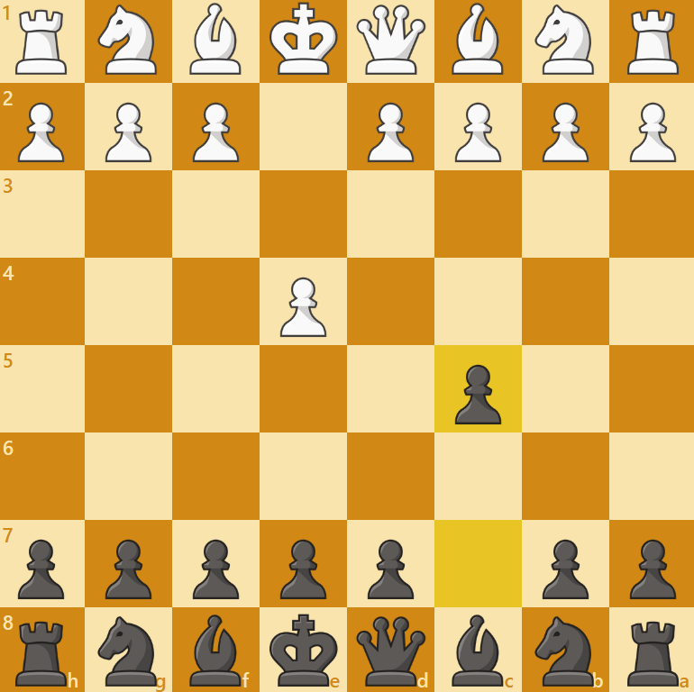
EDA - Most Common First Move

Slide 12
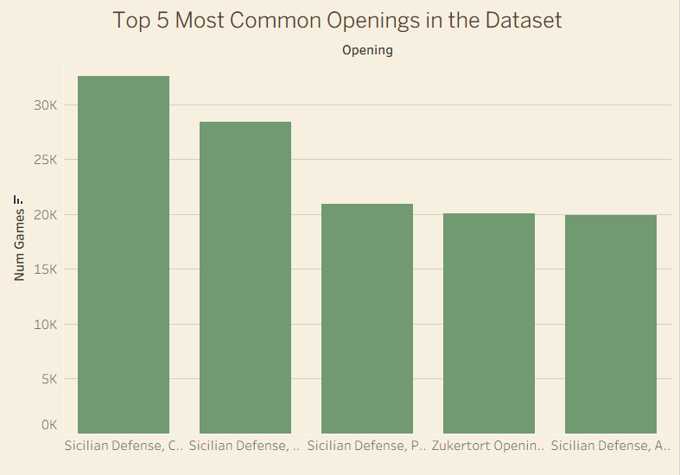
EDA – Most Popular Openings Played
Opening Name | Number of Games:
Sicilian Defense, Closed | 32,617
Sicilian Defense, Najdorf | 28,415
Sicilian Defense, Alapin | 20,979
Sicilian Defense, Paulsen | 20,045
Zukertort Opening, Sicilian Invitation | 19,885

Slide 13
Playstyle Categories
Tactical
Positional
Dynamic
Aggressive, sharp play focusing on short-term combinations.
Slow, strategic buildup and long-term planning.
Mix of tactics and position; flexible and unpredictable
Hypermodern
Classical
Sharp
Controls the center from a distance, invites opponent forward.
Solid, traditional structure focusing on direct central control.
Highly risky, forcing lines, thrives on complications.

Slide 14
04
Model

Slide 15
Model
Random Forest Classifier
Game Data
Input: First 8 moves, player rating, colour
Output: Predicted player playstyle (e.g., Tactical, Positional, Dynamic)
Training Size: 42,000 games
Random Forest
Playstyle

Slide 16
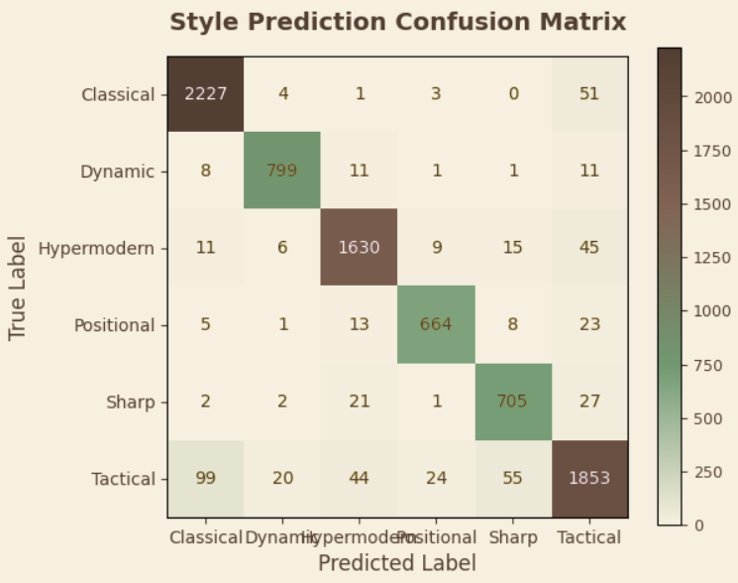
Model Performance
93.7%
Accuracy
Model correctly predicts playstyle in nearly all cases

Slide 17
05
Live Demo + conclusion

Slide 18
DEMO TIME!
https://capstonewebsite-nl9a.onrender.com

Slide 19
Conclusion
Openings do have a major impact on win rate
Many players struggle to choose the right opening
This system offers a personalised solution to a problem many people face such as myself

Slide 20

THANKS
ANY QUESTIONS?
Please keep this slide for attribution

