Slide 1

Subscribe to DeepL Pro to edit this document.
Visit www.DeepL.com/pro for more information.

Slide 2
MARKETING OUTCOME PREDICTION
PROJECT
TOM HAVYARIMANA
23/02/2023

Slide 3





UNDERSTAND
ANALYZE
Introducing datasets and the problem
Graphics that address the problem
CLEAN
PREDIRE
Data processing: zero values, incomplete values, extreme values
Presentation of the models used and their results

Slide 4
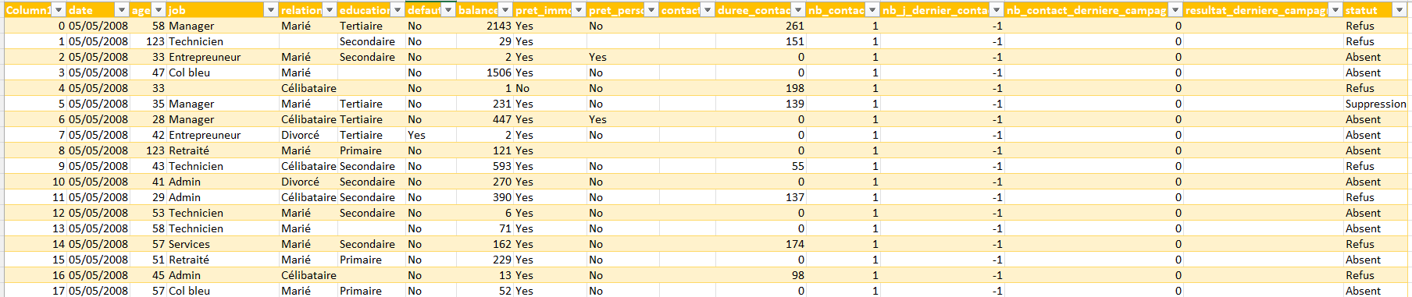
UNDERSTAND
DATA PRESENTATION
The data are taken from direct marketing campaigns (telephone canvassing) by a major banking institution, relating to a "term deposit" product. A term deposit is a bank deposit that can only be withdrawn at the end of a certain term or period, in return for an interest rate that is generally higher than for a conventional (sight) deposit.

Slide 5
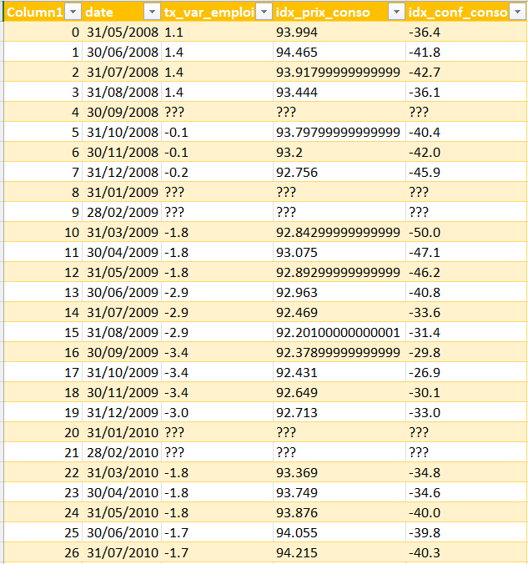
UNDERSTAND
DATA PRESENTATION
Data set containing socio-economic and contextual market indicators.
Variables:
DATE: End date of reference month for indicators
TX_VAR_EMPLOI: Rate of change in employment (quarterly indicator)
IDX_PRIX_CONSO: Consumer price index (monthly indicator)
IDX_CONF_CONSO: Consumer confidence index (monthly indicator)

Slide 6
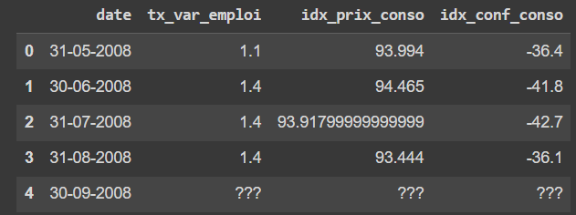
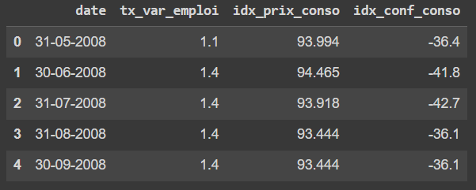
CLEAN
SOCIO ECO
Treatment of null values: In this dataset, question marks are considered as null values. They have been replaced by the previous month's values.
Rounded values: To make data and graphs easier to read, idx_prix_conso values have been rounded to the 3rd decimal place.

Slide 7
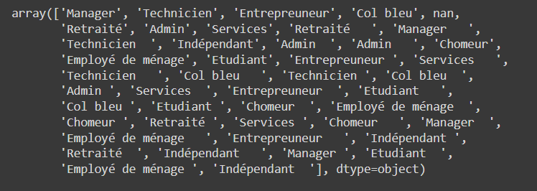

CLEAN
DATA
Similar values, different syntax: There were identical values but written with extra spaces. They were therefore removed.
Dealing with null values: This time, they've either been replaced by the most represented value in that column, or renamed.

Slide 8
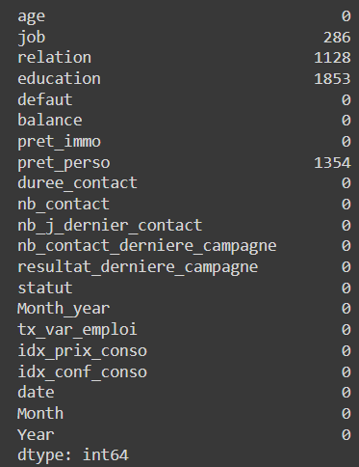
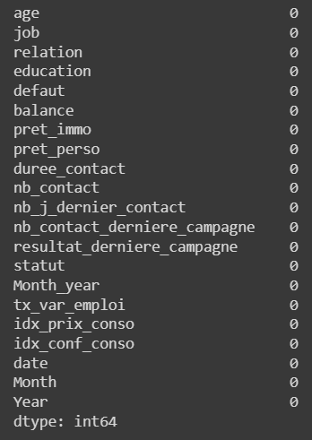
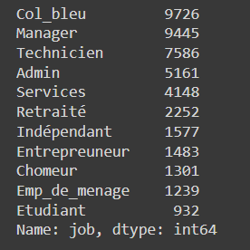
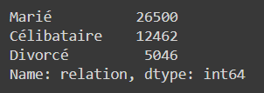

CLEAN
DATA
Similar values, different syntax: There were identical values but written with extra spaces. They were therefore removed.
Dealing with null values: This time, they've either been replaced by the most represented value in that column, or renamed.

Slide 9
WHAT IS THE IDEAL CUSTOMER PROFILE?
AGE:
TRADE:
RELATIONSHIP:
REAL ESTATE LOAN:
PERSONAL LOAN:

Slide 10
ANALYZE
Interpretation
THE AGE MOST REPRESENTED IN THIS TELEPHONE MARKETING CAMPAIGN IS 32. OVERALL, WE CAN SEE THAT IT WAS THE THIRTY-SOMETHINGS WHO WERE MOST SOLICITED.

Slide 11
ANALYZE
Interpretation
THE AGE GROUPS MOST LIKELY TO SUBSCRIBE TO THE DEPOT PRODUCT ARE THOSE BETWEEN 60 AND 100. THEY ALONE ACCOUNT FOR OVER 60% OF SUBSCRIPTIONS.
CONVERSELY, THE LEAST FREQUENT SUBSCRIBERS ARE THOSE AGED BETWEEN 40 AND 50.

Slide 12
ANALYZE
Interpretation
OVER 350 PEOPLE BETWEEN 60 AND 100 ARE RETIRED. FAR BEHIND, 47 HOLD MANAGERIAL POSITIONS.

Slide 13
ANALYZE
INTERPRETATION
THIS GRAPH SHOWS THAT PENSIONERS HAVE THE HIGHEST AVERAGE BALANCE (ALMOST 2000 EUROS), AHEAD OF MANAGERS.

Slide 14
ANALYZE

Slide 15
ANALYZE
AGE: 60 to 100 years
PROFESSION: Retired
RELATIONSHIP: Married
REAL ESTATE LOAN: No
PERSONAL LOAN: No

Slide 16
PREDIRE
1
Class imbalance
2
Variable selection
3
Models
4
Results

Slide 17
PREDIRE
1
Class imbalance: use of SMOTE for over and undersampling. This makes it possible to generate samples for
balance the two classes.

Slide 18
PREDIRE
2
Variable selection: Use the MI score to determine the importance of each variable. The higher the score,
the more information the variable contains in relation to the target variable.
relationship_Single
job_Student
job_Indépendant
job_Chomeur
job_Other
job_Employment
job_Retraité
age_group_60 to 80
fault
age_group_80 to 100
age_group_20 to 30

Slide 19
PREDIRE
3
Models: Use of three models. Logistic Regression, Random Forest and XGBoost for a classification problem.
LOGISTIC REGRESSION
XGBOOST
RANDOM FOREST

Slide 20



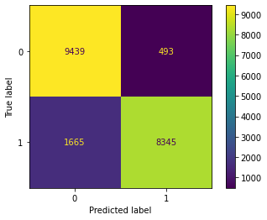
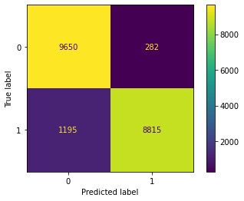
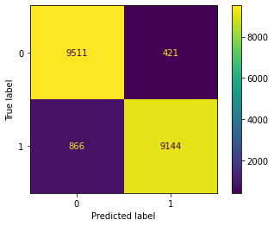
PREDIRE
4
Results: The best model is Random Forest. Accuracy is lower than XGBoost, but Recall is higher.
LOGISTIC REGRESSION
XGBOOST
RANDOM FOREST

Slide 21
GO TO THE INTERFACE, FOR MORE INTERACTION WITH GRAPHICS AND MODELS

Slide 23
THANK YOU FOR LISTENING
TOM HAVYARIMANA
23/02/2023

