Slide 1
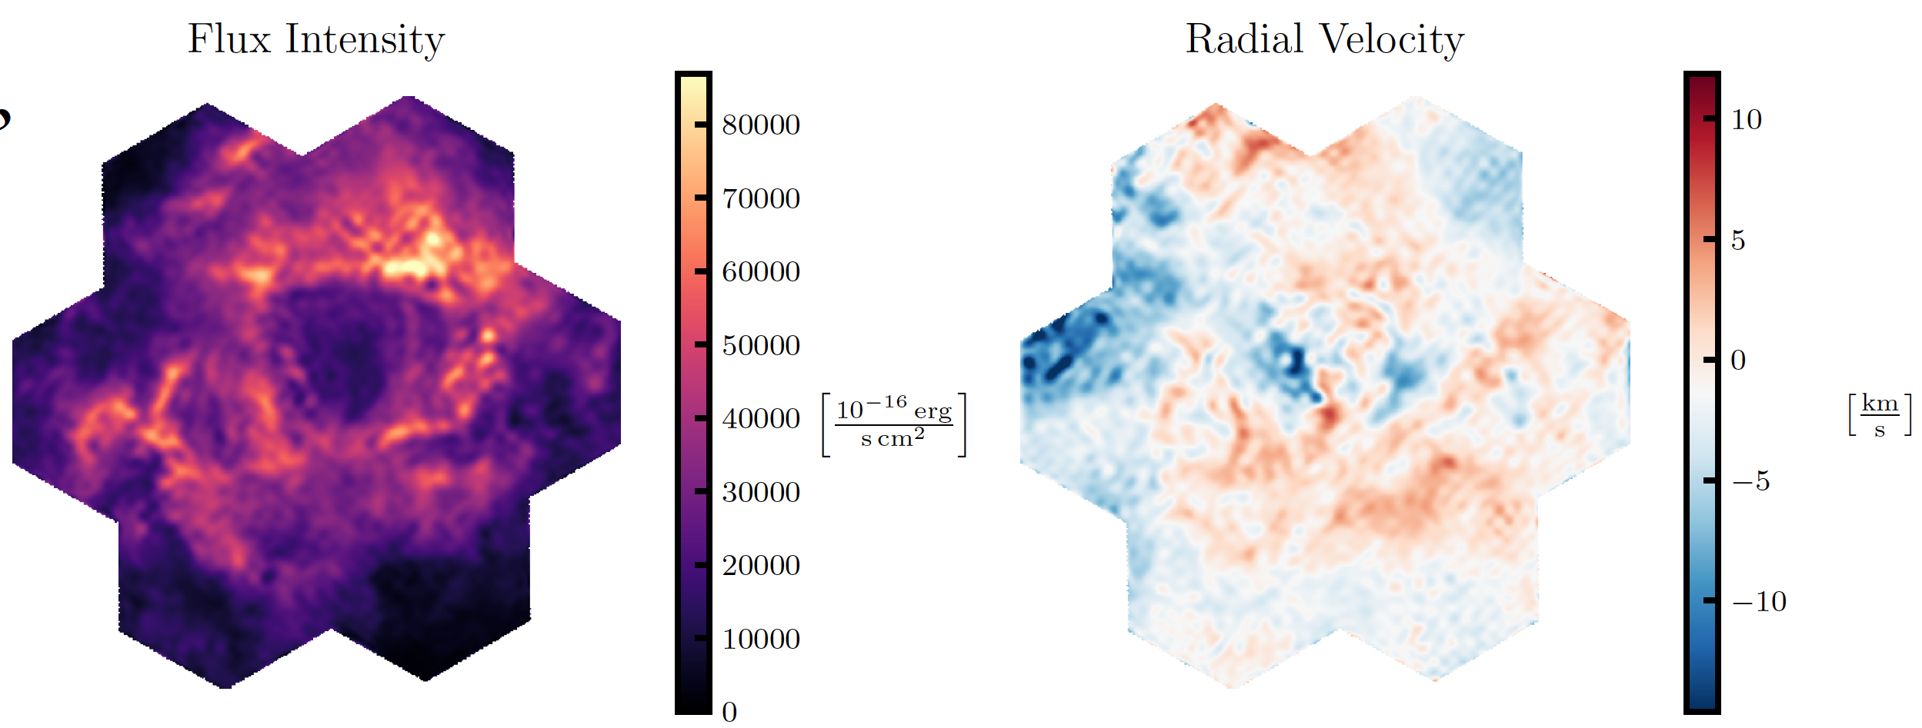
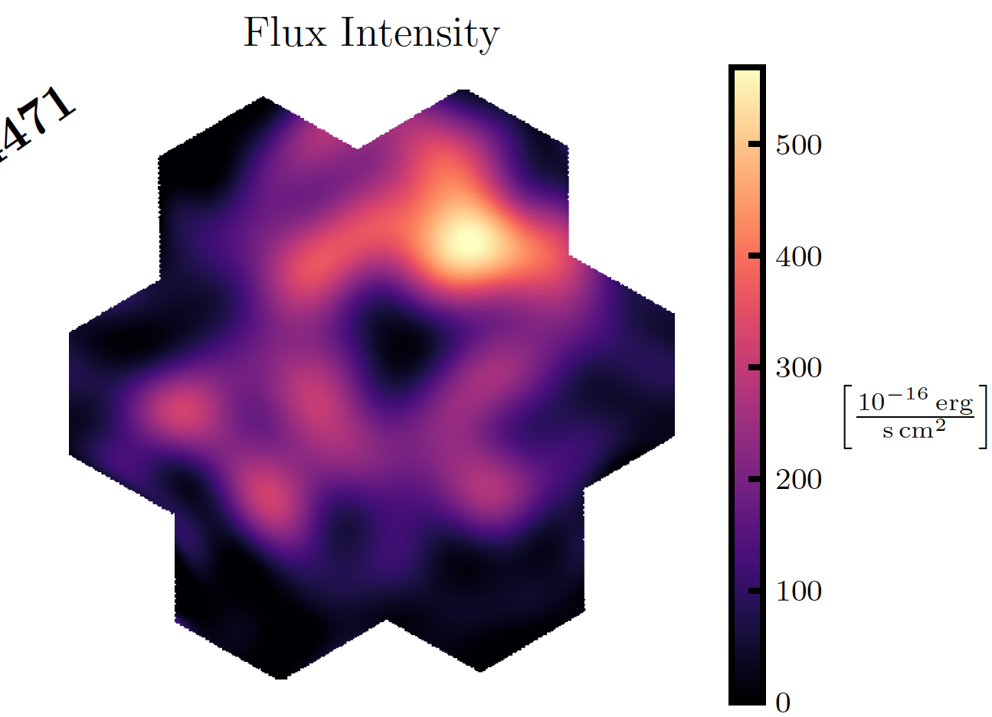
IMPROVEMENTS COMPARISON
H⍺
He I 4471
OLD
CURRENT
19 tiles for new H⍺

