Slide 1
Dwarven Generator

Slide 2
The Brief
Creating a application with a service-orientated architecture
4 services communicating
Fully integrated with a CI server
Deployed using containerisation
Using ansible to provision the environment for the application

Slide 3
My solution
My solution for the brief was to create a random dwarven generator.
Service 1
Service 2
Service 3
Service 4

Slide 4
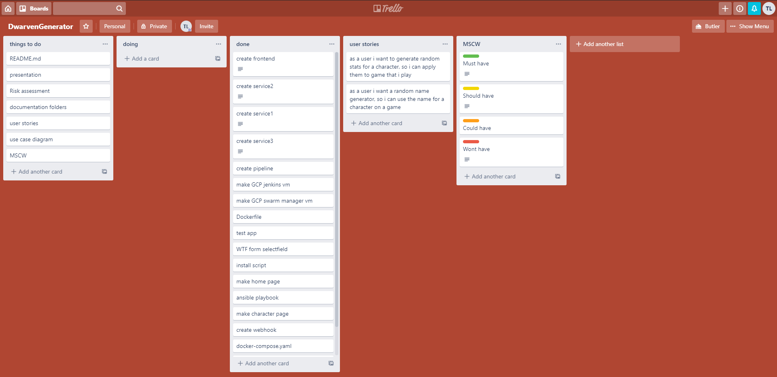
Planning
Trello was used
MSCW
User stories
Things to do/done

Slide 5
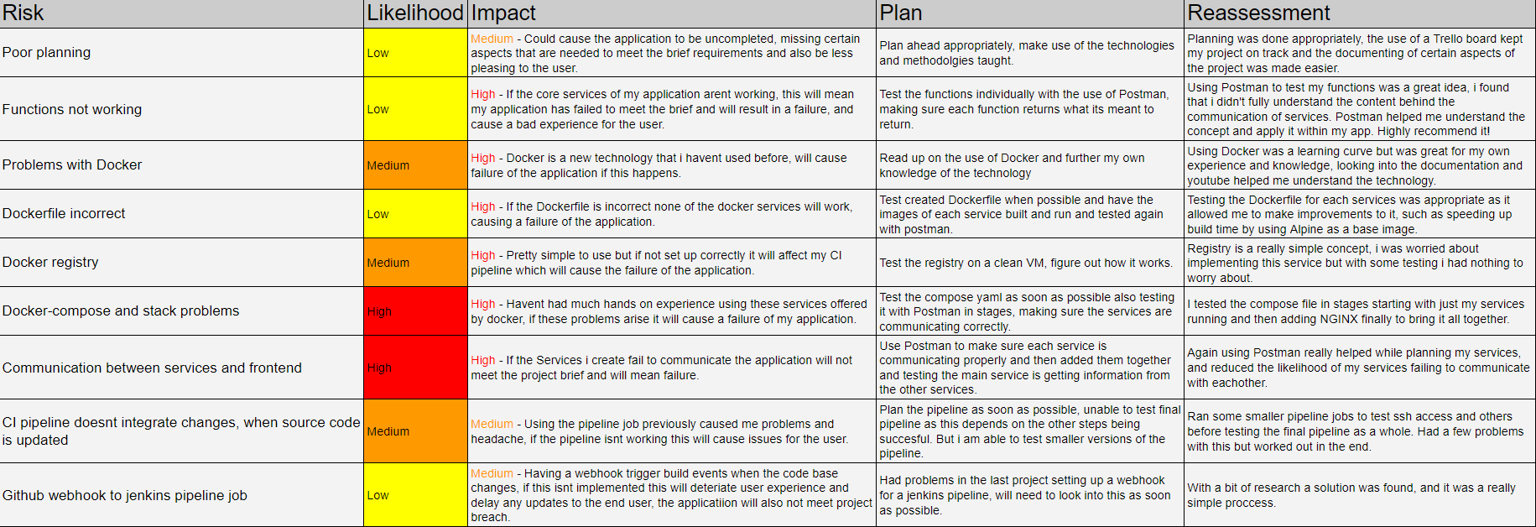
Risk assessment

Slide 6
Technologies used
Python flask
Git
Github
Ansible
Trello
jenkins
Docker
NGINX

Slide 7
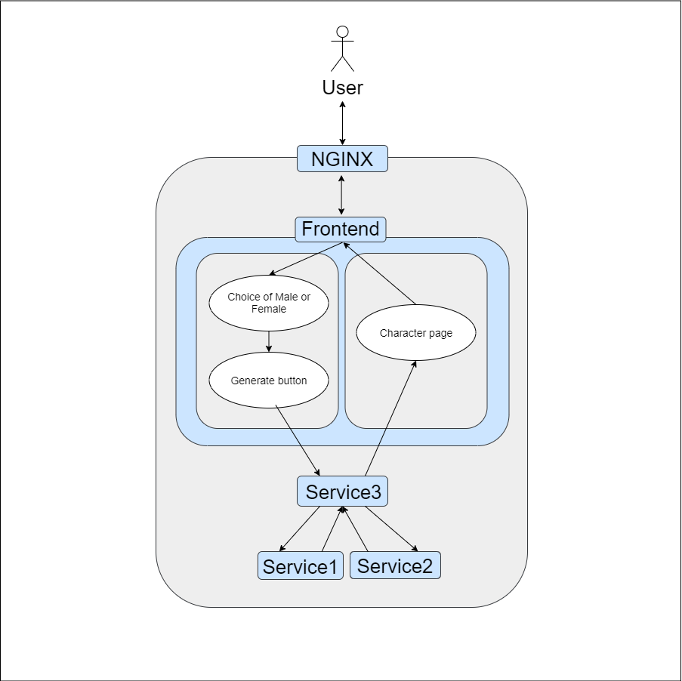
User journey
User gets to homepage
User selects gender
User clicks generate
Application processes data
Application returns character page

Slide 8
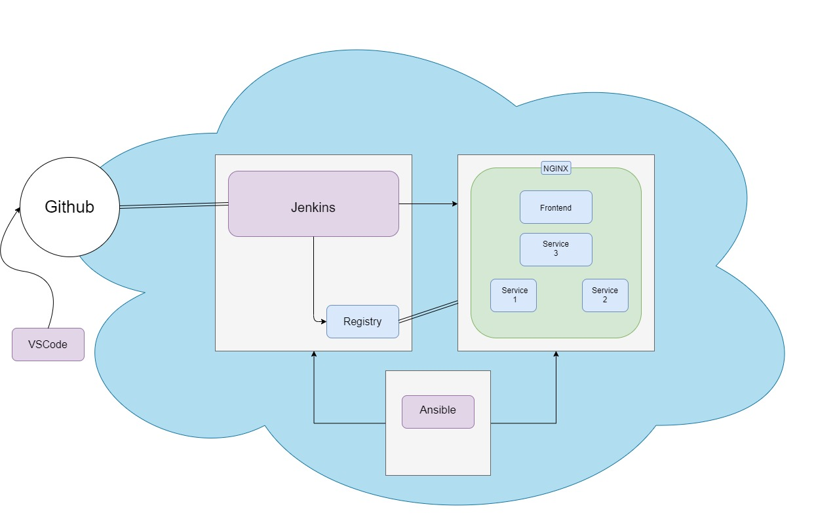
Deployment
Environments created with ansible
Containerisation
Git webhook with jenkins
Jenkins updates application

Slide 9
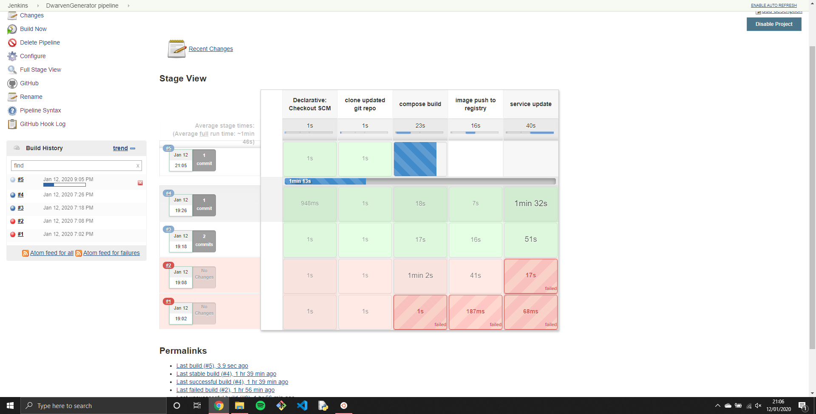
Continuous Deployment

Slide 10
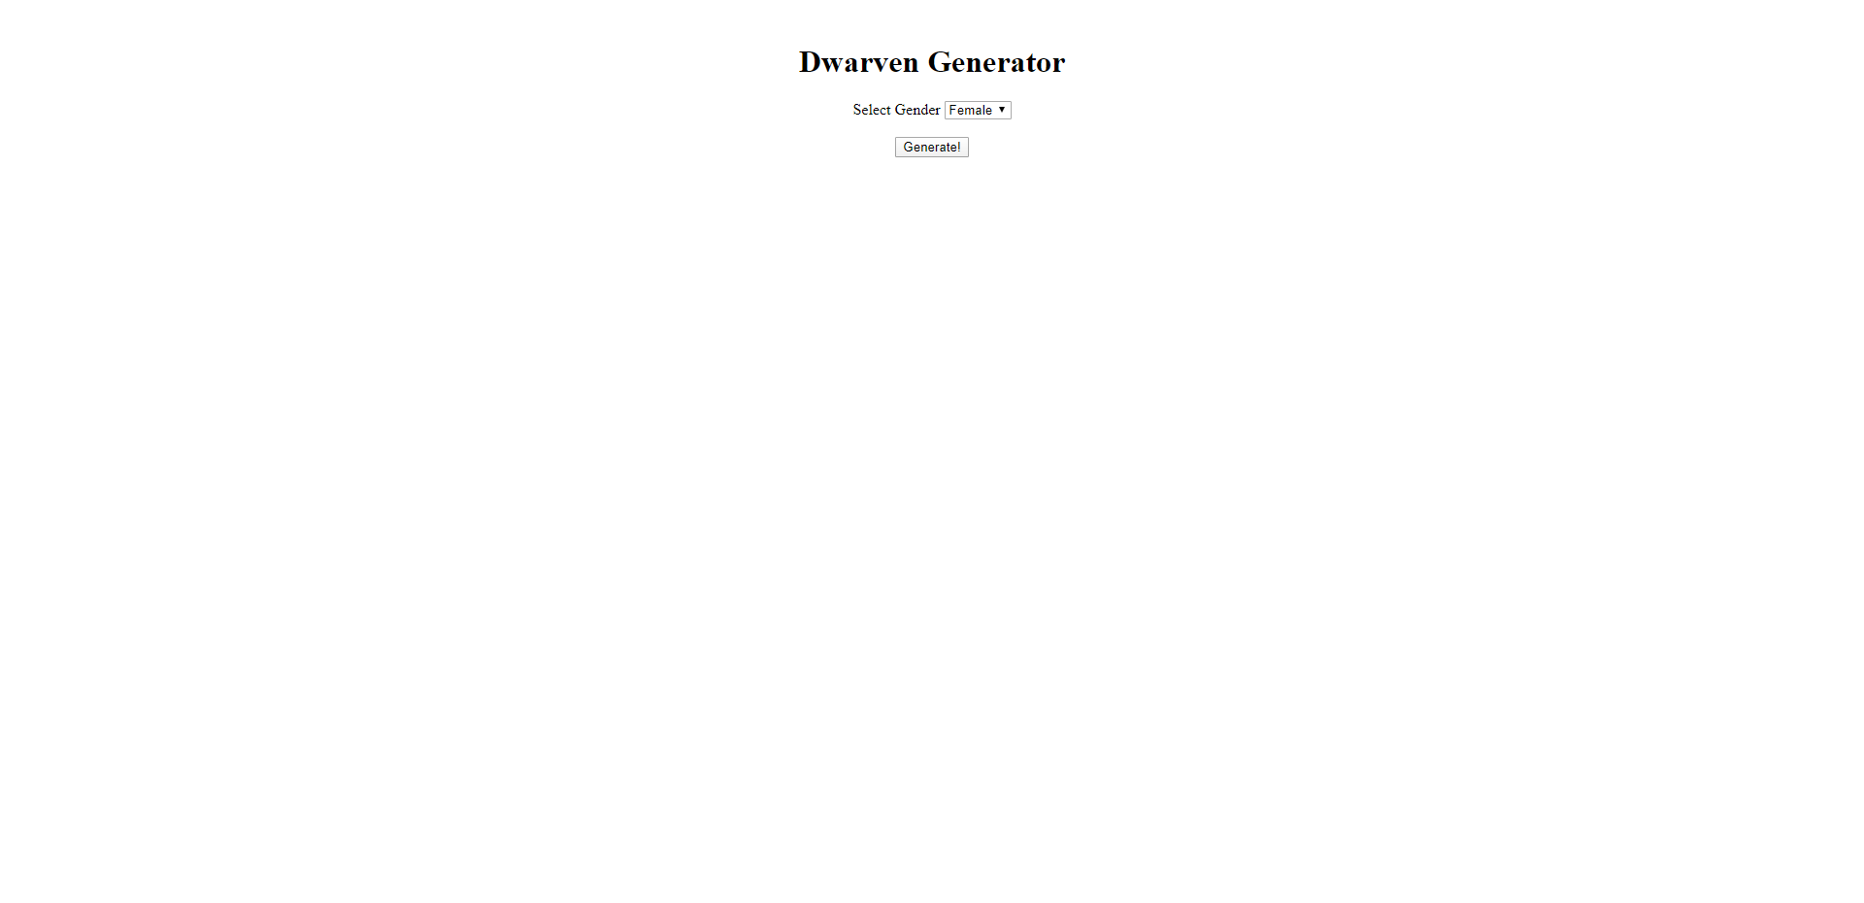
Front end

Slide 11
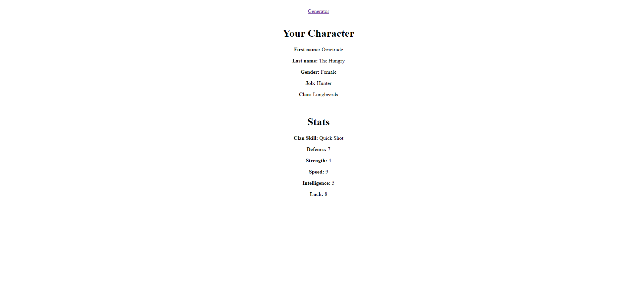
Character page

Slide 12
Future ideas
Many things can be added, for the future. I would like to add more races to the application, this will appeal to a wider audience. I also would like to have a service that allows for the user to create their own accounts and save the characters that are generated for them where they can delete them if they wanted.

Slide 13
Product demonstration
http://35.189.76.12/home

Slide 14
Summary
Learnt a lot
Improve the GUI
Happy with it all coming together

Slide 15
Questions?

