Slide 1
Workout Log
Individual project

Slide 2
The brief
To create a CRUD application with utilisation of supporting tools, methodologies and technologies that encapsulate all core modules covered during training.

Slide 3
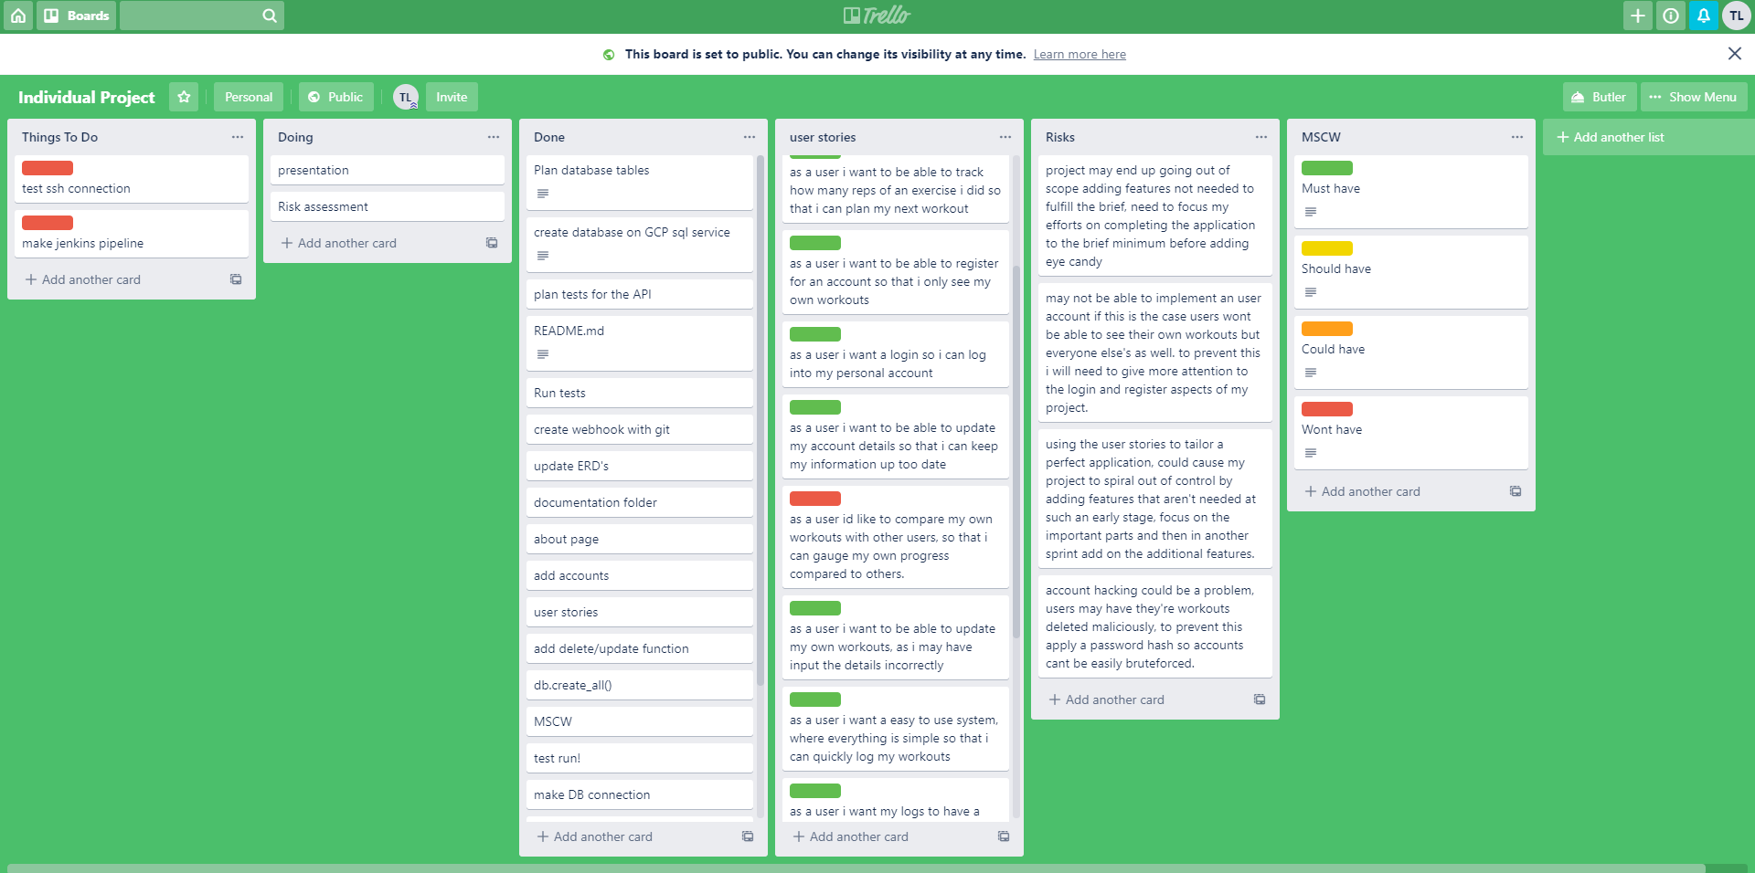
My solution
User stories
Risks
MSCW
Things to do

Slide 4
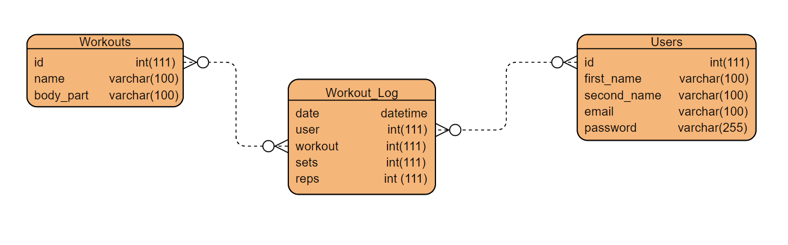
ERD
Initial ERD –

Slide 5
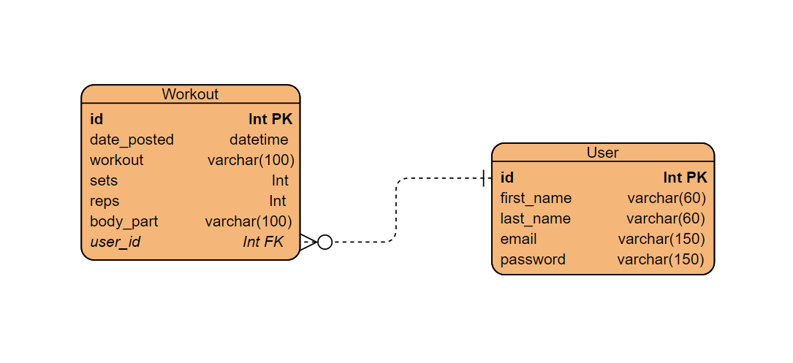
Final ERD -
Notes:
Due to time constraints decided on this for my final ERD

Slide 6
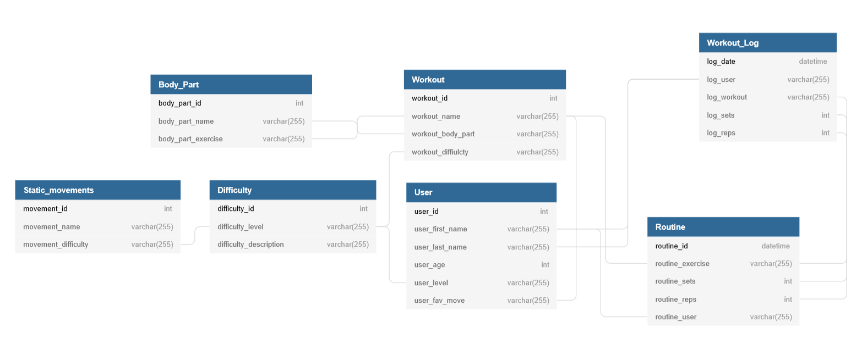
Future ideas

Slide 7
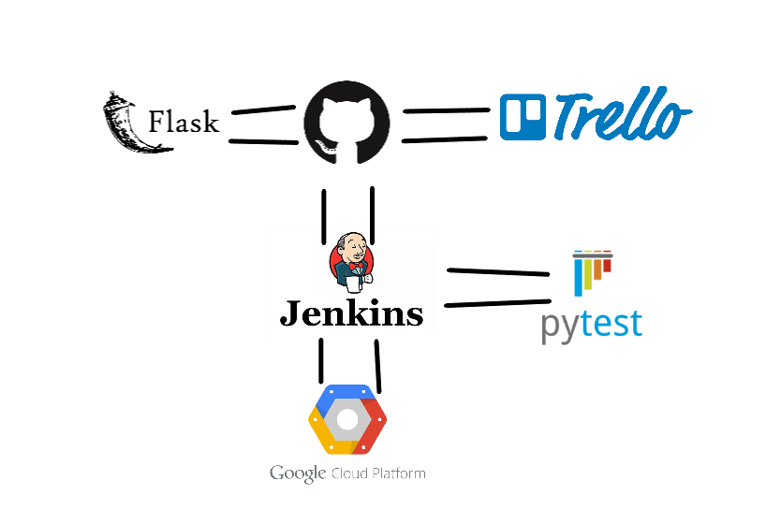
CI pipeline
Notes:
Wanted to get Jenkins pipline working with ssh over to another vm sadly wastn able to implement this but I have a webhook setup to the git repository that pull it down and deploys it using gunicorn

Slide 8
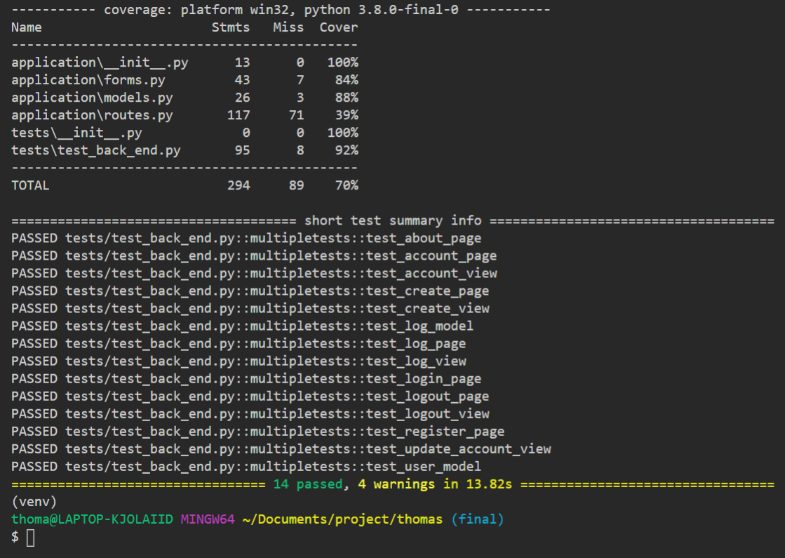
Testing
Tests run with pytest
70% with back end tests
59% without back end tests
Would’ve liked to give selenium a go

Slide 9
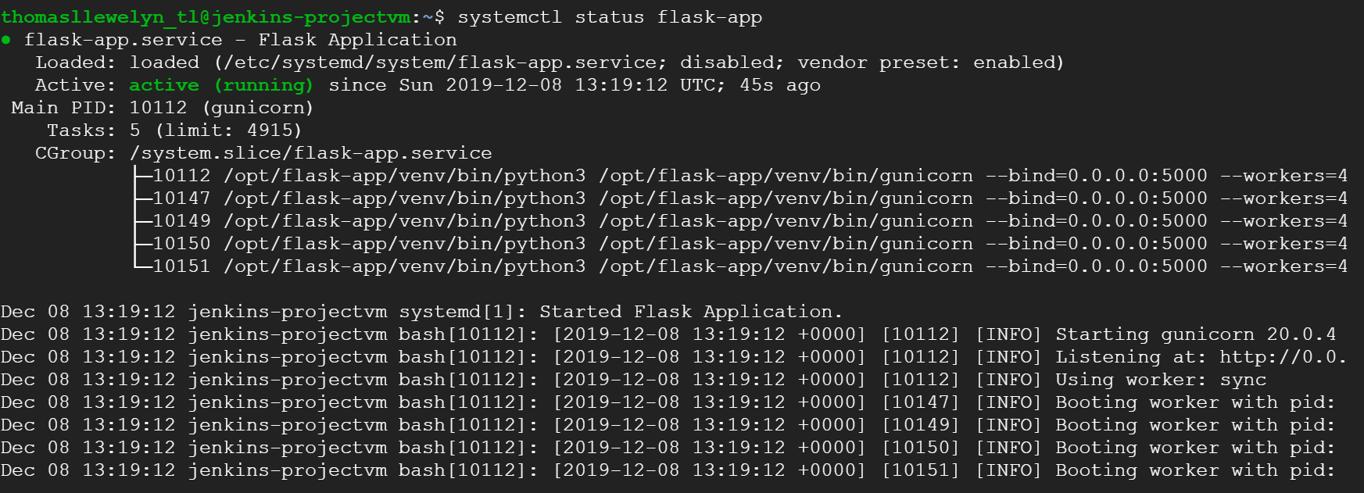
Deployment

Slide 10
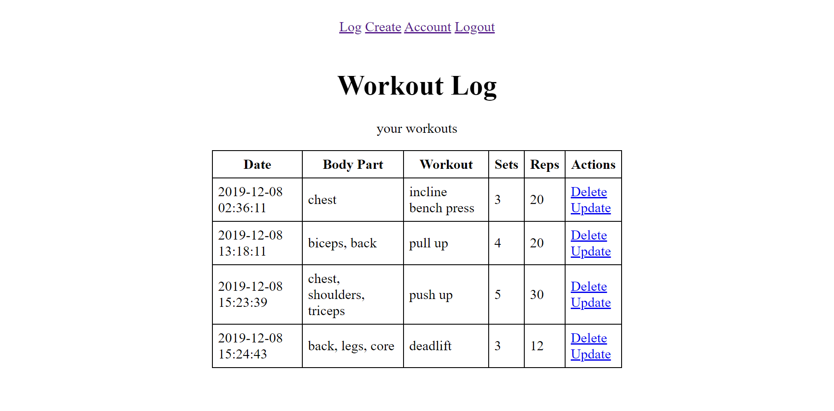
Front end

Slide 11
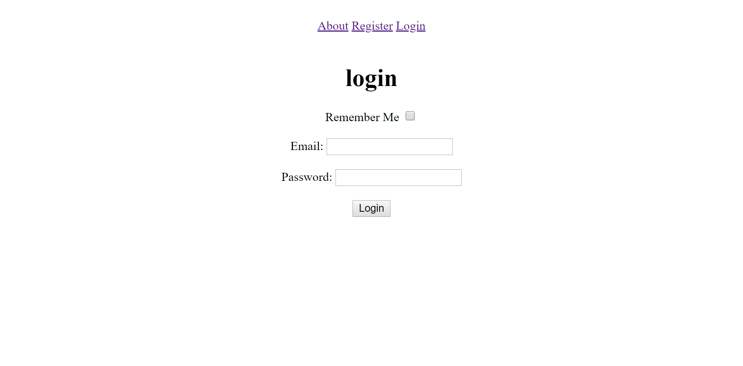
Product demonstration
Workout Log = http://35.204.10.247:5000
Notes:
Don’t forget to turn it all on

Slide 12
Summary
I learnt a lot!
There are areas I need to improve
Project tracking
Selenium testing to improve coverage of tests
Improve the GUI
Happy with it all coming together

Slide 13
Questions?

