Slide 1
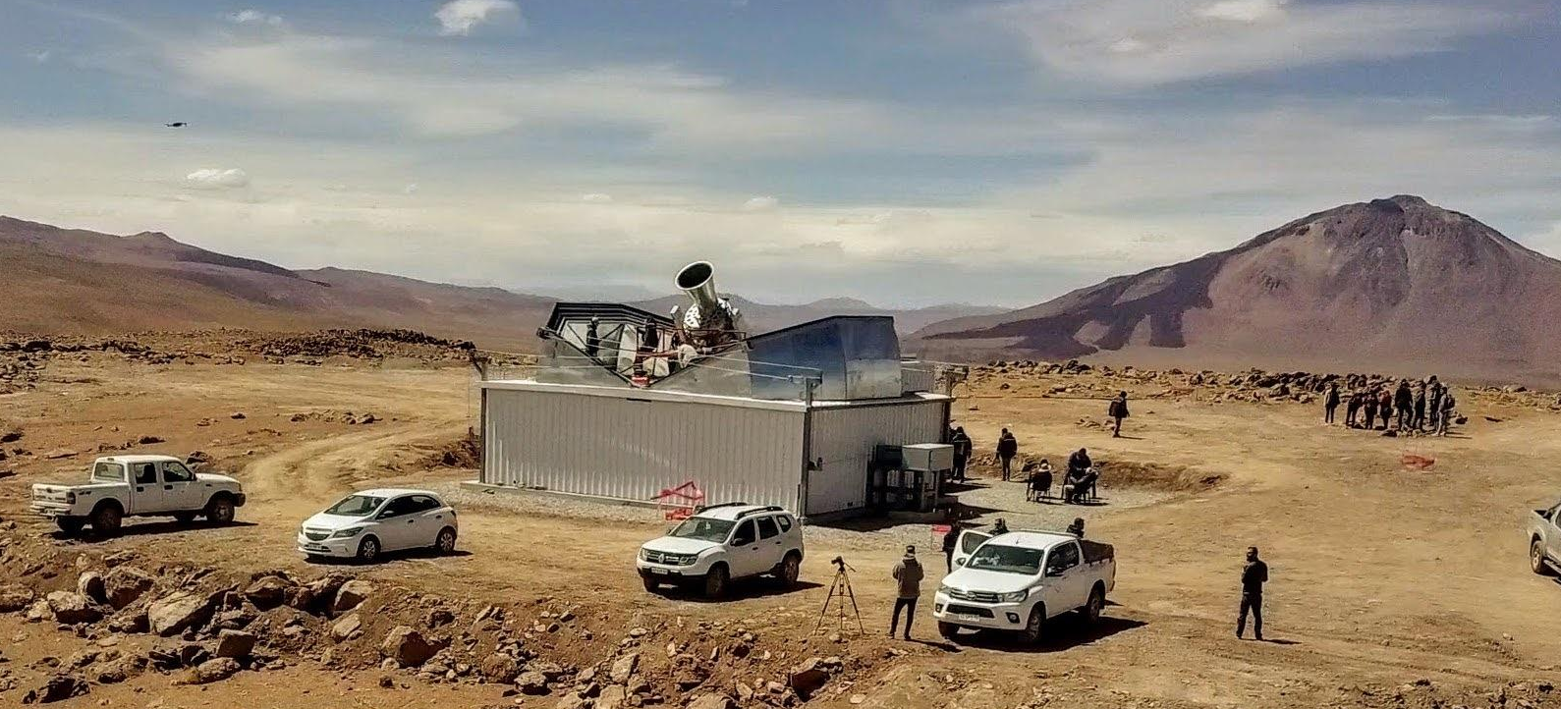
Spectral Imaging with QUBIC :
Component separation using Bolometric Interferometry
Tom Laclavère on behalf of the QUBIC Collaboration

Slide 2
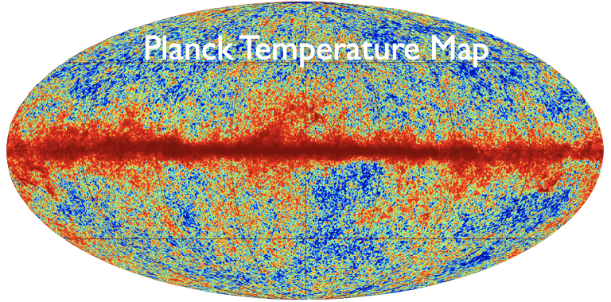
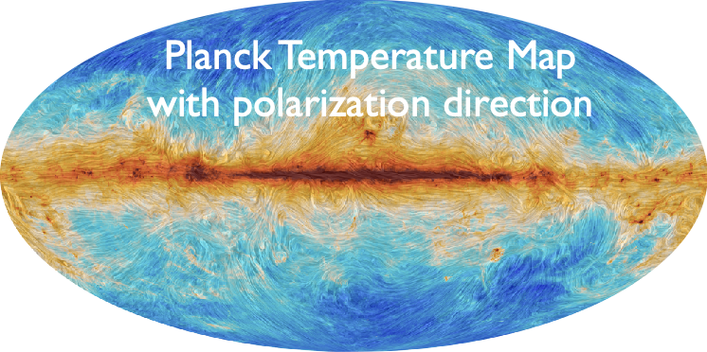
Scientific context
Density fluctuations in the primordial plasma
Fluctuations in the CMB
E-modes:
Well measured
Expected from Primordial Gravitational Waves ⟺ Inflation
B-modes:
Not observed

Slide 3
Scientific purpose
QUBIC goal : Constraints on cosmic inflation by the detection of primordial polarization B modes in the cosmic microwave background

Slide 4
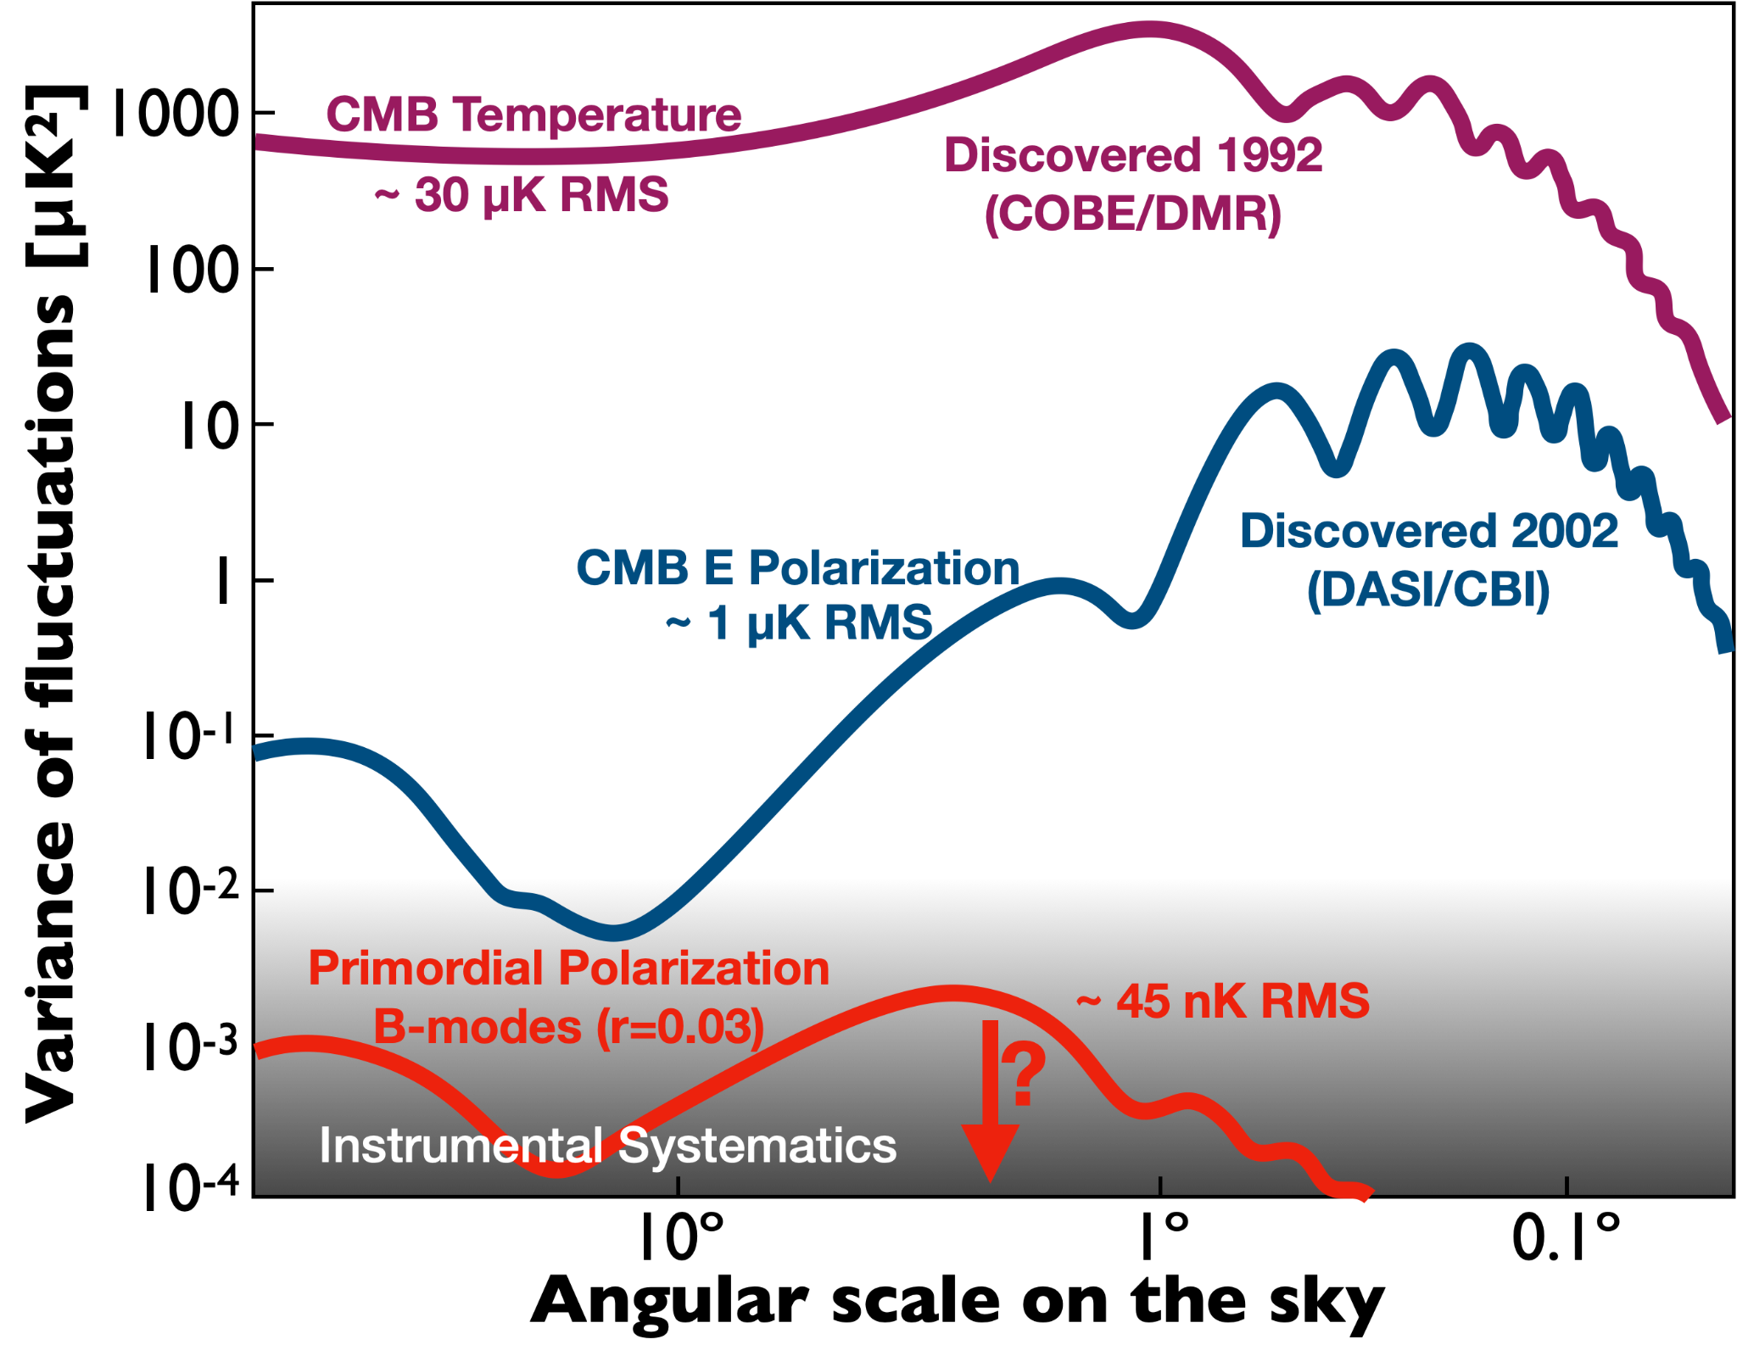
Scientific purpose
QUBIC goal : Constraints on cosmic inflation by the detection of primordial polarization B modes in the cosmic microwave background
→ Difficulties :
Sensitivity
  Very small signal
[Bicep/Keck+Planck 2021 + SPTPol, ActPol, Polarbear]

Slide 5
Scientific purpose
QUBIC goal : Constraints on cosmic inflation by the detection of primordial polarization B modes in the cosmic microwave background
→ Difficulties :
Sensitivity
  Very small signal
  Instrumental systematics
[Bicep/Keck+Planck 2021 + SPTPol, ActPol, Polarbear]

Slide 6
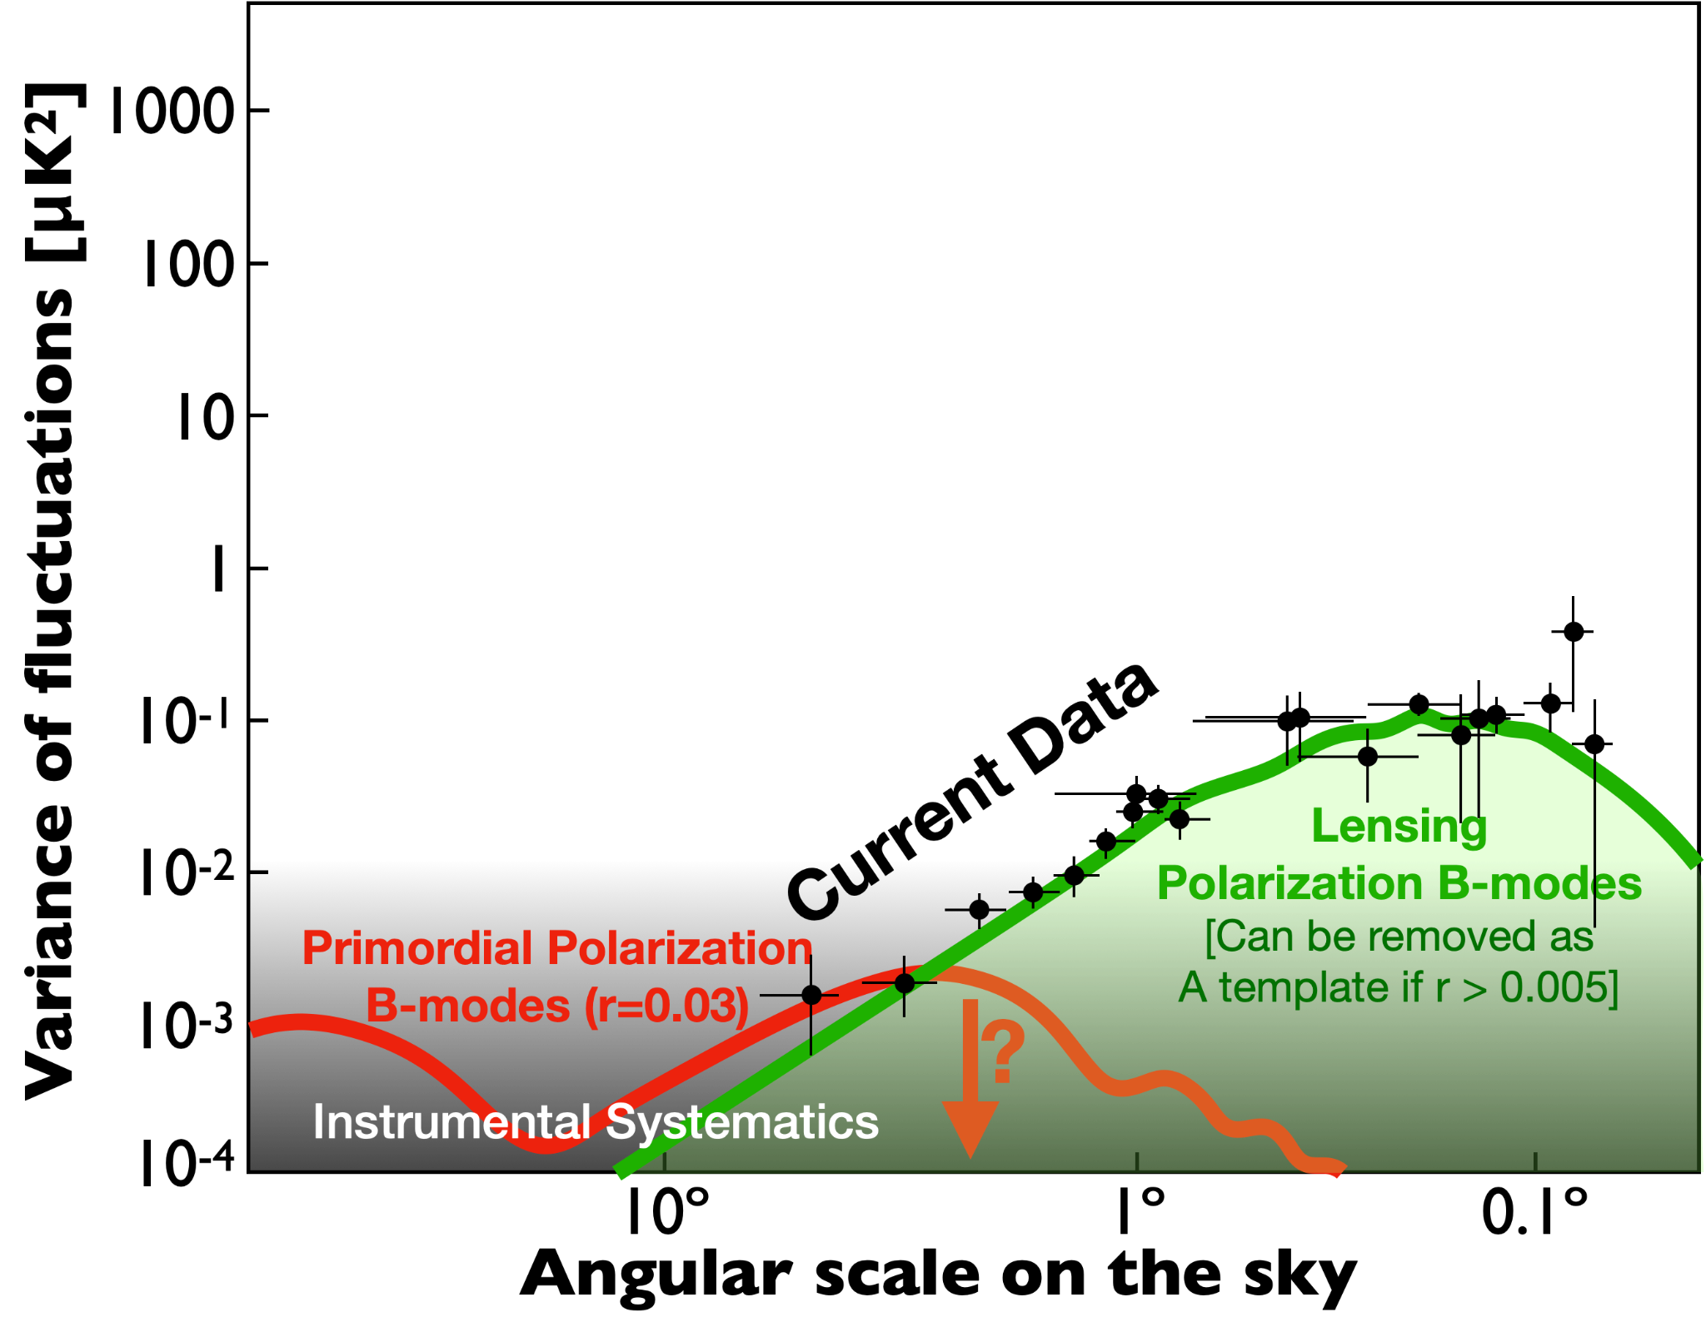
Scientific purpose
QUBIC goal : Constraints on cosmic inflation by the detection of primordial polarization B modes in the cosmic microwave background
→ Difficulties :
Sensitivity
  Very small signal
  Instrumental systematics
Polarized astrophysical foregrounds :
  Gravitational lensing
Synchrotron
[Bicep/Keck+Planck 2021 + SPTPol, ActPol, Polarbear]

Slide 7
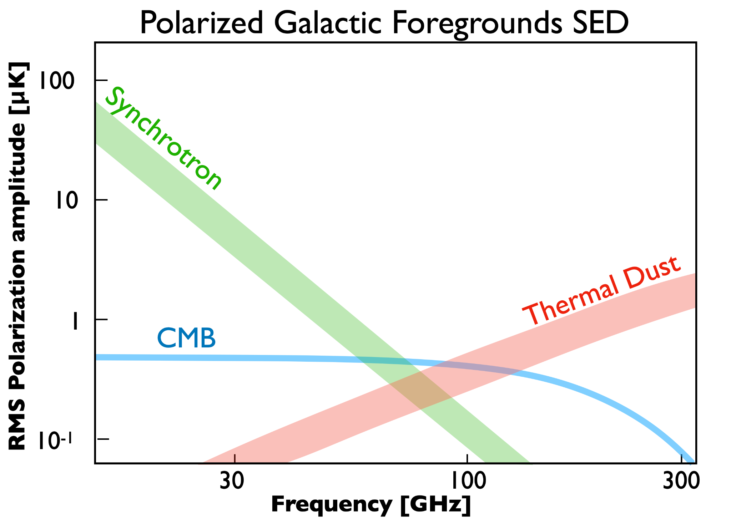
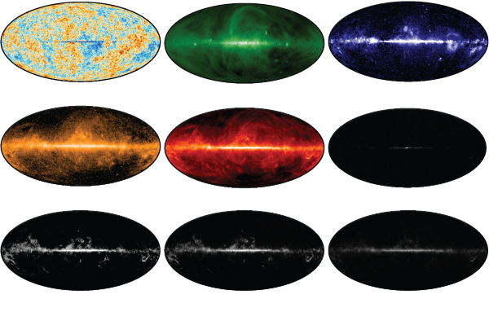
Scientific purpose
QUBIC goal : Constraints on cosmic inflation by the detection of primordial polarization B modes in the cosmic microwave background
→ Difficulties :
Sensitivity
  Very small signal
  Instrumental systematics
Polarized astrophysical foregrounds :
  Gravitational lensing
  Dust & Synchrotron
Synchrotron
Dust
CMB

Slide 8
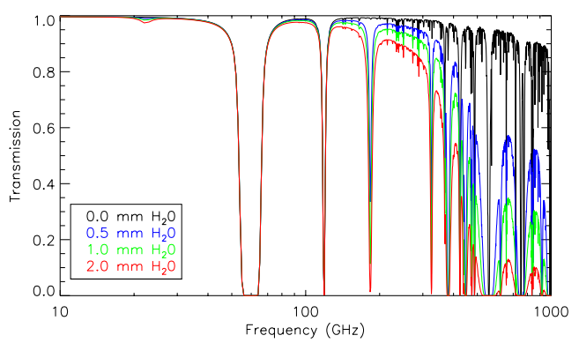
Scientific purpose
QUBIC goal : Constraints on cosmic inflation by the detection of primordial polarization B modes in the cosmic microwave background
→ Difficulties :
Sensitivity
  Very small signal
  Instrumental systematics
Polarized astrophysical foregrounds :
  Gravitational lensing
  Dust & Synchrotron
Atmospheric contamination
Dust
Contribution to the temperature of the detectors
Water vapor distribution is inhomogeneous and moving:
⇒ Temporal and spatial correlations
[J. Errard et al., arXiv:1501.07911]

Slide 9
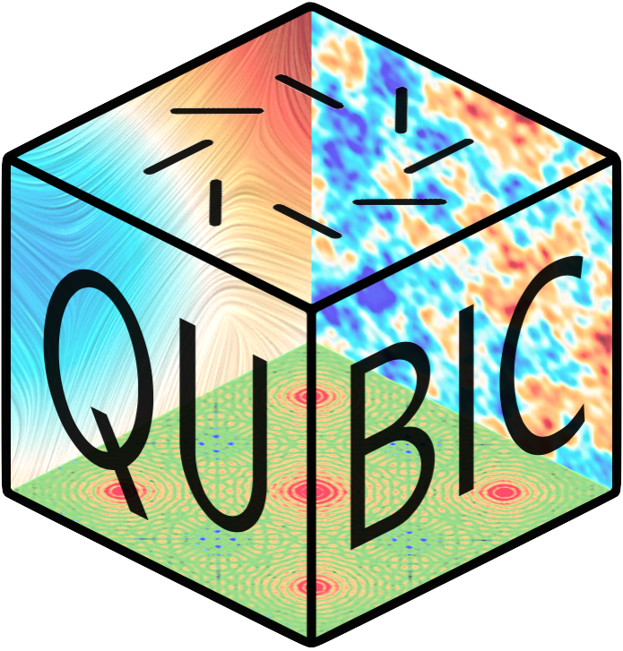



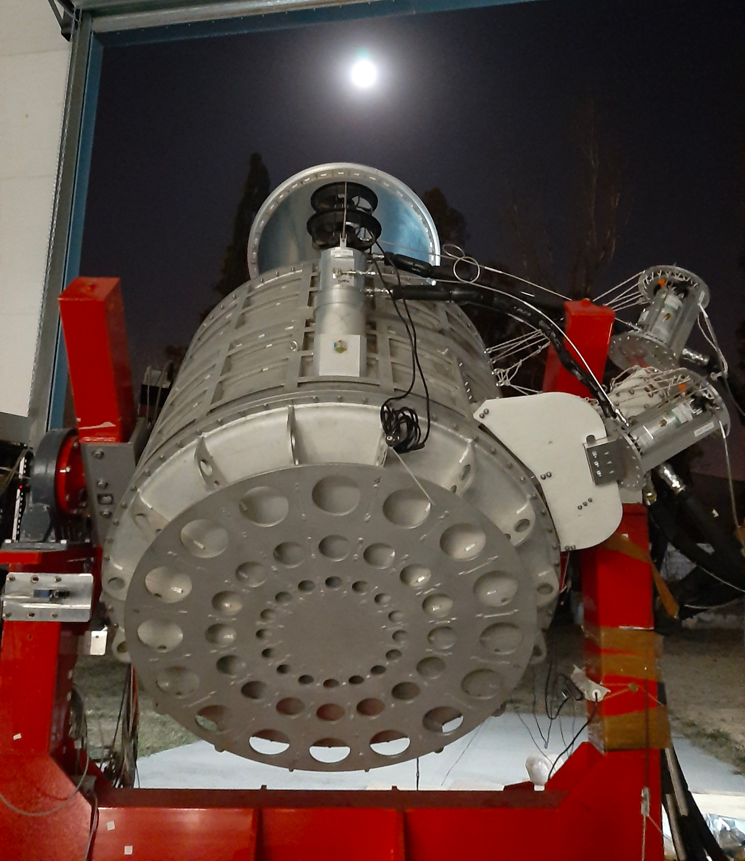


QUBIC:
Q & U Bolometric Interferometer for Cosmology
The collaboration
  130 collaborators
  Observing site: Argentina (5000m a.s.l.)
  First light: July 2022 (Moon from Salta)
  QUBIC is cold !!

Slide 10
QUBIC:
Q & U Bolometric Interferometer for Cosmology
The collaboration
  130 collaborators
  Observing site: Argentina (5000m a.s.l.)
  First light: July 2022 (Moon from Salta)
  QUBIC is cold !!
- High Sensitivity (Transition-Edge-Sensor)
Bolometers
The first Bolometric Interferometer
- Instrumental Systematics control (Self-Calibration)
- Polarized Galactic foregrounds separation (High spectral resolution)
Interferometry

Slide 11
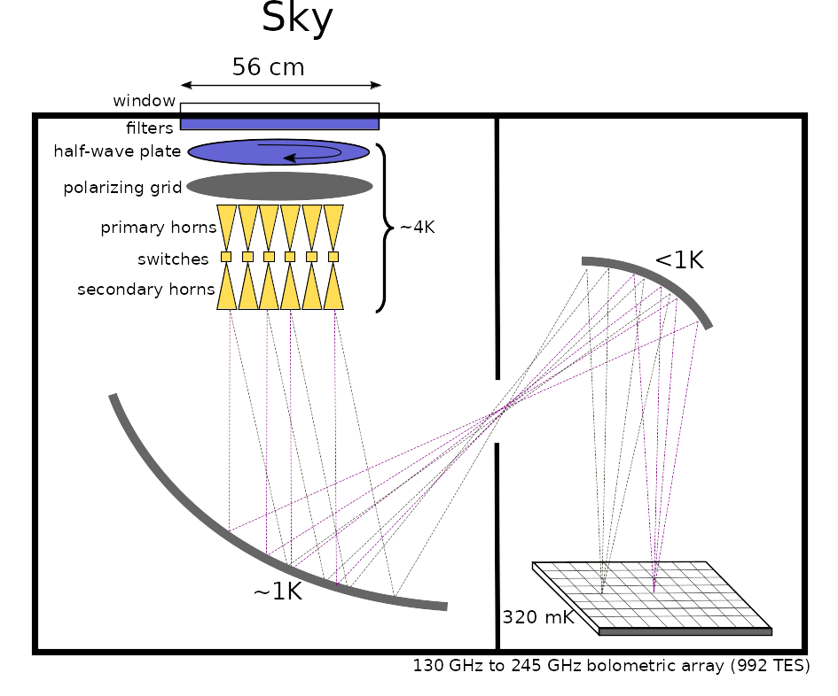
Bolometric Interferometry:
Spectral Imaging

Slide 12
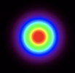
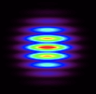
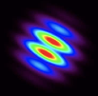
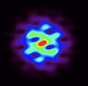
QUBIC:
Q & U Bolometric Interferometer for Cosmology
1 Horn open
2 Horns open
2 Horns open
All Horns open
Fringe and Synthesized Beam data: [Torchinsky et al., QUBIC III, arXiv:2008.10056v3 ] (JCAP 2022)

Slide 13
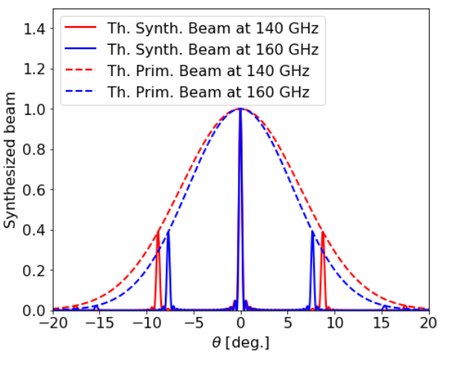
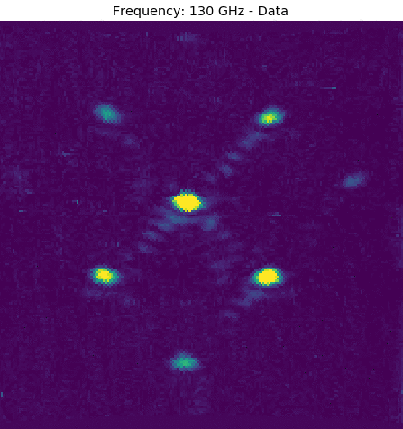
Bolometric Interferometry:
Spectral Imaging
Monochromatic source (Diagram)
Monochromatic source (Laboratory)
[Louise Mousset et al., arXiv:2010.15119]

Slide 14
Bolometric Interferometry:
Spectral Imaging
Monochromatic source (Diagram)
Monochromatic source (Laboratory)
We can increase our spectral sensitivity by using the secondary peaks data
[Louise Mousset et al., arXiv:2010.15119]

Slide 15
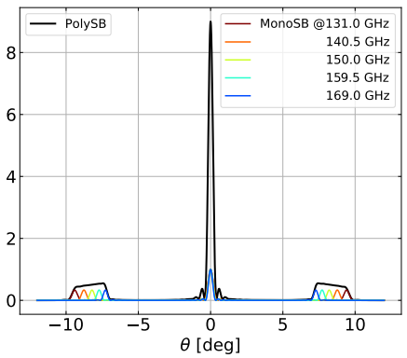
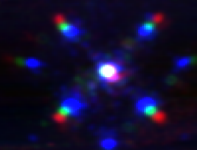
Bolometric Interferometry:
Spectral Imaging
Polychromatic source (Diagram)
Polychromatic source (Laboratory)
[Louise Mousset et al., arXiv:2010.15119]

Slide 16
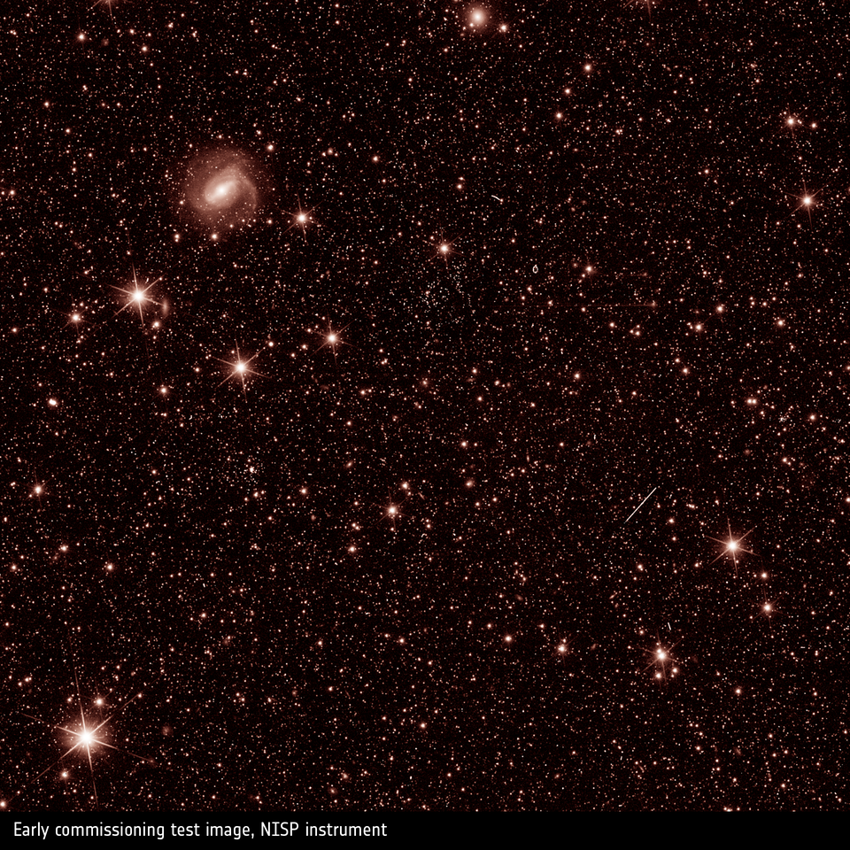
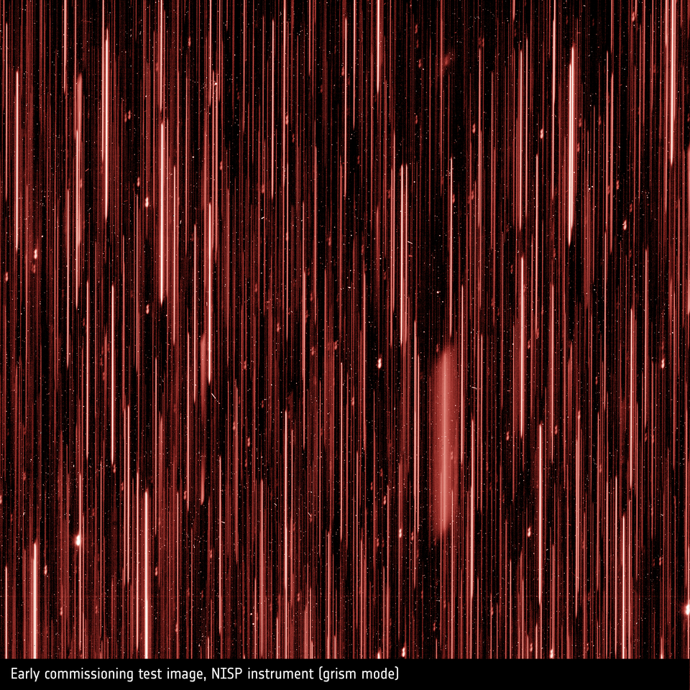
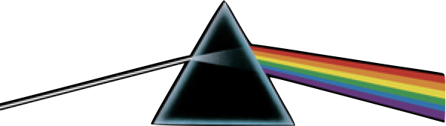
Bolometric Interferometry:
Spectral Imaging
Perfect analogy with “grism spectroscopy” (Euclid test images)
Grism

Slide 17
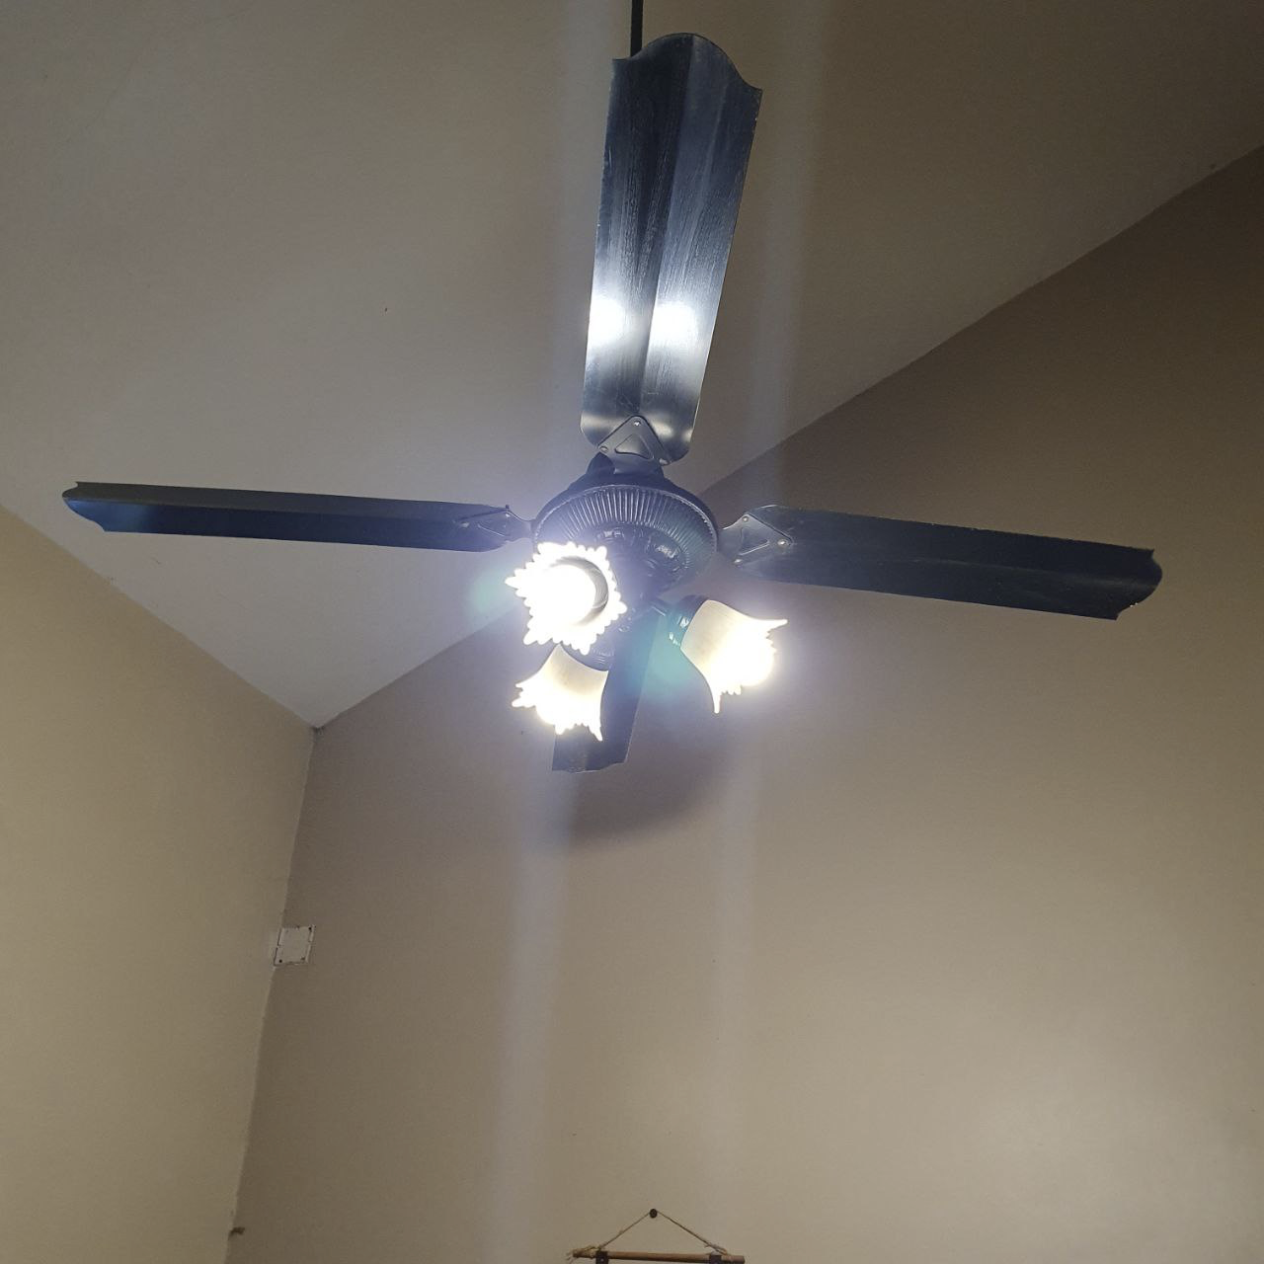
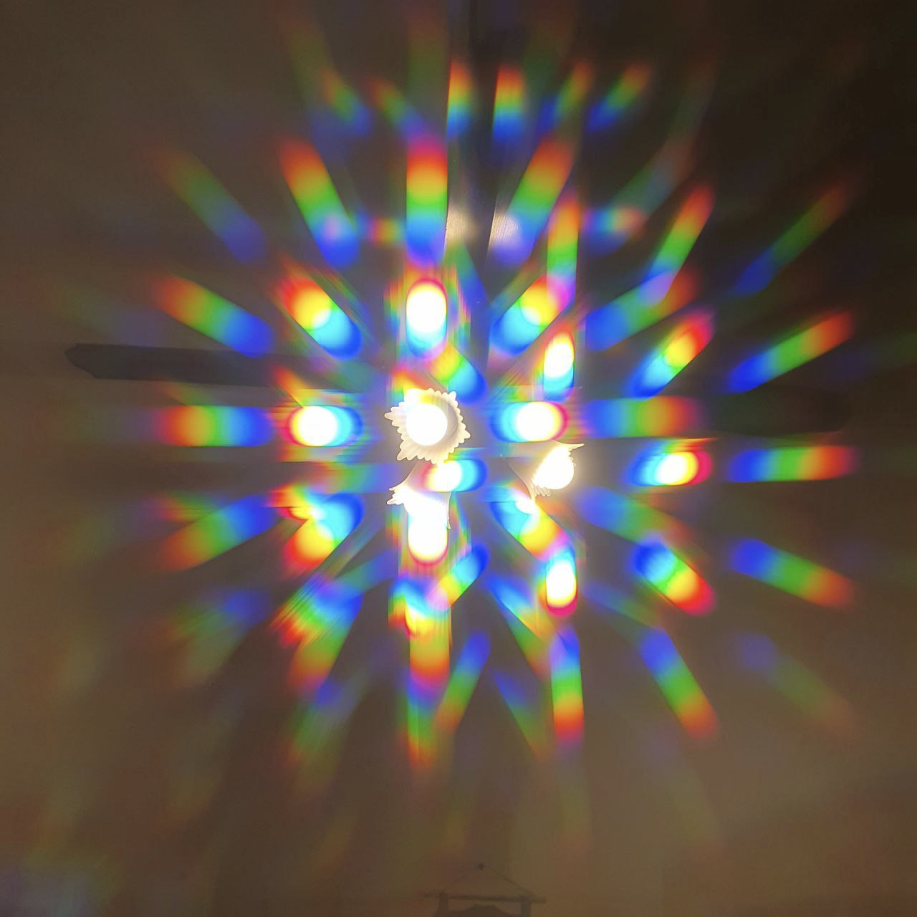
Bolometric Interferometry:
Spectral Imaging
Seeing the world like QUBIC
QUBIC

Slide 18
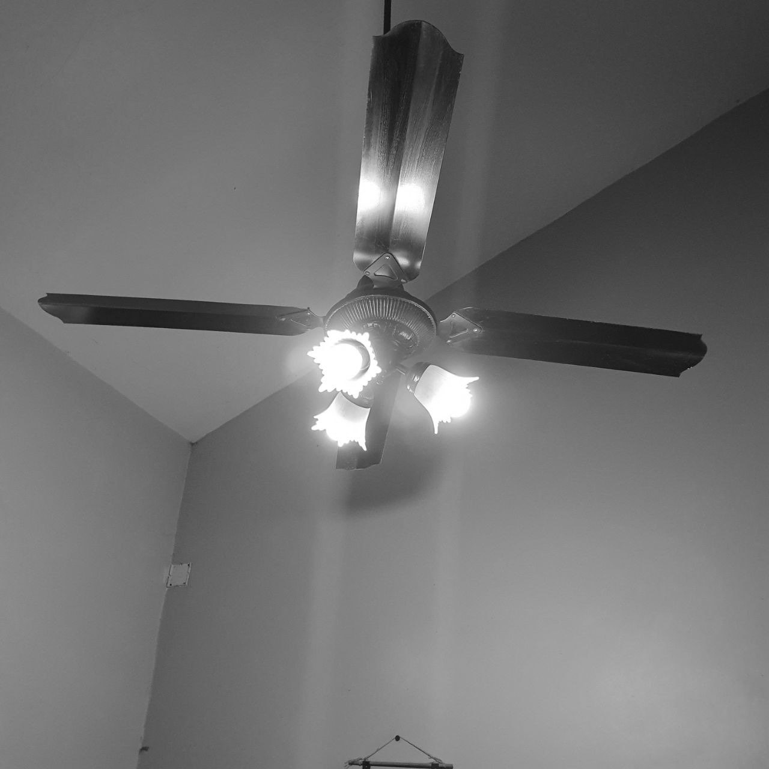
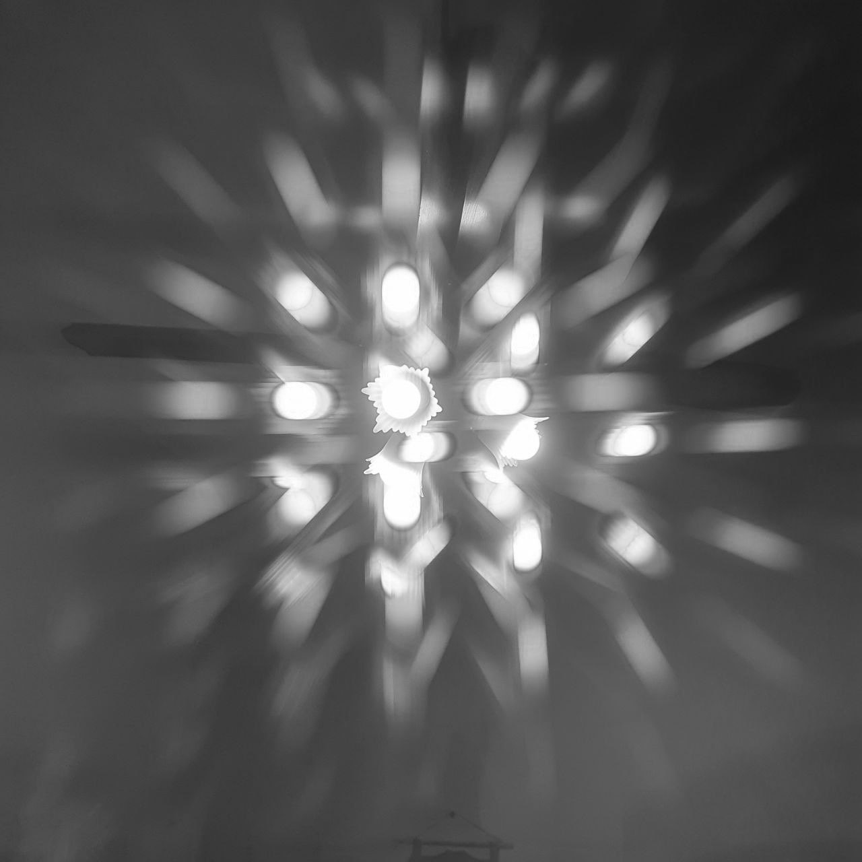
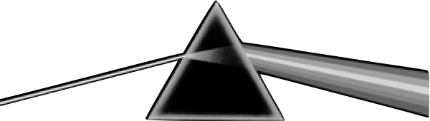
Bolometric Interferometry:
Spectral Imaging
Seeing the world like QUBIC
QUBIC
}
Colors are not visible by bolometers, but spatially encoded !

Slide 19

Frequency Map-Making
Bolometer data (TOD)
Inst. model
Sky
noise
[Chanial, Régnier, et al., A&A submitted, arXiv:2409.18698]

Slide 20

Frequency Map-Making
Bolometer data (TOD)
Inst. model
Sky in
sub-bands
noise
[Chanial, Régnier, et al., A&A submitted, arXiv:2409.18698]

Slide 21
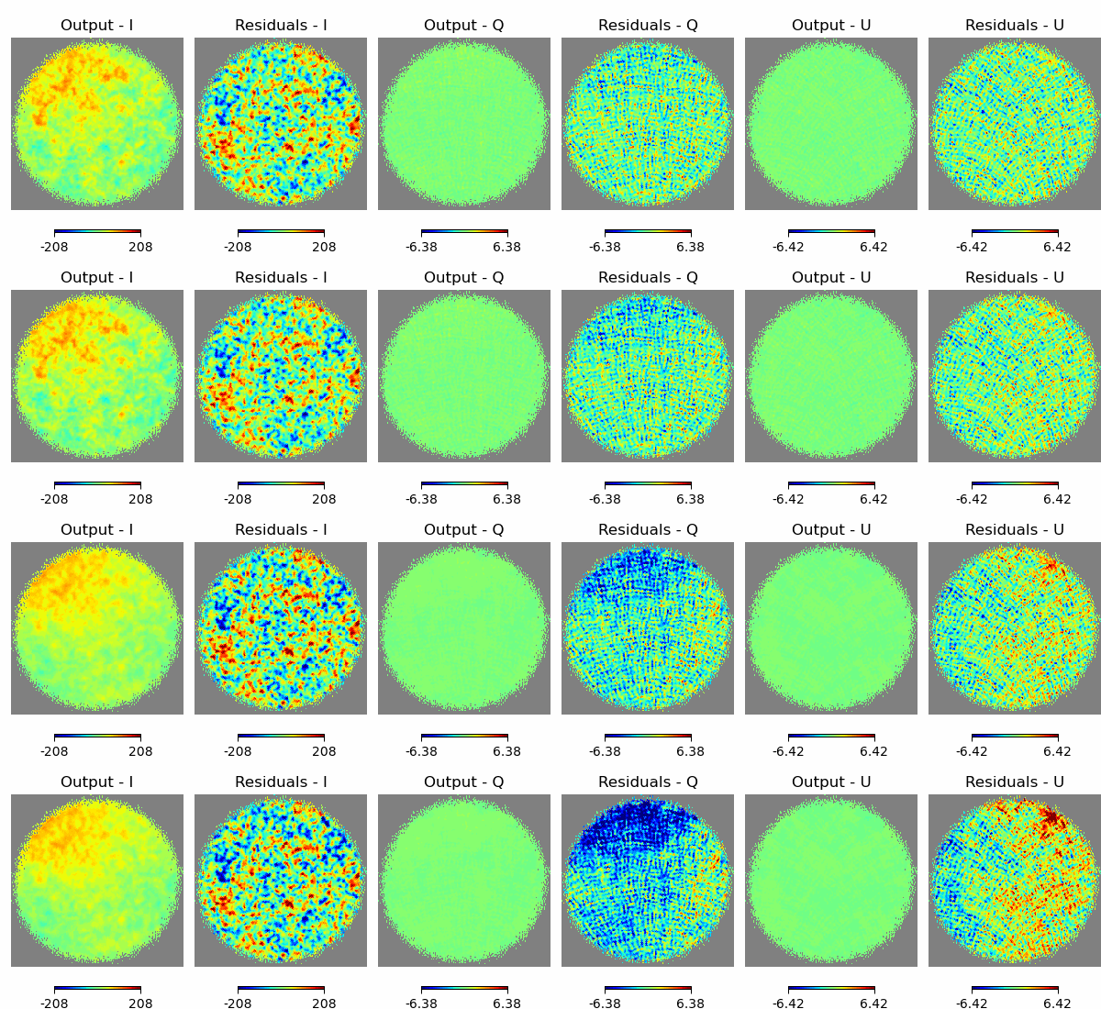
Frequency Map-Making
Intensity
Polarization
Bolometer data (TOD)
140.0 GHz
Inst. model
150 GHz physical band
Sky in
sub-bands
noise
158.8 GHz
205.4 GHz
Solution for : Preconditioned Gradient Descent (PCG)
220 GHz physical band
232.9 GHz
[Chanial, Régnier, et al., A&A submitted, arXiv:2409.18698]

Slide 22
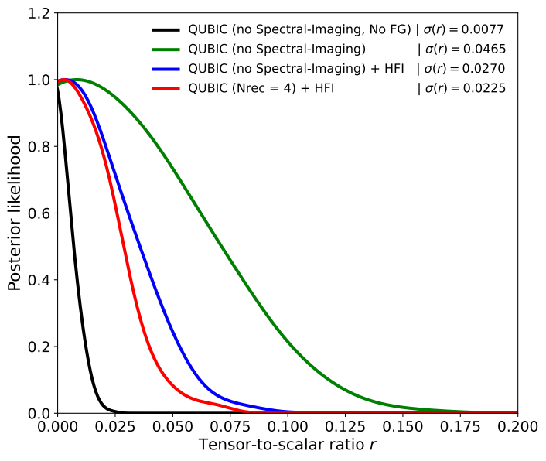
Frequency Map-Making: Forecasts
Current upper limit for r from BK18 + PR4 : r < 0.032 at 95% C.L.
[Tristram et al., arXiv:2112.07961]
[Chanial, Régnier, et al., A&A submitted, arXiv:2409.18698]

Slide 23
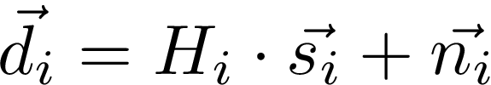
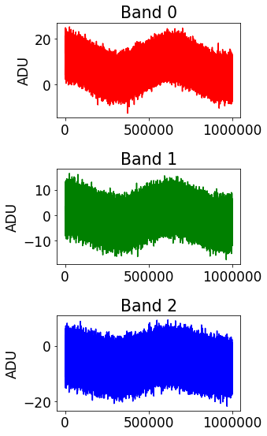
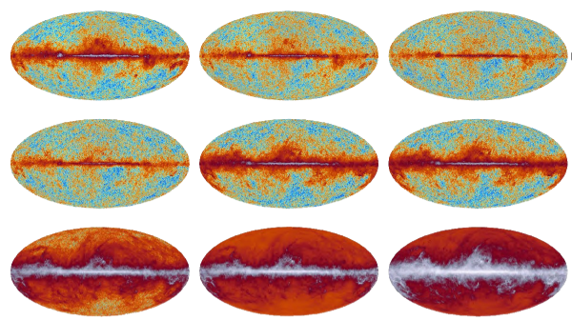
From Frequency to Component Map-Making
TOD
Frequency maps
Components maps
Map
Making
Component
Separation
Classical Imager Pipeline

Slide 24
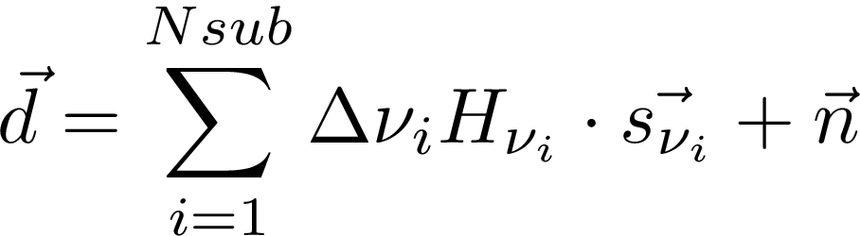
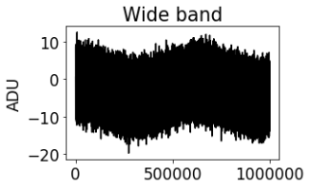
From Frequency to Component Map-Making
TOD
Frequency maps
Components maps
Frequency Map
Making
Component
Separation
Bolometric Interferometer Pipeline
Frequency Map-Making

Slide 25
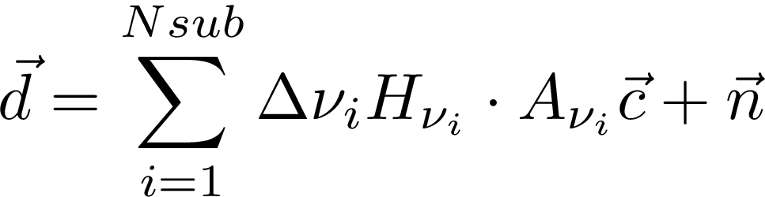
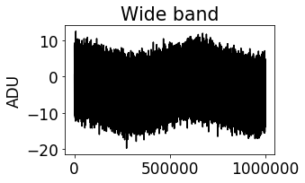
Component Map-Making
Component Maps
Sky
Mixing Matrix
Components maps
TOD
Component Separation Map Making
Spectral-imaging based:
Frequency Information in TOD
Only possible with B.I. !

Slide 26
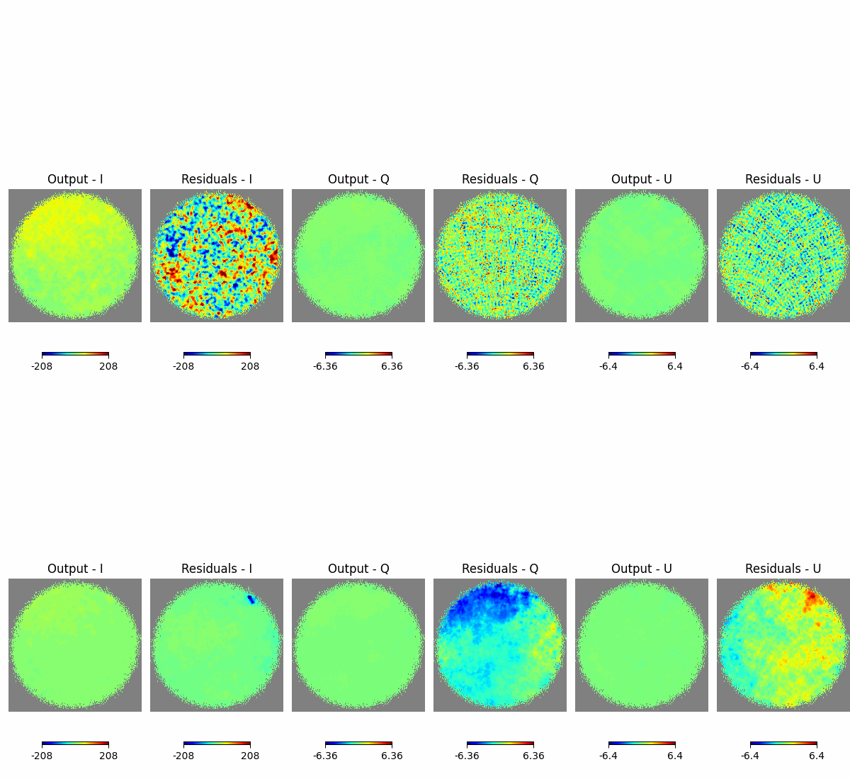
Component Map-Making
Component Maps
(CO)
(CO)
(CO)
(CO)
Mixing Matrix
CMB
I
Q
U
Dust
[Régnier, Laclavère, et al., A&A submitted, arXiv:2409.18714]

Slide 27
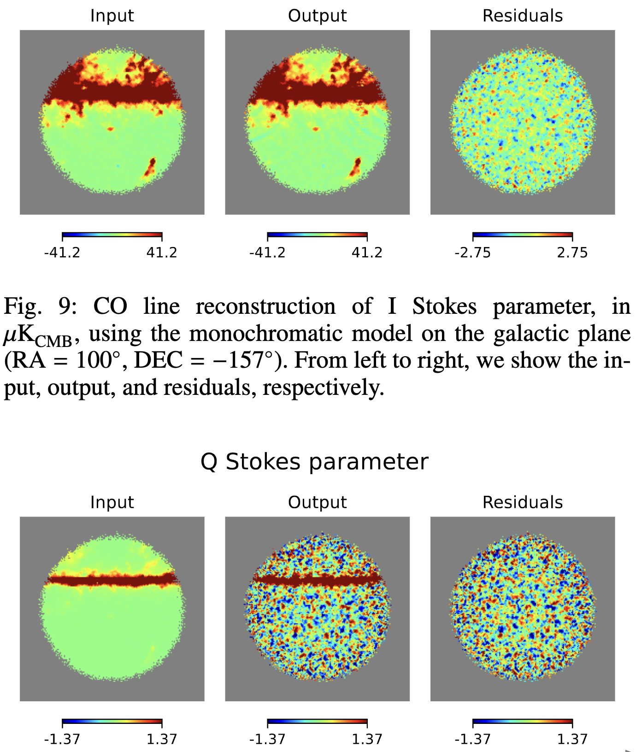
Component Map-Making
Component Maps
(CO)
(CO)
(CO)
(CO)
Mixing Matrix
CMB
I
Q
U
I
Q
Dust
CO Line
I
I
Q
Q
(CO)
(CO)
(CO)
(CO)
[Régnier, Laclavère, et al., A&A submitted, arXiv:2409.18714]

Slide 28
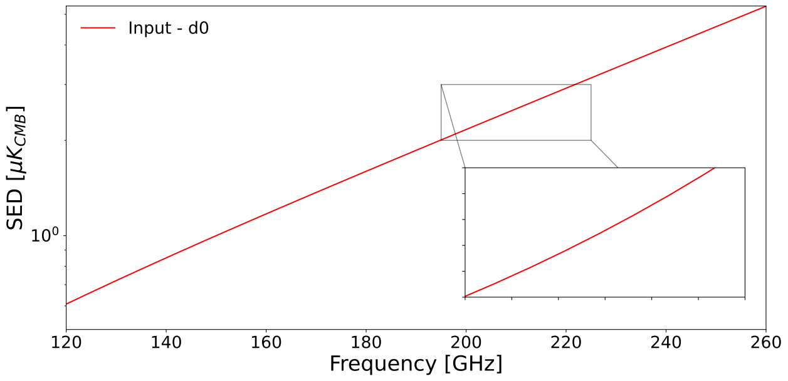
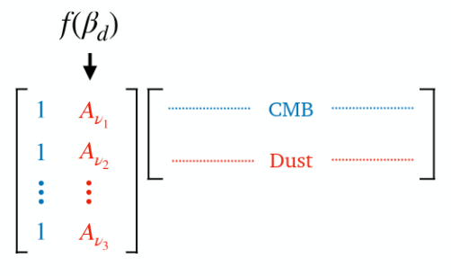



Component Map-Making: Parametric or Blind
Parametric dust model
[Régnier, Laclavère, et al., A&A submitted, arXiv:2409.18714]

Slide 29
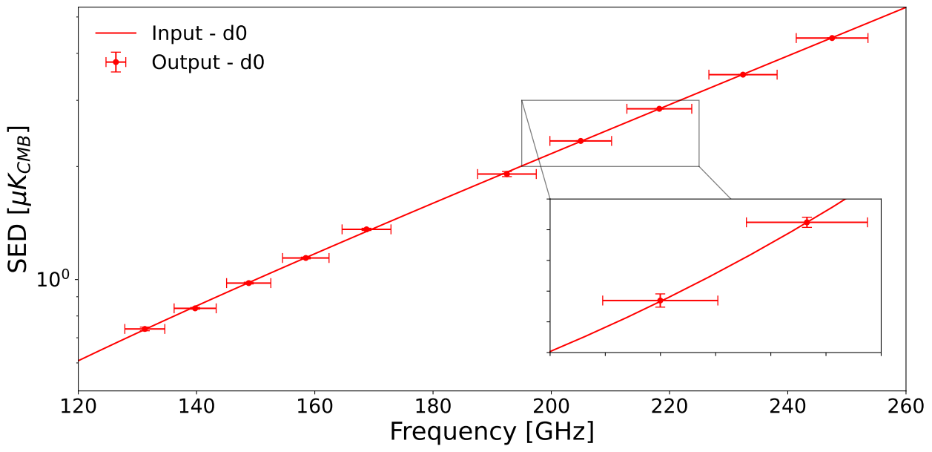
Component Map-Making: Parametric or Blind
Parametric dust model
[Régnier, Laclavère, et al., A&A submitted, arXiv:2409.18714]

Slide 30
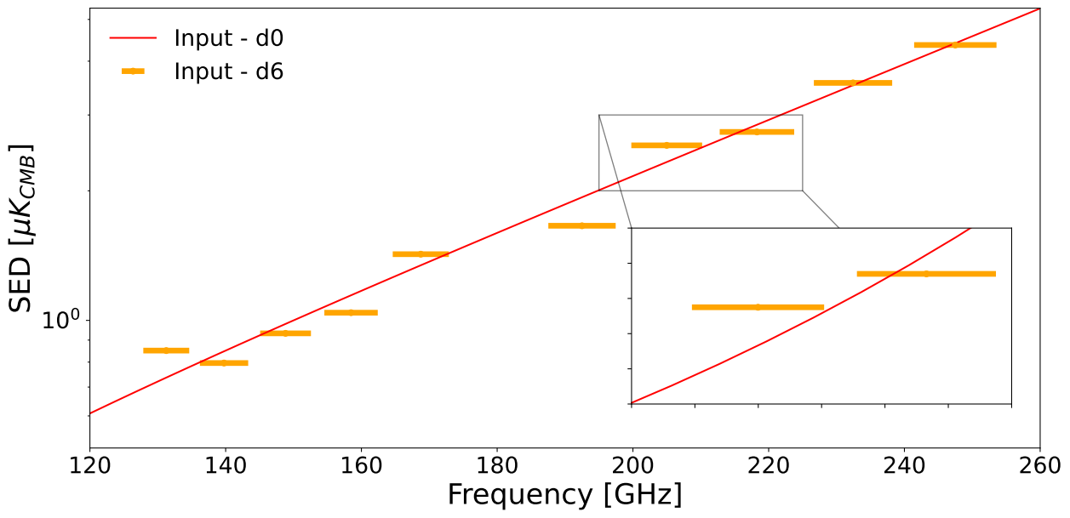
Component Map-Making: Parametric or Blind
Frequency decorrelation
Parametric dust model
[Régnier, Laclavère, et al., A&A submitted, arXiv:2409.18714]

Slide 31

Component Map-Making: Parametric or Blind
Frequency decorrelation
Reconstruct mixing matrix elements
Parametric dust model
[Régnier, Laclavère, et al., A&A submitted, arXiv:2409.18714]

Slide 32
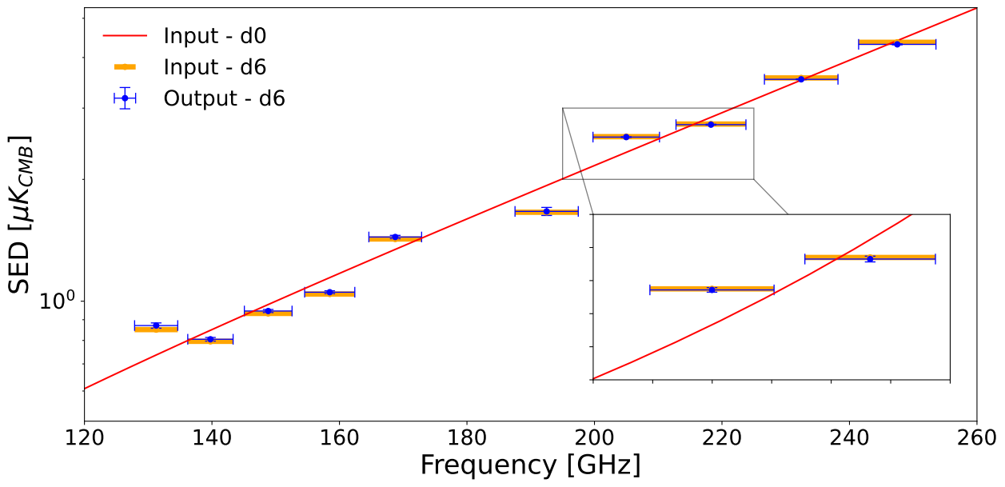
Component Map-Making: Parametric or Blind
Reconstruct mixing matrix elements
Parametric dust model
[Régnier, Laclavère, et al., A&A submitted, arXiv:2409.18714]

Slide 33
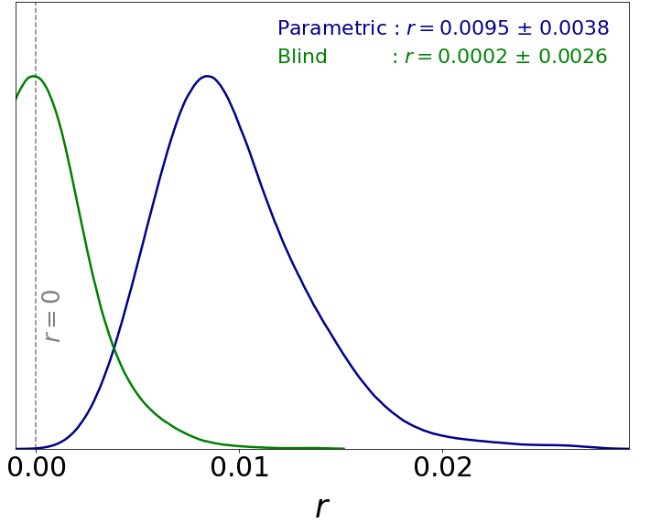
Component Map-Making: Parametric or Blind
[BI with enhanced sensitivity assumed]
Unbiased result !
[Régnier, Laclavère, et al., A&A submitted, arXiv:2409.18714]

Slide 34
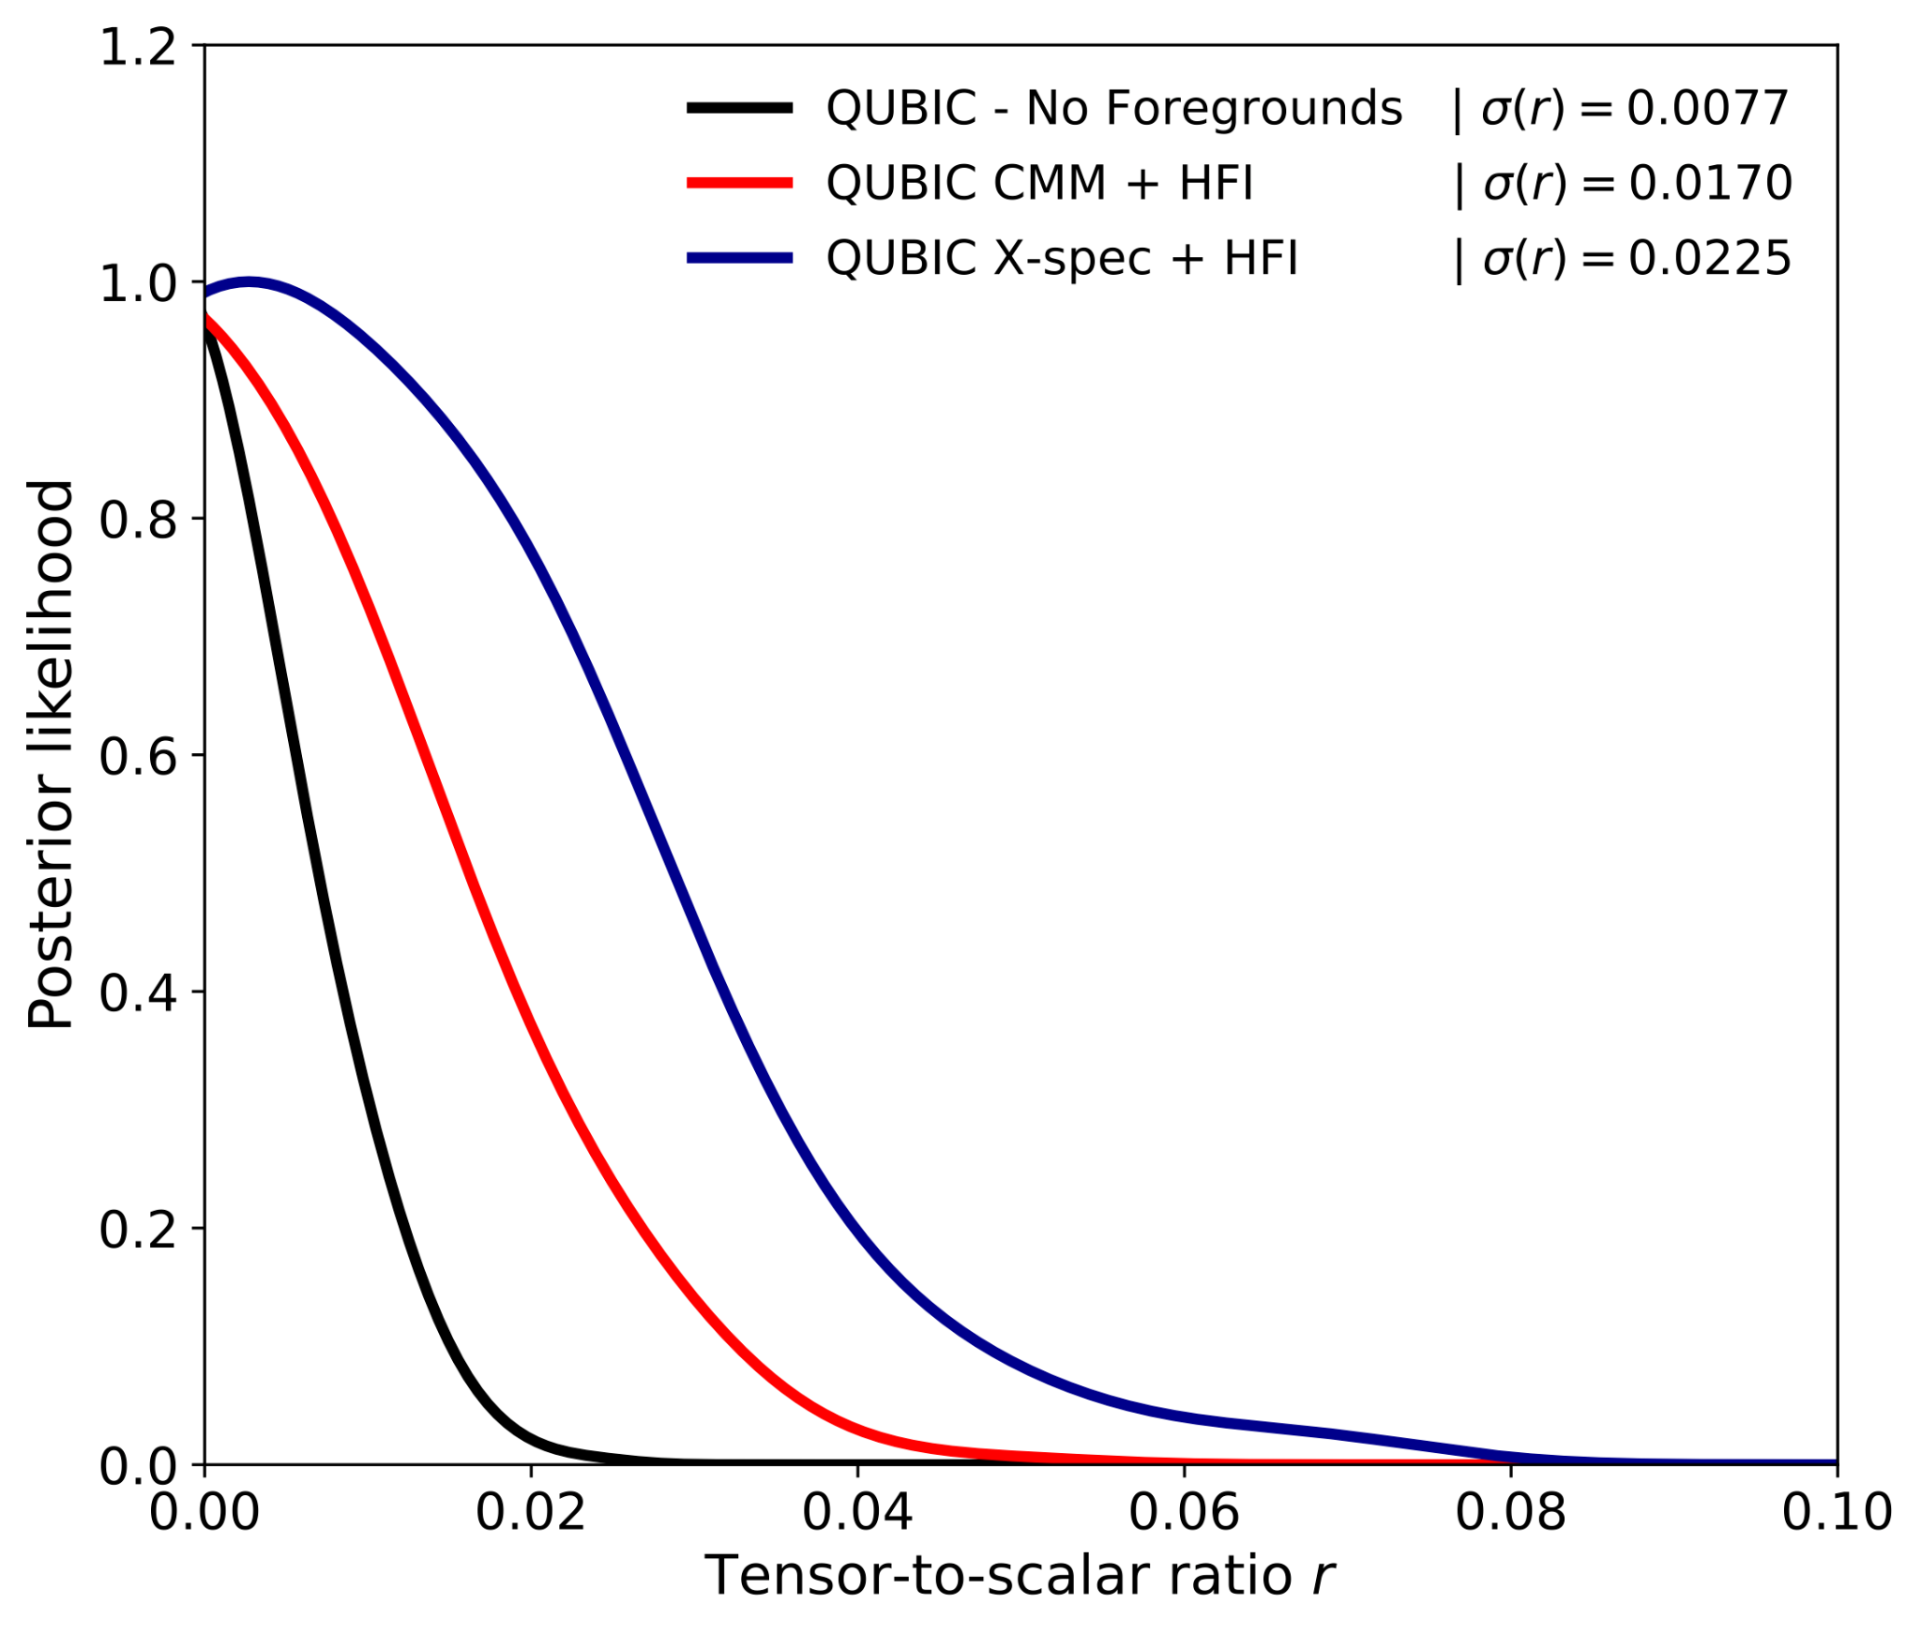

QUBIC Forecasts (end-to-end simulations)
QUBIC MM - No Foregrounds
QUBIC CMM + Planck HFI
QUBIC FMM + Planck HFI
PRELIMINARY
Current upper limit for r from BK18 + PR4 : r < 0.032 at 95% C.L.
[Tristram et al., arXiv:2112.07961]
[M. Régnier, PhD Thesis]

Slide 35
Atmosphere Map-Making
[T. W. Morris et al., The Atacama Cosmology Telescope: Modeling Bulk Atmospheric Motion, 2021]

Slide 36
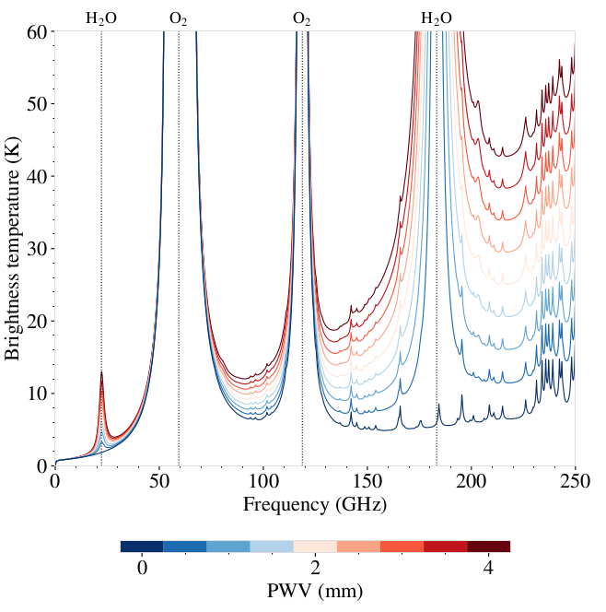
Atmosphere Map-Making
Contribution to the photonic noise
⇒ Limited by observing through 150 GHz and 220 GHz windows
⇒ Instrument placed in a dry location and at high altitude
1
[T. W. Morris et al., The Atacama Cosmology Telescope: Modeling Bulk Atmospheric Motion, 2021]

Slide 37
Atmosphere Map-Making
Contribution to the photonic noise
⇒ Limited by observing through 150 GHz and 220 GHz windows
⇒ Instrument placed in a dry location and at high altitude
1
2
Inhomogeneous + time-dependent
⇒ Temporal and spatial correlation between detectors
[T. W. Morris et al., The Atacama Cosmology Telescope: Modeling Bulk Atmospheric Motion, 2021]

Slide 38
Atmosphere Map-Making
Contribution to the photonic noise
⇒ Limited by observing through 150 GHz and 220 GHz windows
⇒ Instrument placed in a dry location and at high altitude
1
2
Inhomogeneous + time-dependent
⇒ Temporal and spatial correlation between detectors
3
Specific spectrum depending on water vapor density
⇒ Can be used for component separation
[T. W. Morris et al., The Atacama Cosmology Telescope: Modeling Bulk Atmospheric Motion, 2021]

Slide 39
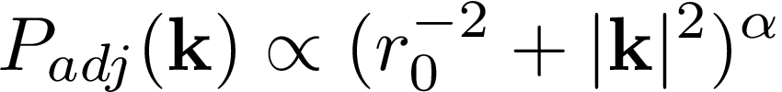
Atmosphere Map-Making
Water vapor density fluctuations :
↪ modeled by Kolmogorov power spectrum :
-8/6
-11/6
2D
3D
r0 : max size of turbulences
[T. W. Morris et al., The Atacama Cosmology Telescope: Modeling Bulk Atmospheric Motion, 2021]

Slide 40
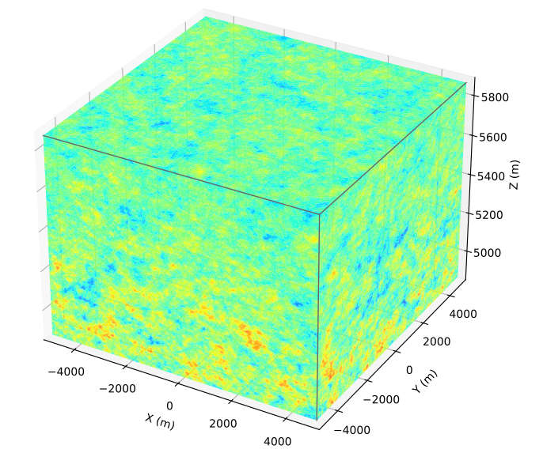
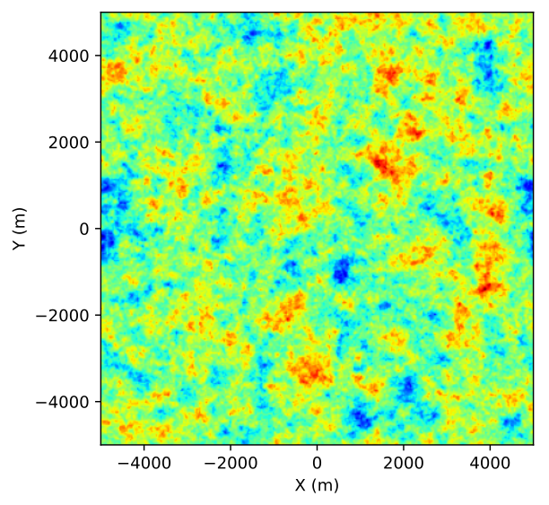
Atmosphere Map-Making
Water vapor density fluctuations :
↪ modeled by Kolmogorov power spectrum :
-8/6
-11/6
2D
3D
r0 : max size of turbulences
[T. W. Morris et al., The Atacama Cosmology Telescope: Modeling Bulk Atmospheric Motion, 2021]

Slide 41
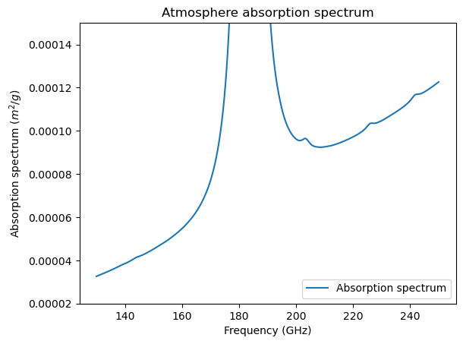
Atmosphere Map-Making
[The am Atmospheric Model, S. Paine, https://lweb.cfa.harvard.edu/~spaine/am/]

Slide 42

Atmosphere Map-Making
[The am Atmospheric Model, S. Paine, https://lweb.cfa.harvard.edu/~spaine/am/]

Slide 43


Atmosphere Map-Making
Galactic coordinates
Local coordinates

Slide 44
Atmosphere Map-Making
Simplifying hypothesis:
Atmosphere = 2d plane
Stable Atmosphere Spectrum
No wind
Galactic coordinates
Local coordinates

Slide 45


Atmosphere Map-Making
Uniform pointing in 15° radius circle centered on the QUBIC patch position

Slide 46





Atmosphere Map-Making
Uniform pointing in 15° radius circle centered on the QUBIC patch position
No longer a circle in local coordinates, as the patch moves in the sky

Slide 47

Atmosphere Map-Making

Slide 48


Atmosphere Map-Making
Intensity

Slide 49
Atmosphere Map-Making
Intensity
Edge effect : secondary peaks falling outside the patch
⇒ Adding external data
(Planck)
[Chanial, Régnier, et al.,
A&A submitted, arXiv:2409.18698]

Slide 50
Atmosphere Map-Making
Intensity
Edge effect : secondary peaks falling outside the patch
⇒ Adding external data
(Planck)
Stripes : Movement of the atmosphere
⇒ Improve convergence
[Chanial, Régnier, et al.,
A&A submitted, arXiv:2409.18698]

Slide 51

Atmosphere Map-Making
Polarisation

Slide 52
Atmosphere Map-Making
Polarisation
Lack of convergence ?

Slide 53
Atmosphere Map-Making
Next steps :
Fix edge effect : add external data outside patch
Improve convergence : compute proper preconditioner
Add constraints : CMB Intensity, Atm Polarisation
External Atm information : weather station, camera
Add wind
3d atmosphere

Slide 54
Spectral Imaging with QUBIC :
Component separation using Bolometric Interferometry
Thank you for your attention !
Tom Laclavère on behalf of the QUBIC Collaboration

Slide 55
Back-up Slides

Slide 56
Cosmology

Slide 57




Anisotropic fluxes on the Last Scattering Surface
Credit: BICEP Collaboration

Slide 58
QUBIC

Slide 59


QUBIC design

Slide 60


Instrumental model
Time domain
Pixels domain
Various foregrounds model :
Parametric methods
  constant spectral index
  Varying spectral indices
Blind methods
Instrumental systematics determination

Slide 61





Polarisation
Stokes parameter
[Drawing: M. Stolpovskiy]
[Louise Mousset, https: //hal-cea.archives-ouvertes.fr/tel-03783687/]

Slide 62


TES
Absorbed photon ⇒
Absorber temperature increases ⇒
Thermometer resistance increases ⇒
Voltage decreases
[Diagram bolometer : NPAC detector physics courses, A. Tonazzo]
[M. Piat et al., arXiv:2101.06787]

Slide 63


Self-Calibration
Interferometer aperture array
Fringe differences for baselines on focal plane can only come from instrumental systematics (cross-polarization, differential beams, intercalibration, …)
A
Fringe from (A,B)
Fringe from (C,D)
C
B
D
[Louise Mousset, https: //hal-cea.archives-ouvertes.fr/tel-03783687/]
Focal Plane signal (Simulation)

Slide 64







The QUBIC Synthesized beam from baselines
1 Horn open
[L. Mousset, PhD, 2021]
QUBIC Sim.
QUBIC Cal Data
2 Horns open
2 Horns open
All Horns open

Slide 65


Bolometric Interferometry:
Spectral Imaging
First Spectral Imaging reconstruction with real data (Calibration Source operating at 150 GHz at APC)
With Real Data
(26 detectors)
[indoor calibration source]
[Torchinsky et al., QUBIC III arXiv:2008.10056v3 ] (JCAP 2022)

Slide 66

Moon observation

Slide 67



Frequency Map-Making
Sum over the bandwidth
Instrumental Model
Simulated
𝜒²
Observed

Slide 68




Frequency Map-Making
Sum over the bandwidth
Instrumental Model
Simulated
𝜒²
Observed

Slide 69

Frequency Map-Making: improve spectral resolution

Slide 70

Frequency Map-Making: improve spectral resolution

Slide 71


Frequency Map-Making: improve spectral resolution
Non-minimal dust model: Dust SED decorrelation (Corr_length = 15: 3x smaller than current constraints)
[BI with CMB-S4 sensitivity assumed]
⇒ Decorrelation undetected by direct imager
⇒ Dust residuals in CMB
⇒ Wrong r detection!
Dust with decorrelation
No decorrelation r=0.006
Decorrelation length 15, r=0
No decorrelation r=0
Imager
Bolometric Interferometer
[Régnier et al. A&A 2024]
B.I. is needed to complement direct imaging: Dust decorrelation is to be expected from realistic dust

Slide 72

Frequency Map-Making: improve spectral resolution
Non-minimal dust model: Dust SED decorrelation (Corr_length = 15: 3x smaller than current constraints)
[BI with CMB-S4 sensitivity assumed]
⇒ Decorrelation undetected by direct imager
⇒ Dust residuals in CMB
⇒ Wrong r detection!
Multi-band analysis with B.I. reveals the effect
Dust with decorrelation
Imager
Bolometric Interferometer
[Régnier et al. A&A 2024]
B.I. is needed to complement direct imaging: Dust decorrelation is to be expected from realistic dust

Slide 73
Astrophysical Foregrounds

Slide 74







Astrophysical components
Dust grains
Synchrotron
[K. J. Andersen et al., arXiv:2201.08188]
[N. Krachmalnicoff]

Slide 75
Atmosphere

Slide 76








Atmospheric contribution to one detector (aligned with the line of sight)

Slide 77


Let’s simulate a simple scanning strategy :
5°/s
[Errard, 2015]

Slide 78


wrt to the initial LOS
[Errard, 2015]

Slide 79

wrt to the initial LOS
[Errard, 2015]

Slide 80

wrt to the initial LOS
[Errard, 2015]

Slide 81

Parallax effect of the atmosphere
Atmosphere is a 3d system:
→We will lost the correlation information with time due to the wind
→It will be even worse if we consider that wind is altitude-dependent

