Slide 1
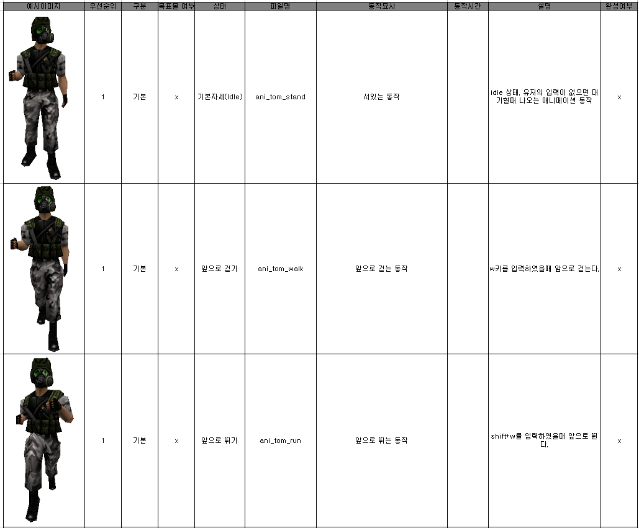
3. Character Animation (Tom)

Slide 2
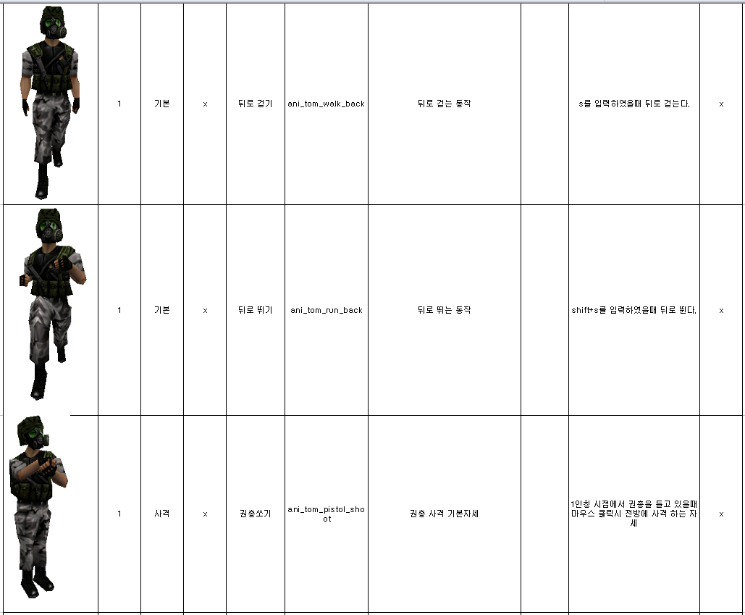
3. Character Animation (Tom)

Slide 3
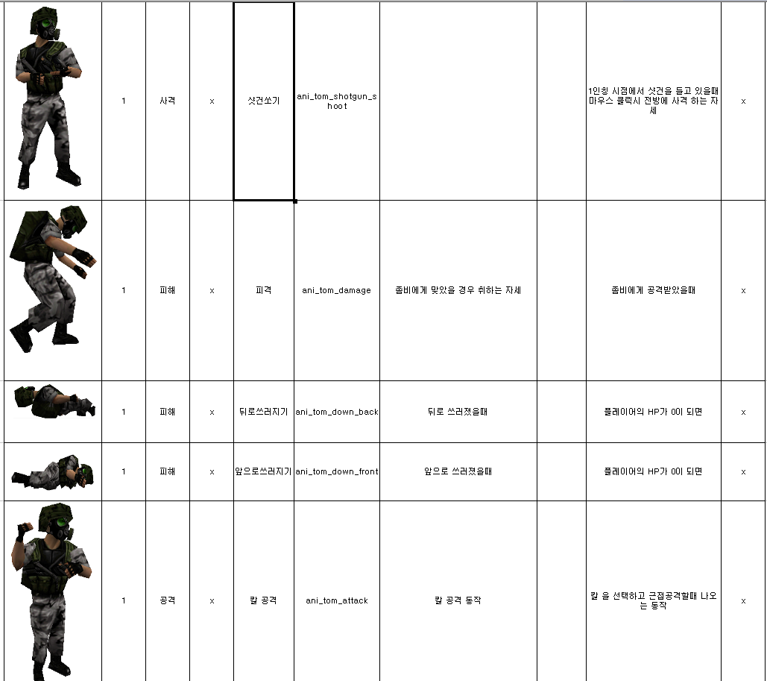
3. Character Animation (Tom)

Slide 4
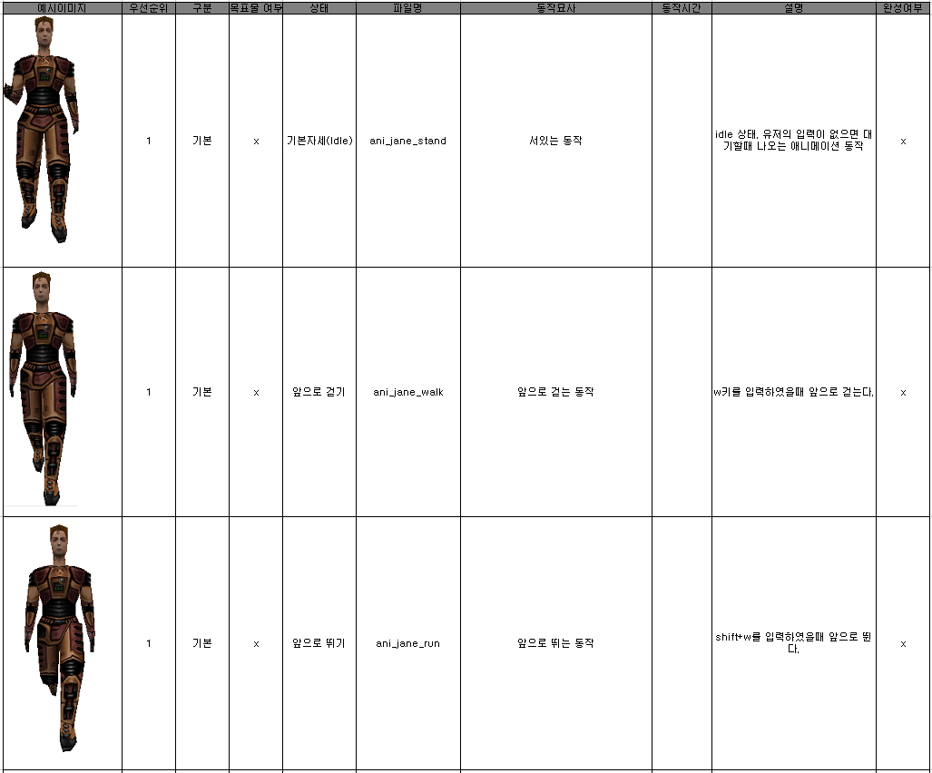
3. Character Animation (Jane)

Slide 5
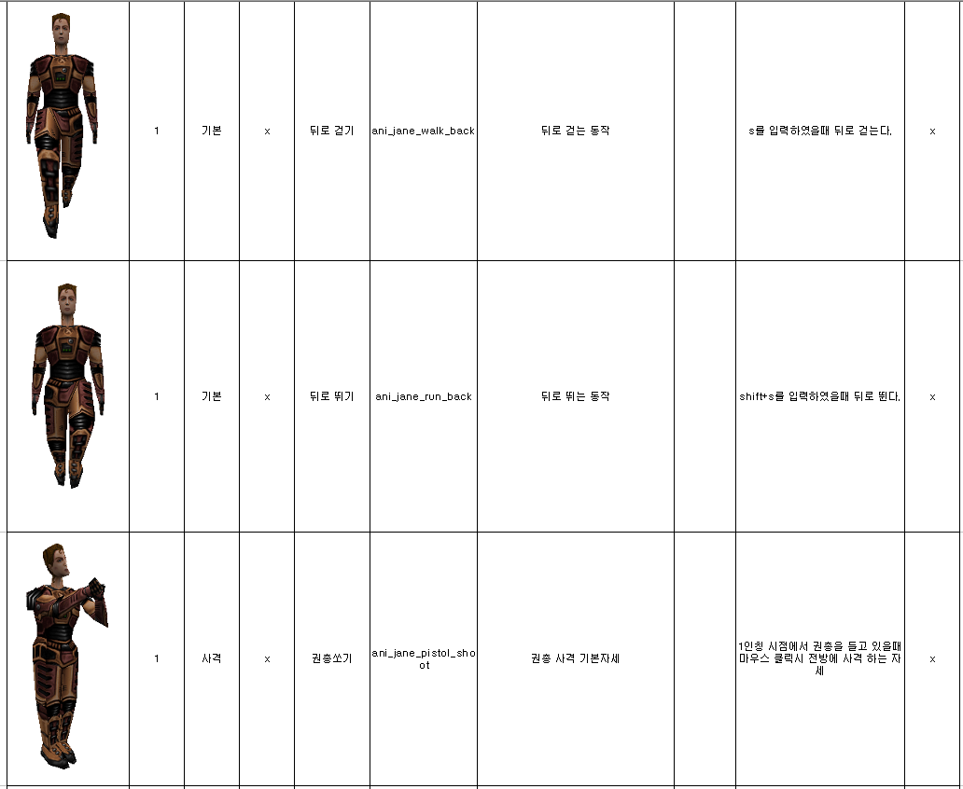
3. Character Animation (Jane)

Slide 6
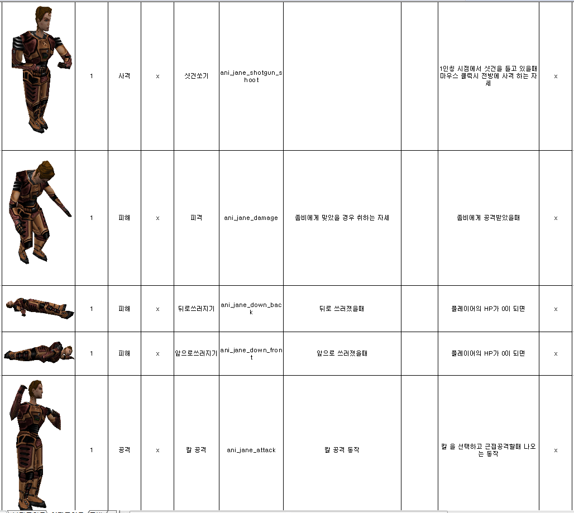
3. Character Animation (Jane)

Slide 7
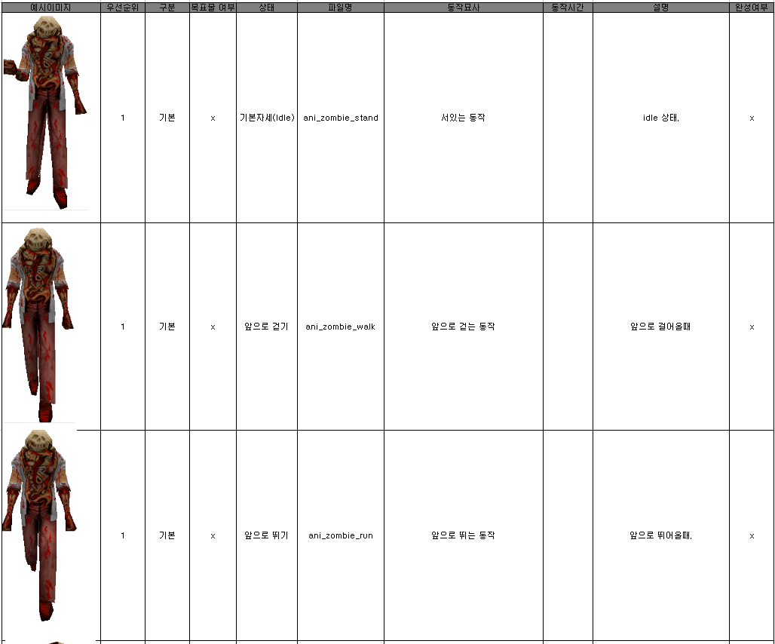
3. Character Animation (Zombie)

Slide 8
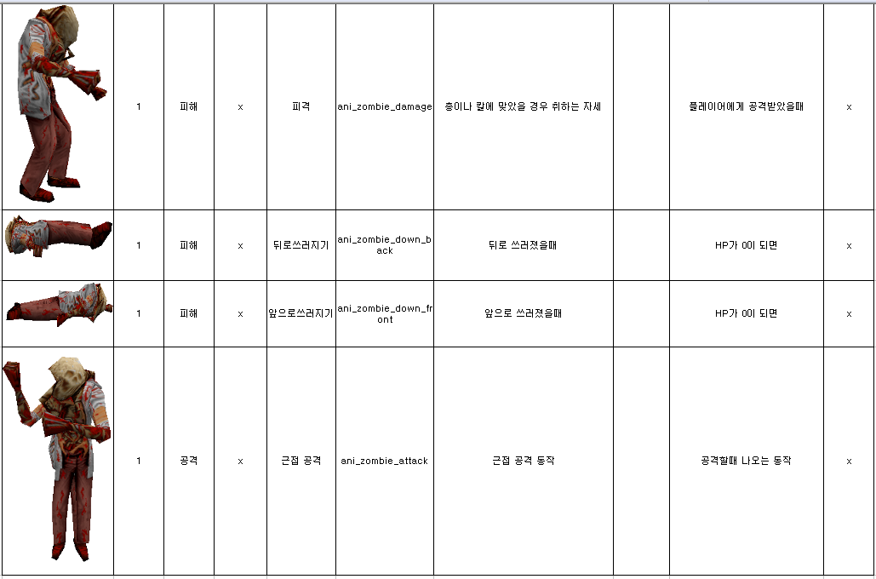
3. Character Animation (Zombie)

