Slide 1
5. Training Cifar10 Classifier Using VGG16 (20%)
(出題: Tommy)
5.1 Show Training Images (4%)
5.2 Show Hyperparameters (4%)
5.3 Show Model Structure (4%)
5.4 Show Accuracy and Loss (4%)
5.5 Test (4%)

Slide 2
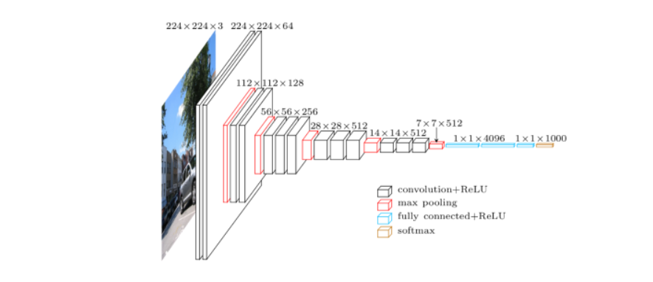
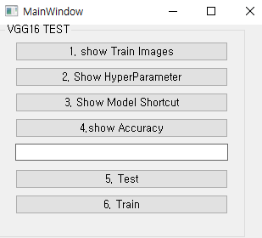
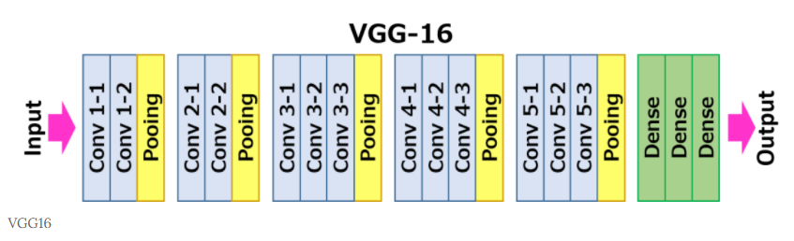
5.0 Training Cifar10 Classifier Using VGG16 (出題：Tommy)
Learn how to construct VGG16 and train it on Cifar10.
Environment Requirement
Python
Tensorflow / PyTorch (Can choose the one)
opencv-contrib-python
Matplotlib
Reference
https://paperswithcode.com/method/vgg (VGG16, Paper and Source Code)
https://www.cs.toronto.edu/~kriz/cifar.html (Cifar10 Dataset)
GUI example
VGG16 framework

Slide 3
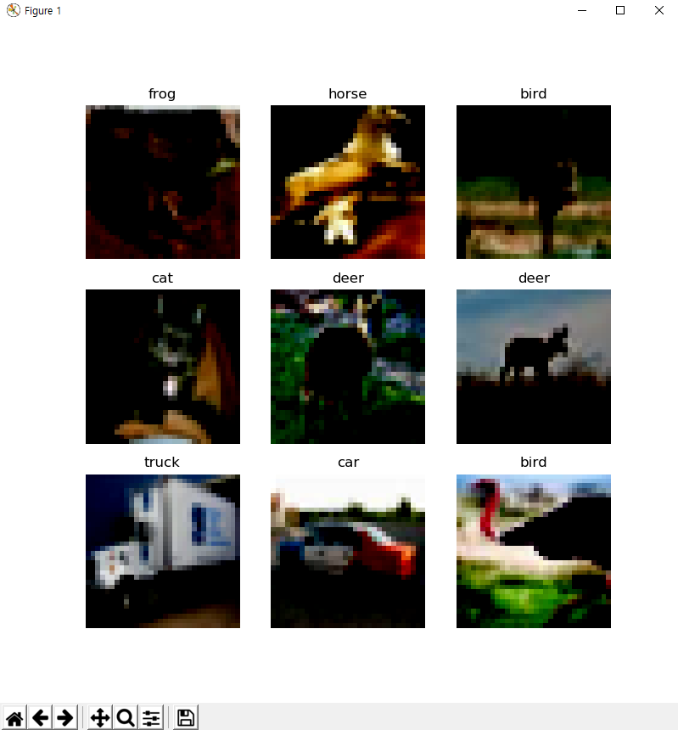
5.1 Load Cifar10 training dataset, and then show 9 Images(Pop-up) and Labels respectively (4%)
Class
Label
0 airplane
1 automobile
2 bird
3 cat
4 deer
5 dog
6 frog
7 horse
8 ship
9 truck
Image
10 Class of CIFAR 10 Dataset
◆ Hint
Use Matplotlib 4 function
figure()
title()
Axis()
imshow()
Can refer by tutorial at the Matplotlib library official web-site
https://matplotlib.org/stable/tutorials/index.html

Slide 4

5.2 Print out training hyperparameters on the terminal
(batch size, learning rate, optimizer). (4%)
◆ Hint
Use the python print function
Print(‘Batch Size {} ’, format(Batchsize variable name))

Slide 5
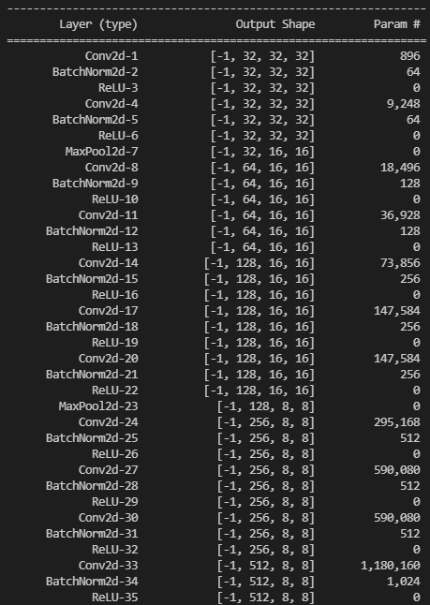
5.3 Construct and show your model structure by print out on the terminal (You can use available architecture provided by ML framework to build your model) (4%)
◆ Hint
Pytorch API
Use the two option
Summary function
from torchsummary import summary
-> import the package
summary(Model name, (Input Channel, Input Width, Input Height))
-> run the function and print on the terminal
Print function
From torchvision import models
-> import the package
Model = VGG16()
-> Make the mode data
Print(Model)
Can refer this web-site
https://pypi.org/project/pytorch-model-summary/
Layers List of
Model
After processing
each layer
Change of input
data type
Number of
trainable
parameters

Slide 6
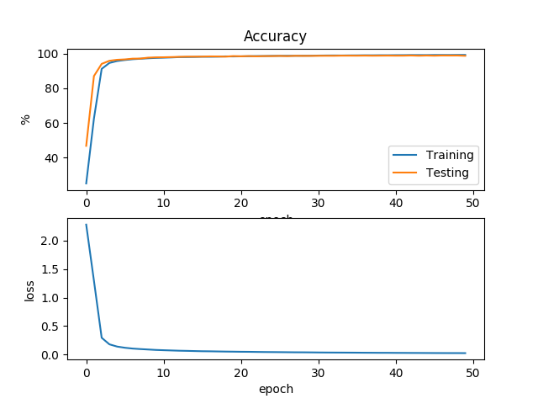
5.4 Training your model at least 20 epochs by your own computer, then save your model and take a screenshot of your training loss and accuracy. No saved images no points (4%)
◆ Hint
There are two option.
Just use the normal method(Above image used this way)
https://www.pyimagesearch.com/2021/07/19/pytorch-training-your-first-convolutional-neural-network-cnn/
2) Use tensorboard in Tensorflow API or tensorboard in pytorch
https://pytorch.org/tutorials/intermediate/tensorboard_tutorial.html
(record accuracy/loss per epoch)

Slide 7

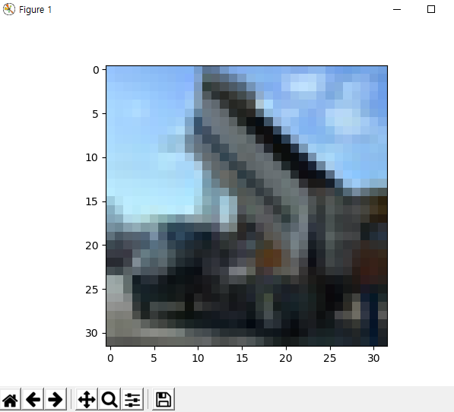
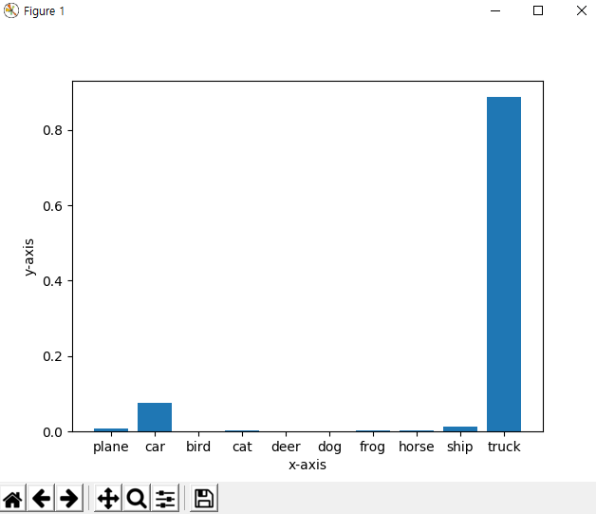
5.5 Load your model trained at 5.4, let us choose one image from test images, inference the image, show the result image and class(use the pop-up) (4%)
1. Choose the any data
2. Run Inference
3. Show the result
◆ Hint
Can refer two web-site
https://towardsdatascience.com/understanding-pytorch-with-an-example-a-step-by-step-tutorial-81fc5f8c4e8e#5017
https://pytorch.org/tutorials/

