Slide 1
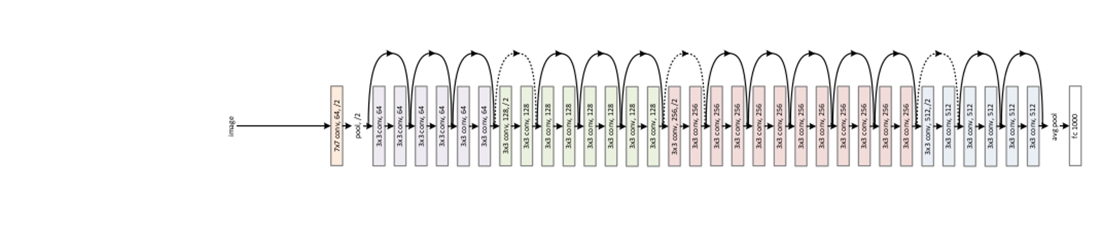
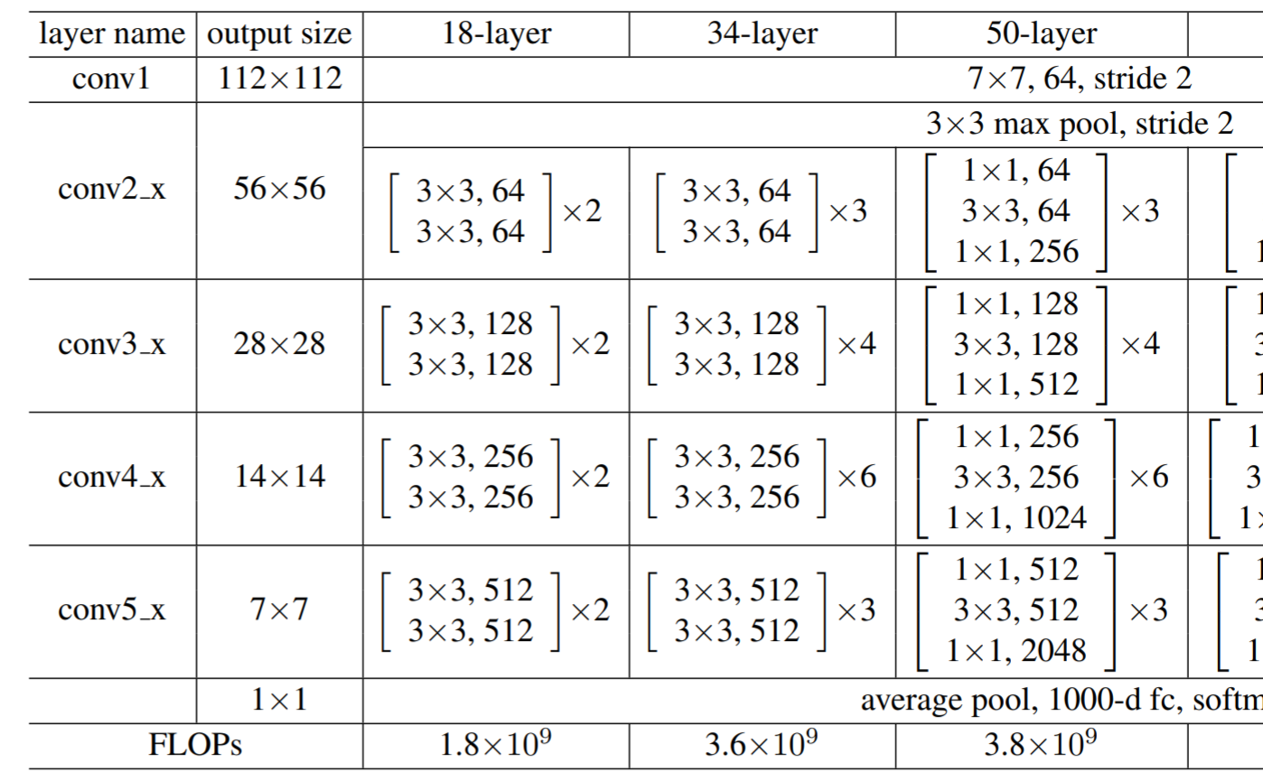
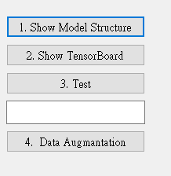
5.0 (20%)Dogs and Cats classification Using ResNet50 (出題：育成)
1) Dataset introduction:
ASIRRA (Animal Species Image Recognition for Restricting Access) is a HIP(Human Interactive Proof) that works by asking users to identify photographs of cats and dogs, that's supposed to be easy for people to solve, but difficult for computers. Now we can use artificial intelligence technology to achieve this goal.
(2) The dataset includes 12501 photos of cats and 12501 photos of dogs. You need to download them in Reference below(R2), and split the training set, validation set and test set using 8:1:1 ratio in both dogs and cats directory.
2) Environment Requirement
(1) Python
(2) Tensorflow
(3) Opencv-contrib-python
(4) Matplotlib
Fig. Example UI
Fig. ResNet’s Network Architecture
R. Reference
R1) Deep Residual Learning for Image Recognition
R2) https://www.microsoft.com/en-us/download/details.aspx?id=54765 (ASIRRA)
Fig. ResNet50's Schematic Diagram

Slide 2
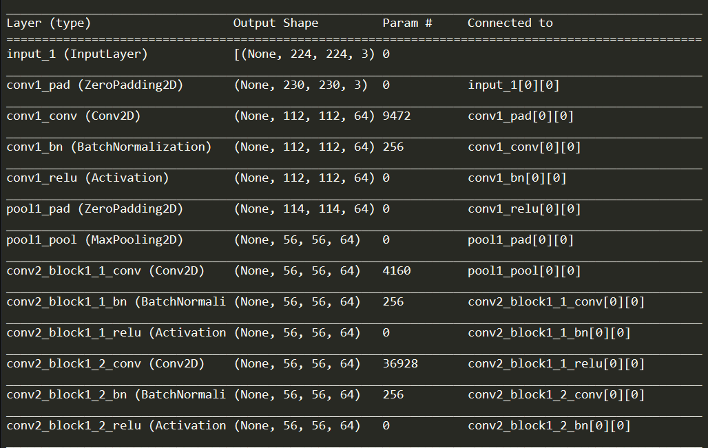
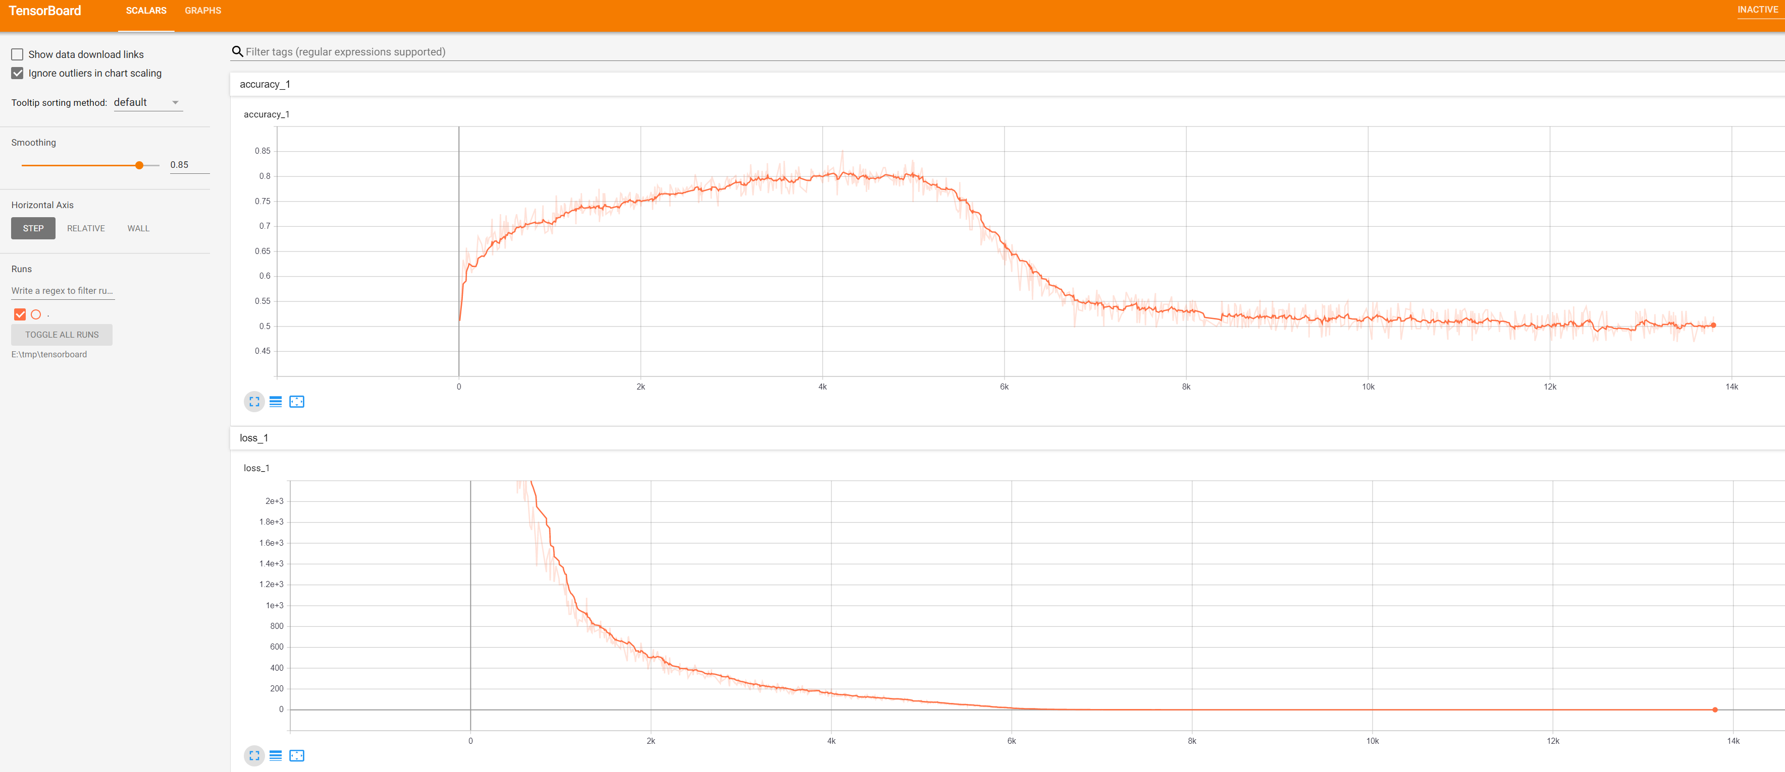
5.1 Construct and show summary of your model structure by printing out on the terminal. (5%)
Fig. Summary of ResNet50
5.2 Training at home at least 5 epochs and use TensorBoard to monitor, then save the final screenshot of TensorBoard (5%, Use other tools can get 3%).
Fig. Example of training with TensorBoard

Slide 3
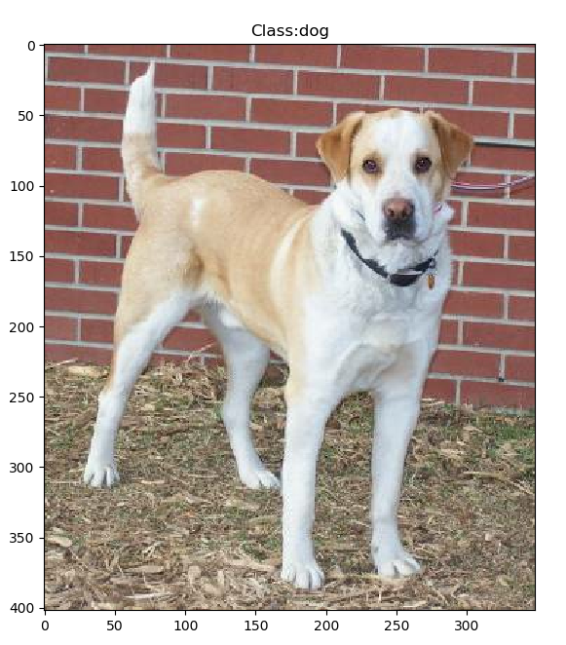
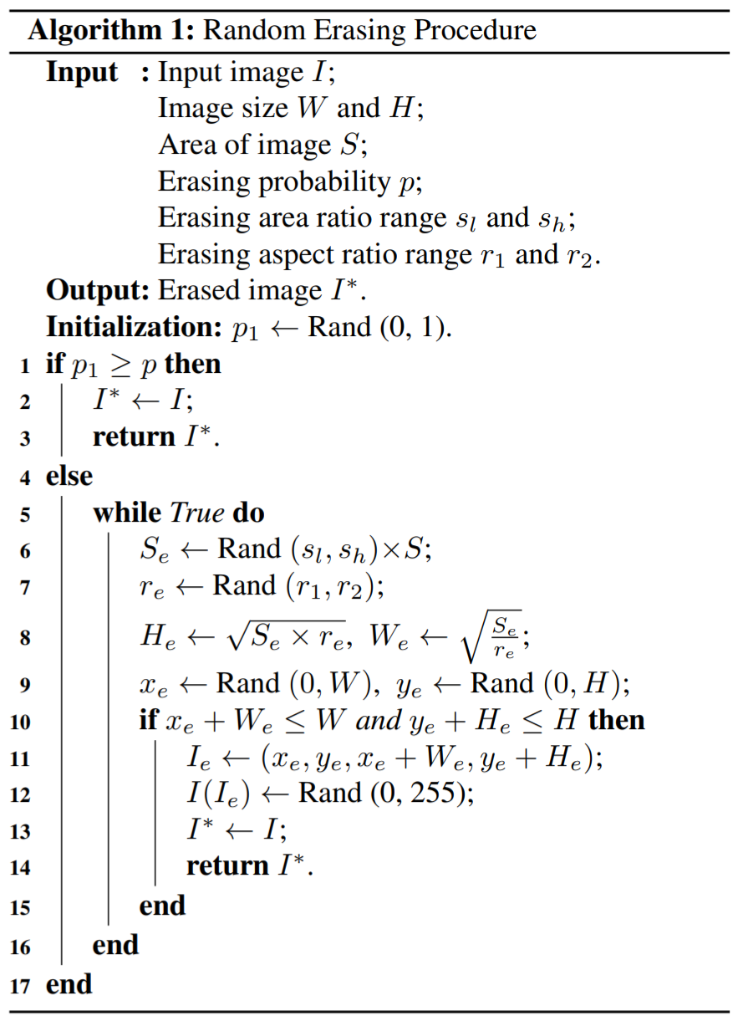
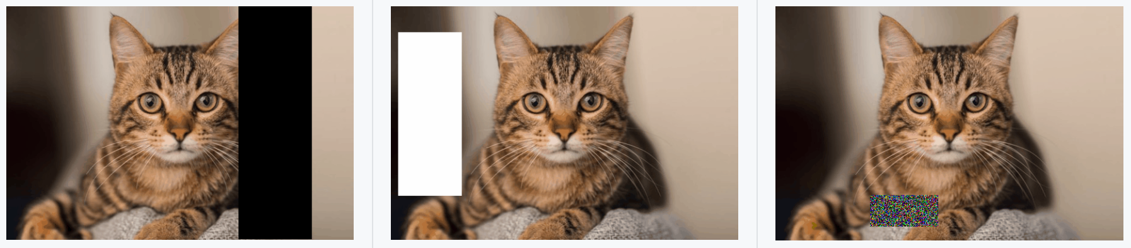
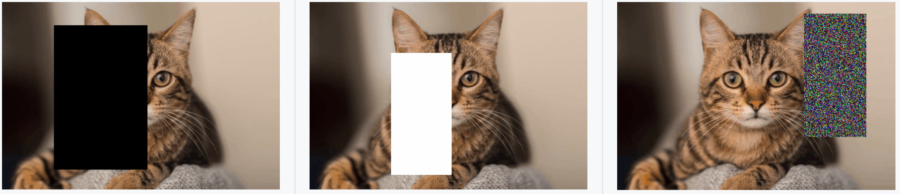
5.3 Randomly select a picture from the test set and mark its predicted category.(5%)
Fig. Classification display example
Fig. Random-Erasing algorithm
5.4 Train another model with Random-Erasing or any other data augmentation method. Write the code of your augmentation method(3%) and draw the comparison table of accuracy, save it as a picture.(2%)
Accuracy
Fig. Examples of the use of Random-Erasing
Fig. Random-Erasing effect comparison example
R. Reference
Random Erasing Data Augmentation

