Slide 1
Lecture 8:
Introduction to Matplotlib
SCIF10002 – Introduction to Coding and Data
Tom Maullin-Sapey
20th November 2025
Slide 0/14

Slide 2
Today’s Lecture
Slide 1/14

Slide 3
Today’s Lecture
Lecture 8: Introduction to Matplotlib
Slide 1/14

Slide 4
Today’s Lecture
Lecture 8: Introduction to Matplotlib
What is Matplotlib?
Slide 1/14

Slide 5
Today’s Lecture
Lecture 8: Introduction to Matplotlib
What is Matplotlib?
Approaches to Plotting
Slide 1/14

Slide 6
Today’s Lecture
Lecture 8: Introduction to Matplotlib
What is Matplotlib?
Approaches to Plotting
Figures and Axes
Slide 1/14

Slide 7
Today’s Lecture
Lecture 8: Introduction to Matplotlib
What is Matplotlib?
Approaches to Plotting
Figures and Axes
Customising Plots
Slide 1/14

Slide 8
Today’s Lecture
Lecture 8: Introduction to Matplotlib
What is Matplotlib?
Approaches to Plotting
Figures and Axes
Customising Plots
Practical
Slide 1/14

Slide 9
Today’s Lecture
Lecture 8: Introduction to Matplotlib
What is Matplotlib?
Approaches to Plotting
Figures and Axes
Customising Plots
Practical
Lecture 9: Multi-dimensional Arrays
Properties
Broadcasting
Matrices as Images
Practical
Slide 1/14

Slide 10
Important Announcement: Project 2
Slide 2/14

Slide 11
Important Announcement: Project 2
Important
Slide 2/14

Slide 12
Important Announcement: Project 2
Important: Project 2 has been released!
Slide 2/14

Slide 13
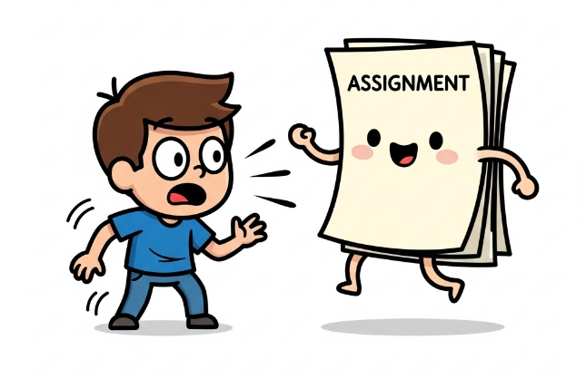
Important Announcement: Project 2
Important: Project 2 has been released!
Slide 2/14

Slide 14
Important Announcement: Project 2
Important: Project 2 has been released!
Released: Wednesday 19th November at 12:00 midday
Slide 2/14

Slide 15
Important Announcement: Project 2
Important: Project 2 has been released!
Released: Wednesday 19th November at 12:00 midday
Due: Wednesday 3rd December at 12:00 midday
Slide 2/14

Slide 16
Important Announcement: Project 2
Important: Project 2 has been released!
Released: Wednesday 19th November at 12:00 midday
Due: Wednesday 3rd December at 12:00 midday
The tasks require you to solve a scientific problem and complete a template Notebook.
Slide 2/14

Slide 17
Important Announcement: Project 2
Important: Project 2 has been released!
Released: Wednesday 19th November at 12:00 midday
Due: Wednesday 3rd December at 12:00 midday
The tasks require you to solve a scientific problem and complete a template Notebook.
You will have to write code, alongside reflective text about your code
Slide 2/14

Slide 18
Important Announcement: Project 2
Important: Project 2 has been released!
Released: Wednesday 19th November at 12:00 midday
Due: Wednesday 3rd December at 12:00 midday
The tasks require you to solve a scientific problem and complete a template Notebook.
You will have to write code, alongside reflective text about your code
This will be submitted via Blackboard, not noteable!
Slide 2/14

Slide 19
Important Announcement: Project 2
Important: Project 2 has been released!
Released: Wednesday 19th November at 12:00 midday
Due: Wednesday 3rd December at 12:00 midday
The tasks require you to solve a scientific problem and complete a template Notebook.
You will have to write code, alongside reflective text about your code
This will be submitted via Blackboard, not noteable!
Look for “Brief for Project 2” for instructions
Slide 2/14

Slide 20
Important Announcement: Project 2
Important: Project 2 has been released!
Released: Wednesday 19th November at 12:00 midday
Due: Wednesday 3rd December at 12:00 midday
The tasks require you to solve a scientific problem and complete a template Notebook.
You will have to write code, alongside reflective text about your code
This will be submitted via Blackboard, not noteable!
Look for “Brief for Project 2” for instructions
This is assessed!
Slide 2/14

Slide 21
Important Announcement: Project 2
Important: Project 2 has been released!
Released: Wednesday 19th November at 12:00 midday
Due: Wednesday 3rd December at 12:00 midday
The tasks require you to solve a scientific problem and complete a template Notebook.
You will have to write code, alongside reflective text about your code
This will be submitted via Blackboard, not noteable!
Look for “Brief for Project 2” for instructions
This is assessed! 30% of your grade
Slide 2/14

Slide 22
Important Announcement: Project 2
Slide 3/14

Slide 23
Important Announcement: Project 2
No use of autograding: follow the instructions on Blackboard.
Slide 3/14

Slide 24
Important Announcement: Project 2
No use of autograding: follow the instructions on Blackboard.
You must:
Slide 3/14

Slide 25
Important Announcement: Project 2
No use of autograding: follow the instructions on Blackboard.
You must:
Download the assignment from Blackboard
Slide 3/14

Slide 26
Important Announcement: Project 2
No use of autograding: follow the instructions on Blackboard.
You must:
Download the assignment from Blackboard
Upload it to Noteable, so that you can edit the notebook
Slide 3/14

Slide 27
Important Announcement: Project 2
No use of autograding: follow the instructions on Blackboard.
You must:
Download the assignment from Blackboard
Upload it to Noteable, so that you can edit the notebook
Complete the assignment
Slide 3/14

Slide 28
Important Announcement: Project 2
No use of autograding: follow the instructions on Blackboard.
You must:
Download the assignment from Blackboard
Upload it to Noteable, so that you can edit the notebook
Complete the assignment
Download the completed assignment and upload it to the submission point on Blackboard
Slide 3/14

Slide 29
Important Announcement: Project 2
No use of autograding: follow the instructions on Blackboard.
You must:
Download the assignment from Blackboard
Upload it to Noteable, so that you can edit the notebook
Complete the assignment
Download the completed assignment and upload it to the submission point on Blackboard
The assignment will be marked by your tutors.
Slide 3/14

Slide 30
Important Announcement: Project 2
Slide 4/14

Slide 31
Important Announcement: Project 2
General Advice:
Slide 4/14

Slide 32
Important Announcement: Project 2
General Advice:
Write clear code – use comments, intuitive variable names and think about the structure
Slide 4/14

Slide 33
Important Announcement: Project 2
General Advice:
Write clear code – use comments, intuitive variable names and think about the structure
Follow the advice provided during the tutorials.
Slide 4/14

Slide 34
Important Announcement: Project 2
General Advice:
Write clear code – use comments, intuitive variable names and think about the structure
Follow the advice provided during the tutorials.
Keep it simple - the tasks all have relatively simple solutions.
Slide 4/14

Slide 35
Important Announcement: Project 2
General Advice:
Write clear code – use comments, intuitive variable names and think about the structure
Follow the advice provided during the tutorials.
Keep it simple - the tasks all have relatively simple solutions.
Demonstrate understanding - use comments and write answers in the mandatory Markdown explanation boxes
Slide 4/14

Slide 36
What is Matplotlib?
Slide 5/14

Slide 37
What is Matplotlib?
Over the last few weeks, we’ve been looking at the NumPy module.
Slide 5/14

Slide 38
What is Matplotlib?
Over the last few weeks, we’ve been looking at the NumPy module.
This week, we’re going to take a slight detour and look at a different module: Matplotlib.
Slide 5/14

Slide 39
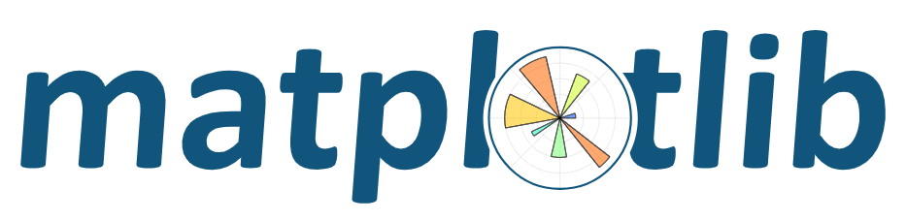
What is Matplotlib?
Over the last few weeks, we’ve been looking at the NumPy module.
This week, we’re going to take a slight detour and look at a different module: Matplotlib.
Slide 5/14

Slide 40
What is Matplotlib?
Over the last few weeks, we’ve been looking at the NumPy module.
This week, we’re going to take a slight detour and look at a different module: Matplotlib.
matplotlib is a powerful and widely-used Python library for creating static, animated, and interactive visualizations.
Slide 5/14

Slide 41
What is Matplotlib?
Over the last few weeks, we’ve been looking at the NumPy module.
This week, we’re going to take a slight detour and look at a different module: Matplotlib.
matplotlib is a powerful and widely-used Python library for creating static, animated, and interactive visualizations.
Why do we need plotting?
Slide 5/14

Slide 42
What is Matplotlib?
Over the last few weeks, we’ve been looking at the NumPy module.
This week, we’re going to take a slight detour and look at a different module: Matplotlib.
matplotlib is a powerful and widely-used Python library for creating static, animated, and interactive visualizations.
Why do we need plotting?
Visualize patterns in data
Slide 5/14

Slide 43
What is Matplotlib?
Over the last few weeks, we’ve been looking at the NumPy module.
This week, we’re going to take a slight detour and look at a different module: Matplotlib.
matplotlib is a powerful and widely-used Python library for creating static, animated, and interactive visualizations.
Why do we need plotting?
Visualize patterns in data
Communicate results effectively
Slide 5/14

Slide 44
What is Matplotlib?
Over the last few weeks, we’ve been looking at the NumPy module.
This week, we’re going to take a slight detour and look at a different module: Matplotlib.
matplotlib is a powerful and widely-used Python library for creating static, animated, and interactive visualizations.
Why do we need plotting?
Visualize patterns in data
Communicate results effectively
Explore relationships between variables
Slide 5/14

Slide 45
What is Matplotlib?
Over the last few weeks, we’ve been looking at the NumPy module.
This week, we’re going to take a slight detour and look at a different module: Matplotlib.
matplotlib is a powerful and widely-used Python library for creating static, animated, and interactive visualizations.
Why do we need plotting?
Visualize patterns in data
Communicate results effectively
Explore relationships between variables
Present findings to others
Slide 5/14

Slide 46
What is Matplotlib?
Slide 5/14

Slide 47
What is Matplotlib?
Slide 5/14

Slide 48
Getting Started
Slide 6/14

Slide 49
Getting Started
We can import matplotlib much like we have been for NumPy
Slide 6/14

Slide 50
Getting Started
We can import matplotlib much like we have been for NumPy
Specifically, we will work with pyplot, which we often abbreviate to plt
Slide 6/14

Slide 51
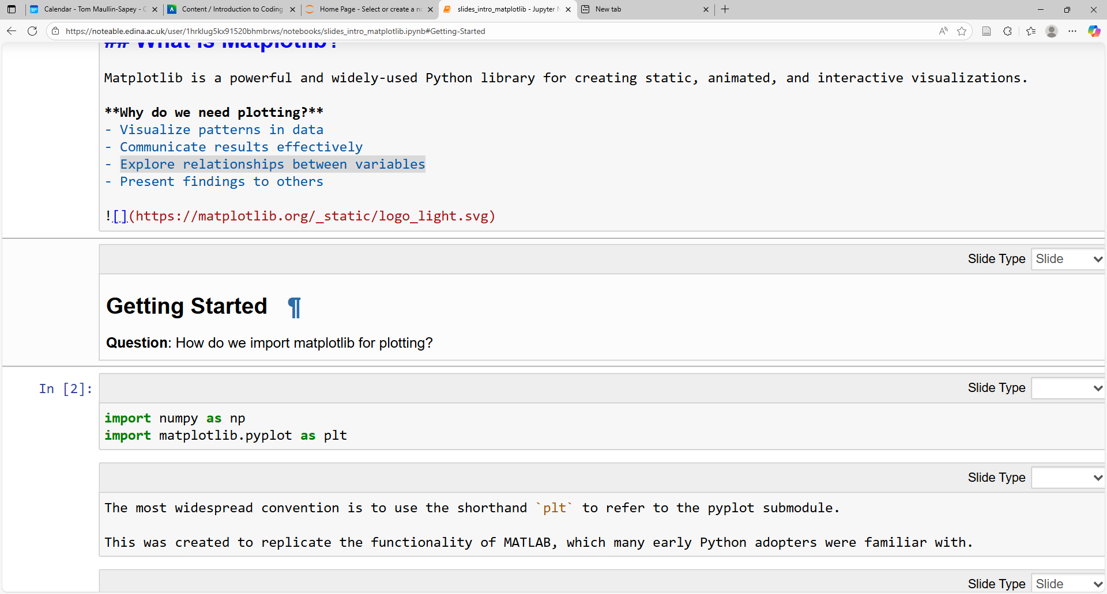
Getting Started
We can import matplotlib much like we have been for NumPy
Specifically, we will work with pyplot, which we often abbreviate to plt
Slide 6/14

Slide 52
Getting Started
We can import matplotlib much like we have been for NumPy
Specifically, we will work with pyplot, which we often abbreviate to plt
Slide 6/14

Slide 53
Getting Started
We can import matplotlib much like we have been for NumPy
Specifically, we will work with pyplot, which we often abbreviate to plt
Slide 6/14

Slide 54
Getting Started
We can import matplotlib much like we have been for NumPy
Specifically, we will work with pyplot, which we often abbreviate to plt
Recall: The import keyword loads in pre-written functions from a specific library
Slide 6/14

Slide 55
Getting Started
We can import matplotlib much like we have been for NumPy
Specifically, we will work with pyplot, which we often abbreviate to plt
Recall: The import keyword loads in pre-written functions from a specific library
Today we will look at:
Slide 6/14

Slide 56
Getting Started
We can import matplotlib much like we have been for NumPy
Specifically, we will work with pyplot, which we often abbreviate to plt
Recall: The import keyword loads in pre-written functions from a specific library
Today we will look at:
Basics of plotting in Python using matplotlib
Slide 6/14

Slide 57
Getting Started
We can import matplotlib much like we have been for NumPy
Specifically, we will work with pyplot, which we often abbreviate to plt
Recall: The import keyword loads in pre-written functions from a specific library
Today we will look at:
Basics of plotting in Python using matplotlib
Reading and plotting from file
Slide 6/14

Slide 58
Getting Started
We can import matplotlib much like we have been for NumPy
Specifically, we will work with pyplot, which we often abbreviate to plt
Recall: The import keyword loads in pre-written functions from a specific library
Today we will look at:
Basics of plotting in Python using matplotlib
Reading and plotting from file
Customising plots
Slide 6/14

Slide 59
Getting Started
We can import matplotlib much like we have been for NumPy
Specifically, we will work with pyplot, which we often abbreviate to plt
Recall: The import keyword loads in pre-written functions from a specific library
Today we will look at:
Basics of plotting in Python using matplotlib
Reading and plotting from file
Customising plots
Historical note: matplotlib was created originally to replicate plotting in MATLAB.
Slide 6/14

Slide 60
Two Main Approaches
Slide 7/14

Slide 61
Two Main Approaches
Slide 7/14

Slide 62
Two Main Approaches
There are two different ways we can create plots in matplotlib
Slide 7/14

Slide 63
Two Main Approaches
There are two different ways we can create plots in matplotlib
Method 1:
Slide 7/14

Slide 64
Two Main Approaches
There are two different ways we can create plots in matplotlib
Method 1: The pyplot interface
Slide 7/14

Slide 65
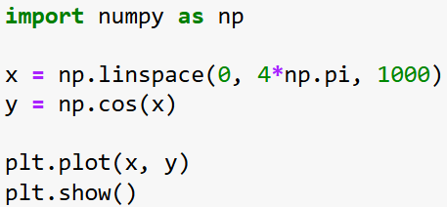
Two Main Approaches
There are two different ways we can create plots in matplotlib
Method 1: The pyplot interface
Slide 7/14

Slide 66
Two Main Approaches
There are two different ways we can create plots in matplotlib
Method 1: The pyplot interface
Slide 7/14

Slide 67
Two Main Approaches
There are two different ways we can create plots in matplotlib
Method 1: The pyplot interface
Slide 7/14

Slide 68
Two Main Approaches
There are two different ways we can create plots in matplotlib
Method 1: The pyplot interface
Slide 7/14

Slide 69
Two Main Approaches
There are two different ways we can create plots in matplotlib
Method 1: The pyplot interface
Use plt.plot to tell Python what you want to plot
Slide 7/14

Slide 70
Two Main Approaches
There are two different ways we can create plots in matplotlib
Method 1: The pyplot interface
Use plt.plot to tell Python what you want to plot
Slide 7/14

Slide 71
Two Main Approaches
There are two different ways we can create plots in matplotlib
Method 1: The pyplot interface
Use plt.plot to tell Python what you want to plot
Use plt.show to show the plot
Slide 7/14

Slide 72
Two Main Approaches
There are two different ways we can create plots in matplotlib
Method 1: The pyplot interface
Use plt.plot to tell Python what you want to plot
Use plt.show to show the plot
Slide 7/14

Slide 73
Two Main Approaches
There are two different ways we can create plots in matplotlib
Method 1: The pyplot interface
Use plt.plot to tell Python what you want to plot
Use plt.show to show the plot
Slide 7/14

Slide 74
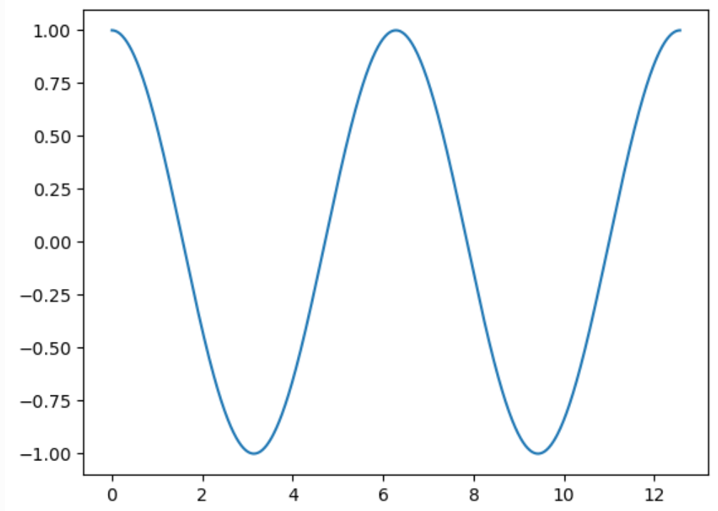
Two Main Approaches
There are two different ways we can create plots in matplotlib
Method 1: The pyplot interface
Use plt.plot to tell Python what you want to plot
Use plt.show to show the plot
Slide 7/14

Slide 75
Two Main Approaches
There are two different ways we can create plots in matplotlib
Method 1: The pyplot interface
Use plt.plot to tell Python what you want to plot
Use plt.show to show the plot
Syntax based on MATLAB
Slide 7/14

Slide 76
Two Main Approaches
There are two different ways we can create plots in matplotlib
Method 1: The pyplot interface
Use plt.plot to tell Python what you want to plot
Use plt.show to show the plot
Syntax based on MATLAB
Quick and easy for basic plots
Slide 7/14

Slide 77
Two Main Approaches
There are two different ways we can create plots in matplotlib
Method 1: The pyplot interface
Use plt.plot to tell Python what you want to plot
Use plt.show to show the plot
Syntax based on MATLAB
Quick and easy for basic plots
Often seen in online examples
Slide 7/14

Slide 78
Two Main Approaches
There are two different ways we can create plots in matplotlib
Slide 8/14

Slide 79
Two Main Approaches
There are two different ways we can create plots in matplotlib
Method 2:
Slide 8/14

Slide 80
Two Main Approaches
There are two different ways we can create plots in matplotlib
Method 2: Object-Oriented Approach
Slide 8/14

Slide 81
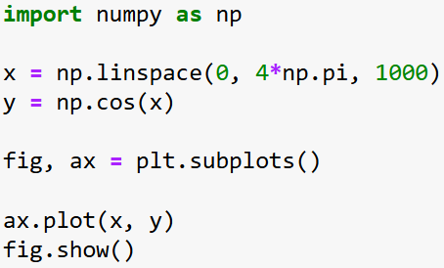
Two Main Approaches
There are two different ways we can create plots in matplotlib
Method 2: Object-Oriented Approach
Slide 8/14

Slide 82
Two Main Approaches
There are two different ways we can create plots in matplotlib
Method 2: Object-Oriented Approach
Slide 8/14

Slide 83
Two Main Approaches
There are two different ways we can create plots in matplotlib
Method 2: Object-Oriented Approach
Slide 8/14

Slide 84
Two Main Approaches
There are two different ways we can create plots in matplotlib
Method 2: Object-Oriented Approach
Slide 8/14

Slide 85
Two Main Approaches
There are two different ways we can create plots in matplotlib
Method 2: Object-Oriented Approach
Use plt.subplots to get figure and axis objects
Slide 8/14

Slide 86
Two Main Approaches
There are two different ways we can create plots in matplotlib
Method 2: Object-Oriented Approach
Use plt.subplots to get figure and axis objects
Slide 8/14

Slide 87
Two Main Approaches
There are two different ways we can create plots in matplotlib
Method 2: Object-Oriented Approach
Use plt.subplots to get figure and axis objects
Use ax.plot to tell python what you want to plot on the axes
Slide 8/14

Slide 88
Two Main Approaches
There are two different ways we can create plots in matplotlib
Method 2: Object-Oriented Approach
Use plt.subplots to get figure and axis objects
Use ax.plot to tell python what you want to plot on the axes
Slide 8/14

Slide 89
Two Main Approaches
There are two different ways we can create plots in matplotlib
Method 2: Object-Oriented Approach
Use plt.subplots to get figure and axis objects
Use ax.plot to tell python what you want to plot on the axes
Use fig.show to show the plot
Slide 8/14

Slide 90
Two Main Approaches
There are two different ways we can create plots in matplotlib
Method 2: Object-Oriented Approach
Use plt.subplots to get figure and axis objects
Use ax.plot to tell python what you want to plot on the axes
Use fig.show to show the plot
Slide 8/14

Slide 91
Two Main Approaches
There are two different ways we can create plots in matplotlib
Method 2: Object-Oriented Approach
Use plt.subplots to get figure and axis objects
Use ax.plot to tell python what you want to plot on the axes
Use fig.show to show the plot
Slide 8/14

Slide 92
Two Main Approaches
There are two different ways we can create plots in matplotlib
Method 2: Object-Oriented Approach
Use plt.subplots to get figure and axis objects
Use ax.plot to tell python what you want to plot on the axes
Use fig.show to show the plot
Slide 8/14

Slide 93
Two Main Approaches
There are two different ways we can create plots in matplotlib
Method 2: Object-Oriented Approach
Use plt.subplots to get figure and axis objects
Use ax.plot to tell python what you want to plot on the axes
Use fig.show to show the plot
A little more complicated… But gives much more control
Slide 8/14

Slide 94
Two Main Approaches
There are two different ways we can create plots in matplotlib
Method 2: Object-Oriented Approach
Use plt.subplots to get figure and axis objects
Use ax.plot to tell python what you want to plot on the axes
Use fig.show to show the plot
A little more complicated… But gives much more control
fig and ax are Python objects describing the figure and axes
Slide 8/14

Slide 95
Two Main Approaches
There are two different ways we can create plots in matplotlib
Method 2: Object-Oriented Approach
Use plt.subplots to get figure and axis objects
Use ax.plot to tell python what you want to plot on the axes
Use fig.show to show the plot
A little more complicated… But gives much more control
fig and ax are Python objects describing the figure and axes
Recommended approach!
Slide 8/14

Slide 96
Two Main Approaches
There are two different ways we can create plots in matplotlib
Method 2: Object-Oriented Approach
Use plt.subplots to get figure and axis objects
Use ax.plot to tell python what you want to plot on the axes
Use fig.show to show the plot
A little more complicated… But gives much more control
fig and ax are Python objects describing the figure and axes
Slide 8/14

Slide 97
Figures and Axes
Slide 9/14

Slide 98
Figures and Axes
What is the difference between a Figure and Axes?
Slide 9/14

Slide 99
Figures and Axes
What is the difference between a Figure and Axes?
Figure: The entire canvas, like a piece of paper
Slide 9/14

Slide 100
Figures and Axes
What is the difference between a Figure and Axes?
Figure: The entire canvas, like a piece of paper
Axes: The plotting area on the paper with x-y coordinates (where the data goes)
Slide 9/14

Slide 101
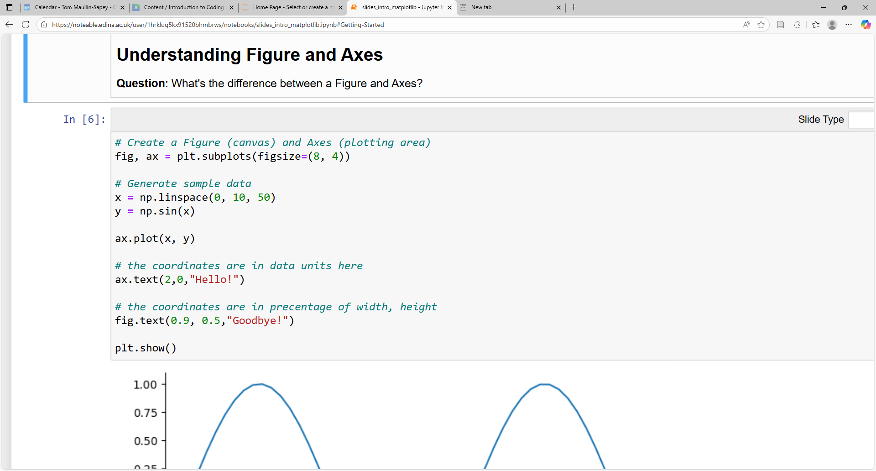
Figures and Axes
What is the difference between a Figure and Axes?
Figure: The entire canvas, like a piece of paper
Axes: The plotting area on the paper with x-y coordinates (where the data goes)
Slide 9/14

Slide 102
Figures and Axes
What is the difference between a Figure and Axes?
Figure: The entire canvas, like a piece of paper
Axes: The plotting area on the paper with x-y coordinates (where the data goes)
Slide 9/14

Slide 103
Figures and Axes
What is the difference between a Figure and Axes?
Figure: The entire canvas, like a piece of paper
Axes: The plotting area on the paper with x-y coordinates (where the data goes)
Slide 9/14

Slide 104
Figures and Axes
What is the difference between a Figure and Axes?
Figure: The entire canvas, like a piece of paper
Axes: The plotting area on the paper with x-y coordinates (where the data goes)
Slide 9/14

Slide 105
Figures and Axes
What is the difference between a Figure and Axes?
Figure: The entire canvas, like a piece of paper
Axes: The plotting area on the paper with x-y coordinates (where the data goes)
Slide 9/14

Slide 106
Figures and Axes
What is the difference between a Figure and Axes?
Figure: The entire canvas, like a piece of paper
Axes: The plotting area on the paper with x-y coordinates (where the data goes)
Slide 9/14

Slide 107
Figures and Axes
What is the difference between a Figure and Axes?
Figure: The entire canvas, like a piece of paper
Axes: The plotting area on the paper with x-y coordinates (where the data goes)
Slide 9/14

Slide 108
Figures and Axes
What is the difference between a Figure and Axes?
Figure: The entire canvas, like a piece of paper
Axes: The plotting area on the paper with x-y coordinates (where the data goes)
Slide 9/14

Slide 109
Figures and Axes
What is the difference between a Figure and Axes?
Figure: The entire canvas, like a piece of paper
Axes: The plotting area on the paper with x-y coordinates (where the data goes)
Slide 9/14

Slide 110
Figures and Axes
What is the difference between a Figure and Axes?
Figure: The entire canvas, like a piece of paper
Axes: The plotting area on the paper with x-y coordinates (where the data goes)
Slide 9/14

Slide 111
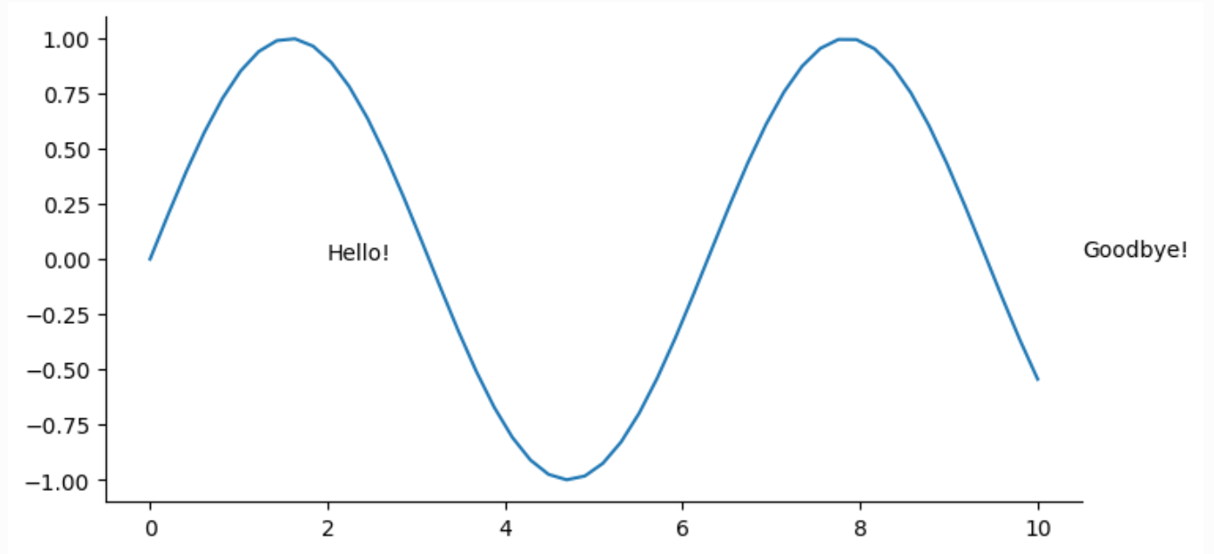
Figures and Axes
What is the difference between a Figure and Axes?
Figure: The entire canvas, like a piece of paper
Axes: The plotting area on the paper with x-y coordinates (where the data goes)
Slide 9/14

Slide 112
Figures and Axes
What is the difference between a Figure and Axes?
Figure: The entire canvas, like a piece of paper
Axes: The plotting area on the paper with x-y coordinates (where the data goes)
Figure = Whole canvas
Slide 9/14

Slide 113
Figures and Axes
What is the difference between a Figure and Axes?
Figure: The entire canvas, like a piece of paper
Axes: The plotting area on the paper with x-y coordinates (where the data goes)
Slide 9/14

Slide 114
Figures and Axes
What is the difference between a Figure and Axes?
Figure: The entire canvas, like a piece of paper
Axes: The plotting area on the paper with x-y coordinates (where the data goes)
Axes = xy plot
Slide 9/14

Slide 115
Figures and Axes
What is the difference between a Figure and Axes?
Figure: The entire canvas, like a piece of paper
Axes: The plotting area on the paper with x-y coordinates (where the data goes)
Slide 9/14

Slide 116
Figures and Axes
What is the difference between a Figure and Axes?
Figure: The entire canvas, like a piece of paper
Axes: The plotting area on the paper with x-y coordinates (where the data goes)
Slide 9/14

Slide 117
Figures and Axes
What is the difference between a Figure and Axes?
Figure: The entire canvas, like a piece of paper
Axes: The plotting area on the paper with x-y coordinates (where the data goes)
Slide 9/14

Slide 118
Figures and Axes
What is the difference between a Figure and Axes?
Figure: The entire canvas, like a piece of paper
Axes: The plotting area on the paper with x-y coordinates (where the data goes)
“Hello!” was drawn inside the axes
Slide 9/14

Slide 119
Figures and Axes
What is the difference between a Figure and Axes?
Figure: The entire canvas, like a piece of paper
Axes: The plotting area on the paper with x-y coordinates (where the data goes)
Slide 9/14

Slide 120
Figures and Axes
What is the difference between a Figure and Axes?
Figure: The entire canvas, like a piece of paper
Axes: The plotting area on the paper with x-y coordinates (where the data goes)
Slide 9/14

Slide 121
Figures and Axes
What is the difference between a Figure and Axes?
Figure: The entire canvas, like a piece of paper
Axes: The plotting area on the paper with x-y coordinates (where the data goes)
Slide 9/14

Slide 122
Figures and Axes
What is the difference between a Figure and Axes?
Figure: The entire canvas, like a piece of paper
Axes: The plotting area on the paper with x-y coordinates (where the data goes)
“Goodbye!” was drawn outside the axes, but inside the figure
Slide 9/14

Slide 123
Figures and Axes
What is the difference between a Figure and Axes?
Figure: The entire canvas, like a piece of paper
Axes: The plotting area on the paper with x-y coordinates (where the data goes)
Slide 9/14

Slide 124
Figures and Axes
What is the difference between a Figure and Axes?
Figure: The entire canvas, like a piece of paper
Axes: The plotting area on the paper with x-y coordinates (where the data goes)
It is possible to have multiple axes on one figure!
Slide 9/14

Slide 125
Figures and Axes
What is the difference between a Figure and Axes?
Figure: The entire canvas, like a piece of paper
Axes: The plotting area on the paper with x-y coordinates (where the data goes)
It is possible to have multiple axes on one figure!
(Not covered today)
Slide 9/14

Slide 126
Types of Plot
Slide 10/14

Slide 127
Types of Plot
So far, we’ve seen how matplotlib can be used to make line graphs
Slide 10/14

Slide 128
Types of Plot
So far, we’ve seen how matplotlib can be used to make line graphs
But we can use it to make other plots too.
Slide 10/14

Slide 129
Types of Plot
So far, we’ve seen how matplotlib can be used to make line graphs
But we can use it to make other plots too. For instance:
Slide 10/14

Slide 130
Types of Plot
So far, we’ve seen how matplotlib can be used to make line graphs
But we can use it to make other plots too. For instance:
ax.scatter creates a scatter plot
Slide 10/14

Slide 131
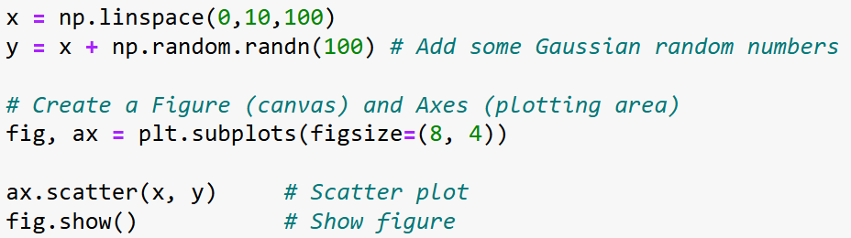
Types of Plot
So far, we’ve seen how matplotlib can be used to make line graphs
But we can use it to make other plots too. For instance:
ax.scatter creates a scatter plot
Slide 10/14

Slide 132
Types of Plot
So far, we’ve seen how matplotlib can be used to make line graphs
But we can use it to make other plots too. For instance:
ax.scatter creates a scatter plot
Slide 10/14

Slide 133
Types of Plot
So far, we’ve seen how matplotlib can be used to make line graphs
But we can use it to make other plots too. For instance:
ax.scatter creates a scatter plot
Slide 10/14

Slide 134
Types of Plot
So far, we’ve seen how matplotlib can be used to make line graphs
But we can use it to make other plots too. For instance:
ax.scatter creates a scatter plot
Slide 10/14

Slide 135
Types of Plot
So far, we’ve seen how matplotlib can be used to make line graphs
But we can use it to make other plots too. For instance:
ax.scatter creates a scatter plot
Slide 10/14

Slide 136
Types of Plot
So far, we’ve seen how matplotlib can be used to make line graphs
But we can use it to make other plots too. For instance:
ax.scatter creates a scatter plot
Slide 10/14

Slide 137
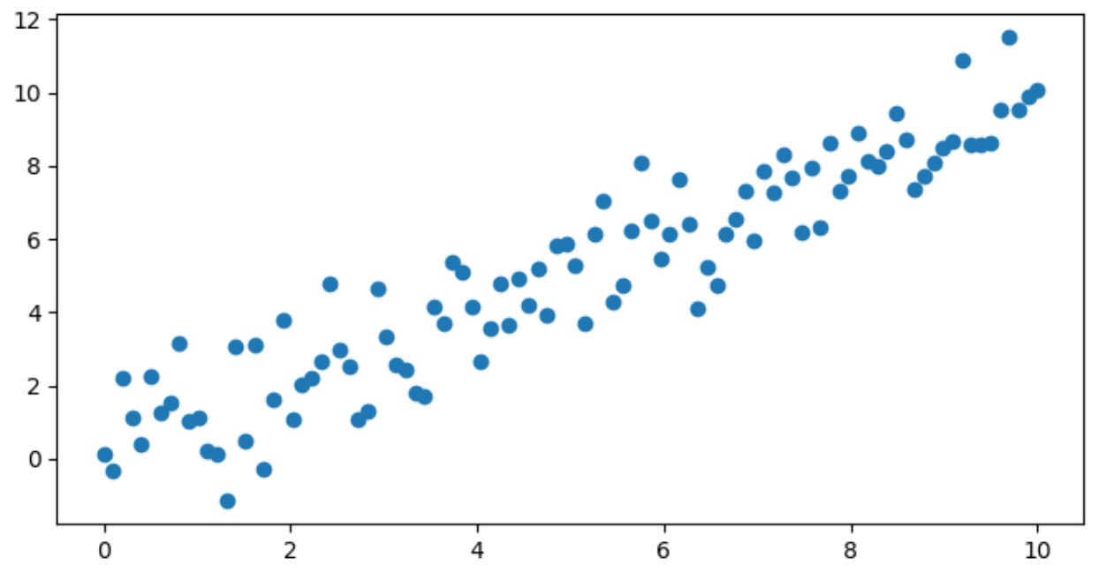
Types of Plot
So far, we’ve seen how matplotlib can be used to make line graphs
But we can use it to make other plots too. For instance:
ax.scatter creates a scatter plot
Slide 10/14

Slide 138
Types of Plot
So far, we’ve seen how matplotlib can be used to make line graphs
But we can use it to make other plots too. For instance:
ax.scatter creates a scatter plot
ax.hist creates a histogram
Slide 10/14

Slide 139
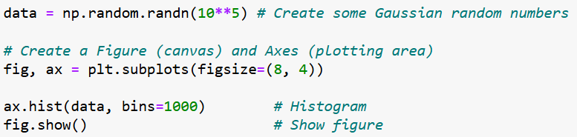
Types of Plot
So far, we’ve seen how matplotlib can be used to make line graphs
But we can use it to make other plots too. For instance:
ax.scatter creates a scatter plot
ax.hist creates a histogram
Slide 10/14

Slide 140
Types of Plot
So far, we’ve seen how matplotlib can be used to make line graphs
But we can use it to make other plots too. For instance:
ax.scatter creates a scatter plot
ax.hist creates a histogram
Slide 10/14

Slide 141
Types of Plot
So far, we’ve seen how matplotlib can be used to make line graphs
But we can use it to make other plots too. For instance:
ax.scatter creates a scatter plot
ax.hist creates a histogram
Slide 10/14

Slide 142
Types of Plot
So far, we’ve seen how matplotlib can be used to make line graphs
But we can use it to make other plots too. For instance:
ax.scatter creates a scatter plot
ax.hist creates a histogram
Slide 10/14

Slide 143
Types of Plot
So far, we’ve seen how matplotlib can be used to make line graphs
But we can use it to make other plots too. For instance:
ax.scatter creates a scatter plot
ax.hist creates a histogram
Slide 10/14

Slide 144
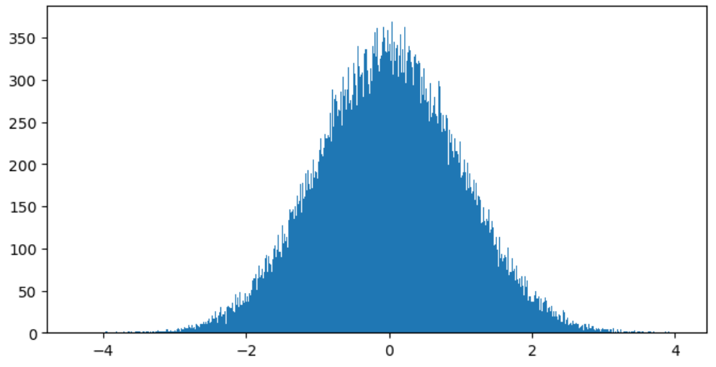
Types of Plot
So far, we’ve seen how matplotlib can be used to make line graphs
But we can use it to make other plots too. For instance:
ax.scatter creates a scatter plot
ax.hist creates a histogram
Slide 10/14

Slide 145
Types of Plot
So far, we’ve seen how matplotlib can be used to make line graphs
But we can use it to make other plots too. For instance:
ax.scatter creates a scatter plot
ax.hist creates a histogram
And many more… (see documentation here)
Slide 10/14

Slide 146
Types of Plot
So far, we’ve seen how matplotlib can be used to make line graphs
But we can use it to make other plots too. For instance:
ax.scatter creates a scatter plot
ax.hist creates a histogram
And many more… (see documentation here)
A good rule of thumb is:
Slide 10/14

Slide 147
Types of Plot
So far, we’ve seen how matplotlib can be used to make line graphs
But we can use it to make other plots too. For instance:
ax.scatter creates a scatter plot
ax.hist creates a histogram
And many more… (see documentation here)
A good rule of thumb is:
Use scatter and line plots for looking at relationships between variables and correlation
Slide 10/14

Slide 148
Types of Plot
So far, we’ve seen how matplotlib can be used to make line graphs
But we can use it to make other plots too. For instance:
ax.scatter creates a scatter plot
ax.hist creates a histogram
And many more… (see documentation here)
A good rule of thumb is:
Use scatter and line plots for looking at relationships between variables and correlation
Use bar diagrams and histograms for distributions and frequencies
Slide 10/14

Slide 149
Worked Example: Combining Visualisations
Slide 11/14

Slide 150
Worked Example: Combining Visualisations
Scenario:
Slide 11/14

Slide 151
Worked Example: Combining Visualisations
Scenario: We have measurements and a fitted model.
Slide 11/14

Slide 152
Worked Example: Combining Visualisations
Scenario: We have measurements and a fitted model.
How do we plot both simultaneously?
Slide 11/14

Slide 153
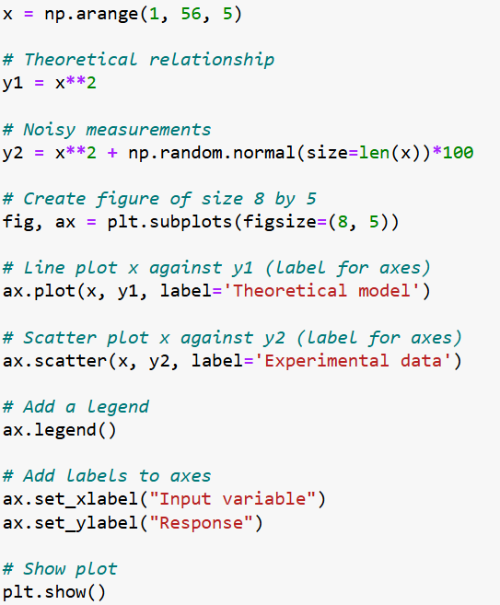
Worked Example: Combining Visualisations
Scenario: We have measurements and a fitted model.
How do we plot both simultaneously?
Slide 11/14

Slide 154
Worked Example: Combining Visualisations
Scenario: We have measurements and a fitted model.
How do we plot both simultaneously?
Slide 11/14

Slide 155
Worked Example: Combining Visualisations
Scenario: We have measurements and a fitted model.
How do we plot both simultaneously?
Slide 11/14

Slide 156
Worked Example: Combining Visualisations
Scenario: We have measurements and a fitted model.
How do we plot both simultaneously?
Slide 11/14

Slide 157
Worked Example: Combining Visualisations
Scenario: We have measurements and a fitted model.
How do we plot both simultaneously?
Slide 11/14

Slide 158
Worked Example: Combining Visualisations
Scenario: We have measurements and a fitted model.
How do we plot both simultaneously?
Slide 11/14

Slide 159
Worked Example: Combining Visualisations
Scenario: We have measurements and a fitted model.
How do we plot both simultaneously?
Slide 11/14

Slide 160
Worked Example: Combining Visualisations
Scenario: We have measurements and a fitted model.
How do we plot both simultaneously?
Slide 11/14

Slide 161
Worked Example: Combining Visualisations
Scenario: We have measurements and a fitted model.
How do we plot both simultaneously?
Slide 11/14

Slide 162
Worked Example: Combining Visualisations
Scenario: We have measurements and a fitted model.
How do we plot both simultaneously?
Slide 11/14

Slide 163
Worked Example: Combining Visualisations
Scenario: We have measurements and a fitted model.
How do we plot both simultaneously?
Slide 11/14

Slide 164
Worked Example: Combining Visualisations
Scenario: We have measurements and a fitted model.
How do we plot both simultaneously?
Slide 11/14

Slide 165
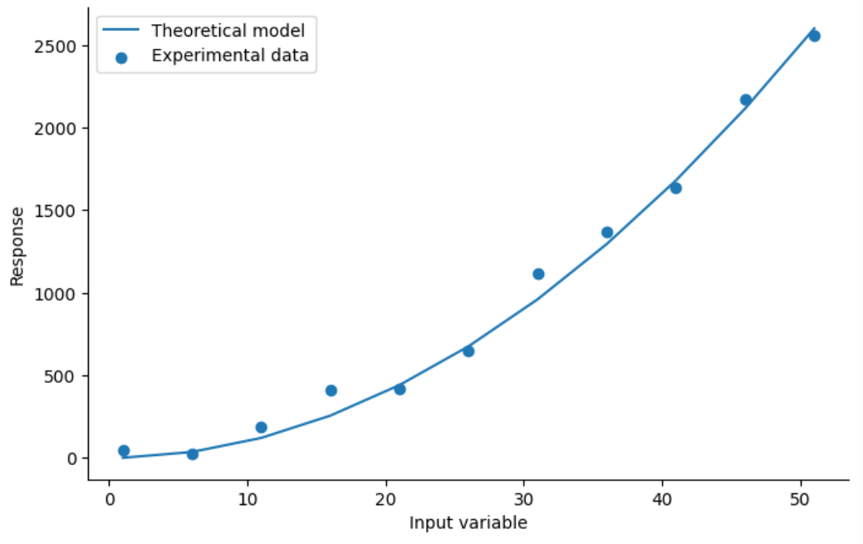
Worked Example: Combining Visualisations
Scenario: We have measurements and a fitted model.
How do we plot both simultaneously?
Slide 11/14

Slide 166
Customising Plots
Slide 12/14

Slide 167
Customising Plots
So far, we’ve looked at default plot settings.
Slide 12/14

Slide 168
Customising Plots
So far, we’ve looked at default plot settings.
But there are many options we can use to make our plots look more professional
Slide 12/14

Slide 169
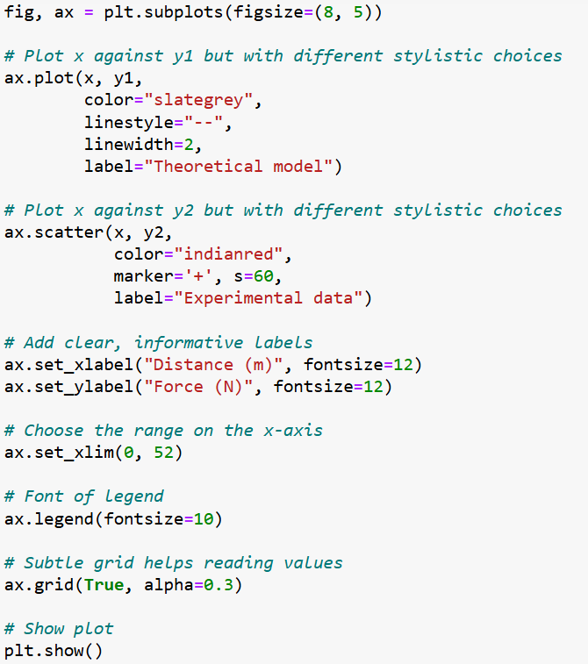
Customising Plots
So far, we’ve looked at default plot settings.
But there are many options we can use to make our plots look more professional
Slide 12/14

Slide 170
Customising Plots
So far, we’ve looked at default plot settings.
But there are many options we can use to make our plots look more professional
Slide 12/14

Slide 171
Customising Plots
So far, we’ve looked at default plot settings.
But there are many options we can use to make our plots look more professional
Slide 12/14

Slide 172
Customising Plots
So far, we’ve looked at default plot settings.
But there are many options we can use to make our plots look more professional
Slide 12/14

Slide 173
Customising Plots
So far, we’ve looked at default plot settings.
But there are many options we can use to make our plots look more professional
Slide 12/14

Slide 174
Customising Plots
So far, we’ve looked at default plot settings.
But there are many options we can use to make our plots look more professional
Slide 12/14

Slide 175
Customising Plots
So far, we’ve looked at default plot settings.
But there are many options we can use to make our plots look more professional
Slide 12/14

Slide 176
Customising Plots
So far, we’ve looked at default plot settings.
But there are many options we can use to make our plots look more professional
Slide 12/14

Slide 177
Customising Plots
So far, we’ve looked at default plot settings.
But there are many options we can use to make our plots look more professional
Slide 12/14

Slide 178
Customising Plots
So far, we’ve looked at default plot settings.
But there are many options we can use to make our plots look more professional
Slide 12/14

Slide 179
Customising Plots
So far, we’ve looked at default plot settings.
But there are many options we can use to make our plots look more professional
Slide 12/14

Slide 180
Customising Plots
So far, we’ve looked at default plot settings.
But there are many options we can use to make our plots look more professional
Slide 12/14

Slide 181
Customising Plots
So far, we’ve looked at default plot settings.
But there are many options we can use to make our plots look more professional
Slide 12/14

Slide 182
Customising Plots
So far, we’ve looked at default plot settings.
But there are many options we can use to make our plots look more professional
Slide 12/14

Slide 183
Customising Plots
So far, we’ve looked at default plot settings.
But there are many options we can use to make our plots look more professional
Slide 12/14

Slide 184
Customising Plots
So far, we’ve looked at default plot settings.
But there are many options we can use to make our plots look more professional
Slide 12/14

Slide 185
Customising Plots
So far, we’ve looked at default plot settings.
But there are many options we can use to make our plots look more professional
Slide 12/14

Slide 186
Customising Plots
So far, we’ve looked at default plot settings.
But there are many options we can use to make our plots look more professional
Slide 12/14

Slide 187
Customising Plots
So far, we’ve looked at default plot settings.
But there are many options we can use to make our plots look more professional
Slide 12/14

Slide 188
Customising Plots
So far, we’ve looked at default plot settings.
But there are many options we can use to make our plots look more professional
Slide 12/14

Slide 189
Customising Plots
So far, we’ve looked at default plot settings.
But there are many options we can use to make our plots look more professional
Slide 12/14

Slide 190
Customising Plots
So far, we’ve looked at default plot settings.
But there are many options we can use to make our plots look more professional
Slide 12/14

Slide 191
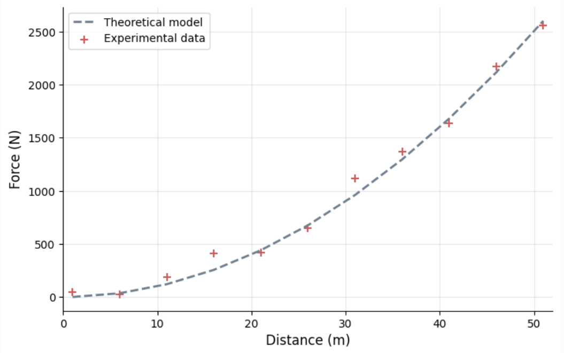
Customising Plots
So far, we’ve looked at default plot settings.
But there are many options we can use to make our plots look more professional
Slide 12/14

Slide 192
Customising Plots
So far, we’ve looked at default plot settings.
But there are many options we can use to make our plots look more professional
Slide 12/14

Slide 193
Customising Plots
So far, we’ve looked at default plot settings.
But there are many options we can use to make our plots look more professional
Slide 12/14

Slide 194
Customising Plots
So far, we’ve looked at default plot settings.
But there are many options we can use to make our plots look more professional
See the documentation for further detail
Slide 12/14

Slide 195
Practical
Slide 13/14

Slide 196
Practical
We now move over to Python
Slide 13/14

Slide 197
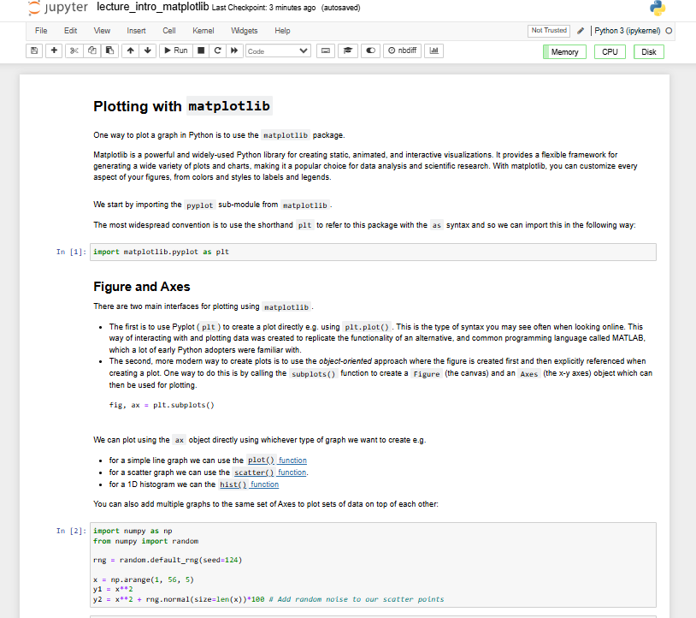
Practical
We now move over to Python
Slide 13/14

Slide 198
Practical
We now move over to Python
For the rest of today, you must do the following:
Slide 13/14

Slide 199
Practical
We now move over to Python
For the rest of today, you must do the following:
First, read through:
Slide 13/14

Slide 200
Practical
We now move over to Python
For the rest of today, you must do the following:
First, read through: lecture_intro_matplotlin.ipynb
Slide 13/14

Slide 201
Practical
We now move over to Python
For the rest of today, you must do the following:
First, read through: lecture_intro_matplotlin.ipynb
Then, work through the exercises in:
Slide 13/14

Slide 202
Practical
We now move over to Python
For the rest of today, you must do the following:
First, read through: lecture_intro_matplotlin.ipynb
Then, work through the exercises in: exercises_plotting_data_from_file.ipynb
Slide 13/14

Slide 203
Practical
We now move over to Python
For the rest of today, you must do the following:
First, read through: lecture_intro_matplotlin.ipynb
Then, work through the exercises in: exercises_plotting_data_from_file.ipynb
After that, work through:
Slide 13/14

Slide 204
Practical
We now move over to Python
For the rest of today, you must do the following:
First, read through: lecture_intro_matplotlin.ipynb
Then, work through the exercises in: exercises_plotting_data_from_file.ipynb
After that, work through: fun_matplotlib_decoration.ipynb
Slide 13/14

Slide 205
Practical
We now move over to Python
For the rest of today, you must do the following:
First, read through: lecture_intro_matplotlin.ipynb
Then, work through the exercises in: exercises_plotting_data_from_file.ipynb
After that, work through: fun_matplotlib_decoration.ipynb
If you finish early, work through intermediate or advanced notebooks from weeks 1-5 that you haven’t yet tried!
Slide 13/14

Slide 206
Practical
We now move over to Python
For the rest of today, you must do the following:
First, read through: lecture_intro_matplotlin.ipynb
Then, work through the exercises in: exercises_plotting_data_from_file.ipynb
After that, work through: fun_matplotlib_decoration.ipynb
Slide 13/14

Slide 207
Next Time
Lecture 8: Introduction to Matplotlib
What is Matplotlib?
Approaches to Plotting
Figures and Axes
Customising Plots
Practical
Lecture 9: Multi-dimensional Arrays
Properties
Broadcasting
Matrices as Images
Practical
Slide 14/14

