Slide 1
Lecture 11:
Introduction to Pandas
SCIF10002 – Introduction to Coding and Data Analysis for Scientists
Tom Maullin-Sapey
22nd January 2026
Slide 0/17

Slide 2
Today’s Lecture
Slide 1/17

Slide 3
Today’s Lecture
Lecture 11: Introduction to Pandas
What is Pandas?
The Pandas DataFrame
Accessing Elements
Practical
Slide 1/17

Slide 4
Todays Lecture
Lecture 11: Introduction to Pandas
What is Pandas?
The Pandas DataFrame
Accessing Elements
Practical
Lecture 12: Pandas Preprocessing
Loading Data
Exploratory Investigation
Data Type Conversion
Practical
Slide 1/17

Slide 5
What is Pandas?
Slide 2/17

Slide 6
What is Pandas?
pandas is the Python library for data science
Slide 2/17

Slide 7

What is Pandas?
pandas is the Python library for data science
Slide 2/17

Slide 8

What is Pandas?
pandas is the Python library for data science
Slide 2/17

Slide 9
What is Pandas?
pandas is the Python library for data science
Powerful Python library for data manipulation and analysis
Slide 2/17

Slide 10
What is Pandas?
pandas is the Python library for data science
Powerful Python library for data manipulation and analysis
Works with tabulated data
Slide 2/17

Slide 11
What is Pandas?
pandas is the Python library for data science
Powerful Python library for data manipulation and analysis
Works with tabulated data
Combines features of lists, numpy arrays, and dictionaries
Slide 2/17

Slide 12
Powerful Tables: The Pandas DataFrame
Slide 3/17

Slide 13
Powerful Tables: The Pandas DataFrame
pandas allows us to store tabular data.
Slide 3/17

Slide 14
Powerful Tables: The Pandas DataFrame
pandas allows us to store tabular data. E.g.:
Slide 3/17

Slide 15
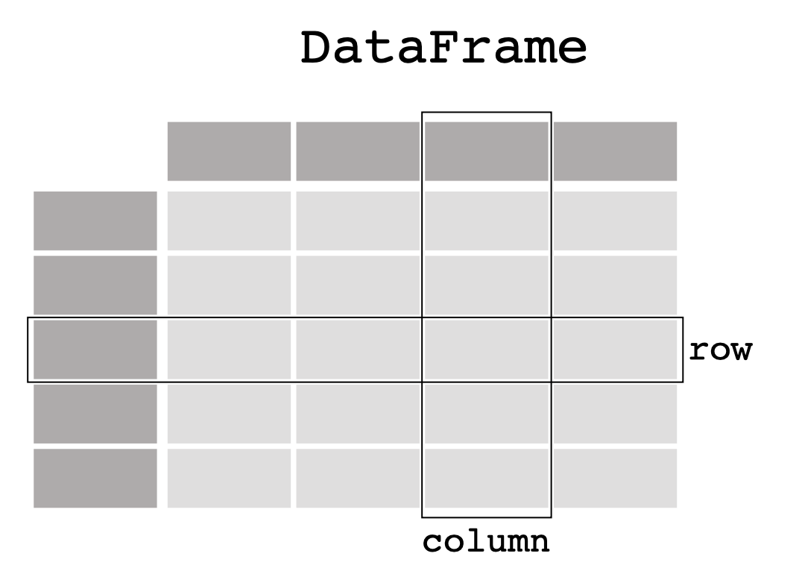
Powerful Tables: The Pandas DataFrame
pandas allows us to store tabular data. E.g.:
Slide 3/17

Slide 16
Powerful Tables: The Pandas DataFrame
pandas allows us to store tabular data. E.g.:
Every line is an observation
Slide 3/17

Slide 17
Powerful Tables: The Pandas DataFrame
pandas allows us to store tabular data. E.g.:
Every line is an observation
Every column represents a type of measurement
Slide 3/17

Slide 18
Powerful Tables: The Pandas DataFrame
pandas allows us to store tabular data. E.g.:
Every line is an observation
Every column represents a type of measurement
Not necessarily numerical!
Slide 3/17

Slide 19
Powerful Tables: The Pandas DataFrame
pandas allows us to store tabular data. E.g.:
Every line is an observation
Every column represents a type of measurement
Not necessarily numerical!
Tables in pandas are a new datatype:
Slide 3/17

Slide 20
Powerful Tables: The Pandas DataFrame
pandas allows us to store tabular data. E.g.:
Every line is an observation
Every column represents a type of measurement
Not necessarily numerical!
Tables in pandas are a new datatype:
The pandas DataFrame
Slide 3/17

Slide 21
Powerful Tables: The Pandas DataFrame
pandas allows us to store tabular data. E.g.:
Every line is an observation
Every column represents a type of measurement
Not necessarily numerical!
Tables in pandas are a new datatype:
The pandas DataFrame
Much like an array, but designed for arbitrary data
Slide 3/17

Slide 22
Powerful Tables: The Pandas DataFrame
Slide 4/17

Slide 23
Powerful Tables: The Pandas DataFrame
pandas does not assume table entries have a specific format/datatype
Slide 4/17

Slide 24
Powerful Tables: The Pandas DataFrame
pandas does not assume table entries have a specific format/datatype
As a result, it can be used to read a wide range of file types and formats!
Slide 4/17

Slide 25
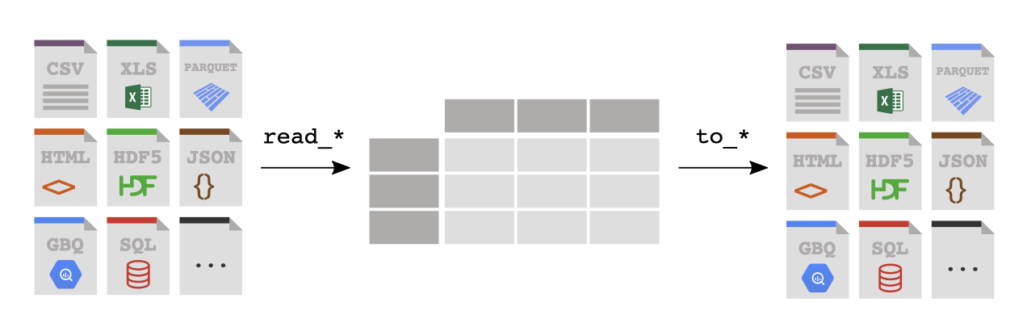

Powerful Tables: The Pandas DataFrame
pandas does not assume table entries have a specific format/datatype
As a result, it can be used to read a wide range of file types and formats!
Slide 4/17

Slide 26
Powerful Tables: The Pandas DataFrame
pandas does not assume table entries have a specific format/datatype
As a result, it can be used to read a wide range of file types and formats!
Slide 4/17

Slide 27
Powerful Tables: The Pandas DataFrame
pandas does not assume table entries have a specific format/datatype
As a result, it can be used to read a wide range of file types and formats!
Slide 4/17

Slide 28
Powerful Tables: The Pandas DataFrame
pandas does not assume table entries have a specific format/datatype
As a result, it can be used to read a wide range of file types and formats!
Slide 4/17

Slide 29
Powerful Tables: The Pandas DataFrame
pandas does not assume table entries have a specific format/datatype
As a result, it can be used to read a wide range of file types and formats!
Slide 4/17

Slide 30
Powerful Tables: The Pandas DataFrame
pandas does not assume table entries have a specific format/datatype
As a result, it can be used to read a wide range of file types and formats!
Slide 4/17

Slide 31
Powerful Tables: The Pandas DataFrame
pandas does not assume table entries have a specific format/datatype
As a result, it can be used to read a wide range of file types and formats!
Slide 4/17

Slide 32
Powerful Tables: The Pandas DataFrame
pandas does not assume table entries have a specific format/datatype
As a result, it can be used to read a wide range of file types and formats!
Slide 4/17

Slide 33
Powerful Tables: The Pandas DataFrame
pandas does not assume table entries have a specific format/datatype
As a result, it can be used to read a wide range of file types and formats!
Slide 4/17

Slide 34

Powerful Tables: The Pandas DataFrame
pandas does not assume table entries have a specific format/datatype
As a result, it can be used to read a wide range of file types and formats!
Slide 4/17

Slide 35

Powerful Tables: The Pandas DataFrame
pandas does not assume table entries have a specific format/datatype
As a result, it can be used to read a wide range of file types and formats!
Slide 4/17

Slide 36

Powerful Tables: The Pandas DataFrame
pandas does not assume table entries have a specific format/datatype
As a result, it can be used to read a wide range of file types and formats!
Slide 4/17

Slide 37
Powerful Tables: The Pandas DataFrame
pandas does not assume table entries have a specific format/datatype
As a result, it can be used to read a wide range of file types and formats!
Slide 4/17

Slide 38
Terminology: The Pandas DataFrame
Slide 5/17

Slide 39
Terminology: The Pandas DataFrame
DataFrames in Pandas can be created from Python dictionaries
Slide 5/17

Slide 40
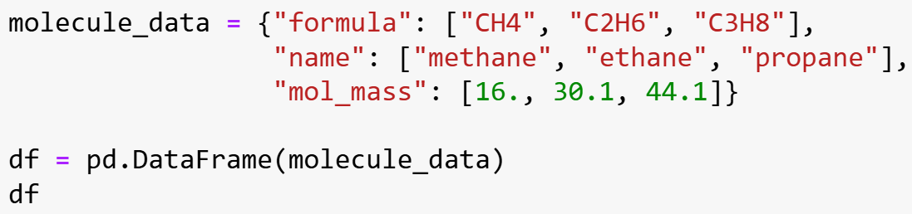

Terminology: The Pandas DataFrame
DataFrames in Pandas can be created from Python dictionaries
Slide 5/17

Slide 41

Terminology: The Pandas DataFrame
DataFrames in Pandas can be created from Python dictionaries
Slide 5/17

Slide 42

Terminology: The Pandas DataFrame
DataFrames in Pandas can be created from Python dictionaries
Slide 5/17

Slide 43

Terminology: The Pandas DataFrame
DataFrames in Pandas can be created from Python dictionaries
Slide 5/17

Slide 44
Terminology: The Pandas DataFrame
DataFrames in Pandas can be created from Python dictionaries
Slide 5/17

Slide 45
Terminology: The Pandas DataFrame
DataFrames in Pandas can be created from Python dictionaries
Slide 5/17

Slide 46
Terminology: The Pandas DataFrame
DataFrames in Pandas can be created from Python dictionaries
Slide 5/17

Slide 47
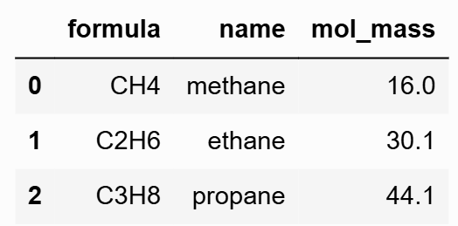
Terminology: The Pandas DataFrame
DataFrames in Pandas can be created from Python dictionaries
Slide 5/17

Slide 48
Terminology: The Pandas DataFrame
DataFrames in Pandas can be created from Python dictionaries
Rows are accessed via labels known as indices
Slide 5/17

Slide 49
Terminology: The Pandas DataFrame
DataFrames in Pandas can be created from Python dictionaries
Rows are accessed via labels known as indices
Indices don’t have to be numerical!
Slide 5/17

Slide 50
Terminology: The Pandas DataFrame
DataFrames in Pandas can be created from Python dictionaries
Rows are accessed via labels known as indices
Indices don’t have to be numerical!
Columns of a pandas dataframe are known as series
Slide 5/17

Slide 51
Terminology: The Pandas DataFrame
Slide 5/17

Slide 52
Working with Rows
Slide 6/17

Slide 53
Working with Rows
Slide 6/17

Slide 54
Working with Rows
We access rows of a DataFrame using the index
Slide 6/17

Slide 55
Working with Rows
We access rows of a DataFrame using the index
By default, the index is set to 0,1,2,…
Slide 6/17

Slide 56
Working with Rows
We access rows of a DataFrame using the index
By default, the index is set to 0,1,2,…
However, we can set meaningful labels using the .set_index function
Slide 6/17

Slide 57
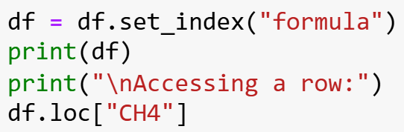

Working with Rows
We access rows of a DataFrame using the index
By default, the index is set to 0,1,2,…
However, we can set meaningful labels using the .set_index function
Slide 6/17

Slide 58
Working with Rows
We access rows of a DataFrame using the index
By default, the index is set to 0,1,2,…
However, we can set meaningful labels using the .set_index function
Slide 6/17

Slide 59
Working with Rows
We access rows of a DataFrame using the index
By default, the index is set to 0,1,2,…
However, we can set meaningful labels using the .set_index function
Slide 6/17

Slide 60
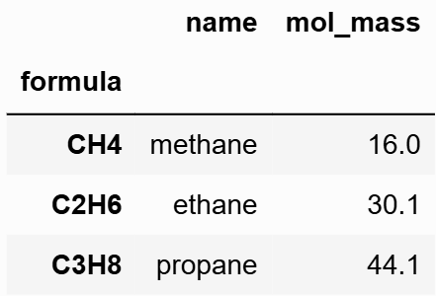
Working with Rows
We access rows of a DataFrame using the index
By default, the index is set to 0,1,2,…
However, we can set meaningful labels using the .set_index function
Slide 6/17

Slide 61
Working with Rows
We access rows of a DataFrame using the index
By default, the index is set to 0,1,2,…
However, we can set meaningful labels using the .set_index function
We can then access rows via these labels using the .loc function
Slide 6/17

Slide 62
Working with Rows
We access rows of a DataFrame using the index
By default, the index is set to 0,1,2,…
However, we can set meaningful labels using the .set_index function
We can then access rows via these labels using the .loc function
Slide 6/17

Slide 63
Working with Rows
We access rows of a DataFrame using the index
By default, the index is set to 0,1,2,…
However, we can set meaningful labels using the .set_index function
We can then access rows via these labels using the .loc function
Slide 6/17

Slide 64
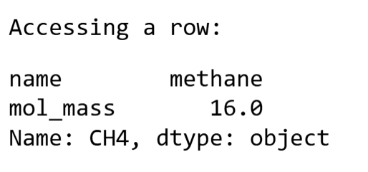
Working with Rows
We access rows of a DataFrame using the index
By default, the index is set to 0,1,2,…
However, we can set meaningful labels using the .set_index function
We can then access rows via these labels using the .loc function
Slide 6/17

Slide 65
Working with Rows
Slide 6/17

Slide 66
Working with Columns
Slide 6/17

Slide 67
Working with Columns
Slide 7/17

Slide 68
Working with Columns
Columns of a DataFrame can be accessed using their names and square brackets
Slide 7/17

Slide 69
Working with Columns
Columns of a DataFrame can be accessed using their names and square brackets
E.g. dataframe[column_name]
Slide 7/17

Slide 70
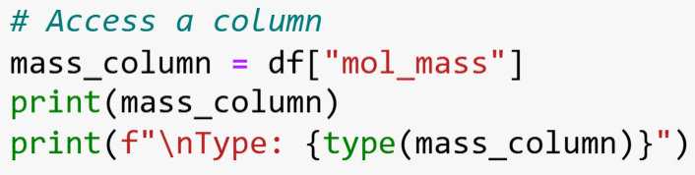

Working with Columns
Columns of a DataFrame can be accessed using their names and square brackets
E.g. dataframe[column_name]
Slide 7/17

Slide 71
Working with Columns
Columns of a DataFrame can be accessed using their names and square brackets
E.g. dataframe[column_name]
Slide 7/17

Slide 72
Working with Columns
Columns of a DataFrame can be accessed using their names and square brackets
E.g. dataframe[column_name]
Slide 7/17

Slide 73
Working with Columns
Columns of a DataFrame can be accessed using their names and square brackets
E.g. dataframe[column_name]
Slide 7/17

Slide 74
Working with Columns
Columns of a DataFrame can be accessed using their names and square brackets
E.g. dataframe[column_name]
Slide 7/17

Slide 75
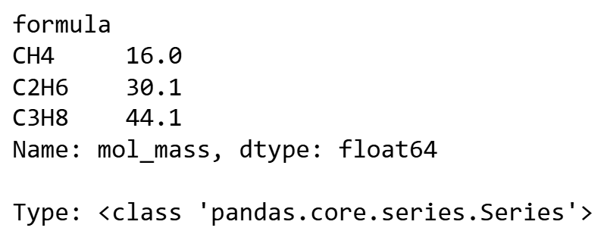
Working with Columns
Columns of a DataFrame can be accessed using their names and square brackets
E.g. dataframe[column_name]
Slide 7/17

Slide 76
Working with Columns
Columns of a DataFrame can be accessed using their names and square brackets
E.g. dataframe[column_name]
A single column of a DataFrame is a special object known as a Series
Slide 7/17

Slide 77
Working with Columns
Columns of a DataFrame can be accessed using their names and square brackets
E.g. dataframe[column_name]
A single column of a DataFrame is a special object known as a Series
Series: A single 1-D column of data with an index
Slide 7/17

Slide 78
Working with Columns
Columns of a DataFrame can be accessed using their names and square brackets
E.g. dataframe[column_name]
A single column of a DataFrame is a special object known as a Series
Series: A single 1-D column of data with an index
DataFrame: A collection of 1-D Series stored under a common index and viewed as a table
Slide 7/17

Slide 79
Working with Columns
Slide 7/17

Slide 80
Accessing Individual Values
Slide 8/17

Slide 81
Accessing Individual Values
You can access individual values of a dataframe using .loc
Slide 8/17

Slide 82
Accessing Individual Values
You can access individual values of a dataframe using .loc
E.g. dataframe.loc[row, column]
Slide 8/17

Slide 83
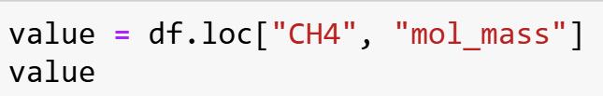
Accessing Individual Values
You can access individual values of a dataframe using .loc
E.g. dataframe.loc[row, column]
Slide 8/17

Slide 84
Accessing Individual Values
You can access individual values of a dataframe using .loc
E.g. dataframe.loc[row, column]
Slide 8/17

Slide 85
Accessing Individual Values
You can access individual values of a dataframe using .loc
E.g. dataframe.loc[row, column]
Slide 8/17

Slide 86

Accessing Individual Values
You can access individual values of a dataframe using .loc
E.g. dataframe.loc[row, column]
Slide 8/17

Slide 87
Accessing Individual Values
You can access individual values of a dataframe using .loc
E.g. dataframe.loc[row, column]
Indices are comma separated - this is a bit like numpy…
Slide 8/17

Slide 88
Accessing Individual Values
You can access individual values of a dataframe using .loc
E.g. dataframe.loc[row, column]
Indices are comma separated - this is a bit like numpy…
…but row and column are not necessarily numerical!
Slide 8/17

Slide 89
Accessing Individual Values
Slide 8/17

Slide 90
Arithmetic Operations
Slide 9/17

Slide 91
Arithmetic Operations
Much like with NumPy, Pandas supports vectorised operations
Slide 9/17

Slide 92
Arithmetic Operations
Much like with NumPy, Pandas supports vectorised operations
I.e. you can apply the same operation to an entire column at once
Slide 9/17

Slide 93
Arithmetic Operations
Much like with NumPy, Pandas supports vectorised operations
I.e. you can apply the same operation to an entire column at once
This includes:
Slide 9/17

Slide 94
Arithmetic Operations
Much like with NumPy, Pandas supports vectorised operations
I.e. you can apply the same operation to an entire column at once
This includes:
Arithmetic operations (+,-,*,//,/,^,…)
Slide 9/17

Slide 95
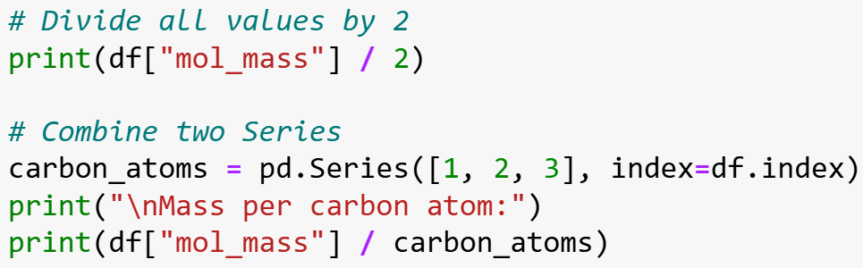

Arithmetic Operations
Much like with NumPy, Pandas supports vectorised operations
I.e. you can apply the same operation to an entire column at once
This includes:
Arithmetic operations (+,-,*,//,/,^,…)
Slide 9/17

Slide 96

Arithmetic Operations
Much like with NumPy, Pandas supports vectorised operations
I.e. you can apply the same operation to an entire column at once
This includes:
Arithmetic operations (+,-,*,//,/,^,…)
Slide 9/17

Slide 97

Arithmetic Operations
Much like with NumPy, Pandas supports vectorised operations
I.e. you can apply the same operation to an entire column at once
This includes:
Arithmetic operations (+,-,*,//,/,^,…)
Slide 9/17

Slide 98
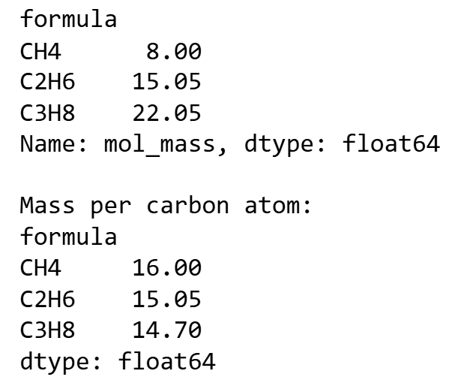

Arithmetic Operations
Much like with NumPy, Pandas supports vectorised operations
I.e. you can apply the same operation to an entire column at once
This includes:
Arithmetic operations (+,-,*,//,/,^,…)
Slide 9/17

Slide 99

Arithmetic Operations
Much like with NumPy, Pandas supports vectorised operations
I.e. you can apply the same operation to an entire column at once
This includes:
Arithmetic operations (+,-,*,//,/,^,…)
Slide 9/17

Slide 100

Arithmetic Operations
Much like with NumPy, Pandas supports vectorised operations
I.e. you can apply the same operation to an entire column at once
This includes:
Arithmetic operations (+,-,*,//,/,^,…)
Slide 9/17

Slide 101
Arithmetic Operations
Much like with NumPy, Pandas supports vectorised operations
I.e. you can apply the same operation to an entire column at once
This includes:
Arithmetic operations (+,-,*,//,/,^,…)
Slide 9/17

Slide 102
Arithmetic Operations
Much like with NumPy, Pandas supports vectorised operations
I.e. you can apply the same operation to an entire column at once
This includes:
Arithmetic operations (+,-,*,//,/,^,…)
Slide 9/17

Slide 103
Arithmetic Operations
Much like with NumPy, Pandas supports vectorised operations
I.e. you can apply the same operation to an entire column at once
This includes:
Arithmetic operations (+,-,*,//,/,^,…)
Slide 9/17

Slide 104
Arithmetic Operations
Much like with NumPy, Pandas supports vectorised operations
I.e. you can apply the same operation to an entire column at once
This includes:
Arithmetic operations (+,-,*,//,/,^,…)
Slide 9/17

Slide 105
Arithmetic Operations
Much like with NumPy, Pandas supports vectorised operations
I.e. you can apply the same operation to an entire column at once
This includes:
Arithmetic operations (+,-,*,//,/,^,…)
Boolean operations (<=,>=,==,>,…)
Slide 9/17

Slide 106
Arithmetic Operations
Much like with NumPy, Pandas supports vectorised operations
I.e. you can apply the same operation to an entire column at once
This includes:
Arithmetic operations (+,-,*,//,/,^,…)
Boolean operations (<=,>=,==,>,…)
NumPy universal functions (np.sin,np.exp…)
Slide 9/17

Slide 107
Arithmetic Operations
Much like with NumPy, Pandas supports vectorised operations
I.e. you can apply the same operation to an entire column at once
This includes:
Arithmetic operations (+,-,*,//,/,^,…)
Boolean operations (<=,>=,==,>,…)
NumPy universal functions (np.sin,np.exp…)
And many more…
Slide 9/17

Slide 108
Arithmetic Operations
Slide 9/17

Slide 109
Statistical Operations
Slide 10/17

Slide 110
Statistical Operations
Pandas can also be used to perform statistical analyses on datasets
Slide 10/17

Slide 111
Statistical Operations
Pandas can also be used to perform statistical analyses on datasets
Built-in statistical methods
Slide 10/17

Slide 112
Statistical Operations
Pandas can also be used to perform statistical analyses on datasets
Built-in statistical methods
.describe() provides summary statistics for numerical columns
Slide 10/17

Slide 113

Statistical Operations
Pandas can also be used to perform statistical analyses on datasets
Built-in statistical methods
.describe() provides summary statistics for numerical columns
Slide 10/17

Slide 114
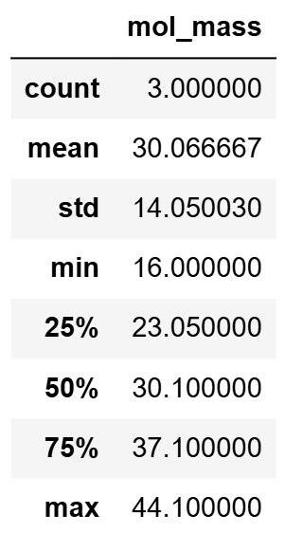
Statistical Operations
Pandas can also be used to perform statistical analyses on datasets
Built-in statistical methods
.describe() provides summary statistics for numerical columns
Slide 10/17

Slide 115
Statistical Operations
Pandas can also be used to perform statistical analyses on datasets
Built-in statistical methods
.describe() provides summary statistics for numerical columns
.mean(),.max(),.sum(),.min(),… etc
Slide 10/17

Slide 116
Statistical Operations
Pandas can also be used to perform statistical analyses on datasets
Built-in statistical methods
.describe() provides summary statistics for numerical columns
.mean(),.max(),.sum(),.min(),… etc
.idxmax() returns the index of the maximum value
Slide 10/17

Slide 117
Expanding DataFrames
Slide 11/17

Slide 118
Expanding DataFrames
We can assign new columns to a pandas dataframe using dictionary-like syntax
Slide 11/17

Slide 119
Expanding DataFrames
We can assign new columns to a pandas dataframe using dictionary-like syntax
dataframe[new_col_name] = new_col_data
Slide 11/17

Slide 120
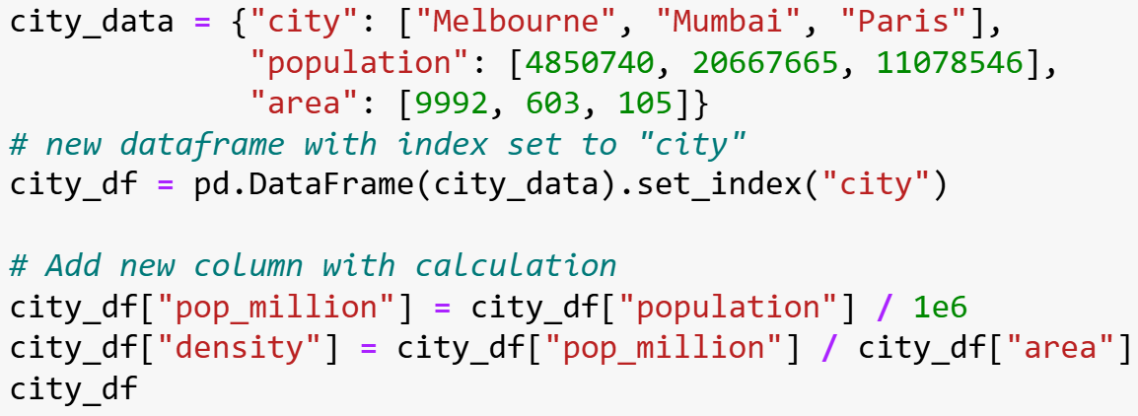
Expanding DataFrames
We can assign new columns to a pandas dataframe using dictionary-like syntax
dataframe[new_col_name] = new_col_data
Slide 11/17

Slide 121
Expanding DataFrames
We can assign new columns to a pandas dataframe using dictionary-like syntax
dataframe[new_col_name] = new_col_data
Slide 11/17

Slide 122
Expanding DataFrames
We can assign new columns to a pandas dataframe using dictionary-like syntax
dataframe[new_col_name] = new_col_data
Slide 11/17

Slide 123
Expanding DataFrames
We can assign new columns to a pandas dataframe using dictionary-like syntax
dataframe[new_col_name] = new_col_data
Slide 11/17

Slide 124
Expanding DataFrames
We can assign new columns to a pandas dataframe using dictionary-like syntax
dataframe[new_col_name] = new_col_data
Slide 11/17

Slide 125
Expanding DataFrames
We can assign new columns to a pandas dataframe using dictionary-like syntax
dataframe[new_col_name] = new_col_data
Slide 11/17

Slide 126
Expanding DataFrames
We can assign new columns to a pandas dataframe using dictionary-like syntax
dataframe[new_col_name] = new_col_data
Slide 11/17

Slide 127
Expanding DataFrames
We can assign new columns to a pandas dataframe using dictionary-like syntax
dataframe[new_col_name] = new_col_data
Slide 11/17

Slide 128
Expanding DataFrames
We can assign new columns to a pandas dataframe using dictionary-like syntax
dataframe[new_col_name] = new_col_data
Slide 11/17

Slide 129
Expanding DataFrames
We can assign new columns to a pandas dataframe using dictionary-like syntax
dataframe[new_col_name] = new_col_data
Slide 11/17

Slide 130
Expanding DataFrames
We can assign new columns to a pandas dataframe using dictionary-like syntax
dataframe[new_col_name] = new_col_data
Slide 11/17

Slide 131
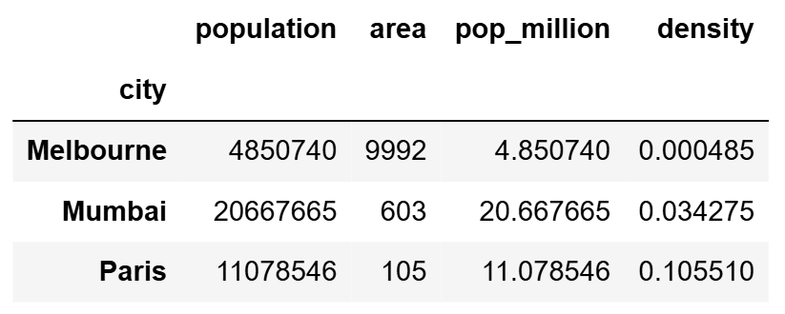
Expanding DataFrames
We can assign new columns to a pandas dataframe using dictionary-like syntax
dataframe[new_col_name] = new_col_data
Slide 11/17

Slide 132
Expanding DataFrames
We can assign new columns to a pandas dataframe using dictionary-like syntax
dataframe[new_col_name] = new_col_data
Typically, new_col_data is a Pandas Series
Slide 11/17

Slide 133
Expanding DataFrames
We can assign new columns to a pandas dataframe using dictionary-like syntax
dataframe[new_col_name] = new_col_data
Typically, new_col_data is a Pandas Series
However, you can also use other datatypes such as lists, or NumPy arrays.
Slide 11/17

Slide 134
Expanding DataFrames
We can assign new columns to a pandas dataframe using dictionary-like syntax
dataframe[new_col_name] = new_col_data
Typically, new_col_data is a Pandas Series
However, you can also use other datatypes such as lists, or NumPy arrays.
The new data must have the same number of rows
Slide 11/17

Slide 135
Filtering Data
Slide 12/17

Slide 136
Filtering Data
pandas also allows to filter data based on conditions, using Boolean statements
Slide 12/17

Slide 137
Filtering Data
pandas also allows to filter data based on conditions, using Boolean statements
You can create filters (masks) using comparison operators
Slide 12/17

Slide 138
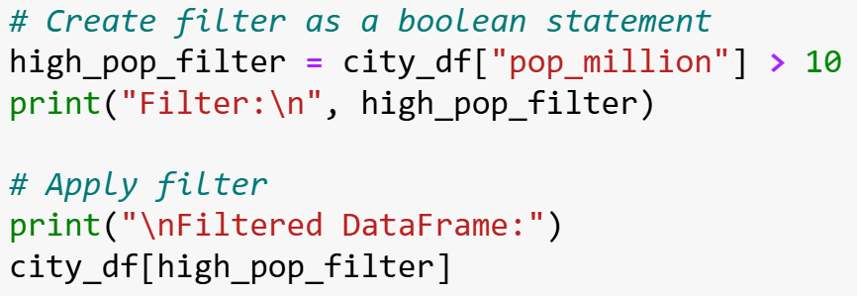

Filtering Data
pandas also allows to filter data based on conditions, using Boolean statements
You can create filters (masks) using comparison operators
Slide 12/17

Slide 139

Filtering Data
pandas also allows to filter data based on conditions, using Boolean statements
You can create filters (masks) using comparison operators
Slide 12/17

Slide 140

Filtering Data
pandas also allows to filter data based on conditions, using Boolean statements
You can create filters (masks) using comparison operators
Slide 12/17

Slide 141

Filtering Data
pandas also allows to filter data based on conditions, using Boolean statements
You can create filters (masks) using comparison operators
Slide 12/17

Slide 142
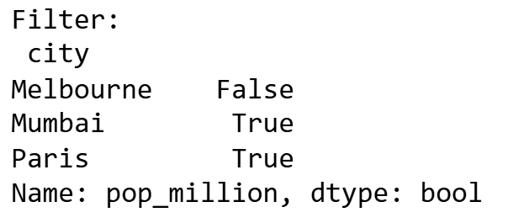
Filtering Data
pandas also allows to filter data based on conditions, using Boolean statements
You can create filters (masks) using comparison operators
Slide 12/17

Slide 143
Filtering Data
pandas also allows to filter data based on conditions, using Boolean statements
You can create filters (masks) using comparison operators
These contain True/False values for each row
Slide 12/17

Slide 144
Filtering Data
pandas also allows to filter data based on conditions, using Boolean statements
You can create filters (masks) using comparison operators
These contain True/False values for each row
You can then apply the filter to the DataFrame to reduce to only the rows which satisfy the Boolean condition.
Slide 12/17

Slide 145
Filtering Data
pandas also allows to filter data based on conditions, using Boolean statements
You can create filters (masks) using comparison operators
These contain True/False values for each row
You can then apply the filter to the DataFrame to reduce to only the rows which satisfy the Boolean condition.
Slide 12/17

Slide 146
Filtering Data
pandas also allows to filter data based on conditions, using Boolean statements
You can create filters (masks) using comparison operators
These contain True/False values for each row
You can then apply the filter to the DataFrame to reduce to only the rows which satisfy the Boolean condition.
Slide 12/17

Slide 147
Filtering Data
pandas also allows to filter data based on conditions, using Boolean statements
You can create filters (masks) using comparison operators
These contain True/False values for each row
You can then apply the filter to the DataFrame to reduce to only the rows which satisfy the Boolean condition.
Slide 12/17

Slide 148
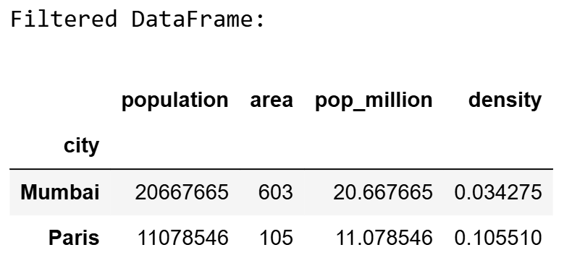
Filtering Data
pandas also allows to filter data based on conditions, using Boolean statements
You can create filters (masks) using comparison operators
These contain True/False values for each row
You can then apply the filter to the DataFrame to reduce to only the rows which satisfy the Boolean condition.
Slide 12/17

Slide 149
Multiple Conditions
Slide 13/17

Slide 150
Multiple Conditions
Much like in NumPy, we can build more complex filters using Boolean operations
Slide 13/17

Slide 151
Multiple Conditions
Much like in NumPy, we can build more complex filters using Boolean operations
Use & (and) or | (or) operators
Slide 13/17

Slide 152
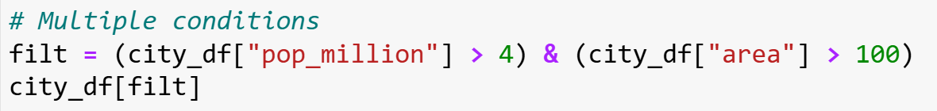
Multiple Conditions
Much like in NumPy, we can build more complex filters using Boolean operations
Use & (and) or | (or) operators
Slide 13/17

Slide 153
Multiple Conditions
Much like in NumPy, we can build more complex filters using Boolean operations
Use & (and) or | (or) operators
Slide 13/17

Slide 154
Multiple Conditions
Much like in NumPy, we can build more complex filters using Boolean operations
Use & (and) or | (or) operators
Slide 13/17

Slide 155
Multiple Conditions
Much like in NumPy, we can build more complex filters using Boolean operations
Use & (and) or | (or) operators
Slide 13/17

Slide 156
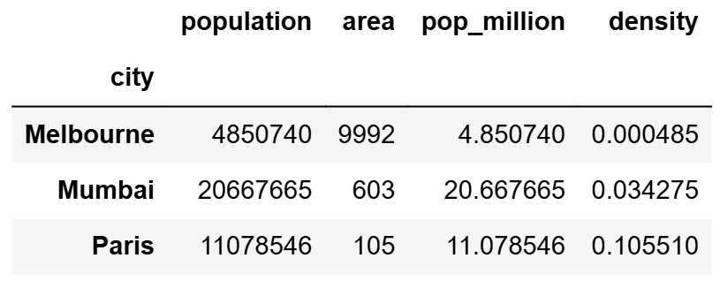
Multiple Conditions
Much like in NumPy, we can build more complex filters using Boolean operations
Use & (and) or | (or) operators
Slide 13/17

Slide 157
Multiple Conditions
Much like in NumPy, we can build more complex filters using Boolean operations
Use & (and) or | (or) operators
Slide 13/17

Slide 158
Multiple Conditions
Much like in NumPy, we can build more complex filters using Boolean operations
Use & (and) or | (or) operators
Slide 13/17

Slide 159
Multiple Conditions
Much like in NumPy, we can build more complex filters using Boolean operations
Use & (and) or | (or) operators
Slide 13/17

Slide 160
Multiple Conditions
Much like in NumPy, we can build more complex filters using Boolean operations
Use & (and) or | (or) operators
Slide 13/17

Slide 161

Multiple Conditions
Much like in NumPy, we can build more complex filters using Boolean operations
Use & (and) or | (or) operators
Slide 13/17

Slide 162
Multiple Conditions
Much like in NumPy, we can build more complex filters using Boolean operations
Use & (and) or | (or) operators
Slide 13/17

Slide 163
Multiple Conditions
Much like in NumPy, we can build more complex filters using Boolean operations
Use & (and) or | (or) operators
Slide 13/17

Slide 164
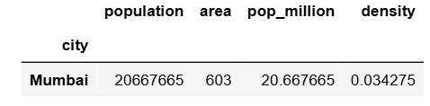
Multiple Conditions
Much like in NumPy, we can build more complex filters using Boolean operations
Use & (and) or | (or) operators
Slide 13/17

Slide 165
Multiple Conditions
Much like in NumPy, we can build more complex filters using Boolean operations
Use & (and) or | (or) operators
Each condition in parentheses
Slide 13/17

Slide 166
Multiple Conditions
Much like in NumPy, we can build more complex filters using Boolean operations
Use & (and) or | (or) operators
Each condition in parentheses
Combine multiple column filters
Slide 13/17

Slide 167
Multiple Conditions
Much like in NumPy, we can build more complex filters using Boolean operations
Use & (and) or | (or) operators
Each condition in parentheses
Combine multiple column filters
Note: Pandas uses & and | rather than and and or!
Slide 13/17

Slide 168
Multiple Conditions
Much like in NumPy, we can build more complex filters using Boolean operations
Use & (and) or | (or) operators
Each condition in parentheses
Combine multiple column filters
Note: Pandas uses & and | rather than and and or!
This is to avoid confusion with Truthy and Falsey values
Slide 13/17

Slide 169
Multiple Conditions
Much like in NumPy, we can build more complex filters using Boolean operations
Use & (and) or | (or) operators
Each condition in parentheses
Combine multiple column filters
Note: Pandas uses & and | rather than and and or!
This is to avoid confusion with Truthy and Falsey values (see Week 2 advanced notebook for further detail on Truthy and Falsey)
Slide 13/17

Slide 170
Reading CSV Files
Slide 14/17

Slide 171
Reading CSV Files
So far, we have created Dataframes from dictionaries
Slide 14/17

Slide 172
Reading CSV Files
So far, we have created Dataframes from dictionaries
Real-world data is often stored in CSV or other tabulated data file-types
Slide 14/17

Slide 173
Reading CSV Files
So far, we have created Dataframes from dictionaries
Real-world data is often stored in CSV or other tabulated data file-types
Pandas provides easy-to-use functions to read these files into DataFrames:
Slide 14/17

Slide 174
Reading CSV Files
So far, we have created Dataframes from dictionaries
Real-world data is often stored in CSV or other tabulated data file-types
Pandas provides easy-to-use functions to read these files into DataFrames:
CSV = Comma Separated Values
Slide 14/17

Slide 175
Reading CSV Files
So far, we have created Dataframes from dictionaries
Real-world data is often stored in CSV or other tabulated data file-types
Pandas provides easy-to-use functions to read these files into DataFrames:
CSV = Comma Separated Values
Use pd.read_csv(filename)
Slide 14/17

Slide 176
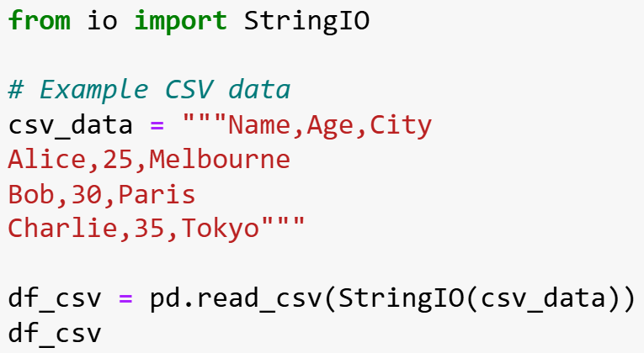

Reading CSV Files
So far, we have created Dataframes from dictionaries
Real-world data is often stored in CSV or other tabulated data file-types
Pandas provides easy-to-use functions to read these files into DataFrames:
CSV = Comma Separated Values
Use pd.read_csv(filename)
Slide 14/17

Slide 177
Reading CSV Files
So far, we have created Dataframes from dictionaries
Real-world data is often stored in CSV or other tabulated data file-types
Pandas provides easy-to-use functions to read these files into DataFrames:
CSV = Comma Separated Values
Use pd.read_csv(filename)
Slide 14/17

Slide 178
Reading CSV Files
So far, we have created Dataframes from dictionaries
Real-world data is often stored in CSV or other tabulated data file-types
Pandas provides easy-to-use functions to read these files into DataFrames:
CSV = Comma Separated Values
Use pd.read_csv(filename)
Slide 14/17

Slide 179
Reading CSV Files
So far, we have created Dataframes from dictionaries
Real-world data is often stored in CSV or other tabulated data file-types
Pandas provides easy-to-use functions to read these files into DataFrames:
CSV = Comma Separated Values
Use pd.read_csv(filename)
Slide 14/17

Slide 180

Reading CSV Files
So far, we have created Dataframes from dictionaries
Real-world data is often stored in CSV or other tabulated data file-types
Pandas provides easy-to-use functions to read these files into DataFrames:
CSV = Comma Separated Values
Use pd.read_csv(filename)
Slide 14/17

Slide 181

Reading CSV Files
So far, we have created Dataframes from dictionaries
Real-world data is often stored in CSV or other tabulated data file-types
Pandas provides easy-to-use functions to read these files into DataFrames:
CSV = Comma Separated Values
Use pd.read_csv(filename)
Slide 14/17

Slide 182

Reading CSV Files
So far, we have created Dataframes from dictionaries
Real-world data is often stored in CSV or other tabulated data file-types
Pandas provides easy-to-use functions to read these files into DataFrames:
CSV = Comma Separated Values
Use pd.read_csv(filename)
Slide 14/17

Slide 183
Reading CSV Files
So far, we have created Dataframes from dictionaries
Real-world data is often stored in CSV or other tabulated data file-types
Pandas provides easy-to-use functions to read these files into DataFrames:
CSV = Comma Separated Values
Use pd.read_csv(filename)
Slide 14/17

Slide 184
Reading CSV Files
So far, we have created Dataframes from dictionaries
Real-world data is often stored in CSV or other tabulated data file-types
Pandas provides easy-to-use functions to read these files into DataFrames:
CSV = Comma Separated Values
Use pd.read_csv(filename)
Slide 14/17

Slide 185
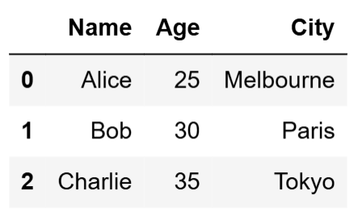
Reading CSV Files
So far, we have created Dataframes from dictionaries
Real-world data is often stored in CSV or other tabulated data file-types
Pandas provides easy-to-use functions to read these files into DataFrames:
CSV = Comma Separated Values
Use pd.read_csv(filename)
Slide 14/17

Slide 186
Reading CSV Files
So far, we have created Dataframes from dictionaries
Real-world data is often stored in CSV or other tabulated data file-types
Pandas provides easy-to-use functions to read these files into DataFrames:
CSV = Comma Separated Values
Use pd.read_csv(filename)
Options: skiprows,sep (delimiter)
Slide 14/17

Slide 187
Summary
Slide 15/17

Slide 188
Summary
Slide 15/17

Slide 189
Summary
pandas is a powerful tool for working with tabulated data
Slide 15/17

Slide 190
Summary
pandas is a powerful tool for working with tabulated data
Much like NumPy, pandas contains many built-in functions for synthesizing and analysing data
Slide 15/17

Slide 191
Summary
pandas is a powerful tool for working with tabulated data
Much like NumPy, pandas contains many built-in functions for synthesizing and analysing data
Unlike in NumPy, data is not treated like a mathematical object (e.g. matrices, vectors,…)
Slide 15/17

Slide 192
Summary
pandas is a powerful tool for working with tabulated data
Much like NumPy, pandas contains many built-in functions for synthesizing and analysing data
Unlike in NumPy, data is not treated like a mathematical object (e.g. matrices, vectors,…)
Slide 15/17

Slide 193
Summary
pandas is a powerful tool for working with tabulated data
Much like NumPy, pandas contains many built-in functions for synthesizing and analysing data
Unlike in NumPy, data is not treated like a mathematical object (e.g. matrices, vectors,…)
Data in pandas can be any format and can be read in from many different file types
Slide 15/17

Slide 194
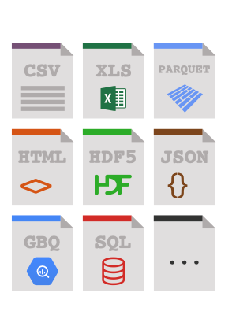
Summary
pandas is a powerful tool for working with tabulated data
Much like NumPy, pandas contains many built-in functions for synthesizing and analysing data
Unlike in NumPy, data is not treated like a mathematical object (e.g. matrices, vectors,…)
Data in pandas can be any format and can be read in from many different file types
Slide 15/17

Slide 195
Practical
Slide 16/17

Slide 196
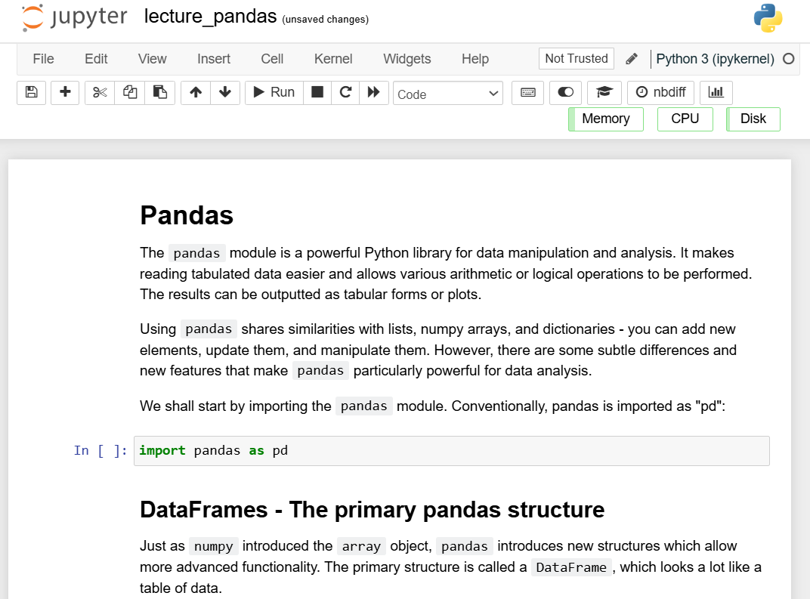
Practical
Slide 16/17

Slide 197
Practical
For the rest of today, you must:
Slide 16/17

Slide 198
Practical
For the rest of today, you must:
Read through the material in:
Slide 16/17

Slide 199
Practical
For the rest of today, you must:
Read through the material in: lecture_pandas.ipynb
Slide 16/17

Slide 200
Practical
For the rest of today, you must:
Read through the material in: lecture_pandas.ipynb
Work through the Pandas exercises in:
Slide 16/17

Slide 201
Practical
For the rest of today, you must:
Read through the material in: lecture_pandas.ipynb
Work through the Pandas exercises in: exercises_pandas.ipynb
Slide 16/17

Slide 202
Practical
For the rest of today, you must:
Read through the material in: lecture_pandas.ipynb
Work through the Pandas exercises in: exercises_pandas.ipynb supplementary_pandas.ipynb
Slide 16/17

Slide 203
Next Time
Lecture 11: Introduction to Pandas
What is Pandas
The Pandas DataFrame
Accessing Elements
Practical
Lecture 12: Introduction to Pandas
Loading Data
Exploratory Investigation
Data Type Conversion
Practical
Slide 17/17

