Slide 1
Lecture 1:
Introduction & Data Types
SCIF10002 – Introduction to Coding and Data
Tom Maullin-Sapey
25th September 2025
Slide 0/19

Slide 2
Today’s Lecture
Slide 1/19

Slide 3
Today’s Lecture
Lecture 1: Introduction and Data Types
Slide 1/19

Slide 4
Today’s Lecture
Lecture 1: Introduction and Data Types
Course Structure
Slide 1/19

Slide 5
Today’s Lecture
Lecture 1: Introduction and Data Types
Course Structure
Setting up Noteable
Slide 1/19

Slide 6
Today’s Lecture
Lecture 1: Introduction and Data Types
Course Structure
Setting up Noteable
Introduction to Coding
Slide 1/19

Slide 7
Today’s Lecture
Lecture 1: Introduction and Data Types
Course Structure
Setting up Noteable
Introduction to Coding
Data Types
Slide 1/19

Slide 8
Today’s Lecture
Lecture 1: Introduction and Data Types
Course Structure
Setting up Noteable
Introduction to Coding
Data Types
Practical
Slide 1/19

Slide 9
Today’s Lecture
Lecture 1: Introduction and Data Types
Course Structure
Setting up Noteable
Introduction to Coding
Data Types
Practical
Lecture 2: Booleans and Conditionals
Recap: Accessing Noteable
Recap: Booleans
If statements
Practical
Slide 1/19

Slide 10
Course Structure
Slide 2/19

Slide 11
Course Structure
This course will run for 20 weeks
Slide 2/19

Slide 12
Course Structure
This course will run for 20 weeks
We will cover:
Slide 2/19

Slide 13
Course Structure
This course will run for 20 weeks
We will cover:
Data types, conditionals and loops
Slide 2/19

Slide 14
Course Structure
This course will run for 20 weeks
We will cover:
Data types, conditionals and loops
Building functions
Slide 2/19

Slide 15
Course Structure
This course will run for 20 weeks
We will cover:
Data types, conditionals and loops
Building functions
Numpy arrays and linear algebra in python
Slide 2/19

Slide 16
Course Structure
This course will run for 20 weeks
We will cover:
Data types, conditionals and loops
Building functions
Numpy arrays and linear algebra in python
Pandas dataframes
Slide 2/19

Slide 17
Course Structure
This course will run for 20 weeks
We will cover:
Data types, conditionals and loops
Building functions
Numpy arrays and linear algebra in python
Pandas dataframes
Plotting and visualisation
Slide 2/19

Slide 18

Course Structure
This course will run for 20 weeks
We will cover:
Data types, conditionals and loops
Building functions
Numpy arrays and linear algebra in python
Pandas dataframes
Plotting and visualisation
Slide 2/19

Slide 19
Course Structure
This course will run for 20 weeks
We will cover:
Data types, conditionals and loops
Building functions
Numpy arrays and linear algebra in python
Pandas dataframes
Plotting and visualisation
Contact Details:
Email: Thomas.Maullin-Sapey@Bristol.ac.uk
Office Hours: Weds 2-4pm, Room 1.84 Fry
Slide 2/19

Slide 20

Course Structure
This course will run for 20 weeks
We will cover:
Data types, conditionals and loops
Building functions
Numpy arrays and linear algebra in python
Pandas dataframes
Plotting and visualisation
Contact Details:
Email: Thomas.Maullin-Sapey@Bristol.ac.uk
Office Hours: Weds 2-4pm, Room 1.84 Fry
Slide 2/19

Slide 21
Course Structure
This course will run for 20 weeks
We will cover:
Data types, conditionals and loops
Building functions
Numpy arrays and linear algebra in python
Pandas dataframes
Plotting and visualisation
Contact Details:
Email: Thomas.Maullin-Sapey@Bristol.ac.uk
Office Hours: Weds 2-4pm, Room 1.84 Fry
Contact Details:
Email: ft14968@Bristol.ac.uk
Slide 2/19

Slide 22
Course Structure
This course will run for 20 weeks
We will cover:
Data types, conditionals and loops
Building functions
Numpy arrays and linear algebra in python
Pandas dataframes
Plotting and visualisation
Classes:
Contact Details:
Email: Thomas.Maullin-Sapey@Bristol.ac.uk
Office Hours: Weds 2-4pm, Room 1.84 Fry
Contact Details:
Email: ft14968@Bristol.ac.uk
Slide 2/19

Slide 23
Course Structure
This course will run for 20 weeks
We will cover:
Data types, conditionals and loops
Building functions
Numpy arrays and linear algebra in python
Pandas dataframes
Plotting and visualisation
Classes:
1 lecture per week (Thursday)
Contact Details:
Email: Thomas.Maullin-Sapey@Bristol.ac.uk
Office Hours: Weds 2-4pm, Room 1.84 Fry
Contact Details:
Email: ft14968@Bristol.ac.uk
Slide 2/19

Slide 24
Course Structure
This course will run for 20 weeks
We will cover:
Data types, conditionals and loops
Building functions
Numpy arrays and linear algebra in python
Pandas dataframes
Plotting and visualisation
Classes:
1 lecture per week (Thursday)
1 small-group tutorial per two weeks (date should be on calendar)
Contact Details:
Email: Thomas.Maullin-Sapey@Bristol.ac.uk
Office Hours: Weds 2-4pm, Room 1.84 Fry
Contact Details:
Email: ft14968@Bristol.ac.uk
Slide 2/19

Slide 25
Lectures
Slide 3/19

Slide 26

Lectures
Slide 3/19

Slide 27
Lectures
The weekly lecture will consist of
Slide 3/19

Slide 28
Lectures
The weekly lecture will consist of
≈ 30-40 minutes presentation time covering:
Slide 3/19

Slide 29
Lectures
The weekly lecture will consist of
≈ 30-40 minutes presentation time covering:
Key concepts
Slide 3/19

Slide 30
Lectures
The weekly lecture will consist of
≈ 30-40 minutes presentation time covering:
Key concepts
Administrative points (e.g. homework submission etc)
Slide 3/19

Slide 31
Lectures
The weekly lecture will consist of
≈ 30-40 minutes presentation time covering:
Key concepts
Administrative points (e.g. homework submission etc)
Code Demonstrations
Slide 3/19

Slide 32
Lectures
The weekly lecture will consist of
≈ 30-40 minutes presentation time covering:
Key concepts
Administrative points (e.g. homework submission etc)
Code Demonstrations
10 minute break on the hour
Slide 3/19

Slide 33
Lectures
The weekly lecture will consist of
≈ 30-40 minutes presentation time covering:
Key concepts
Administrative points (e.g. homework submission etc)
Code Demonstrations
Slide 3/19

Slide 34
Lectures
The weekly lecture will consist of
≈ 30-40 minutes presentation time covering:
Key concepts
Administrative points (e.g. homework submission etc)
Code Demonstrations
Please bring a laptop/device – must be able to type code and access the internet!
Slide 3/19

Slide 35
Lectures
The weekly lecture will consist of
≈ 30-40 minutes presentation time covering:
Key concepts
Administrative points (e.g. homework submission etc)
Code Demonstrations
Don’t be this guy!
Please bring a laptop/device – must be able to type code and access the internet!
Slide 3/19

Slide 36
Lectures
The weekly lecture will consist of
≈ 30-40 minutes presentation time covering:
Key concepts
Administrative points (e.g. homework submission etc)
Code Demonstrations
Slide 3/19

Slide 37
Lectures
The weekly lecture will consist of
≈ 30-40 minutes presentation time covering:
Key concepts
Administrative points (e.g. homework submission etc)
Code Demonstrations
≈ 1-1.5 hours practical
Slide 3/19

Slide 38
Lectures
The weekly lecture will consist of
≈ 30-40 minutes presentation time covering:
Key concepts
Administrative points (e.g. homework submission etc)
Code Demonstrations
≈ 1-1.5 hours practical
Designed to provide hands on experience
Slide 3/19

Slide 39
Lectures
The weekly lecture will consist of
≈ 30-40 minutes presentation time covering:
Key concepts
Administrative points (e.g. homework submission etc)
Code Demonstrations
≈ 1-1.5 hours practical
Designed to provide hands on experience
CRUCIAL TO CODING!!
Slide 3/19

Slide 40
Lectures
The weekly lecture will consist of
≈ 30-40 minutes presentation time covering:
Key concepts
Administrative points (e.g. homework submission etc)
Code Demonstrations
≈ 1-1.5 hours practical
Designed to provide hands on experience
Slide 3/19

Slide 41
Lectures
The weekly lecture will consist of
≈ 30-40 minutes presentation time covering:
Key concepts
Administrative points (e.g. homework submission etc)
Code Demonstrations
≈ 1-1.5 hours practical
Designed to provide hands on experience
Opportunity to ask for help from
Slide 3/19

Slide 42
Lectures
The weekly lecture will consist of
≈ 30-40 minutes presentation time covering:
Key concepts
Administrative points (e.g. homework submission etc)
Code Demonstrations
≈ 1-1.5 hours practical
Designed to provide hands on experience
Opportunity to ask for help from
Lecturer
Slide 3/19

Slide 43
Lectures
The weekly lecture will consist of
≈ 30-40 minutes presentation time covering:
Key concepts
Administrative points (e.g. homework submission etc)
Code Demonstrations
≈ 1-1.5 hours practical
Designed to provide hands on experience
Opportunity to ask for help from
Lecturer
PhD helpers
Slide 3/19

Slide 44
Lectures
The weekly lecture will consist of
≈ 30-40 minutes presentation time covering:
Key concepts
Administrative points (e.g. homework submission etc)
Code Demonstrations
≈ 1-1.5 hours practical
Designed to provide hands on experience
Opportunity to ask for help from
Lecturer
PhD helpers
Each other!
Slide 3/19

Slide 45
Assignments
Slide 4/19

Slide 46
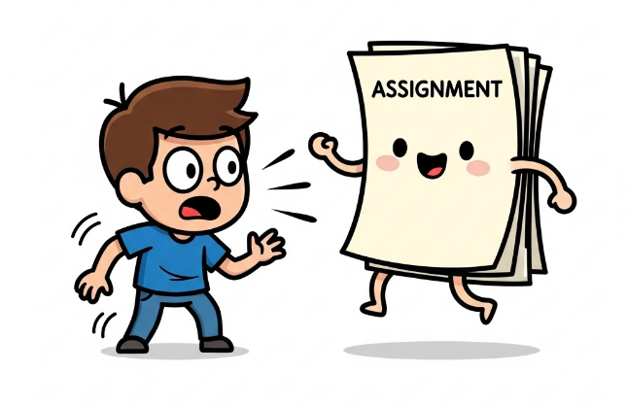
Assignments
Slide 4/19

Slide 47
Assignments
Formative:
Slide 4/19

Slide 48
Assignments
Formative:
Weekly (optional) assignments available on quarto
Slide 4/19

Slide 49
Assignments
Formative:
Weekly (optional) assignments available on quarto
Summative:
Slide 4/19

Slide 50
Assignments
Formative:
Weekly (optional) assignments available on quarto
Summative:
This module is 100% coursework
Slide 4/19

Slide 51
Assignments
Formative:
Weekly (optional) assignments available on quarto
Summative:
This module is 100% coursework
4 pieces of coursework
Slide 4/19

Slide 52
Assignments
Formative:
Weekly (optional) assignments available on quarto
Summative:
This module is 100% coursework
4 pieces of coursework
Assignment 1 (15%)
Slide 4/19

Slide 53
Assignments
Formative:
Weekly (optional) assignments available on quarto
Summative:
This module is 100% coursework
4 pieces of coursework
Assignment 1 (15%)
Assignment 2 (30%)
Slide 4/19

Slide 54
Assignments
Formative:
Weekly (optional) assignments available on quarto
Summative:
This module is 100% coursework
4 pieces of coursework
Assignment 1 (15%)
Assignment 2 (30%)
Assignment 3 (15%)
Slide 4/19

Slide 55
Assignments
Formative:
Weekly (optional) assignments available on quarto
Summative:
This module is 100% coursework
4 pieces of coursework
Assignment 1 (15%)
Assignment 2 (30%)
Assignment 3 (15%)
Assignment 4 (40%)
Slide 4/19

Slide 56
Assignments
Formative:
Weekly (optional) assignments available on quarto
Summative:
This module is 100% coursework
4 pieces of coursework
Assignment 1 (15%)
Assignment 2 (30%)
Assignment 3 (15%)
Assignment 4 (40%)
Assignments 1-3 will be exercises
Slide 4/19

Slide 57
Assignments
Formative:
Weekly (optional) assignments available on quarto
Summative:
This module is 100% coursework
4 pieces of coursework
Assignment 1 (15%)
Assignment 2 (30%)
Assignment 3 (15%)
Assignment 4 (40%)
Assignments 1-3 will be exercises
Assignment 4 will be different
Slide 4/19

Slide 58
Assignments
Formative:
Weekly (optional) assignments available on quarto
Summative:
This module is 100% coursework
4 pieces of coursework
Assignment 1 (15%)
Assignment 2 (30%)
Assignment 3 (15%)
Assignment 4 (40%)
Assignments 1-3 will be exercises
Assignment 4 will be different
Project report analysing a dataset
Slide 4/19

Slide 59
Online Material
Slide 5/19

Slide 60
Online Material
The course material is available online via:
Slide 5/19

Slide 61
Online Material
The course material is available online via:
Quarto – online searchable version
Slide 5/19

Slide 62

Online Material
The course material is available online via:
Quarto – online searchable version
Slide 5/19

Slide 63
Online Material
The course material is available online via:
Quarto – online searchable version
Noteable – interactive interface we shall work in during class
Slide 5/19

Slide 64

Online Material
The course material is available online via:
Quarto – online searchable version
Noteable – interactive interface we shall work in during class
Slide 5/19

Slide 65
Accessing Noteable
Slide 6/19

Slide 66
Accessing Noteable
Open Blackboard
Slide 6/19

Slide 67
Accessing Noteable
Open Blackboard
Go to “Introduction to Coding and Data Analysis for Scientists 2025”
Slide 6/19

Slide 68
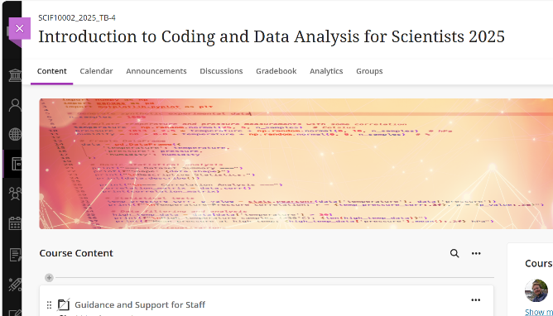
Accessing Noteable
Open Blackboard
Go to “Introduction to Coding and Data Analysis for Scientists 2025”
Slide 6/19

Slide 69
Accessing Noteable
Open Blackboard
Go to “Introduction to Coding and Data Analysis for Scientists 2025”
Click “Unit Information and Resources”
Slide 6/19

Slide 70
Accessing Noteable
Open Blackboard
Go to “Introduction to Coding and Data Analysis for Scientists 2025”
Click “Unit Information and Resources”
Open Noteable
Slide 6/19

Slide 71
Accessing Noteable
Open Blackboard
Go to “Introduction to Coding and Data Analysis for Scientists 2025”
Click “Unit Information and Resources”
Open Noteable
Make sure “Jupyter Classic (Legacy)” is selected.
Slide 6/19

Slide 72
Accessing Noteable
Open Blackboard
Go to “Introduction to Coding and Data Analysis for Scientists 2025”
Click “Unit Information and Resources”
Open Noteable
Make sure “Jupyter Classic (Legacy)” is selected.
Click Start
Slide 6/19

Slide 73
Accessing Noteable
Open Blackboard
Go to “Introduction to Coding and Data Analysis for Scientists 2025”
Click “Unit Information and Resources”
Open Noteable
Make sure “Jupyter Classic (Legacy)” is selected.
Click Start
Click “+GitRepo”
Slide 6/19

Slide 74
Accessing Noteable
Open Blackboard
Go to “Introduction to Coding and Data Analysis for Scientists 2025”
Click “Unit Information and Resources”
Open Noteable
Make sure “Jupyter Classic (Legacy)” is selected.
Click Start
Click “+GitRepo”
Slide 6/19

Slide 75
Accessing Noteable
Open Blackboard
Go to “Introduction to Coding and Data Analysis for Scientists 2025”
Click “Unit Information and Resources”
Open Noteable
Make sure “Jupyter Classic (Legacy)” is selected.
Click Start
Click “+GitRepo”
Slide 6/19

Slide 76
Accessing Noteable
Open Blackboard
Go to “Introduction to Coding and Data Analysis for Scientists 2025”
Click “Unit Information and Resources”
Open Noteable
Make sure “Jupyter Classic (Legacy)” is selected.
Click Start
Click “+GitRepo”
Slide 6/19

Slide 77
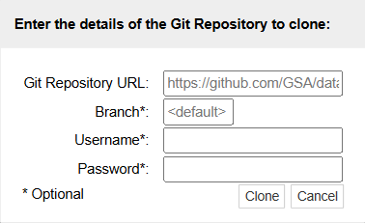
Accessing Noteable
Open Blackboard
Go to “Introduction to Coding and Data Analysis for Scientists 2025”
Click “Unit Information and Resources”
Open Noteable
Make sure “Jupyter Classic (Legacy)” is selected.
Click Start
Click “+GitRepo”
Slide 6/19

Slide 78
Accessing Noteable
Open Blackboard
Go to “Introduction to Coding and Data Analysis for Scientists 2025”
Click “Unit Information and Resources”
Open Noteable
Make sure “Jupyter Classic (Legacy)” is selected.
Click Start
Click “+GitRepo”
Slide 6/19

Slide 79
Accessing Noteable
Open Blackboard
Go to “Introduction to Coding and Data Analysis for Scientists 2025”
Click “Unit Information and Resources”
Open Noteable
Make sure “Jupyter Classic (Legacy)” is selected.
Click Start
Click “+GitRepo”
Paste into Git Repository URL:
Slide 6/19

Slide 80
Accessing Noteable
Open Blackboard
Go to “Introduction to Coding and Data Analysis for Scientists 2025”
Click “Unit Information and Resources”
Open Noteable
Make sure “Jupyter Classic (Legacy)” is selected.
Click Start
Click “+GitRepo”
Paste into Git Repository URL: git@github.com:TomMaullin/SCIF10002-2025.git
Slide 6/19

Slide 81
Accessing Noteable
Open Blackboard
Go to “Introduction to Coding and Data Analysis for Scientists 2025”
Click “Unit Information and Resources”
Open Noteable
Make sure “Jupyter Classic (Legacy)” is selected.
Click Start
Click “+GitRepo”
Paste into Git Repository URL: git@github.com:TomMaullin/SCIF10002-2025.git
Slide 6/19

Slide 82
Accessing Noteable
Open Blackboard
Go to “Introduction to Coding and Data Analysis for Scientists 2025”
Click “Unit Information and Resources”
Open Noteable
Make sure “Jupyter Classic (Legacy)” is selected.
Click Start
Click “+GitRepo”
Paste into Git Repository URL: git@github.com:TomMaullin/SCIF10002-2025.git
Press clone
Slide 6/19

Slide 83
Accessing Noteable
Open Blackboard
Go to “Introduction to Coding and Data Analysis for Scientists 2025”
Click “Unit Information and Resources”
Open Noteable
Make sure “Jupyter Classic (Legacy)” is selected.
Click Start
Click “+GitRepo”
Paste into Git Repository URL: git@github.com:TomMaullin/SCIF10002-2025.git
Press clone
Slide 6/19

Slide 84
Accessing Noteable
Open Blackboard
Go to “Introduction to Coding and Data Analysis for Scientists 2025”
Click “Unit Information and Resources”
Open Noteable
Make sure “Jupyter Classic (Legacy)” is selected.
Click Start
Click “+GitRepo”
Paste into Git Repository URL: git@github.com:TomMaullin/SCIF10002-2025.git
Press clone
Slide 6/19

Slide 85
Introduction to Coding
Slide 7/19

Slide 86

Introduction to Coding
Slide 7/19

Slide 87
Introduction to Coding
In this module, we shall be learning to code in Python
Slide 7/19

Slide 88
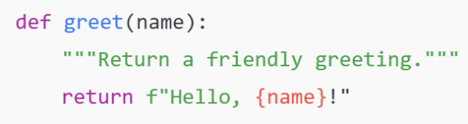
Introduction to Coding
In this module, we shall be learning to code in Python
Slide 7/19

Slide 89
Introduction to Coding
In this module, we shall be learning to code in Python
Python is a programming language
Slide 7/19

Slide 90
Introduction to Coding
In this module, we shall be learning to code in Python
Python is a programming language
In the same way humans communicate using different languages, there are many languages we can use to communicate with a computer
Slide 7/19

Slide 91
Introduction to Coding
In this module, we shall be learning to code in Python
Python is a programming language
In the same way humans communicate using different languages, there are many languages we can use to communicate with a computer
Python is particularly useful for:
Slide 7/19

Slide 92
Introduction to Coding
In this module, we shall be learning to code in Python
Python is a programming language
In the same way humans communicate using different languages, there are many languages we can use to communicate with a computer
Python is particularly useful for:
Analysing data
Slide 7/19

Slide 93
Introduction to Coding
In this module, we shall be learning to code in Python
Python is a programming language
In the same way humans communicate using different languages, there are many languages we can use to communicate with a computer
Python is particularly useful for:
Analysing data
Making plots and visualisations
Slide 7/19

Slide 94
Introduction to Coding
In this module, we shall be learning to code in Python
Python is a programming language
In the same way humans communicate using different languages, there are many languages we can use to communicate with a computer
Python is particularly useful for:
Analysing data
Making plots and visualisations
Running simulations
Slide 7/19

Slide 95
Introduction to Coding
In this module, we shall be learning to code in Python
Python is a programming language
In the same way humans communicate using different languages, there are many languages we can use to communicate with a computer
Python is particularly useful for:
Analysing data
Making plots and visualisations
Running simulations
Machine learning and AI
Slide 7/19

Slide 96
Learning to Code
Slide 8/19

Slide 97
Learning to Code
In fact, learning to code is a lot like learning a language
Slide 8/19

Slide 98
Learning to Code
In fact, learning to code is a lot like learning a language
When learning French, you might:
Slide 8/19

Slide 99
Learning to Code
In fact, learning to code is a lot like learning a language
When learning French, you might:
Learn many phrases
Slide 8/19

Slide 100
Learning to Code
In fact, learning to code is a lot like learning a language
When learning French, you might:
Learn many phrases
Practice writing sentences
Slide 8/19

Slide 101
Learning to Code
In fact, learning to code is a lot like learning a language
When learning French, you might:
Learn many phrases
Practice writing sentences
Speak to people who know the language
Slide 8/19

Slide 102
Learning to Code
In fact, learning to code is a lot like learning a language
When learning French, you might:
Learn many phrases
Practice writing sentences
Speak to people who know the language
You can’t learn a language by listening to other people describe it…
Slide 8/19

Slide 103
Learning to Code
In fact, learning to code is a lot like learning a language
When learning French, you might:
Learn many phrases
Practice writing sentences
Speak to people who know the language
You can’t learn a language by listening to other people describe it…
Hands-on experience and regular practice are crucial!
Slide 8/19

Slide 104
Learning to Code
In fact, learning to code is a lot like learning a language
When learning French, you might:
Learn many phrases
Practice writing sentences
Speak to people who know the language
You can’t learn a language by listening to other people describe it…
Hands-on experience and regular practice are crucial!
Our goal is to give you as much practice as possible!
Slide 8/19

Slide 105
Learning to Code
In fact, learning to code is a lot like learning a language
When learning French, you might:
Learn many phrases
Practice writing sentences
Speak to people who know the language
You can’t learn a language by listening to other people describe it…
Hands-on experience and regular practice are crucial!
Slide 8/19

Slide 106
Getting Started
Slide 9/19

Slide 107
Getting Started
So… what actually is coding?
Slide 9/19

Slide 108
Getting Started
So… what actually is coding?
You can think of writing code as like writing a recipe…
Slide 9/19

Slide 109
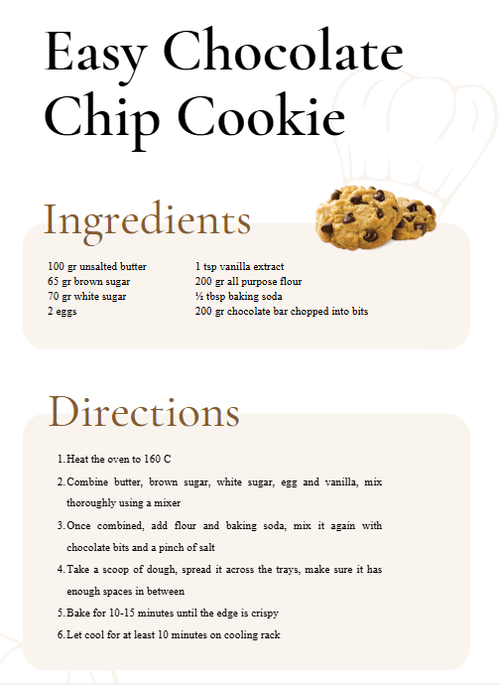
Getting Started
So… what actually is coding?
You can think of writing code as like writing a recipe…
Slide 9/19

Slide 110
Getting Started
So… what actually is coding?
You can think of writing code as like writing a recipe…
You might start by specifying some ingredients…
Slide 9/19

Slide 111
Getting Started
So… what actually is coding?
You can think of writing code as like writing a recipe…
You might start by specifying some ingredients…
Slide 9/19

Slide 112
Getting Started
So… what actually is coding?
You can think of writing code as like writing a recipe…
You might start by specifying some ingredients…
Slide 9/19

Slide 113
Getting Started
So… what actually is coding?
You can think of writing code as like writing a recipe…
You might start by specifying some ingredients…
Then list some instructions…
Slide 9/19

Slide 114
Getting Started
So… what actually is coding?
You can think of writing code as like writing a recipe…
You might start by specifying some ingredients…
Then list some instructions…
Slide 9/19

Slide 115
Getting Started
So… what actually is coding?
You can think of writing code as like writing a recipe…
You might start by specifying some ingredients…
Then list some instructions…
Slide 9/19

Slide 116
Getting Started
So… what actually is coding?
You can think of writing code as like writing a recipe…
You might start by specifying some ingredients…
Then list some instructions…
To get a desired output
Slide 9/19

Slide 117
Getting Started
So… what actually is coding?
You can think of writing code as like writing a recipe…
You might start by specifying some ingredients…
Then list some instructions…
To get a desired output
Slide 9/19

Slide 118
Getting Started
So… what actually is coding?
You can think of writing code as like writing a recipe…
You might start by specifying some ingredients…
Then list some instructions…
To get a desired output
Slide 9/19

Slide 119
Getting Started
So… what actually is coding?
You can think of writing code as like writing a recipe…
You might start by specifying some ingredients…
Then list some instructions…
To get a desired output
Coding is pretty similar
Slide 9/19

Slide 120
Getting Started
So… what actually is coding?
You can think of writing code as like writing a recipe…
You might start by specifying some ingredients…
Then list some instructions…
To get a desired output
Coding is pretty similar
Slide 9/19

Slide 121
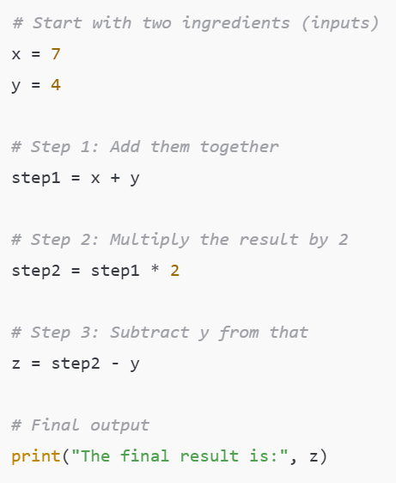
Getting Started
So… what actually is coding?
You can think of writing code as like writing a recipe…
You might start by specifying some ingredients…
Then list some instructions…
To get a desired output
Coding is pretty similar
Slide 9/19

Slide 122
Getting Started
So… what actually is coding?
You can think of writing code as like writing a recipe…
You might start by specifying some inputs…
Then list some instructions…
To get a desired output
Coding is pretty similar
Slide 10/19

Slide 123
Getting Started
So… what actually is coding?
You can think of writing code as like writing a recipe…
You might start by specifying some inputs…
Then list some instructions…
To get a desired output
Coding is pretty similar
Slide 10/19

Slide 124
Getting Started
So… what actually is coding?
You can think of writing code as like writing a recipe…
You might start by specifying some inputs…
Then list some instructions…
To get a desired output
Coding is pretty similar
Slide 10/19

Slide 125
Getting Started
So… what actually is coding?
You can think of writing code as like writing a recipe…
You might start by specifying some inputs…
Then list some instructions…
To get a desired output
Coding is pretty similar
Slide 10/19

Slide 126
Getting Started
So… what actually is coding?
You can think of writing code as like writing a recipe…
You might start by specifying some inputs…
Then list some instructions…
To get a desired output
Coding is pretty similar
Slide 10/19

Slide 127
Getting Started
So… what actually is coding?
You can think of writing code as like writing a recipe…
You might start by specifying some inputs…
Then list some instructions…
To get a desired output
Coding is pretty similar
Slide 10/19

Slide 128
Getting Started
So… what actually is coding?
You can think of writing code as like writing a recipe…
You might start by specifying some inputs…
Then list some instructions…
To get a desired output
Coding is pretty similar
Slide 10/19

Slide 129
Getting Started
So… what actually is coding?
You can think of writing code as like writing a recipe…
You might start by specifying some inputs…
Then list some instructions…
To get a desired output
Coding is pretty similar
Slide 10/19

Slide 130
Getting Started
So… what actually is coding?
You can think of writing code as like writing a recipe…
You might start by specifying some inputs…
Then list some instructions…
To get a desired output
Coding is pretty similar
Slide 10/19

Slide 131
Getting Started
So… what actually is coding?
You can think of writing code as like writing a recipe…
You might start by specifying some inputs…
Then list some instructions…
To get a desired output
Coding is pretty similar
Here we are producing some output that might be difficult to compute or evaluate by hand
Slide 10/19

Slide 132
Getting Started
Slide 10/19

Slide 133
Assigning Variables
Slide 11/19

Slide 134

Assigning Variables
Slide 11/19

Slide 135
Assigning Variables
Slide 11/19

Slide 136
Assigning Variables
In this code, x and y are variables
Slide 11/19

Slide 137
Assigning Variables
In this code, x and y are variables
These are named pieces of data which we can use for future computations
Slide 11/19

Slide 138
Assigning Variables
In this code, x and y are variables
These are named pieces of data which we can use for future computations
The ‘=‘ symbol is the assignment operator.
Slide 11/19

Slide 139
Assigning Variables
In this code, x and y are variables
These are named pieces of data which we can use for future computations
The ‘=‘ symbol is the assignment operator.
Assignment operator
Slide 11/19

Slide 140
Assigning Variables
In this code, x and y are variables
These are named pieces of data which we can use for future computations
The ‘=‘ symbol is the assignment operator.
Slide 11/19

Slide 141
Assigning Variables
In this code, x and y are variables
These are named pieces of data which we can use for future computations
The ‘=‘ symbol is the assignment operator.
Unlike in maths, this is an instruction
Slide 11/19

Slide 142
Assigning Variables
In this code, x and y are variables
These are named pieces of data which we can use for future computations
The ‘=‘ symbol is the assignment operator.
Unlike in maths, this is an instruction
E.g. “x=7” means “Save the integer 7 under the variable name x”
Slide 11/19

Slide 143
Data Types
Slide 12/19

Slide 144
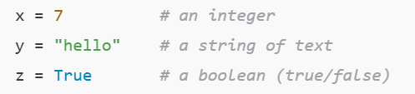
Data Types
Slide 12/19

Slide 145
Data Types
When writing the recipe, some foods were of the “same type”
Slide 12/19

Slide 146
Data Types
When writing the recipe, some foods were of the “same type”
E.g. we had 2 eggs
Slide 12/19

Slide 147
Data Types
When writing the recipe, some foods were of the “same type”
E.g. we had 2 eggs
In the same way, in coding we have different types of data
Slide 12/19

Slide 148
Data Types
When writing the recipe, some foods were of the “same type”
E.g. we had 2 eggs
In the same way, in coding we have different types of data
Today, we shall look at some of these
Slide 12/19

Slide 149
Data Types
When writing the recipe, some foods were of the “same type”
E.g. we had 2 eggs
In the same way, in coding we have different types of data
Today, we shall look at some of these
Understanding data types is important, as we want to use different data types for different tasks
Slide 12/19

Slide 150
Numeric Data Types
Slide 13/19

Slide 151
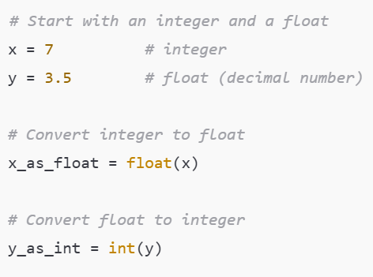

Numeric Data Types
Slide 13/19

Slide 152
Numeric Data Types
The most ubiquitous data types are numeric
Slide 13/19

Slide 153
Numeric Data Types
The most ubiquitous data types are numeric
Slide 13/19

Slide 154
Numeric Data Types
The most ubiquitous data types are numeric
Integers: Whole numbers/Integers
Slide 13/19

Slide 155
Numeric Data Types
The most ubiquitous data types are numeric
Integers: Whole numbers/Integers ℤ = {…, -3, -2, -1, 0, 1, 2, 3,… }
Slide 13/19

Slide 156
Numeric Data Types
The most ubiquitous data types are numeric
Integers: Whole numbers/Integers ℤ = {…, -3, -2, -1, 0, 1, 2, 3,… }
Slide 13/19

Slide 157
Numeric Data Types
The most ubiquitous data types are numeric
Integers: Whole numbers/Integers ℤ = {…, -3, -2, -1, 0, 1, 2, 3,… }
Floats: Decimal numbers
Slide 13/19

Slide 158
Numeric Data Types
The most ubiquitous data types are numeric
Integers: Whole numbers/Integers ℤ = {…, -3, -2, -1, 0, 1, 2, 3,… }
Floats: Decimal numbers
ℝ = Real numbers
Slide 13/19

Slide 159
Numeric Data Types
The most ubiquitous data types are numeric
Integers: Whole numbers/Integers ℤ = {…, -3, -2, -1, 0, 1, 2, 3,… }
Floats: Decimal numbers
ℝ = Real numbers
Slide 13/19

Slide 160
Numeric Data Types
The most ubiquitous data types are numeric
Integers: Whole numbers/Integers ℤ = {…, -3, -2, -1, 0, 1, 2, 3,… }
Floats: Decimal numbers
ℝ = Real numbers
We can convert between float’s and integers using the float and int functions.
Slide 13/19

Slide 161
Numeric Data Types
The most ubiquitous data types are numeric
Integers: Whole numbers/Integers ℤ = {…, -3, -2, -1, 0, 1, 2, 3,… }
Floats: Decimal numbers
ℝ = Real numbers
We can convert between float’s and integers using the float and int functions.
Slide 13/19

Slide 162
Numeric Data Types
The most ubiquitous data types are numeric
Integers: Whole numbers/Integers ℤ = {…, -3, -2, -1, 0, 1, 2, 3,… }
Floats: Decimal numbers
ℝ = Real numbers
We can convert between float’s and integers using the float and int functions.
Slide 13/19

Slide 163
Numeric Data Types
The most ubiquitous data types are numeric
Integers: Whole numbers/Integers ℤ = {…, -3, -2, -1, 0, 1, 2, 3,… }
Floats: Decimal numbers
ℝ = Real numbers
We can convert between float’s and integers using the float and int functions.
What do you think might happen if we convert y to an integer?
Slide 13/19

Slide 164
Numeric Data Types
The most ubiquitous data types are numeric
Integers: Whole numbers/Integers ℤ = {…, -3, -2, -1, 0, 1, 2, 3,… }
Floats: Decimal numbers
ℝ = Real numbers
We can convert between float’s and integers using the float and int functions.
What do you think might happen if we convert y to an integer?
Warning: A computer cannot actually describe arbitrarily small and large numbers – it approximates instead
Slide 13/19

Slide 165
Numeric Data Types
The most ubiquitous data types are numeric
Integers: Whole numbers/Integers ℤ = {…, -3, -2, -1, 0, 1, 2, 3,… }
Floats: Decimal numbers
ℝ = Real numbers
We can convert between float’s and integers using the float and int functions.
What do you think might happen if we convert y to an integer?
Slide 13/19

Slide 166
Strings
Slide 14/19

Slide 167
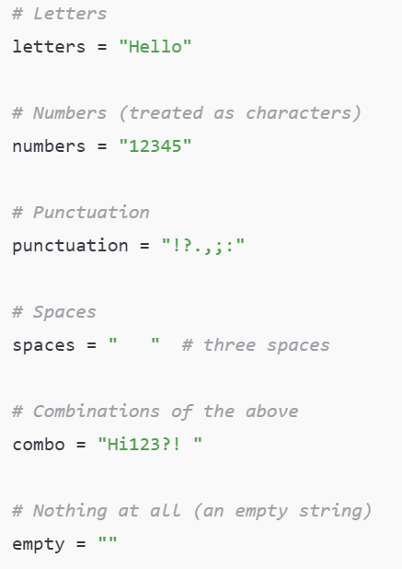
Strings
Slide 14/19

Slide 168
Strings
A string is a sequence of characters. Strings can contain:
Slide 14/19

Slide 169
Strings
A string is a sequence of characters. Strings can contain:
Letters
Slide 14/19

Slide 170
Strings
A string is a sequence of characters. Strings can contain:
Letters
Slide 14/19

Slide 171
Strings
A string is a sequence of characters. Strings can contain:
Letters
Numbers (treated as characters)
Slide 14/19

Slide 172
Strings
A string is a sequence of characters. Strings can contain:
Letters
Numbers (treated as characters)
Slide 14/19

Slide 173
Strings
A string is a sequence of characters. Strings can contain:
Letters
Numbers (treated as characters)
Punctuation
Slide 14/19

Slide 174
Strings
A string is a sequence of characters. Strings can contain:
Letters
Numbers (treated as characters)
Punctuation
Slide 14/19

Slide 175
Strings
A string is a sequence of characters. Strings can contain:
Letters
Numbers (treated as characters)
Punctuation
Spaces
Slide 14/19

Slide 176
Strings
A string is a sequence of characters. Strings can contain:
Letters
Numbers (treated as characters)
Punctuation
Spaces
Slide 14/19

Slide 177
Strings
A string is a sequence of characters. Strings can contain:
Letters
Numbers (treated as characters)
Punctuation
Spaces
Combinations of the above
Slide 14/19

Slide 178
Strings
A string is a sequence of characters. Strings can contain:
Letters
Numbers (treated as characters)
Punctuation
Spaces
Combinations of the above
Slide 14/19

Slide 179
Strings
A string is a sequence of characters. Strings can contain:
Letters
Numbers (treated as characters)
Punctuation
Spaces
Combinations of the above
Nothing at all
Slide 14/19

Slide 180
Strings
A string is a sequence of characters. Strings can contain:
Letters
Numbers (treated as characters)
Punctuation
Spaces
Combinations of the above
Nothing at all
Slide 14/19

Slide 181
Strings
A string is a sequence of characters. Strings can contain:
Letters
Numbers (treated as characters)
Punctuation
Spaces
Combinations of the above
Nothing at all
Slide 14/19

Slide 182
Strings
A string is a sequence of characters. Strings can contain:
Letters
Numbers (treated as characters)
Punctuation
Spaces
Combinations of the above
Nothing at all
Slide 14/19

Slide 183
Strings
A string is a sequence of characters. Strings can contain:
Letters
Numbers (treated as characters)
Punctuation
Spaces
Combinations of the above
Nothing at all
Slide 14/19

Slide 184
Strings
A string is a sequence of characters. Strings can contain:
Letters
Numbers (treated as characters)
Punctuation
Spaces
Combinations of the above
Nothing at all
Slide 14/19

Slide 185
Strings
A string is a sequence of characters. Strings can contain:
Letters
Numbers (treated as characters)
Punctuation
Spaces
Combinations of the above
Nothing at all
Slide 14/19

Slide 186
Strings
A string is a sequence of characters. Strings can contain:
Letters
Numbers (treated as characters)
Punctuation
Spaces
Combinations of the above
Nothing at all
Slide 14/19

Slide 187
Strings
A string is a sequence of characters. Strings can contain:
Letters
Numbers (treated as characters)
Punctuation
Spaces
Combinations of the above
Nothing at all
Slide 14/19

Slide 188
Strings
A string is a sequence of characters. Strings can contain:
Letters
Numbers (treated as characters)
Punctuation
Spaces
Combinations of the above
Nothing at all
In practice, there are many things we may want to do with text in Python
Slide 14/19

Slide 189
Strings
A string is a sequence of characters. Strings can contain:
Letters
Numbers (treated as characters)
Punctuation
Spaces
Combinations of the above
Nothing at all
In practice, there are many things we may want to do with text in Python
Split it into sentences
Slide 14/19

Slide 190
Strings
A string is a sequence of characters. Strings can contain:
Letters
Numbers (treated as characters)
Punctuation
Spaces
Combinations of the above
Nothing at all
In practice, there are many things we may want to do with text in Python
Split it into sentences
Search through it
Slide 14/19

Slide 191
Strings
A string is a sequence of characters. Strings can contain:
Letters
Numbers (treated as characters)
Punctuation
Spaces
Combinations of the above
Nothing at all
In practice, there are many things we may want to do with text in Python
Split it into sentences
Search through it
Replace words
Slide 14/19

Slide 192
Strings
A string is a sequence of characters. Strings can contain:
Letters
Numbers (treated as characters)
Punctuation
Spaces
Combinations of the above
Nothing at all
In practice, there are many things we may want to do with text in Python
Split it into sentences
Search through it
Replace words
After todays practical you will be able to perform some of these operations!
Slide 14/19

Slide 193
Strings
A string is a sequence of characters. Strings can contain:
Letters
Numbers (treated as characters)
Punctuation
Spaces
Combinations of the above
Nothing at all
In practice, there are many things we may want to do with text in Python
Split it into sentences
Search through it
Replace words
Slide 14/19

Slide 194
Booleans
Slide 15/19

Slide 195
Booleans
A Boolean is variable that can be either True or False
Slide 15/19

Slide 196
Booleans
A Boolean is variable that can be either True or False
Booleans represent logical statements.
Slide 15/19

Slide 197
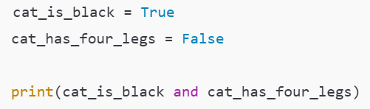
Booleans
A Boolean is variable that can be either True or False
Booleans represent logical statements.
Slide 15/19

Slide 198
Booleans
A Boolean is variable that can be either True or False
Booleans represent logical statements.
For instance, we might think of:
Slide 15/19

Slide 199
Booleans
A Boolean is variable that can be either True or False
Booleans represent logical statements.
For instance, we might think of:
cat_is_black as representing the sentence “The cat is black”
Slide 15/19

Slide 200
Booleans
A Boolean is variable that can be either True or False
Booleans represent logical statements.
For instance, we might think of:
cat_is_black as representing the sentence “The cat is black”
Slide 15/19

Slide 201
Booleans
A Boolean is variable that can be either True or False
Booleans represent logical statements.
For instance, we might think of:
cat_is_black as representing the sentence “The cat is black”
cat_has_four_legs as representing the sentence “The cat has four legs”
Slide 15/19

Slide 202
Booleans
A Boolean is variable that can be either True or False
Booleans represent logical statements.
For instance, we might think of:
cat_is_black as representing the sentence “The cat is black”
cat_has_four_legs as representing the sentence “The cat has four legs”
Slide 15/19

Slide 203
Booleans
A Boolean is variable that can be either True or False
Booleans represent logical statements.
For instance, we might think of:
cat_is_black as representing the sentence “The cat is black”
cat_has_four_legs as representing the sentence “The cat has four legs”
We can use logical operators to combine Boolean statements
Slide 15/19

Slide 204
Booleans
A Boolean is variable that can be either True or False
Booleans represent logical statements.
For instance, we might think of:
cat_is_black as representing the sentence “The cat is black”
cat_has_four_legs as representing the sentence “The cat has four legs”
We can use logical operators to combine Boolean statements
cat_is_black and cat_has_four_legs represents the sentence “The cat is black and has four legs”
Slide 15/19

Slide 205
Booleans
A Boolean is variable that can be either True or False
Booleans represent logical statements.
For instance, we might think of:
cat_is_black as representing the sentence “The cat is black”
cat_has_four_legs as representing the sentence “The cat has four legs”
We can use logical operators to combine Boolean statements
cat_is_black and cat_has_four_legs represents the sentence “The cat is black and has four legs”
Slide 15/19

Slide 206
Booleans
A Boolean is variable that can be either True or False
Booleans represent logical statements.
For instance, we might think of:
cat_is_black as representing the sentence “The cat is black”
cat_has_four_legs as representing the sentence “The cat has four legs”
We can use logical operators to combine Boolean statements
cat_is_black and cat_has_four_legs represents the sentence “The cat is black and has four legs”
Slide 15/19

Slide 207

Booleans
A Boolean is variable that can be either True or False
Booleans represent logical statements.
For instance, we might think of:
cat_is_black as representing the sentence “The cat is black”
cat_has_four_legs as representing the sentence “The cat has four legs”
We can use logical operators to combine Boolean statements
cat_is_black and cat_has_four_legs represents the sentence “The cat is black and has four legs”
Slide 15/19

Slide 208
Booleans
A Boolean is variable that can be either True or False
Booleans represent logical statements.
For instance, we might think of:
cat_is_black as representing the sentence “The cat is black”
cat_has_four_legs as representing the sentence “The cat has four legs”
We can use logical operators to combine Boolean statements
cat_is_black and cat_has_four_legs represents the sentence “The cat is black and has four legs”
Slide 15/19

Slide 209

Booleans
A Boolean is variable that can be either True or False
Booleans represent logical statements.
For instance, we might think of:
cat_is_black as representing the sentence “The cat is black”
cat_has_four_legs as representing the sentence “The cat has four legs”
We can use logical operators to combine Boolean statements
cat_is_black and cat_has_four_legs represents the sentence “The cat is black and has four legs”
Slide 15/19

Slide 210

Booleans
A Boolean is variable that can be either True or False
Booleans represent logical statements.
For instance, we might think of:
cat_is_black as representing the sentence “The cat is black”
cat_has_four_legs as representing the sentence “The cat has four legs”
We can use logical operators to combine Boolean statements
cat_is_black and cat_has_four_legs represents the sentence “The cat is black and has four legs”
Slide 15/19

Slide 211
Booleans
A Boolean is variable that can be either True or False
Booleans represent logical statements.
For instance, we might think of:
cat_is_black as representing the sentence “The cat is black”
cat_has_four_legs as representing the sentence “The cat has four legs”
We can use logical operators to combine Boolean statements
cat_is_black and cat_has_four_legs represents the sentence “The cat is black and has four legs”
Slide 15/19

Slide 212
Booleans
A Boolean is variable that can be either True or False
Booleans represent logical statements.
For instance, we might think of:
cat_is_black as representing the sentence “The cat is black”
cat_has_four_legs as representing the sentence “The cat has four legs”
We can use logical operators to combine Boolean statements
cat_is_black and cat_has_four_legs represents the sentence “The cat is black and has four legs”
Slide 15/19

Slide 213
Booleans
A Boolean is variable that can be either True or False
Booleans represent logical statements.
For instance, we might think of:
cat_is_black as representing the sentence “The cat is black”
cat_has_four_legs as representing the sentence “The cat has four legs”
We can use logical operators to combine Boolean statements
cat_is_black and cat_has_four_legs represents the sentence “The cat is black and has four legs”
Slide 15/19

Slide 214

Booleans
A Boolean is variable that can be either True or False
Booleans represent logical statements.
For instance, we might think of:
cat_is_black as representing the sentence “The cat is black”
cat_has_four_legs as representing the sentence “The cat has four legs”
We can use logical operators to combine Boolean statements
cat_is_black and cat_has_four_legs represents the sentence “The cat is black and has four legs”
Slide 15/19

Slide 215
Booleans
A Boolean is variable that can be either True or False
Booleans represent logical statements.
For instance, we might think of:
cat_is_black as representing the sentence “The cat is black”
cat_has_four_legs as representing the sentence “The cat has four legs”
We can use logical operators to combine Boolean statements
cat_is_black and cat_has_four_legs represents the sentence “The cat is black and has four legs”
Slide 15/19

Slide 216
Booleans
A Boolean is variable that can be either True or False
Booleans represent logical statements.
For instance, we might think of:
cat_is_black as representing the sentence “The cat is black”
cat_has_four_legs as representing the sentence “The cat has four legs”
We can use logical operators to combine Boolean statements
cat_is_black and cat_has_four_legs represents the sentence “The cat is black and has four legs”
Slide 15/19

Slide 217
Booleans
A Boolean is variable that can be either True or False
Booleans represent logical statements.
For instance, we might think of:
cat_is_black as representing the sentence “The cat is black”
cat_has_four_legs as representing the sentence “The cat has four legs”
We can use logical operators to combine Boolean statements
cat_is_black and cat_has_four_legs represents the sentence “The cat is black and has four legs”
Slide 15/19

Slide 218
Booleans
A Boolean is variable that can be either True or False
Booleans represent logical statements.
For instance, we might think of:
cat_is_black as representing the sentence “The cat is black”
cat_has_four_legs as representing the sentence “The cat has four legs”
We can use logical operators to combine Boolean statements
cat_is_black and cat_has_four_legs represents the sentence “The cat is black and has four legs”
Slide 15/19

Slide 219
Booleans
A Boolean is variable that can be either True or False
Booleans represent logical statements.
For instance, we might think of:
cat_is_black as representing the sentence “The cat is black”
cat_has_four_legs as representing the sentence “The cat has four legs”
We can use logical operators to combine Boolean statements
cat_is_black and cat_has_four_legs represents the sentence “The cat is black and has four legs”
Slide 15/19

Slide 220
Booleans
A Boolean is variable that can be either True or False
Booleans represent logical statements.
For instance, we might think of:
cat_is_black as representing the sentence “The cat is black”
cat_has_four_legs as representing the sentence “The cat has four legs”
We can use logical operators to combine Boolean statements
cat_is_black and cat_has_four_legs represents the sentence “The cat is black and has four legs”
Slide 15/19

Slide 221
Booleans
A Boolean is variable that can be either True or False
Booleans represent logical statements.
For instance, we might think of:
cat_is_black as representing the sentence “The cat is black”
cat_has_four_legs as representing the sentence “The cat has four legs”
We can use logical operators to combine Boolean statements
cat_is_black and cat_has_four_legs represents the sentence “The cat is black and has four legs”
Slide 15/19

Slide 222
Collections
Slide 16/19

Slide 223
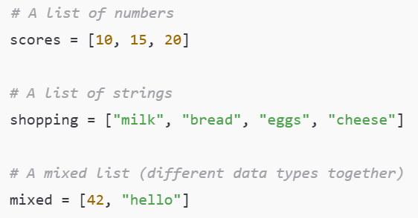
Collections
Slide 16/19

Slide 224
Collections
We’ve now seen some simple examples of datatypes:
Slide 16/19

Slide 225
Collections
We’ve now seen some simple examples of datatypes:
Numeric, strings, and booleans.
Slide 16/19

Slide 226
Collections
We’ve now seen some simple examples of datatypes:
Numeric, strings, and booleans.
Data types don’t always have to be this simple!
Slide 16/19

Slide 227
Collections
We’ve now seen some simple examples of datatypes:
Numeric, strings, and booleans.
Data types don’t always have to be this simple!
Sometimes we need data types that can hold more complex information.
Slide 16/19

Slide 228
Collections
We’ve now seen some simple examples of datatypes:
Numeric, strings, and booleans.
Data types don’t always have to be this simple!
Sometimes we need data types that can hold more complex information.
We’ll see more examples throughout the course but for now we’ll provide just one
Slide 16/19

Slide 229
Collections
We’ve now seen some simple examples of datatypes:
Numeric, strings, and booleans.
Data types don’t always have to be this simple!
Sometimes we need data types that can hold more complex information.
We’ll see more examples throughout the course but for now we’ll provide just one
A collection is any in-built data type that can group multiple objects together.
Slide 16/19

Slide 230
Collections
We’ve now seen some simple examples of datatypes:
Numeric, strings, and booleans.
Data types don’t always have to be this simple!
Sometimes we need data types that can hold more complex information.
We’ll see more examples throughout the course but for now we’ll provide just one
A collection is any in-built data type that can group multiple objects together.
The most common collection is a list: an ordered group of items.
Slide 16/19

Slide 231
Collections
We’ve now seen some simple examples of datatypes:
Numeric, strings, and booleans.
Data types don’t always have to be this simple!
Sometimes we need data types that can hold more complex information.
We’ll see more examples throughout the course but for now we’ll provide just one
A collection is any in-built data type that can group multiple objects together.
The most common collection is a list: an ordered group of items.
Slide 16/19

Slide 232
Collections
We’ve now seen some simple examples of datatypes:
Numeric, strings, and booleans.
Data types don’t always have to be this simple!
Sometimes we need data types that can hold more complex information.
We’ll see more examples throughout the course but for now we’ll provide just one
A collection is any in-built data type that can group multiple objects together.
The most common collection is a list: an ordered group of items.
Slide 16/19

Slide 233
Collections
We’ve now seen some simple examples of datatypes:
Numeric, strings, and booleans.
Data types don’t always have to be this simple!
Sometimes we need data types that can hold more complex information.
We’ll see more examples throughout the course but for now we’ll provide just one
A collection is any in-built data type that can group multiple objects together.
The most common collection is a list: an ordered group of items.
Slide 16/19

Slide 234
Collections
We’ve now seen some simple examples of datatypes:
Numeric, strings, and booleans.
Data types don’t always have to be this simple!
Sometimes we need data types that can hold more complex information.
We’ll see more examples throughout the course but for now we’ll provide just one
A collection is any in-built data type that can group multiple objects together.
The most common collection is a list: an ordered group of items.
Lists let you store, organize, and work with many values at once.
Slide 16/19

Slide 235
Practical
Slide 17/19

Slide 236
Practical
We have students from a range of courses and backgrounds in this class
Slide 17/19

Slide 237
Practical
We have students from a range of courses and backgrounds in this class
Chemistry
Slide 17/19

Slide 238

Practical
We have students from a range of courses and backgrounds in this class
Chemistry
Slide 17/19

Slide 239
Practical
We have students from a range of courses and backgrounds in this class
Chemistry
Physics
Slide 17/19

Slide 240
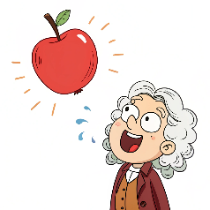
Practical
We have students from a range of courses and backgrounds in this class
Chemistry
Physics
Slide 17/19

Slide 241
Practical
We have students from a range of courses and backgrounds in this class
Chemistry
Physics
Data Science
Slide 17/19

Slide 242

Practical
We have students from a range of courses and backgrounds in this class
Chemistry
Physics
Data Science
Slide 17/19

Slide 243
Practical
We have students from a range of courses and backgrounds in this class
Chemistry
Physics
Data Science
Some people in the room will have less experience than others
Slide 17/19

Slide 244
Practical
We have students from a range of courses and backgrounds in this class
Chemistry
Physics
Data Science
Some people in the room will have less experience than others
For the first few weeks, we shall try to account for the differences in ability where possible
Slide 17/19

Slide 245
Practical
Slide 18/19

Slide 246
Practical
We now move over to Python
Slide 18/19

Slide 247
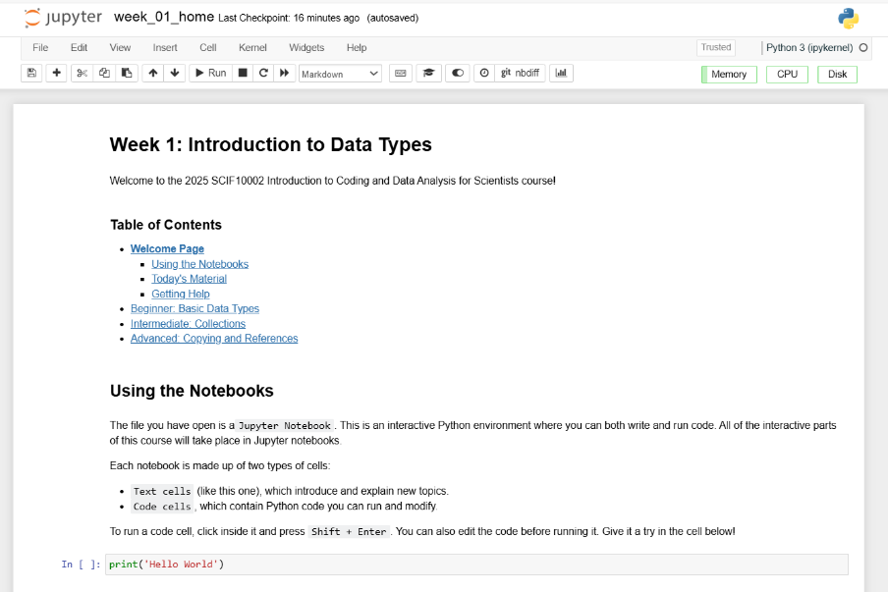
Practical
We now move over to Python
Slide 18/19

Slide 248
Practical
We now move over to Python
Please open `week_01_home.ipynb`
Slide 18/19

Slide 249
Practical
We now move over to Python
Please open `week_01_home.ipynb`
For the rest of today, you must work through a Python notebook
Slide 18/19

Slide 250
Practical
We now move over to Python
Please open `week_01_home.ipynb`
For the rest of today, you must work through a Python notebook
You have a choice of one of three options
Slide 18/19

Slide 251
Practical
We now move over to Python
Please open `week_01_home.ipynb`
For the rest of today, you must work through a Python notebook
You have a choice of one of three options
Option 1: Beginner - Basic Data Types
Slide 18/19

Slide 252
Practical
We now move over to Python
Please open `week_01_home.ipynb`
For the rest of today, you must work through a Python notebook
You have a choice of one of three options
Option 1: Beginner - Basic Data Types
Option 2: Intermediate - Collections
Slide 18/19

Slide 253
Practical
We now move over to Python
Please open `week_01_home.ipynb`
For the rest of today, you must work through a Python notebook
You have a choice of one of three options
Option 1: Beginner - Basic Data Types
Option 2: Intermediate - Collections
Option 3: Advanced - Copying and References
Slide 18/19

Slide 254
Practical
We now move over to Python
Please open `week_01_home.ipynb`
For the rest of today, you must work through a Python notebook
You have a choice of one of three options
Option 1: Beginner - Basic Data Types
Option 2: Intermediate - Collections
Option 3: Advanced - Copying and References
Choose this if you are new to the Python language or do not code regularly
Slide 18/19

Slide 255
Practical
We now move over to Python
Please open `week_01_home.ipynb`
For the rest of today, you must work through a Python notebook
You have a choice of one of three options
Option 1: Beginner - Basic Data Types
Option 2: Intermediate - Collections
Option 3: Advanced - Copying and References
Slide 18/19

Slide 256
Practical
We now move over to Python
Please open `week_01_home.ipynb`
For the rest of today, you must work through a Python notebook
You have a choice of one of three options
Option 1: Beginner - Basic Data Types
Option 2: Intermediate - Collections
Option 3: Advanced - Copying and References
Choose this if you have some experience with Python and are reasonably confident in your programming abilities
Slide 18/19

Slide 257
Practical
We now move over to Python
Please open `week_01_home.ipynb`
For the rest of today, you must work through a Python notebook
You have a choice of one of three options
Option 1: Beginner - Basic Data Types
Option 2: Intermediate - Collections
Option 3: Advanced - Copying and References
Slide 18/19

Slide 258
Practical
We now move over to Python
Please open `week_01_home.ipynb`
For the rest of today, you must work through a Python notebook
You have a choice of one of three options
Option 1: Beginner - Basic Data Types
Option 2: Intermediate - Collections
Option 3: Advanced - Copying and References
Choose this if you are a very strong Python programmer with a lot of experience
Slide 18/19

Slide 259
Practical
We now move over to Python
Please open `week_01_home.ipynb`
For the rest of today, you must work through a Python notebook
You have a choice of one of three options
Option 1: Beginner - Basic Data Types
Option 2: Intermediate - Collections
Option 3: Advanced - Copying and References
Slide 18/19

Slide 260
Practical
We now move over to Python
Please open `week_01_home.ipynb`
For the rest of today, you must work through a Python notebook
You have a choice of one of three options
Option 1: Beginner - Basic Data Types
Option 2: Intermediate - Collections
Option 3: Advanced - Copying and References
Important: If you choose the intermediate or advanced options, make sure you are comfortable with the material in Beginner first!!
Slide 18/19

Slide 261
Practical
We now move over to Python
Please open `week_01_home.ipynb`
For the rest of today, you must work through a Python notebook
You have a choice of one of three options
Option 1: Beginner - Basic Data Types
Option 2: Intermediate - Collections
Option 3: Advanced - Copying and References
Important: If you choose the intermediate or advanced options, make sure you are comfortable with the material in Beginner first!!
Slide 18/19

Slide 262
Practical
We now move over to Python
Please open `week_01_home.ipynb`
For the rest of today, you must work through a Python notebook
You have a choice of one of three options
Option 1: Beginner - Basic Data Types
Option 2: Intermediate - Collections
Option 3: Advanced - Copying and References
Slide 18/19

Slide 263
Next Time
Lecture 1: Introduction and Data Types
Course Structure
Setting up Noteable
Introduction to Coding
Data Types
Practical
Lecture 2: Booleans and Conditionals
Recap: Accessing Noteable
Recap: Booleans
If statements
Practical
Slide 19/19

