Slide 1
Lecture 6:
The NumPy Module
SCIF10002 – Introduction to Coding and Data
Tom Maullin-Sapey
6th November 2025
Slide 0/19

Slide 2
Today’s Lecture
Slide 1/19

Slide 3
Today’s Lecture
Lecture 6: The NumPy Module
Slide 1/19

Slide 4
Today’s Lecture
Lecture 6: The NumPy Module
What is NumPy?
Slide 1/19

Slide 5
Today’s Lecture
Lecture 6: The NumPy Module
What is NumPy?
Arrays vs Lists
Slide 1/19

Slide 6
Today’s Lecture
Lecture 6: The NumPy Module
What is NumPy?
Arrays vs Lists
Operations on Arrays
Slide 1/19

Slide 7
Today’s Lecture
Lecture 6: The NumPy Module
What is NumPy?
Arrays vs Lists
Operations on Arrays
Practical
Slide 1/19

Slide 8
Today’s Lecture
Lecture 6: The NumPy Module
What is NumPy?
Arrays vs Lists
Operations on Arrays
Practical
Lecture 7: Working with NumPy Arrays
Array indexing and slicing
Boolean indexing
Array generation functions
Random data generation
Practical
Slide 1/19

Slide 9
Aims
Slide 2/19

Slide 10
Aims
By the end of this lecture, you will be able to:
Slide 2/19

Slide 11
Aims
By the end of this lecture, you will be able to:
Explain what the NumPy module is and why it is used
Slide 2/19

Slide 12
Aims
By the end of this lecture, you will be able to:
Explain what the NumPy module is and why it is used
Create and manipulate NumPy arrays
Slide 2/19

Slide 13
Aims
By the end of this lecture, you will be able to:
Explain what the NumPy module is and why it is used
Create and manipulate NumPy arrays
Perform element-wise operations and mathematical functions on arrays
Slide 2/19

Slide 14
Aims
By the end of this lecture, you will be able to:
Explain what the NumPy module is and why it is used
Create and manipulate NumPy arrays
Perform element-wise operations and mathematical functions on arrays
Compare NumPy arrays with Python lists in terms of performance and functionality
Slide 2/19

Slide 15
Aims
By the end of this lecture, you will be able to:
Explain what the NumPy module is and why it is used
Create and manipulate NumPy arrays
Perform element-wise operations and mathematical functions on arrays
Compare NumPy arrays with Python lists in terms of performance and functionality
Use basic aggregation and array manipulation functions in NumPy
Slide 2/19

Slide 16
What is NumPy ?
Slide 3/19

Slide 17
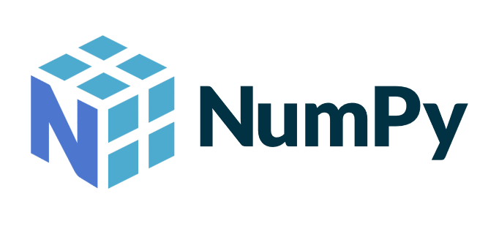
What is NumPy ?
Slide 3/19

Slide 18
What is NumPy ?
NumPy is a Python library that makes working with numbers and large collections of data fast and easy.
Slide 3/19

Slide 19
What is NumPy ?
NumPy is a Python library that makes working with numbers and large collections of data fast and easy.
It provides special array objects and tools for doing math efficiently, which is useful for data analysis and scientific computing.
Slide 3/19

Slide 20
What is NumPy ?
NumPy is a Python library that makes working with numbers and large collections of data fast and easy.
It provides special array objects and tools for doing math efficiently, which is useful for data analysis and scientific computing.
It is imported in your session using the following command
Slide 3/19

Slide 21


What is NumPy ?
NumPy is a Python library that makes working with numbers and large collections of data fast and easy.
It provides special array objects and tools for doing math efficiently, which is useful for data analysis and scientific computing.
It is imported in your session using the following command
Slide 3/19

Slide 22
What is NumPy ?
NumPy is a Python library that makes working with numbers and large collections of data fast and easy.
It provides special array objects and tools for doing math efficiently, which is useful for data analysis and scientific computing.
It is imported in your session using the following command
Slide 3/19

Slide 23
What is NumPy ?
NumPy is a Python library that makes working with numbers and large collections of data fast and easy.
It provides special array objects and tools for doing math efficiently, which is useful for data analysis and scientific computing.
It is imported in your session using the following command
We will follow a common practice and use the as syntax
Slide 3/19

Slide 24

What is NumPy ?
NumPy is a Python library that makes working with numbers and large collections of data fast and easy.
It provides special array objects and tools for doing math efficiently, which is useful for data analysis and scientific computing.
It is imported in your session using the following command
We will follow a common practice and use the as syntax
Slide 3/19

Slide 25
What is NumPy ?
NumPy is a Python library that makes working with numbers and large collections of data fast and easy.
It provides special array objects and tools for doing math efficiently, which is useful for data analysis and scientific computing.
It is imported in your session using the following command
We will follow a common practice and use the as syntax
Slide 3/19

Slide 26
What is NumPy ?
NumPy is a Python library that makes working with numbers and large collections of data fast and easy.
It provides special array objects and tools for doing math efficiently, which is useful for data analysis and scientific computing.
It is imported in your session using the following command
We will follow a common practice and use the as syntax
Load in numpy but “call it” np
Slide 3/19

Slide 27
What is NumPy ?
NumPy is a Python library that makes working with numbers and large collections of data fast and easy.
It provides special array objects and tools for doing math efficiently, which is useful for data analysis and scientific computing.
It is imported in your session using the following command
We will follow a common practice and use the as syntax
Slide 3/19

Slide 28
What is NumPy ?
NumPy is a Python library that makes working with numbers and large collections of data fast and easy.
It provides special array objects and tools for doing math efficiently, which is useful for data analysis and scientific computing.
It is imported in your session using the following command
We will follow a common practice and use the as syntax
So, np will always mean numpy for us.
Slide 3/19

Slide 29
Arrays vs Lists
Slide 4/19

Slide 30
Arrays vs Lists
Python Lists
Slide 4/19

Slide 31
Arrays vs Lists
Python Lists
Ordered, Mutable
Slide 4/19

Slide 32
Arrays vs Lists
Python Lists
Ordered, Mutable
Mixed data types
Slide 4/19

Slide 33
Arrays vs Lists
Python Lists
Ordered, Mutable
Mixed data types
Explicit operations needed
Slide 4/19

Slide 34
Arrays vs Lists
Python Lists
Ordered, Mutable
Mixed data types
Explicit operations needed
Slower performance
Slide 4/19

Slide 35
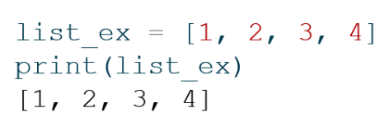
Arrays vs Lists
Python Lists
Ordered, Mutable
Mixed data types
Explicit operations needed
Slower performance
Slide 4/19

Slide 36
Arrays vs Lists
Python Lists
Ordered, Mutable
Mixed data types
Explicit operations needed
Slower performance
Slide 4/19

Slide 37
Arrays vs Lists
Python Lists
Ordered, Mutable
Mixed data types
Explicit operations needed
Slower performance
Slide 4/19

Slide 38
Arrays vs Lists
Python Lists
Ordered, Mutable
Mixed data types
Explicit operations needed
Slower performance
Slide 4/19

Slide 39
Arrays vs Lists
Python Lists
Ordered, Mutable
Mixed data types
Explicit operations needed
Slower performance
NumPy Arrays
Slide 4/19

Slide 40
Arrays vs Lists
Python Lists
Ordered, Mutable
Mixed data types
Explicit operations needed
Slower performance
NumPy Arrays
Ordered, Mutable
Slide 4/19

Slide 41
Arrays vs Lists
Python Lists
Ordered, Mutable
Mixed data types
Explicit operations needed
Slower performance
NumPy Arrays
Ordered, Mutable
One data type per array
Slide 4/19

Slide 42
Arrays vs Lists
Python Lists
Ordered, Mutable
Mixed data types
Explicit operations needed
Slower performance
NumPy Arrays
Ordered, Mutable
One data type per array
Element-wise operations
Slide 4/19

Slide 43
Arrays vs Lists
Python Lists
Ordered, Mutable
Mixed data types
Explicit operations needed
Slower performance
NumPy Arrays
Ordered, Mutable
One data type per array
Element-wise operations
Fast & memory efficient
Slide 4/19

Slide 44
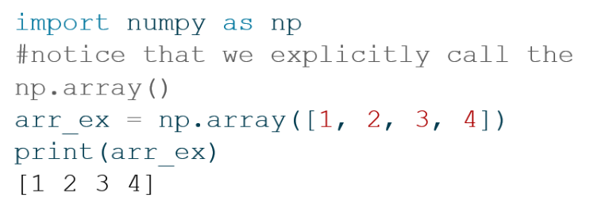
Arrays vs Lists
Python Lists
Ordered, Mutable
Mixed data types
Explicit operations needed
Slower performance
NumPy Arrays
Ordered, Mutable
One data type per array
Element-wise operations
Fast & memory efficient
Slide 4/19

Slide 45
Arrays vs Lists
Python Lists
Ordered, Mutable
Mixed data types
Explicit operations needed
Slower performance
NumPy Arrays
Ordered, Mutable
One data type per array
Element-wise operations
Fast & memory efficient
Slide 4/19

Slide 46
Arrays vs Lists
Python Lists
Ordered, Mutable
Mixed data types
Explicit operations needed
Slower performance
NumPy Arrays
Ordered, Mutable
One data type per array
Element-wise operations
Fast & memory efficient
Slide 4/19

Slide 47
Arrays vs Lists
Python Lists
Ordered, Mutable
Mixed data types
Explicit operations needed
Slower performance
NumPy Arrays
Ordered, Mutable
One data type per array
Element-wise operations
Fast & memory efficient
Slide 4/19

Slide 48
Arrays vs Lists
Python Lists
Ordered, Mutable
Mixed data types
Explicit operations needed
Slower performance
NumPy Arrays
Ordered, Mutable
One data type per array
Element-wise operations
Fast & memory efficient
Slide 4/19

Slide 49
Arrays vs Lists
Python Lists
Ordered, Mutable
Mixed data types
Explicit operations needed
Slower performance
NumPy Arrays
Ordered, Mutable
One data type per array
Element-wise operations
Fast & memory efficient
Slide 4/19

Slide 50
Arrays from Lists
Slide 5/19

Slide 51
Arrays from Lists
A purely numerical list can readily be converted to an array.
Slide 5/19

Slide 52
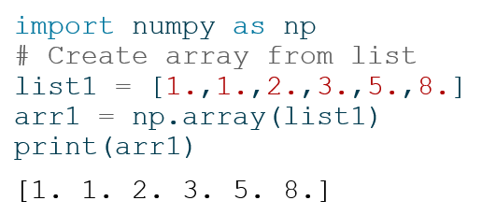
Arrays from Lists
A purely numerical list can readily be converted to an array.
Slide 5/19

Slide 53
Arrays from Lists
A purely numerical list can readily be converted to an array.
Slide 5/19

Slide 54
Arrays from Lists
A purely numerical list can readily be converted to an array.
Slide 5/19

Slide 55
Arrays from Lists
A purely numerical list can readily be converted to an array.
Slide 5/19

Slide 56
Arrays from Lists
A purely numerical list can readily be converted to an array.
Slide 5/19

Slide 57
Arrays from Lists
A purely numerical list can readily be converted to an array.
Slide 5/19

Slide 58
Arrays from Lists
A purely numerical list can readily be converted to an array.
Slide 5/19

Slide 59
Arrays from Lists
A purely numerical list can readily be converted to an array.
The dtype of the array yields the data type of the elements inside it.
Slide 5/19

Slide 60

Arrays from Lists
A purely numerical list can readily be converted to an array.
The dtype of the array yields the data type of the elements inside it.
Slide 5/19

Slide 61

Arrays from Lists
A purely numerical list can readily be converted to an array.
The dtype of the array yields the data type of the elements inside it.
Slide 5/19

Slide 62
Arrays from Lists
A purely numerical list can readily be converted to an array.
The dtype of the array yields the data type of the elements inside it.
Slide 5/19

Slide 63
Arrays from Lists
A purely numerical list can readily be converted to an array.
The dtype of the array yields the data type of the elements inside it.
If we the elements in list1 to integers, the dtype would be int64
Slide 5/19

Slide 64
Array Properties
Slide 6/19

Slide 65
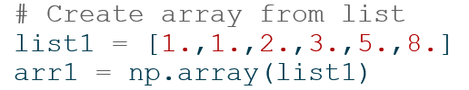
Array Properties
Slide 6/19

Slide 66
Array Properties
Slide 6/19

Slide 67
Array Properties
Arrays possess plenty of properties (also known as attributes).
Slide 6/19

Slide 68
Array Properties
Arrays possess plenty of properties (also known as attributes).
These are accessed with the . notation.
Slide 6/19

Slide 69
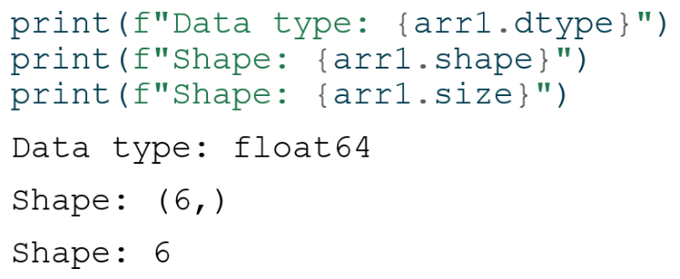
Array Properties
Arrays possess plenty of properties (also known as attributes).
These are accessed with the . notation.
Slide 6/19

Slide 70
Array Properties
Arrays possess plenty of properties (also known as attributes).
These are accessed with the . notation.
Slide 6/19

Slide 71
Array Properties
Arrays possess plenty of properties (also known as attributes).
These are accessed with the . notation.
Slide 6/19

Slide 72
Array Properties
Arrays possess plenty of properties (also known as attributes).
These are accessed with the . notation.
Slide 6/19

Slide 73
Array Properties
Arrays possess plenty of properties (also known as attributes).
These are accessed with the . notation.
Slide 6/19

Slide 74
Array Properties
Arrays possess plenty of properties (also known as attributes).
These are accessed with the . notation.
Slide 6/19

Slide 75
Array Properties
Arrays possess plenty of properties (also known as attributes).
These are accessed with the . notation.
Slide 6/19

Slide 76
Array Properties
Arrays possess plenty of properties (also known as attributes).
These are accessed with the . notation.
For now, we consider only 1d arrays, i.e. sequences.
Slide 6/19

Slide 77
Array Properties
Arrays possess plenty of properties (also known as attributes).
These are accessed with the . notation.
For now, we consider only 1d arrays, i.e. sequences.
Their length is their size and corresponds to the first element of the property shape.
Slide 6/19

Slide 78
Accessing Array Elements
Slide 7/19

Slide 79
Accessing Array Elements
Similarly to lists, we access an element in an array via zero-based indexing
Slide 7/19

Slide 80
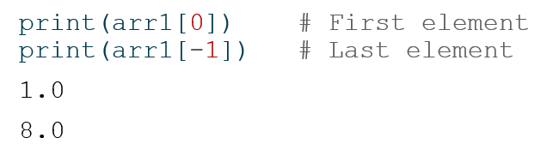
Accessing Array Elements
Similarly to lists, we access an element in an array via zero-based indexing
Slide 7/19

Slide 81
Accessing Array Elements
Similarly to lists, we access an element in an array via zero-based indexing
Slide 7/19

Slide 82
Accessing Array Elements
Similarly to lists, we access an element in an array via zero-based indexing
Slide 7/19

Slide 83
Accessing Array Elements
Similarly to lists, we access an element in an array via zero-based indexing
Slide 7/19

Slide 84
Accessing Array Elements
Similarly to lists, we access an element in an array via zero-based indexing
Slide 7/19

Slide 85
Accessing Array Elements
Similarly to lists, we access an element in an array via zero-based indexing
Again, much like with lists, we can access collections of elements via slicing
Slide 7/19

Slide 86
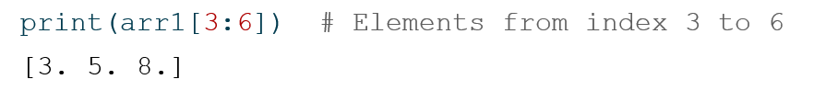
Accessing Array Elements
Similarly to lists, we access an element in an array via zero-based indexing
Again, much like with lists, we can access collections of elements via slicing
Slide 7/19

Slide 87
Accessing Array Elements
Similarly to lists, we access an element in an array via zero-based indexing
Again, much like with lists, we can access collections of elements via slicing
Slide 7/19

Slide 88
Accessing Array Elements
Similarly to lists, we access an element in an array via zero-based indexing
Again, much like with lists, we can access collections of elements via slicing
Slide 7/19

Slide 89
Element-wise Operations
Slide 8/19

Slide 90
Element-wise Operations
The main motivation to use arrays is that lists are cumbersome when performing maths.
Slide 8/19

Slide 91
Element-wise Operations
The main motivation to use arrays is that lists are cumbersome when performing maths.
Suppose we have a list and want to double each of its elements:
Slide 8/19

Slide 92


Element-wise Operations
The main motivation to use arrays is that lists are cumbersome when performing maths.
Suppose we have a list and want to double each of its elements:
Slide 8/19

Slide 93
Element-wise Operations
The main motivation to use arrays is that lists are cumbersome when performing maths.
Suppose we have a list and want to double each of its elements:
Slide 8/19

Slide 94
Element-wise Operations
The main motivation to use arrays is that lists are cumbersome when performing maths.
Suppose we have a list and want to double each of its elements:
We need to loop over all elements in list1 and create a new list
Slide 8/19

Slide 95
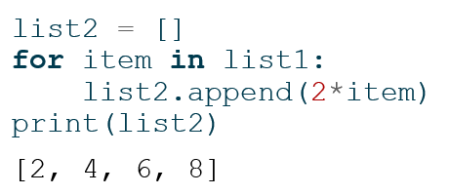
Element-wise Operations
The main motivation to use arrays is that lists are cumbersome when performing maths.
Suppose we have a list and want to double each of its elements:
We need to loop over all elements in list1 and create a new list
Slide 8/19

Slide 96
Element-wise Operations
The main motivation to use arrays is that lists are cumbersome when performing maths.
Suppose we have a list and want to double each of its elements:
We need to loop over all elements in list1 and create a new list
Slide 8/19

Slide 97
Element-wise Operations
The main motivation to use arrays is that lists are cumbersome when performing maths.
Suppose we have a list and want to double each of its elements:
We need to loop over all elements in list1 and create a new list
Slide 8/19

Slide 98
Element-wise Operations
The main motivation to use arrays is that lists are cumbersome when performing maths.
Suppose we have a list and want to double each of its elements:
We need to loop over all elements in list1 and create a new list
Slide 8/19

Slide 99
Element-wise Operations
The main motivation to use arrays is that lists are cumbersome when performing maths.
Suppose we have a list and want to double each of its elements:
We need to loop over all elements in list1 and create a new list
Slide 8/19

Slide 100
Element-wise Operations
The main motivation to use arrays is that lists are cumbersome when performing maths.
Suppose we have a list and want to double each of its elements:
We need to loop over all elements in list1 and create a new list
We can also do this computation using a list comprehension
Slide 8/19

Slide 101
Element-wise Operations
The main motivation to use arrays is that lists are cumbersome when performing maths.
Suppose we have a list and want to double each of its elements:
We need to loop over all elements in list1 and create a new list
We can also do this computation using a list comprehension
Slide 8/19

Slide 102
Element-wise Operations
The main motivation to use arrays is that lists are cumbersome when performing maths.
Suppose we have a list and want to double each of its elements:
We need to loop over all elements in list1 and create a new list
We can also do this computation using a list comprehension
Slide 8/19

Slide 103
Element-wise Operations
The main motivation to use arrays is that lists are cumbersome when performing maths.
Suppose we have a list and want to double each of its elements:
We need to loop over all elements in list1 and create a new list
We can also do this computation using a list comprehension
See week 3 advanced notebook for more on list comprehensions
Slide 8/19

Slide 104
Element-wise Operations
The main motivation to use arrays is that lists are cumbersome when performing maths.
Suppose we have a list and want to double each of its elements:
We need to loop over all elements in list1 and create a new list
We can also do this computation using a list comprehension
Slide 8/19

Slide 105
Element-wise Operations
The main motivation to use arrays is that lists are cumbersome when performing maths.
Suppose we have a list and want to double each of its elements:
We need to loop over all elements in list1 and create a new list
We can also do this computation using a list comprehension
Still, an explicit loop is needed. Loops in Python are slow.
Slide 8/19

Slide 106
Element-wise Operations
Slide 8/19

Slide 107
Element-wise Operations
Slide 9/19

Slide 108
Element-wise Operations
The NumPy syntax avoids the explicit Python loop.
Slide 9/19

Slide 109
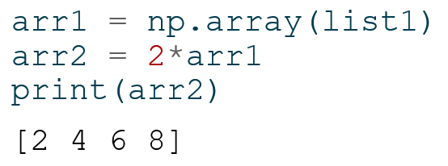
Element-wise Operations
The NumPy syntax avoids the explicit Python loop.
Slide 9/19

Slide 110
Element-wise Operations
The NumPy syntax avoids the explicit Python loop.
Slide 9/19

Slide 111
Element-wise Operations
The NumPy syntax avoids the explicit Python loop.
Slide 9/19

Slide 112
Element-wise Operations
The NumPy syntax avoids the explicit Python loop.
Slide 9/19

Slide 113
Element-wise Operations
The NumPy syntax avoids the explicit Python loop.
Slide 9/19

Slide 114
Element-wise Operations
The NumPy syntax avoids the explicit Python loop.
This is not just a cosmetic change!
Slide 9/19

Slide 115
Element-wise Operations
The NumPy syntax avoids the explicit Python loop.
This is not just a cosmetic change!
Under the hood, numpy uses an efficient architecture that performs operations in compiled code, making it much faster than Python loops.
Slide 9/19

Slide 116
Performance Advantage
Slide 10/19

Slide 117
Performance Advantage
We can track the performance difference explicitly.
Slide 10/19

Slide 118
Performance Advantage
We can track the performance difference explicitly.
We create a large list and array with identical elements.
Slide 10/19

Slide 119
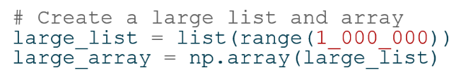
Performance Advantage
We can track the performance difference explicitly.
We create a large list and array with identical elements.
Slide 10/19

Slide 120
Performance Advantage
We can track the performance difference explicitly.
We create a large list and array with identical elements.
Slide 10/19

Slide 121
Performance Advantage
We can track the performance difference explicitly.
We create a large list and array with identical elements.
Slide 10/19

Slide 122
Performance Advantage
We can track the performance difference explicitly.
We create a large list and array with identical elements.
Slide 10/19

Slide 123
Performance Advantage
We can track the performance difference explicitly.
We create a large list and array with identical elements.
And then track the time for the two operations
Slide 10/19

Slide 124
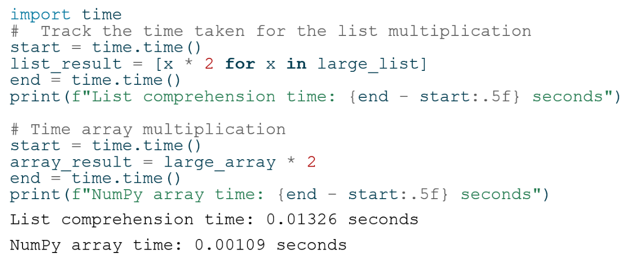
Performance Advantage
We can track the performance difference explicitly.
We create a large list and array with identical elements.
And then track the time for the two operations
Slide 10/19

Slide 125
Performance Advantage
We can track the performance difference explicitly.
We create a large list and array with identical elements.
And then track the time for the two operations
Slide 10/19

Slide 126
Performance Advantage
We can track the performance difference explicitly.
We create a large list and array with identical elements.
And then track the time for the two operations
Slide 10/19

Slide 127
Performance Advantage
We can track the performance difference explicitly.
We create a large list and array with identical elements.
And then track the time for the two operations
Slide 10/19

Slide 128
Performance Advantage
We can track the performance difference explicitly.
We create a large list and array with identical elements.
And then track the time for the two operations
Slide 10/19

Slide 129
Performance Advantage
We can track the performance difference explicitly.
We create a large list and array with identical elements.
And then track the time for the two operations
Slide 10/19

Slide 130
Performance Advantage
We can track the performance difference explicitly.
We create a large list and array with identical elements.
And then track the time for the two operations
Slide 10/19

Slide 131
Performance Advantage
We can track the performance difference explicitly.
We create a large list and array with identical elements.
And then track the time for the two operations
Slide 10/19

Slide 132
Performance Advantage
We can track the performance difference explicitly.
We create a large list and array with identical elements.
And then track the time for the two operations
Slide 10/19

Slide 133
Performance Advantage
We can track the performance difference explicitly.
We create a large list and array with identical elements.
And then track the time for the two operations
Slide 10/19

Slide 134
Performance Advantage
We can track the performance difference explicitly.
We create a large list and array with identical elements.
And then track the time for the two operations
Slide 10/19

Slide 135
Mathematical Operations in NumPy
Slide 11/19

Slide 136
Mathematical Operations in NumPy
The multiplication we saw earlier was performed element-wise
Slide 11/19

Slide 137
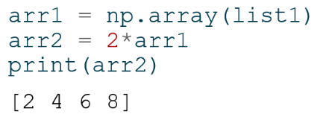
Mathematical Operations in NumPy
The multiplication we saw earlier was performed element-wise
Slide 11/19

Slide 138
Mathematical Operations in NumPy
The multiplication we saw earlier was performed element-wise
That is, each element was updated according to the same rule.
Slide 11/19

Slide 139
Mathematical Operations in NumPy
The multiplication we saw earlier was performed element-wise
That is, each element was updated according to the same rule.
We can apply plenty of element-wise operations to NumPy arrays.
Slide 11/19

Slide 140
Mathematical Operations in NumPy
The multiplication we saw earlier was performed element-wise
That is, each element was updated according to the same rule.
We can apply plenty of element-wise operations to NumPy arrays.
Many of these are available as NumPy functions directly accessed from the np. module
Slide 11/19

Slide 141

Mathematical Operations in NumPy
The multiplication we saw earlier was performed element-wise
That is, each element was updated according to the same rule.
We can apply plenty of element-wise operations to NumPy arrays.
Many of these are available as NumPy functions directly accessed from the np. module
Slide 11/19

Slide 142
Mathematical Operations in NumPy
The multiplication we saw earlier was performed element-wise
That is, each element was updated according to the same rule.
We can apply plenty of element-wise operations to NumPy arrays.
Many of these are available as NumPy functions directly accessed from the np. module
Slide 11/19

Slide 143
Mathematical Operations in NumPy
The multiplication we saw earlier was performed element-wise
That is, each element was updated according to the same rule.
We can apply plenty of element-wise operations to NumPy arrays.
Many of these are available as NumPy functions directly accessed from the np. module
Slide 11/19

Slide 144
Mathematical Operations in NumPy
The multiplication we saw earlier was performed element-wise
That is, each element was updated according to the same rule.
We can apply plenty of element-wise operations to NumPy arrays.
Many of these are available as NumPy functions directly accessed from the np. module
Slide 11/19

Slide 145
Mathematical Operations in NumPy
The multiplication we saw earlier was performed element-wise
That is, each element was updated according to the same rule.
We can apply plenty of element-wise operations to NumPy arrays.
Many of these are available as NumPy functions directly accessed from the np. module
Slide 11/19

Slide 146
Mathematical Operations in NumPy
The multiplication we saw earlier was performed element-wise
That is, each element was updated according to the same rule.
We can apply plenty of element-wise operations to NumPy arrays.
Many of these are available as NumPy functions directly accessed from the np. module
Slide 11/19

Slide 147
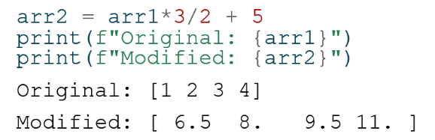
Mathematical Operations in NumPy
The multiplication we saw earlier was performed element-wise
That is, each element was updated according to the same rule.
We can apply plenty of element-wise operations to NumPy arrays.
Many of these are available as NumPy functions directly accessed from the np. module
Slide 11/19

Slide 148
Mathematical Operations in NumPy
The multiplication we saw earlier was performed element-wise
That is, each element was updated according to the same rule.
We can apply plenty of element-wise operations to NumPy arrays.
Many of these are available as NumPy functions directly accessed from the np. module
Slide 11/19

Slide 149
Mathematical Operations in NumPy
The multiplication we saw earlier was performed element-wise
That is, each element was updated according to the same rule.
We can apply plenty of element-wise operations to NumPy arrays.
Many of these are available as NumPy functions directly accessed from the np. module
Slide 11/19

Slide 150
Mathematical Operations in NumPy
The multiplication we saw earlier was performed element-wise
That is, each element was updated according to the same rule.
We can apply plenty of element-wise operations to NumPy arrays.
Many of these are available as NumPy functions directly accessed from the np. module
Slide 11/19

Slide 151
Mathematical Operations in NumPy
The multiplication we saw earlier was performed element-wise
That is, each element was updated according to the same rule.
We can apply plenty of element-wise operations to NumPy arrays.
Many of these are available as NumPy functions directly accessed from the np. module
Slide 11/19

Slide 152
Mathematical Operations in NumPy
The multiplication we saw earlier was performed element-wise
That is, each element was updated according to the same rule.
We can apply plenty of element-wise operations to NumPy arrays.
Many of these are available as NumPy functions directly accessed from the np. module
Slide 11/19

Slide 153
Mathematical Operations in NumPy
The multiplication we saw earlier was performed element-wise
That is, each element was updated according to the same rule.
We can apply plenty of element-wise operations to NumPy arrays.
Many of these are available as NumPy functions directly accessed from the np. module
These operations do not modify the original array, but produce new copies
Slide 11/19

Slide 154
Sums
Slide 12/19

Slide 155
Sums
There are also many convenient NumPy functions allow you to accumulate values without loops.
Slide 12/19

Slide 156
Sums
There are also many convenient NumPy functions allow you to accumulate values without loops.
For instance, we can compute the sum of all elements in an array using np.sum
Slide 12/19

Slide 157
Sums
There are also many convenient NumPy functions allow you to accumulate values without loops.
For instance, we can compute the sum of all elements in an array using np.sum
Assume we have an array 𝑥 and we wish to the sum of its elements
Slide 12/19

Slide 158
Sums
There are also many convenient NumPy functions allow you to accumulate values without loops.
For instance, we can compute the sum of all elements in an array using np.sum
Assume we have an array 𝑥 and we wish to the sum of its elements
Slide 12/19

Slide 159
Sums
There are also many convenient NumPy functions allow you to accumulate values without loops.
For instance, we can compute the sum of all elements in an array using np.sum
Assume we have an array 𝑥 and we wish to the sum of its elements
Slide 12/19

Slide 160
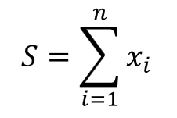
Sums
There are also many convenient NumPy functions allow you to accumulate values without loops.
For instance, we can compute the sum of all elements in an array using np.sum
Assume we have an array 𝑥 and we wish to the sum of its elements
Slide 12/19

Slide 161
Sums
There are also many convenient NumPy functions allow you to accumulate values without loops.
For instance, we can compute the sum of all elements in an array using np.sum
Assume we have an array 𝑥 and we wish to the sum of its elements
Slide 12/19

Slide 162
Sums
There are also many convenient NumPy functions allow you to accumulate values without loops.
For instance, we can compute the sum of all elements in an array using np.sum
Assume we have an array 𝑥 and we wish to the sum of its elements
We can do this with the below code:
Slide 12/19

Slide 163
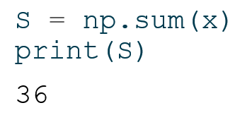
Sums
There are also many convenient NumPy functions allow you to accumulate values without loops.
For instance, we can compute the sum of all elements in an array using np.sum
Assume we have an array 𝑥 and we wish to the sum of its elements
We can do this with the below code:
Slide 12/19

Slide 164
Sums
There are also many convenient NumPy functions allow you to accumulate values without loops.
For instance, we can compute the sum of all elements in an array using np.sum
Assume we have an array 𝑥 and we wish to the sum of its elements
We can do this with the below code:
Slide 12/19

Slide 165

Sums
There are also many convenient NumPy functions allow you to accumulate values without loops.
For instance, we can compute the sum of all elements in an array using np.sum
Assume we have an array 𝑥 and we wish to the sum of its elements
We can do this with the below code:
Slide 12/19

Slide 166
Sums
There are also many convenient NumPy functions allow you to accumulate values without loops.
For instance, we can compute the sum of all elements in an array using np.sum
Assume we have an array 𝑥 and we wish to the sum of its elements
We can do this with the below code:
Slide 12/19

Slide 167
Cumulative Sums
Slide 13/19

Slide 168
Cumulative Sums
We can also perform cumulative sums using np.cumsum
Slide 13/19

Slide 169
Cumulative Sums
We can also perform cumulative sums using np.cumsum
A cumulative sum is a sequence where each element is the sum of all previous elements up to that position.
Slide 13/19

Slide 170
Cumulative Sums
We can also perform cumulative sums using np.cumsum
A cumulative sum is a sequence where each element is the sum of all previous elements up to that position.
For instance, if we take the array 𝑥 from the previous slide
Slide 13/19

Slide 171
Cumulative Sums
We can also perform cumulative sums using np.cumsum
A cumulative sum is a sequence where each element is the sum of all previous elements up to that position.
For instance, if we take the array 𝑥 from the previous slide
Slide 13/19

Slide 172
Cumulative Sums
We can also perform cumulative sums using np.cumsum
A cumulative sum is a sequence where each element is the sum of all previous elements up to that position.
For instance, if we take the array 𝑥 from the previous slide
Slide 13/19

Slide 173
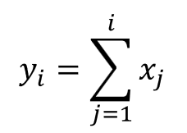
Cumulative Sums
We can also perform cumulative sums using np.cumsum
A cumulative sum is a sequence where each element is the sum of all previous elements up to that position.
For instance, if we take the array 𝑥 from the previous slide
Slide 13/19

Slide 174
Cumulative Sums
We can also perform cumulative sums using np.cumsum
A cumulative sum is a sequence where each element is the sum of all previous elements up to that position.
For instance, if we take the array 𝑥 from the previous slide
Slide 13/19

Slide 175
Cumulative Sums
We can also perform cumulative sums using np.cumsum
A cumulative sum is a sequence where each element is the sum of all previous elements up to that position.
For instance, if we take the array 𝑥 from the previous slide
We can compute the cumulative sums of 𝑥 as follows:
Slide 13/19

Slide 176
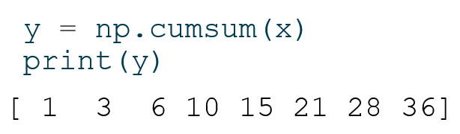
Cumulative Sums
We can also perform cumulative sums using np.cumsum
A cumulative sum is a sequence where each element is the sum of all previous elements up to that position.
For instance, if we take the array 𝑥 from the previous slide
We can compute the cumulative sums of 𝑥 as follows:
Slide 13/19

Slide 177
Cumulative Sums
We can also perform cumulative sums using np.cumsum
A cumulative sum is a sequence where each element is the sum of all previous elements up to that position.
For instance, if we take the array 𝑥 from the previous slide
We can compute the cumulative sums of 𝑥 as follows:
Slide 13/19

Slide 178
Cumulative Sums
We can also perform cumulative sums using np.cumsum
A cumulative sum is a sequence where each element is the sum of all previous elements up to that position.
For instance, if we take the array 𝑥 from the previous slide
We can compute the cumulative sums of 𝑥 as follows:
Slide 13/19

Slide 179
Cumulative Sums
We can also perform cumulative sums using np.cumsum
A cumulative sum is a sequence where each element is the sum of all previous elements up to that position.
For instance, if we take the array 𝑥 from the previous slide
We can compute the cumulative sums of 𝑥 as follows:
Slide 13/19

Slide 180
Example: Molecular Masses
Slide 14/19

Slide 181
Example: Molecular Masses
Consider the formula for the molecular mass of a compound:
Slide 14/19

Slide 182
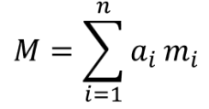
Example: Molecular Masses
Consider the formula for the molecular mass of a compound:
Slide 14/19

Slide 183
Example: Molecular Masses
Consider the formula for the molecular mass of a compound:
Slide 14/19

Slide 184
Example: Molecular Masses
Consider the formula for the molecular mass of a compound: where
Slide 14/19

Slide 185

Example: Molecular Masses
Consider the formula for the molecular mass of a compound: where
$a_{i}$ is the number of atoms of element $i$
Slide 14/19

Slide 186

Example: Molecular Masses
Consider the formula for the molecular mass of a compound: where
$a_{i}$ is the number of atoms of element $i$
$m_{i}$ is the atomic mass of element $i$
Slide 14/19

Slide 187
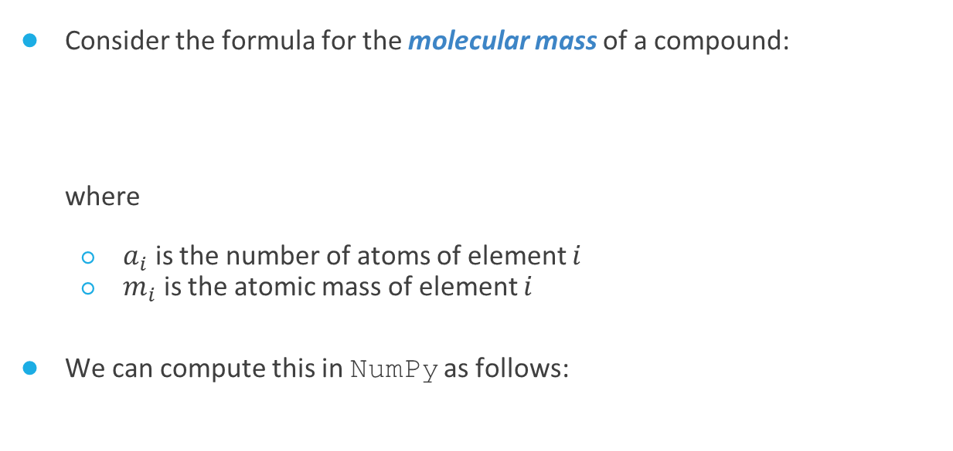
Example: Molecular Masses
Consider the formula for the molecular mass of a compound: where
$a_{i}$ is the number of atoms of element $i$
$m_{i}$ is the atomic mass of element $i$
We can compute this in NumPy as follows:
Slide 14/19

Slide 188
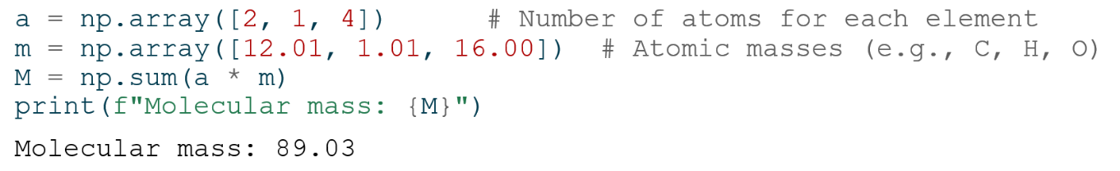
Example: Molecular Masses
Consider the formula for the molecular mass of a compound: where
$a_{i}$ is the number of atoms of element $i$
$m_{i}$ is the atomic mass of element $i$
We can compute this in NumPy as follows:
Slide 14/19

Slide 189
Example: Molecular Masses
Consider the formula for the molecular mass of a compound: where
$a_{i}$ is the number of atoms of element $i$
$m_{i}$ is the atomic mass of element $i$
We can compute this in NumPy as follows:
Slide 14/19

Slide 190
Example: Molecular Masses
Consider the formula for the molecular mass of a compound: where
$a_{i}$ is the number of atoms of element $i$
$m_{i}$ is the atomic mass of element $i$
We can compute this in NumPy as follows:
Slide 14/19

Slide 191
Example: Molecular Masses
Consider the formula for the molecular mass of a compound: where
$a_{i}$ is the number of atoms of element $i$
$m_{i}$ is the atomic mass of element $i$
We can compute this in NumPy as follows:
Slide 14/19

Slide 192
Example: Molecular Masses
Consider the formula for the molecular mass of a compound: where
$a_{i}$ is the number of atoms of element $i$
$m_{i}$ is the atomic mass of element $i$
We can compute this in NumPy as follows:
Slide 14/19

Slide 193
Example: Molecular Masses
Consider the formula for the molecular mass of a compound: where
$a_{i}$ is the number of atoms of element $i$
$m_{i}$ is the atomic mass of element $i$
We can compute this in NumPy as follows:
Slide 14/19

Slide 194
Working with Multiple Arrays
Slide 15/19

Slide 195
Working with Multiple Arrays
You can perform arithmetic operations directly between arrays of the same shape.
Slide 15/19

Slide 196
Working with Multiple Arrays
You can perform arithmetic operations directly between arrays of the same shape.
Operations like addition, subtraction, multiplication, and division are applied element-wise.
Slide 15/19

Slide 197
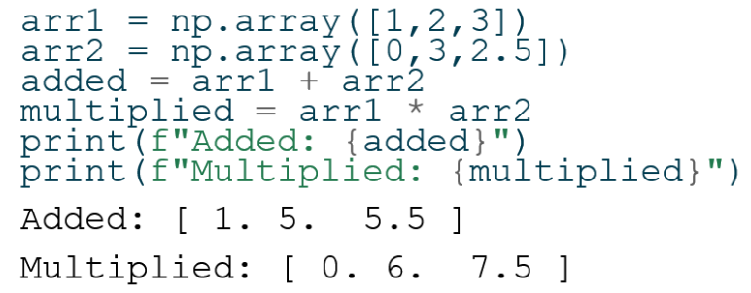
Working with Multiple Arrays
You can perform arithmetic operations directly between arrays of the same shape.
Operations like addition, subtraction, multiplication, and division are applied element-wise.
Slide 15/19

Slide 198
Working with Multiple Arrays
You can perform arithmetic operations directly between arrays of the same shape.
Operations like addition, subtraction, multiplication, and division are applied element-wise.
Slide 15/19

Slide 199
Working with Multiple Arrays
You can perform arithmetic operations directly between arrays of the same shape.
Operations like addition, subtraction, multiplication, and division are applied element-wise.
Slide 15/19

Slide 200
Working with Multiple Arrays
You can perform arithmetic operations directly between arrays of the same shape.
Operations like addition, subtraction, multiplication, and division are applied element-wise.
Slide 15/19

Slide 201
Working with Multiple Arrays
You can perform arithmetic operations directly between arrays of the same shape.
Operations like addition, subtraction, multiplication, and division are applied element-wise.
Slide 15/19

Slide 202
Working with Multiple Arrays
You can perform arithmetic operations directly between arrays of the same shape.
Operations like addition, subtraction, multiplication, and division are applied element-wise.
Slide 15/19

Slide 203
Working with Multiple Arrays
You can perform arithmetic operations directly between arrays of the same shape.
Operations like addition, subtraction, multiplication, and division are applied element-wise.
Slide 15/19

Slide 204
Working with Multiple Arrays
You can perform arithmetic operations directly between arrays of the same shape.
Operations like addition, subtraction, multiplication, and division are applied element-wise.
Slide 15/19

Slide 205
Working with Multiple Arrays
You can perform arithmetic operations directly between arrays of the same shape.
Operations like addition, subtraction, multiplication, and division are applied element-wise.
Slide 15/19

Slide 206
Working with Multiple Arrays
You can perform arithmetic operations directly between arrays of the same shape.
Operations like addition, subtraction, multiplication, and division are applied element-wise.
Slide 15/19

Slide 207
Working with Multiple Arrays
You can perform arithmetic operations directly between arrays of the same shape.
Operations like addition, subtraction, multiplication, and division are applied element-wise.
Slide 15/19

Slide 208
Working with Multiple Arrays
You can perform arithmetic operations directly between arrays of the same shape.
Operations like addition, subtraction, multiplication, and division are applied element-wise.
Slide 15/19

Slide 209
Working with Multiple Arrays
You can perform arithmetic operations directly between arrays of the same shape.
Operations like addition, subtraction, multiplication, and division are applied element-wise.
Slide 15/19

Slide 210
Working with Multiple Arrays
You can perform arithmetic operations directly between arrays of the same shape.
Operations like addition, subtraction, multiplication, and division are applied element-wise.
Note: Arrays must have compatible shapes!
Slide 15/19

Slide 211
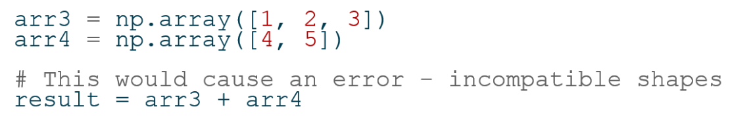
Working with Multiple Arrays
You can perform arithmetic operations directly between arrays of the same shape.
Operations like addition, subtraction, multiplication, and division are applied element-wise.
Note: Arrays must have compatible shapes!
Slide 15/19

Slide 212
Working with Multiple Arrays
You can perform arithmetic operations directly between arrays of the same shape.
Operations like addition, subtraction, multiplication, and division are applied element-wise.
Note: Arrays must have compatible shapes!
Slide 15/19

Slide 213
Working with Multiple Arrays
You can perform arithmetic operations directly between arrays of the same shape.
Operations like addition, subtraction, multiplication, and division are applied element-wise.
Note: Arrays must have compatible shapes!
Slide 15/19

Slide 214
Working with Multiple Arrays
You can perform arithmetic operations directly between arrays of the same shape.
Operations like addition, subtraction, multiplication, and division are applied element-wise.
Note: Arrays must have compatible shapes!
Slide 15/19

Slide 215
Working with Multiple Arrays
You can perform arithmetic operations directly between arrays of the same shape.
Operations like addition, subtraction, multiplication, and division are applied element-wise.
Note: Arrays must have compatible shapes!
Slide 15/19

Slide 216
Concatenation
For lists, the + operator performs list concatenation!
Slide 16/19

Slide 217
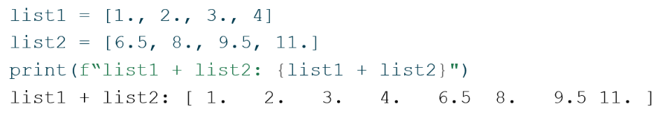
Concatenation
For lists, the + operator performs list concatenation!
Slide 16/19

Slide 218
Concatenation
For lists, the + operator performs list concatenation!
Slide 16/19

Slide 219
Concatenation
For lists, the + operator performs list concatenation!
Slide 16/19

Slide 220
Concatenation
For lists, the + operator performs list concatenation!
Slide 16/19

Slide 221
Concatenation
For lists, the + operator performs list concatenation!
Slide 16/19

Slide 222
Concatenation
For lists, the + operator performs list concatenation!
But for arrays, it performs elementwise addition!
Slide 16/19

Slide 223
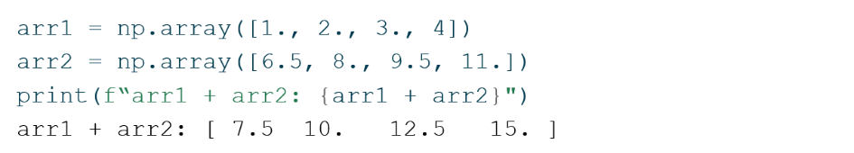
Concatenation
For lists, the + operator performs list concatenation!
But for arrays, it performs elementwise addition!
Slide 16/19

Slide 224
Concatenation
For lists, the + operator performs list concatenation!
But for arrays, it performs elementwise addition!
Slide 16/19

Slide 225
Concatenation
For lists, the + operator performs list concatenation!
But for arrays, it performs elementwise addition!
Slide 16/19

Slide 226
Concatenation
For lists, the + operator performs list concatenation!
But for arrays, it performs elementwise addition!
Slide 16/19

Slide 227
Concatenation
For lists, the + operator performs list concatenation!
But for arrays, it performs elementwise addition!
Slide 16/19

Slide 228
Concatenation
For lists, the + operator performs list concatenation!
But for arrays, it performs elementwise addition!
If you want to concatenate arrays, you can use np.concatenate
Slide 16/19

Slide 229
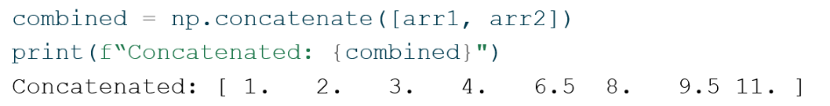
Concatenation
For lists, the + operator performs list concatenation!
But for arrays, it performs elementwise addition!
If you want to concatenate arrays, you can use np.concatenate
Slide 16/19

Slide 230
Concatenation
For lists, the + operator performs list concatenation!
But for arrays, it performs elementwise addition!
If you want to concatenate arrays, you can use np.concatenate
Slide 16/19

Slide 231
Concatenation
For lists, the + operator performs list concatenation!
But for arrays, it performs elementwise addition!
If you want to concatenate arrays, you can use np.concatenate
Slide 16/19

Slide 232
Concatenation
For lists, the + operator performs list concatenation!
But for arrays, it performs elementwise addition!
If you want to concatenate arrays, you can use np.concatenate
Slide 16/19

Slide 233
Key Takeaways
Slide 17/19

Slide 234
Key Takeaways
Slide 17/19

Slide 235
Key Takeaways
NumPy arrays are optimized for numerical operations
Slide 17/19

Slide 236
Key Takeaways
NumPy arrays are optimized for numerical operations
Element-wise operations in NumPy work implicitly
Slide 17/19

Slide 237
Key Takeaways
NumPy arrays are optimized for numerical operations
Element-wise operations in NumPy work implicitly
NumPy provides performance benefits for large datasets
Slide 17/19

Slide 238
Key Takeaways
NumPy arrays are optimized for numerical operations
Element-wise operations in NumPy work implicitly
NumPy provides performance benefits for large datasets
Mathematical functions can be applied to entire arrays
Slide 17/19

Slide 239
Key Takeaways
NumPy arrays are optimized for numerical operations
Element-wise operations in NumPy work implicitly
NumPy provides performance benefits for large datasets
Mathematical functions can be applied to entire arrays
Array shapes must be compatible for many operations
Slide 17/19

Slide 240
Key Takeaways
NumPy arrays are optimized for numerical operations
Element-wise operations in NumPy work implicitly
NumPy provides performance benefits for large datasets
Mathematical functions can be applied to entire arrays
Array shapes must be compatible for many operations
Always choose the right tool for your task
Slide 17/19

Slide 241
Practical
Slide 18/19

Slide 242
Practical
We now move over to Python
Slide 18/19

Slide 243
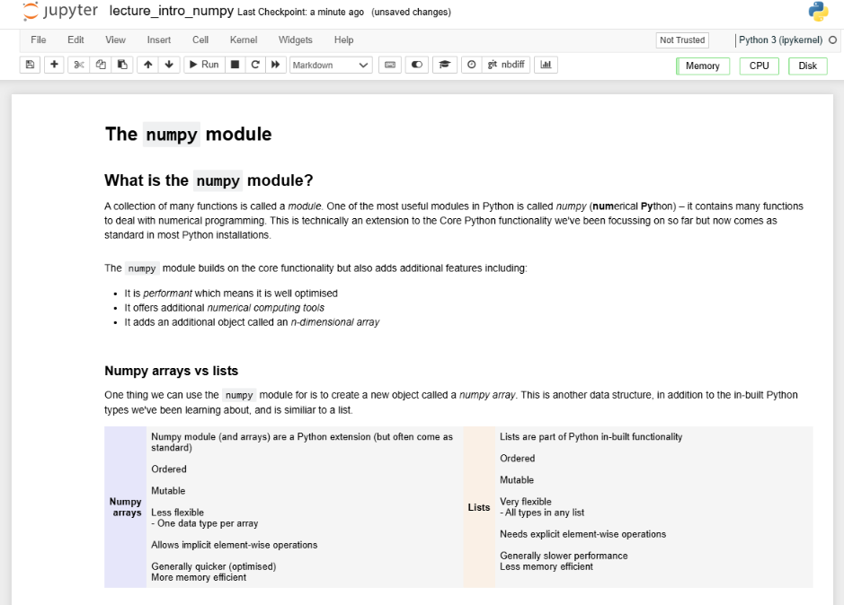
Practical
We now move over to Python
Slide 18/19

Slide 244
Practical
We now move over to Python
For the rest of today, you must do the following:
Slide 18/19

Slide 245
Practical
We now move over to Python
For the rest of today, you must do the following:
First, read through:
Slide 18/19

Slide 246
Practical
We now move over to Python
For the rest of today, you must do the following:
First, read through: lecture_intro_numpy.ipynb
Slide 18/19

Slide 247
Practical
We now move over to Python
For the rest of today, you must do the following:
First, read through: lecture_intro_numpy.ipynb
Then, work through the exercises in:
Slide 18/19

Slide 248
Practical
We now move over to Python
For the rest of today, you must do the following:
First, read through: lecture_intro_numpy.ipynb
Then, work through the exercises in: exercises_numpy.ipynb
Slide 18/19

Slide 249
Practical
We now move over to Python
For the rest of today, you must do the following:
First, read through: lecture_intro_numpy.ipynb
Then, work through the exercises in: exercises_numpy.ipynb
If you finish early, work through intermediate or advanced notebooks from weeks 1-5 that you haven’t yet tried!
Slide 18/19

Slide 250
Practical
We now move over to Python
For the rest of today, you must do the following:
First, read through: lecture_intro_numpy.ipynb
Then, work through the exercises in: exercises_numpy.ipynb
Slide 18/19

Slide 251
Next Time
Lecture 6: The NumPy Module
What is NumPy?
Arrays vs Lists
Operations on Arrays
Practical
Lecture 7: Working with NumPy Arrays
Array Indexing and Slicing
Boolean Indexing
Array Generating Functions
Random Data Generation
Practical
Slide 19/19

