Slide 1
Lecture 15:
Advanced Plotting
SCIF10002 – Introduction to Coding and Data Analysis for Scientists
Tom Maullin-Sapey
19th February 2026
Slide 0/8

Slide 2
Todays Lecture
Lecture 15: Advanced Plotting
3D Plotting
Seaborn
Plotly
Practical
Nextup: Consolidation Week –
No Lecture
Lecture 16: Curve Fitting
Slide 1/8

Slide 3
Overview
Slide 2/8

Slide 4
Overview
In Lecture 8, we met matplotlib which can be used for making figures in Python
Slide 2/8

Slide 5

Overview
In Lecture 8, we met matplotlib which can be used for making figures in Python
Slide 2/8

Slide 6
Overview
In Lecture 8, we met matplotlib which can be used for making figures in Python
Slide 2/8

Slide 7
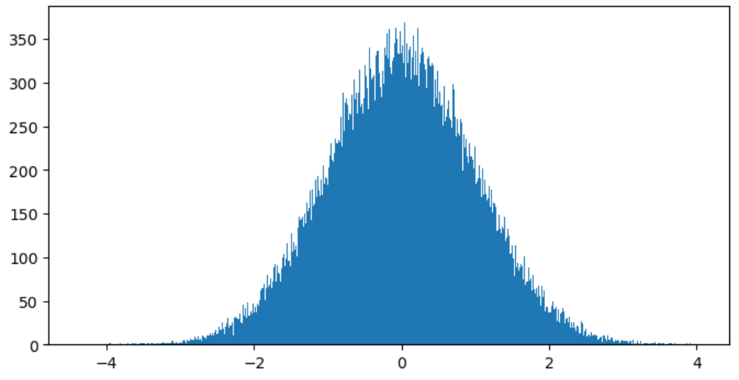
Overview
In Lecture 8, we met matplotlib which can be used for making figures in Python
Slide 2/8

Slide 8
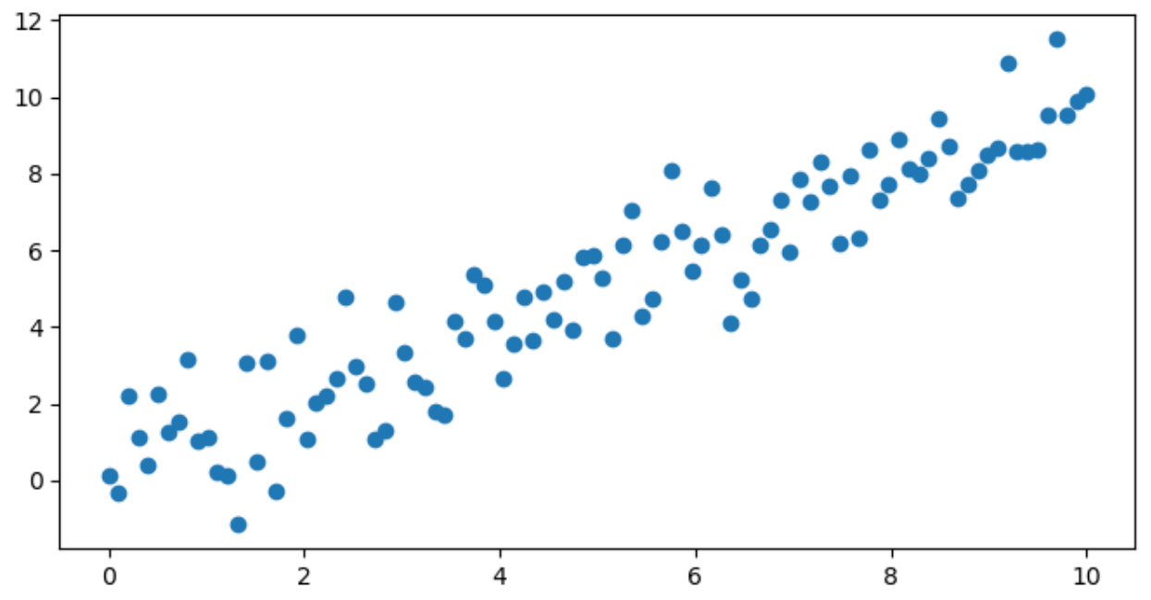
Overview
In Lecture 8, we met matplotlib which can be used for making figures in Python
Slide 2/8

Slide 9
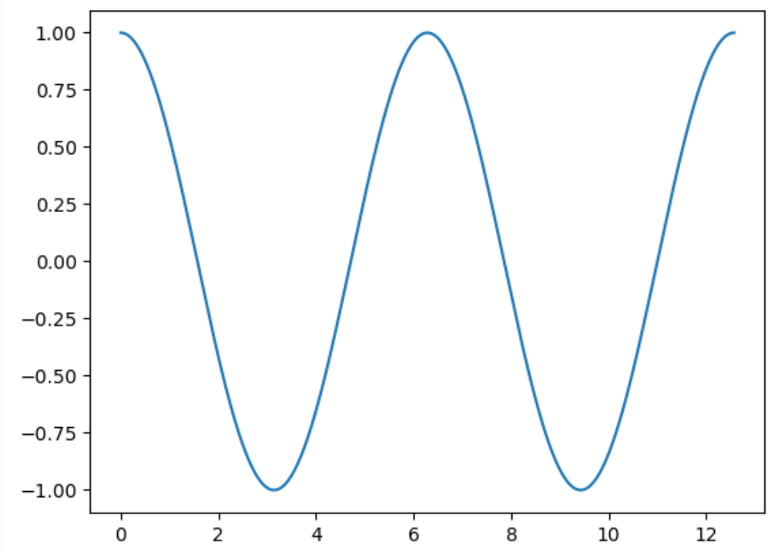
Overview
In Lecture 8, we met matplotlib which can be used for making figures in Python
Slide 2/8

Slide 10
Overview
In Lecture 8, we met matplotlib which can be used for making figures in Python
Today, we’re going to look at some more advanced plotting tools!
Slide 2/8

Slide 11
Overview
In Lecture 8, we met matplotlib which can be used for making figures in Python
Today, we’re going to look at some more advanced plotting tools!
Both in matplotlib and other packages.
Slide 2/8

Slide 12
3D Plotting
Slide 3/8

Slide 13
3D Plotting
So far, we have used matplotlib to make 2D graphs.
Slide 3/8

Slide 14
3D Plotting
So far, we have used matplotlib to make 2D graphs.
However, everything we learnt generalises to 3D too!
Slide 3/8

Slide 15
3D Plotting
So far, we have used matplotlib to make 2D graphs.
However, everything we learnt generalises to 3D too!
The syntax remains largely unchanged!
Slide 3/8

Slide 16
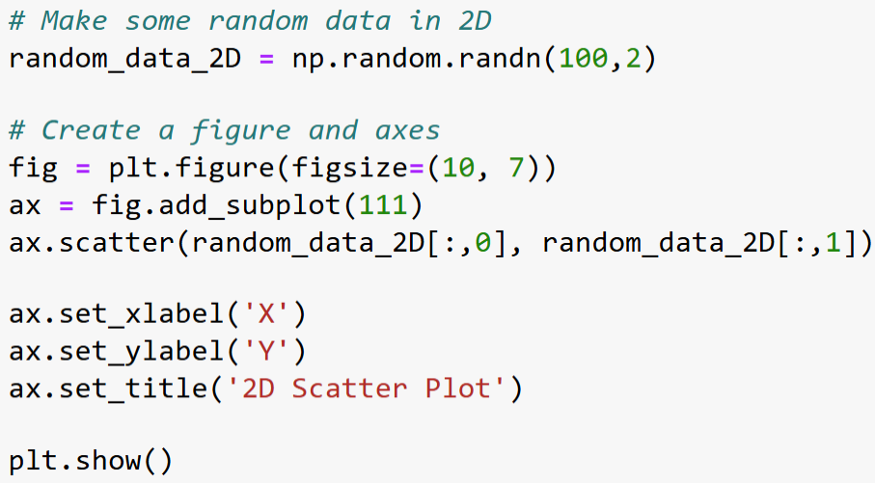
3D Plotting
So far, we have used matplotlib to make 2D graphs.
However, everything we learnt generalises to 3D too!
The syntax remains largely unchanged!
Slide 3/8

Slide 17
3D Plotting
So far, we have used matplotlib to make 2D graphs.
However, everything we learnt generalises to 3D too!
The syntax remains largely unchanged!
Slide 3/8

Slide 18
3D Plotting
So far, we have used matplotlib to make 2D graphs.
However, everything we learnt generalises to 3D too!
The syntax remains largely unchanged!
Slide 3/8

Slide 19
3D Plotting
So far, we have used matplotlib to make 2D graphs.
However, everything we learnt generalises to 3D too!
The syntax remains largely unchanged!
Slide 3/8

Slide 20
3D Plotting
So far, we have used matplotlib to make 2D graphs.
However, everything we learnt generalises to 3D too!
The syntax remains largely unchanged!
Slide 3/8

Slide 21
3D Plotting
So far, we have used matplotlib to make 2D graphs.
However, everything we learnt generalises to 3D too!
The syntax remains largely unchanged!
Slide 3/8

Slide 22
3D Plotting
So far, we have used matplotlib to make 2D graphs.
However, everything we learnt generalises to 3D too!
The syntax remains largely unchanged!
Slide 3/8

Slide 23
3D Plotting
So far, we have used matplotlib to make 2D graphs.
However, everything we learnt generalises to 3D too!
The syntax remains largely unchanged!
Slide 3/8

Slide 24
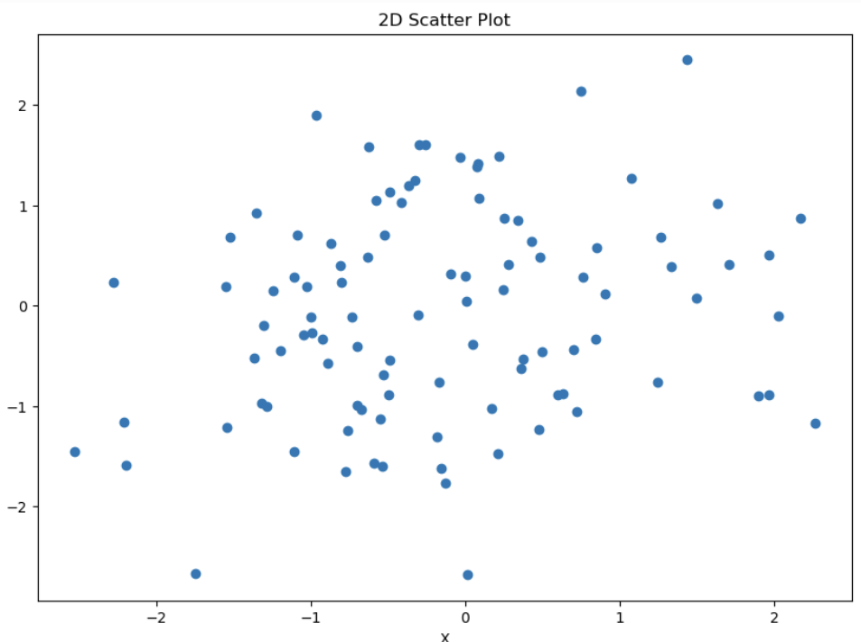
3D Plotting
So far, we have used matplotlib to make 2D graphs.
However, everything we learnt generalises to 3D too!
The syntax remains largely unchanged!
Slide 3/8

Slide 25
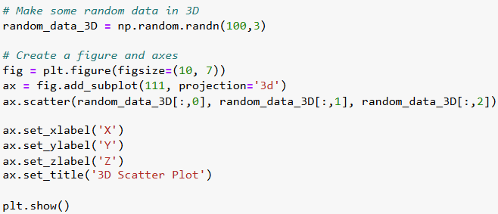
3D Plotting
So far, we have used matplotlib to make 2D graphs.
However, everything we learnt generalises to 3D too!
The syntax remains largely unchanged!
Slide 3/8

Slide 26
3D Plotting
So far, we have used matplotlib to make 2D graphs.
However, everything we learnt generalises to 3D too!
The syntax remains largely unchanged!
Slide 3/8

Slide 27
3D Plotting
So far, we have used matplotlib to make 2D graphs.
However, everything we learnt generalises to 3D too!
The syntax remains largely unchanged!
Slide 3/8

Slide 28
3D Plotting
So far, we have used matplotlib to make 2D graphs.
However, everything we learnt generalises to 3D too!
The syntax remains largely unchanged!
Slide 3/8

Slide 29
3D Plotting
So far, we have used matplotlib to make 2D graphs.
However, everything we learnt generalises to 3D too!
The syntax remains largely unchanged!
Slide 3/8

Slide 30
3D Plotting
So far, we have used matplotlib to make 2D graphs.
However, everything we learnt generalises to 3D too!
The syntax remains largely unchanged!
Slide 3/8

Slide 31
3D Plotting
So far, we have used matplotlib to make 2D graphs.
However, everything we learnt generalises to 3D too!
The syntax remains largely unchanged!
Slide 3/8

Slide 32
3D Plotting
So far, we have used matplotlib to make 2D graphs.
However, everything we learnt generalises to 3D too!
The syntax remains largely unchanged!
Slide 3/8

Slide 33
3D Plotting
So far, we have used matplotlib to make 2D graphs.
However, everything we learnt generalises to 3D too!
The syntax remains largely unchanged!
Slide 3/8

Slide 34
3D Plotting
So far, we have used matplotlib to make 2D graphs.
However, everything we learnt generalises to 3D too!
The syntax remains largely unchanged!
Slide 3/8

Slide 35
3D Plotting
So far, we have used matplotlib to make 2D graphs.
However, everything we learnt generalises to 3D too!
The syntax remains largely unchanged!
Slide 3/8

Slide 36
3D Plotting
So far, we have used matplotlib to make 2D graphs.
However, everything we learnt generalises to 3D too!
The syntax remains largely unchanged!
Slide 3/8

Slide 37
3D Plotting
So far, we have used matplotlib to make 2D graphs.
However, everything we learnt generalises to 3D too!
The syntax remains largely unchanged!
Slide 3/8

Slide 38
3D Plotting
So far, we have used matplotlib to make 2D graphs.
However, everything we learnt generalises to 3D too!
The syntax remains largely unchanged!
Slide 3/8

Slide 39
3D Plotting
So far, we have used matplotlib to make 2D graphs.
However, everything we learnt generalises to 3D too!
The syntax remains largely unchanged!
Slide 3/8

Slide 40
3D Plotting
So far, we have used matplotlib to make 2D graphs.
However, everything we learnt generalises to 3D too!
The syntax remains largely unchanged!
Slide 3/8

Slide 41
3D Plotting
So far, we have used matplotlib to make 2D graphs.
However, everything we learnt generalises to 3D too!
The syntax remains largely unchanged!
Slide 3/8

Slide 42
3D Plotting
So far, we have used matplotlib to make 2D graphs.
However, everything we learnt generalises to 3D too!
The syntax remains largely unchanged!
Slide 3/8

Slide 43
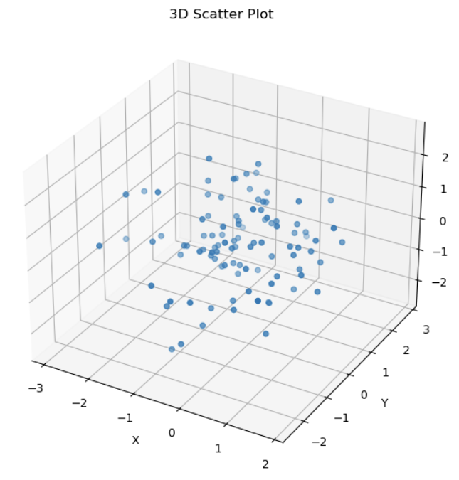
3D Plotting
So far, we have used matplotlib to make 2D graphs.
However, everything we learnt generalises to 3D too!
The syntax remains largely unchanged!
Slide 3/8

Slide 44
Seaborn
Slide 4/8

Slide 45
Seaborn
matplotlib is good for quick, easy plotting…
Slide 4/8

Slide 46

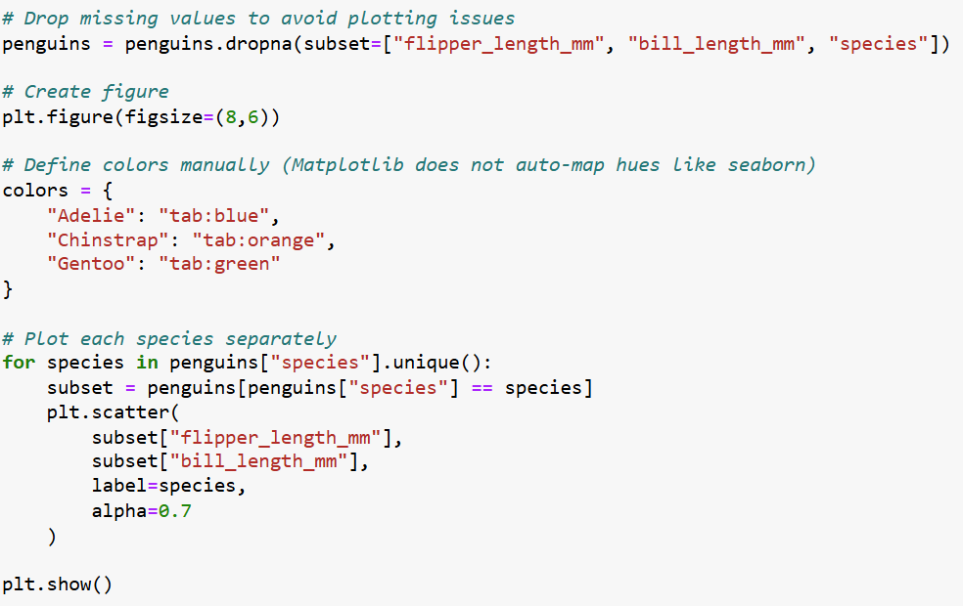
Seaborn
matplotlib is good for quick, easy plotting…
Slide 4/8

Slide 47
Seaborn
matplotlib is good for quick, easy plotting…
Slide 4/8

Slide 48
Seaborn
matplotlib is good for quick, easy plotting…
Slide 4/8

Slide 49

Seaborn
matplotlib is good for quick, easy plotting…
Slide 4/8

Slide 50
Seaborn
matplotlib is good for quick, easy plotting…
Slide 4/8

Slide 51
Seaborn
matplotlib is good for quick, easy plotting…
Slide 4/8

Slide 52
Seaborn
matplotlib is good for quick, easy plotting…
Slide 4/8

Slide 53
Seaborn
matplotlib is good for quick, easy plotting…
Slide 4/8

Slide 54
Seaborn
matplotlib is good for quick, easy plotting…
Slide 4/8

Slide 55
Seaborn
matplotlib is good for quick, easy plotting…
Slide 4/8

Slide 56
Seaborn
matplotlib is good for quick, easy plotting…
Slide 4/8

Slide 57
Seaborn
matplotlib is good for quick, easy plotting…
Slide 4/8

Slide 58
Seaborn
matplotlib is good for quick, easy plotting…
Slide 4/8

Slide 59
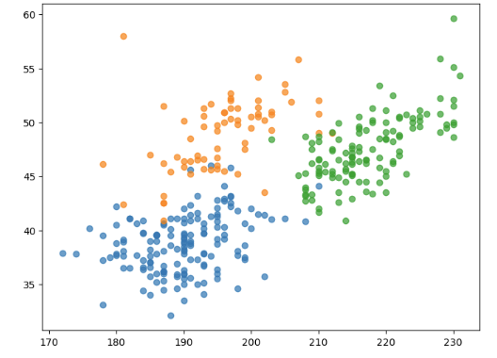
Seaborn
matplotlib is good for quick, easy plotting…
Slide 4/8

Slide 60
Seaborn
matplotlib is good for quick, easy plotting…
Slide 4/8

Slide 61
Seaborn
matplotlib is good for quick, easy plotting…
… but what if you want something more informative and publication ready?
Slide 4/8

Slide 62
Seaborn
matplotlib is good for quick, easy plotting…
… but what if you want something more informative and publication ready?
seaborn!
Slide 4/8

Slide 63
Seaborn
matplotlib is good for quick, easy plotting…
… but what if you want something more informative and publication ready?
Slide 4/8

Slide 64
Seaborn
matplotlib is good for quick, easy plotting…
… but what if you want something more informative and publication ready?
seaborn can be used for
Slide 4/8

Slide 65
Seaborn
matplotlib is good for quick, easy plotting…
… but what if you want something more informative and publication ready?
seaborn can be used for
Exploratory statistical visualisation e.g. pairs plots, simple linear fits, confidence intervals
Slide 4/8

Slide 66
Seaborn
matplotlib is good for quick, easy plotting…
… but what if you want something more informative and publication ready?
seaborn can be used for
Exploratory statistical visualisation e.g. pairs plots, simple linear fits, confidence intervals
Visualising structure in pandas dataframes
Slide 4/8

Slide 67
Seaborn
matplotlib is good for quick, easy plotting…
… but what if you want something more informative and publication ready?
seaborn can be used for
Exploratory statistical visualisation e.g. pairs plots, simple linear fits, confidence intervals
Visualising structure in pandas dataframes
Creating visually aesthetic figures using attractive default styles
Slide 4/8

Slide 68
Seaborn
matplotlib is good for quick, easy plotting…
… but what if you want something more informative and publication ready?
seaborn can be used for
Exploratory statistical visualisation e.g. pairs plots, simple linear fits, confidence intervals
Visualising structure in pandas dataframes
Creating visually aesthetic figures using attractive default styles
A bit like ggplot for Python!
Slide 4/8

Slide 69
Seaborn
matplotlib is good for quick, easy plotting…
… but what if you want something more informative and publication ready?
seaborn can be used for
Exploratory statistical visualisation e.g. pairs plots, simple linear fits, confidence intervals
Visualising structure in pandas dataframes
Creating visually aesthetic figures using attractive default styles
A bit like ggplot for Python!
Slide 4/8

Slide 70
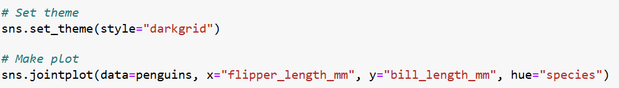
Seaborn
matplotlib is good for quick, easy plotting…
… but what if you want something more informative and publication ready?
seaborn can be used for
Exploratory statistical visualisation e.g. pairs plots, simple linear fits, confidence intervals
Visualising structure in pandas dataframes
Creating visually aesthetic figures using attractive default styles
A bit like ggplot for Python!
Slide 4/8

Slide 71
Seaborn
matplotlib is good for quick, easy plotting…
… but what if you want something more informative and publication ready?
seaborn can be used for
Exploratory statistical visualisation e.g. pairs plots, simple linear fits, confidence intervals
Visualising structure in pandas dataframes
Creating visually aesthetic figures using attractive default styles
A bit like ggplot for Python!
Slide 4/8

Slide 72
Seaborn
matplotlib is good for quick, easy plotting…
… but what if you want something more informative and publication ready?
seaborn can be used for
Exploratory statistical visualisation e.g. pairs plots, simple linear fits, confidence intervals
Visualising structure in pandas dataframes
Creating visually aesthetic figures using attractive default styles
A bit like ggplot for Python!
Slide 4/8

Slide 73
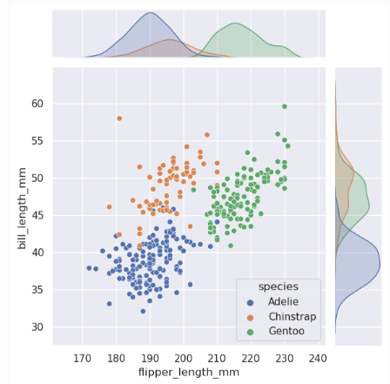
Seaborn
matplotlib is good for quick, easy plotting…
… but what if you want something more informative and publication ready?
seaborn can be used for
Exploratory statistical visualisation e.g. pairs plots, simple linear fits, confidence intervals
Visualising structure in pandas dataframes
Creating visually aesthetic figures using attractive default styles
A bit like ggplot for Python!
Slide 4/8

Slide 74
Seaborn
matplotlib is good for quick, easy plotting…
… but what if you want something more informative and publication ready?
seaborn can be used for
Exploratory statistical visualisation e.g. pairs plots, simple linear fits, confidence intervals
Visualising structure in pandas dataframes
Creating visually aesthetic figures using attractive default styles
A bit like ggplot for Python!
Slide 4/8

Slide 75
Interactive Plots
We saw earlier that matplotlib can create 3D plots…
However, these can be…
Static
Difficult to explore from different angles
Hard to extract information from due to perspective
Sometimes you might prefer a dynamic/interactive plot
For this, you can use plotly !
plotly can be used to create:
Interactive 3D visualizations
Dashboards and web apps
Presentation-ready, dynamic charts
Code can be found in:
demo_Ethereum_price.ipynb
Slide 5/8

Slide 76
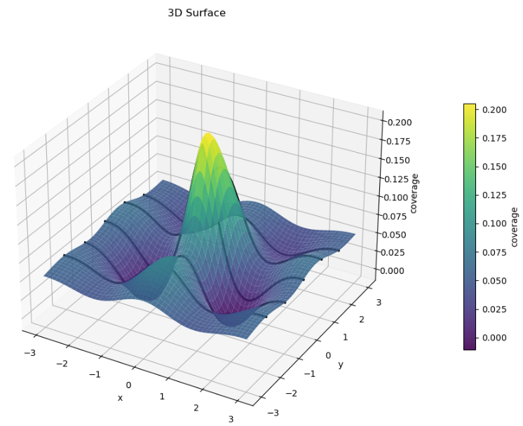
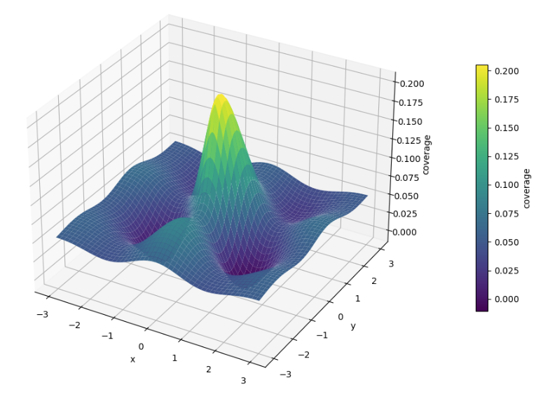
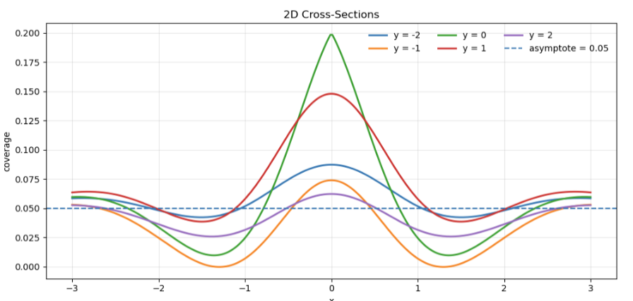
General Advice
Different tools serve different purposes
matplotlib might be preferable if you want to quickly look at the data
seaborn might be better for making figures for academic publication
plotly might be better suited for apps and interactive reports
Always make sure your plots are fit for purpose!
A 3D plot might look nice…
But can you actually read values on the plot?
(Do you need to read the values?)
Slide 6/8

Slide 77
Practical
Slide 7/8

Slide 78
Practical
For the rest of today, you must:
Slide 7/8

Slide 79
Practical
For the rest of today, you must:
Read through the material in:
Slide 7/8

Slide 80
Practical
For the rest of today, you must:
Read through the material in: lecture_advanced_plotting.ipynb
Slide 7/8

Slide 81
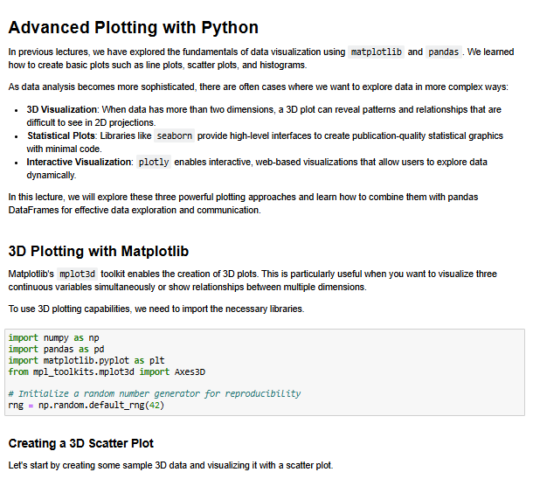
Practical
For the rest of today, you must:
Read through the material in: lecture_advanced_plotting.ipynb
Slide 7/8

Slide 82
Practical
For the rest of today, you must:
Read through the material in: lecture_advanced_plotting.ipynb
Work through the Pandas exercises in:
Slide 7/8

Slide 83
Practical
For the rest of today, you must:
Read through the material in: lecture_advanced_plotting.ipynb
Work through the plotting exercises in: exercises_advanced_plotting.ipynb
Slide 7/8

Slide 84
Next Time
Lecture 15: Advanced Plotting
3d Plotting
Seaborn
Plotly
Practical
Nextup: Consolidation Week
No lecture
Lecture 16: Curve Fitting
Slide 8/8

