Slide 1
Lecture 10:
Consolidation: Beyond the Notebook
SCIF10002 – Introduction to Coding and Data Analysis for Scientists
Tom Maullin-Sapey
3rd December 2025
Slide 0/14

Slide 2
Today’s Lecture
Slide 1/14

Slide 3
Today’s Lecture
Lecture 10: Beyond the Notebook
Slide 1/14

Slide 4
Today’s Lecture
Lecture 10: Beyond the Notebook
Jupyter Notebook vs Jupyter Lab
Slide 1/14

Slide 5
Today’s Lecture
Lecture 10: Beyond the Notebook
Jupyter Notebook vs Jupyter Lab
Using Bash from a notebook
Slide 1/14

Slide 6
Today’s Lecture
Lecture 10: Beyond the Notebook
Jupyter Notebook vs Jupyter Lab
Using Bash from a notebook
The Terminal
Slide 1/14

Slide 7
Today’s Lecture
Lecture 10: Beyond the Notebook
Jupyter Notebook vs Jupyter Lab
Using Bash from a notebook
The Terminal
Practical
Slide 1/14

Slide 8
Today’s Lecture
Lecture 10: Beyond the Notebook
Jupyter Notebook vs Jupyter Lab
Using Bash from a notebook
The Terminal
Practical
Lecture 11: Pandas Series and DataFrames
What is Pandas?
Pandas Series
Pandas DataFrames
Data Analysis in Pandas
Practical
Slide 1/14

Slide 9
Aims
Slide 2/14

Slide 10

Aims
Slide 2/14

Slide 11
Aims
Slide 2/14

Slide 12
Aims
Today we shall:
Slide 2/14

Slide 13
Aims
Today we shall:
Explore alternative ways to interact with Python code beyond Jupyter Notebooks
Slide 2/14

Slide 14
Aims
Today we shall:
Explore alternative ways to interact with Python code beyond Jupyter Notebooks
Discover some basic file management tools
Slide 2/14

Slide 15
Aims
Today we shall:
Explore alternative ways to interact with Python code beyond Jupyter Notebooks
Discover some basic file management tools
Consolidate your Python understanding with extra problems
Slide 2/14

Slide 16
Aims
Today we shall:
Explore alternative ways to interact with Python code beyond Jupyter Notebooks
Discover some basic file management tools
Consolidate your Python understanding with extra problems
Today's session will how you how to interact with the notebook using a more advanced interface.
Slide 2/14

Slide 17
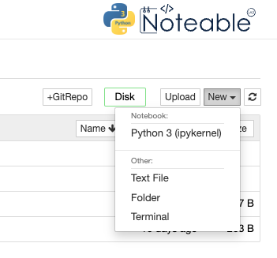
Aims
Today we shall:
Explore alternative ways to interact with Python code beyond Jupyter Notebooks
Discover some basic file management tools
Consolidate your Python understanding with extra problems
Today's session will how you how to interact with the notebook using a more advanced interface.
Slide 2/14

Slide 18
Aims
Today we shall:
Explore alternative ways to interact with Python code beyond Jupyter Notebooks
Discover some basic file management tools
Consolidate your Python understanding with extra problems
Today's session will how you how to interact with the notebook using a more advanced interface.
You will learn how to navigate directories and use python scripts to store useful code for future use.
Slide 2/14

Slide 19
Aims
Today we shall:
Explore alternative ways to interact with Python code beyond Jupyter Notebooks
Discover some basic file management tools
Consolidate your Python understanding with extra problems
Today's session will how you how to interact with the notebook using a more advanced interface.
You will learn how to navigate directories and use python scripts to store useful code for future use.
Slide 2/14

Slide 20
Jupyter Lab
Slide 3/14

Slide 21
Jupyter Lab
In previous workshops, we used the Jupyter Notebook interface
Slide 3/14

Slide 22
Jupyter Lab
In previous workshops, we used the Jupyter Notebook interface
We did this by selecting Jupyter Classic (Legacy) on Noteable
Slide 3/14

Slide 23
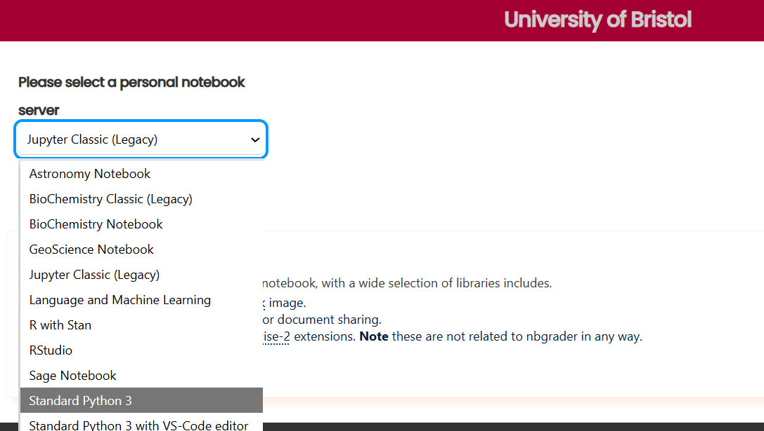
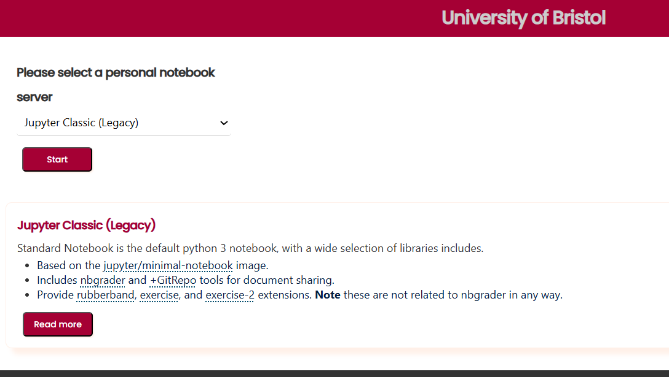
Jupyter Lab
In previous workshops, we used the Jupyter Notebook interface
We did this by selecting Jupyter Classic (Legacy) on Noteable
Slide 3/14

Slide 24
Jupyter Lab
In previous workshops, we used the Jupyter Notebook interface
We did this by selecting Jupyter Classic (Legacy) on Noteable
Slide 3/14

Slide 25
Jupyter Lab
In previous workshops, we used the Jupyter Notebook interface
We did this by selecting Jupyter Classic (Legacy) on Noteable
Slide 3/14

Slide 26
Jupyter Lab
In previous workshops, we used the Jupyter Notebook interface
We did this by selecting Jupyter Classic (Legacy) on Noteable
Today, we’ll instead using the Jupyter Lab interface
Slide 3/14

Slide 27
Jupyter Lab
In previous workshops, we used the Jupyter Notebook interface
We did this by selecting Jupyter Classic (Legacy) on Noteable
Today, we’ll instead using the Jupyter Lab interface
To do so, we must select Standard Python 3 on Noteable
Slide 3/14

Slide 28
Jupyter Lab
In previous workshops, we used the Jupyter Notebook interface
We did this by selecting Jupyter Classic (Legacy) on Noteable
Today, we’ll instead using the Jupyter Lab interface
To do so, we must select Standard Python 3 on Noteable
Slide 3/14

Slide 29
Jupyter Lab
In previous workshops, we used the Jupyter Notebook interface
We did this by selecting Jupyter Classic (Legacy) on Noteable
Today, we’ll instead using the Jupyter Lab interface
To do so, we must select Standard Python 3 on Noteable
Slide 3/14

Slide 30
Jupyter Lab
In previous workshops, we used the Jupyter Notebook interface
We did this by selecting Jupyter Classic (Legacy) on Noteable
Today, we’ll instead using the Jupyter Lab interface
To do so, we must select Standard Python 3 on Noteable
Slide 3/14

Slide 31
Jupyter Lab
In previous workshops, we used the Jupyter Notebook interface
We did this by selecting Jupyter Classic (Legacy) on Noteable
Today, we’ll instead using the Jupyter Lab interface
To do so, we must select Standard Python 3 on Noteable
Slide 3/14

Slide 32
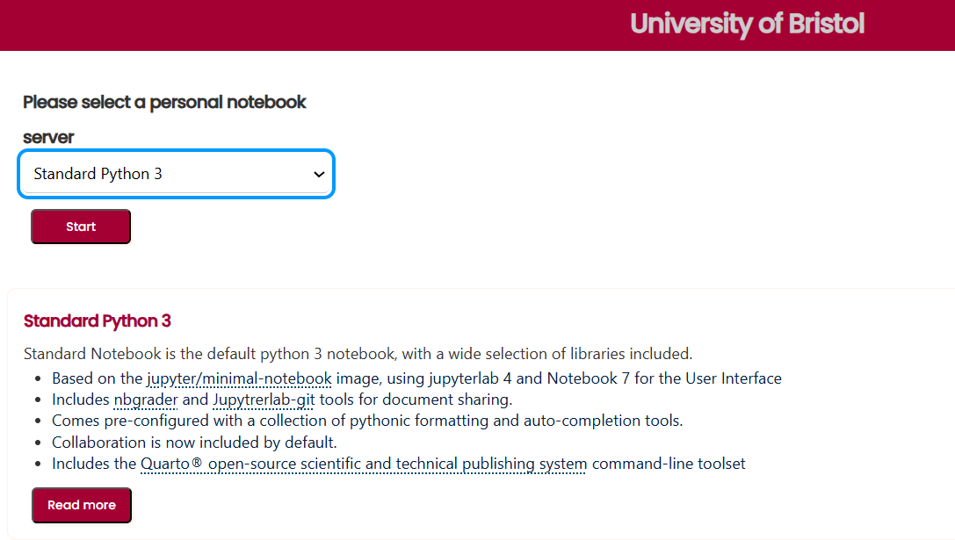
Jupyter Lab
In previous workshops, we used the Jupyter Notebook interface
We did this by selecting Jupyter Classic (Legacy) on Noteable
Today, we’ll instead using the Jupyter Lab interface
To do so, we must select Standard Python 3 on Noteable
Slide 3/14

Slide 33
Jupyter Lab
In previous workshops, we used the Jupyter Notebook interface
We did this by selecting Jupyter Classic (Legacy) on Noteable
Today, we’ll instead using the Jupyter Lab interface
To do so, we must select Standard Python 3 on Noteable
Slide 3/14

Slide 34
Jupyter Lab
In previous workshops, we used the Jupyter Notebook interface
We did this by selecting Jupyter Classic (Legacy) on Noteable
Today, we’ll instead using the Jupyter Lab interface
To do so, we must select Standard Python 3 on Noteable
Slide 3/14

Slide 35
Jupyter Lab
In previous workshops, we used the Jupyter Notebook interface
We did this by selecting Jupyter Classic (Legacy) on Noteable
Today, we’ll instead using the Jupyter Lab interface
To do so, we must select Standard Python 3 on Noteable
Slide 3/14

Slide 36
Jupyter Lab
In previous workshops, we used the Jupyter Notebook interface
We did this by selecting Jupyter Classic (Legacy) on Noteable
Today, we’ll instead using the Jupyter Lab interface
To do so, we must select Standard Python 3 on Noteable
You may have briefly used the Jupyter Lab interface if you did the week 2 intermediate match statements notebook!
Slide 3/14

Slide 37
Jupyter Lab
In previous workshops, we used the Jupyter Notebook interface
We did this by selecting Jupyter Classic (Legacy) on Noteable
Today, we’ll instead using the Jupyter Lab interface
To do so, we must select Standard Python 3 on Noteable
Slide 3/14

Slide 38
Jupyter Lab
Slide 4/14

Slide 39
Jupyter Lab
The Jupyter Lab interface is more complex, but also more powerful.
Slide 4/14

Slide 40
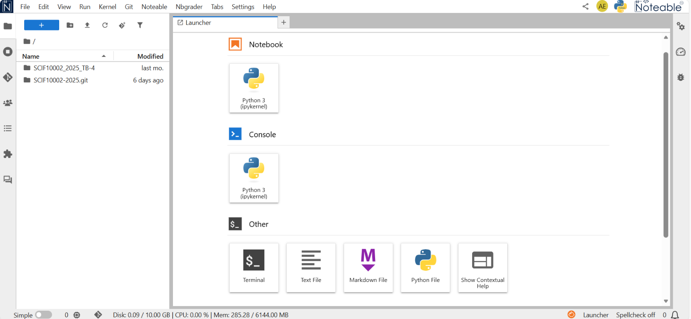
Jupyter Lab
The Jupyter Lab interface is more complex, but also more powerful.
Slide 4/14

Slide 41
Jupyter Lab
The Jupyter Lab interface is more complex, but also more powerful.
We have on the left a file browser that allows us to navigate the file system.
Slide 4/14

Slide 42
Jupyter Lab
The Jupyter Lab interface is more complex, but also more powerful.
We have on the left a file browser that allows us to navigate the file system.
Slide 4/14

Slide 43
Jupyter Lab
The Jupyter Lab interface is more complex, but also more powerful.
We have on the left a file browser that allows us to navigate the file system.
Slide 4/14

Slide 44
Jupyter Lab
The Jupyter Lab interface is more complex, but also more powerful.
We have on the left a file browser that allows us to navigate the file system.
On the right using the launcher we can create new notebooks, text files, terminals, and other useful items.
Slide 4/14

Slide 45
Jupyter Lab
The Jupyter Lab interface is more complex, but also more powerful.
We have on the left a file browser that allows us to navigate the file system.
On the right using the launcher we can create new notebooks, text files, terminals, and other useful items.
Slide 4/14

Slide 46
Jupyter Lab
The Jupyter Lab interface is more complex, but also more powerful.
We have on the left a file browser that allows us to navigate the file system.
On the right using the launcher we can create new notebooks, text files, terminals, and other useful items.
Slide 4/14

Slide 47
Jupyter Lab
The Jupyter Lab interface is more complex, but also more powerful.
We have on the left a file browser that allows us to navigate the file system.
On the right using the launcher we can create new notebooks, text files, terminals, and other useful items.
Downloading the material on Jupyter Lab is a little different… but pretty similar!
Slide 4/14

Slide 48
Jupyter Lab
The Jupyter Lab interface is more complex, but also more powerful.
We have on the left a file browser that allows us to navigate the file system.
On the right using the launcher we can create new notebooks, text files, terminals, and other useful items.
Downloading the material on Jupyter Lab is a little different… but pretty similar!
Slide 4/14

Slide 49
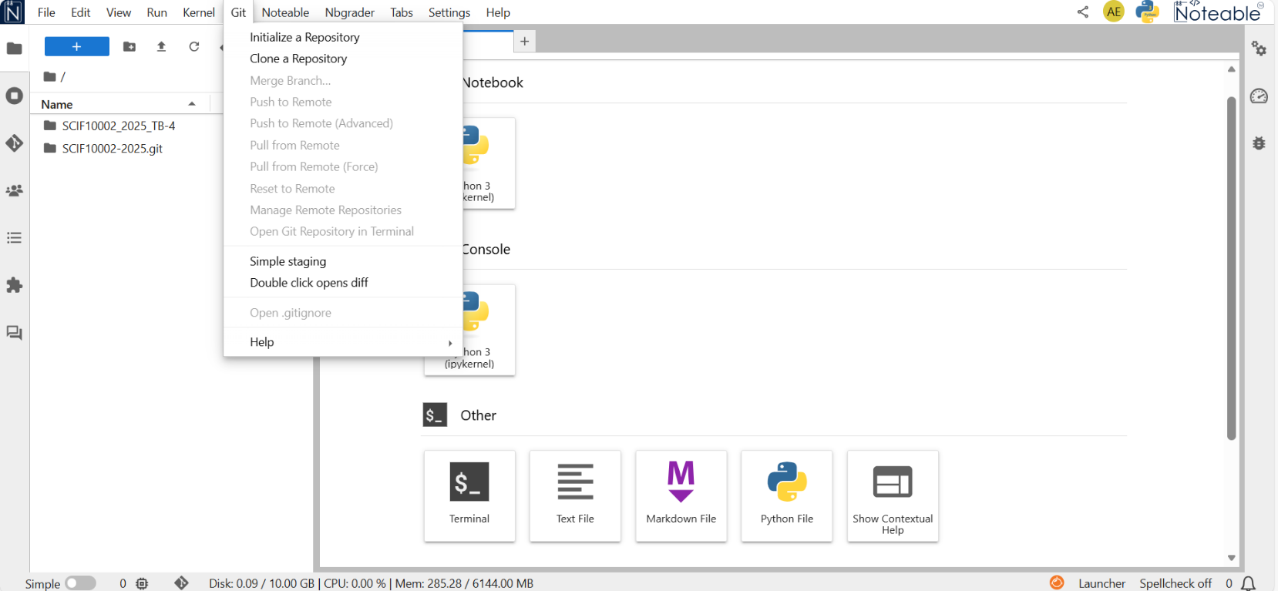
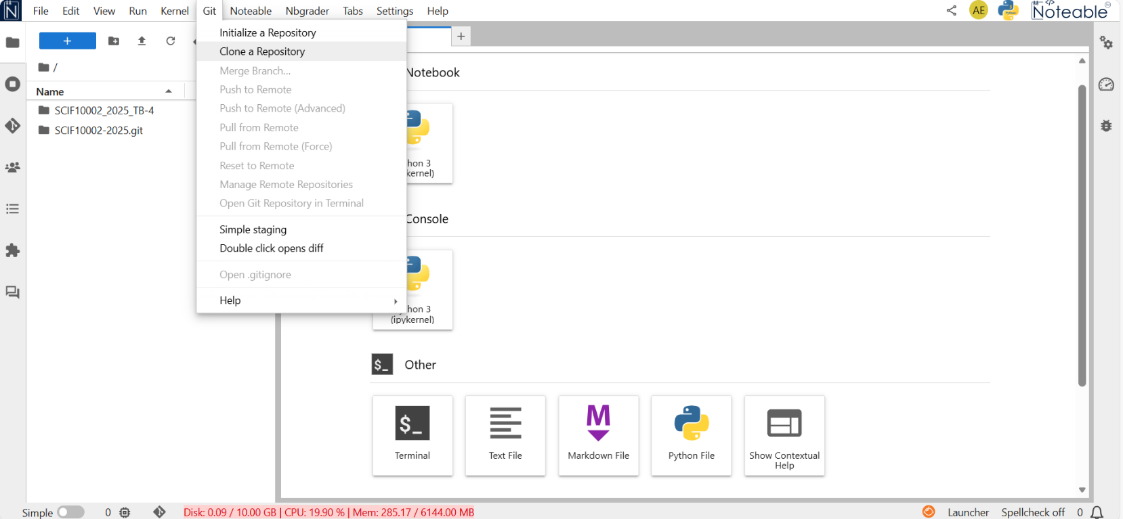
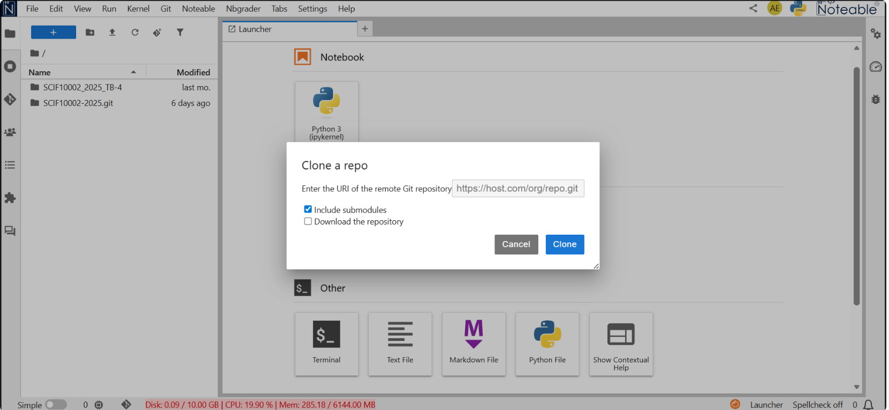
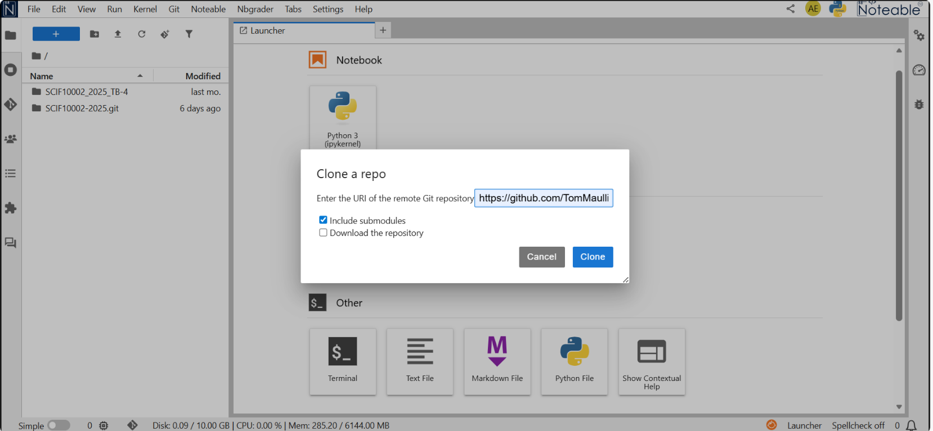
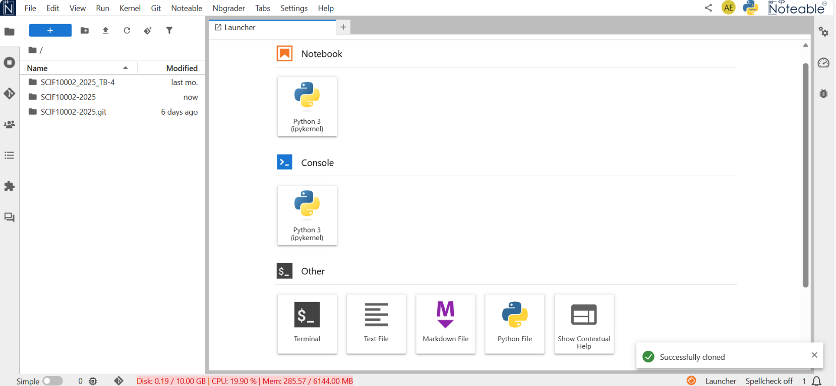
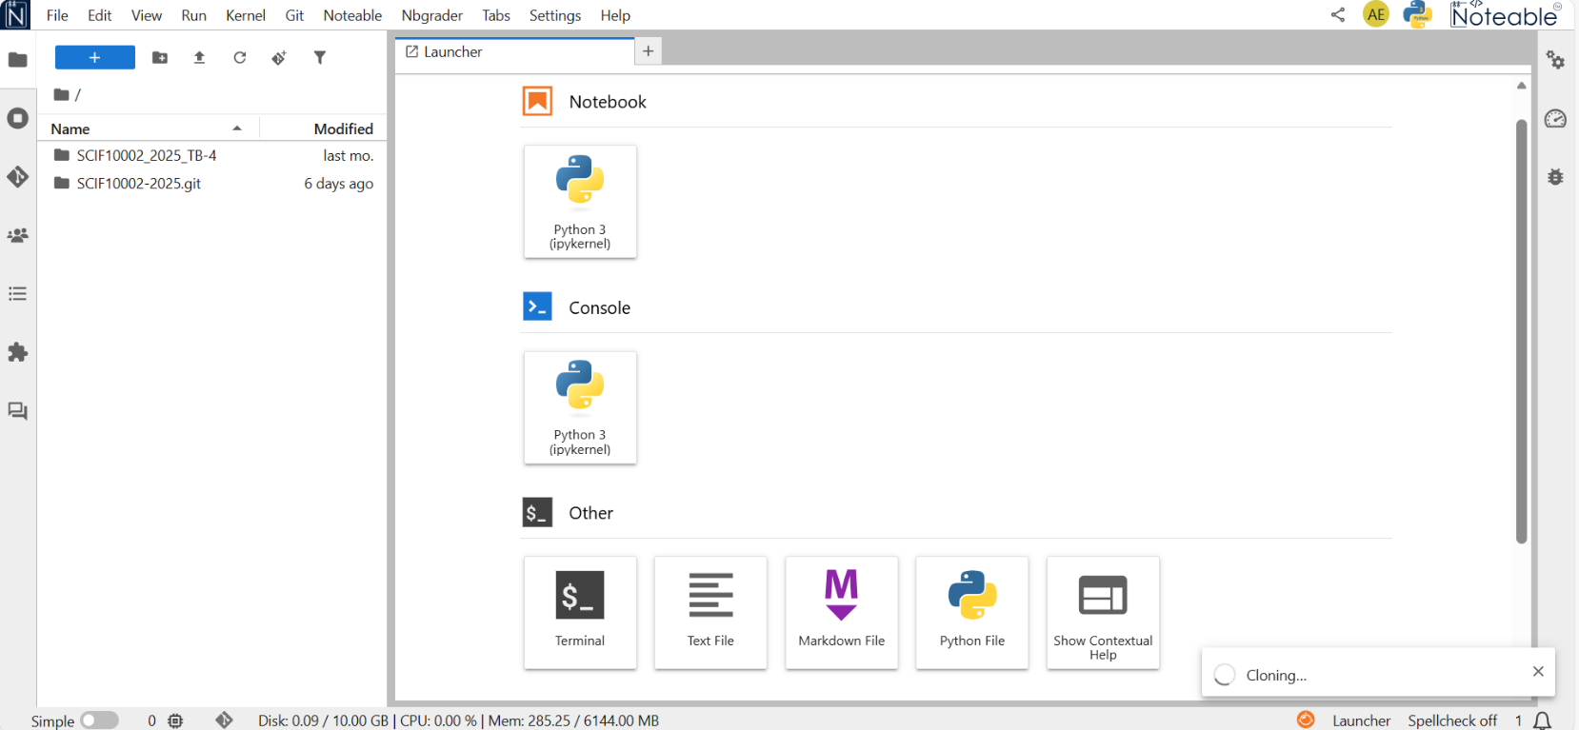
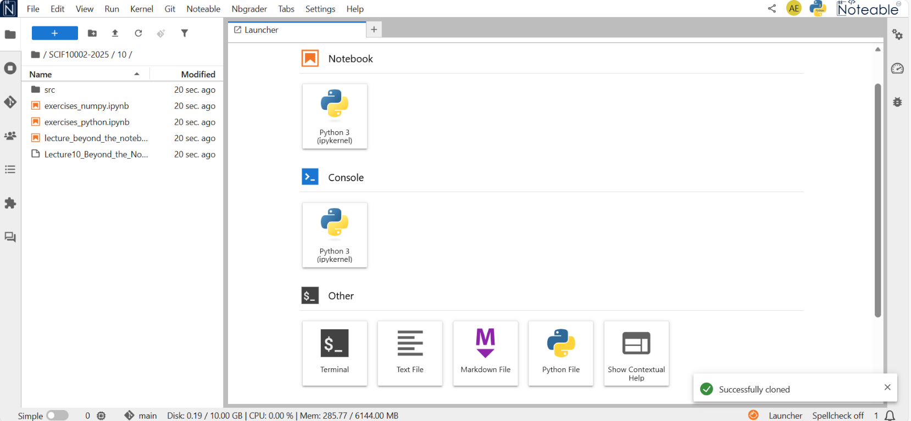
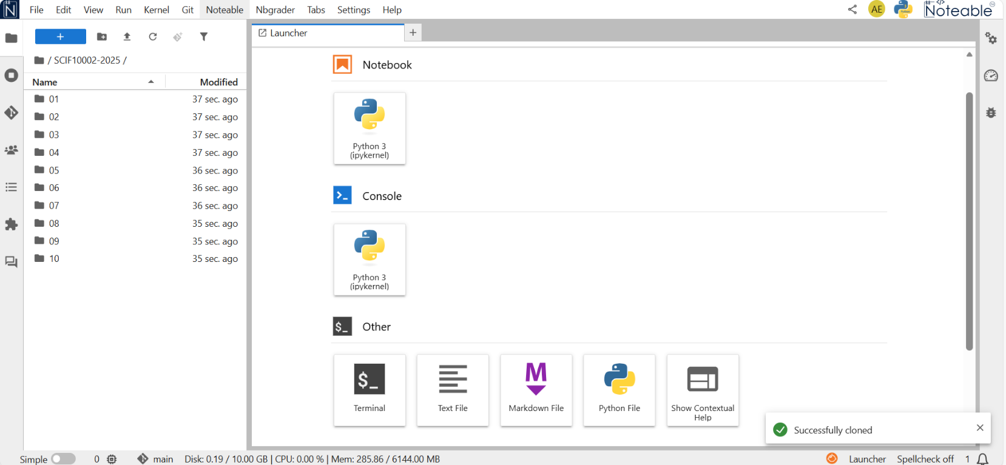
Jupyter Lab
The Jupyter Lab interface is more complex, but also more powerful.
We have on the left a file browser that allows us to navigate the file system.
On the right using the launcher we can create new notebooks, text files, terminals, and other useful items.
Downloading the material on Jupyter Lab is a little different… but pretty similar!
Slide 4/14

Slide 50
Jupyter Lab
The Jupyter Lab interface is more complex, but also more powerful.
We have on the left a file browser that allows us to navigate the file system.
On the right using the launcher we can create new notebooks, text files, terminals, and other useful items.
Downloading the material on Jupyter Lab is a little different… but pretty similar!
Slide 4/14

Slide 51
Jupyter Lab
The Jupyter Lab interface is more complex, but also more powerful.
We have on the left a file browser that allows us to navigate the file system.
On the right using the launcher we can create new notebooks, text files, terminals, and other useful items.
Downloading the material on Jupyter Lab is a little different… but pretty similar!
Slide 4/14

Slide 52
Jupyter Lab
The Jupyter Lab interface is more complex, but also more powerful.
We have on the left a file browser that allows us to navigate the file system.
On the right using the launcher we can create new notebooks, text files, terminals, and other useful items.
Downloading the material on Jupyter Lab is a little different… but pretty similar!
Slide 4/14

Slide 53
Jupyter Lab
The Jupyter Lab interface is more complex, but also more powerful.
We have on the left a file browser that allows us to navigate the file system.
On the right using the launcher we can create new notebooks, text files, terminals, and other useful items.
Downloading the material on Jupyter Lab is a little different… but pretty similar!
Slide 4/14

Slide 54
Jupyter Lab
The Jupyter Lab interface is more complex, but also more powerful.
We have on the left a file browser that allows us to navigate the file system.
On the right using the launcher we can create new notebooks, text files, terminals, and other useful items.
Downloading the material on Jupyter Lab is a little different… but pretty similar!
Slide 4/14

Slide 55
Jupyter Lab
The Jupyter Lab interface is more complex, but also more powerful.
We have on the left a file browser that allows us to navigate the file system.
On the right using the launcher we can create new notebooks, text files, terminals, and other useful items.
Downloading the material on Jupyter Lab is a little different… but pretty similar!
Slide 4/14

Slide 56
Jupyter Lab
The Jupyter Lab interface is more complex, but also more powerful.
We have on the left a file browser that allows us to navigate the file system.
On the right using the launcher we can create new notebooks, text files, terminals, and other useful items.
Downloading the material on Jupyter Lab is a little different… but pretty similar!
Slide 4/14

Slide 57
Jupyter Lab
The Jupyter Lab interface is more complex, but also more powerful.
We have on the left a file browser that allows us to navigate the file system.
On the right using the launcher we can create new notebooks, text files, terminals, and other useful items.
Downloading the material on Jupyter Lab is a little different… but pretty similar!
Slide 4/14

Slide 58
Jupyter Lab
The Jupyter Lab interface is more complex, but also more powerful.
We have on the left a file browser that allows us to navigate the file system.
On the right using the launcher we can create new notebooks, text files, terminals, and other useful items.
Downloading the material on Jupyter Lab is a little different… but pretty similar!
Slide 4/14

Slide 59
Jupyter Lab
The Jupyter Lab interface is more complex, but also more powerful.
We have on the left a file browser that allows us to navigate the file system.
On the right using the launcher we can create new notebooks, text files, terminals, and other useful items.
Downloading the material on Jupyter Lab is a little different… but pretty similar!
Slide 4/14

Slide 60
Jupyter Lab
The Jupyter Lab interface is more complex, but also more powerful.
We have on the left a file browser that allows us to navigate the file system.
On the right using the launcher we can create new notebooks, text files, terminals, and other useful items.
Downloading the material on Jupyter Lab is a little different… but pretty similar!
Slide 4/14

Slide 61
Jupyter Lab
The Jupyter Lab interface is more complex, but also more powerful.
We have on the left a file browser that allows us to navigate the file system.
On the right using the launcher we can create new notebooks, text files, terminals, and other useful items.
Downloading the material on Jupyter Lab is a little different… but pretty similar!
Slide 4/14

Slide 62
Jupyter Lab
The Jupyter Lab interface is more complex, but also more powerful.
We have on the left a file browser that allows us to navigate the file system.
On the right using the launcher we can create new notebooks, text files, terminals, and other useful items.
Downloading the material on Jupyter Lab is a little different… but pretty similar!
Slide 4/14

Slide 63
Jupyter Lab
The Jupyter Lab interface is more complex, but also more powerful.
We have on the left a file browser that allows us to navigate the file system.
On the right using the launcher we can create new notebooks, text files, terminals, and other useful items.
Downloading the material on Jupyter Lab is a little different… but pretty similar!
Slide 4/14

Slide 64
Jupyter Lab
The Jupyter Lab interface is more complex, but also more powerful.
We have on the left a file browser that allows us to navigate the file system.
On the right using the launcher we can create new notebooks, text files, terminals, and other useful items.
Downloading the material on Jupyter Lab is a little different… but pretty similar!
Slide 4/14

Slide 65
Jupyter Lab
The Jupyter Lab interface is more complex, but also more powerful.
We have on the left a file browser that allows us to navigate the file system.
On the right using the launcher we can create new notebooks, text files, terminals, and other useful items.
Downloading the material on Jupyter Lab is a little different… but pretty similar!
Slide 4/14

Slide 66
Jupyter Lab
The Jupyter Lab interface is more complex, but also more powerful.
We have on the left a file browser that allows us to navigate the file system.
On the right using the launcher we can create new notebooks, text files, terminals, and other useful items.
Slide 4/14

Slide 67
Jupyter Lab
The Jupyter Lab interface is more complex, but also more powerful.
We have on the left a file browser that allows us to navigate the file system.
On the right using the launcher we can create new notebooks, text files, terminals, and other useful items.
Let’s have a look in Noteable!
Slide 4/14

Slide 68
Jupyter Lab
The Jupyter Lab interface is more complex, but also more powerful.
We have on the left a file browser that allows us to navigate the file system.
On the right using the launcher we can create new notebooks, text files, terminals, and other useful items.
Slide 4/14

Slide 69
Jupyter Lab: Recap
Slide 5/14

Slide 70
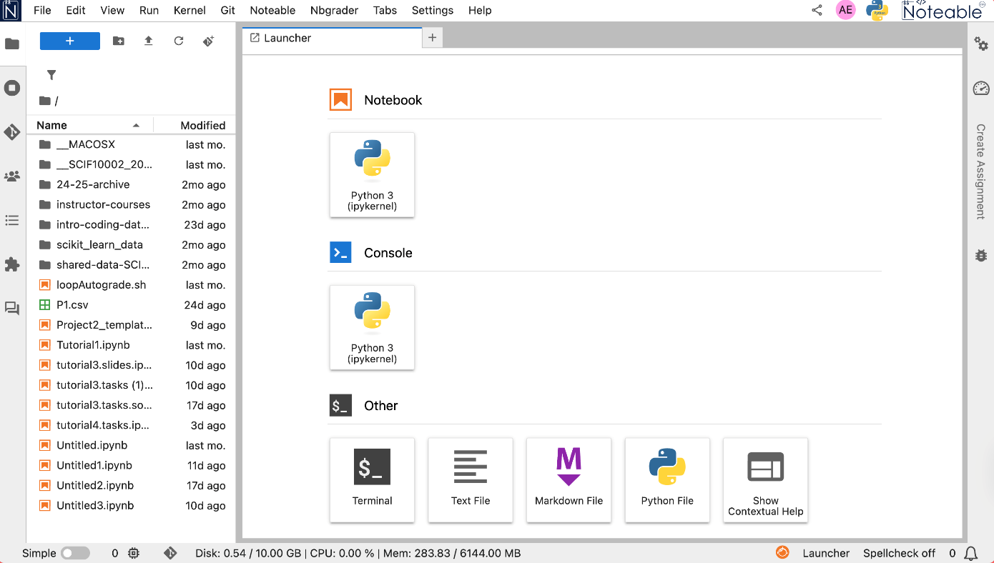
Jupyter Lab: Recap
Slide 5/14

Slide 71
Jupyter Lab: Recap
Using the graphical file manager, you can manage the files on noteable.
Slide 5/14

Slide 72
Jupyter Lab: Recap
Using the graphical file manager, you can manage the files on noteable. Here are some common tasks you can perform:
Slide 5/14

Slide 73
Jupyter Lab: Recap
Using the graphical file manager, you can manage the files on noteable. Here are some common tasks you can perform:
Create a new folder:
Slide 5/14

Slide 74
Jupyter Lab: Recap
Using the graphical file manager, you can manage the files on noteable. Here are some common tasks you can perform:
Create a new folder: Right-click in the file browser and select "New Folder" to create a new directory.
Slide 5/14

Slide 75
Jupyter Lab: Recap
Using the graphical file manager, you can manage the files on noteable. Here are some common tasks you can perform:
Create a new folder: Right-click in the file browser and select "New Folder" to create a new directory.
Upload files:
Slide 5/14

Slide 76
Jupyter Lab: Recap
Using the graphical file manager, you can manage the files on noteable. Here are some common tasks you can perform:
Create a new folder: Right-click in the file browser and select "New Folder" to create a new directory.
Upload files: Click the "Upload" button to upload files from your local machine to the current directory.
Slide 5/14

Slide 77
Jupyter Lab: Recap
Using the graphical file manager, you can manage the files on noteable. Here are some common tasks you can perform:
Create a new folder: Right-click in the file browser and select "New Folder" to create a new directory.
Upload files: Click the "Upload" button to upload files from your local machine to the current directory.
Rename files/folders:
Slide 5/14

Slide 78
Jupyter Lab: Recap
Using the graphical file manager, you can manage the files on noteable. Here are some common tasks you can perform:
Create a new folder: Right-click in the file browser and select "New Folder" to create a new directory.
Upload files: Click the "Upload" button to upload files from your local machine to the current directory.
Rename files/folders: Right-click on a file or folder and select "Rename”
Slide 5/14

Slide 79
Jupyter Lab: Recap
Using the graphical file manager, you can manage the files on noteable. Here are some common tasks you can perform:
Create a new folder: Right-click in the file browser and select "New Folder" to create a new directory.
Upload files: Click the "Upload" button to upload files from your local machine to the current directory.
Rename files/folders: Right-click on a file or folder and select "Rename”
Create a new file:
Slide 5/14

Slide 80
Jupyter Lab: Recap
Using the graphical file manager, you can manage the files on noteable. Here are some common tasks you can perform:
Create a new folder: Right-click in the file browser and select "New Folder" to create a new directory.
Upload files: Click the "Upload" button to upload files from your local machine to the current directory.
Rename files/folders: Right-click on a file or folder and select "Rename”
Create a new file: Click on File -> New -> Text File or Python File
Slide 5/14

Slide 81
Python Files vs Notebooks
Slide 6/14

Slide 82
Python Files vs Notebooks
Python files are pure text files that contain Python code. They have a .py extension.
Slide 6/14

Slide 83
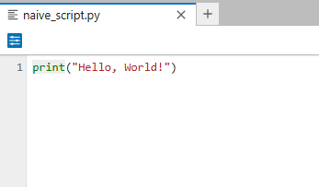
Python Files vs Notebooks
Python files are pure text files that contain Python code. They have a .py extension.
Slide 6/14

Slide 84
Python Files vs Notebooks
Python files are pure text files that contain Python code. They have a .py extension.
Notebooks are interactive documents that can contain code, text, images, and more. They have a .ipynb extension.
Slide 6/14

Slide 85
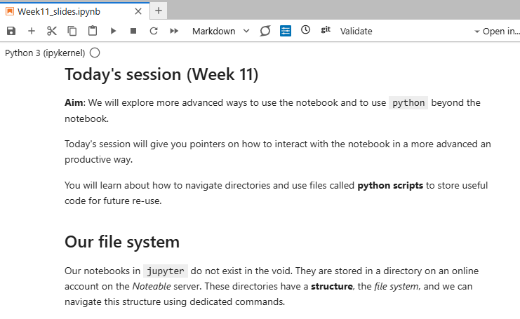
Python Files vs Notebooks
Python files are pure text files that contain Python code. They have a .py extension.
Notebooks are interactive documents that can contain code, text, images, and more. They have a .ipynb extension.
Slide 6/14

Slide 86
Python Files vs Notebooks
Python files are pure text files that contain Python code. They have a .py extension.
Notebooks are interactive documents that can contain code, text, images, and more. They have a .ipynb extension.
Notebooks are the primary way we have been interacting with Python so far.
Slide 6/14

Slide 87
Python Files vs Notebooks
Python files are pure text files that contain Python code. They have a .py extension.
Notebooks are interactive documents that can contain code, text, images, and more. They have a .ipynb extension.
Notebooks are the primary way we have been interacting with Python so far.
Python files are useful for storing reusable code, while notebooks are great for exploration and documentation.
Slide 6/14

Slide 88
Bash Commands in Jupyter
Slide 7/14

Slide 89
Bash Commands in Jupyter
From a notebook, we can interact with the file system
Slide 7/14

Slide 90
Bash Commands in Jupyter
From a notebook, we can interact with the file system
For instance, we can scan directories, create files and folders, and move files around.
Slide 7/14

Slide 91
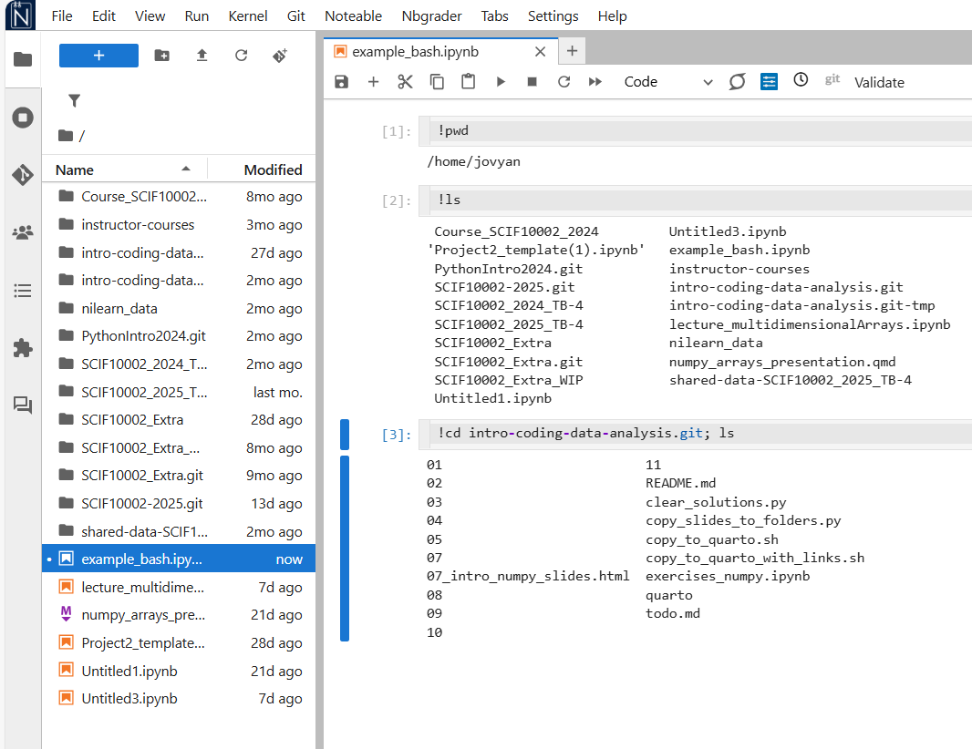
Bash Commands in Jupyter
From a notebook, we can interact with the file system
For instance, we can scan directories, create files and folders, and move files around.
Slide 7/14

Slide 92
Bash Commands in Jupyter
From a notebook, we can interact with the file system
For instance, we can scan directories, create files and folders, and move files around.
We can do this using the ! character.
Slide 7/14

Slide 93
Bash Commands in Jupyter
From a notebook, we can interact with the file system
For instance, we can scan directories, create files and folders, and move files around.
We can do this using the ! character.
Slide 7/14

Slide 94
Bash Commands in Jupyter
From a notebook, we can interact with the file system
For instance, we can scan directories, create files and folders, and move files around.
We can do this using the ! character.
Slide 7/14

Slide 95
Bash Commands in Jupyter
From a notebook, we can interact with the file system
For instance, we can scan directories, create files and folders, and move files around.
We can do this using the ! character.
Slide 7/14

Slide 96
Bash Commands in Jupyter
From a notebook, we can interact with the file system
For instance, we can scan directories, create files and folders, and move files around.
We can do this using the ! character.
Slide 7/14

Slide 97
Bash Commands in Jupyter
From a notebook, we can interact with the file system
For instance, we can scan directories, create files and folders, and move files around.
We can do this using the ! character.
This allows us to run shell commands (commands you’d normally run in a terminal or command prompt).
Slide 7/14

Slide 98
Bash Commands in Jupyter
From a notebook, we can interact with the file system
For instance, we can scan directories, create files and folders, and move files around.
We can do this using the ! character.
This allows us to run shell commands (commands you’d normally run in a terminal or command prompt).
They use a different language to Python called Bash.
Slide 7/14

Slide 99
Bash Commands in Jupyter
From a notebook, we can interact with the file system
For instance, we can scan directories, create files and folders, and move files around.
We can do this using the ! character.
This allows us to run shell commands (commands you’d normally run in a terminal or command prompt).
They use a different language to Python called Bash.
Let’s try some bash commands in Jupyter!
Slide 7/14

Slide 100
Bash Commands in Jupyter
From a notebook, we can interact with the file system
For instance, we can scan directories, create files and folders, and move files around.
We can do this using the ! character.
This allows us to run shell commands (commands you’d normally run in a terminal or command prompt).
They use a different language to Python called Bash.
Slide 7/14

Slide 101
Bash Commands in the Terminal
Slide 8/14

Slide 102
Bash Commands in the Terminal
Bash allows us to interact with the operating system and perform tasks that are not directly related to Python.
Slide 8/14

Slide 103
Bash Commands in the Terminal
Bash allows us to interact with the operating system and perform tasks that are not directly related to Python.
E.g. communicating with remote servers, managing files, automating tasks.
Slide 8/14

Slide 104
Bash Commands in the Terminal
Bash allows us to interact with the operating system and perform tasks that are not directly related to Python.
E.g. communicating with remote servers, managing files, automating tasks.
In Noteable, you can also launch a Terminal to code in Bash.
Slide 8/14

Slide 105
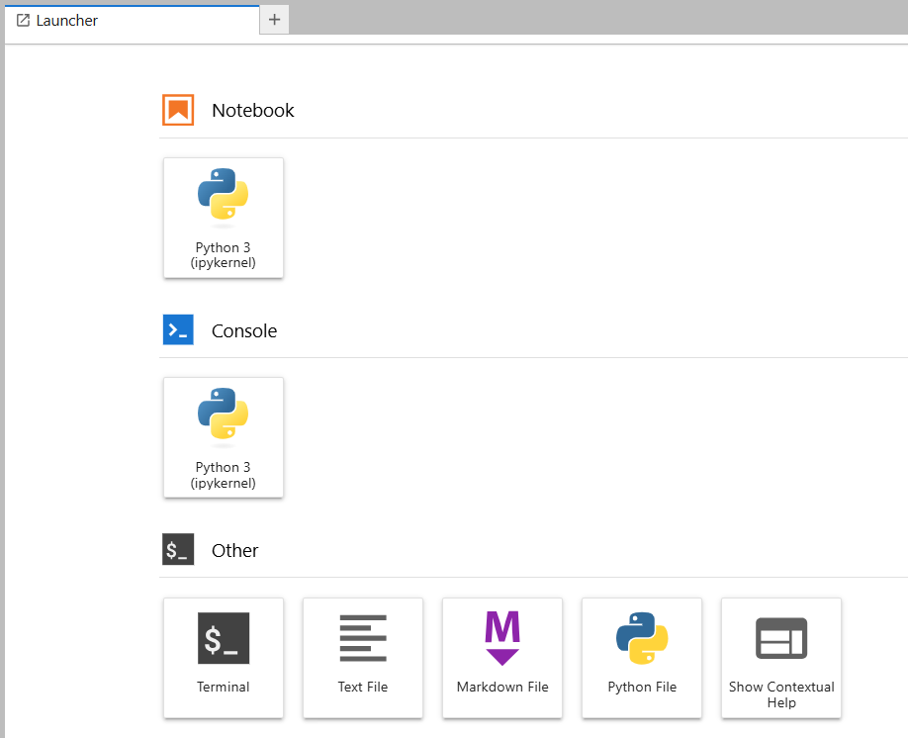
Bash Commands in the Terminal
Bash allows us to interact with the operating system and perform tasks that are not directly related to Python.
E.g. communicating with remote servers, managing files, automating tasks.
In Noteable, you can also launch a Terminal to code in Bash.
Slide 8/14

Slide 106
Bash Commands in the Terminal
Bash allows us to interact with the operating system and perform tasks that are not directly related to Python.
E.g. communicating with remote servers, managing files, automating tasks.
In Noteable, you can also launch a Terminal to code in Bash.
Slide 8/14

Slide 107
Bash Commands in the Terminal
Bash allows us to interact with the operating system and perform tasks that are not directly related to Python.
E.g. communicating with remote servers, managing files, automating tasks.
In Noteable, you can also launch a Terminal to code in Bash.
Slide 8/14

Slide 108
Bash Commands in the Terminal
Bash allows us to interact with the operating system and perform tasks that are not directly related to Python.
E.g. communicating with remote servers, managing files, automating tasks.
In Noteable, you can also launch a Terminal to code in Bash.
File > New > Terminal
Slide 8/14

Slide 109
Bash Commands in the Terminal
Bash allows us to interact with the operating system and perform tasks that are not directly related to Python.
E.g. communicating with remote servers, managing files, automating tasks.
In Noteable, you can also launch a Terminal to code in Bash.
File > New > Terminal
Let’s have a look at how we can use the terminal!
Slide 8/14

Slide 110
Bash Commands in the Terminal
Bash allows us to interact with the operating system and perform tasks that are not directly related to Python.
E.g. communicating with remote servers, managing files, automating tasks.
In Noteable, you can also launch a Terminal to code in Bash.
File > New > Terminal
Slide 8/14

Slide 111
Recap: Bash Commands in the Terminal
Slide 9/14

Slide 112
Recap: Bash Commands in the Terminal
The terminal is a text-based interface to an operating system (local or remote).
Slide 9/14

Slide 113
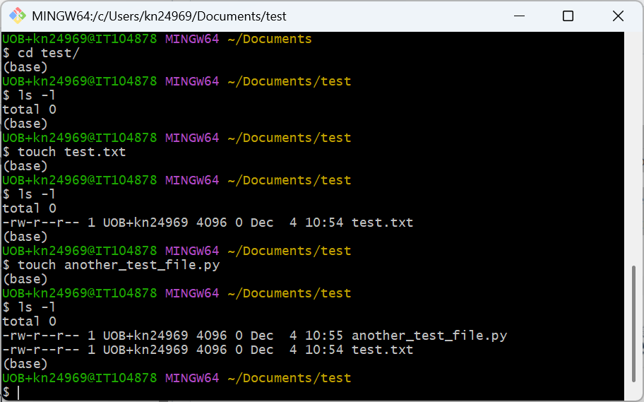
Recap: Bash Commands in the Terminal
The terminal is a text-based interface to an operating system (local or remote).
Slide 9/14

Slide 114
Recap: Bash Commands in the Terminal
The terminal is a text-based interface to an operating system (local or remote).
The terminal is a bit like your local file system.
Slide 9/14

Slide 115
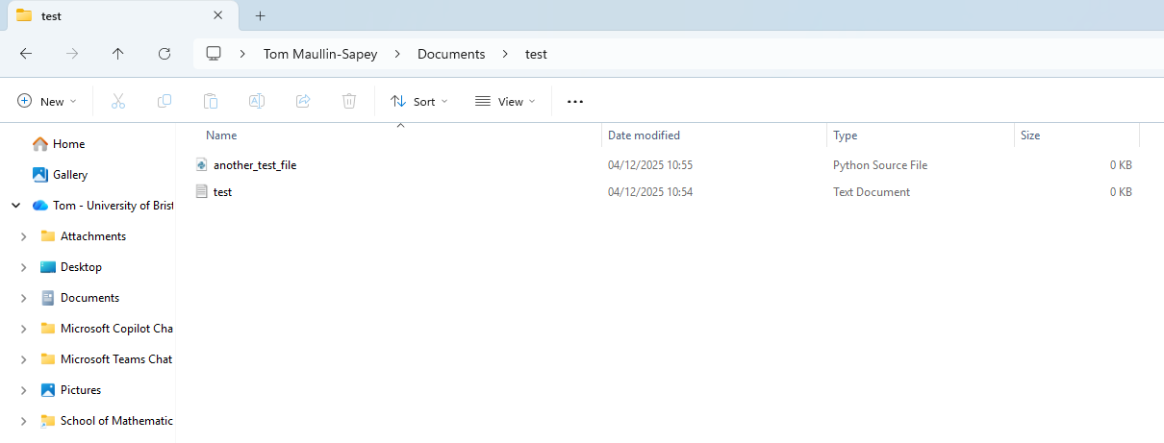
Recap: Bash Commands in the Terminal
The terminal is a text-based interface to an operating system (local or remote).
The terminal is a bit like your local file system.
Slide 9/14

Slide 116
Recap: Bash Commands in the Terminal
The terminal is a text-based interface to an operating system (local or remote).
The terminal is a bit like your local file system.
You do not use the mouse to perform actions. Instead, you write commands.
Slide 9/14

Slide 117
Recap: Bash Commands in the Terminal
The terminal is a text-based interface to an operating system (local or remote).
The terminal is a bit like your local file system.
You do not use the mouse to perform actions. Instead, you write commands.
These commands belong to the scripting language called bash.
Slide 9/14

Slide 118
Recap: Bash Commands in the Terminal
The terminal is a text-based interface to an operating system (local or remote).
The terminal is a bit like your local file system.
You do not use the mouse to perform actions. Instead, you write commands.
These commands belong to the scripting language called bash.
Bash is a different language to Python, but they can interact together in the notebook.
Slide 9/14

Slide 119
Recap: Bash Commands
Slide 10/14

Slide 120
Recap: Bash Commands
Slide 10/14

Slide 121
Recap: Bash Commands
Here are some common bash commands
Slide 10/14

Slide 122
Recap: Bash Commands
Here are some common bash commands
pwd: Prints the Working Directory
Slide 10/14

Slide 123
Recap: Bash Commands
Here are some common bash commands
pwd: Prints the Working Directory
ls: Lists the contents (files and folders) in a directory
Slide 10/14

Slide 124
Recap: Bash Commands
Here are some common bash commands
pwd: Prints the Working Directory
ls: Lists the contents (files and folders) in a directory
mkdir: Makes a directory
Slide 10/14

Slide 125
Recap: Bash Commands
Here are some common bash commands
pwd: Prints the Working Directory
ls: Lists the contents (files and folders) in a directory
mkdir: Makes a directory
cd: Change directory (move to a new folder)
Slide 10/14

Slide 126
Recap: Bash Commands
Here are some common bash commands
pwd: Prints the Working Directory
ls: Lists the contents (files and folders) in a directory
mkdir: Makes a directory
cd: Change directory (move to a new folder)
touch: Create a new file (or update the timestamp on an existing one)
Slide 10/14

Slide 127
Recap: Bash Commands
Here are some common bash commands
pwd: Prints the Working Directory
ls: Lists the contents (files and folders) in a directory
mkdir: Makes a directory
cd: Change directory (move to a new folder)
touch: Create a new file (or update the timestamp on an existing one)
cat: Concatenate and output the contents of a file or set of files
Slide 10/14

Slide 128
Running Scripts from the Notebook
Slide 11/14

Slide 129
Running Scripts from the Notebook
So far, we’ve been running our Python code directly in the notebook.
Slide 11/14

Slide 130
Running Scripts from the Notebook
So far, we’ve been running our Python code directly in the notebook.
As your coding improves, you might find yourself writing larger, unwieldy chunks of code.
Slide 11/14

Slide 131
Running Scripts from the Notebook
So far, we’ve been running our Python code directly in the notebook.
As your coding improves, you might find yourself writing larger, unwieldy chunks of code.
You might not want to put these in a notebook directly!
Slide 11/14

Slide 132
Running Scripts from the Notebook
So far, we’ve been running our Python code directly in the notebook.
As your coding improves, you might find yourself writing larger, unwieldy chunks of code.
You might not want to put these in a notebook directly!
Instead, you can put them in a script (.py file)!
Slide 11/14

Slide 133
Running Scripts from the Notebook
So far, we’ve been running our Python code directly in the notebook.
As your coding improves, you might find yourself writing larger, unwieldy chunks of code.
You might not want to put these in a notebook directly!
Instead, you can put them in a script (.py file)!
You can run a script from a Jupyter notebook using the run command
Slide 11/14

Slide 134
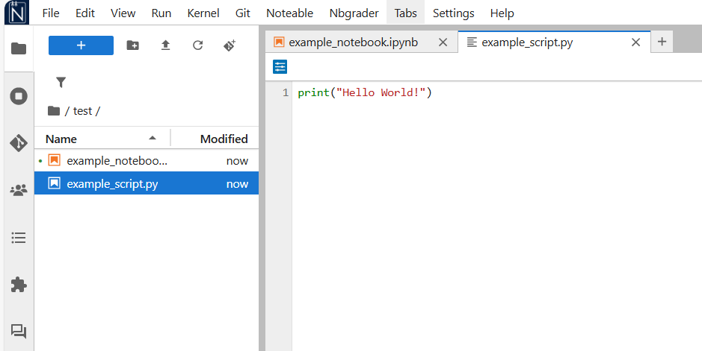
Running Scripts from the Notebook
So far, we’ve been running our Python code directly in the notebook.
As your coding improves, you might find yourself writing larger, unwieldy chunks of code.
You might not want to put these in a notebook directly!
Instead, you can put them in a script (.py file)!
You can run a script from a Jupyter notebook using the run command
Slide 11/14

Slide 135
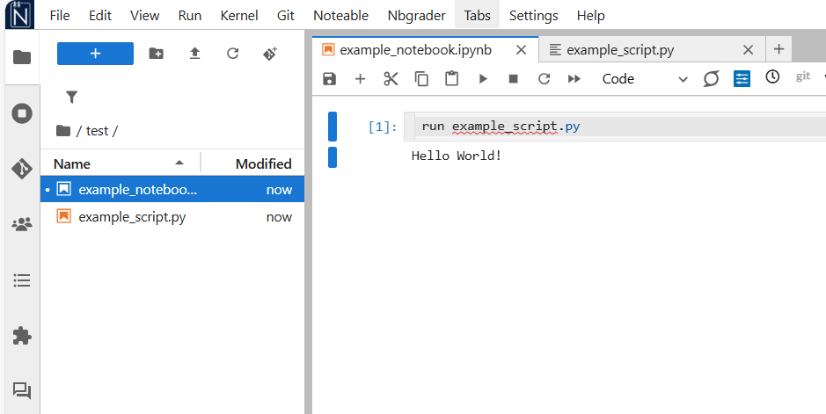
Running Scripts from the Notebook
So far, we’ve been running our Python code directly in the notebook.
As your coding improves, you might find yourself writing larger, unwieldy chunks of code.
You might not want to put these in a notebook directly!
Instead, you can put them in a script (.py file)!
You can run a script from a Jupyter notebook using the run command
Slide 11/14

Slide 136
Running Scripts from the Notebook
So far, we’ve been running our Python code directly in the notebook.
As your coding improves, you might find yourself writing larger, unwieldy chunks of code.
You might not want to put these in a notebook directly!
Instead, you can put them in a script (.py file)!
You can run a script from a Jupyter notebook using the run command
Let’s see this example in noteable
Slide 11/14

Slide 137
Running Scripts from the Notebook
So far, we’ve been running our Python code directly in the notebook.
As your coding improves, you might find yourself writing larger, unwieldy chunks of code.
You might not want to put these in a notebook directly!
Instead, you can put them in a script (.py file)!
You can run a script from a Jupyter notebook using the run command
Slide 11/14

Slide 138
Running Scripts from the Notebook
Slide 12/14

Slide 139
Running Scripts from the Notebook
We can also load code from a script using the import keyword
Slide 12/14

Slide 140
Running Scripts from the Notebook
We can also load code from a script using the import keyword
We’ve already seen plenty of examples of this!
Slide 12/14

Slide 141
Running Scripts from the Notebook
We can also load code from a script using the import keyword
We’ve already seen plenty of examples of this!
Slide 12/14

Slide 142
Running Scripts from the Notebook
We can also load code from a script using the import keyword
We’ve already seen plenty of examples of this!
Slide 12/14

Slide 143
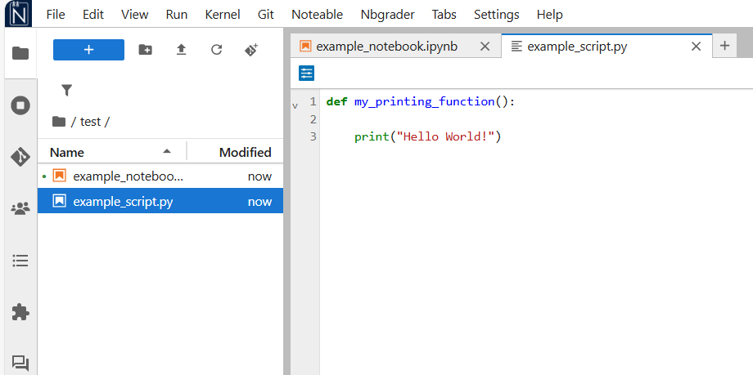
Running Scripts from the Notebook
We can also load code from a script using the import keyword
We’ve already seen plenty of examples of this!
Slide 12/14

Slide 144
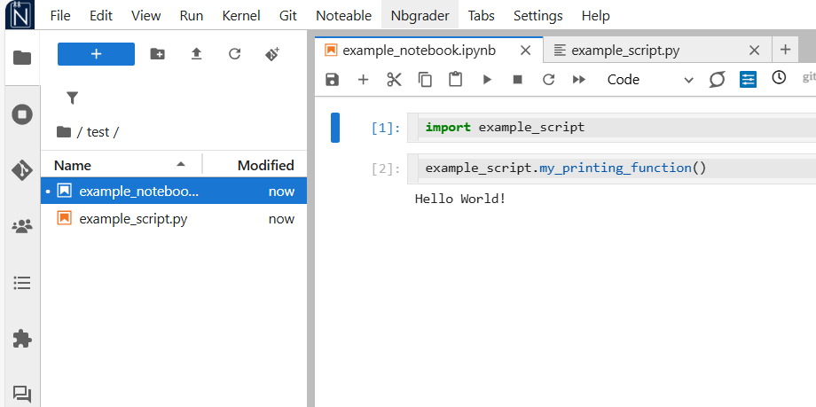
Running Scripts from the Notebook
We can also load code from a script using the import keyword
We’ve already seen plenty of examples of this!
Slide 12/14

Slide 145
Running Scripts from the Notebook
We can also load code from a script using the import keyword
We’ve already seen plenty of examples of this!
This is powerful, as you can save functions in scripts, share them with others and load them only when needed
Slide 12/14

Slide 146
Running Scripts from the Notebook
We can also load code from a script using the import keyword
We’ve already seen plenty of examples of this!
This is powerful, as you can save functions in scripts, share them with others and load them only when needed
Let’s see one final quick example!
Slide 12/14

Slide 147
Practical
Slide 13/14

Slide 148
Practical
For the rest of today, you must:
Slide 13/14

Slide 149
Practical
For the rest of today, you must:
First, make sure you select the Standard Python 3 environment when opening Noteable
Slide 13/14

Slide 150
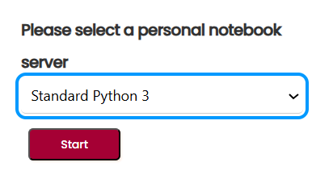
Practical
For the rest of today, you must:
First, make sure you select the Standard Python 3 environment when opening Noteable
Slide 13/14

Slide 151
Practical
For the rest of today, you must:
First, make sure you select the Standard Python 3 environment when opening Noteable
Then, read through and attempt the exercises in:
Slide 13/14

Slide 152
Practical
For the rest of today, you must:
First, make sure you select the Standard Python 3 environment when opening Noteable
Then, read through and attempt the exercises in: lecture_beyond_the_notebook.ipynb
Slide 13/14

Slide 153
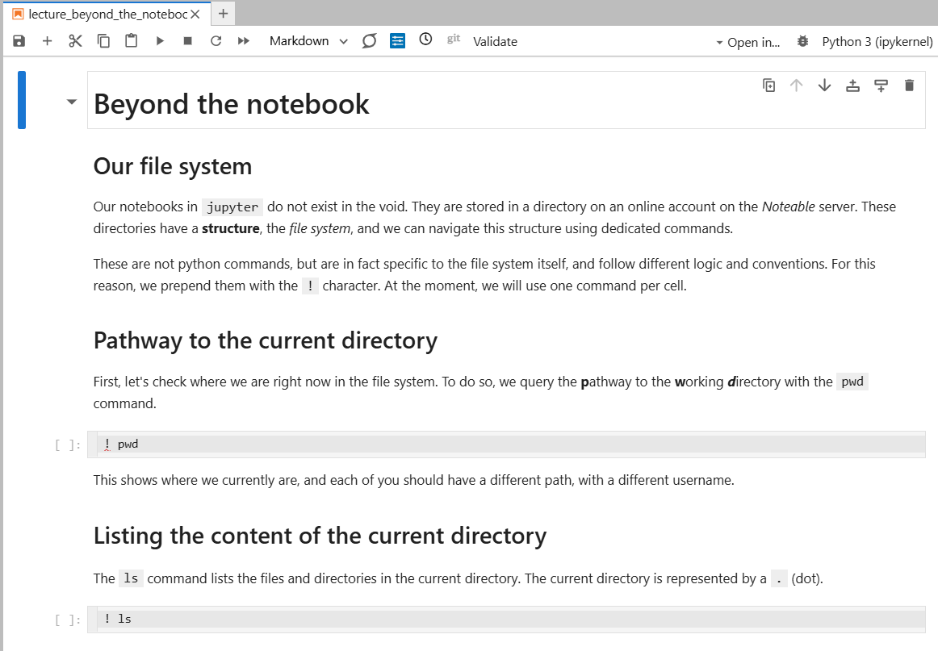
Practical
For the rest of today, you must:
First, make sure you select the Standard Python 3 environment when opening Noteable
Then, read through and attempt the exercises in: lecture_beyond_the_notebook.ipynb
Slide 13/14

Slide 154
Practical
For the rest of today, you must:
First, make sure you select the Standard Python 3 environment when opening Noteable
Then, read through and attempt the exercises in: lecture_beyond_the_notebook.ipynb
Work through the Python consolidation exercises in:
Slide 13/14

Slide 155
Practical
For the rest of today, you must:
First, make sure you select the Standard Python 3 environment when opening Noteable
Then, read through and attempt the exercises in: lecture_beyond_the_notebook.ipynb
Work through the Python consolidation exercises in: exercises_python.ipynb
Slide 13/14

Slide 156
Practical
For the rest of today, you must:
First, make sure you select the Standard Python 3 environment when opening Noteable
Then, read through and attempt the exercises in: lecture_beyond_the_notebook.ipynb
Work through the Python consolidation exercises in: exercises_python.ipynb
Finally, work through the Numpy consolidation exercises in:
Slide 13/14

Slide 157
Practical
For the rest of today, you must:
First, make sure you select the Standard Python 3 environment when opening Noteable
Then, read through and attempt the exercises in: lecture_beyond_the_notebook.ipynb
Work through the Python consolidation exercises in: exercises_python.ipynb
Finally, work through the Numpy consolidation exercises in: exercises_numpy.ipynb
Slide 13/14

Slide 158
Next Time
Lecture 10: Beyond the Notebook
Jupyter Notebook vs Jupyter Lab
Using Bash from a notebook
The Terminal
Practical
Lecture 11: Pandas Series and DataFrames
What is Pandas?
Pandas Series
Pandas DataFrames
Data Analysis in Pandas
Practical
Slide 14/14

