Slide 1
Lecture 16:
Curve Fitting
SCIF10002 – Introduction to Coding and Data Analysis for Scientists
Tom Maullin
5th March 2026
Slide 0/13

Slide 2
Todays Lecture
Lecture 16: Curve Fitting
Overview
The Linear Model
Practical
Lecture 17: Introduction to Software Engineering
Introduction
Principles of Software Engineering
Practical
Slide 1/13

Slide 3
Overview
Slide 2/13

Slide 4
Overview
We’ve now spent a few lectures looking at how we can make various plots of data
Slide 2/13

Slide 5
Overview
We’ve now spent a few lectures looking at how we can make various plots of data
Slide 2/13

Slide 6
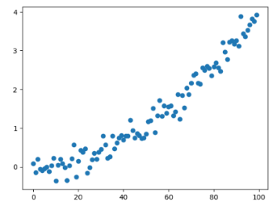
Overview
We’ve now spent a few lectures looking at how we can make various plots of data
Slide 2/13

Slide 7
Overview
We’ve now spent a few lectures looking at how we can make various plots of data
Today, we are going to look at something a little more mathematical
Slide 2/13

Slide 8
Overview
We’ve now spent a few lectures looking at how we can make various plots of data
Today, we are going to look at something a little more mathematical
How can we fit a curve to this data?
Slide 2/13

Slide 9
Overview
We’ve now spent a few lectures looking at how we can make various plots of data
Today, we are going to look at something a little more mathematical
How can we fit a curve to this data?
Slide 2/13

Slide 10
Overview
We’ve now spent a few lectures looking at how we can make various plots of data
Today, we are going to look at something a little more mathematical
How can we fit a curve to this data?
To do this, we’re going to look at the linear model
Slide 2/13

Slide 11
Overview
We’ve now spent a few lectures looking at how we can make various plots of data
Today, we are going to look at something a little more mathematical
How can we fit a curve to this data?
To do this, we’re going to look at the linear model
Warning: Today we shall use some matrix algebra!
Slide 2/13

Slide 12
Overview
We’ve now spent a few lectures looking at how we can make various plots of data
Today, we are going to look at something a little more mathematical
How can we fit a curve to this data?
To do this, we’re going to look at the linear model
Warning: Today we shall use some matrix algebra! If you aren’t sure about matrix operations, please ask me or one of the tutors during the session
Slide 2/13

Slide 13
Overview
We’ve now spent a few lectures looking at how we can make various plots of data
Today, we are going to look at something a little more mathematical
How can we fit a curve to this data?
To do this, we’re going to look at the linear model
Slide 2/13

Slide 14
Curve Fitting: Introduction
Slide 3/13

Slide 15
Curve Fitting: Introduction
The Linear Model
Slide 3/13

Slide 16
Curve Fitting: Introduction
The Linear Model
The linear model is a generalisation of a line of best fit
Slide 3/13

Slide 17
Curve Fitting: Introduction
The Linear Model
The linear model is a generalisation of a line of best fit
It assesses how well a set of variables (columns of data) predict another.
Slide 3/13

Slide 18
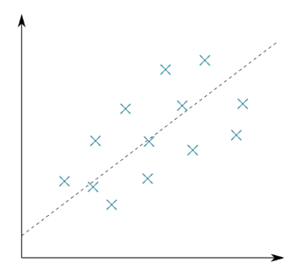
Curve Fitting: Introduction
The Linear Model
The linear model is a generalisation of a line of best fit
It assesses how well a set of variables (columns of data) predict another.
Y
X
Slide 3/13

Slide 19
Curve Fitting: Introduction
The Linear Model
The linear model is a generalisation of a line of best fit
It assesses how well a set of variables (columns of data) predict another.
It does this minimising the sum of squared differences.
Y
X
Slide 3/13

Slide 20
Curve Fitting: Introduction
The Linear Model
The linear model is a generalisation of a line of best fit
It assesses how well a set of variables (columns of data) predict another.
It does this minimising the sum of squared differences.
A standard linear model takes the form:
Y
X
Slide 3/13

Slide 21

Curve Fitting: Introduction
The Linear Model
The linear model is a generalisation of a line of best fit
It assesses how well a set of variables (columns of data) predict another.
It does this minimising the sum of squared differences.
A standard linear model takes the form:
Y
X
Slide 3/13

Slide 22
Curve Fitting: Introduction
The Linear Model
The linear model is a generalisation of a line of best fit
It assesses how well a set of variables (columns of data) predict another.
It does this minimising the sum of squared differences.
A standard linear model takes the form: where:
Y
X
Slide 3/13

Slide 23
Curve Fitting: Introduction
The Linear Model
The linear model is a generalisation of a line of best fit
It assesses how well a set of variables (columns of data) predict another.
It does this minimising the sum of squared differences.
A standard linear model takes the form: where:
X is the (N x p) design matrix
Y
X
Slide 3/13

Slide 24
Curve Fitting: Introduction
The Linear Model
The linear model is a generalisation of a line of best fit
It assesses how well a set of variables (columns of data) predict another.
It does this minimising the sum of squared differences.
A standard linear model takes the form: where:
X is the (N x p) design matrix
𝛽 is the (p x 1) vector of regression coefficients
Y
X
Slide 3/13

Slide 25
Curve Fitting: Introduction
The Linear Model
The linear model is a generalisation of a line of best fit
It assesses how well a set of variables (columns of data) predict another.
It does this minimising the sum of squared differences.
A standard linear model takes the form: where:
X is the (N x p) design matrix
𝛽 is the (p x 1) vector of regression coefficients
Y is the (N x 1) response vector
Y
X
Slide 3/13

Slide 26
Curve Fitting: Introduction
The Linear Model
The linear model is a generalisation of a line of best fit
It assesses how well a set of variables (columns of data) predict another.
It does this minimising the sum of squared differences.
A standard linear model takes the form: where:
X is the (N x p) design matrix
𝛽 is the (p x 1) vector of regression coefficients
Y is the (N x 1) response vector
𝜖 is the (N x 1) error vector
Y
X
Slide 3/13

Slide 27
Curve Fitting: Introduction
The Linear Model
The linear model is a generalisation of a line of best fit
It assesses how well a set of variables (columns of data) predict another.
It does this minimising the sum of squared differences.
A standard linear model takes the form: where:
X is the (N x p) design matrix
𝛽 is the (p x 1) vector of regression coefficients
Y is the (N x 1) response vector
𝜖 is the (N x 1) error vector
Y
X
Let’s build some intuition for this!
Slide 3/13

Slide 28
Curve Fitting: Introduction
The Linear Model
The linear model is a generalisation of a line of best fit
It assesses how well a set of variables (columns of data) predict another.
It does this minimising the sum of squared differences.
A standard linear model takes the form: where:
X is the (N x p) design matrix
𝛽 is the (p x 1) vector of regression coefficients
Y is the (N x 1) response vector
𝜖 is the (N x 1) error vector
Y
X
Slide 3/13

Slide 29
The Linear Model
Slide 4/13

Slide 30
The Linear Model
The Linear Model (Worked Example)
Slide 4/13

Slide 31
The Linear Model
The Linear Model (Worked Example)
Suppose we have some data
Slide 4/13

Slide 32
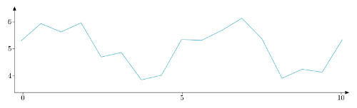
The Linear Model
The Linear Model (Worked Example)
Suppose we have some data
Data
Slide 4/13

Slide 33
The Linear Model
The Linear Model (Worked Example)
Suppose we have some data
(e.g. average motivation of data science researchers over last 10 months, ranked out of 10)
Data
Slide 4/13

Slide 34
The Linear Model
The Linear Model (Worked Example)
Suppose we have some data
(e.g. average motivation of data science researchers over last 10 months, ranked out of 10)
And we want to fit a horizontal trend.
Data
Slide 4/13

Slide 35
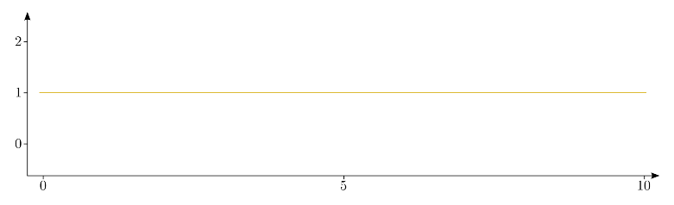
The Linear Model
The Linear Model (Worked Example)
Suppose we have some data
(e.g. average motivation of data science researchers over last 10 months, ranked out of 10)
And we want to fit a horizontal trend.
Data
Horizontal Trend
Slide 4/13

Slide 36
The Linear Model
The Linear Model (Worked Example)
Suppose we have some data
(e.g. average motivation of data science researchers over last 10 months, ranked out of 10)
And we want to fit a horizontal trend.
(Draw a horizontal line of best fit.)
Data
Horizontal Trend
Slide 4/13

Slide 37
The Linear Model
The Linear Model (Worked Example)
Slide 5/13

Slide 38
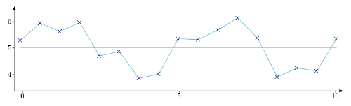
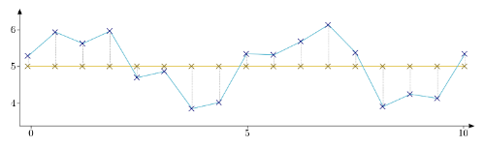
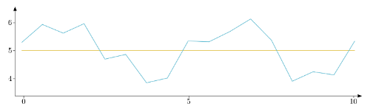

The Linear Model
The Linear Model (Worked Example)
0.9
0.9
0.9
0.2
0.5
0.2
0.2
0.5
0.2
0.1
0.1
0.0
1.0
0.9
0.9
0.6
0.7
Good fit
Slide 5/13

Slide 39
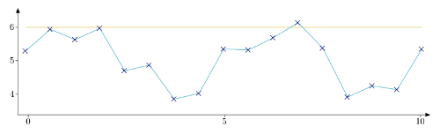
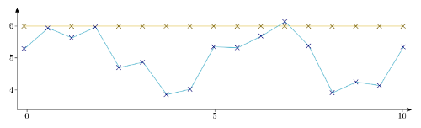
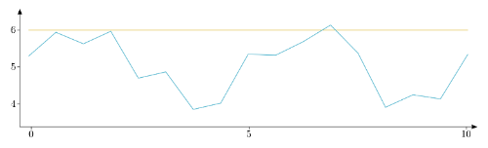
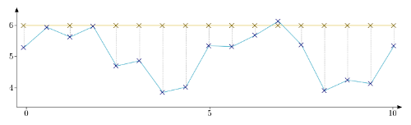
The Linear Model
The Linear Model (Worked Example)
0.9
0.9
0.9
0.0
0.2
0.5
0.2
0.2
0.5
0.2
0.1
0.1
0.0
0.2
0.0
0.2
0.7
0.7
0.7
0.6
0.9
0.0
1.3
1.0
1.0
0.9
0.9
0.6
0.7
2.1
2.0
2.1
1.9
2.0
Good fit
Bad fit
Slide 5/13

Slide 40
The Linear Model
The Linear Model (Worked Example)
But how do we know?
0.9
0.9
0.9
0.0
0.2
0.5
0.2
0.2
0.5
0.2
0.1
0.1
0.0
0.2
0.0
0.2
0.7
0.7
0.7
0.6
0.9
0.0
1.3
1.0
1.0
0.9
0.9
0.6
0.7
2.1
2.0
2.1
1.9
2.0
Good fit
Bad fit
Slide 5/13

Slide 41
The Linear Model
The Linear Model (Worked Example)
But how do we know?
One line is closer!
0.9
0.9
0.9
0.0
0.2
0.5
0.2
0.2
0.5
0.2
0.1
0.1
0.0
0.2
0.0
0.2
0.7
0.7
0.7
0.6
0.9
0.0
1.3
1.0
1.0
0.9
0.9
0.6
0.7
2.1
2.0
2.1
1.9
2.0
Good fit
Bad fit
Slide 5/13

Slide 42
The Linear Model
The Linear Model (Worked Example)
But how do we know?
One line is closer!
What does close mean though?
0.9
0.9
0.9
0.0
0.2
0.5
0.2
0.2
0.5
0.2
0.1
0.1
0.0
0.2
0.0
0.2
0.7
0.7
0.7
0.6
0.9
0.0
1.3
1.0
1.0
0.9
0.9
0.6
0.7
2.1
2.0
2.1
1.9
2.0
Good fit
Bad fit
Slide 5/13

Slide 43
The Linear Model
The Linear Model (Worked Example)
But how do we know?
One line is closer!
What does close mean though?
Sum of squares
0.9
0.9
0.9
0.0
0.2
0.5
0.2
0.2
0.5
0.2
0.1
0.1
0.0
0.2
0.0
0.2
0.7
0.7
0.7
0.6
0.9
0.0
1.3
1.0
1.0
0.9
0.9
0.6
0.7
2.1
2.0
2.1
1.9
2.0
Good fit
Bad fit
Slide 5/13

Slide 44
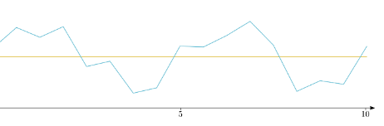
The Linear Model
The Linear Model (Worked Example)
But how do we know?
One line is closer!
What does close mean though?
Sum of squares
0.9
0.9
0.9
0.0
0.2
0.5
0.2
0.2
0.5
0.2
0.1
0.1
0.0
0.2
0.0
0.2
0.7
0.7
0.7
0.6
0.9
0.0
1.3
1.0
1.0
0.9
0.9
0.6
0.7
2.1
2.0
2.1
1.9
2.0
Good fit
Bad fit
Slide 5/13

Slide 45
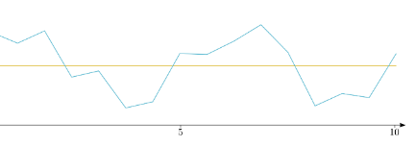
The Linear Model
The Linear Model (Worked Example)
But how do we know?
One line is closer!
What does close mean though?
Sum of squares
0.9
0.9
0.9
0.0
0.2
0.5
0.2
0.2
0.5
0.2
0.1
0.1
0.0
0.2
0.0
0.2
0.7
0.7
0.7
0.6
0.9
0.0
1.3
1.0
1.0
0.9
0.9
0.6
0.7
2.1
2.0
2.1
1.9
2.0
Good fit
Bad fit
Slide 5/13

Slide 46
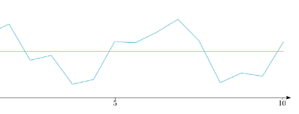
The Linear Model
The Linear Model (Worked Example)
But how do we know?
One line is closer!
What does close mean though?
Sum of squares
0.9
0.9
0.9
0.0
0.2
0.5
0.2
0.2
0.5
0.2
0.1
0.1
0.0
0.2
0.0
0.2
0.7
0.7
0.7
0.6
0.9
0.0
1.3
1.0
1.0
0.9
0.9
0.6
0.7
2.1
2.0
2.1
1.9
2.0
Good fit
Bad fit
Slide 5/13

Slide 47
The Linear Model
The Linear Model (Worked Example)
But how do we know?
One line is closer!
What does close mean though?
Sum of squares
0.9
0.9
0.9
0.0
0.2
0.5
0.2
0.2
0.5
0.2
0.1
0.1
0.0
0.2
0.0
0.2
0.7
0.7
0.7
0.6
0.9
0.0
1.3
1.0
1.0
0.9
0.9
0.6
0.7
2.1
2.0
2.1
1.9
2.0
Good fit
Bad fit
Slide 5/13

Slide 48
The Linear Model
The Linear Model (Worked Example)
But how do we know?
One line is closer!
What does close mean though?
Sum of squares
0.0
0.0
0.2
0.0
0.2
0.7
0.7
0.7
0.6
0.9
1.3
1.0
2.1
2.0
2.1
1.9
2.0
Good fit
Bad fit
Slide 5/13

Slide 49
The Linear Model
The Linear Model (Worked Example)
But how do we know?
One line is closer!
What does close mean though?
Sum of squares
0.0
0.0
0.2
0.0
0.2
0.7
0.7
0.7
0.6
0.9
1.3
1.0
2.1
2.0
2.1
1.9
2.0
Good fit
Bad fit
Slide 5/13

Slide 50
The Linear Model
The Linear Model (Worked Example)
But how do we know?
One line is closer!
What does close mean though?
Sum of squares
0.9
0.9
0.9
0.2
0.5
0.2
0.2
0.5
0.2
0.1
0.1
0.0
1.0
0.9
0.9
0.6
0.7
Good fit
Bad fit
Slide 5/13

Slide 51
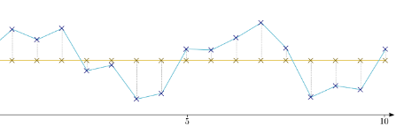
The Linear Model
The Linear Model (Worked Example)
But how do we know?
One line is closer!
What does close mean though?
Sum of squares
0.9
0.9
0.9
0.5
0.2
0.2
0.5
0.2
0.1
0.1
0.0
1.0
0.9
0.9
0.6
0.7
Good fit
Bad fit
Good fit Sum of Squares:
Slide 5/13

Slide 52
The Linear Model
The Linear Model (Worked Example)
But how do we know?
One line is closer!
What does close mean though?
Sum of squares
0.9
0.9
0.9
0.2
0.5
0.2
0.2
0.5
0.2
0.1
0.1
0.0
1.0
0.9
0.9
0.6
0.7
Good fit
Bad fit
Good fit Sum of Squares:
0.2²
Slide 5/13

Slide 53
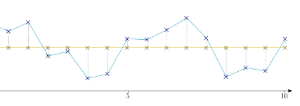
The Linear Model
The Linear Model (Worked Example)
But how do we know?
One line is closer!
What does close mean though?
Sum of squares
0.9
0.9
0.9
0.2
0.5
0.2
0.2
0.5
0.2
0.1
0.1
0.0
1.0
0.9
0.9
0.6
0.7
Good fit
Bad fit
Good fit Sum of Squares:
0.2²+0.9²
Slide 5/13

Slide 54
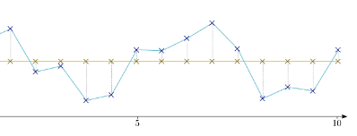
The Linear Model
The Linear Model (Worked Example)
But how do we know?
One line is closer!
What does close mean though?
Sum of squares
0.9
0.9
0.9
0.2
0.5
0.2
0.2
0.5
0.2
0.1
0.1
0.0
1.0
0.9
0.9
0.6
0.7
Good fit
Bad fit
Good fit Sum of Squares:
0.2²+0.9²+0.5²
Slide 5/13

Slide 55
The Linear Model
The Linear Model (Worked Example)
But how do we know?
One line is closer!
What does close mean though?
Sum of squares
0.9
0.9
0.9
0.2
0.5
0.2
0.2
0.5
0.2
0.1
0.1
0.0
1.0
0.9
0.9
0.6
0.7
Good fit
Bad fit
Good fit Sum of Squares:
0.2²+0.9²+0.5²+0.9²+0.1²+0.0²+1.0²+0.9²+0.2²+0.2²+0.5²+0.9²+0.2²+0.9²+0.6²+0.7²+0.1²
Slide 5/13

Slide 56
The Linear Model
The Linear Model (Worked Example)
But how do we know?
One line is closer!
What does close mean though?
Sum of squares
0.9
0.9
0.9
0.2
0.5
0.2
0.2
0.5
0.2
0.1
0.1
0.0
1.0
0.9
0.9
0.6
0.7
Good fit
Bad fit
Good fit Sum of Squares:
0.2²+0.9²+0.5²+0.9²+0.1²+0.0²+1.0²+0.9²+0.2²+0.2²+0.5²+0.9²+0.2²+0.9²+0.6²+0.7²+0.1²
= 6.58
Slide 5/13

Slide 57
The Linear Model
The Linear Model (Worked Example)
But how do we know?
One line is closer!
What does close mean though?
Sum of squares
0.9
0.9
0.9
0.2
0.5
0.2
0.2
0.5
0.2
0.1
0.1
0.0
1.0
0.9
0.9
0.6
0.7
Good fit
Bad fit
Good fit Sum of Squares:
0.2²+0.9²+0.5²+0.9²+0.1²+0.0²+1.0²+0.9²+0.2²+0.2²+0.5²+0.9²+0.2²+0.9²+0.6²+0.7²+0.1²
= 6.58
Slide 5/13

Slide 58
The Linear Model
The Linear Model (Worked Example)
But how do we know?
One line is closer!
What does close mean though?
Sum of squares
0.9
0.9
0.9
0.2
0.5
0.2
0.2
0.5
0.2
0.1
0.1
0.0
1.0
0.9
0.9
0.6
0.7
Good fit
Bad fit
Good fit Sum of Squares:
0.2²+0.9²+0.5²+0.9²+0.1²+0.0²+1.0²+0.9²+0.2²+0.2²+0.5²+0.9²+0.2²+0.9²+0.6²+0.7²+0.1²
= 6.58
Slide 5/13

Slide 59
The Linear Model
The Linear Model (Worked Example)
But how do we know?
One line is closer!
What does close mean though?
Sum of squares
0.9
0.9
0.9
0.2
0.5
0.2
0.2
0.5
0.2
0.1
0.1
0.0
1.0
0.9
0.9
0.6
0.7
Good fit
Bad fit
Good fit Sum of Squares:
0.2²+0.9²+0.5²+0.9²+0.1²+0.0²+1.0²+0.9²+0.2²+0.2²+0.5²+0.9²+0.2²+0.9²+0.6²+0.7²+0.1²
= 6.58
Slide 5/13

Slide 60
The Linear Model
The Linear Model (Worked Example)
But how do we know?
One line is closer!
What does close mean though?
Sum of squares
0.9
0.9
0.9
0.2
0.5
0.2
0.2
0.5
0.2
0.1
0.1
0.0
1.0
0.9
0.9
0.6
0.7
Good fit
Bad fit
Good fit Sum of Squares:
0.2²+0.9²+0.5²+0.9²+0.1²+0.0²+1.0²+0.9²+0.2²+0.2²+0.5²+0.9²+0.2²+0.9²+0.6²+0.7²+0.1²
= 6.58
Slide 5/13

Slide 61
The Linear Model
The Linear Model (Worked Example)
But how do we know?
One line is closer!
What does close mean though?
Sum of squares
0.9
0.9
0.9
0.2
0.5
0.2
0.2
0.5
0.2
0.1
0.1
0.0
1.0
0.9
0.9
0.6
0.7
Good fit
Bad fit
Good fit Sum of Squares:
0.2²+0.9²+0.5²+0.9²+0.1²+0.0²+1.0²+0.9²+0.2²+0.2²+0.5²+0.9²+0.2²+0.9²+0.6²+0.7²+0.1²
= 6.58
Bad fit Sum of Squares:
Slide 5/13

Slide 62
The Linear Model
The Linear Model (Worked Example)
But how do we know?
One line is closer!
What does close mean though?
Sum of squares
0.9
0.9
0.9
0.2
0.5
0.2
0.2
0.5
0.2
0.1
0.1
0.7
0.0
1.0
0.9
0.9
0.6
0.7
Good fit
Bad fit
Good fit Sum of Squares:
0.2²+0.9²+0.5²+0.9²+0.1²+0.0²+1.0²+0.9²+0.2²+0.2²+0.5²+0.9²+0.2²+0.9²+0.6²+0.7²+0.1²
= 6.58
Bad fit Sum of Squares:
0.7²
Slide 5/13

Slide 63
The Linear Model
The Linear Model (Worked Example)
But how do we know?
One line is closer!
What does close mean though?
Sum of squares
0.9
0.9
0.9
0.2
0.5
0.2
0.2
0.5
0.2
0.1
0.1
0.7
0.0
1.0
0.9
0.9
0.6
0.7
Good fit
Bad fit
Good fit Sum of Squares:
0.2²+0.9²+0.5²+0.9²+0.1²+0.0²+1.0²+0.9²+0.2²+0.2²+0.5²+0.9²+0.2²+0.9²+0.6²+0.7²+0.1²
= 6.58
Bad fit Sum of Squares:
0.7²
Slide 5/13

Slide 64
The Linear Model
The Linear Model (Worked Example)
But how do we know?
One line is closer!
What does close mean though?
Sum of squares
0.9
0.9
0.9
0.2
0.5
0.2
0.2
0.5
0.2
0.1
0.1
0.0
0.7
0.0
1.0
0.9
0.9
0.6
0.7
Good fit
Bad fit
Good fit Sum of Squares:
0.2²+0.9²+0.5²+0.9²+0.1²+0.0²+1.0²+0.9²+0.2²+0.2²+0.5²+0.9²+0.2²+0.9²+0.6²+0.7²+0.1²
= 6.58
Bad fit Sum of Squares:
0.7²+0.0²
Slide 5/13

Slide 65
The Linear Model
The Linear Model (Worked Example)
But how do we know?
One line is closer!
What does close mean though?
Sum of squares
0.9
0.9
0.9
0.2
0.5
0.2
0.2
0.5
0.2
0.1
0.1
0.0
0.2
0.7
0.0
1.0
0.9
0.9
0.6
0.7
Good fit
Bad fit
Good fit Sum of Squares:
0.2²+0.9²+0.5²+0.9²+0.1²+0.0²+1.0²+0.9²+0.2²+0.2²+0.5²+0.9²+0.2²+0.9²+0.6²+0.7²+0.1²
= 6.58
Bad fit Sum of Squares:
0.7²+0.0²+0.2²
Slide 5/13

Slide 66
The Linear Model
The Linear Model (Worked Example)
But how do we know?
One line is closer!
What does close mean though?
Sum of squares
0.9
0.9
0.9
0.0
0.2
0.5
0.2
0.2
0.5
0.2
0.1
0.1
0.0
0.2
0.0
0.2
0.7
0.7
0.7
0.6
0.9
0.0
1.3
1.0
1.0
0.9
0.9
0.6
0.7
2.1
2.0
2.1
1.9
2.0
Good fit
Bad fit
Good fit Sum of Squares:
0.2²+0.9²+0.5²+0.9²+0.1²+0.0²+1.0²+0.9²+0.2²+0.2²+0.5²+0.9²+0.2²+0.9²+0.6²+0.7²+0.1²
= 6.58
Bad fit Sum of Squares:
0.7²+0.0²+0.2²+0.0²+1.3²+1.0²+2.1²+2.0²+0.7²+0.7²+0.2²+0.0²+0.6²+2.1²+1.9²+2.0²+0.9²
Slide 5/13

Slide 67
The Linear Model
The Linear Model (Worked Example)
But how do we know?
One line is closer!
What does close mean though?
Sum of squares
0.9
0.9
0.9
0.0
0.2
0.5
0.2
0.2
0.5
0.2
0.1
0.1
0.0
0.2
0.0
0.2
0.7
0.7
0.7
0.6
0.9
0.0
1.3
1.0
1.0
0.9
0.9
0.6
0.7
2.1
2.0
2.1
1.9
2.0
Good fit
Bad fit
Good fit Sum of Squares:
0.2²+0.9²+0.5²+0.9²+0.1²+0.0²+1.0²+0.9²+0.2²+0.2²+0.5²+0.9²+0.2²+0.9²+0.6²+0.7²+0.1²
= 6.58
Bad fit Sum of Squares:
0.7²+0.0²+0.2²+0.0²+1.3²+1.0²+2.1²+2.0²+0.7²+0.7²+0.2²+0.0²+0.6²+2.1²+1.9²+2.0²+0.9²
= 25.84
Slide 5/13

Slide 68
The Linear Model
The Linear Model (Worked Example)
But how do we know?
One line is closer!
What does close mean though?
Sum of squares
0.9
0.9
0.9
0.0
0.2
0.5
0.2
0.2
0.5
0.2
0.1
0.1
0.0
0.2
0.0
0.2
0.7
0.7
0.7
0.6
0.9
0.0
1.3
1.0
1.0
0.9
0.9
0.6
0.7
2.1
2.0
2.1
1.9
2.0
Good fit
Bad fit
Good fit Sum of Squares:
0.2²+0.9²+0.5²+0.9²+0.1²+0.0²+1.0²+0.9²+0.2²+0.2²+0.5²+0.9²+0.2²+0.9²+0.6²+0.7²+0.1²
= 6.58
Bad fit Sum of Squares:
0.7²+0.0²+0.2²+0.0²+1.3²+1.0²+2.1²+2.0²+0.7²+0.7²+0.2²+0.0²+0.6²+2.1²+1.9²+2.0²+0.9²
= 25.84
Smaller SS = Better Fit!
Slide 5/13

Slide 69
The Linear Model
The Linear Model (Worked Example)
Slide 6/13

Slide 70
The Linear Model
The Linear Model (Worked Example)
Slide 6/13

Slide 71
The Linear Model
The Linear Model (Worked Example)
Good fit
Slide 6/13

Slide 72

The Linear Model
The Linear Model (Worked Example)
Good fit
Slide 6/13

Slide 73
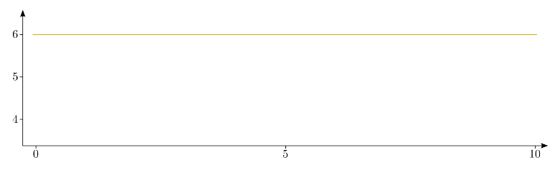
The Linear Model
The Linear Model (Worked Example)
Good fit
Bad fit
Slide 6/13

Slide 74
The Linear Model
The Linear Model (Worked Example)
Good fit
Bad fit
Slide 6/13

Slide 75
The Linear Model
The Linear Model (Worked Example)
= 5 x
Good fit
Bad fit
Slide 6/13

Slide 76
The Linear Model
The Linear Model (Worked Example)
= 5 x
= 6 x
Good fit
Bad fit
Slide 6/13

Slide 77
The Linear Model
The Linear Model (Worked Example)
Slide 7/13

Slide 78
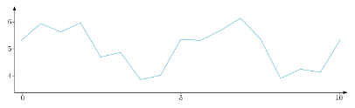
The Linear Model
The Linear Model (Worked Example)
Slide 7/13

Slide 79
The Linear Model
The Linear Model (Worked Example)
By looking at the SS, we found the best value to scale the line of best fit by.
Slide 7/13

Slide 80

The Linear Model
The Linear Model (Worked Example)
By looking at the SS, we found the best value to scale the line of best fit by.
≈ 5 x
Slide 7/13

Slide 81
The Linear Model
The Linear Model (Worked Example)
By looking at the SS, we found the best value to scale the line of best fit by.
This is all that regression does!
≈ 5 x
Slide 7/13

Slide 82
The Linear Model
The Linear Model (Worked Example)
By looking at the SS, we found the best value to scale the line of best fit by.
This is all that regression does!
Coefficients called 𝛽
≈ 5 x
Slide 7/13

Slide 83
The Linear Model
The Linear Model (Worked Example)
By looking at the SS, we found the best value to scale the line of best fit by.
This is all that regression does!
Coefficients called 𝛽
≈ 𝛽 x
Slide 7/13

Slide 84
The Linear Model
The Linear Model (Worked Example)
By looking at the SS, we found the best value to scale the line of best fit by.
This is all that regression does!
Coefficients called 𝛽
Remaining noise called 𝛆
≈ 𝛽 x
Slide 7/13

Slide 85
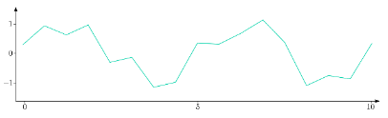
The Linear Model
The Linear Model (Worked Example)
By looking at the SS, we found the best value to scale the line of best fit by.
This is all that regression does!
Coefficients called 𝛽
Remaining noise called 𝛆
= 𝛽 x
+ 𝛆
Slide 7/13

Slide 86
The Linear Model
Slide 8/13

Slide 87
The Linear Model
The Linear Model (Worked Example)
Slide 8/13

Slide 88
The Linear Model
The Linear Model (Worked Example)
Slide 8/13

Slide 89
The Linear Model
The Linear Model (Worked Example)
But can we do better here?
Slide 8/13

Slide 90
The Linear Model
The Linear Model (Worked Example)
But can we do better here?
The data looks kind of seasonal…
Slide 8/13

Slide 91
The Linear Model
The Linear Model (Worked Example)
But can we do better here?
The data looks kind of seasonal…
Could we predict it with a sine wave?
Slide 8/13

Slide 92
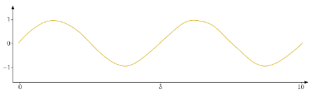
The Linear Model
The Linear Model (Worked Example)
But can we do better here?
The data looks kind of seasonal…
Could we predict it with a sine wave?
Slide 8/13

Slide 93
The Linear Model
The Linear Model (Worked Example)
But can we do better here?
The data looks kind of seasonal…
Could we predict it with a sine wave?
It looks a bit like:
data ≈ 5 x line + 1 x sine
Slide 8/13

Slide 94
The Linear Model
The Linear Model (Worked Example)
But can we do better here?
The data looks kind of seasonal…
Could we predict it with a sine wave?
It looks a bit like:
data ≈ 5 x line + 1 x sine
Slide 8/13

Slide 95
The Linear Model
The Linear Model (Worked Example)
But can we do better here?
The data looks kind of seasonal…
Could we predict it with a sine wave?
It looks a bit like:
data ≈ 5 x line + 1 x sine
≈
1 x
+
5 x
Slide 8/13

Slide 96
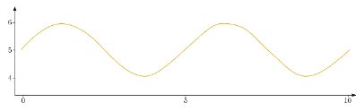
The Linear Model
The Linear Model (Worked Example)
But can we do better here?
The data looks kind of seasonal…
Could we predict it with a sine wave?
It looks a bit like:
data ≈ 5 x line + 1 x sine
≈
1 x
+
5 x
=
Slide 8/13

Slide 97
The Linear Model
The Linear Model (Worked Example)
Slide 9/13

Slide 98
The Linear Model
The Linear Model (Worked Example)
data ≈ 5 x line + 1 x sine
Slide 9/13

Slide 99
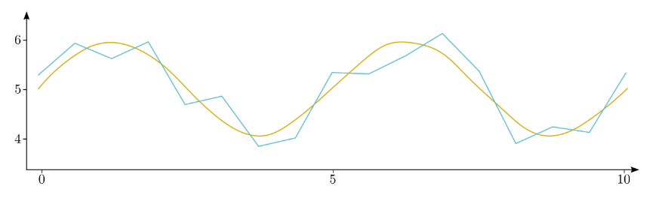
The Linear Model
The Linear Model (Worked Example)
data ≈ 5 x line + 1 x sine
Slide 9/13

Slide 100
The Linear Model
The Linear Model (Worked Example)
data ≈ 5 x line + 1 x sine
Previous Sum of Squares
= 6.58
Slide 9/13

Slide 101
The Linear Model
The Linear Model (Worked Example)
data ≈ 5 x line + 1 x sine
Previous Sum of Squares
= 6.58
Slide 9/13

Slide 102
The Linear Model
The Linear Model (Worked Example)
data ≈ 5 x line + 1 x sine
Previous Sum of Squares
= 6.58
New Sum of Squares:
Slide 9/13

Slide 103
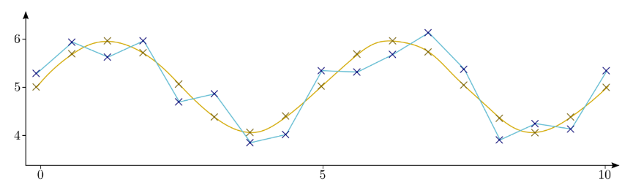

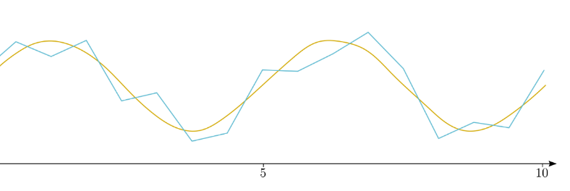
The Linear Model
The Linear Model (Worked Example)
data ≈ 5 x line + 1 x sine
Previous Sum of Squares
= 6.58
0.1
0.1
0.1
0.1
0.2
0.1
New Sum of Squares:
0.1²
0.1
0.1
0.1
0.1
0.1
0.2
0.2
0.2
0.1
0.1
0.1
Slide 9/13

Slide 104
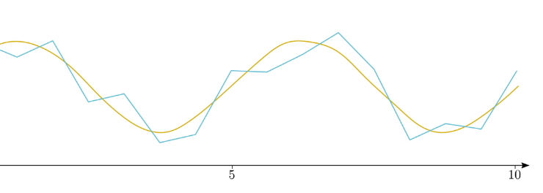
The Linear Model
The Linear Model (Worked Example)
data ≈ 5 x line + 1 x sine
Previous Sum of Squares
= 6.58
0.1
0.1
0.1
0.1
0.2
0.1
New Sum of Squares:
0.1²+0.1²
0.1
0.1
0.1
0.1
0.1
0.2
0.2
0.2
0.1
0.1
0.1
Slide 9/13

Slide 105
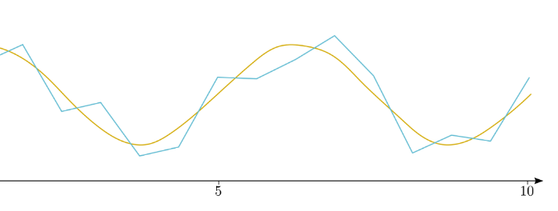
The Linear Model
The Linear Model (Worked Example)
data ≈ 5 x line + 1 x sine
Previous Sum of Squares
= 6.58
0.1
0.1
0.1
0.1
0.2
0.1
New Sum of Squares:
0.1²+0.1²+0.1²
0.1
0.1
0.1
0.1
0.1
0.2
0.2
0.2
0.1
0.1
0.1
Slide 9/13

Slide 106
The Linear Model
The Linear Model (Worked Example)
data ≈ 5 x line + 1 x sine
Previous Sum of Squares
= 6.58
0.1
0.1
0.1
0.1
0.2
0.1
New Sum of Squares:
0.1²+0.1²+0.1²+0.1²+0.1²+0.2²+0.1²+0.2²+0.1²+0.1²+0.1²+0.2²+0.1²+0.2²+0.1²+0.1²+0.1²
0.1
0.1
0.1
0.1
0.1
0.2
0.2
0.2
0.1
0.1
0.1
Slide 9/13

Slide 107
The Linear Model
The Linear Model (Worked Example)
data ≈ 5 x line + 1 x sine
Previous Sum of Squares
= 6.58
0.1
0.1
0.1
0.1
0.2
0.1
New Sum of Squares:
0.1²+0.1²+0.1²+0.1²+0.1²+0.2²+0.1²+0.2²+0.1²+0.1²+0.1²+0.2²+0.1²+0.2²+0.1²+0.1²+0.1²
= 0.29
0.1
0.1
0.1
0.1
0.1
0.2
0.2
0.2
0.1
0.1
0.1
Slide 9/13

Slide 108
The Linear Model
The Linear Model (Worked Example)
data ≈ 5 x line + 1 x sine
Previous Sum of Squares
= 6.58
0.1
0.1
0.1
0.1
0.2
0.1
New Sum of Squares:
0.1²+0.1²+0.1²+0.1²+0.1²+0.2²+0.1²+0.2²+0.1²+0.1²+0.1²+0.2²+0.1²+0.2²+0.1²+0.1²+0.1²
= 0.29
0.1
0.1
0.1
0.1
0.1
0.2
0.2
0.2
0.1
0.1
0.1
Much Better
Slide 9/13

Slide 109
The Linear Model
The Linear Model (Worked Example)
data ≈ 5 x line + 1 x sine
Previous Sum of Squares
= 6.58
0.1
0.1
0.1
0.1
0.2
0.1
New Sum of Squares:
0.1²+0.1²+0.1²+0.1²+0.1²+0.2²+0.1²+0.2²+0.1²+0.1²+0.1²+0.2²+0.1²+0.2²+0.1²+0.1²+0.1²
= 0.29
0.1
0.1
0.1
0.1
0.1
0.2
0.2
0.2
0.1
0.1
0.1
Much Better
Slide 9/13

Slide 110
The Linear Model
The Linear Model (Worked Example)
data ≈ 5 x line + 1 x sine
Previous Sum of Squares
= 6.58
0.1
0.1
0.1
0.1
0.2
0.1
New Sum of Squares:
0.1²+0.1²+0.1²+0.1²+0.1²+0.2²+0.1²+0.2²+0.1²+0.1²+0.1²+0.2²+0.1²+0.2²+0.1²+0.1²+0.1²
= 0.29
0.1
0.1
0.1
0.1
0.1
0.2
0.2
0.2
0.1
0.1
0.1
Much Better*
*Note: This is a slight simplification… in general, to compare models we need to look at more than the sum of squares
Slide 9/13

Slide 111
The Linear Model
The Linear Model (Worked Example)
Slide 10/13

Slide 112
The Linear Model
The Linear Model (Worked Example)
data ≈ 5 x line + 1 x sine
Slide 10/13

Slide 113
The Linear Model
The Linear Model (Worked Example)
data ≈ 5 x line + 1 x sine
≈
1 x
+
5 x
Slide 10/13

Slide 114
The Linear Model
The Linear Model (Worked Example)
data = 5 x line + 1 x sine + noise
≈
1 x
+
5 x
Slide 10/13

Slide 115
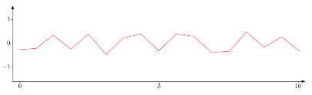
The Linear Model
The Linear Model (Worked Example)
data = 5 x line + 1 x sine + noise
=
1 x
+
5 x
+
Slide 10/13

Slide 116
The Linear Model
The Linear Model (Worked Example)
data = 5 x line + 1 x sine + noise
Y = X₀ 𝛽₀ + X₁ 𝛽₁ + 𝜺
=
1 x
+
5 x
+
Slide 10/13

Slide 117
The Linear Model
The Linear Model (Worked Example)
data = 5 x line + 1 x sine + noise
Y = X₀ 𝛽₀ + X₁ 𝛽₁ + 𝜺
=
𝛽₀ x
+
𝛽₁ x
+
Slide 10/13

Slide 118
The Linear Model
The Linear Model (Worked Example)
data = 5 x line + 1 x sine + noise
Y = X₀ 𝛽₀ + X₁ 𝛽₁ + 𝜺
Y
=
𝛽₀ x
X₀
+
𝛽₁ x
X₁
+
𝜺
Slide 10/13

Slide 119
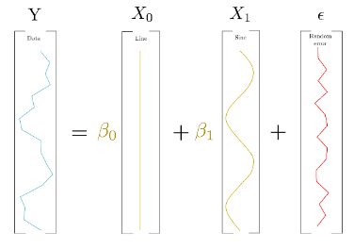
The Linear Model
The Linear Model (Worked Example)
data = 5 x line + 1 x sine + noise
Y = X₀ 𝛽₀ + X₁ 𝛽₁ + 𝜺
Y
=
𝛽₀ x
X₀
+
𝛽₁ x
X₁
+
𝜺
Slide 10/13

Slide 120
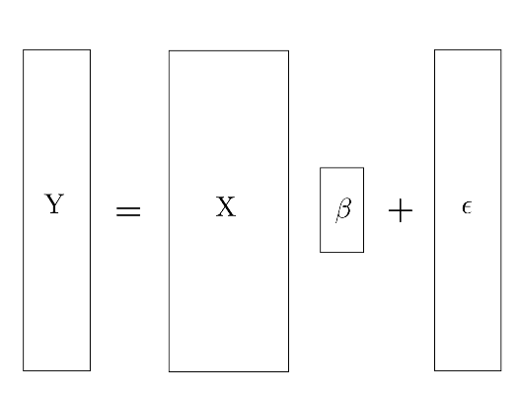
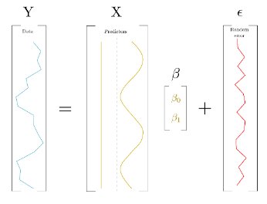
The Linear Model
The Linear Model (Worked Example)
data = 5 x line + 1 x sine + noise
Y = X₀ 𝛽₀ + X₁ 𝛽₁ + 𝜺
Y
=
𝛽₀ x
X₀
+
𝛽₁ x
X₁
+
𝜺
Slide 10/13

Slide 121
The Linear Model
The Linear Model (Worked Example)
data = 5 x line + 1 x sine + noise
Y = X₀ 𝛽₀ + X₁ 𝛽₁ + 𝜺
Y
=
𝛽₀ x
X₀
+
1
1
1
1
1
1
1
1
1
1
1
1
1
1
1
1
1
𝛽₁ x
X₁
+
𝜺
Slide 10/13

Slide 122
The Linear Model
The Linear Model (Worked Example)
data = 5 x line + 1 x sine + noise
Y = X₀ 𝛽₀ + X₁ 𝛽₁ + 𝜺
Y
=
𝛽₀ x
X₀
+
1
1
1
1
1
1
1
1
1
1
1
1
1
1
1
1
1
0
0.7
1
0.7
0
-0.7
-1
-0.7
0
0.7
1
-0.7
0
-0.7
-1
-0.7
0
𝛽₁ x
X₁
+
𝜺
Slide 10/13

Slide 123
The Linear Model
The Linear Model (Worked Example)
data = 5 x line + 1 x sine + noise
Y = X₀ 𝛽₀ + X₁ 𝛽₁ + 𝜺
Y
=
𝛽₀ x
X₀
+
5.1
6.0
5.6
5.9
4.8
4.9
4.0
4.1
5.1
5.0
5.2
6.0
5.0
3.9
4.1
4.5
5.2
1
1
1
1
1
1
1
1
1
1
1
1
1
1
1
1
1
0
0.7
1
0.7
0
-0.7
-1
-0.7
0
0.7
1
-0.7
0
-0.7
-1
-0.7
0
𝛽₁ x
X₁
+
𝜺
Slide 10/13

Slide 124
The Linear Model
The Linear Model (Worked Example)
data = 5 x line + 1 x sine + noise
Y = X₀ 𝛽₀ + X₁ 𝛽₁ + 𝜺
Y
=
𝛽₀ x
X₀
+
𝛽₁ x
X₁
+
𝜺
Slide 10/13

Slide 125
The Linear Model
The Linear Model (Worked Example)
data = 5 x line + 1 x sine + noise
Y = X₀ 𝛽₀ + X₁ 𝛽₁ + 𝜺
Y
=
𝛽₀ x
X₀
+
𝛽₁ x
X₁
+
𝜺
Slide 10/13

Slide 126
The Linear Model
The Linear Model (Worked Example)
data = 5 x line + 1 x sine + noise
Y = X₀ 𝛽₀ + X₁ 𝛽₁ + 𝜺
Y
=
𝛽₀ x
X₀
+
1
N
𝛽₁ x
X₁
+
𝜺
Slide 10/13

Slide 127
The Linear Model
The Linear Model (Worked Example)
data = 5 x line + 1 x sine + noise
Y = X₀ 𝛽₀ + X₁ 𝛽₁ + 𝜺
Y
=
𝛽₀ x
X₀
+
𝛽₁ x
X₁
+
𝜺
Slide 10/13

Slide 128
The Linear Model
The Linear Model (Worked Example)
data = 5 x line + 1 x sine + noise
Y = X₀ 𝛽₀ + X₁ 𝛽₁ + 𝜺
Y
=
𝛽₀ x
X₀
+
p
N
𝛽₁ x
X₁
+
𝜺
Slide 10/13

Slide 129
The Linear Model
The Linear Model (Worked Example)
data = 5 x line + 1 x sine + noise
Y = X₀ 𝛽₀ + X₁ 𝛽₁ + 𝜺
Y
=
𝛽₀ x
X₀
+
𝛽₁ x
X₁
+
𝜺
Slide 10/13

Slide 130
The Linear Model
The Linear Model (Worked Example)
data = 5 x line + 1 x sine + noise
Y = X₀ 𝛽₀ + X₁ 𝛽₁ + 𝜺
Y
=
𝛽₀ x
X₀
+
1
𝛽₁ x
X₁
+
p
𝜺
Slide 10/13

Slide 131
The Linear Model
The Linear Model (Worked Example)
data = 5 x line + 1 x sine + noise
Y = X₀ 𝛽₀ + X₁ 𝛽₁ + 𝜺
Y
=
𝛽₀ x
X₀
+
𝛽₁ x
X₁
+
𝜺
Slide 10/13

Slide 132
The Linear Model
The Linear Model (Worked Example)
data = 5 x line + 1 x sine + noise
Y = X₀ 𝛽₀ + X₁ 𝛽₁ + 𝜺
Y
=
𝛽₀ x
X₀
+
1
N
𝛽₁ x
X₁
+
𝜺
Slide 10/13

Slide 133
The Linear Model
The Linear Model (Worked Example)
data = 5 x line + 1 x sine + noise
Y = X₀ 𝛽₀ + X₁ 𝛽₁ + 𝜺
Y
=
𝛽₀ x
X₀
+
𝛽₁ x
X₁
+
𝜺
Slide 10/13

Slide 134
The Linear Model
The Linear Model (Worked Example)
data = 5 x line + 1 x sine + noise
Y = X 𝛽 + 𝜺
Y
=
𝛽₀ x
X₀
+
𝛽₁ x
X₁
+
𝜺
Slide 10/13

Slide 135
Summary
Slide 11/13

Slide 136
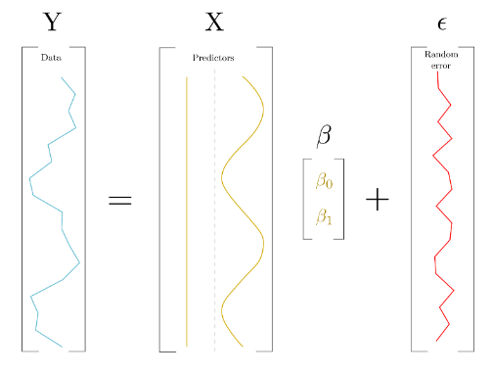
Summary
Slide 11/13

Slide 137
Summary
The Linear Model
Slide 11/13

Slide 138
Summary
The Linear Model
Fits a curve to data by estimating 𝛽 to minimise the residual sum of squares.
Slide 11/13

Slide 139
Summary
The Linear Model
Fits a curve to data by estimating 𝛽 to minimise the residual sum of squares.
We shall use, but not prove, a useful fact about the linear model today:
Slide 11/13

Slide 140
Summary
The Linear Model
Fits a curve to data by estimating 𝛽 to minimise the residual sum of squares.
We shall use, but not prove, a useful fact about the linear model today:
The “best estimate” for 𝛽 has to satisfy this equation:
Slide 11/13

Slide 141

Summary
The Linear Model
Fits a curve to data by estimating 𝛽 to minimise the residual sum of squares.
We shall use, but not prove, a useful fact about the linear model today:
The “best estimate” for 𝛽 has to satisfy this equation:
Slide 11/13

Slide 142
Summary
The Linear Model
Fits a curve to data by estimating 𝛽 to minimise the residual sum of squares.
We shall use, but not prove, a useful fact about the linear model today:
The “best estimate” for 𝛽 has to satisfy this equation:
It turns out that this is enough information for Numpy to compute 𝛽!
Slide 11/13

Slide 143
Summary
The Linear Model
Fits a curve to data by estimating 𝛽 to minimise the residual sum of squares.
We shall use, but not prove, a useful fact about the linear model today:
The “best estimate” for 𝛽 has to satisfy this equation:
It turns out that this is enough information for Numpy to compute 𝛽!
Today, you shall explore how to do this!
Slide 11/13

Slide 144
Summary
The Linear Model
Fits a curve to data by estimating 𝛽 to minimise the residual sum of squares.
We shall use, but not prove, a useful fact about the linear model today:
The “best estimate” for 𝛽 has to satisfy this equation:
It turns out that this is enough information for Numpy to compute 𝛽!
Slide 11/13

Slide 145
Practical
Slide 12/13

Slide 146
Practical
For the rest of today, you must:
Slide 12/13

Slide 147
Practical
For the rest of today, you must:
Read through the material in:
Slide 12/13

Slide 148
Practical
For the rest of today, you must:
Read through the material in: lecture_curve_fitting.ipynb
Slide 12/13

Slide 149
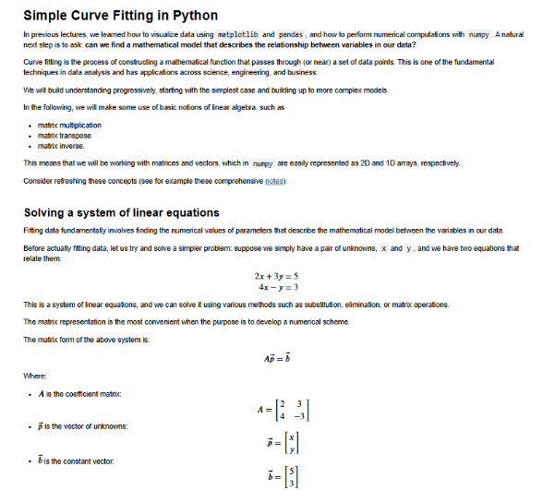
Practical
For the rest of today, you must:
Read through the material in: lecture_curve_fitting.ipynb
Slide 12/13

Slide 150
Practical
For the rest of today, you must:
Read through the material in: lecture_curve_fitting.ipynb
Work through the exercises in:
Slide 12/13

Slide 151
Practical
For the rest of today, you must:
Read through the material in: lecture_curve_fitting.ipynb
Work through the exercises in: exercises_curve_fitting.ipynb
Slide 12/13

Slide 152
Next Time
Lecture 16: Curve Fitting
Overview
The Linear Model
Practical
Lecture 17: Introduction to Software Engineering
Introduction
Principles of Software Engineering
Practical
Slide 13/13

