Slide 1
Lecture 2:
Booleans and Conditionals
SCIF10002 – Introduction to Coding and Data
Tom Maullin-Sapey
2nd October 2025
Slide 0/10

Slide 2
Today’s Lecture
Slide 1/10

Slide 3
Today’s Lecture
Lecture 2: Booleans and Conditionals
Slide 1/10

Slide 4
Today’s Lecture
Lecture 2: Booleans and Conditionals
Recap: Accessing Noteable
Slide 1/10

Slide 5
Today’s Lecture
Lecture 2: Booleans and Conditionals
Recap: Accessing Noteable
Recap: Booleans
Slide 1/10

Slide 6
Today’s Lecture
Lecture 2: Booleans and Conditionals
Recap: Accessing Noteable
Recap: Booleans
If statements
Slide 1/10

Slide 7
Today’s Lecture
Lecture 2: Booleans and Conditionals
Recap: Accessing Noteable
Recap: Booleans
If statements
Practical
Slide 1/10

Slide 8
Today’s Lecture
Lecture 2: Booleans and Conditionals
Recap: Accessing Noteable
Recap: Booleans
If statements
Practical
Lecture 3: Loops
Slide 1/10

Slide 9
Today’s Lecture
Lecture 2: Booleans and Conditionals
Recap: Accessing Noteable
Recap: Booleans
If statements
Practical
Lecture 3: Loops
Recap: Accessing Noteable
Slide 1/10

Slide 10
Today’s Lecture
Lecture 2: Booleans and Conditionals
Recap: Accessing Noteable
Recap: Booleans
If statements
Practical
Lecture 3: Loops
Recap: Accessing Noteable
Recap: If Statements
Slide 1/10

Slide 11
Today’s Lecture
Lecture 2: Booleans and Conditionals
Recap: Accessing Noteable
Recap: Booleans
If statements
Practical
Lecture 3: Loops
Recap: Accessing Noteable
Recap: If Statements
For Loops
Slide 1/10

Slide 12
Today’s Lecture
Lecture 2: Booleans and Conditionals
Recap: Accessing Noteable
Recap: Booleans
If statements
Practical
Lecture 3: Loops
Recap: Accessing Noteable
Recap: If Statements
For Loops
While Loops
Slide 1/10

Slide 13
Today’s Lecture
Lecture 2: Booleans and Conditionals
Recap: Accessing Noteable
Recap: Booleans
If statements
Practical
Lecture 3: Loops
Recap: Accessing Noteable
Recap: If Statements
For Loops
While Loops
Practical
Slide 1/10

Slide 14
Why learn to code?
Slide 2/10

Slide 15
Why learn to code?
Whichever course you are taking you will likely need to write code at some point
Slide 2/10

Slide 16
Why learn to code?
Whichever course you are taking you will likely need to write code at some point
Chemistry
Slide 2/10

Slide 17
Why learn to code?
Whichever course you are taking you will likely need to write code at some point
Chemistry
Analyse experimental data
Slide 2/10

Slide 18
Why learn to code?
Whichever course you are taking you will likely need to write code at some point
Chemistry
Analyse experimental data
Automate repetitive calculations
Slide 2/10

Slide 19
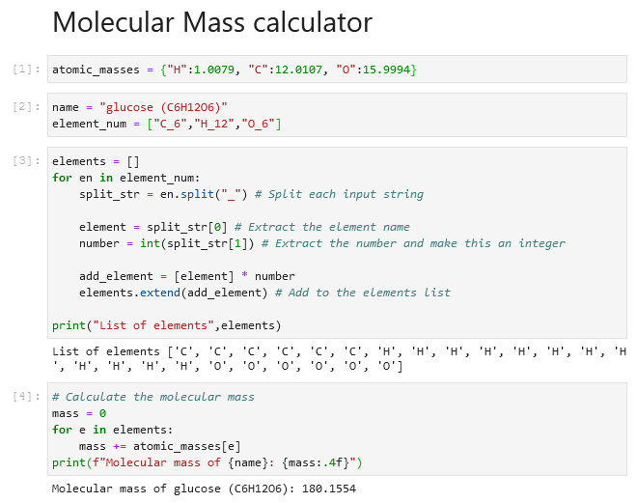
Why learn to code?
Whichever course you are taking you will likely need to write code at some point
Chemistry
Analyse experimental data
Automate repetitive calculations
Slide 2/10

Slide 20
Why learn to code?
Whichever course you are taking you will likely need to write code at some point
Chemistry
Analyse experimental data
Automate repetitive calculations
Model chemical reactions/simulations
Slide 2/10

Slide 21
Why learn to code?
Whichever course you are taking you will likely need to write code at some point
Chemistry
Analyse experimental data
Automate repetitive calculations
Model chemical reactions/simulations
Slide 2/10

Slide 22
Why learn to code?
Whichever course you are taking you will likely need to write code at some point
Chemistry
Analyse experimental data
Automate repetitive calculations
Model chemical reactions/simulations
Physics
Slide 2/10

Slide 23
Why learn to code?
Whichever course you are taking you will likely need to write code at some point
Chemistry
Analyse experimental data
Automate repetitive calculations
Model chemical reactions/simulations
Physics
Simulate physical systems
Slide 2/10

Slide 24
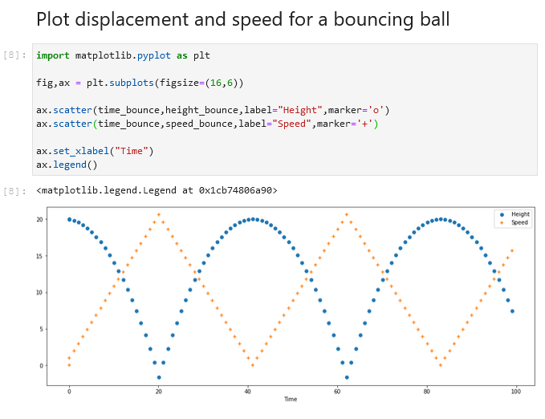
Why learn to code?
Whichever course you are taking you will likely need to write code at some point
Chemistry
Analyse experimental data
Automate repetitive calculations
Model chemical reactions/simulations
Physics
Simulate physical systems
Slide 2/10

Slide 25
Why learn to code?
Whichever course you are taking you will likely need to write code at some point
Chemistry
Analyse experimental data
Automate repetitive calculations
Model chemical reactions/simulations
Physics
Simulate physical systems
Process experimental measurements
Slide 2/10

Slide 26
Why learn to code?
Whichever course you are taking you will likely need to write code at some point
Chemistry
Analyse experimental data
Automate repetitive calculations
Model chemical reactions/simulations
Physics
Simulate physical systems
Process experimental measurements
Visualise complex phenomena
Slide 2/10

Slide 27
Why learn to code?
Whichever course you are taking you will likely need to write code at some point
Chemistry
Analyse experimental data
Automate repetitive calculations
Model chemical reactions/simulations
Physics
Simulate physical systems
Process experimental measurements
Visualise complex phenomena
Slide 2/10

Slide 28
Why learn to code?
Whichever course you are taking you will likely need to write code at some point
Chemistry
Analyse experimental data
Automate repetitive calculations
Model chemical reactions/simulations
Physics
Simulate physical systems
Process experimental measurements
Visualise complex phenomena
Data Science
Slide 2/10

Slide 29
Why learn to code?
Whichever course you are taking you will likely need to write code at some point
Chemistry
Analyse experimental data
Automate repetitive calculations
Model chemical reactions/simulations
Physics
Simulate physical systems
Process experimental measurements
Visualise complex phenomena
Data Science
Clean and organise datasets
Slide 2/10

Slide 30
Why learn to code?
Whichever course you are taking you will likely need to write code at some point
Chemistry
Analyse experimental data
Automate repetitive calculations
Model chemical reactions/simulations
Physics
Simulate physical systems
Process experimental measurements
Visualise complex phenomena
Data Science
Clean and organise datasets
Apply statistical methods and machine learning
Slide 2/10

Slide 31
Why learn to code?
Whichever course you are taking you will likely need to write code at some point
Chemistry
Analyse experimental data
Automate repetitive calculations
Model chemical reactions/simulations
Physics
Simulate physical systems
Process experimental measurements
Visualise complex phenomena
Data Science
Clean and organise datasets
Apply statistical methods and machine learning
Communicate insights with visualisations
Slide 2/10

Slide 32
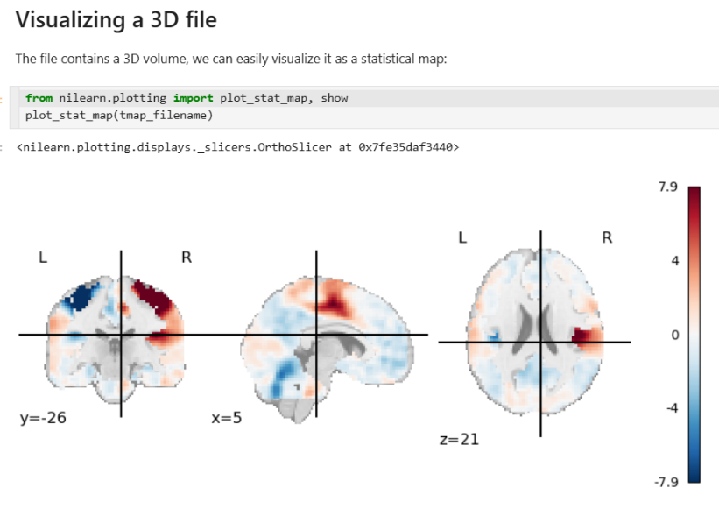
Why learn to code?
Whichever course you are taking you will likely need to write code at some point
Chemistry
Analyse experimental data
Automate repetitive calculations
Model chemical reactions/simulations
Physics
Simulate physical systems
Process experimental measurements
Visualise complex phenomena
Data Science
Clean and organise datasets
Apply statistical methods and machine learning
Communicate insights with visualisations
Slide 2/10

Slide 33
Recap: Accessing Noteable
Slide 3/10

Slide 34
Recap: Accessing Noteable
Open Blackboard
Slide 3/10

Slide 35
Recap: Accessing Noteable
Open Blackboard
Go to “Introduction to Coding and Data Analysis for Scientists 2025”
Slide 3/10

Slide 36
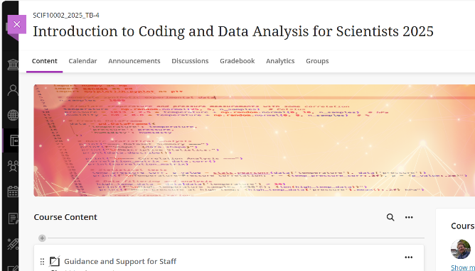
Recap: Accessing Noteable
Open Blackboard
Go to “Introduction to Coding and Data Analysis for Scientists 2025”
Slide 3/10

Slide 37
Recap: Accessing Noteable
Open Blackboard
Go to “Introduction to Coding and Data Analysis for Scientists 2025”
Click “Unit Information and Resources”
Slide 3/10

Slide 38
Recap: Accessing Noteable
Open Blackboard
Go to “Introduction to Coding and Data Analysis for Scientists 2025”
Click “Unit Information and Resources”
Open Noteable
Slide 3/10

Slide 39
Recap: Accessing Noteable
Open Blackboard
Go to “Introduction to Coding and Data Analysis for Scientists 2025”
Click “Unit Information and Resources”
Open Noteable
Make sure “Jupyter Classic (Legacy)” is selected.
Slide 3/10

Slide 40
Recap: Accessing Noteable
Open Blackboard
Go to “Introduction to Coding and Data Analysis for Scientists 2025”
Click “Unit Information and Resources”
Open Noteable
Make sure “Jupyter Classic (Legacy)” is selected.
Click Start
Slide 3/10

Slide 41
Recap: Accessing Noteable
Open Blackboard
Go to “Introduction to Coding and Data Analysis for Scientists 2025”
Click “Unit Information and Resources”
Open Noteable
Make sure “Jupyter Classic (Legacy)” is selected.
Click Start
Click “+GitRepo”
Slide 3/10

Slide 42
Recap: Accessing Noteable
Open Blackboard
Go to “Introduction to Coding and Data Analysis for Scientists 2025”
Click “Unit Information and Resources”
Open Noteable
Make sure “Jupyter Classic (Legacy)” is selected.
Click Start
Click “+GitRepo”
Slide 3/10

Slide 43
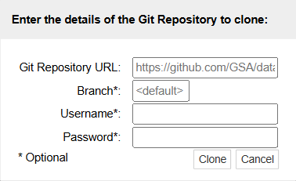
Recap: Accessing Noteable
Open Blackboard
Go to “Introduction to Coding and Data Analysis for Scientists 2025”
Click “Unit Information and Resources”
Open Noteable
Make sure “Jupyter Classic (Legacy)” is selected.
Click Start
Click “+GitRepo”
Slide 3/10

Slide 44
Recap: Accessing Noteable
Open Blackboard
Go to “Introduction to Coding and Data Analysis for Scientists 2025”
Click “Unit Information and Resources”
Open Noteable
Make sure “Jupyter Classic (Legacy)” is selected.
Click Start
Click “+GitRepo”
Paste into Git Repository URL: git@github.com:TomMaullin/SCIF10002-2025.git
Slide 3/10

Slide 45
Recap: Accessing Noteable
Open Blackboard
Go to “Introduction to Coding and Data Analysis for Scientists 2025”
Click “Unit Information and Resources”
Open Noteable
Make sure “Jupyter Classic (Legacy)” is selected.
Click Start
Click “+GitRepo”
Paste into Git Repository URL: git@github.com:TomMaullin/SCIF10002-2025.git
Press clone
Slide 3/10

Slide 46
Recap: Last Time
Slide 4/10

Slide 47
Recap: Last Time
Last week, we started looking at the Python language
Slide 4/10

Slide 48
Recap: Last Time
Last week, we started looking at the Python language
We saw that variables can be assigned values using =
Slide 4/10

Slide 49


Recap: Last Time
Last week, we started looking at the Python language
We saw that variables can be assigned values using =
Slide 4/10

Slide 50
Recap: Last Time
Last week, we started looking at the Python language
We saw that variables can be assigned values using =
To display the values of variables we can use print
Slide 4/10

Slide 51
Recap: Last Time
Last week, we started looking at the Python language
We saw that variables can be assigned values using =
To display the values of variables we can use print
Slide 4/10

Slide 52
Recap: Last Time
Last week, we started looking at the Python language
We saw that variables can be assigned values using =
To display the values of variables we can use print
Variables have their own Data Types
Slide 4/10

Slide 53
Recap: Last Time
Last week, we started looking at the Python language
We saw that variables can be assigned values using =
To display the values of variables we can use print
Variables have their own Data Types
Strings are sequences of characters
Slide 4/10

Slide 54

Recap: Last Time
Last week, we started looking at the Python language
We saw that variables can be assigned values using =
To display the values of variables we can use print
Variables have their own Data Types
Strings are sequences of characters
Slide 4/10

Slide 55
Recap: Last Time
Last week, we started looking at the Python language
We saw that variables can be assigned values using =
To display the values of variables we can use print
Variables have their own Data Types
Strings are sequences of characters
Floats are decimals, Ints are integers
Slide 4/10

Slide 56
Recap: Last Time
Last week, we started looking at the Python language
We saw that variables can be assigned values using =
To display the values of variables we can use print
Variables have their own Data Types
Strings are sequences of characters
Floats are decimals, Ints are integers
Booleans are True/False values
Slide 4/10

Slide 57

Recap: Last Time
Last week, we started looking at the Python language
We saw that variables can be assigned values using =
To display the values of variables we can use print
Variables have their own Data Types
Strings are sequences of characters
Floats are decimals, Ints are integers
Booleans are True/False values
Slide 4/10

Slide 58
Recap: Last Time
Last week, we started looking at the Python language
We saw that variables can be assigned values using =
To display the values of variables we can use print
Variables have their own Data Types
Strings are sequences of characters
Floats are decimals, Ints are integers
Booleans are True/False values
Lists are ordered groups of items
Slide 4/10

Slide 59

Recap: Last Time
Last week, we started looking at the Python language
We saw that variables can be assigned values using =
To display the values of variables we can use print
Variables have their own Data Types
Strings are sequences of characters
Floats are decimals, Ints are integers
Booleans are True/False values
Lists are ordered groups of items
Slide 4/10

Slide 60
Recap: Last Time
Last week, we started looking at the Python language
We saw that variables can be assigned values using =
To display the values of variables we can use print
Variables have their own Data Types
Strings are sequences of characters
Floats are decimals, Ints are integers
Booleans are True/False values
Lists are ordered groups of items
We spent some time looking at various things we could do with some of these data types
Slide 4/10

Slide 61
Recap: Booleans
Slide 5/10

Slide 62
Recap: Booleans
A Boolean is variable that can be either True or False
Slide 5/10

Slide 63
Recap: Booleans
A Boolean is variable that can be either True or False
Booleans represent logical statements.
Slide 5/10

Slide 64
Recap: Booleans
A Boolean is variable that can be either True or False
Booleans represent logical statements.
For instance, we saw an example where:
Slide 5/10

Slide 65
Recap: Booleans
A Boolean is variable that can be either True or False
Booleans represent logical statements.
For instance, we saw an example where:
cat_is_black represented the sentence “The cat is black”
Slide 5/10

Slide 66
Recap: Booleans
A Boolean is variable that can be either True or False
Booleans represent logical statements.
For instance, we saw an example where:
cat_is_black represented the sentence “The cat is black”
cat_has_four_legs represented the sentence “The cat has four legs”
Slide 5/10

Slide 67
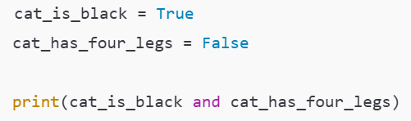

Recap: Booleans
A Boolean is variable that can be either True or False
Booleans represent logical statements.
For instance, we saw an example where:
cat_is_black represented the sentence “The cat is black”
cat_has_four_legs represented the sentence “The cat has four legs”
Slide 5/10

Slide 68
Recap: Booleans
A Boolean is variable that can be either True or False
Booleans represent logical statements.
For instance, we saw an example where:
cat_is_black represented the sentence “The cat is black”
cat_has_four_legs represented the sentence “The cat has four legs”
We used logical operators to combine Boolean statements
Slide 5/10

Slide 69
Recap: Booleans
A Boolean is variable that can be either True or False
Booleans represent logical statements.
For instance, we saw an example where:
cat_is_black represented the sentence “The cat is black”
cat_has_four_legs represented the sentence “The cat has four legs”
We used logical operators to combine Boolean statements
cat_is_black and cat_has_four_legs represented the sentence “The cat is black and has four legs”
Slide 5/10

Slide 70
Recap: Booleans
A Boolean is variable that can be either True or False
Booleans represent logical statements.
For instance, we saw an example where:
cat_is_black represented the sentence “The cat is black”
cat_has_four_legs represented the sentence “The cat has four legs”
We used logical operators to combine Boolean statements
cat_is_black and cat_has_four_legs represented the sentence “The cat is black and has four legs”
Slide 5/10

Slide 71




Recap: Booleans
A Boolean is variable that can be either True or False
Booleans represent logical statements.
For instance, we saw an example where:
cat_is_black represented the sentence “The cat is black”
cat_has_four_legs represented the sentence “The cat has four legs”
We used logical operators to combine Boolean statements
cat_is_black and cat_has_four_legs represented the sentence “The cat is black and has four legs”
Slide 5/10

Slide 72
If Statements
Slide 6/10

Slide 73
If Statements
We should be starting to feel comfortable with giving a computer instructions via code
Slide 6/10

Slide 74



If Statements
We should be starting to feel comfortable with giving a computer instructions via code
Slide 6/10

Slide 75
If Statements
We should be starting to feel comfortable with giving a computer instructions via code
But sometimes, we don’t want every line to run automatically
Slide 6/10

Slide 76
If Statements
We should be starting to feel comfortable with giving a computer instructions via code
But sometimes, we don’t want every line to run automatically
Instead, we may want Python to act only when a specific condition is true
Slide 6/10

Slide 77
If Statements
We should be starting to feel comfortable with giving a computer instructions via code
But sometimes, we don’t want every line to run automatically
Instead, we may want Python to act only when a specific condition is true
Slide 6/10

Slide 78
If Statements
We should be starting to feel comfortable with giving a computer instructions via code
But sometimes, we don’t want every line to run automatically
Instead, we may want Python to act only when a specific condition is true
True/False… should be thinking Booleans!
Slide 6/10

Slide 79
If Statements
We should be starting to feel comfortable with giving a computer instructions via code
But sometimes, we don’t want every line to run automatically
Instead, we may want Python to act only when a specific condition is true
Slide 6/10

Slide 80
If Statements
We should be starting to feel comfortable with giving a computer instructions via code
But sometimes, we don’t want every line to run automatically
Instead, we may want Python to act only when a specific condition is true
This is where the if statement comes in…
Slide 6/10

Slide 81
If Statements
Slide 7/10

Slide 82
If Statements
An if statement lets you run code when a Boolean statement is True
Slide 7/10

Slide 83
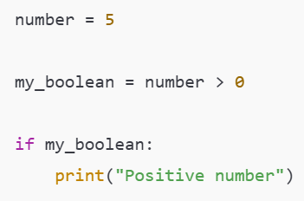
If Statements
An if statement lets you run code when a Boolean statement is True
Slide 7/10

Slide 84
If Statements
An if statement lets you run code when a Boolean statement is True
Slide 7/10

Slide 85
If Statements
An if statement lets you run code when a Boolean statement is True
Slide 7/10

Slide 86
If Statements
An if statement lets you run code when a Boolean statement is True
Slide 7/10

Slide 87
If Statements
An if statement lets you run code when a Boolean statement is True
Slide 7/10

Slide 88
If Statements
An if statement lets you run code when a Boolean statement is True
Integer value
Slide 7/10

Slide 89
If Statements
An if statement lets you run code when a Boolean statement is True
Slide 7/10

Slide 90
If Statements
An if statement lets you run code when a Boolean statement is True
Boolean value This is True if the number is positive, False otherwise
Slide 7/10

Slide 91
If Statements
An if statement lets you run code when a Boolean statement is True
Boolean value This is True if the number is positive, False otherwise
Slide 7/10

Slide 92
If Statements
An if statement lets you run code when a Boolean statement is True
Slide 7/10

Slide 93
If Statements
An if statement lets you run code when a Boolean statement is True
Translation: If the number is positive, print “positive number”
Slide 7/10

Slide 94
If Statements
An if statement lets you run code when a Boolean statement is True
Translation: If the number is positive, print “positive number”
Slide 7/10

Slide 95
If Statements
An if statement lets you run code when a Boolean statement is True
Slide 7/10

Slide 96
If Statements
An if statement lets you run code when a Boolean statement is True
If keyword
Slide 7/10

Slide 97
If Statements
An if statement lets you run code when a Boolean statement is True
Slide 7/10

Slide 98
If Statements
An if statement lets you run code when a Boolean statement is True
Colon
Slide 7/10

Slide 99
If Statements
An if statement lets you run code when a Boolean statement is True
Slide 7/10

Slide 100
If Statements
An if statement lets you run code when a Boolean statement is True
Body of the if statement
Everything here will be run if the Boolean is True
Slide 7/10

Slide 101
If Statements
An if statement lets you run code when a Boolean statement is True
Body of the if statement
Everything here will be run if the Boolean is True
Slide 7/10

Slide 102
If Statements
An if statement lets you run code when a Boolean statement is True
Slide 7/10

Slide 103
If Statements
An if statement lets you run code when a Boolean statement is True
Indentation: This is important! Python tells what is in the body by looking at which code is indented!
Slide 7/10

Slide 104
If Statements
An if statement lets you run code when a Boolean statement is True
Indentation: This is important! Python tells what is in the body by looking at which code is indented!
Slide 7/10

Slide 105
If Statements
An if statement lets you run code when a Boolean statement is True
Slide 7/10

Slide 106
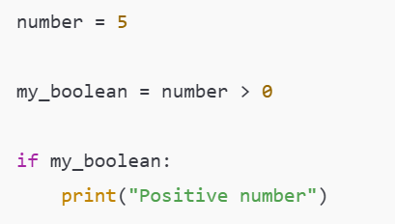
If Statements
An if statement lets you run code when a Boolean statement is True
Slide 8/10

Slide 107
If Statements
An if statement lets you run code when a Boolean statement is True
Often we don’t bother naming the boolean, and instead write it directly inside the if statement
Slide 8/10

Slide 108
If Statements
An if statement lets you run code when a Boolean statement is True
Often we don’t bother naming the boolean, and instead write it directly inside the if statement
Slide 8/10

Slide 109
If Statements
An if statement lets you run code when a Boolean statement is True
Often we don’t bother naming the boolean, and instead write it directly inside the if statement
Slide 8/10

Slide 110
If Statements
An if statement lets you run code when a Boolean statement is True
Often we don’t bother naming the boolean, and instead write it directly inside the if statement
Slide 8/10

Slide 111
If Statements
An if statement lets you run code when a Boolean statement is True
Often we don’t bother naming the boolean, and instead write it directly inside the if statement
Slide 8/10

Slide 112
If Statements
An if statement lets you run code when a Boolean statement is True
Often we don’t bother naming the boolean, and instead write it directly inside the if statement
Slide 8/10

Slide 113

If Statements
An if statement lets you run code when a Boolean statement is True
Often we don’t bother naming the boolean, and instead write it directly inside the if statement
Slide 8/10

Slide 114
If Statements
An if statement lets you run code when a Boolean statement is True
Slide 8/10

Slide 115
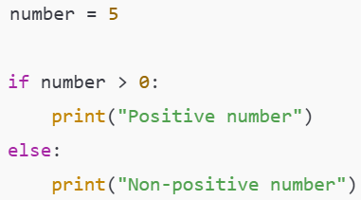
If Statements
An if statement lets you run code when a Boolean statement is True
Slide 8/10

Slide 116
If Statements
An if statement lets you run code when a Boolean statement is True
We can also tell the if statement what to do when the Boolean is False by using else
Slide 8/10

Slide 117
If Statements
An if statement lets you run code when a Boolean statement is True
We can also tell the if statement what to do when the Boolean is False by using else
Slide 8/10

Slide 118
If Statements
An if statement lets you run code when a Boolean statement is True
We can also tell the if statement what to do when the Boolean is False by using else
Translation: If the number is positive, print “positive number”, otherwise print “Non-positive number”
Slide 8/10

Slide 119
If Statements
An if statement lets you run code when a Boolean statement is True
We can also tell the if statement what to do when the Boolean is False by using else
Slide 8/10

Slide 120
If Statements
An if statement lets you run code when a Boolean statement is True
We can also tell the if statement what to do when the Boolean is False by using else
An elif (short for else if) can be added to check more extra conditions.
Slide 8/10

Slide 121
If Statements
An if statement lets you run code when a Boolean statement is True
We can also tell the if statement what to do when the Boolean is False by using else
An elif (short for else if) can be added to check more extra conditions.
Slide 8/10

Slide 122
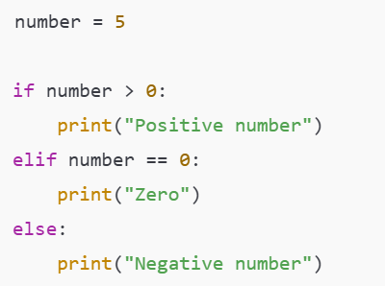
If Statements
An if statement lets you run code when a Boolean statement is True
We can also tell the if statement what to do when the Boolean is False by using else
An elif (short for else if) can be added to check more extra conditions.
Slide 8/10

Slide 123
If Statements
An if statement lets you run code when a Boolean statement is True
We can also tell the if statement what to do when the Boolean is False by using else
An elif (short for else if) can be added to check more extra conditions.
Slide 8/10

Slide 124
If Statements
An if statement lets you run code when a Boolean statement is True
We can also tell the if statement what to do when the Boolean is False by using else
An elif (short for else if) can be added to check more extra conditions.
Slide 8/10

Slide 125
If Statements
An if statement lets you run code when a Boolean statement is True
We can also tell the if statement what to do when the Boolean is False by using else
An elif (short for else if) can be added to check more extra conditions.
First, the if statement is checked…
Slide 8/10

Slide 126
If Statements
An if statement lets you run code when a Boolean statement is True
We can also tell the if statement what to do when the Boolean is False by using else
An elif (short for else if) can be added to check more extra conditions.
First, the if statement is checked…
Slide 8/10

Slide 127
If Statements
An if statement lets you run code when a Boolean statement is True
We can also tell the if statement what to do when the Boolean is False by using else
An elif (short for else if) can be added to check more extra conditions.
First, the if statement is checked…
Slide 8/10

Slide 128
If Statements
An if statement lets you run code when a Boolean statement is True
We can also tell the if statement what to do when the Boolean is False by using else
An elif (short for else if) can be added to check more extra conditions.
First, the if statement is checked…
Slide 8/10

Slide 129
If Statements
An if statement lets you run code when a Boolean statement is True
We can also tell the if statement what to do when the Boolean is False by using else
An elif (short for else if) can be added to check more extra conditions.
First, the if statement is checked…
Slide 8/10

Slide 130
If Statements
An if statement lets you run code when a Boolean statement is True
We can also tell the if statement what to do when the Boolean is False by using else
An elif (short for else if) can be added to check more extra conditions.
First, the if statement is checked…
If the condition in the if is False, the elif is checked…
Slide 8/10

Slide 131
If Statements
An if statement lets you run code when a Boolean statement is True
We can also tell the if statement what to do when the Boolean is False by using else
An elif (short for else if) can be added to check more extra conditions.
First, the if statement is checked…
If the condition in the if is False, the elif is checked…
Slide 8/10

Slide 132
If Statements
An if statement lets you run code when a Boolean statement is True
We can also tell the if statement what to do when the Boolean is False by using else
An elif (short for else if) can be added to check more extra conditions.
First, the if statement is checked…
If the condition in the if is False, the elif is checked…
Slide 8/10

Slide 133
If Statements
An if statement lets you run code when a Boolean statement is True
We can also tell the if statement what to do when the Boolean is False by using else
An elif (short for else if) can be added to check more extra conditions.
First, the if statement is checked…
If the condition in the if is False, the elif is checked…
Slide 8/10

Slide 134
If Statements
An if statement lets you run code when a Boolean statement is True
We can also tell the if statement what to do when the Boolean is False by using else
An elif (short for else if) can be added to check more extra conditions.
First, the if statement is checked…
If the condition in the if is False, the elif is checked…
Slide 8/10

Slide 135
If Statements
An if statement lets you run code when a Boolean statement is True
We can also tell the if statement what to do when the Boolean is False by using else
An elif (short for else if) can be added to check more extra conditions.
First, the if statement is checked…
If the condition in the if is False, the elif is checked…
Lastly, if the if and elif conditions are False, the else is checked
Slide 8/10

Slide 136
If Statements
An if statement lets you run code when a Boolean statement is True
We can also tell the if statement what to do when the Boolean is False by using else
An elif (short for else if) can be added to check more extra conditions.
First, the if statement is checked…
If the condition in the if is False, the elif is checked…
Lastly, if the if and elif conditions are False, the else is checked
Slide 8/10

Slide 137
If Statements
An if statement lets you run code when a Boolean statement is True
We can also tell the if statement what to do when the Boolean is False by using else
An elif (short for else if) can be added to check more extra conditions.
First, the if statement is checked…
If the condition in the if is False, the elif is checked…
Lastly, if the if and elif conditions are False, the else is checked
Slide 8/10

Slide 138
If Statements
An if statement lets you run code when a Boolean statement is True
We can also tell the if statement what to do when the Boolean is False by using else
An elif (short for else if) can be added to check more extra conditions.
Slide 8/10

Slide 139
If Statements
An if statement lets you run code when a Boolean statement is True
We can also tell the if statement what to do when the Boolean is False by using else
An elif (short for else if) can be added to check more extra conditions.
Multiple elif can be added.
Slide 8/10

Slide 140
Practical
Slide 9/10

Slide 141
Practical
We now move over to Python
Slide 9/10

Slide 142
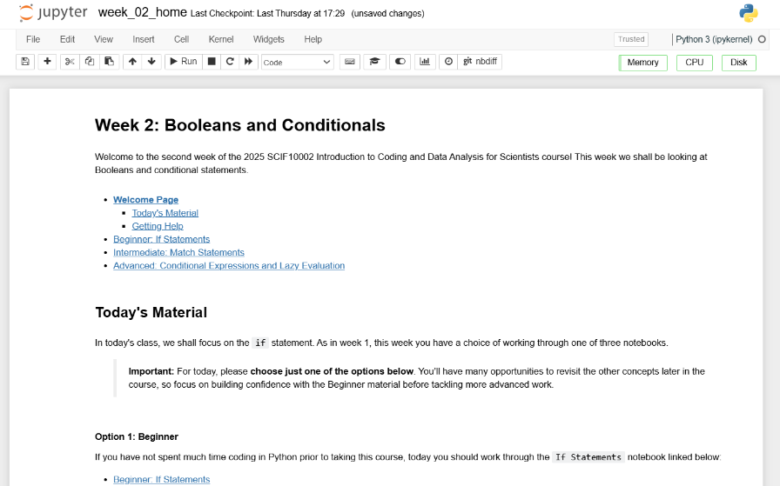
Practical
We now move over to Python
Slide 9/10

Slide 143
Practical
We now move over to Python
Please open `week_02_home.ipynb`
Slide 9/10

Slide 144
Practical
We now move over to Python
Please open `week_02_home.ipynb`
For the rest of today, you must work through a Python notebook
Slide 9/10

Slide 145
Practical
We now move over to Python
Please open `week_02_home.ipynb`
For the rest of today, you must work through a Python notebook
You have a choice of one of three options
Slide 9/10

Slide 146
Practical
We now move over to Python
Please open `week_02_home.ipynb`
For the rest of today, you must work through a Python notebook
You have a choice of one of three options
Option 1: Beginner – If Statements
Slide 9/10

Slide 147
Practical
We now move over to Python
Please open `week_02_home.ipynb`
For the rest of today, you must work through a Python notebook
You have a choice of one of three options
Option 1: Beginner – If Statements
Option 2: Intermediate – Match Statements
Slide 9/10

Slide 148
Practical
We now move over to Python
Please open `week_02_home.ipynb`
For the rest of today, you must work through a Python notebook
You have a choice of one of three options
Option 1: Beginner – If Statements
Option 2: Intermediate – Match Statements
Option 3: Advanced – Conditional Expressions and Lazy Evaluation
Slide 9/10

Slide 149
Practical
We now move over to Python
Please open `week_02_home.ipynb`
For the rest of today, you must work through a Python notebook
You have a choice of one of three options
Option 1: Beginner – If Statements
Option 2: Intermediate – Match Statements
Option 3: Advanced – Conditional Expressions and Lazy Evaluation
Choose this if you are not familiar with, or confident on, if statements
Slide 9/10

Slide 150
Practical
We now move over to Python
Please open `week_02_home.ipynb`
For the rest of today, you must work through a Python notebook
You have a choice of one of three options
Option 1: Beginner – If Statements
Option 2: Intermediate – Match Statements
Option 3: Advanced – Conditional Expressions and Lazy Evaluation
Slide 9/10

Slide 151
Practical
We now move over to Python
Please open `week_02_home.ipynb`
For the rest of today, you must work through a Python notebook
You have a choice of one of three options
Option 1: Beginner – If Statements
Option 2: Intermediate – Match Statements
Option 3: Advanced – Conditional Expressions and Lazy Evaluation
Choose this if you have strong experience coding if statements in Python
Slide 9/10

Slide 152
Practical
We now move over to Python
Please open `week_02_home.ipynb`
For the rest of today, you must work through a Python notebook
You have a choice of one of three options
Option 1: Beginner – If Statements
Option 2: Intermediate – Match Statements
Option 3: Advanced – Conditional Expressions and Lazy Evaluation
Slide 9/10

Slide 153
Practical
We now move over to Python
Please open `week_02_home.ipynb`
For the rest of today, you must work through a Python notebook
You have a choice of one of three options
Option 1: Beginner – If Statements
Option 2: Intermediate – Match Statements
Option 3: Advanced – Conditional Expressions and Lazy Evaluation
Choose this if you are a strong Python programmer with several years experience
Slide 9/10

Slide 154
Practical
We now move over to Python
Please open `week_02_home.ipynb`
For the rest of today, you must work through a Python notebook
You have a choice of one of three options
Option 1: Beginner – If Statements
Option 2: Intermediate – Match Statements
Option 3: Advanced – Conditional Expressions and Lazy Evaluation
Slide 9/10

Slide 155
Practical
We now move over to Python
Please open `week_02_home.ipynb`
For the rest of today, you must work through a Python notebook
You have a choice of one of three options
Option 1: Beginner – If Statements
Option 2: Intermediate – Match Statements
Option 3: Advanced – Conditional Expressions and Lazy Evaluation
Important: If you choose the intermediate or advanced options, make sure you are comfortable with the material in Beginner first!!
Slide 9/10

Slide 156
Practical
We now move over to Python
Please open `week_02_home.ipynb`
For the rest of today, you must work through a Python notebook
You have a choice of one of three options
Option 1: Beginner – If Statements
Option 2: Intermediate – Match Statements
Option 3: Advanced – Conditional Expressions and Lazy Evaluation
Slide 9/10

Slide 157
Next Time
Lecture 2: Booleans and Conditionals
Recap Accessing Noteable
Recap: Booleans
If statements
Practical
Lecture 3: Loops
Recap: Accessing Noteable
Recap: If Statements
For Loops
While Loops
Practical
Slide 10/10

