Slide 1
Lecture 7:
Working with NumPy Arrays
SCIF10002 – Introduction to Coding and Data
Tom Maullin-Sapey
13th November 2025
Slide 0/14

Slide 2
Today’s Lecture
Slide 1/14

Slide 3
Today’s Lecture
Lecture 7: Working with NumPy Arrays
Slide 1/14

Slide 4
Today’s Lecture
Lecture 7: Working with NumPy Arrays
Array indexing and slicing
Slide 1/14

Slide 5
Today’s Lecture
Lecture 7: Working with NumPy Arrays
Array indexing and slicing
Boolean indexing
Slide 1/14

Slide 6
Today’s Lecture
Lecture 7: Working with NumPy Arrays
Array indexing and slicing
Boolean indexing
Array generation functions
Slide 1/14

Slide 7
Today’s Lecture
Lecture 7: Working with NumPy Arrays
Array indexing and slicing
Boolean indexing
Array generation functions
Random data generation
Slide 1/14

Slide 8
Today’s Lecture
Lecture 7: Working with NumPy Arrays
Array indexing and slicing
Boolean indexing
Array generation functions
Random data generation
Practical
Slide 1/14

Slide 9
Today’s Lecture
Lecture 7: Working with NumPy Arrays
Array indexing and slicing
Boolean indexing
Array generation functions
Random data generation
Practical
Lecture 8: Plotting with Matplotlib
Figures and axes
Annotating and adding features
Types of plot
Anatomy of a plot
Practical
Slide 1/14

Slide 10
Overview
Slide 2/14

Slide 11
Overview
Last week, we met the NumPy module.
Slide 2/14

Slide 12

Overview
Last week, we met the NumPy module.
Slide 2/14

Slide 13
Overview
Last week, we met the NumPy module.
Slide 2/14

Slide 14
Overview
Last week, we met the NumPy module.
In particular, we started working with the NumPy array.
Slide 2/14

Slide 15
Overview
Last week, we met the NumPy module.
In particular, we started working with the NumPy array.
Slide 2/14

Slide 16
Overview
Last week, we met the NumPy module.
In particular, we started working with the NumPy array.
Today, we continue with NumPy arrays.
Slide 2/14

Slide 17
Overview
Last week, we met the NumPy module.
In particular, we started working with the NumPy array.
Today, we continue with NumPy arrays. Specifically, we will look at:
Slide 2/14

Slide 18
Overview
Last week, we met the NumPy module.
In particular, we started working with the NumPy array.
Today, we continue with NumPy arrays. Specifically, we will look at:
Array indexing and slicing
Slide 2/14

Slide 19
Overview
Last week, we met the NumPy module.
In particular, we started working with the NumPy array.
Today, we continue with NumPy arrays. Specifically, we will look at:
Array indexing and slicing
Boolean indexing
Slide 2/14

Slide 20
Overview
Last week, we met the NumPy module.
In particular, we started working with the NumPy array.
Today, we continue with NumPy arrays. Specifically, we will look at:
Array indexing and slicing
Boolean indexing
Array generation functions
Slide 2/14

Slide 21
Overview
Last week, we met the NumPy module.
In particular, we started working with the NumPy array.
Today, we continue with NumPy arrays. Specifically, we will look at:
Array indexing and slicing
Boolean indexing
Array generation functions
Random data generation
Slide 2/14

Slide 22
Overview
Last week, we met the NumPy module.
In particular, we started working with the NumPy array.
Today, we continue with NumPy arrays. Specifically, we will look at:
Array indexing and slicing
Boolean indexing
Array generation functions
Random data generation
Slide 2/14

Slide 23
Array Indexing and Slicing
Slide 3/14

Slide 24
Array Indexing and Slicing
Slide 3/14

Slide 25
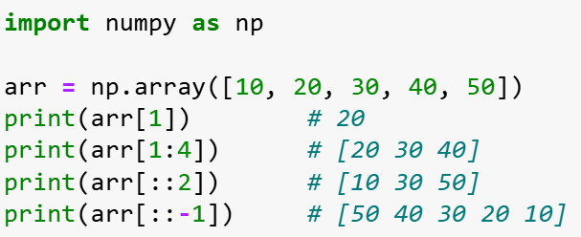

Array Indexing and Slicing
Slide 3/14

Slide 26
Array Indexing and Slicing
Slide 3/14

Slide 27
Array Indexing and Slicing
Slide 3/14

Slide 28
Array Indexing and Slicing
We can access array elements using integer indices and slicing:
Slide 3/14

Slide 29
Array Indexing and Slicing
We can access array elements using integer indices and slicing:
Single element: arr[1] gets element at position 1
Slide 3/14

Slide 30
Array Indexing and Slicing
We can access array elements using integer indices and slicing:
Single element: arr[1] gets element at position 1
Slide 3/14

Slide 31
Array Indexing and Slicing
We can access array elements using integer indices and slicing:
Single element: arr[1] gets element at position 1
Slide 3/14

Slide 32
Array Indexing and Slicing
We can access array elements using integer indices and slicing:
Single element: arr[1] gets element at position 1
Slice range: arr[1:4] extracts elements 1 to 3 (end exclusive)
Slide 3/14

Slide 33
Array Indexing and Slicing
We can access array elements using integer indices and slicing:
Single element: arr[1] gets element at position 1
Slice range: arr[1:4] extracts elements 1 to 3 (end exclusive)
Slide 3/14

Slide 34
Array Indexing and Slicing
We can access array elements using integer indices and slicing:
Single element: arr[1] gets element at position 1
Slice range: arr[1:4] extracts elements 1 to 3 (end exclusive)
Slide 3/14

Slide 35
Array Indexing and Slicing
We can access array elements using integer indices and slicing:
Single element: arr[1] gets element at position 1
Slice range: arr[1:4] extracts elements 1 to 3 (end exclusive)
Step size: arr[::2] takes every 2nd element
Slide 3/14

Slide 36
Array Indexing and Slicing
We can access array elements using integer indices and slicing:
Single element: arr[1] gets element at position 1
Slice range: arr[1:4] extracts elements 1 to 3 (end exclusive)
Step size: arr[::2] takes every 2nd element
Slide 3/14

Slide 37
Array Indexing and Slicing
We can access array elements using integer indices and slicing:
Single element: arr[1] gets element at position 1
Slice range: arr[1:4] extracts elements 1 to 3 (end exclusive)
Step size: arr[::2] takes every 2nd element
Slide 3/14

Slide 38
Array Indexing and Slicing
We can access array elements using integer indices and slicing:
Single element: arr[1] gets element at position 1
Slice range: arr[1:4] extracts elements 1 to 3 (end exclusive)
Step size: arr[::2] takes every 2nd element
Reverse: arr[::-1] reverses the entire array
Slide 3/14

Slide 39
Array Indexing and Slicing
We can access array elements using integer indices and slicing:
Single element: arr[1] gets element at position 1
Slice range: arr[1:4] extracts elements 1 to 3 (end exclusive)
Step size: arr[::2] takes every 2nd element
Reverse: arr[::-1] reverses the entire array
Slide 3/14

Slide 40
Array Indexing and Slicing
We can access array elements using integer indices and slicing:
Single element: arr[1] gets element at position 1
Slice range: arr[1:4] extracts elements 1 to 3 (end exclusive)
Step size: arr[::2] takes every 2nd element
Reverse: arr[::-1] reverses the entire array
Slide 3/14

Slide 41
Array Indexing and Slicing
We can access array elements using integer indices and slicing:
Single element: arr[1] gets element at position 1
Slice range: arr[1:4] extracts elements 1 to 3 (end exclusive)
Step size: arr[::2] takes every 2nd element
Reverse: arr[::-1] reverses the entire array
Taking a step size of 1, but backwards!
Slide 3/14

Slide 42
Array Indexing and Slicing
We can access array elements using integer indices and slicing:
Single element: arr[1] gets element at position 1
Slice range: arr[1:4] extracts elements 1 to 3 (end exclusive)
Step size: arr[::2] takes every 2nd element
Reverse: arr[::-1] reverses the entire array
Slide 3/14

Slide 43
Array Indexing and Slicing
We can access array elements using integer indices and slicing:
Single element: arr[1] gets element at position 1
Slice range: arr[1:4] extracts elements 1 to 3 (end exclusive)
Step size: arr[::2] takes every 2nd element
Reverse: arr[::-1] reverses the entire array
General syntax: arr[a:b:c] start at a, end at b, and take steps of size c
Slide 3/14

Slide 44
Views vs Copies
Slide 4/14

Slide 45
Views vs Copies
Important memory concept:
Slide 4/14

Slide 46
Views vs Copies
Important memory concept:
Slicing creates views that share the same underlying data
Slide 4/14

Slide 47
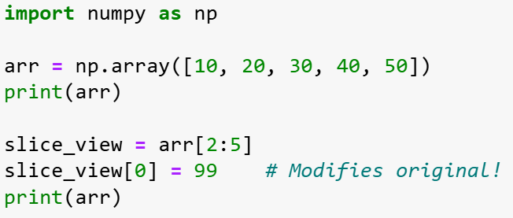
Views vs Copies
Important memory concept:
Slicing creates views that share the same underlying data
Slide 4/14

Slide 48
Views vs Copies
View
Important memory concept:
Slicing creates views that share the same underlying data
Slide 4/14

Slide 49
Views vs Copies
View
Important memory concept:
Slicing creates views that share the same underlying data
Slide 4/14

Slide 50
Views vs Copies
View
Important memory concept:
Slicing creates views that share the same underlying data
Slide 4/14

Slide 51
Views vs Copies
View
Important memory concept:
Slicing creates views that share the same underlying data
Slide 4/14

Slide 52
Views vs Copies
View
Important memory concept:
Slicing creates views that share the same underlying data
Slide 4/14

Slide 53
Views vs Copies
View
Important memory concept:
Slicing creates views that share the same underlying data
Slide 4/14

Slide 54
Views vs Copies
View
Important memory concept:
Slicing creates views that share the same underlying data
Slide 4/14

Slide 55


Views vs Copies
View
Important memory concept:
Slicing creates views that share the same underlying data
Slide 4/14

Slide 56
Views vs Copies
View
Important memory concept:
Slicing creates views that share the same underlying data
Slide 4/14

Slide 57
Views vs Copies
View
Important memory concept:
Slicing creates views that share the same underlying data
Slide 4/14

Slide 58
Views vs Copies
View
Important memory concept:
Slicing creates views that share the same underlying data
Slide 4/14

Slide 59
Views vs Copies
View
Important memory concept:
Slicing creates views that share the same underlying data
Modifying slice_view changes arr!
Slide 4/14

Slide 60
Views vs Copies
View
Important memory concept:
Slicing creates views that share the same underlying data
Slide 4/14

Slide 61
Views vs Copies
View
Important memory concept:
Slicing creates views that share the same underlying data
Modifying a view changes the original array
Slide 4/14

Slide 62
Views vs Copies
View
Important memory concept:
Slicing creates views that share the same underlying data
Modifying a view changes the original array
Use .copy() to create independent arrays when needed
Slide 4/14

Slide 63
Views vs Copies
View
Important memory concept:
Slicing creates views that share the same underlying data
Modifying a view changes the original array
Use .copy() to create independent arrays when needed
Copy
Slide 4/14

Slide 64
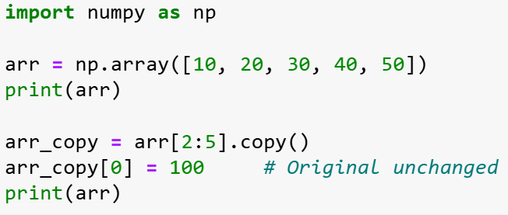
Views vs Copies
View
Important memory concept:
Slicing creates views that share the same underlying data
Modifying a view changes the original array
Use .copy() to create independent arrays when needed
Copy
Slide 4/14

Slide 65
Views vs Copies
View
Important memory concept:
Slicing creates views that share the same underlying data
Modifying a view changes the original array
Use .copy() to create independent arrays when needed
Copy
Slide 4/14

Slide 66
Views vs Copies
View
Important memory concept:
Slicing creates views that share the same underlying data
Modifying a view changes the original array
Use .copy() to create independent arrays when needed
Copy
Slide 4/14

Slide 67
Views vs Copies
View
Important memory concept:
Slicing creates views that share the same underlying data
Modifying a view changes the original array
Use .copy() to create independent arrays when needed
Copy
Slide 4/14

Slide 68
Views vs Copies
View
Important memory concept:
Slicing creates views that share the same underlying data
Modifying a view changes the original array
Use .copy() to create independent arrays when needed
Copy
Slide 4/14

Slide 69
Views vs Copies
View
Important memory concept:
Slicing creates views that share the same underlying data
Modifying a view changes the original array
Use .copy() to create independent arrays when needed
Copy
Slide 4/14

Slide 70
Views vs Copies
View
Important memory concept:
Slicing creates views that share the same underlying data
Modifying a view changes the original array
Use .copy() to create independent arrays when needed
Copy
Slide 4/14

Slide 71
Views vs Copies
View
Important memory concept:
Slicing creates views that share the same underlying data
Modifying a view changes the original array
Use .copy() to create independent arrays when needed
Copy
Slide 4/14

Slide 72
Views vs Copies
View
Important memory concept:
Slicing creates views that share the same underlying data
Modifying a view changes the original array
Use .copy() to create independent arrays when needed
Copy
Slide 4/14

Slide 73


Views vs Copies
View
Important memory concept:
Slicing creates views that share the same underlying data
Modifying a view changes the original array
Use .copy() to create independent arrays when needed
Copy
Slide 4/14

Slide 74
Views vs Copies
View
Important memory concept:
Slicing creates views that share the same underlying data
Modifying a view changes the original array
Use .copy() to create independent arrays when needed
Copy
Slide 4/14

Slide 75
Views vs Copies
View
Important memory concept:
Slicing creates views that share the same underlying data
Modifying a view changes the original array
Use .copy() to create independent arrays when needed
Copy
Slide 4/14

Slide 76
Views vs Copies
View
Important memory concept:
Slicing creates views that share the same underlying data
Modifying a view changes the original array
Use .copy() to create independent arrays when needed
Copy
Slide 4/14

Slide 77
Views vs Copies
View
Important memory concept:
Slicing creates views that share the same underlying data
Modifying a view changes the original array
Use .copy() to create independent arrays when needed
Copy
Modifying arr_copy does not change arr!
Slide 4/14

Slide 78
Views vs Copies
View
Important memory concept:
Slicing creates views that share the same underlying data
Modifying a view changes the original array
Use .copy() to create independent arrays when needed
Copy
Slide 4/14

Slide 79
Views vs Copies
View
Important memory concept:
Slicing creates views that share the same underlying data
Modifying a view changes the original array
Use .copy() to create independent arrays when needed
This behaviour is efficient but can cause unexpected side effects!
Copy
Slide 4/14

Slide 80
Boolean Indexing
Slide 5/14

Slide 81
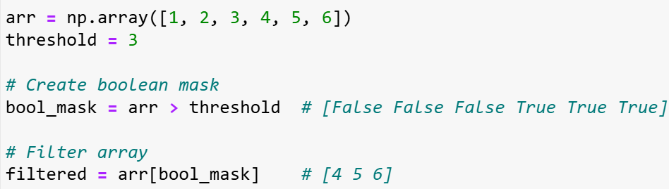
Boolean Indexing
Slide 5/14

Slide 82
Boolean Indexing
Slide 5/14

Slide 83
Boolean Indexing
We’ve seen that we can access elements of an array using integer indices
Slide 5/14

Slide 84
Boolean Indexing
We’ve seen that we can access elements of an array using integer indices (e.g. arr[1])
Slide 5/14

Slide 85
Boolean Indexing
We’ve seen that we can access elements of an array using integer indices (e.g. arr[1])
We can also access array entries using Booleans!
Slide 5/14

Slide 86
Boolean Indexing
We’ve seen that we can access elements of an array using integer indices (e.g. arr[1])
We can also access array entries using Booleans! (e.g. arr[False, True, False, False, False, False])
Slide 5/14

Slide 87
Boolean Indexing
We’ve seen that we can access elements of an array using integer indices (e.g. arr[1])
We can also access array entries using Booleans! (e.g. arr[False, True, False, False, False, False])
Boolean indexing allows data filtering based on conditions
Slide 5/14

Slide 88
Boolean Indexing
We’ve seen that we can access elements of an array using integer indices (e.g. arr[1])
We can also access array entries using Booleans! (e.g. arr[False, True, False, False, False, False])
Boolean indexing allows data filtering based on conditions
Let’s see how this is usually done…
Slide 5/14

Slide 89
Boolean Indexing
We’ve seen that we can access elements of an array using integer indices (e.g. arr[1])
We can also access array entries using Booleans! (e.g. arr[False, True, False, False, False, False])
Boolean indexing allows data filtering based on conditions
Let’s see how this is usually done…
Step 1:
Slide 5/14

Slide 90
Boolean Indexing
We’ve seen that we can access elements of an array using integer indices (e.g. arr[1])
We can also access array entries using Booleans! (e.g. arr[False, True, False, False, False, False])
Boolean indexing allows data filtering based on conditions
Let’s see how this is usually done…
Step 1: Apply a condition to create a boolean mask (True/False array)
Slide 5/14

Slide 91
Boolean Indexing
We’ve seen that we can access elements of an array using integer indices (e.g. arr[1])
We can also access array entries using Booleans! (e.g. arr[False, True, False, False, False, False])
Boolean indexing allows data filtering based on conditions
Let’s see how this is usually done…
Step 1: Apply a condition to create a boolean mask (True/False array)
Slide 5/14

Slide 92
Boolean Indexing
We’ve seen that we can access elements of an array using integer indices (e.g. arr[1])
We can also access array entries using Booleans! (e.g. arr[False, True, False, False, False, False])
Boolean indexing allows data filtering based on conditions
Let’s see how this is usually done…
Step 1: Apply a condition to create a boolean mask (True/False array)
Slide 5/14

Slide 93
Boolean Indexing
We’ve seen that we can access elements of an array using integer indices (e.g. arr[1])
We can also access array entries using Booleans! (e.g. arr[False, True, False, False, False, False])
Boolean indexing allows data filtering based on conditions
Let’s see how this is usually done…
Step 1: Apply a condition to create a boolean mask (True/False array)
Slide 5/14

Slide 94
Boolean Indexing
We’ve seen that we can access elements of an array using integer indices (e.g. arr[1])
We can also access array entries using Booleans! (e.g. arr[False, True, False, False, False, False])
Boolean indexing allows data filtering based on conditions
Let’s see how this is usually done…
Step 1: Apply a condition to create a boolean mask (True/False array)
Step 2:
Slide 5/14

Slide 95
Boolean Indexing
We’ve seen that we can access elements of an array using integer indices (e.g. arr[1])
We can also access array entries using Booleans! (e.g. arr[False, True, False, False, False, False])
Boolean indexing allows data filtering based on conditions
Let’s see how this is usually done…
Step 1: Apply a condition to create a boolean mask (True/False array)
Step 2: Use the mask to select only elements that meet the condition
Slide 5/14

Slide 96
Boolean Indexing
We’ve seen that we can access elements of an array using integer indices (e.g. arr[1])
We can also access array entries using Booleans! (e.g. arr[False, True, False, False, False, False])
Boolean indexing allows data filtering based on conditions
Let’s see how this is usually done…
Step 1: Apply a condition to create a boolean mask (True/False array)
Step 2: Use the mask to select only elements that meet the condition
Slide 5/14

Slide 97
Boolean Indexing
We’ve seen that we can access elements of an array using integer indices (e.g. arr[1])
We can also access array entries using Booleans! (e.g. arr[False, True, False, False, False, False])
Boolean indexing allows data filtering based on conditions
Let’s see how this is usually done…
Step 1: Apply a condition to create a boolean mask (True/False array)
Step 2: Use the mask to select only elements that meet the condition
Slide 5/14

Slide 98
The np.where function
Slide 6/14

Slide 99

The np.where function
Slide 6/14

Slide 100
The np.where function
Slide 6/14

Slide 101
The np.where function
Advanced conditional operations:
Slide 6/14

Slide 102
The np.where function
Advanced conditional operations:
np.where(condition) returns the indices where a condition is True
Slide 6/14

Slide 103
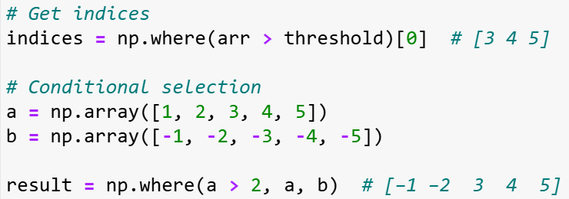
The np.where function
Advanced conditional operations:
np.where(condition) returns the indices where a condition is True
Slide 6/14

Slide 104
The np.where function
Advanced conditional operations:
np.where(condition) returns the indices where a condition is True
Slide 6/14

Slide 105
The np.where function
Advanced conditional operations:
np.where(condition) returns the indices where a condition is True
Slide 6/14

Slide 106
The np.where function
Advanced conditional operations:
np.where(condition) returns the indices where a condition is True
np.where(condition, x, y) creates a new array
Slide 6/14

Slide 107
The np.where function
Advanced conditional operations:
np.where(condition) returns the indices where a condition is True
np.where(condition, x, y) creates a new array
This array elements from x where condition is True, from y where False
Slide 6/14

Slide 108
The np.where function
Advanced conditional operations:
np.where(condition) returns the indices where a condition is True
np.where(condition, x, y) creates a new array
This array elements from x where condition is True, from y where False
Slide 6/14

Slide 109
The np.where function
Advanced conditional operations:
np.where(condition) returns the indices where a condition is True
np.where(condition, x, y) creates a new array
This array elements from x where condition is True, from y where False
Slide 6/14

Slide 110
The np.where function
Advanced conditional operations:
np.where(condition) returns the indices where a condition is True
np.where(condition, x, y) creates a new array
This array elements from x where condition is True, from y where False
Slide 6/14

Slide 111
The np.where function
Advanced conditional operations:
np.where(condition) returns the indices where a condition is True
np.where(condition, x, y) creates a new array
This array elements from x where condition is True, from y where False
Slide 6/14

Slide 112
The np.where function
Advanced conditional operations:
np.where(condition) returns the indices where a condition is True
np.where(condition, x, y) creates a new array
This array elements from x where condition is True, from y where False
Slide 6/14

Slide 113
The np.where function
Advanced conditional operations:
np.where(condition) returns the indices where a condition is True
np.where(condition, x, y) creates a new array
This array elements from x where condition is True, from y where False
Powerful for element-wise conditional logic without loops
Slide 6/14

Slide 114
Array Generation: Sequences
Slide 7/14

Slide 115
Array Generation: Sequences
Creating ordered numerical sequences:
Slide 7/14

Slide 116
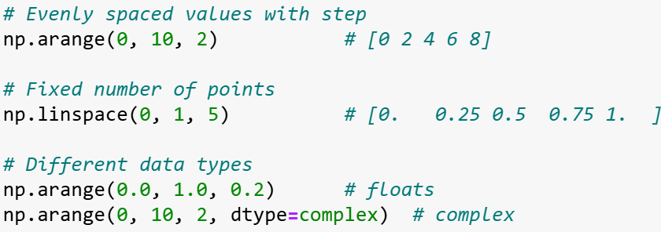
Array Generation: Sequences
Creating ordered numerical sequences:
Slide 7/14

Slide 117
Array Generation: Sequences
Creating ordered numerical sequences:
np.arange(start, stop, step)
Slide 7/14

Slide 118
Array Generation: Sequences
Creating ordered numerical sequences:
np.arange(start, stop, step)- like Python's range() but for arrays
Slide 7/14

Slide 119
Array Generation: Sequences
Creating ordered numerical sequences:
np.arange(start, stop, step)- like Python's range() but for arrays
Slide 7/14

Slide 120
Array Generation: Sequences
Creating ordered numerical sequences:
np.arange(start, stop, step)- like Python's range() but for arrays
Slide 7/14

Slide 121
Array Generation: Sequences
Creating ordered numerical sequences:
np.arange(start, stop, step)- like Python's range() but for arrays
np.linspace(start, stop, num)
Slide 7/14

Slide 122
Array Generation: Sequences
Creating ordered numerical sequences:
np.arange(start, stop, step)- like Python's range() but for arrays
np.linspace(start, stop, num)- exactly num evenly spaced points
Slide 7/14

Slide 123
Array Generation: Sequences
Creating ordered numerical sequences:
np.arange(start, stop, step)- like Python's range() but for arrays
np.linspace(start, stop, num)- exactly num evenly spaced points
Slide 7/14

Slide 124
Array Generation: Sequences
Creating ordered numerical sequences:
np.arange(start, stop, step)- like Python's range() but for arrays
np.linspace(start, stop, num)- exactly num evenly spaced points
Slide 7/14

Slide 125
Array Generation: Sequences
Creating ordered numerical sequences:
np.arange(start, stop, step)- like Python's range() but for arrays
np.linspace(start, stop, num)- exactly num evenly spaced points
Choose arange when you know the step size
Slide 7/14

Slide 126
Array Generation: Sequences
Creating ordered numerical sequences:
np.arange(start, stop, step)- like Python's range() but for arrays
np.linspace(start, stop, num)- exactly num evenly spaced points
Choose arange when you know the step size, linspace when you know the number of points
Slide 7/14

Slide 127
Array Generation: Sequences
Creating ordered numerical sequences:
np.arange(start, stop, step)- like Python's range() but for arrays
np.linspace(start, stop, num)- exactly num evenly spaced points
Choose arange when you know the step size, linspace when you know the number of points
Slide 7/14

Slide 128
Array Generation: Sequences
Creating ordered numerical sequences:
np.arange(start, stop, step)- like Python's range() but for arrays
np.linspace(start, stop, num)- exactly num evenly spaced points
Choose arange when you know the step size, linspace when you know the number of points
Slide 7/14

Slide 129
Array Generation: Sequences
Creating ordered numerical sequences:
np.arange(start, stop, step)- like Python's range() but for arrays
np.linspace(start, stop, num)- exactly num evenly spaced points
Choose arange when you know the step size, linspace when you know the number of points
Slide 7/14

Slide 130
Array Generation: Filled Arrays
Slide 8/14

Slide 131
Array Generation: Filled Arrays
Initialize arrays with specific values:
Slide 8/14

Slide 132
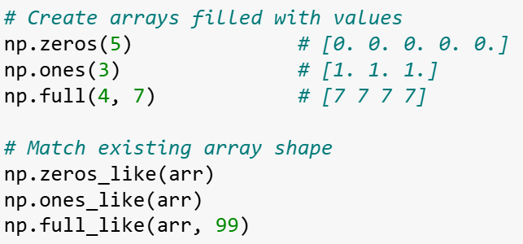

Array Generation: Filled Arrays
Initialize arrays with specific values:
Slide 8/14

Slide 133
Array Generation: Filled Arrays
Initialize arrays with specific values:
Slide 8/14

Slide 134
Array Generation: Filled Arrays
Initialize arrays with specific values:
Useful for creating placeholders before computations or initializing data structures.
Slide 8/14

Slide 135
Array Generation: Filled Arrays
Initialize arrays with specific values:
Useful for creating placeholders before computations or initializing data structures.
np.zeros(): array of zeros
Slide 8/14

Slide 136
Array Generation: Filled Arrays
Initialize arrays with specific values:
Useful for creating placeholders before computations or initializing data structures.
np.zeros(): array of zeros
Slide 8/14

Slide 137
Array Generation: Filled Arrays
Initialize arrays with specific values:
Useful for creating placeholders before computations or initializing data structures.
np.zeros(): array of zeros
Slide 8/14

Slide 138
Array Generation: Filled Arrays
Initialize arrays with specific values:
Useful for creating placeholders before computations or initializing data structures.
np.zeros(): array of zeros
np.ones(): array of ones
Slide 8/14

Slide 139
Array Generation: Filled Arrays
Initialize arrays with specific values:
Useful for creating placeholders before computations or initializing data structures.
np.zeros(): array of zeros
np.ones(): array of ones
Slide 8/14

Slide 140
Array Generation: Filled Arrays
Initialize arrays with specific values:
Useful for creating placeholders before computations or initializing data structures.
np.zeros(): array of zeros
np.ones(): array of ones
Slide 8/14

Slide 141
Array Generation: Filled Arrays
Initialize arrays with specific values:
Useful for creating placeholders before computations or initializing data structures.
np.zeros(): array of zeros
np.ones(): array of ones
np.full(): fill an array with a specific value
Slide 8/14

Slide 142
Array Generation: Filled Arrays
Initialize arrays with specific values:
Useful for creating placeholders before computations or initializing data structures.
np.zeros(): array of zeros
np.ones(): array of ones
np.full(): fill an array with a specific value
Slide 8/14

Slide 143
Array Generation: Filled Arrays
Initialize arrays with specific values:
Useful for creating placeholders before computations or initializing data structures.
np.zeros(): array of zeros
np.ones(): array of ones
np.full(): fill an array with a specific value
Slide 8/14

Slide 144
Array Generation: Filled Arrays
Initialize arrays with specific values:
Useful for creating placeholders before computations or initializing data structures.
np.zeros(): array of zeros
np.ones(): array of ones
np.full(): fill an array with a specific value
np.*_like(): functions preserve shape and data type of existing arrays
Slide 8/14

Slide 145
Array Generation: Filled Arrays
Initialize arrays with specific values:
Useful for creating placeholders before computations or initializing data structures.
np.zeros(): array of zeros
np.ones(): array of ones
np.full(): fill an array with a specific value
np.*_like(): functions preserve shape and data type of existing arrays
Slide 8/14

Slide 146
Array Generation: Filled Arrays
Initialize arrays with specific values:
Useful for creating placeholders before computations or initializing data structures.
np.zeros(): array of zeros
np.ones(): array of ones
np.full(): fill an array with a specific value
np.*_like(): functions preserve shape and data type of existing arrays
Slide 8/14

Slide 147
Array Generation: Filled Arrays
Initialize arrays with specific values:
Useful for creating placeholders before computations or initializing data structures.
np.zeros(): array of zeros
np.ones(): array of ones
np.full(): fill an array with a specific value
np.*_like(): functions preserve shape and data type of existing arrays
Slide 8/14

Slide 148
Array Generation: Filled Arrays
Initialize arrays with specific values:
Useful for creating placeholders before computations or initializing data structures.
np.zeros(): array of zeros
np.ones(): array of ones
np.full(): fill an array with a specific value
np.*_like(): functions preserve shape and data type of existing arrays
Slide 8/14

Slide 149
Array Generation: Filled Arrays
Initialize arrays with specific values:
Useful for creating placeholders before computations or initializing data structures.
np.zeros(): array of zeros
np.ones(): array of ones
np.full(): fill an array with a specific value
np.*_like(): functions preserve shape and data type of existing arrays
np.empty(): fastest but contains arbitrary values
Slide 8/14

Slide 150

Array Generation: Filled Arrays
Initialize arrays with specific values:
Useful for creating placeholders before computations or initializing data structures.
np.zeros(): array of zeros
np.ones(): array of ones
np.full(): fill an array with a specific value
np.*_like(): functions preserve shape and data type of existing arrays
np.empty(): fastest but contains arbitrary values
Slide 8/14

Slide 151
Array Generation: Filled Arrays
Initialize arrays with specific values:
Useful for creating placeholders before computations or initializing data structures.
np.zeros(): array of zeros
np.ones(): array of ones
np.full(): fill an array with a specific value
np.*_like(): functions preserve shape and data type of existing arrays
np.empty(): fastest but contains arbitrary values
Slide 8/14

Slide 152
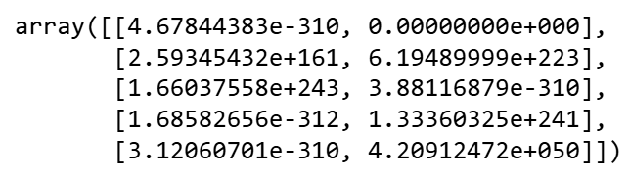

Array Generation: Filled Arrays
Initialize arrays with specific values:
Useful for creating placeholders before computations or initializing data structures.
np.zeros(): array of zeros
np.ones(): array of ones
np.full(): fill an array with a specific value
np.*_like(): functions preserve shape and data type of existing arrays
np.empty(): fastest but contains arbitrary values
Slide 8/14

Slide 153
Array Generation: Filled Arrays
Initialize arrays with specific values:
Useful for creating placeholders before computations or initializing data structures.
np.zeros(): array of zeros
np.ones(): array of ones
np.full(): fill an array with a specific value
np.*_like(): functions preserve shape and data type of existing arrays
np.empty(): fastest but contains arbitrary values
Slide 8/14

Slide 154
Random Data Generation
Slide 9/14

Slide 155
Random Data Generation
Pseudo-random Numbers
Slide 9/14

Slide 156
Random Data Generation
Pseudo-random Numbers
Often when coding you might want to generate a random number.
Slide 9/14

Slide 157
Random Data Generation
Pseudo-random Numbers
Often when coding you might want to generate a random number.
If you did the week 5 data science challenge, think of the robot!
Slide 9/14

Slide 158

Random Data Generation
Pseudo-random Numbers
Often when coding you might want to generate a random number.
If you did the week 5 data science challenge, think of the robot!
Slide 9/14

Slide 159
Random Data Generation
Pseudo-random Numbers
Often when coding you might want to generate a random number.
Slide 9/14

Slide 160
Random Data Generation
Pseudo-random Numbers
Often when coding you might want to generate a random number.
Computers are deterministic machines (same input → same output)
Slide 9/14

Slide 161

Random Data Generation
Pseudo-random Numbers
Often when coding you might want to generate a random number.
Computers are deterministic machines (same input → same output)
Slide 9/14

Slide 162
Random Data Generation
Pseudo-random Numbers
Often when coding you might want to generate a random number.
Computers are deterministic machines (same input → same output)
Slide 9/14

Slide 163
Random Data Generation
Pseudo-random Numbers
Often when coding you might want to generate a random number.
Computers are deterministic machines (same input → same output)
Slide 9/14

Slide 164
Random Data Generation
Pseudo-random Numbers
Often when coding you might want to generate a random number.
Computers are deterministic machines (same input → same output)
Pseudo-Random Number Generators (PRNGs) use mathematical algorithms to make sequences of random numbers
Slide 9/14

Slide 165
Random Data Generation
Pseudo-random Numbers
Often when coding you might want to generate a random number.
Computers are deterministic machines (same input → same output)
Pseudo-Random Number Generators (PRNGs) use mathematical algorithms to make sequences of random numbers
The “seed” value determines the starting point of the sequence
Slide 9/14

Slide 166
Random Data Generation
Pseudo-random Numbers
Often when coding you might want to generate a random number.
Computers are deterministic machines (same input → same output)
Pseudo-Random Number Generators (PRNGs) use mathematical algorithms to make sequences of random numbers
The “seed” value determines the starting point of the sequence
Same seed = same sequence (crucial for reproducible research!)
Slide 9/14

Slide 167
Random Data Generation
Slide 10/14

Slide 168
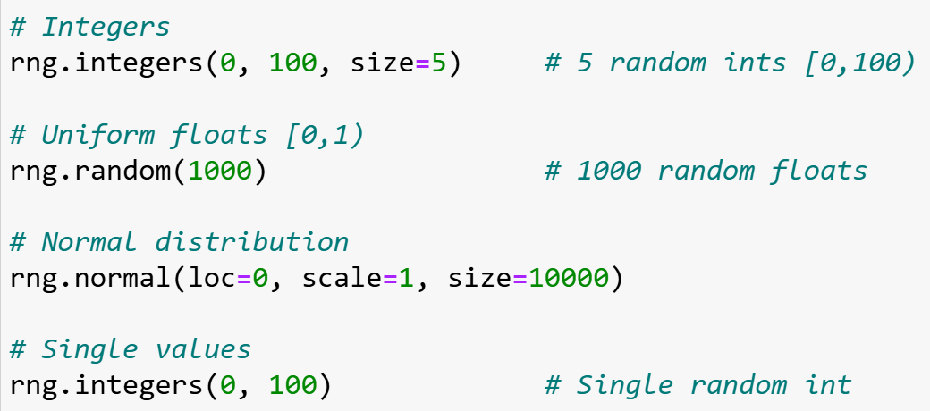
Random Data Generation
Slide 10/14

Slide 169
Random Data Generation
Numpy offers many tools to generate samples from different distributions
Slide 10/14

Slide 170
Random Data Generation
Numpy offers many tools to generate samples from different distributions
You can generate:
Slide 10/14

Slide 171
Random Data Generation
Numpy offers many tools to generate samples from different distributions
You can generate:
Uniform random integers from {1,…, k} using rng.integers
Slide 10/14

Slide 172
Random Data Generation
Numpy offers many tools to generate samples from different distributions
You can generate:
Uniform random integers from {1,…, k} using rng.integers
Slide 10/14

Slide 173
Random Data Generation
Numpy offers many tools to generate samples from different distributions
You can generate:
Uniform random integers from {1,…, k} using rng.integers
Slide 10/14

Slide 174
Random Data Generation
Numpy offers many tools to generate samples from different distributions
You can generate:
Uniform random integers from {1,…, k} using rng.integers
Uniform random floats from [0,1) or a custom range using rng.random
Slide 10/14

Slide 175
Random Data Generation
Numpy offers many tools to generate samples from different distributions
You can generate:
Uniform random integers from {1,…, k} using rng.integers
Uniform random floats from [0,1) or a custom range using rng.random
Slide 10/14

Slide 176
Random Data Generation
Numpy offers many tools to generate samples from different distributions
You can generate:
Uniform random integers from {1,…, k} using rng.integers
Uniform random floats from [0,1) or a custom range using rng.random
Slide 10/14

Slide 177
Random Data Generation
Numpy offers many tools to generate samples from different distributions
You can generate:
Uniform random integers from {1,…, k} using rng.integers
Uniform random floats from [0,1) or a custom range using rng.random
Gaussian distributed floats with specified mean and standard deviation using rng.normal
Slide 10/14

Slide 178
Random Data Generation
Numpy offers many tools to generate samples from different distributions
You can generate:
Uniform random integers from {1,…, k} using rng.integers
Uniform random floats from [0,1) or a custom range using rng.random
Gaussian distributed floats with specified mean and standard deviation using rng.normal
Slide 10/14

Slide 179
Random Data Generation
Numpy offers many tools to generate samples from different distributions
You can generate:
Uniform random integers from {1,…, k} using rng.integers
Uniform random floats from [0,1) or a custom range using rng.random
Gaussian distributed floats with specified mean and standard deviation using rng.normal
And many more… (see documentation)
Slide 10/14

Slide 180
Random Data Generation
Numpy offers many tools to generate samples from different distributions
You can generate:
Uniform random integers from {1,…, k} using rng.integers
Uniform random floats from [0,1) or a custom range using rng.random
Gaussian distributed floats with specified mean and standard deviation using rng.normal
And many more… (see documentation)
Slide 10/14

Slide 181
Random Data Generation
Numpy offers many tools to generate samples from different distributions
You can generate:
Uniform random integers from {1,…, k} using rng.integers
Uniform random floats from [0,1) or a custom range using rng.random
Gaussian distributed floats with specified mean and standard deviation using rng.normal
And many more… (see documentation)
Slide 10/14

Slide 182
Performance Tip
Slide 11/14

Slide 183
Performance Tip
Memory vs. Speed Trade-off:
Slide 11/14

Slide 184
Performance Tip
Memory vs. Speed Trade-off:
Generating random numbers one-by-one in loops is slow due to function call overhead.
Slide 11/14

Slide 185
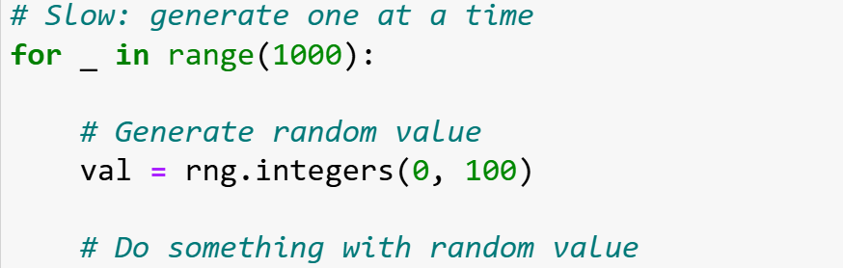
Performance Tip
Memory vs. Speed Trade-off:
Generating random numbers one-by-one in loops is slow due to function call overhead.
Slide 11/14

Slide 186
Performance Tip
Memory vs. Speed Trade-off:
Generating random numbers one-by-one in loops is slow due to function call overhead.
Slide 11/14

Slide 187
Performance Tip
Memory vs. Speed Trade-off:
Generating random numbers one-by-one in loops is slow due to function call overhead.
Slide 11/14

Slide 188
Performance Tip
Memory vs. Speed Trade-off:
Generating random numbers one-by-one in loops is slow due to function call overhead.
Slide 11/14

Slide 189
Performance Tip
Memory vs. Speed Trade-off:
Generating random numbers one-by-one in loops is slow due to function call overhead.
Slide 11/14

Slide 190
Performance Tip
Memory vs. Speed Trade-off:
Generating random numbers one-by-one in loops is slow due to function call overhead.
Pre-allocating larger arrays is much faster!
Slide 11/14

Slide 191
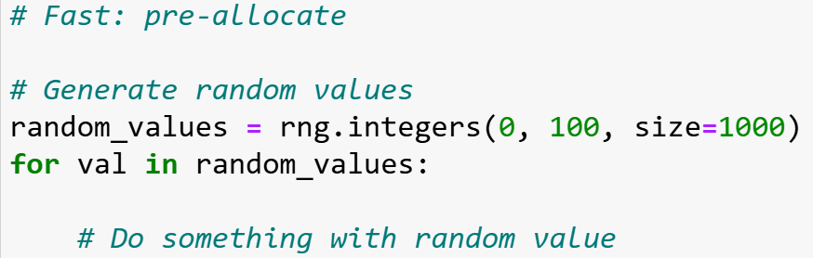
Performance Tip
Memory vs. Speed Trade-off:
Generating random numbers one-by-one in loops is slow due to function call overhead.
Pre-allocating larger arrays is much faster!
Slide 11/14

Slide 192
Performance Tip
Memory vs. Speed Trade-off:
Generating random numbers one-by-one in loops is slow due to function call overhead.
Pre-allocating larger arrays is much faster!
Slide 11/14

Slide 193
Performance Tip
Memory vs. Speed Trade-off:
Generating random numbers one-by-one in loops is slow due to function call overhead.
Pre-allocating larger arrays is much faster!
Slide 11/14

Slide 194
Performance Tip
Memory vs. Speed Trade-off:
Generating random numbers one-by-one in loops is slow due to function call overhead.
Pre-allocating larger arrays is much faster!
Slide 11/14

Slide 195
Performance Tip
Memory vs. Speed Trade-off:
Generating random numbers one-by-one in loops is slow due to function call overhead.
Pre-allocating larger arrays is much faster!
Slide 11/14

Slide 196
Performance Tip
Memory vs. Speed Trade-off:
Generating random numbers one-by-one in loops is slow due to function call overhead.
Pre-allocating larger arrays is much faster!
I.e. if you think you will need to save a large quantity of values, plan ahead!
Slide 11/14

Slide 197
Summary
Slide 12/14

Slide 198
Summary
Slide 12/14

Slide 199
Summary
Slide 12/14

Slide 200
Summary
Indexing: Integer, slicing, Boolean
Slide 12/14

Slide 201
Summary
Indexing: Integer, slicing, Boolean
Slide 12/14

Slide 202
Summary
Indexing: Integer, slicing, Boolean
Slide 12/14

Slide 203
Summary
Indexing: Integer, slicing, Boolean
Views vs Copies: Slicing creates views
Slide 12/14

Slide 204
Summary
Indexing: Integer, slicing, Boolean
Views vs Copies: Slicing creates views
Slide 12/14

Slide 205
Summary
Indexing: Integer, slicing, Boolean
Views vs Copies: Slicing creates views
Slide 12/14

Slide 206
Summary
Indexing: Integer, slicing, Boolean
Views vs Copies: Slicing creates views
Slide 12/14

Slide 207
Summary
Indexing: Integer, slicing, Boolean
Views vs Copies: Slicing creates views
Slide 12/14

Slide 208
Summary
Indexing: Integer, slicing, Boolean
Views vs Copies: Slicing creates views
Generation: arange, linspace, filled arrays
Slide 12/14

Slide 209
Summary
Indexing: Integer, slicing, Boolean
Views vs Copies: Slicing creates views
Generation: arange, linspace, filled arrays
Slide 12/14

Slide 210
Summary
Indexing: Integer, slicing, Boolean
Views vs Copies: Slicing creates views
Generation: arange, linspace, filled arrays
Slide 12/14

Slide 211
Summary
Indexing: Integer, slicing, Boolean
Views vs Copies: Slicing creates views
Generation: arange, linspace, filled arrays
Slide 12/14

Slide 212
Summary
Indexing: Integer, slicing, Boolean
Views vs Copies: Slicing creates views
Generation: arange, linspace, filled arrays
Slide 12/14

Slide 213
Summary
Indexing: Integer, slicing, Boolean
Views vs Copies: Slicing creates views
Generation: arange, linspace, filled arrays
Slide 12/14

Slide 214
Summary
Indexing: Integer, slicing, Boolean
Views vs Copies: Slicing creates views
Generation: arange, linspace, filled arrays
Slide 12/14

Slide 215
Summary
Indexing: Integer, slicing, Boolean
Views vs Copies: Slicing creates views
Generation: arange, linspace, filled arrays
Random: Seed for reproducibility, pre-allocate for speed
Slide 12/14

Slide 216
Summary
Indexing: Integer, slicing, Boolean
Views vs Copies: Slicing creates views
Generation: arange, linspace, filled arrays
Random: Seed for reproducibility, pre-allocate for speed
Slide 12/14

Slide 217
Summary
Indexing: Integer, slicing, Boolean
Views vs Copies: Slicing creates views
Generation: arange, linspace, filled arrays
Random: Seed for reproducibility, pre-allocate for speed
Slide 12/14

Slide 218
Practical
Slide 13/14

Slide 219
Practical
We now move over to Python
Slide 13/14

Slide 220
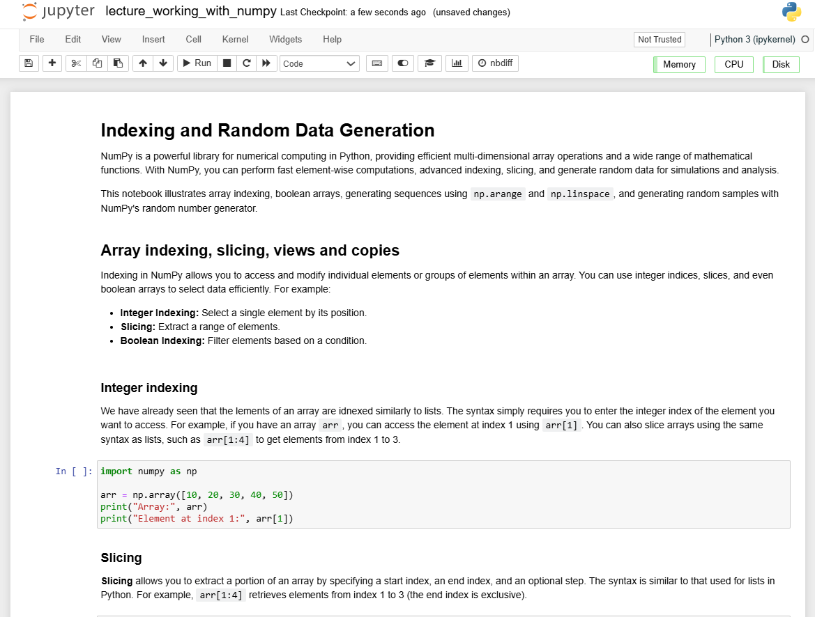
Practical
We now move over to Python
Slide 13/14

Slide 221
Practical
We now move over to Python
For the rest of today, you must do the following:
Slide 13/14

Slide 222
Practical
We now move over to Python
For the rest of today, you must do the following:
First, read through:
Slide 13/14

Slide 223
Practical
We now move over to Python
For the rest of today, you must do the following:
First, read through: lecture_working_with_numpy.ipynb
Slide 13/14

Slide 224
Practical
We now move over to Python
For the rest of today, you must do the following:
First, read through: lecture_working_with_numpy.ipynb
Then, work through the exercises in:
Slide 13/14

Slide 225
Practical
We now move over to Python
For the rest of today, you must do the following:
First, read through: lecture_working_with_numpy.ipynb
Then, work through the exercises in: exercises_lecture_working_with_numpy.ipynb
Slide 13/14

Slide 226
Practical
We now move over to Python
For the rest of today, you must do the following:
First, read through: lecture_working_with_numpy.ipynb
Then, work through the exercises in: exercises_lecture_working_with_numpy.ipynb
If you finish early, work through intermediate or advanced notebooks from weeks 1-5 that you haven’t yet tried!
Slide 13/14

Slide 227
Practical
We now move over to Python
For the rest of today, you must do the following:
First, read through: lecture_working_with_numpy.ipynb
Then, work through the exercises in: exercises_lecture_working_with_numpy.ipynb
Slide 13/14

Slide 228
Next Time
Lecture 7: Working with NumPy Arrays
Array Indexing and Slicing
Boolean Indexing
Array Generating Functions
Random Data Generation
Practical
Lecture 8: Plotting with Matplotlib
Figures and axes
Annotating and adding features
Types of plot
Anatomy of a plot
Practical
Slide 14/14

