Slide 1
Lecture 17:
Modularisation and Error Handling
SCIF10002 – Introduction to Coding and Data Analysis for Scientists
Tom Maullin-Sapey
12th March 2026
Slide 0/16

Slide 2
Todays Lecture
Lecture 17: Modularisation and Error Handling
Modules
Introspection
Error Handling
Practical
Lecture 18: Writing a Scientific Computing Report
Writing a Report
Advice and Good Practice
Practical
Slide 1/16

Slide 3
Jupyter Lab
Slide 2/16

Slide 4
Jupyter Lab
Today, we’ll be using the Jupyter Lab interface
Slide 2/16

Slide 5
Jupyter Lab
Today, we’ll be using the Jupyter Lab interface
To do so, we must select Standard Python 3 on Noteable
Slide 2/16

Slide 6
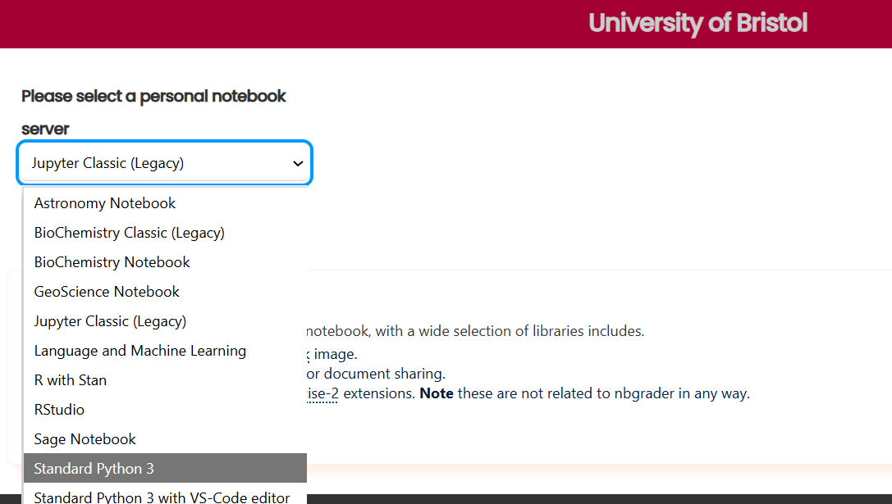
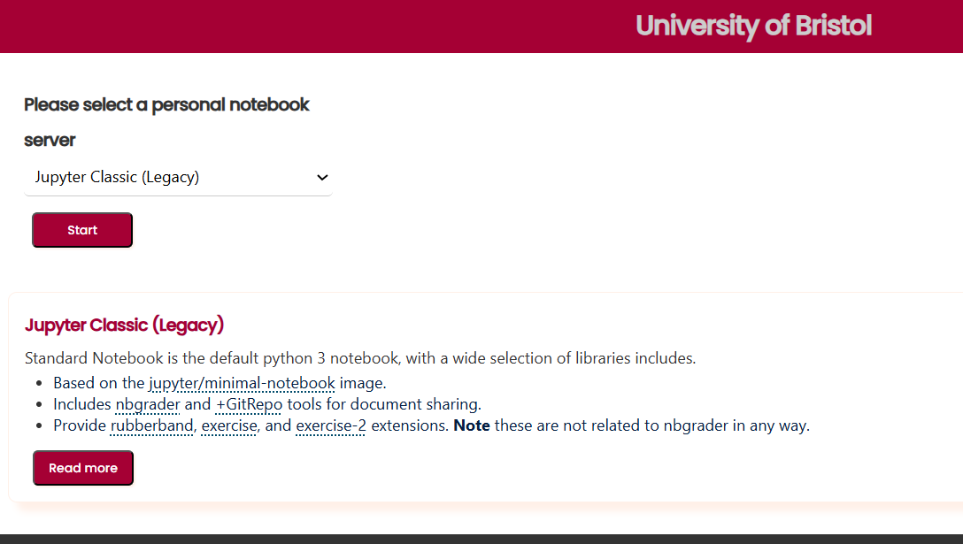
Jupyter Lab
Today, we’ll be using the Jupyter Lab interface
To do so, we must select Standard Python 3 on Noteable
Slide 2/16

Slide 7
Jupyter Lab
Today, we’ll be using the Jupyter Lab interface
To do so, we must select Standard Python 3 on Noteable
Slide 2/16

Slide 8
Jupyter Lab
Today, we’ll be using the Jupyter Lab interface
To do so, we must select Standard Python 3 on Noteable
Slide 2/16

Slide 9
Jupyter Lab
Today, we’ll be using the Jupyter Lab interface
To do so, we must select Standard Python 3 on Noteable
Slide 2/16

Slide 10
Jupyter Lab
Today, we’ll be using the Jupyter Lab interface
To do so, we must select Standard Python 3 on Noteable
Slide 2/16

Slide 11
Jupyter Lab
Today, we’ll be using the Jupyter Lab interface
To do so, we must select Standard Python 3 on Noteable
Slide 2/16

Slide 12
Jupyter Lab
Today, we’ll be using the Jupyter Lab interface
To do so, we must select Standard Python 3 on Noteable
Slide 2/16

Slide 13
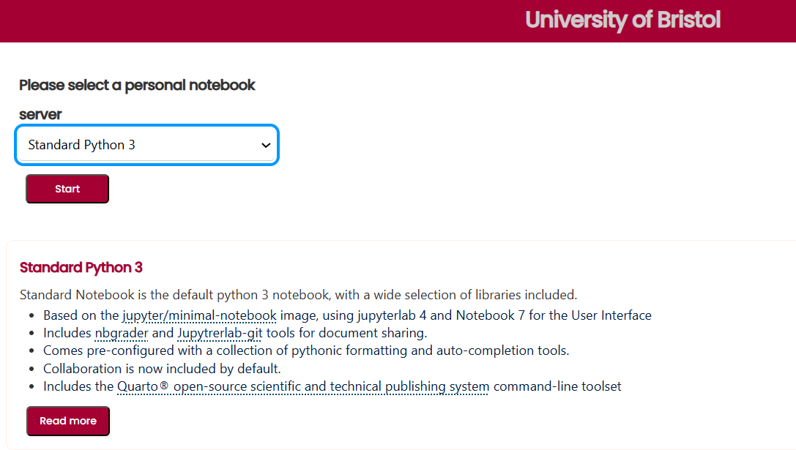
Jupyter Lab
Today, we’ll be using the Jupyter Lab interface
To do so, we must select Standard Python 3 on Noteable
Slide 2/16

Slide 14
Jupyter Lab
Today, we’ll be using the Jupyter Lab interface
To do so, we must select Standard Python 3 on Noteable
Slide 2/16

Slide 15
Jupyter Lab
Today, we’ll be using the Jupyter Lab interface
To do so, we must select Standard Python 3 on Noteable
We previously used this in Lectures 2 & 10
Slide 2/16

Slide 16
Jupyter Lab
Today, we’ll be using the Jupyter Lab interface
To do so, we must select Standard Python 3 on Noteable
We previously used this in Lectures 2 & 10
Slide 2/16

Slide 17
Recap: Python Files and Packages
Slide 3/16

Slide 18
Recap: Python Files and Packages
In week 11 we saw that python files are pure text files that contain Python code. They have a .py extension.
Slide 3/16

Slide 19
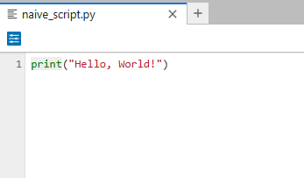
Recap: Python Files and Packages
In week 11 we saw that python files are pure text files that contain Python code. They have a .py extension.
Slide 3/16

Slide 20
Recap: Python Files and Packages
In week 11 we saw that python files are pure text files that contain Python code. They have a .py extension.
Notebooks are interactive documents that can contain code, text, images, and more. They have a .ipynb extension.
Slide 3/16

Slide 21
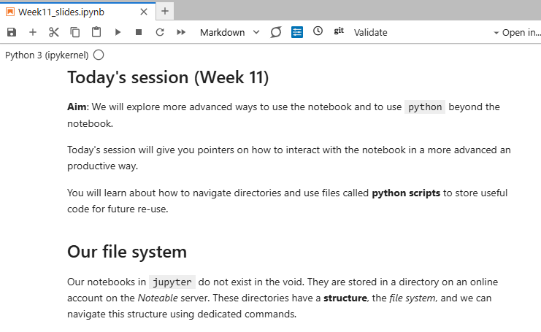
Recap: Python Files and Packages
In week 11 we saw that python files are pure text files that contain Python code. They have a .py extension.
Notebooks are interactive documents that can contain code, text, images, and more. They have a .ipynb extension.
Slide 3/16

Slide 22
Recap: Python Files and Packages
In week 11 we saw that python files are pure text files that contain Python code. They have a .py extension.
Notebooks are interactive documents that can contain code, text, images, and more. They have a .ipynb extension.
Python files are useful for storing reusable code, while notebooks are great for exploration and documentation.
Slide 3/16

Slide 23
Recap: Python Files and Packages
In week 11 we saw that python files are pure text files that contain Python code. They have a .py extension.
Notebooks are interactive documents that can contain code, text, images, and more. They have a .ipynb extension.
Python files are useful for storing reusable code, while notebooks are great for exploration and documentation.
Today, we shall be referring to Python files as modules.
Slide 3/16

Slide 24
Recap: Python Files and Packages
In week 11 we saw that python files are pure text files that contain Python code. They have a .py extension.
Notebooks are interactive documents that can contain code, text, images, and more. They have a .ipynb extension.
Python files are useful for storing reusable code, while notebooks are great for exploration and documentation.
Today, we shall be referring to Python files as modules.
A collection of modules together in one folder, alongside an empty file named __init__.py is known as a package
Slide 3/16

Slide 25
Recap: Importing Modules
Slide 4/16

Slide 26
Recap: Importing Modules
We can load a module into the notebook or another module by using the import keyword
Slide 4/16

Slide 27
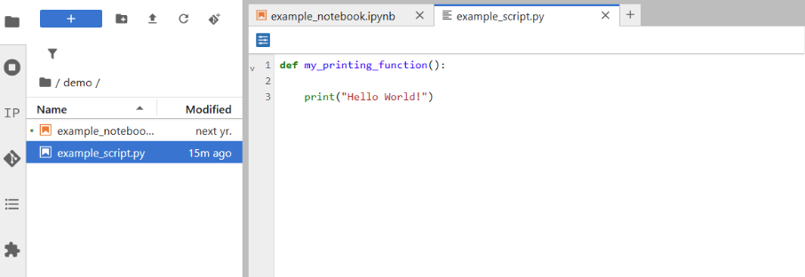
Recap: Importing Modules
We can load a module into the notebook or another module by using the import keyword
Slide 4/16

Slide 28
Recap: Importing Modules
We can load a module into the notebook or another module by using the import keyword
To read modules in the same directory:
Slide 4/16

Slide 29
Recap: Importing Modules
We can load a module into the notebook or another module by using the import keyword
To read modules in the same directory: import module_name
Slide 4/16

Slide 30
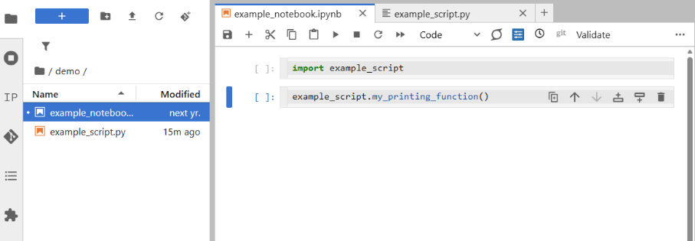

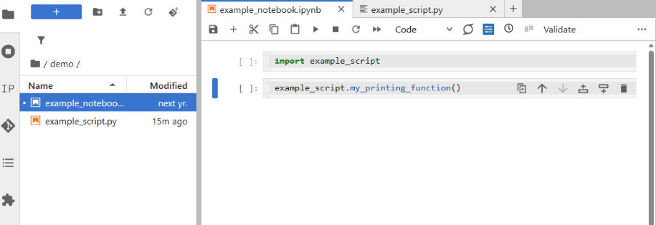
Recap: Importing Modules
We can load a module into the notebook or another module by using the import keyword
To read modules in the same directory: import module_name
Slide 4/16

Slide 31
Recap: Importing Modules
We can load a module into the notebook or another module by using the import keyword
To read modules in the same directory: import module_name
Slide 4/16

Slide 32
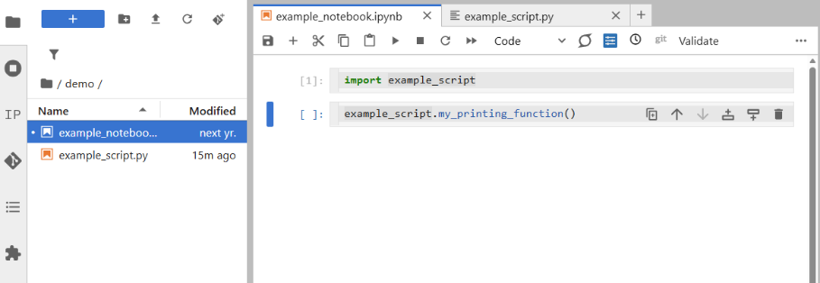
Recap: Importing Modules
We can load a module into the notebook or another module by using the import keyword
To read modules in the same directory: import module_name
Slide 4/16

Slide 33
Recap: Importing Modules
We can load a module into the notebook or another module by using the import keyword
To read modules in the same directory: import module_name
Slide 4/16

Slide 34
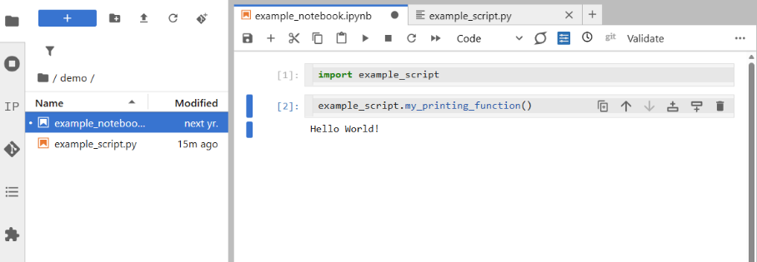
Recap: Importing Modules
We can load a module into the notebook or another module by using the import keyword
To read modules in the same directory: import module_name
Slide 4/16

Slide 35
Recap: Importing Modules
We can load a module into the notebook or another module by using the import keyword
To read modules in the same directory: import module_name
To read modules in a neighbouring directory:
Slide 4/16

Slide 36
Recap: Importing Modules
We can load a module into the notebook or another module by using the import keyword
To read modules in the same directory: import module_name
To read modules in a neighbouring directory: import folder_name.module_name
Slide 4/16

Slide 37
Recap: Importing Modules
We can load a module into the notebook or another module by using the import keyword
To read modules in the same directory: import module_name
To read modules in a neighbouring directory: import folder_name.module_name
Slide 4/16

Slide 38
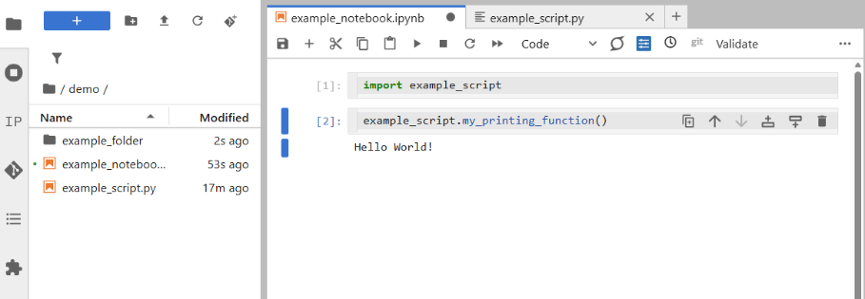
Recap: Importing Modules
We can load a module into the notebook or another module by using the import keyword
To read modules in the same directory: import module_name
To read modules in a neighbouring directory: import folder_name.module_name
Slide 4/16

Slide 39
Recap: Importing Modules
We can load a module into the notebook or another module by using the import keyword
To read modules in the same directory: import module_name
To read modules in a neighbouring directory: import folder_name.module_name
Slide 4/16

Slide 40
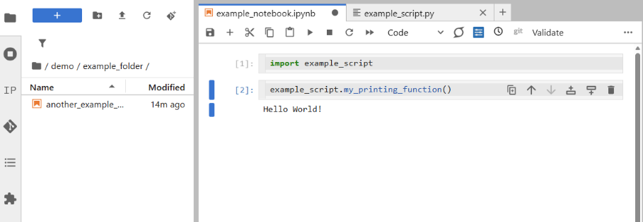
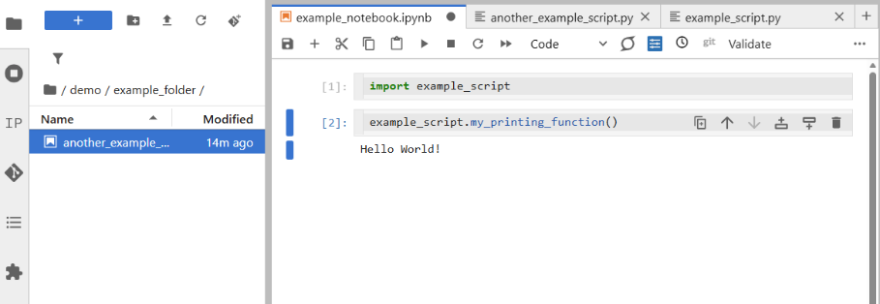
Recap: Importing Modules
We can load a module into the notebook or another module by using the import keyword
To read modules in the same directory: import module_name
To read modules in a neighbouring directory: import folder_name.module_name
Slide 4/16

Slide 41
Recap: Importing Modules
We can load a module into the notebook or another module by using the import keyword
To read modules in the same directory: import module_name
To read modules in a neighbouring directory: import folder_name.module_name
Slide 4/16

Slide 42
Recap: Importing Modules
We can load a module into the notebook or another module by using the import keyword
To read modules in the same directory: import module_name
To read modules in a neighbouring directory: import folder_name.module_name
Slide 4/16

Slide 43
Recap: Importing Modules
We can load a module into the notebook or another module by using the import keyword
To read modules in the same directory: import module_name
To read modules in a neighbouring directory: import folder_name.module_name
Slide 4/16

Slide 44
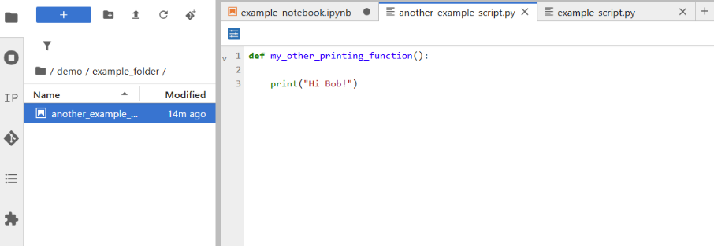
Recap: Importing Modules
We can load a module into the notebook or another module by using the import keyword
To read modules in the same directory: import module_name
To read modules in a neighbouring directory: import folder_name.module_name
Slide 4/16

Slide 45
Recap: Importing Modules
We can load a module into the notebook or another module by using the import keyword
To read modules in the same directory: import module_name
To read modules in a neighbouring directory: import folder_name.module_name
Slide 4/16

Slide 46
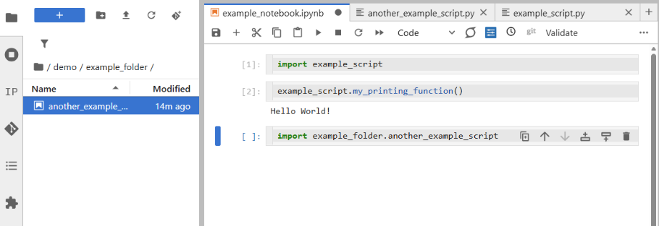
Recap: Importing Modules
We can load a module into the notebook or another module by using the import keyword
To read modules in the same directory: import module_name
To read modules in a neighbouring directory: import folder_name.module_name
Slide 4/16

Slide 47
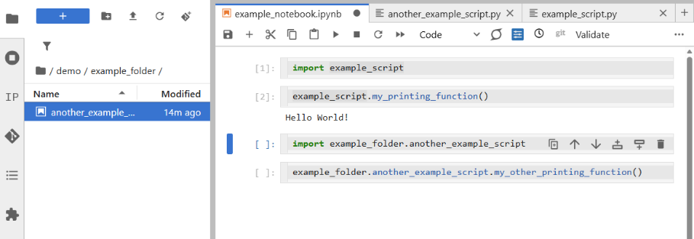
Recap: Importing Modules
We can load a module into the notebook or another module by using the import keyword
To read modules in the same directory: import module_name
To read modules in a neighbouring directory: import folder_name.module_name
Slide 4/16

Slide 48
Recap: Importing Modules
We can load a module into the notebook or another module by using the import keyword
To read modules in the same directory: import module_name
To read modules in a neighbouring directory: import folder_name.module_name
Slide 4/16

Slide 49
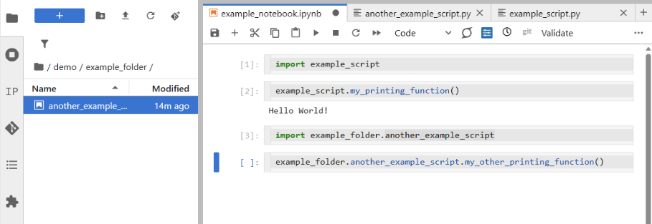
Recap: Importing Modules
We can load a module into the notebook or another module by using the import keyword
To read modules in the same directory: import module_name
To read modules in a neighbouring directory: import folder_name.module_name
Slide 4/16

Slide 50
Recap: Importing Modules
We can load a module into the notebook or another module by using the import keyword
To read modules in the same directory: import module_name
To read modules in a neighbouring directory: import folder_name.module_name
Slide 4/16

Slide 51

Recap: Importing Modules
We can load a module into the notebook or another module by using the import keyword
To read modules in the same directory: import module_name
To read modules in a neighbouring directory: import folder_name.module_name
Slide 4/16

Slide 52
Recap: Importing Modules
We can load a module into the notebook or another module by using the import keyword
To read modules in the same directory: import module_name
To read modules in a neighbouring directory: import folder_name.module_name
To read modules from directory above:
Slide 4/16

Slide 53
Recap: Importing Modules
We can load a module into the notebook or another module by using the import keyword
To read modules in the same directory: import module_name
To read modules in a neighbouring directory: import folder_name.module_name
To read modules from directory above: import ..folder_name.module_name
Slide 4/16

Slide 54
Recap: Importing Modules
We can load a module into the notebook or another module by using the import keyword
To read modules in the same directory: import module_name
To read modules in a neighbouring directory: import folder_name.module_name
To read modules from directory above: import ..folder_name.module_name
Slide 4/16

Slide 55
Recap: Importing Modules
We can load a module into the notebook or another module by using the import keyword
To read modules in the same directory: import module_name
To read modules in a neighbouring directory: import folder_name.module_name
To read modules from directory above: import ..folder_name.module_name
Can only be used in modules inside packages
Slide 4/16

Slide 56
Recap: Importing Modules
We can load a module into the notebook or another module by using the import keyword
To read modules in the same directory: import module_name
To read modules in a neighbouring directory: import folder_name.module_name
To read modules from directory above: import ..folder_name.module_name
Slide 4/16

Slide 57
Recap: Importing Modules
We can load a module into the notebook or another module by using the import keyword
To read modules in the same directory: import module_name
To read modules in a neighbouring directory: import folder_name.module_name
To read modules from directory above: import ..folder_name.module_name
General syntax: folder.module.function
Slide 4/16

Slide 58
What is in a Module?
Slide 5/16

Slide 59
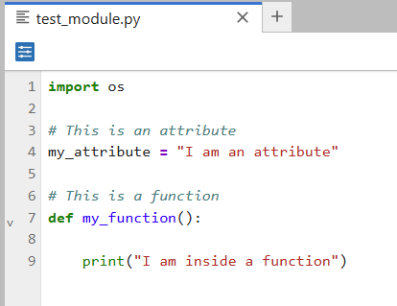
What is in a Module?
Slide 5/16

Slide 60
What is in a Module?
Typically, modules are composed of import statements, definitions (attributes) and functions
Slide 5/16

Slide 61
What is in a Module?
Typically, modules are composed of import statements, definitions (attributes) and functions
Import
Slide 5/16

Slide 62
What is in a Module?
Typically, modules are composed of import statements, definitions (attributes) and functions
Slide 5/16

Slide 63
What is in a Module?
Typically, modules are composed of import statements, definitions (attributes) and functions
Attribute
Slide 5/16

Slide 64
What is in a Module?
Typically, modules are composed of import statements, definitions (attributes) and functions
Slide 5/16

Slide 65
What is in a Module?
Typically, modules are composed of import statements, definitions (attributes) and functions
Function
Slide 5/16

Slide 66
What is in a Module?
Typically, modules are composed of import statements, definitions (attributes) and functions
Slide 5/16

Slide 67
What is in a Module?
Typically, modules are composed of import statements, definitions (attributes) and functions
We can specify attributes and functions in the usual way
Slide 5/16

Slide 68
What is in a Module?
Typically, modules are composed of import statements, definitions (attributes) and functions
We can specify attributes and functions in the usual way
And recall them using, e.g.:
Slide 5/16

Slide 69
What is in a Module?
Typically, modules are composed of import statements, definitions (attributes) and functions
We can specify attributes and functions in the usual way
And recall them using, e.g.: import test_module
Slide 5/16

Slide 70
What is in a Module?
Typically, modules are composed of import statements, definitions (attributes) and functions
We can specify attributes and functions in the usual way
And recall them using, e.g.: import test_module print(test_module.my_attribute)
Slide 5/16

Slide 71
What is in a Module?
Typically, modules are composed of import statements, definitions (attributes) and functions
We can specify attributes and functions in the usual way
And recall them using, e.g.: import test_module print(test_module.my_attribute) test_module.my_function
Slide 5/16

Slide 72
Introspection
Slide 6/16

Slide 73
Introspection
Slide 6/16

Slide 74
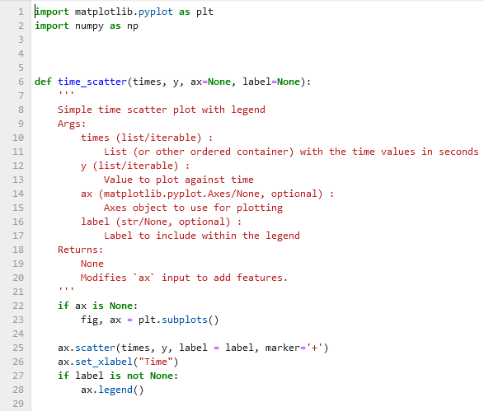
Introspection
Slide 6/16

Slide 75
Introspection
Introspection refers to a coding language’s ability to show us information about data and variables as our code is running
Slide 6/16

Slide 76
Introspection
Introspection refers to a coding language’s ability to show us information about data and variables as our code is running
E.g. print(x),
Slide 6/16

Slide 77
Introspection
Introspection refers to a coding language’s ability to show us information about data and variables as our code is running
E.g. print(x), type(x),
Slide 6/16

Slide 78
Introspection
Introspection refers to a coding language’s ability to show us information about data and variables as our code is running
E.g. print(x), type(x), str(x)
Slide 6/16

Slide 79
Introspection
Introspection refers to a coding language’s ability to show us information about data and variables as our code is running
E.g. print(x), type(x), str(x)
Python provides many functions for us to inspect the contents of a module once it has been imported.
Slide 6/16

Slide 80
Introspection
Introspection refers to a coding language’s ability to show us information about data and variables as our code is running
E.g. print(x), type(x), str(x)
Python provides many functions for us to inspect the contents of a module once it has been imported.
Let’s see a few examples for this module
Slide 6/16

Slide 81
Introspection
Slide 6/16

Slide 82
Introspection: Examples
Slide 7/16

Slide 83
Introspection: Examples
The dir function allows us to see all of the functions and attributes inside the module:
Slide 7/16

Slide 84
Introspection: Examples
The dir function allows us to see all of the functions and attributes inside the module:
Slide 7/16

Slide 85
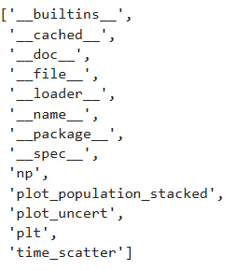
Introspection: Examples
The dir function allows us to see all of the functions and attributes inside the module:
Slide 7/16

Slide 86
Introspection: Examples
The dir function allows us to see all of the functions and attributes inside the module:
Underscores indicate that the function is intended for developer use
Slide 7/16

Slide 87
Introspection: Examples
The dir function allows us to see all of the functions and attributes inside the module:
Underscores indicate that the function is intended for developer use
Slide 7/16

Slide 88
Introspection: Examples
The dir function allows us to see all of the functions and attributes inside the module:
Underscores indicate that the function is intended for developer use
Slide 7/16

Slide 89
Introspection: Examples
The dir function allows us to see all of the functions and attributes inside the module:
Underscores indicate that the function is intended for developer use
Python adds several helpful hidden attributes to each module
Slide 7/16

Slide 90
Introspection: Examples
Slide 7/16

Slide 91
Introspection: Examples
The docstring is a comment at the start of a function surrounded by triple quotes
Slide 8/16

Slide 92
Introspection: Examples
The docstring is a comment at the start of a function surrounded by triple quotes
Slide 8/16

Slide 93
Introspection: Examples
The docstring is a comment at the start of a function surrounded by triple quotes
Slide 8/16

Slide 94
Introspection: Examples
The docstring is a comment at the start of a function surrounded by triple quotes
The docstring can be accessed using the help function
Slide 8/16

Slide 95
Introspection: Examples
The docstring is a comment at the start of a function surrounded by triple quotes
The docstring can be accessed using the help function
Slide 8/16

Slide 96
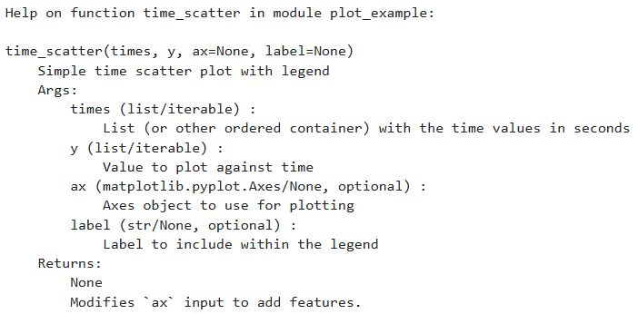
Introspection: Examples
The docstring is a comment at the start of a function surrounded by triple quotes
The docstring can be accessed using the help function
Slide 8/16

Slide 97
Introspection: Examples
Slide 8/16

Slide 98
Introspection: Examples
We can also view the code itself using ??
Slide 9/16

Slide 99
Introspection: Examples
We can also view the code itself using ??
Slide 9/16

Slide 100
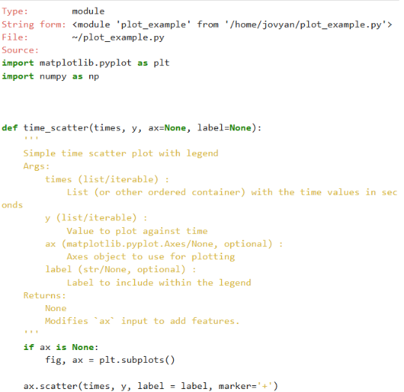
Introspection: Examples
We can also view the code itself using ??
Slide 9/16

Slide 101
Introspection: Examples
Slide 9/16

Slide 102
Introspection: Examples
The hidden attributes inside a module are also useful tools for introspection
Slide 10/16

Slide 103
Introspection: Examples
The hidden attributes inside a module are also useful tools for introspection
Slide 10/16

Slide 104
Introspection: Examples
The hidden attributes inside a module are also useful tools for introspection
Slide 10/16

Slide 105
Introspection: Examples
The hidden attributes inside a module are also useful tools for introspection
Slide 10/16

Slide 106
Introspection: Examples
The hidden attributes inside a module are also useful tools for introspection
Slide 10/16

Slide 107
Introspection: Examples
The hidden attributes inside a module are also useful tools for introspection
Slide 10/16

Slide 108
Introspection: Examples
The hidden attributes inside a module are also useful tools for introspection
Slide 10/16

Slide 109
Making Changes to a Module
Slide 11/16

Slide 110
Making Changes to a Module
When working with modules, files are edited frequently and eventually imported in notebooks.
Slide 11/16

Slide 111
Making Changes to a Module
When working with modules, files are edited frequently and eventually imported in notebooks.
Notebooks do not automatically load changes!!
Slide 11/16

Slide 112
Making Changes to a Module
When working with modules, files are edited frequently and eventually imported in notebooks.
Notebooks do not automatically load changes!!
There are two ways to ensure that your notebook uses the latest version of a module:
Slide 11/16

Slide 113
Making Changes to a Module
When working with modules, files are edited frequently and eventually imported in notebooks.
Notebooks do not automatically load changes!!
There are two ways to ensure that your notebook uses the latest version of a module:
Approach 1: Save the module, Restart the kernel and run all notebook cells..
Slide 11/16

Slide 114
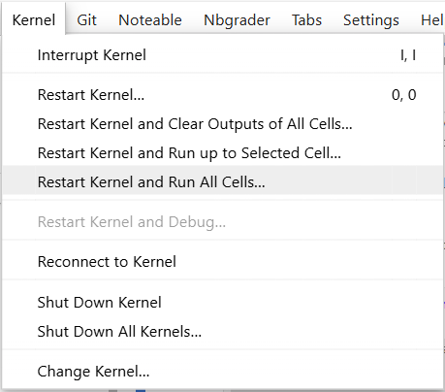
Making Changes to a Module
When working with modules, files are edited frequently and eventually imported in notebooks.
Notebooks do not automatically load changes!!
There are two ways to ensure that your notebook uses the latest version of a module:
Approach 1: Save the module, Restart the kernel and run all notebook cells..
Slide 11/16

Slide 115
Making Changes to a Module
When working with modules, files are edited frequently and eventually imported in notebooks.
Notebooks do not automatically load changes!!
There are two ways to ensure that your notebook uses the latest version of a module:
Approach 1: Save the module, Restart the kernel and run all notebook cells..
Slide 11/16

Slide 116
Making Changes to a Module
When working with modules, files are edited frequently and eventually imported in notebooks.
Notebooks do not automatically load changes!!
There are two ways to ensure that your notebook uses the latest version of a module:
Approach 1: Save the module, Restart the kernel and run all notebook cells..
Slide 11/16

Slide 117
Making Changes to a Module
When working with modules, files are edited frequently and eventually imported in notebooks.
Notebooks do not automatically load changes!!
There are two ways to ensure that your notebook uses the latest version of a module:
Approach 1: Save the module, Restart the kernel and run all notebook cells..
Slide 11/16

Slide 118
Making Changes to a Module
When working with modules, files are edited frequently and eventually imported in notebooks.
Notebooks do not automatically load changes!!
There are two ways to ensure that your notebook uses the latest version of a module:
Approach 1: Save the module, Restart the kernel and run all notebook cells.
Approach 2: Use the importlib library to reload the module without restarting the kernel.
Slide 11/16

Slide 119
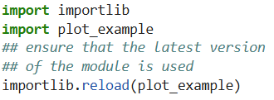

Making Changes to a Module
When working with modules, files are edited frequently and eventually imported in notebooks.
Notebooks do not automatically load changes!!
There are two ways to ensure that your notebook uses the latest version of a module:
Approach 1: Save the module, Restart the kernel and run all notebook cells.
Approach 2: Use the importlib library to reload the module without restarting the kernel.
Slide 11/16

Slide 120
Making Changes to a Module
When working with modules, files are edited frequently and eventually imported in notebooks.
Notebooks do not automatically load changes!!
There are two ways to ensure that your notebook uses the latest version of a module:
Approach 1: Save the module, Restart the kernel and run all notebook cells.
Approach 2: Use the importlib library to reload the module without restarting the kernel.
Slide 11/16

Slide 121
Making Changes to a Module
When working with modules, files are edited frequently and eventually imported in notebooks.
Notebooks do not automatically load changes!!
There are two ways to ensure that your notebook uses the latest version of a module:
Approach 1: Save the module, Restart the kernel and run all notebook cells.
Approach 2: Use the importlib library to reload the module without restarting the kernel.
Slide 11/16

Slide 122
Making Changes to a Module
When working with modules, files are edited frequently and eventually imported in notebooks.
Notebooks do not automatically load changes!!
There are two ways to ensure that your notebook uses the latest version of a module:
Approach 1: Save the module, Restart the kernel and run all notebook cells.
Approach 2: Use the importlib library to reload the module without restarting the kernel.
Slide 11/16

Slide 123
Error Handling
Slide 12/16

Slide 124
Error Handling
Introspection is great for identifying what an object is as code is running
Slide 12/16

Slide 125
Error Handling
Introspection is great for identifying what an object is as code is running
But it doesn’t tell us what went wrong when code fails
Slide 12/16

Slide 126
Error Handling
Introspection is great for identifying what an object is as code is running
But it doesn’t tell us what went wrong when code fails
The second topic we shall look at today is how you can handle errors in Python
Slide 12/16

Slide 127

Error Handling
Introspection is great for identifying what an object is as code is running
But it doesn’t tell us what went wrong when code fails
The second topic we shall look at today is how you can handle errors in Python
Slide 12/16

Slide 128
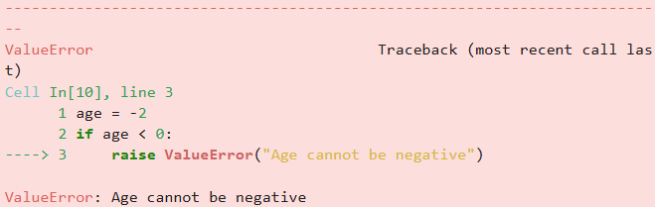
Error Handling
Introspection is great for identifying what an object is as code is running
But it doesn’t tell us what went wrong when code fails
The second topic we shall look at today is how you can handle errors in Python
Slide 12/16

Slide 129
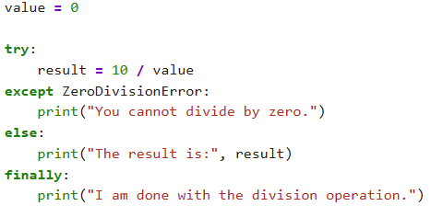
Error Handling
Introspection is great for identifying what an object is as code is running
But it doesn’t tell us what went wrong when code fails
The second topic we shall look at today is how you can handle errors in Python
Slide 12/16

Slide 130
Error Handling
Introspection is great for identifying what an object is as code is running
But it doesn’t tell us what went wrong when code fails
The second topic we shall look at today is how you can handle errors in Python
In Python, the words error and exception are used interchangeably
Slide 12/16

Slide 131
Error Handling
Introspection is great for identifying what an object is as code is running
But it doesn’t tell us what went wrong when code fails
The second topic we shall look at today is how you can handle errors in Python
In Python, the words error and exception are used interchangeably
We can handle errors using the raise keyword and the try-except syntax
Slide 12/16

Slide 132
Raising Errors
Slide 13/16

Slide 133
Raising Errors
To throw an error and interrupt code execution, we can use the raise keyword:
Slide 13/16

Slide 134
Raising Errors
To throw an error and interrupt code execution, we can use the raise keyword: raise Type_of_error(Error_message)
Slide 13/16

Slide 135

Raising Errors
To throw an error and interrupt code execution, we can use the raise keyword: raise Type_of_error(Error_message)
Slide 13/16

Slide 136
Raising Errors
To throw an error and interrupt code execution, we can use the raise keyword: raise Type_of_error(Error_message)
Slide 13/16

Slide 137
Raising Errors
To throw an error and interrupt code execution, we can use the raise keyword: raise Type_of_error(Error_message)
Slide 13/16

Slide 138
Raising Errors
To throw an error and interrupt code execution, we can use the raise keyword: raise Type_of_error(Error_message)
Slide 13/16

Slide 139
Raising Errors
To throw an error and interrupt code execution, we can use the raise keyword: raise Type_of_error(Error_message)
Slide 13/16

Slide 140
Raising Errors
To throw an error and interrupt code execution, we can use the raise keyword: raise Type_of_error(Error_message)
There are different types of error in python.
Slide 13/16

Slide 141
Raising Errors
To throw an error and interrupt code execution, we can use the raise keyword: raise Type_of_error(Error_message)
There are different types of error in python. Common examples include:
Slide 13/16

Slide 142
Raising Errors
To throw an error and interrupt code execution, we can use the raise keyword: raise Type_of_error(Error_message)
There are different types of error in python. Common examples include:
ValueError: The user has entered a value incorrectly
Slide 13/16

Slide 143
Raising Errors
To throw an error and interrupt code execution, we can use the raise keyword: raise Type_of_error(Error_message)
There are different types of error in python. Common examples include:
ValueError: The user has entered a value incorrectly
TypeError: The user has used the wrong type of object
Slide 13/16

Slide 144

Raising Errors
To throw an error and interrupt code execution, we can use the raise keyword: raise Type_of_error(Error_message)
There are different types of error in python. Common examples include:
ValueError: The user has entered a value incorrectly
TypeError: The user has used the wrong type of object
Slide 13/16

Slide 145
Raising Errors
To throw an error and interrupt code execution, we can use the raise keyword: raise Type_of_error(Error_message)
There are different types of error in python. Common examples include:
ValueError: The user has entered a value incorrectly
TypeError: The user has used the wrong type of object
Slide 13/16

Slide 146
Raising Errors
To throw an error and interrupt code execution, we can use the raise keyword: raise Type_of_error(Error_message)
There are different types of error in python. Common examples include:
ValueError: The user has entered a value incorrectly
TypeError: The user has used the wrong type of object
Slide 13/16

Slide 147
Raising Errors
To throw an error and interrupt code execution, we can use the raise keyword: raise Type_of_error(Error_message)
There are different types of error in python. Common examples include:
ValueError: The user has entered a value incorrectly
TypeError: The user has used the wrong type of object
Slide 13/16

Slide 148
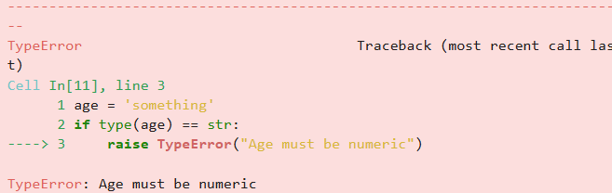
Raising Errors
To throw an error and interrupt code execution, we can use the raise keyword: raise Type_of_error(Error_message)
There are different types of error in python. Common examples include:
ValueError: The user has entered a value incorrectly
TypeError: The user has used the wrong type of object
Slide 13/16

Slide 149
Raising Errors
To throw an error and interrupt code execution, we can use the raise keyword: raise Type_of_error(Error_message)
There are different types of error in python. Common examples include:
ValueError: The user has entered a value incorrectly
TypeError: The user has used the wrong type of object
RuntimeError: Something has gone wrong when the code ran, but it is too complicated to describe simply
Slide 13/16

Slide 150
Raising Errors
To throw an error and interrupt code execution, we can use the raise keyword: raise Type_of_error(Error_message)
There are different types of error in python. Common examples include:
ValueError: The user has entered a value incorrectly
TypeError: The user has used the wrong type of object
RuntimeError: Something has gone wrong when the code ran, but it is too complicated to describe simply
NotImplementedError: The user has tried to run some code that the developers haven’t finished yet
Slide 13/16

Slide 151
Try-except Statements
Slide 14/16

Slide 152
Try-except Statements
You can also handle an error in Python using a try-except statement.
Slide 14/16

Slide 153

Try-except Statements
You can also handle an error in Python using a try-except statement.
Slide 14/16

Slide 154
Try-except Statements
You can also handle an error in Python using a try-except statement.
Slide 14/16

Slide 155
Try-except Statements
You can also handle an error in Python using a try-except statement.
try: Python will attempt to execute code written under try.
Slide 14/16

Slide 156
Try-except Statements
You can also handle an error in Python using a try-except statement.
try: Python will attempt to execute code written under try.
Slide 14/16

Slide 157
Try-except Statements
You can also handle an error in Python using a try-except statement.
try: Python will attempt to execute code written under try.
Slide 14/16

Slide 158
Try-except Statements
You can also handle an error in Python using a try-except statement.
try: Python will attempt to execute code written under try.
except: If the code under try raises an error, the except code will run instead.
Slide 14/16

Slide 159
Try-except Statements
You can also handle an error in Python using a try-except statement.
try: Python will attempt to execute code written under try.
except: If the code under try raises an error, the except code will run instead.
Slide 14/16

Slide 160
Try-except Statements
You can also handle an error in Python using a try-except statement.
try: Python will attempt to execute code written under try.
except: If the code under try raises an error, the except code will run instead.
Slide 14/16

Slide 161
Try-except Statements
You can also handle an error in Python using a try-except statement.
try: Python will attempt to execute code written under try.
except: If the code under try raises an error, the except code will run instead.
else: If the code under try does not throw an error, this code will run.
Slide 14/16

Slide 162
Try-except Statements
You can also handle an error in Python using a try-except statement.
try: Python will attempt to execute code written under try.
except: If the code under try raises an error, the except code will run instead.
else: If the code under try does not throw an error, this code will run.
Slide 14/16

Slide 163
Try-except Statements
You can also handle an error in Python using a try-except statement.
try: Python will attempt to execute code written under try.
except: If the code under try raises an error, the except code will run instead.
else: If the code under try does not throw an error, this code will run.
Slide 14/16

Slide 164
Try-except Statements
You can also handle an error in Python using a try-except statement.
try: Python will attempt to execute code written under try.
except: If the code under try raises an error, the except code will run instead.
else: If the code under try does not throw an error, this code will run.
finally: This code always runs
Slide 14/16

Slide 165
Try-except Statements
You can also handle an error in Python using a try-except statement.
try: Python will attempt to execute code written under try.
except: If the code under try raises an error, the except code will run instead.
else: If the code under try does not throw an error, this code will run.
finally: This code always runs
Slide 14/16

Slide 166
Try-except Statements
You can also handle an error in Python using a try-except statement.
try: Python will attempt to execute code written under try.
except: If the code under try raises an error, the except code will run instead.
else: If the code under try does not throw an error, this code will run.
finally: This code always runs
Slide 14/16

Slide 167
Try-except Statements
You can also handle an error in Python using a try-except statement.
try: Python will attempt to execute code written under try.
except: If the code under try raises an error, the except code will run instead.
else: If the code under try does not throw an error, this code will run.
finally: This code always runs
Slide 14/16

Slide 168
Try-except Statements
You can also handle an error in Python using a try-except statement.
try: Python will attempt to execute code written under try.
except: If the code under try raises an error, the except code will run instead.
else: If the code under try does not throw an error, this code will run.
finally: This code always runs
Python will first try to run this!
Slide 14/16

Slide 169
Try-except Statements
You can also handle an error in Python using a try-except statement.
try: Python will attempt to execute code written under try.
except: If the code under try raises an error, the except code will run instead.
else: If the code under try does not throw an error, this code will run.
finally: This code always runs
Slide 14/16

Slide 170
Try-except Statements
You can also handle an error in Python using a try-except statement.
try: Python will attempt to execute code written under try.
except: If the code under try raises an error, the except code will run instead.
else: If the code under try does not throw an error, this code will run.
finally: This code always runs
Slide 14/16

Slide 171
Try-except Statements
You can also handle an error in Python using a try-except statement.
try: Python will attempt to execute code written under try.
except: If the code under try raises an error, the except code will run instead.
else: If the code under try does not throw an error, this code will run.
finally: This code always runs
If the division by value gives a ZeroDivisionError, this code will run
… otherwise, the else will run
Slide 14/16

Slide 172
Try-except Statements
You can also handle an error in Python using a try-except statement.
try: Python will attempt to execute code written under try.
except: If the code under try raises an error, the except code will run instead.
else: If the code under try does not throw an error, this code will run.
finally: This code always runs
If the division by value gives a ZeroDivisionError, this code will run
… otherwise, the else will run
Slide 14/16

Slide 173
Try-except Statements
You can also handle an error in Python using a try-except statement.
try: Python will attempt to execute code written under try.
except: If the code under try raises an error, the except code will run instead.
else: If the code under try does not throw an error, this code will run.
finally: This code always runs
If the division by value gives a ZeroDivisionError, this code will run
… otherwise, the else will run
Slide 14/16

Slide 174
Try-except Statements
You can also handle an error in Python using a try-except statement.
try: Python will attempt to execute code written under try.
except: If the code under try raises an error, the except code will run instead.
else: If the code under try does not throw an error, this code will run.
finally: This code always runs
If the division by value gives a ZeroDivisionError, this code will run
… otherwise, the else will run
Slide 14/16

Slide 175
Try-except Statements
You can also handle an error in Python using a try-except statement.
try: Python will attempt to execute code written under try.
except: If the code under try raises an error, the except code will run instead.
else: If the code under try does not throw an error, this code will run.
finally: This code always runs
Slide 14/16

Slide 176
Try-except Statements
You can also handle an error in Python using a try-except statement.
try: Python will attempt to execute code written under try.
except: If the code under try raises an error, the except code will run instead.
else: If the code under try does not throw an error, this code will run.
finally: This code always runs
Slide 14/16

Slide 177
Try-except Statements
You can also handle an error in Python using a try-except statement.
try: Python will attempt to execute code written under try.
except: If the code under try raises an error, the except code will run instead.
else: If the code under try does not throw an error, this code will run.
finally: This code always runs
This code runs regardless! (Even if everything else errors)
Slide 14/16

Slide 178
Try-except Statements
You can also handle an error in Python using a try-except statement.
try: Python will attempt to execute code written under try.
except: If the code under try raises an error, the except code will run instead.
else: If the code under try does not throw an error, this code will run.
finally: This code always runs
This code runs regardless! (Even if everything else errors)
Slide 14/16

Slide 179
Try-except Statements
You can also handle an error in Python using a try-except statement.
try: Python will attempt to execute code written under try.
except: If the code under try raises an error, the except code will run instead.
else: If the code under try does not throw an error, this code will run.
finally: This code always runs
Slide 14/16

Slide 180
Try-except Statements
You can also handle an error in Python using a try-except statement.
try: Python will attempt to execute code written under try.
except: If the code under try raises an error, the except code will run instead.
else: If the code under try does not throw an error, this code will run.
finally: This code always runs
Else and finally are optional!
Slide 14/16

Slide 181
Practical
Slide 15/16

Slide 182
Practical
For the rest of today, you must:
Slide 15/16

Slide 183
Practical
For the rest of today, you must:
First, make sure you select the Standard Python 3 environment when opening Noteable
Slide 15/16

Slide 184
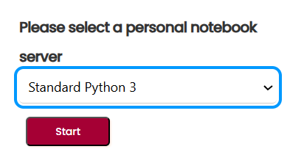
Practical
For the rest of today, you must:
First, make sure you select the Standard Python 3 environment when opening Noteable
Slide 15/16

Slide 185
Practical
For the rest of today, you must:
First, make sure you select the Standard Python 3 environment when opening Noteable
Then, work through:
Slide 15/16

Slide 186
Practical
For the rest of today, you must:
First, make sure you select the Standard Python 3 environment when opening Noteable
Then, work through: lecture_modularisation
Slide 15/16

Slide 187
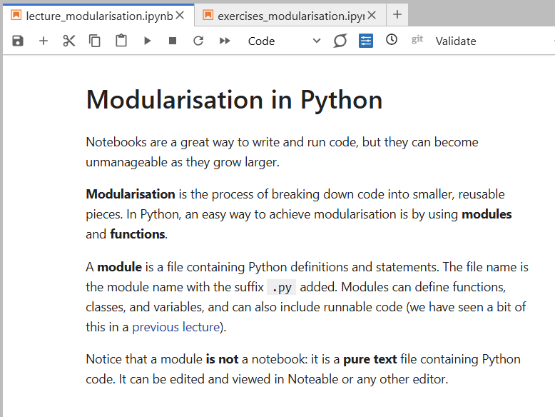
Practical
For the rest of today, you must:
First, make sure you select the Standard Python 3 environment when opening Noteable
Then, work through: lecture_modularisation
Slide 15/16

Slide 188
Practical
For the rest of today, you must:
First, make sure you select the Standard Python 3 environment when opening Noteable
Then, work through: lecture_modularisation
Work through the exercises in:
Slide 15/16

Slide 189
Practical
For the rest of today, you must:
First, make sure you select the Standard Python 3 environment when opening Noteable
Then, work through: lecture_modularisation
Work through the exercises in: exercises_modularisation.ipynb
Slide 15/16

Slide 190
Next Time
Lecture 17: Modularisation and Error Handling
Modules
Introspection
Error Handling
Practical
Lecture 18: Writing a Scientific Computing Report
Writing a Report
Advice and Good Practice
Practical
Slide 16/16

