Slide 1
Lecture 14:
Pandas vs NumPy
SCIF10002 – Introduction to Coding and Data Analysis for Scientists
Tom Maullin-Sapey
12th February 2026
Slide 0/5

Slide 2
Todays Lecture
Lecture 14: Pandas vs NumPy
DataFrames and Arrays
Indexing and Slicing
Plotting
Practical
Lecture 15: Advanced Plotting
3D Plotting
Seaborn
Plotly
Practical
Slide 1/5

Slide 3
Pandas vs Numpy
Slide 2/5

Slide 4
Pandas vs Numpy
We are now reaching the end of the Pandas section of this course
Slide 2/5

Slide 5

Pandas vs Numpy
We are now reaching the end of the Pandas section of this course
Slide 2/5

Slide 6

Pandas vs Numpy
We are now reaching the end of the Pandas section of this course
Slide 2/5

Slide 7
Pandas vs Numpy
We are now reaching the end of the Pandas section of this course
To finish our investigation of Pandas, today we will spend a little time comparing and contrasting Pandas and Numpy.
Slide 2/5

Slide 8

Pandas vs Numpy
We are now reaching the end of the Pandas section of this course
To finish our investigation of Pandas, today we will spend a little time comparing and contrasting Pandas and Numpy.
Slide 2/5

Slide 9
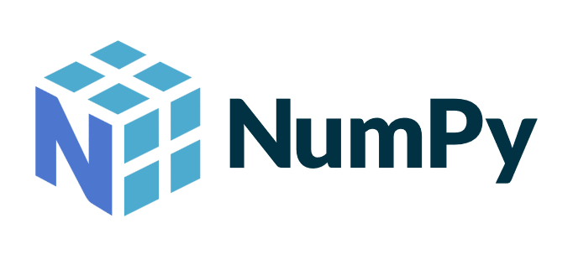
Pandas vs Numpy
We are now reaching the end of the Pandas section of this course
To finish our investigation of Pandas, today we will spend a little time comparing and contrasting Pandas and Numpy.
Slide 2/5

Slide 10
Pandas vs Numpy
We are now reaching the end of the Pandas section of this course
To finish our investigation of Pandas, today we will spend a little time comparing and contrasting Pandas and Numpy.
Next week, we will move on to advanced plotting.
Slide 2/5

Slide 11

Pandas vs Numpy
We are now reaching the end of the Pandas section of this course
To finish our investigation of Pandas, today we will spend a little time comparing and contrasting Pandas and Numpy.
Next week, we will move on to advanced plotting.
Slide 2/5

Slide 12
Demonstration
Slide 3/5

Slide 13
Demonstration
We shall conclude our investigation of Pandas with a comparison to NumPy.
Slide 3/5

Slide 14
Demonstration
We shall conclude our investigation of Pandas with a comparison to NumPy.
Material to follow along:
Slide 3/5

Slide 15
Demonstration
We shall conclude our investigation of Pandas with a comparison to NumPy.
Material to follow along: slides_pandas_vs_numpy.ipynb
Slide 3/5

Slide 16
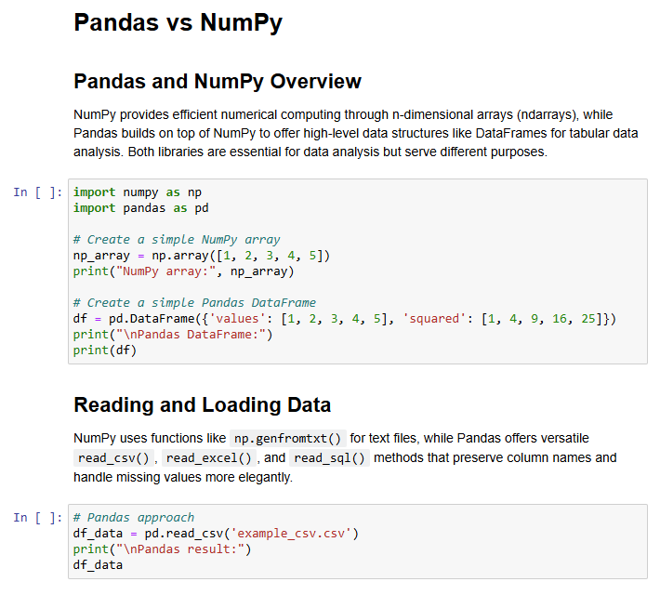
Demonstration
We shall conclude our investigation of Pandas with a comparison to NumPy.
Material to follow along: slides_pandas_vs_numpy.ipynb
Slide 3/5

Slide 17
Practical
Slide 4/5

Slide 18
Practical
For the rest of today, you must:
Slide 4/5

Slide 19
Practical
For the rest of today, you must:
Read through the material in:
Slide 4/5

Slide 20
Practical
For the rest of today, you must:
Read through the material in: lecture_pandas_vs_numpy.ipynb
Slide 4/5

Slide 21
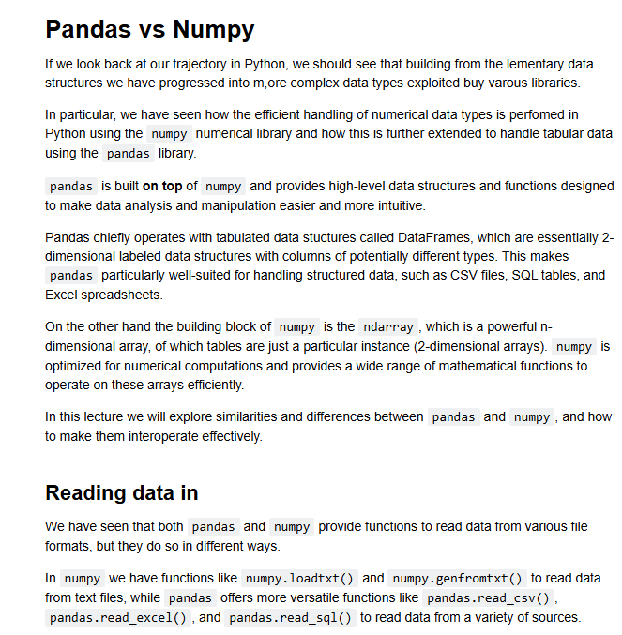
Practical
For the rest of today, you must:
Read through the material in: lecture_pandas_vs_numpy.ipynb
Slide 4/5

Slide 22
Practical
For the rest of today, you must:
Read through the material in: lecture_pandas_vs_numpy.ipynb
Work through the Pandas exercises in:
Slide 4/5

Slide 23
Practical
For the rest of today, you must:
Read through the material in: lecture_pandas_vs_numpy.ipynb
Work through the Pandas exercises in: exercises_pandas_vs_numpy.ipynb
Slide 4/5

Slide 24
Next Time
Lecture 14: Pandas vs NumPy
DataFrames and Arrays
Indexing and Slicing
Plotting
Practical
Lecture 15: Advanced Plotting
3d Plotting
Seaborn
Plotly
Practical
Slide 5/5

